Slide 1

WELCOME TO FOURTH LECTURE OF
Software Testing Techniques and Strategies
COURSE CODE :SE-484

Slide 2
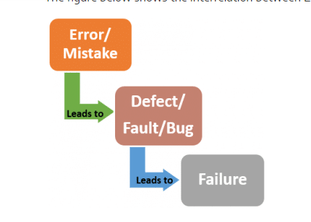
DEFECT/BUG/ERROR/FAILURE
A mistake in coding is called Error, error found by tester is called BUG, BUG accepted by development team then it is called DEFECT, build does not meet the requirements then it Is Failure.” ... In other words Defect is the difference between expected and actual result in the context of testing.

Slide 3
DEFECT/BUG/ERROR/FAILURE
A mistake in coding is called Error, error found by tester is called Defect, defect accepted by development team then it is called Bug, build does not meet the requirements then it Is Failure.” ... In other words Defect is the difference between expected and actual result in the context of testing.
A mistake in coding is called Error, error found by tester is called BUG, BUG accepted by development team then it is called DEFECT, build does not meet the requirements then it Is Failure.” ... In other words Defect is the difference between expected and actual result in the context of testing.

Slide 4
DEFECT/BUG/ERROR/FAILURE:
What is a defect?
The variation between the actual results and expected results is known as defect. If a developer finds an issue and corrects it by himself in the development phase then it’s called a defect.
What is a bug? If testers find any mismatch in the application/system in testing phase then they call it as BUG whereas developer call it as a DEFECT.
There is a contradiction in the usage of Bug and Defect. People widely say the bug is an informal name for the defect.

Slide 5
DEFECT/BUG/ERROR/FAILURE
What is an error?
We can’t compile or run a program due to coding mistake in a program. If a developer unable to successfully compile or run a program then they call it as an error.
What is a failure?
Once the product is deployed and customers find any issues then they call the product as a failure product. After release, if an end user finds an issue then that particular issue is called as failure

Slide 6
EXAMPLE:
Example: This is program of adding two numbers
Let’s see a defect by an example.
a=7
b=5
ans=a*b
print("Addition of {} and {} = {}.".format(a, b, ans))
When you compile and run this program you see the printed statement as below:
Addition of 7 and 5=35
This is program of adding two numbers but the output is deviated from it’s expected result which is 12. Now we have detected a failure. As the failure has been detected a defect can be raised.

Slide 7
Software Testing Life Cycle (STLC)
Software Testing Life Cycle (STLC) is the testing process which is executed in systematic and planned manner.
In STLC process, different activities are carried out to improve and ensure the quality of the product.
Following steps are involved in Software Testing Life Cycle (STLC). Each step has its own Entry Criteria and deliverable.
Requirement Analysis
Test Planning
Test Case Development
Environment Setup
Test Execution
Test Cycle Closure

Slide 8
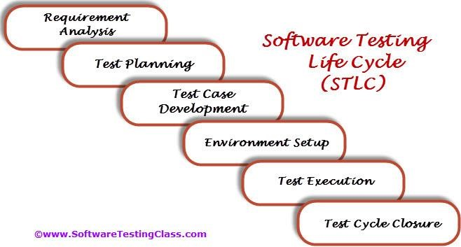
Software testing life cycle
Each of these stages have a definite Entry and Exit criteria; Activities & Deliverables associated with it.

Slide 9
Software testing life cycle
What is Entry and Exit Criteria?
Entry Criteria:
Entry Criteria gives the prerequisite items that must be completed before testing can begin.
Exit Criteria: Exit Criteria defines the items that must be completed before testing can be concluded
You have Entry and Exit Criteria for all levels/Phases in the Software Testing Life Cycle (STLC

Slide 10
Software testing life cycle
1. Requirement Analysis:
Requirement Analysis is the very first step in Software Testing Life Cycle (STLC). In this step Quality Assurance (QA) team understands the requirement in terms of what we will testing & figure out the testable requirements. If any conflict, missing or not understood any requirement, then QA team follow up with the various stakeholders like Business Analyst, System Architecture, Client, Technical Manager/Lead etc to better understand the detail knowledge of requirement.
From very first step QA involved in the where STLC which helps to prevent the introducing defects into Software under test. The requirements can be either Functional or Nonfunctional like Performance, Security testing. Also requirement and Automation feasibility of the project can be done in this stage (if applicable)

Slide 11
Software testing life cycle
1. Requirement Analysis:
Entry Criteria | Activities | Deliverable/ Exit Criteria.
Following documents should be available: Requirements Specification. Application architectural Along with above documents Acceptance criteria should be well defined. | Prepare the list of questions or queries or Updated version of unclear or missing requirement and get resolved from Business Analyst, System Architecture, Client, Technical Manager/Lead etc. Make out the list for what all Types of Tests performed like Functional, Security, and Performance etc. Define the testing focus and priorities. List down the Test environment details where testing activities will be carried out. Checkout the Automation feasibility if required & prepare the Automation feasibility report. | List of questions with all answers to be resolved from business i.e. testable requirements Automation feasibility report (if applicable)

Slide 12
Software testing life cycle
2. Test Planning:
Test Planning is most important phase of Software testing life cycle where all testing strategy is defined. This phase also called as Test Strategy phase. In this phase typically Test Manager (or Test Lead based on company to company) involved to determine the effort and cost estimates for entire project. This phase will be kicked off once the requirement gathering phase is completed & based on the requirement analysis, start preparing the Test Plan. The Result of Test Planning phase will be Test Plan or Test strategy & Testing Effort estimation documents. Once test planning phase is completed the QA team can start with test cases development activity.

Slide 13
Software testing life cycle
2. Test Planning:
Entry Criteria | Activities | Deliverable
Requirements Documents | Define Objective & scope of the testing experiment | Test Plan or Test strategy document.
(Updated version of unclear or missing requirement). Automation feasibility report. | List down the testing types involved in the STLC. Test effort estimation and resource planning. Selection of testing tool if required. Define the testing process overview. Prepare the test schedules. Define the control procedures. Determining roles and responsibilities. List down the testing deliverable. Define the entry criteria, suspension criteria, resumption criteria and exit criteria. Define the risk involved if any. | Testing Effort/Plan document.

Slide 14
Software testing life cycle
3. Test Case Development:
The test case development activity is started once the test planning activity is finished. This is the phase of STLC where testing team write down the detailed test cases.
Along with test cases testing team also prepare the test data if any required for testing. Once the test cases are ready then these test cases are reviewed by peer members or QA lead.
Also the Requirement Traceability Matrix (RTM) is prepared. The Requirement Traceability Matrix is an industry-accepted format for tracking requirements where each test case is mapped with the requirement. Using this RTM we can track backward & forward traceability.
Entry Criteria | Activities | Deliverable/Exit Criteria
Requirements Documents (Updated version of unclear or missing requirement). Automation feasibility report. | Preparation of test cases. Preparation of test automation scripts (if required). Pre-requisite test data preparation for executing test cases. | Test cases. Test data. Test Automation Scripts (if required).

Slide 15
Software testing life cycle
4. Test Environment Setup:
Basically test environment decides on which conditions software is tested. This is independent activity and can be started parallel with Test Case Development. In process of setting up testing environment test team is not involved in it. Based on company to company may be developer or customer creates the testing environment. Mean while testing team should prepare the smoke test cases to check the readiness of the test environment setup
Entry Criteria | Activities | Deliverable /Exit Criteria
Test Plan is available. Smoke Test cases are available. Test data is available. | Analyze the requirements and prepare the list of Software & hardware required to set up test environment.\ Setup the test environment. Once the Test Environment is setup execute the Smoke test cases to check the readiness of the test environment. | Test Environment will be ready with test data. Result of Smoke Test cases.

Slide 16
Software testing life cycle
5. Test Execution:
During this phase the testers will carry out the testing based on the test plans and the test cases prepared. Bugs will be reported back to the development team for correction and retesting will be performed
Once the test case is passed then same can be marked as Passed. If any test case is failed then corresponding defect can be reported to developer team via bug tracking system & bug can be linked for corresponding test case for further analysis. Ideally every failed test case should be associated with at least single bug. Using this linking we can get the failed test case with bug associated with it. Once the bug fixed by development team then same test case can be executed based on your test planning.
If any of the test cases are blocked due to any defect then such test cases can be marked as Blocked, so we can get the report based on how many test cases passed, failed, blocked or not run etc. Once the defects are fixed, same Failed or Blocked test cases can be executed again to retest the functionality.

Slide 17
Software testing life cycle
5. Test Execution:
Entry Criteria | Activities | Deliverable
Test Plan or Test strategy document. Test cases. Test data. | Based on test planning execute the test cases. Mark status of test cases like Passed, Failed, Blocked, Not Run etc. Assign Bug Id for all Failed and Blocked test cases. Do Retesting once the defects are fixed. Track the defects to closure | Test case execution report. Defect report.

Slide 18
Software testing life cycle
6. Test Cycle Closure:
Call out the testing team member meeting & evaluate cycle completion criteria based on Test coverage, Quality, Cost, Time, Critical Business Objectives, and Software.
Discuss what all went good, which area needs to be improve & taking the lessons from current STLC as input to upcoming test cycles, which will help to improve bottleneck in the STLC process.
Test case & bug report will analyze to find out the defect distribution by type and severity. Once complete the test cycle then test closure report & Test metrics will be prepared. Test result analysis to find out the defect distribution by type and severity.
Entry Criteria | Activities | Deliverable
Test case execution is completed Test case Execution report Defect report | Evaluate cycle completion criteria based on Test coverage, Quality, Cost, Time, Critical Business Objectives, and Software Prepare test metrics based on the above parameters. Prepare Test closure report Share best practices for any similar projects in future | Test Closure report Test metrics

Slide 19
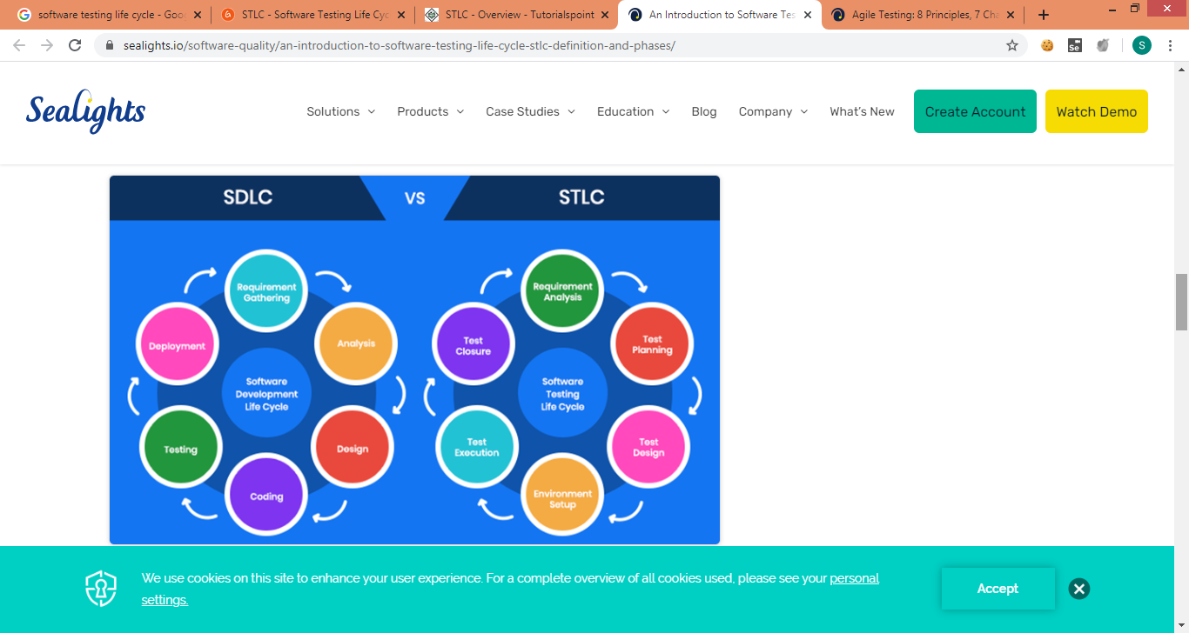
Sdlc vs stlc
Although both are related to software development, with overlapping timelines, Software Development Life Cycle and Software Testing Life Cycle follow different goals and guidelines. STLC can be performed as a series of steps within the SDLC cycle or can be performed alongside SDLC phases.

Slide 20
Sdlc vs Stlc
Following points and thereby, compare STLC and SDLC.
STLC is part of SDLC. It can be said that STLC is a subset of the SDLC set.
STLC is limited to the testing phase where quality of software or product ensures. SDLC has vast and vital role in complete development of a software or product.
However, STLC is a very important phase of SDLC and the final product or the software cannot be released without passing through the STLC process.
STLC is also a part of the post-release/ update cycle, the maintenance phase of SDLC where known defects get fixed or a new functionality is added to the software.
The following table lists down the factors of comparison between SDLC and STLC

Slide 21
Phase | SDLC | STLC
Requirement Gathering | Business Analyst gathers requirements. Development team analyzes the requirements. After high level, the development team starts analyzing from the architecture and the design perspective. | Testing team reviews and analyzes the SRD document. Identifies the testing requirements - Scope, Verification and Validation key points. Reviews the requirements for logical and functional relationship among various modules. This helps in the identification of gaps at an early stage.
Design | The architecture of SDLC helps you develop a high-level and low-level design of the software based on the requirements. Once the design is completed, it is signed off by the stakeholders. | In STLC, either the Test Architect or a Test Lead usually plan the test strategy. Identifies the testing points. Resource allocation and timelines are finalized here.
Development | Development team starts developing the software. Integrate with different systems. Once all integration is done, a ready to test software or product is provided. | Testing team writes the test scenarios to validate the quality of the product. Detailed test cases are written for all modules along with expected behaviour. The prerequisites and the entry and exit criteria of a test module are identified here.
Environment Set up | Development team sets up a test environment with developed product to validate. | The Test team confirms the environment set up based on the prerequisites. Performs smoke testing to make sure the environment is stable for the product to be tested.
Testing | The actual testing is carried out in this phase. It includes unit testing, integration testing, system testing, defect retesting, regression testing, etc. The Development team fixes the bug reported, if any and sends it back to the tester for retesting. UAT testing performs here after getting sign off from SIT testing. | System Integration testing starts based on the test cases. Defects reported, if any, get retested and fixed. Regression testing is performed here and the product is signed off once it meets the exit criteria.
Deployment/ Product Release | Once sign-off is received from various testing team, application is deployed in prod environment for real end users. | Smoke and sanity testing in production environment is completed here as soon as product is deployed. Test reports and matrix preparation are done by testing team to analyze the product.
Maintenance | It covers the post deployment supports, enhancement and updates, if any. | In this phase, the maintaining of test cases, regression suits and automation scripts take place based on the enhancement and updates.

Slide 22
What is a Test Plan?
Test plan document is a document which contains the plan for all the testing activities to be done to deliver a quality product. Test Plan document is derived from the Product Description, SRS, or Use Case documents for all future activities of the project. It is usually prepared by the Test Lead or Test Manager and the focus of the document is to describe what to test, what not to test, how to test when to test and who will do what test. Also, it includes the environment and tools needed, resource allocation, test technique to be followed, risks and contingencies plan. A test plan is a dynamic document and we should always keep it up-to-date. Test plan document guides us how the testing activity should go on. Success of the testing project completely depends on Test Plan.
What is a Test Strategy?
Test Strategy is a high-level document (static document) and usually developed by a project manager. It is a document which captures the approach on how we go about testing the product and achieve the goals. It is normally derived from the Business Requirement Specification (BRS). Documents like Test Plan are prepared by keeping this document as base.

Slide 23
components of the Test Plan document
Test Plan Identifier
References
Introduction
Test Items
Features To Be Tested
Features Not To Be Tested
Approach
Pass/Fail Criteria
Suspension Criteria
Test Deliverables
Testing Tasks
Environmental Needs
Responsibilities
Staffing and Training Needs
Schedule/Cost Estimation
Risks and Contingencies
Approvals

Slide 24
Test Strategy | Test Plan
Test Strategy is a high level document which captures the approach on how we go about testing the product and achieve the goals. | Test plan document is a document which contains the plan for all the testing activities to be done to deliver a quality product.
Components of Test strategy includes Scope and overview, Test Approach, Testing tools, Industry standards to follow, Test deliverables, Testing metrics, Requirement Traceability Matrix, Risk and mitigation, Reporting tool, Test summary | Components of Test plan includes Test Plan Identifier, Features To Be Tested, Features Not To Be Tested, Approach, Pass/Fail Criteria, Suspension Criteria, Test Deliverables, Responsibilities, Staffing and Training Needs, Risks and Contingencies etc.,
It is developed by the project manager | It is prepared by test lead or test manager
It is derived from the Business requirement specifications (BRS) | It is derived from the Product Description, SRS, or Use Case documents
It is a static document. Once defined, it cannot be changed | It is a dynamic document. It can be changed
It is defined at organization level and can be used for other projects of similar nature | It is defined at project level
In smaller projects, test strategy is often found as a section of a test plan. | We can prepare the test plan individually.
Test Strategy is a high level document which captures the approach on how we go about testing the product and achieve the goals. Test plan document is a document which contains the plan for all the testing activities to be done to deliver a quality product.

Slide 25
What is a Test Scenario?
Test Scenario gives a high-level idea of what we need to test.
A Test Scenario is defined as any functionality that can be tested.
A Test Scenario is a statement describing the functionality of the application to be tested.
It is used for end to end testing of a feature and is generally derived from the use cases.
It is a collective set of test cases which helps the testing team to determine the positive and negative characteristics of the project. These test cases define how the test scenario needs to be executed. In other words, a test scenario is a big picture that needs to be tested through various test cases that provide the actual details.
A single test scenario can cover one or more test cases
Therefore a test scenario has a one-to-many relationship with the test cases.
Therefore test scenario is a detailed document contains test cases that cover end to end functionality of a software application in liner statements.
The liner statement is considered as a scenario. Test scenarios are usually a single line statement that tell what needs to be tested. For example, a Test Scenario could be, "Check internet connectivity". This would comprise of multiple test cases that would check the internet connectivity through all the available modes. Hence, a Test Scenario is a broad description of the functionality that needs to be checked.

Slide 26
BenefitS Of Test Scenarios
:
Performing software testing with the assistance of test scenarios offers various benefits to the testers.
Prevents Repetitive Testing: A well thought of Test Scenario can tremendously reduce the testing workload. This is because it prevents the testing of the same feature again and again under different testing techniques.
Saves Time, Money and Efforts: As test scenarios prevent repetitive testing, the efforts, time, as well as money invested in the process is automatically reduced and minimized.
Helps Build Better Test Cases: Helps Build Better Test Cases: Test cases are derived on the basis of test scenarios. Hence, a test scenario that is carefully developed after deep thoughts will lead to such test cases that are meaningful and checks the software thoroughly with minimum effort.
Helps Test a Software from Users Perspective: The biggest advantage of this type of testing is that, it is performed by creating test scenarios that replicate users usage and allow testers to verify the performance and functionality of the software from their perspective.

Slide 27
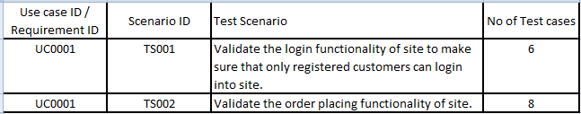
For an ecommerce Application, a few test scenarios would be
Example 1)
Test Scenario 1: Check the Search Functionality
Test Scenario 2: Check the Payments Functionality
Test Scenario 3: Check the Login Functionality
Example 2)
Sample Requirement: Use case ID: UC0001 – Verify and validate the end to end functionality of e-commerce website. Only register customers should be login into site using valid credentials and place the order.
Test Scenario:

Slide 28
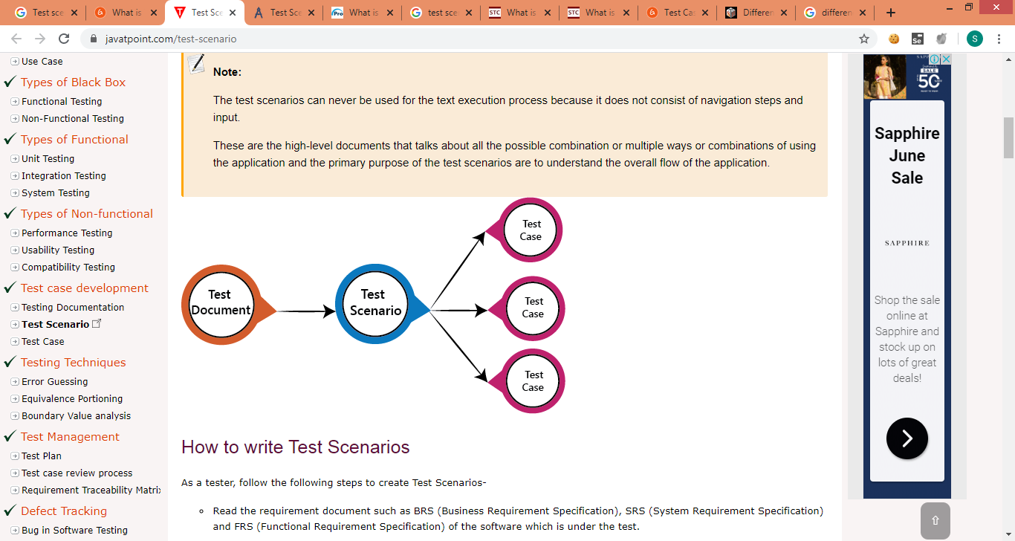
A Test Scenario is defined as any functionality that can be tested. It is a collective set of test cases which helps the testing team to determine the positive and negative characteristics of the project.

Slide 29
Why do we write Test Scenario?
Here, are important reasons to create a Test Scenario:
The main reason to write a test scenario is to verify the complete functionality of the software application
It also helps you to ensure that the business processes and flows are as per the functional requirements
Test Scenarios can be approved by various stakeholders like Business Analyst, Developers, Customers to ensure the Application Under Test is thoroughly tested. It ensures that the software is working for the most common use cases.
They serve as a quick tool to determine the testing work effort and accordingly create a proposal for the client or organize the workforce.
They help determine the most critical end-to-end transactions or the real use of the software applications.
Once these Test Scenarios are finalized, test cases can be easily derived from the Test Scenarios

Slide 30
How to write Test Scenario
As a tester, follow the following steps to create Test Scenarios-
Read the requirement document such as BRS (Business Requirement Specification), SRS (System Requirement Specification) and FRS (Functional Requirement Specification) of the software which is under the test.
Determine all technical aspects and objectives for each requirement.
Find all the possible ways by which the user can operate the software.
Ascertain all the possible scenario due to which system can be misused and also detect the users who can be hackers.
After reading the requirement document and completion of the scheduled analysis make a list of various test scenarios to verify each function of the software.
Once you listed all the possible test scenarios, create a traceability matrix to find out whether each and every requirement has a corresponding test scenario or not.
Supervisor of the project reviews all scenarios. Later, they are evaluated by other stakeholders of the project.

Slide 31
Features of Test Scenario
The test scenario is a liner statement that guides testers for the testing sequence.
Test scenario reduces the complexity and repetition of the product.
Test scenario means talking and thinking about tests in detail but write them in liner statements.
It is a thread of operations.
Test scenario becomes more important when the tester does not have enough time to write test cases, and team members agree with a detailed liner scenario.
The test scenario is a time saver activity.
It provides easy maintenance because the addition and modification of test scenarios are easy and independent.

Slide 32
Test Scenario EXAMPLE of Coffee Machine
UI scenario – Verify that the dimension of the coffee machine is as per the specification
Verify that outer body as well as inner part’s material are as per the specification
Verify that the machine’s body color as well brand are correctly visible and as per specification
Verify the input mechanism for coffee ingredients-milk, water, coffee beans/powder etc
Verify that the quantity of hot water, milk, coffee powder per serving is correct
Verify the power/voltage requirements of the machine
Verify the effect of suddenly switching off the machine or cutting the power. Machine should stop in that situation and in power resumption, the remaining coffee should not get come out of the nozzle.
Verify that coffee should not leak when not in operation
Verify the amount of coffee served in single serving is as per specification

Slide 33
Test Scenario EXAMPLE of Coffee Machine
Verify that machine should work correctly in different climatic, moistures and temperature conditions
Verify that machine should not make too much sound when in operation
Performance test – Check the amount of time the machine takes to serve a single serving of coffee
Performance test – Check the performance of the machine when used continuously till the ingredients run out of the requirements
Negative Test – Check the functioning of coffee machine when two/multiple buttons are pressed simultaneously
Negative Test – Check the functioning of coffee machine with lesser or higher voltage then required
Negative Test – Check the functioning of coffee machine if the ingredient container’s capacity is exceeded

Slide 34
Test Scenario EXAMPLE of Coffee Machine
Verify that the digital display displays correct information
Check if the machine can be switched on and off using the power buttons
Check for the indicator lights when machine is switched on-off
Verify that the functioning of all the buttons work properly when pressed
Verify that each button has image/text with it, indicating the task it performs
Verify that complete quantity of coffee should get poured in single operation, no residual coffee should be present in the nozzle
Verify the mechanism to clean the system work correctly- foamer
Verify that the coffee served has the same and correct temperature each time it is served by the machine
Verify that system should display error when it runs out of ingredients
Verify that pressing coffee button multiple times lead to multiple serving of coffee
Verify that there is passage for residual/extra coffee in the machine

