Slide 1

WELCOME TO FIFTH LECTURE OF
Software Testing Techniques and Strategies
COURSE CODE :SE-484

Slide 2
TEST CASE
A Test Case is a set of instructions on “HOW” to validate a particular test objective/target, which when followed will tell us if the expected behavior of the system is satisfied or not.
TEST CASE is a set of actions executed to verify a particular feature or functionality of your software application.
A Test Case contains test steps, test data, precondition, post-condition developed for specific test scenario to verify any requirement.
The test case includes specific variables or conditions, using which a testing engineer can compare expected and actual results to determine whether a software product is functioning as per the requirements of the customer.
During the test case preparation, analyst has to define the testing data, test conditions, roles that tester would need for the test execution.
Preparation of test cases basically mean that all of the possible scenarios have been decided in advance (and only once). Tester then follows the steps written in the test case and compares the actual result to the expected result.
A test case has components that describe input, action and an expected response, in order to determine if a feature of an application is working correctly.

Slide 3
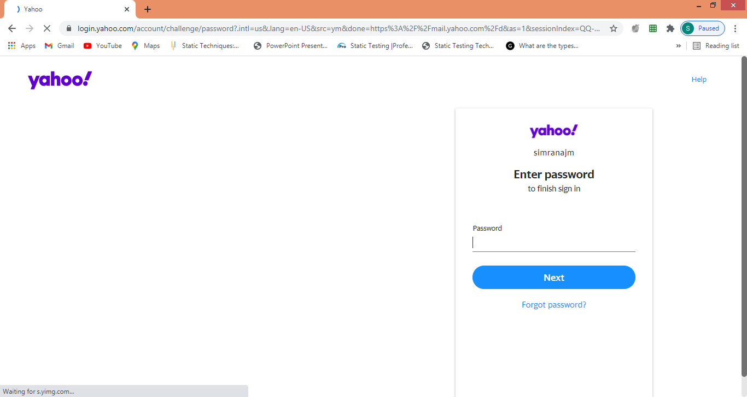
Test case example:
Test cases for the Test Scenario: "Check the Login Functionality" would be
Check system behavior when valid email id and password is entered.
Check system behavior when invalid email id and valid password is entered.
Check system behavior when valid email id and invalid password is entered.
Check system behavior when invalid email id and invalid password is entered.
Check system behavior when email id and password are left blank and Sign in entered.
Check Forgot your password is working as expected
Check system behavior when valid/invalid phone number and password is entered.
Check system behavior when "Keep me signed" is checked

Slide 4
Benefit of creating TEST CASE
What is a benefit of creating test cases?
How the application was previously tested.
Without formal test cases, more mistakes in testing would occur and fewer genuine bugs in the software would be discovered.
Preparation of test cases basically mean that all of the possible scenarios have been covered
Validation of actual result to the expected result.

Slide 5
HOW T O WRITE TEST CASES
Test Cases need to be simple and transparent:
Create Test Case with End User in Mind
Avoid test case repetition
Test Cases must be identifiable.
Ensure 100% Coverage
Repeatable and self-standing
Peer Review. send the final version of test case to your colleagues for peer review. Different people look at the same problem differently and your colleagues may improve parts of your test case, which you may have missed.
Do not Assume. Be PRECISE – Do not assume any functionality and features of your software. Stick to the Specification Documents.
Accurate: Exacts the purpose.
Economical: No unnecessary steps or words.
Traceable: Capable of being traced to requirements.
Reusable: Can be reused if necessary. –Ensure that all positive scenarios AND negative scenarios are covered
Always follow the same RULES – Organize your test cases consistently. Using the same pattern in organizing your test cases makes the testing easier for you as well as your colleagues or successors
Make them SHORT – If the test case contains a long list of steps and an error occurs, the developer would have to backtrack and repeat all the test steps. Having too many test steps can be a disadvantage for the tester, too. The tester would have to repeat each step to ensure that the bug was fixed.

Slide 6
HOW TO WRITE TEST CASES
Writing test cases is one of the key activity performed by the tester in the Software Testing Life Cycle(STLC). But the writing effective test case is a skill & which can be done by doing in-depth study of application for which writing the test cases and most important is the experience. The approach for writing good test cases will be to identify, define and analyze the requirements.
Fields:
Unit to test: What to be verified?
Test case id
Test data: Variables and their values
Steps to be executed
Expected Result
Actual result
Pass/Fail
Comments
As far as possible, write test cases in such a way that you test only one thing at a time. Do not overlap or complicate test cases. Attempt to make your test cases ‘atomic’.
Ensure that all positive scenarios AND negative scenarios are covered.
Language:
Write in simple and easy-to-understand language.
Use active voice instead of passive voice: Do this, do that.
Use exact and consistent names (of forms, fields, etc).

Slide 7
TEST CASE TEMPLATE
Test Scenario | The ID of the test suite to which this test case belongs.
Test Case ID | The ID of the test case.
Test Case Summary | The summary / objective of the test case.
Related Requirement | The ID of the requirement this test case relates/traces to.
Prerequisites | Any prerequisites or preconditions that must be fulfilled prior to executing the test.
Test Procedure | Step-by-step procedure to execute the test.
Test Data | The test data, or links to the test data, that are to be used while conducting the test.
Expected Result | The expected result of the test.
Actual Result | The actual result of the test; to be filled after executing the test.
Status | Pass or Fail. Other statuses can be ‘Not Executed’ if testing is not performed and ‘Blocked’ if testing is blocked.
Remarks | Any comments on the test case or test execution.
Created By | The name of the author of the test case.
Date of Creation | The date of creation of the test case.
Executed By | The name of the person who executed the test.
Date of Execution | The date of execution of the test.
Test Environment | The environment (Hardware/Software/Network) in which the test was executed.

Slide 8
Test Suite ID | TS001
Test Case ID | TC001
Test Case Summary | To verify that clicking the Generate Coin button generates coins.
Related Requirement | RS001
Prerequisites | User is authorized. Coin balance is available.
Test Procedure | Select the coin denomination in the Denomination field. Enter the number of coins in the Quantity field. Click Generate Coin.
Test Data | Denominations: 0.05, 0.10, 0.25, 0.50, 1, 2, 5 Quantities: 0, 1, 5, 10, 20
Expected Result | Coin of the specified denomination should be produced if the specified Quantity is valid (1, 5) A message ‘Please enter a valid quantity between 1 and 10’ should be displayed if the specified quantity is invalid.
Actual Result | If the specified quantity is valid, the result is as expected. If the specified quantity is invalid, nothing happens; the expected message is not displayed
Status | Fail
Remarks | This is a sample test case.
Created By | John Doe
Date of Creation | 01/14/2020
Executed By | Jane Roe
Date of Execution | 02/16/2020
Test Environment | OS: Windows Y Browser: Chrome

Slide 9
Example
Here we are taking the Gmail application and writing test scenarios for different modules which are most commonly used such as Login, Compose, Inbox, and Trash
Test scenario → Login module
Test Suit 1:
Test Cases:
Enter the valid login details (Username, password), and check that the home page is displayed.
Enter the invalid Username and password and check for the home page.
Leave Username and password blank, and check for the error message displayed.
Enter the valid Login, and click on the cancel, and check for the fields reset.
Enter invalid Login, more than three times, and check that account blocked.
Enter valid Login, and check that the Username is displayed on the home screen.

Slide 10
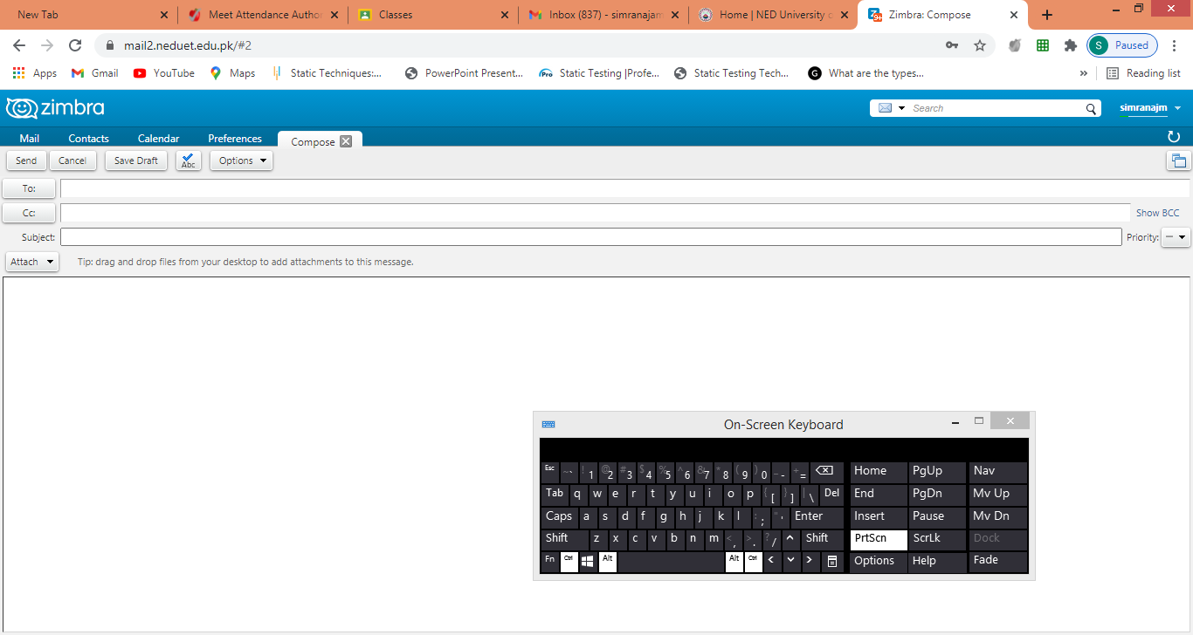

Slide 11
Example
Test scenarios → Compose module:
Test Suite 2 :
Test Cases:
Checks that users can enter email ids in the To, Cc, and Bcc.
Check that the user can enter various email ids in To, Cc, and Bcc.
Compose a mail, send it, and check for the confirmation message.
Compose a mail, send it, and check in the sent item of the sender and the inbox.
Compose a mail, send it, and check for invalid and valid email id (valid format), check the mail in sender inbox.
Compose mail, discard, and then check for conformation message and check-in draft.
Compose mail click on save as draft and check for the confirmation message
Compose mail click on close and check for conformation save as drafts.

Slide 12
Example
Test scenarios on Inbox module
Click on the inbox, and verify all received mail are displayed and highlighted in the inbox.
Check that a latest received mail has been displayed to the sender email id correctly.
Select the mail, reply and forward send it; check in the sent item of sender and inbox of the receiver.
Check for any attached attachments to the mail that are downloaded or not.
Check that attachment is scanned correctly for any viruses before download.
Select the mail, reply and forward save as draft, and check for the confirmation message and checks in the Draft section.
Check all the emails are marked as read are not highlighted.
Check all mail recipients in Cc are visible to all users.
Checks all email recipients in Bcc are not visible to the users.
Select mail, delete it, and then check in the Trash section.
Test scenario on Trash module
Open trash, check all deleted mail present.
Restore mail from Trash; check-in the corresponding module.
Select mail from trash, delete it, and check mail is permanently deleted.

Slide 13
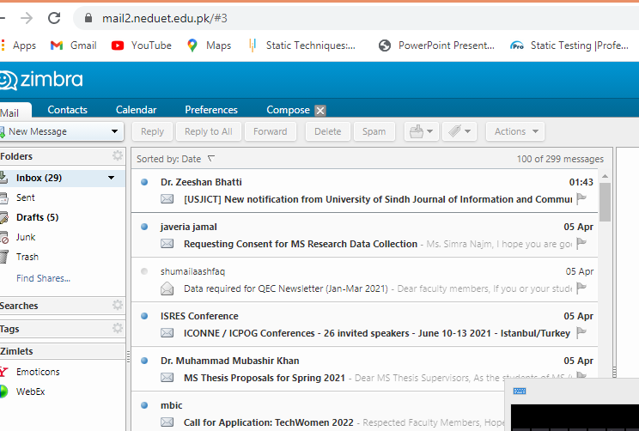

Slide 14
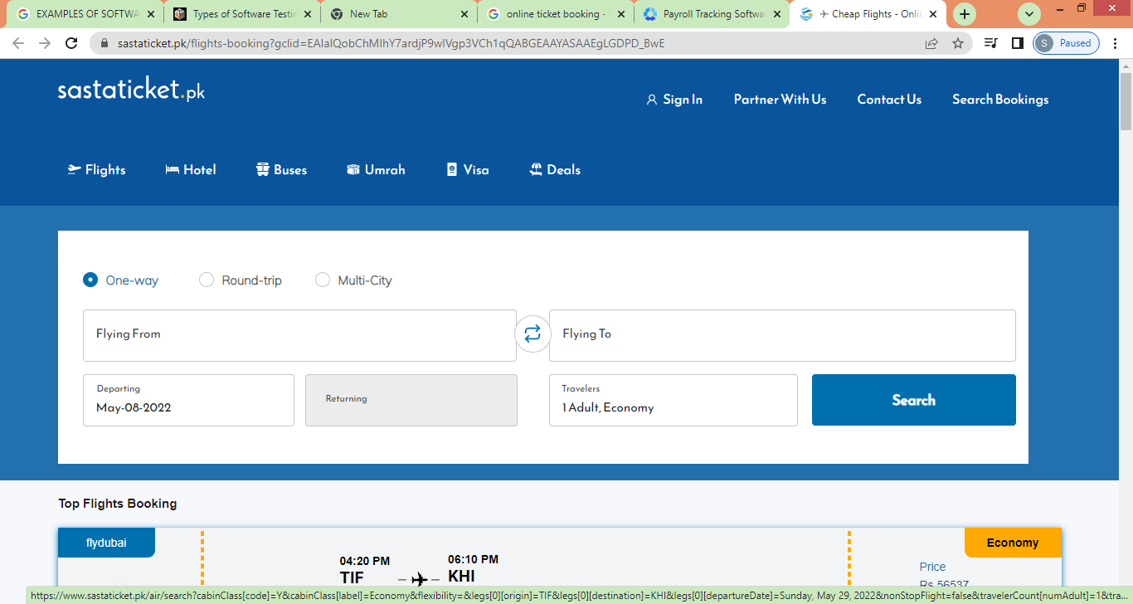

Slide 15
BANKING APPLICATION TEST SCENARIOS
Banking applications are one of the most complex applications in today’s software development and testing industry.
What makes banking applications so complex? What approach should be followed to test the complex workflows involved in banking applications?

Slide 16
What makes banking applications so complex?
Banking software mainly deals with confidential financial data so that the performance of software should be error-free and secure.
Developers prefer a complicated design to develop these applications to ensure that the application runs in a desired secure manner.
Banking is a constantly changing world. Banking, today, is made available to the customer using different channels like brick & mortar branches, ATMs, online banking and customer care.
With the advent of technology, many wallets have flooded the markets which connect to the banking systems for financial transactions.
Banking is also expected to be up and running 24 X 7 with high performance. Software upgrades, instant fixes, etc. cannot be allowed to impact this availability.
The banking world is also highly impacted by the constant changes brought in by the government in the form of banking regulations. Any changes to the tax structure will impact the banking system as well.
The banking system also needs to be up-to-date as far as new technologies are concerned. Data analytics like
Big Data Processing and getting instincts out of big data using Data Science is growing traction in the banking world.
The above mentioned points make the banking system complex for developers to create a software application around it.

Slide 17
Let’s first understand the characteristics of a Banking Application:
Multi-tier functionality to support thousands of concurrent user sessions. (functional testing include end to end, database ,security etc) (map with nonfunctional → load performance ,volume, stress so on)
Large-scale Integration: Typically, a banking application integrates with numerous other applications such as Bill Pay utility and Trading Accounts.
Complex business workflows
Real-Time and Batch processing
High Rate of Transactions per second
Secure Transactions
Robust Reporting section to keep track of day to day transactions.
Strong Audit to troubleshoot customer issues.
Massive storage system
Disaster / Recovery Management
The 10 points listed above are the most important characteristics of a banking application.
Banking applications have multiple tiers involved in performing an operation.

Slide 18
How To Test Banking Applications?
Importance of Testing Banking Application
Banking App Testing Workflow
#1) Requirement Gathering
#2) Requirement Review
#3) Business Scenario Preparations
#4) Functional Testing
#5) Database Testing
#6) Security Testing
Other Stages in Testing the BFSI App
Integration Testing
Usability Testing
Performance Testing
User Acceptance Testing
Sample Test Cases for Banking Application
Conclusion

Slide 19
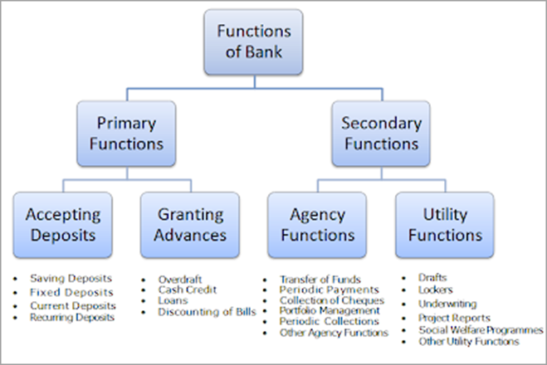
How To Test Banking Applications?
The various Functions performed by Banking Applications are:

Slide 20
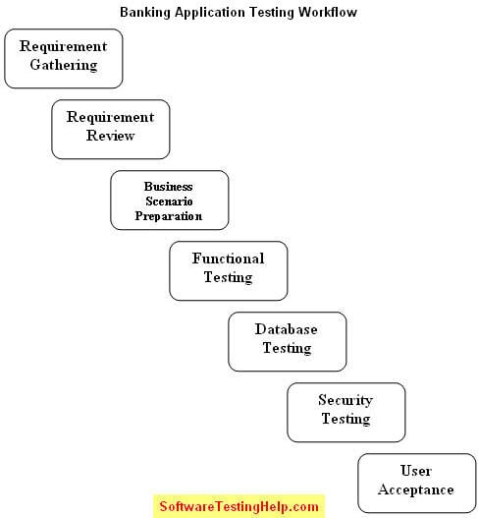
Banking App Testing Workflow

Slide 21
Sample Test Cases For Banking Application
Test cases for New Branch
Create a new branch with valid and invalid test data.
Create a new branch without data.
Create a new branch with existing branch data.
Verify the reset and cancel options.
Update branch details with valid and invalid test data.
Update branch details with existing branch test data.
Verify if the new branch can be saved.
Verify if the cancelation option is working.
Verify the branch deletion with and without dependencies.
Verify if the branch search option is working.
Test Cases for New Role
Create a new role with valid and invalid test data.
Create a new role without data.
Verify if a new role can be created with existing test data.
Verify the role description and role type.
Verify that the cancelation and reset option is working.
Verify the role deletion process with and without dependency.
Verify the links in the role details page.
Verify the admin login without test data.
Verify all home links for the admin role.
Verify if the admin can change the password with valid and invalid test data.
Verify the admin log out successfully.
Sample Test Cases For Banking Application
Test cases for SCENARIO New Branch
Create a new branch with valid and invalid test data.
Create a new branch without data.
Create a new branch with existing branch data.
Verify the reset and cancel options.
Update branch details with valid and invalid test data.
Update branch details with existing branch test data.
Verify if the new branch can be saved.
Verify if the cancelation option is working.
Verify the branch deletion with and without dependencies.
Verify if the branch search option is working.
Test Cases for New Role
Create a new role with valid and invalid test data.
Create a new role without data.
Verify if a new role can be created with existing test data.
Verify the role description and role type.
Verify that the cancelation and reset option is working.
Verify the role deletion process with and without dependency.
Verify the links in the role details page.
Verify the admin login without test data.
Verify all home links for the admin role.
Verify if the admin can change the password with valid and invalid test data.
Verify the admin log out successfully.

Slide 22
Test cases for Customer and Banker
Verify if all visitor and customer links are working properly.
Verify the customer’s login with valid and invalid test data.
Verify the customer’s login without any data.
Verify the banker login without any data.
Verify the banker’s login with valid or invalid test data.
Verify if the customer or banker was able to log out successfully.
Test cases for New users
Verify if the new user can be created with valid and invalid test data.
Create a new user with existing branch test data
Verify if the cancel and reset option is working properly.
Update user details with valid and invalid test data.
Verify the deletion of the new user.
check if the new user can be verified.
Verify mandatory input parameters.
Verify optional input parameters.
Verify if a user can be created without optional parameters.

Slide 23
Test cases for the creation of a New Account
Create a new account with valid and invalid user data.
Verify if the user details can be updated.
Verify if a new user can be saved.
Create a new account with existing user data.
Verify that the user can deposit the amount into the newly created account (and update the balance).
Verify if the user can withdraw the amount from the new account (after depositing and updating the balance).
In the case of salary, the account verifys the company name and other details provided by the user.
Verify if the primary account number is provided in case of a secondary account.
Verify the user details provided in the case of the current account.
Verify the provided proof for the joint account in case of a joint account.
Verify whether you are able to maintain a zero balance in your salary account.
Verify whether you are able to maintain a zero balance or minimum balance for a non-salary account.
Verify that the new user was able to log out successfully.

Slide 24
Test Cases For Net Banking Application
Check if the user is able to open the bank site.
Check if all the links on the site are working.
Verify if the user is able to create a new account.
Check if the user is able to login with a valid and invalid username and password.
Verify if either the username or password is blank while logged in, the user should not be allowed to login and an alert message should be shown.
Check if the user is allowed to change the password.
If an invalid username or password is entered, a proper error message will be shown.
Users with an invalid password should not be allowed to log in.
Verify that after repeated attempts to log in with an incorrect password, the user should be shown an error message and blocked.
Check if the user is able to perform some basic transactions.
Verify that the user is able to add a beneficiary with valid and invalid details.
Verify if the user can delete the beneficiary.
Verify that the user is able to make transactions to the newly added beneficiary.

Slide 25
After the transaction, verify if the accounts of both the user and beneficiary have been updated.
Check if the user is able to enter the amount in decimal number.
Verify if the user is not able to enter negative numbers in the amount field.
Verify if the user is allowed to make transactions with or without a minimum balance.
Verify if the user can make a new RD.
Verify that the correct message is showing in case of transaction done with insufficient balance.
Check if the user is asked for confirmation before any transaction is made.
Verify if acknowledgment receipts are provided on each successful transaction.
Verify if the user is able to transfer money to multiple accounts.
Verify if the user can cancel the transaction.
Verify that the account details reflect the financial transactions done also.
Verify that the timeout feature has been implemented.
Verify that in case of session time out a user should log in again.
Verify that the proper session time out is done in case of any inactivity.
Verify that while doing the transaction the user is taken to secure mode.
Verify if the user was able to log out successfully.
Verify search and reset option

Slide 26
WEB TESTING CHECKLIST ABOUT DATA SECURITY
Are data inputs adequately filtered?
Are data privileges identified (e.g read,write update and query)
Are data access privilege enforced
Have data backup and restore processes been defined
Have data backup and restore processes been tested
Have data backup and restore processes been tested
Have sensitive and critical data been allocated to secure location
Have data archival and retrieval procedure been identified
WEB TESTING CHECKLIST ABOUT PERFORMANCE
Has the database capacity been identified?
Has anticipated growth data been obtained?
Is database self contained?
Is system architecture defined eg. tier ,server, networks etc
Have the various environment been created?
Is load balancing available ?
etc

Slide 27
When to start test activity /When to stop test activities
When to start test activity:
Testing should be started as early as possible to reduce the cost and time to rework and produce software that is bug-free so that it can be delivered to the client.
However, in Software Development Life Cycle (SDLC), testing can be started from the Requirements Gathering phase and continued till the software is out there in productions.
It also depends on the development model that is being used.
For example, in the Waterfall model, testing starts from the testing phase which is quite below in the tree,; but in the V-model, testing is performed parallel to the development phase.

Slide 28
When to stop test activities
When is it Enough Testing?
When can we say that this much testing is enough? Can testing ever be completed?
In order to answer these questions, we will have to analyze testing activities from start to end
An application can never be 100% bug-free. So to ascertain when one can stop testing is difficult
What is Completion or Exit Criteria?
The exit criteria get evaluated at the end of the testing cycle and is defined in Test Plan. It is the set of conditions or activities which must be fulfilled in order to conclude testing.
The Exit criteria define how much testing is enough and when testing activities can be declared complete. Coverage and completion criteria are combined to define exit criteria for testing.
Ideally, Exit or Stop Criteria is defined by combining various factors and hence is unique across all projects. It depends on the project requirement and hence should be defined during Test Planning; at the beginning of the project. Parameters defined in it should be quantified as much as possible.
Below are few pointers to be considered while defining Exit Criteria in case of Functional or System Testing. You may combine few or all the below factors while deciding where to stop testing as per your project needs.
Testing can be stopped when:

Slide 29
When to stop test activities
Requirements: 100% Requirements coverage is achieved.
Defects:
Defined / Desired Defect count is reached.
All High Priority defects are identified and fixed.
Defect Rate falls below defined acceptable rate.
Very few Medium Priority defects are open and have a workaround in place.
Very few low priority open defects that do not impact software usage.
All High Priority defects are re-tested and closed and corresponding Regression scenarios are successfully executed.
Test Coverage:
Test Coverage should be 95% achieved.
Test case Pass Rate should be 95%. This can be calculated by formula
( Total No of TCs Passed / Total number of TCs ) * 100.
All critical Test cases are passed.
5% Test cases can be failed but the Failed Test cases are of low priority.
Complete Functional Coverage is achieved.
All major functional / business flows are executed successfully with various inputs and are working fine.

Slide 30
When to stop test activities
Deadlines:
Project Deadline or Test Finish deadline is reached.
Test Documents:
All Test Documents / deliverables (Example – Test Summary Report) are prepared, reviewed and published across.
Budget:
Complete Testing Budget is exhausted.
“Go / No Go” Meetings:
“Go / No Go” meeting has been conducted with stakeholders and a decision is made whether the project should go to production or not.
Conclusion:
However, the following things are kept in mind while stopping the test activities: • Testing deadlines • Completion of test case execution cycle • Completion of functional testing and code coverage to an agreed limit • No high-priority bug is found and the rate of finding bug declines after a certain level • Management decision A software test process consists of the activities listed below:
Planning and control Analysis and design Implementation and execution Meeting exit criteria Test closure activities

Slide 31
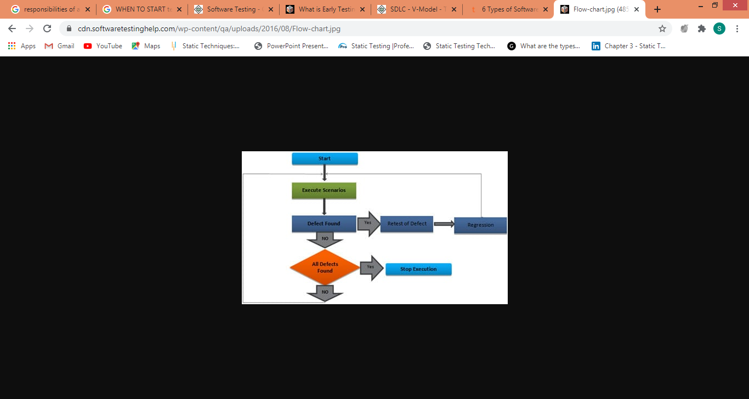
When to stop test activities
Conclusion: Let’s make it very simple at the end.
Please answer questions with a simple Yes or No.
Are all test cases executed at least once?
Is the Test Case Pass rate as defined?
Is complete test coverage achieved?
Are all functional / Business flows executed at least once?
Is the decided defect count reached?
Are all Major High Priority Defects fixed and closed?
Have all Defects been Retested and closed?
Has Regression been done for all open defects?
Have you exhausted the testing budget?
Has the Testing end time reached?
Are all Test Deliverables reviewed and published?

Slide 32
Multiple Roles of Software Testers – People Relationship:
Few Useful Points on Role of Software Testers:
Testing is finally recognized as a profession which needs specialized skills set and qualifications. Also it is convinced testing will not start once the development is completed.
Testing needs to be start in every stage of the software development Life Cycle. Testers need to validate whether the requirements specification documents is developed based on the needs of the organization.
Testers need to be ensuring that the design documents developed based on the requirements specifications.
Testers need to be ensure that the test cases and test plan are created based on the requirements specifications.
Testers need to be ensure that the defects need to find out before the test cycle starts so that the cost spends will gradually decreases.
Testers need to know that the defects can be reproducible by developers.
Testers need to be ensure that they are finding defects of the high priority scenarios first. If you are in Agile methodology, then testers
need to make sure that defects are getting fixed on priority. Finding out defects in the later stage of the product will leads the cost spend to rectify the defects is very costly

Slide 33
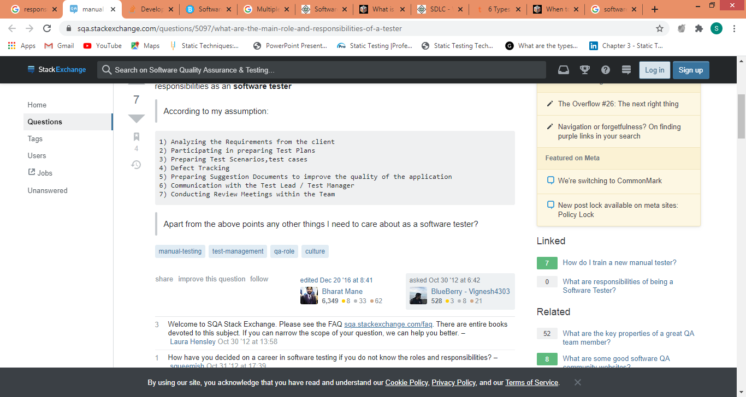
CONCLUSION
The top 10 people challenges have been identified:
Training in Testing
Good Relationship with Developers.
Good Relationship with Customers.
Managers need to understand about testing.
Using of Tools.
Time on Testing
Fighting a lose-lose situation
1. Having to say No
Testing “Over the wall” Software

Slide 34
Why Software Testing is Important?
Testing is important because software bugs could be expensive or even dangerous. Software bugs can potentially cause monetary and human loss, history is full of such examples.
In April 2015, Bloomberg terminal in London crashed due to software glitch affected more than 300,000 traders on financial markets. It forced the government to postpone a 3bn pound debt sale.
Nissan cars have to recall over 1 million cars from the market due to software failure in the airbag sensory detectors. There has been reported two accident due to this software failure.
Starbucks was forced to close about 60 percent of stores in the U.S and Canada due to software failure in its POS system. At one point store served coffee for free as they unable to process the transaction.
Some of the Amazon’s third party retailers saw their product price is reduced to 1p due to a software glitch. They were left with heavy losses.
Vulnerability in Window 10. This bug enables users to escape from security sandboxes through a flaw in the win32k system.
In 2015 fighter plane F-35 fell victim to a software bug, making it unable to detect targets correctly.
China Airlines Airbus A300 crashed due to a software bug on April 26, 1994, killing 264 innocent live
In 1985, Canada's Therac-25 radiation therapy machine malfunctioned due to software bug and delivered lethal radiation doses to patients, leaving 3 people dead and critically injuring 3 others.
In April of 1999, a software bug caused the failure of a $1.2 billion military satellite launch, the costliest accident in history
In may of 1996, a software bug caused the bank accounts of 823 customers of a major U.S. bank to be credited with 920 million US dollars.

Slide 35
THANKYOU
☺

