Slide 1

WELCOME TO SIXTH LECTURE REVIEWS
Software Testing Techniques and Strategies
COURSE CODE :SE-484

Slide 2
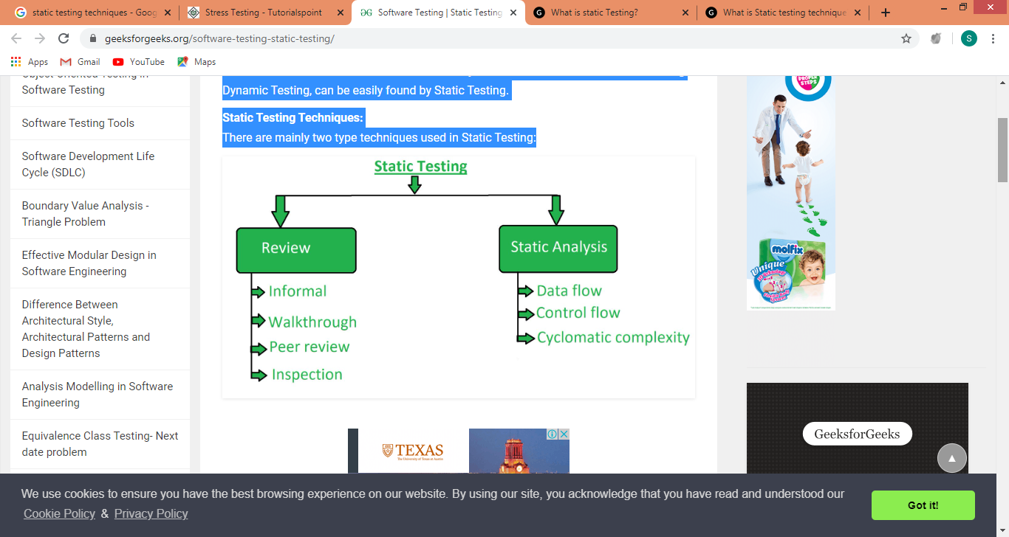
STATIC TESTING TECHNIQUES
Static testing is performed in early stage of development to avoid errors as it is easier to find sources of failures and it can be fixed easily. The errors that can’t not be found using Dynamic Testing, can be easily found by Static Testing.
Static Testing Techniques: There are mainly two type techniques used in Static Testing:

Slide 3
STATIC TESTING TECHNIQUES
1.Review: In static testing review is a process or technique that is performed to find the potential defects in the design of the software. It is process to detect and remove errors and defects in the different supporting documents like software requirements specifications. People examine the documents and sorted out errors, redundancies and ambiguities
Review is of four types:
(a)Formal/ Informal: In informal review the creator of the documents put the contents in front of audience and everyone gives their opinion and thus defects are identified in the early stage.
(b) Peer review: Peer review means checking documents of one-another to detect and fix the defects. It is basically done in a team of colleagues.
(c). Walkthrough: It is basically performed by experienced person or expert to check the defects so that there might not be problem further in the development or testing phase.
(d). Inspection: Inspection is basically the verification of document the higher authority like the verification of software requirement specifications (SRS).
(e)Technical Review This type of review is a documented defect-detection process that involves peers and technical experts. It is often performed as a peer review without management participation. Ideally, it is led by a trained Moderator or by a technical expert

Slide 4
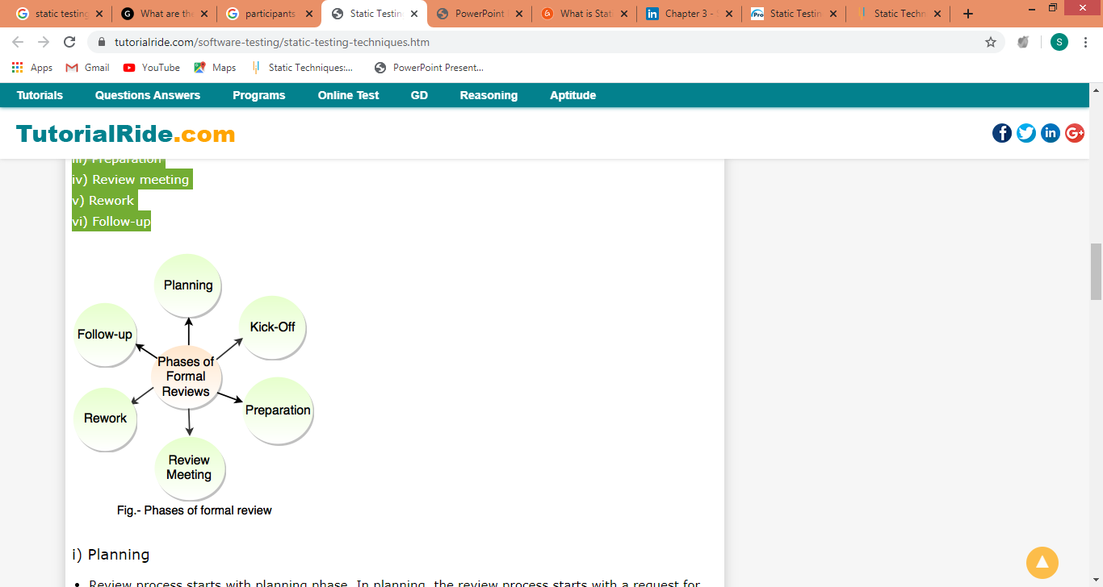
STATIC TESTING TECHNIQUES
1.Review:
(a) Formal reviews
Formal reviews follow the formal process i.e these reviews are well structured and managed. Following are the phases of formal reviews: i) Planning ii) Kick-Off iii) Preparation iv) Review meeting v) Rework vi) Follow-up

Slide 5
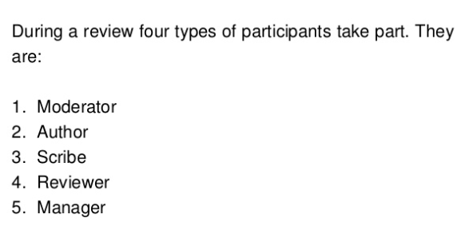
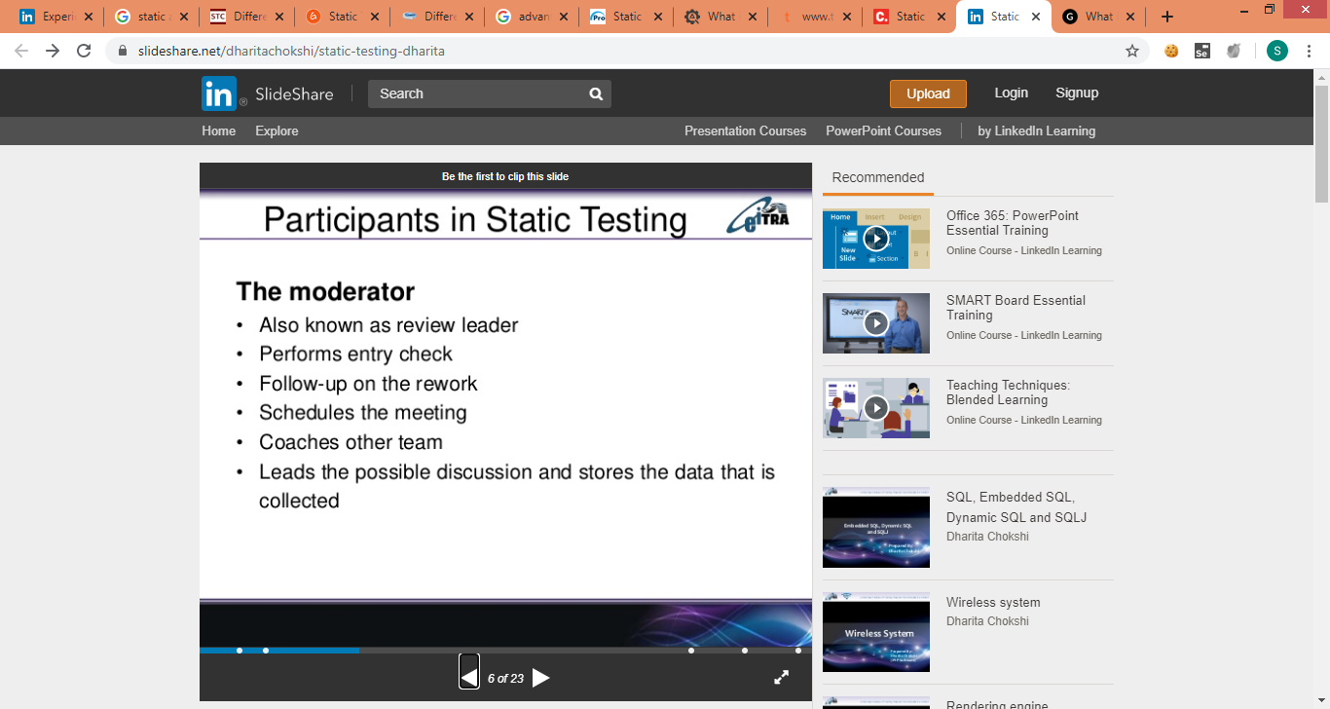
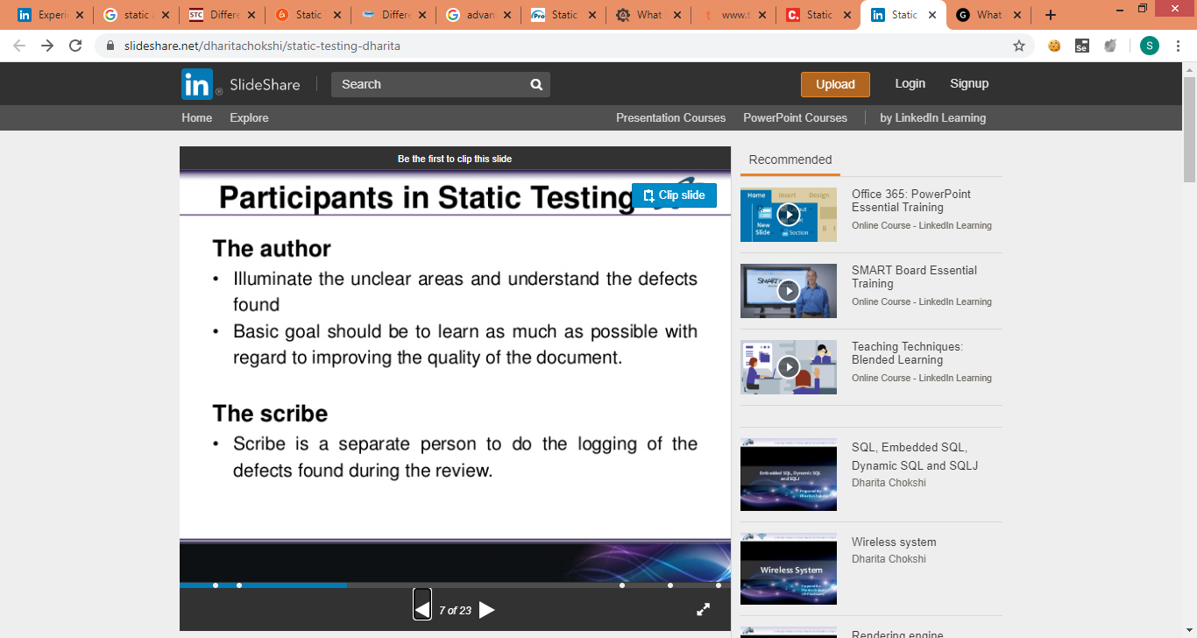
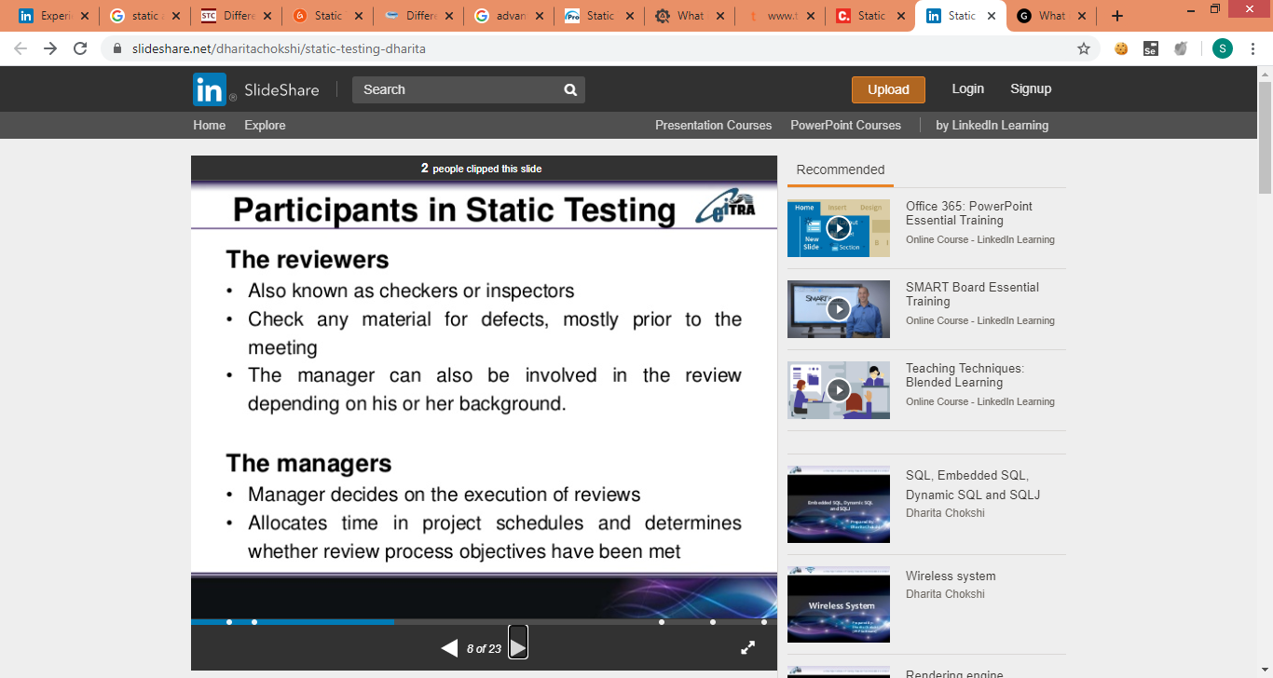
PARTICIPANTS OF REVIEW TEAM

Slide 6
STATIC TESTING TECHNIQUES
(a)Formal reviews
Planning
Review process starts with planning phase. In planning, the review process starts with a request for review by the authors to the inspection leader.
In the formal review, the inspection leader executes the entry check and defines the exit criteria.
Entry criteria verifies the document is ready to enter the formal review process.
ii) Kick-off
Kick-off meeting is optional in review procedure.
The aim of kick-off step is to explain the objectives of review and distribute the documents in meeting etc.
iii) Preparation
In preparation, reviewers review the document separately using related rules, procedures, documents.
Every reviewer recognizes the defects, questions and comments as per their role and understanding of document.

Slide 7
iv) Review meeting
Review meeting includes three phases: 1. Logging Phase - Defects and issues are identified in the preparation step that are logged page by page. 2. Discussion Phase - This phase handles the issues that require discussion. 3. Decision Phase - Decision on the document reviews is constructed by reviewers or participants. Sometimes decision is based on formal exit criteria (Average number of major defects found per page). v) Rework
If the number of defects found per page is more than certain level then the document needs to be reworked. vi) Follow-up
In follow up, moderator ensures that author has taken an action on all known defects.
The distribution of updated document and collection of feedback is completed in follow-up.
In follow up, it is the responsibility of the moderator to ensure that the information is correct and it stored for future analysis.

Slide 8
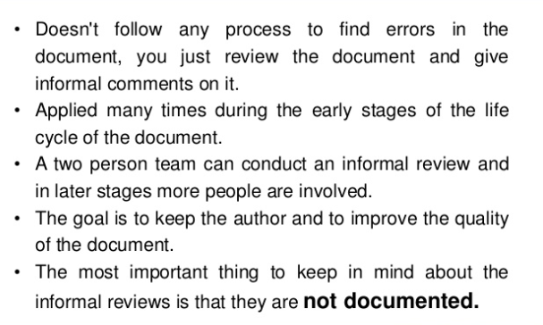
(a) INFORMAL REVIEW
STATIC TESTING TECHNIQUES
1.Review:
Devoid of any process, this aspect involves a general review of working manual of the product and ends with a small bunch of unofficial comments which are never documented. Generally a team of two persons are involved with the aim of improving the quality of the document along with the author.

Slide 9
STATIC TESTING TECHNIQUES
Difference between the Formal Review and Informal Review
Formal Review | Informal Review
A formal review is characterized by documented procedures and requirements such as an inspection. The formal review process is well-structured and regulated. The formality of a review process is related to factors such as the maturity of the development process, legal or regulatory requirements, and the need for an audit trail. | An informal review is not based on a formal, documented procedure. Informal reviews are not as well-structured, yet they still offer significant benefits. Informal reviews come in various shapes and forms. However, they all have one characteristic in common—they are not documented. In reality, the informal review is possibly the most common type of review. Informal reviews are applied at various times during the early stages of the life cycle of a document. A two-person team can conduct an informal review; for example, an Author can ask a colleague to review a document or code. In later stages, these reviews often involve more people and a meeting. This normally involves peers of the Author who try to find defects in the document under review and discuss these defects in a review meeting. The goal is to help the Author improve the quality of the document.

Slide 10
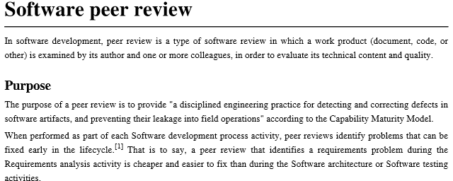
This type of review is conducted by the main author of the software, or it can be between the colleagues so that the evaluation can be done of the technical content or quality of the work. A discussion is always a solution for a software analysis. It always provides a deeper insight of the software shortcomings and also its benefits. If the software shortcoming weigh higher than benefits, the software goes in testing mode again and it rectified as required.

Slide 11
Peer Review Characteristics:
Peer Reviews are documented and uses a defect detection process that has peers and technical specialist as part of the review process.
The Review process doesn't involve management participation.
It is usually led by the author and the moderator.
The report is prepared with the list of issues that needs to be addressed.
Types of Peer Review:
"Code Review": To fix mistakes and to remove vulnerabilities from the software product, systematic examination of the computer source code is conducted, which further improves the quality & security of the product.
"Pair Programming": This is a type of code review, where two programmers work on a single workstation and develop a code together.

Slide 12
Benefits of Peer testing:
Benefits of Peer testing:
Increase in the quality of the work product -Well, quality is definitely addressed through this review, because when one looks into the work product of their fellow members, it is a common psychology to try to find out bugs. A coder thus takes up this task with a lot of enthusiasm in order to trace the loopholes in the code. As a result, the process progresses with an inquisitive approach thus enabling the possibility of least amount of defects.
Steady work progress -A milestone is defined prior commencing the process of peer review. Hence when the process actually begins, the team members gear up for achieving the final objective.
A sense of belonging within the group -Definitely the technique of peer review infuses a sense of team spirit, because the mission is to find bugs and inflict the cause of the same on the other team. It is a kind of competition that eventually leads to a team effort - who wins over another.
.

Slide 13
Benefits of Peer testing:
Enhanced collaboration between teams -The teams working in association with each other occasionally exchange ideas, take opinion of their fellow team members on similar kind of problems. This ensures enhancement of knowledge which can help to face the challenges, effortlessly.
Increased Learning -Unity is strength. This proverb holds so true when people recognize the importance or value of team spirit. Therefore when team members exchange ideas and opinions within the team or with another team, it gradually helps in developing a great deal of knowledge about a subject.
Cost effective -Imbibing peer review as a part of software development life cycle helps to curb cost in terms of outsourcing the application under development for review to some external resource, purchasing or renewing tool licenses and so on.
Conclusion:
Peer review is an efficient technique that adopts a collaborative approach towards problem solving. It helps to gain a better insight into a subject matter, when one delves into the task performed by another. It helps the person to understand different ways of doing a task which he himself may never have practically applied or has thought of.
Peer review is and shall in the long run serve as a method of attaining a quality work product.

Slide 14
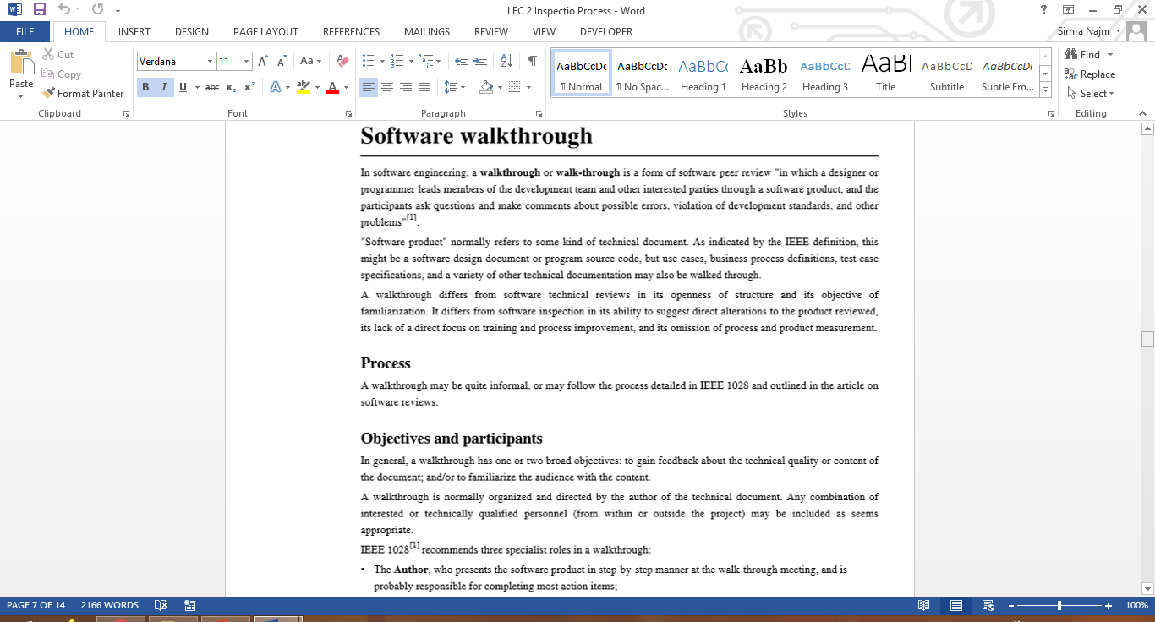

Slide 15
Walkthrough.
Walkthrough is not a formal process
It is led by the authors
Author guide the participants through the document according to his or her thought process to achieve a common understanding and to gather feedback.
May take form scenarios ,dry run group communication
Useful for the people if they are not from the software discipline, who are not used to or cannot easily understand software development process.
In walkthrough, a review team does not require to do detailed study before meeting while authors are already in the scope of preparation.
Walkthrough is useful for higher-level documents i.e requirement specification and architectural documents.
Main purpose is learning gathering understanding, finding defects
Goals of walkthrough Make the document available for the stakeholders both outside and inside the software discipline for collecting the information about the topic under documentation.
Describe and evaluate the content of the document.
Study and discuss the validity of possible alternatives and proposed solution

Slide 16
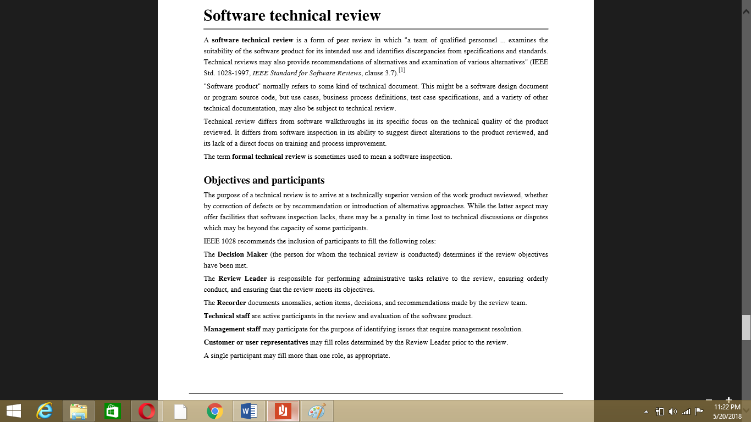

Slide 18
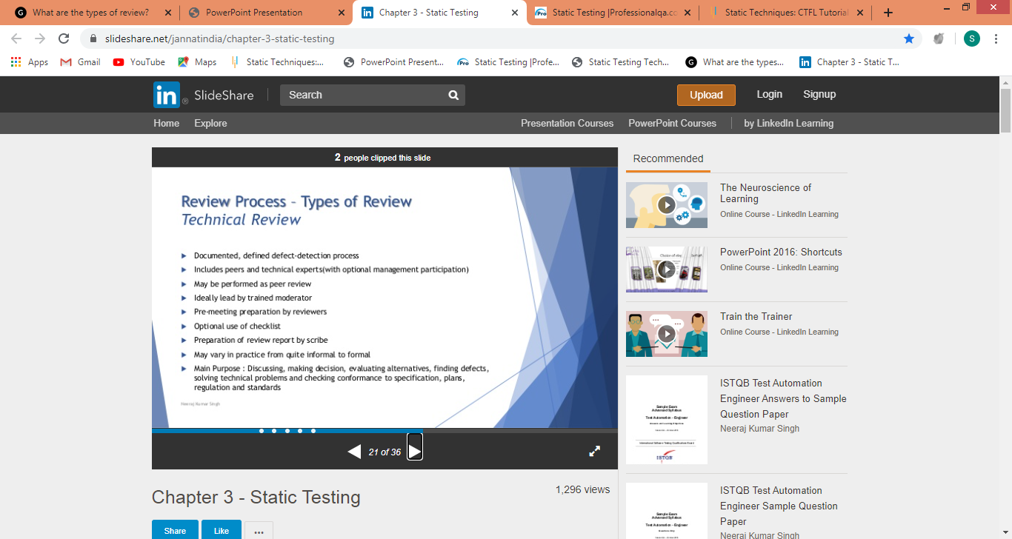
Technical Review
Technical review is a discussion meeting that focuses on technical content of the document. It is a less formal review.
It is guided by a trained moderator or a technical expert.
Defects are found by the experts (such as architects, designers, key users) who focus on the content of the document.
In practice, technical reviews vary from quite informal to very formal
Goals of technical review The goal is to evaluate the value of technical concept in the project environment.
Build the consistency in the use and representation of the technical concepts.
In early stages it ensures that the technical concepts are used correctly.
Notify the participants regarding the technical content of the document.

Slide 19
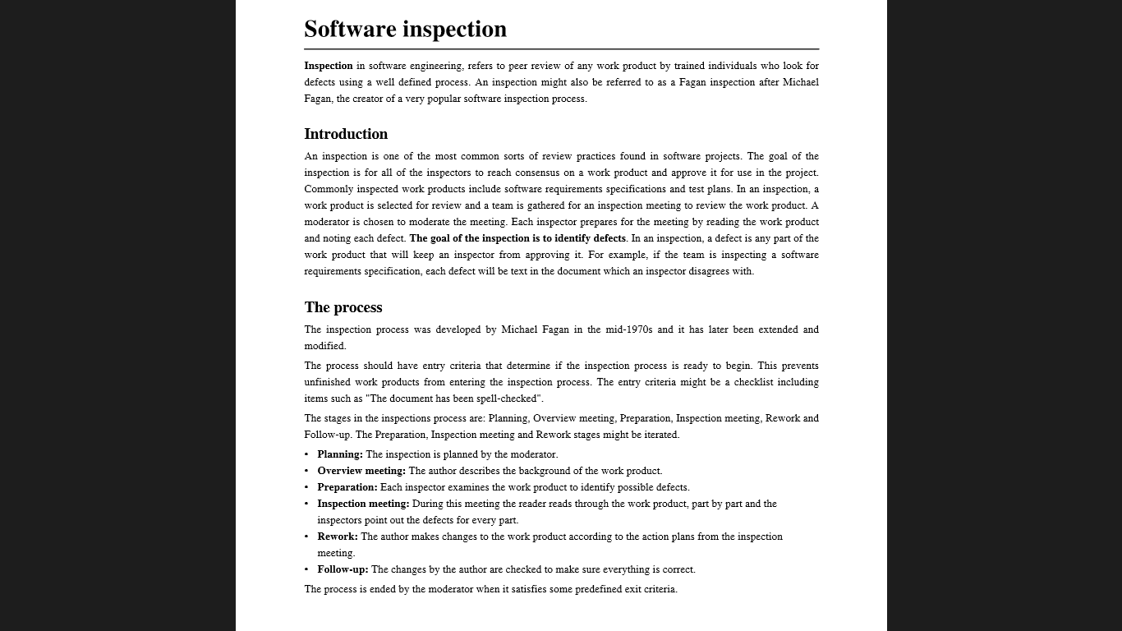

Slide 20
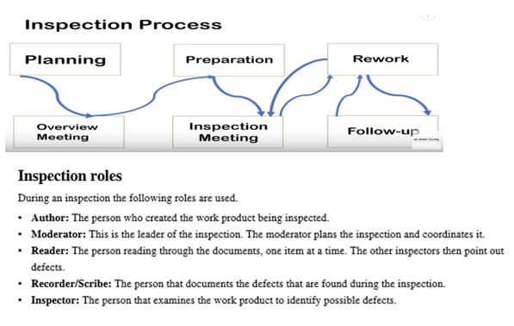

Slide 21

Inspection
The trained moderator guides the Inspection. It is most formal type of review.
The reviewers are prepared and check the documents before the meeting.
In Inspection, a separate preparation is achieved when the product is examined and defects are found. These defects are documented in issue log.
In Inspection, moderator performs a formal follow-up by applying exit criteria.
Goals of Inspection Assist the author to improve the quality of the document under inspection.
Efficiently and rapidly remove the defects.
Generating the documents with higher level of quality and it helps to improve the product quality.
It learns from the previous defects found and prohibits the occurrence of similar defects.
Generate common understanding by interchanging information.

Slide 22
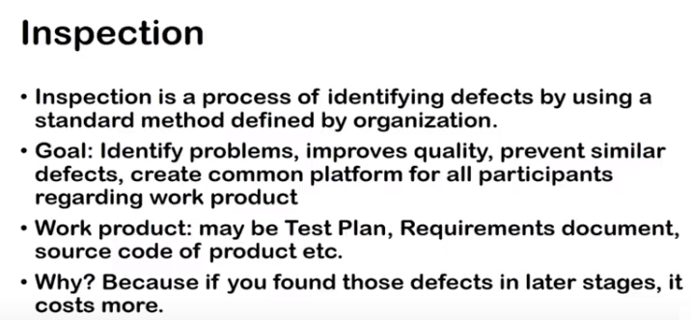
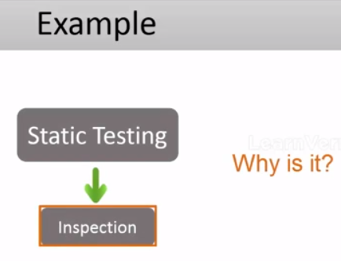

Slide 23
STATIC TESTING TECHNIQUES
2. Static Analysis:
Static Analysis includes the evaluation of the code quality that is written by developers. Different tools are used to do the analysis of the code and comparison of the same with the standard. It also helps in following identification of following defects:
With the assistance of static analysis, the team is able to analyze the code written by software developers. Moreover, it allows them to find structural defects and apertures, which may lead to defects that can impact the quality as well as the functionality of the software. Performed with the assistance of tools, this method enables the team to identify and rectify the following issues and defects:
Helps to identify unreadable and dead codes.
Security vulnerabilities.
Violations of syntaxes and programming standards.
Variables with unidentified values.
Inconsistent variables between modules.

Slide 24
STATIC TESTING TECHNIQUES
2. Static Analysis is of three types:
(a). Data Flow: Data flow is related to the stream processing.
(b). Control Flow: Control flow is basically how the statements or instructions are executed.
(c). Cyclomatic Complexity: Cyclomatic complexity is the measurement of the complexity of the program that is basically related to the number of independent paths in the control flow graph of the program
(a) Unused variables
(b) Dead code
(c) Infinite loops
(d) Variable with undefined value
(e) Wrong syntax

Slide 25
Benefits of Review
A review is part of static testing techniques and is implemented at an early phase of the SDLC. Hence, it offers a variety of benefits.
The different benefits of the review process are the following:
When defects are detected at an early stage, rework expenses are relatively low, and this reduces the overall cost of software products.
As the rework effort is substantially reduced, development productivity is likely to increase.
It also helps in reducing the development timescale, testing time, and associated costs.
This contributes to the overall project or product lifetime cost reduction. Furthermore, a review is often conducted by a team.
This evaluation by a team has the additional advantage of allowing for the exchange of information between the participants.
Reviews also contribute to an increased awareness of quality issues.
Reviews are a suitable method for improving the quality of software work products.
While the product or deliverable under review, benefits directly from the review process, reviews are also critical as they help improve the overall quality of the SDLC.

