Slide 1

WELCOME TO SEVENTH LECTURE OF
Software Testing Techniques and Strategies
COURSE CODE :SE-484

Slide 2
Levels of testing
Defined by a given environment
Environment is a collection of people, hardware, software, interfaces, data etc
An application, it undergoes a thorough testing process to ensure that the app is working in the manner in which it was intended. There are four main stages of testing that need to be completed before a program can be cleared for use:
In general, there are four levels of testing: unit testing, integration testing, system testing, and acceptance testing.
The purpose of Levels of testing is to make software testing systematic and easily identify all possible test cases at a particular level.
These different testing levels which help to check behavior and performance for software testing. These testing levels are designed to recognize missing areas and reconciliation between the development lifecycle
Testing levels helps to identify missing areas and prevent overlap and repetition between the development life cycle phases. In software development life cycle models there are defined phases like requirement gathering and analysis, design, coding or implementation, testing and deployment. Each phase goes through the testing. Hence there are various levels of testing.
Software system go through mainly four stages before it is actually deployed. These four stages are known as
Unit Testing
Integration Testing
System Testing
Acceptance Testing

Slide 3
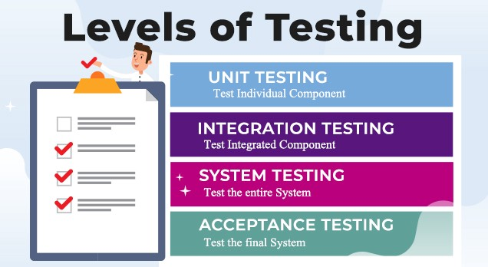
INTRODUCTION

Slide 4
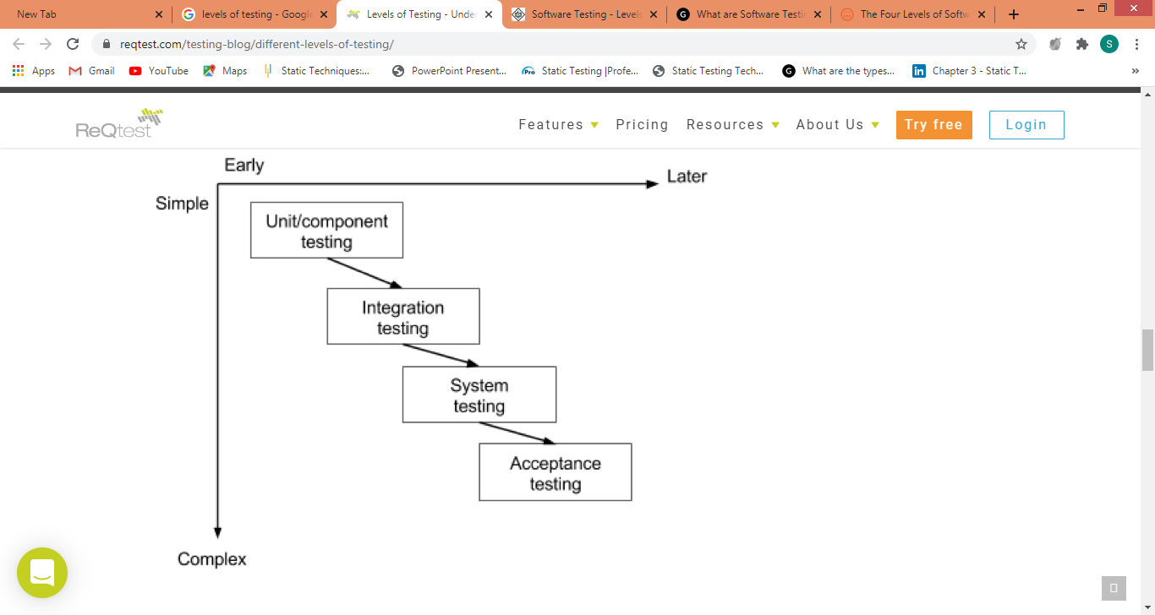
Levels of Testing
INTRODUCTION:
These four testing types cannot be applied haphazardly during development. There is a logical sequence that should be adhered to in order to minimize the risk of bugs cropping up just before the launch date.
Any testing team should know that testing is important at every phase of the development cycle.
By progressively testing the simpler components of the system and moving on the bigger, more complex groupings, the testers can rest assured they are thoroughly examining the software in the most efficient way possible.
The four levels of testing shouldn’t only be seen as a hierarchy that extends from simple to complex, but also as a sequence that spans the whole development process from the early to the later stages.
Note however that later does not imply that acceptance testing is done only after say 6 months of development work., acceptance testing can be carried out as often as every 2-3 weeks, as a part of the sprint demo.

Slide 5
Levels of Testing
Conclusion
Testing early and testing frequently is well worth the effort.
By adopting an attitude of constant alertness and scrutiny in all your projects, as well as a systematic approach to testing, the tester can pinpoint any faults in the system sooner, which translates in less time and money wasted later on.
Detecting software errors early is important since it more effort is needed to fix bugs when the system is nearing launch, and — due to the interactive nature of components in the system — one small bug in a particular component hidden deep within layers of code can result in an effect that is magnified several times over on a system-level.

Slide 6
Levels of testing
What is Unit Testing
The smallest independent and testable part of the source code is referred to as a unit. It is the first step in software testing environment and is generally conducted by the developers or their team mates.
During this first round of testing, the program is submitted to assessments that focus on specific units or components of the software to determine whether each one is fully functional
The main aim of this endeavor is to determine whether the application functions as designed. In this phase, a unit can refer to a function, individual program or even a procedure, and a White-box Testing method is usually used to get the job done. One of the biggest benefits of this testing phase is that it can be run every time a piece of code is changed, allowing issues to be resolved as quickly as possible. It’s quite common for software developers to perform unit tests before delivering software to testers for formal testing
This form of testing is rarely performed by software testers.
In order to perform integration testing it is important to first complete the unit testing for all the units. In order to perform unit testing it is important to have well defined unit test plan and unit test cases.
. When you start unit testing in parallel to development it may look like a slow process as many defects are uncovered during this stage and several changes are made to the code. However, with time the code is refined and number of defects begins to reduce. So, the foundation of the software is strong and in the later stages the software development is carried out at a much faster pace thereby saving a lot of time.

Slide 7
Levels of testing
What is Unit Testing?
Unit Testing of software applications is done during the development (coding) of an application.
The goal of Unit Testing is to isolate each part of the program and show that the individual parts are correct.
In procedural programming a unit may be an individual function or procedure
Unit Testing is usually performed by the developer
Why do Unit Testing? Why is it important?
Sometimes software developers attempt to save time by doing minimal unit testing. This is a myth because skimping on unit testing leads to higher Defect fixing costs during System Testing, Integration Testing and even Beta Testing after the application is completed. Proper unit testing done during the development stage saves both time and money in the end

Slide 8
STATIC UNIT TESTING
Levels of testing
Static unit testing is conducted as a part of a larger philosophical belief that a software product should undergo a phase of inspection and correction at each milestone in its life cycle. At a certain milestone, the product need not be in its final form. For example, completion of coding is a milestone, even though coding of all the units may not make the desired product. After coding, the next milestone is testing all or a substantial number of units forming the major components of the product. Thus, before units are individually tested by actually executing them, those are subject to usual review and correction as it is commonly understood. The idea behind review is to find the defects as close to their points of origin as possible so that those defects are eliminated with less effort, and the interim product contains fewer defects before the next task is undertaken.
In static unit testing, code is reviewed by applying techniques commonly known as inspection and walkthrough. The original definition of inspection was coined by Michael Fagan [1] and that of walkthrough by Edward Yourdon [2]:
Inspection: It is a step-by-step peer group review of a work product, with each step checked against predetermined criteria.
Walkthrough: It is a review where the author leads the team through a manual or simulated execution of the product using predefined scenarios.

Slide 9
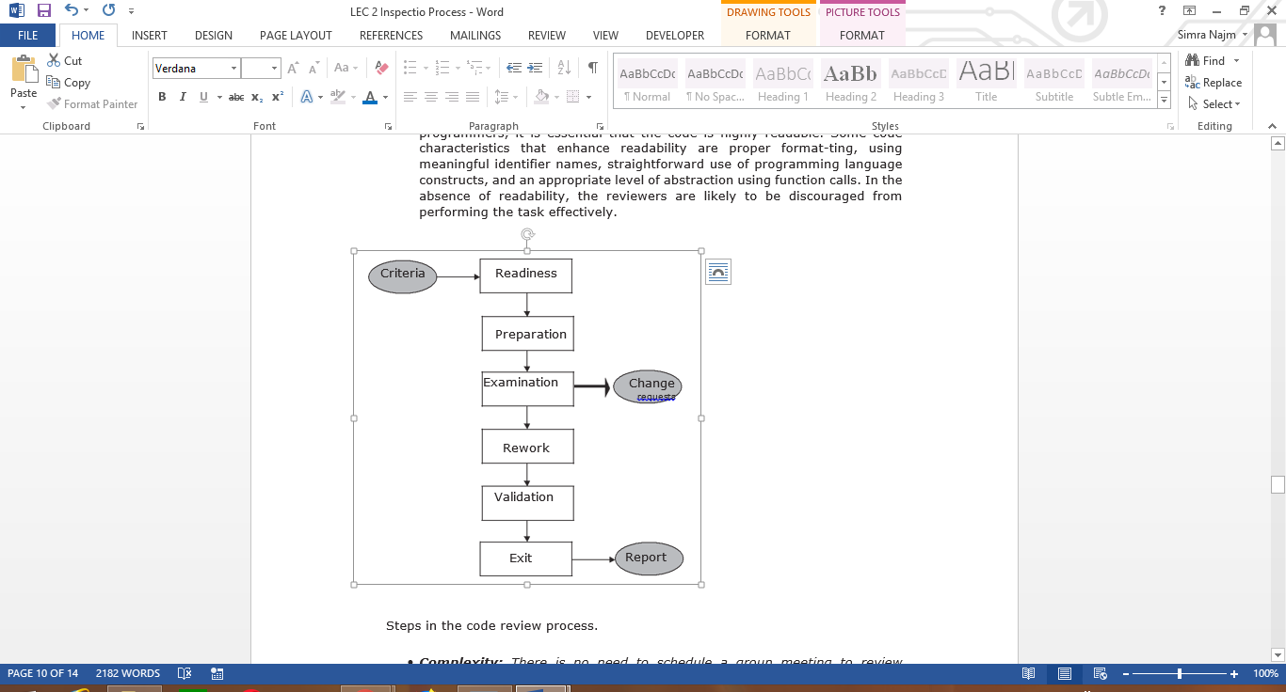
STATIC UNIT TESTING
Levels of testing
Step 1: Readiness The author of the unit ensures that the unit under test is ready for review. A unit is said to be ready if it satisfies the following criteria:
Completeness: All the code relating to the unit to be reviewed must be available. This is because the reviewers are going to read the code and try to understand it. It is unproductive to review partially written code or code that is going to be significantly modified by the programmer.
Minimal Functionality: The code must compile and link.
Readability: Since code review involves actual reading of code by other programmers, it is essential that the code is highly readable. Some code characteristics that enhance readability are proper format-ting, using meaningful identifier names, straightforward use of programming language constructs, and an appropriate level of abstraction using function calls. In the absence of readability, the reviewers are likely to be discouraged from performing the task effectively.
Complexity: There is no need to schedule a group meeting to review straightforward code which can be easily reviewed by the programmer. The code to be reviewed must be of sufficient complexity to warrant group review. Here, complexity is a composite term referring to the number of conditional statements in the code, the number of input data elements of the unit, the number of output data elements produced by the unit, real-time processing of the code, and the number of other units with which the code communicates.
Requirements and Design Documents: The latest approved version of the
low-level design specification or other appropriate descriptions The
composition of the review group involves a number of people with different
roles. These roles are explained as follows:

Slide 10
STATIC UNIT TESTING
Levels of testing
Moderator: A review meeting is chaired by the moderator. The moderator is a trained individual who guides the pace of the review process. The moderator selects the reviewers and schedules the review meetings.
Author: This is the person who has written the code to be reviewed.
Presenter: A presenter is someone other than the author of the code. The presenter reads the code beforehand to understand it. It is the presenter who presents the author’s code in the review meeting for the following reasons: (i) an additional software developer will under-stand the work within the software organization; (ii) if the original programmer leaves the company with a short notice, at least one other programmer in the company knows what is being done; and (iii) the original programmer will have a good feeling about his or her work, if someone else appreciates their work. Usually, the presenter appreciates the author’s work.
Record-keeper: The record-keeper documents the problems found during the review process and the follow-up actions suggested. The person should be different than the author and the moderator.
Reviewers: These are experts in the subject area of the code under review. The group size depends on the content of the material under review
Review. As a rule of thumb, the group size is between 3 to 6 and sometimes 7. Usually this group does not have manager to whom the author reports. This is because it is the author’s ongoing work that is under review, and neither a completed work nor the author himself is being reviewed.
Observers: These are people who want to learn about the code under review. These people do not participate in the review process but are simply passive observers.

Slide 11
STATIC UNIT TESTING
Levels of testing
Step 2: Preparation Before the meeting, each reviewer carefully reviews the work package. It is expected that the reviewers read the code and under-stand its organization and operation before the review meeting. Each reviewer develops the following:
List of Questions: A reviewer prepares a list of questions to be asked, if needed, of the author to clarify issues arising from his or her reading. A general guideline of what to examine while reading the code is outlined .
Potential CR: A reviewer team that may make a formal request to make a change. These are called change requests rather than defect reports. At this stage, since the programmer has not yet made the code pub-lic, it is more appropriate to make suggestions to the author to make changes, rather than report a defect. Though CRs focus on defects in the code, these reports are not included in defect statistics related to the product.
Suggested Improvement Opportunities: The reviewer team may suggest how to fix the problems, if there are any, in the code under review. Since reviewers are experts in the subject area of the code, it is not unusual for them to make suggestions for improvements.

Slide 12
STATIC UNIT TESTING
Levels of testing
Step 3: Examination The examination process consists of the following activities:
The author makes a presentation of the procedural logic used in the code, the paths denoting major computations, and the dependency of the unit under review on other units.
The presenter reads the code line by line. The reviewers may raise questions if the code is seen to have defects. However, problems are not resolved in the meeting. The reviewers may make general suggestions on how to fix the defects, but it is up to the author of the code to take corrective measures after the meeting ends.
The record-keeper documents the change requests and the suggestions for fixing the problems, if there are any. A CR includes the following details:
Give a brief description of the issue or action item.
Assign a priority level (major or minor) to a CR.
Assign a person to follow up the issue. Since a CR documents a potential problem, there is a need for interaction between the author

Slide 13
STATIC UNIT TESTING
Levels of testing
Step 4: Rework At the end of the meeting, the record-keeper produces a sum-mary of the meeting that includes the following information:
A list of all the CRs, the dates by which those will be fixed, and the names of the persons responsible for validating the CRs
A list of improvement opportunities
The minutes of the meeting (optional)
A copy of the report is distributed to all the members of the review group. After the meeting, the author works on the CRs to fix the problems. The author documents the improvements made to the code in the CRs. The author makes an attempt to address the issues within the agreed-upon time frame using the prevailing coding conventions
Step 5: Validation The CRs are independently validated by the moderator or another person designated for this purpose. The validation process involves checking the modified code as documented in the CRs and ensuring that the suggested improvements have been implemented correctly. The revised and final version of the outcome of the review meeting is distributed to all the group members.

Slide 14
STATIC UNIT TESTING
Levels of testing
Step 6: Exit Summarizing the review process, it is said to be complete if all of the following actions have been taken:
Every line of code in the unit has been inspected.
If too many defects are found in a module, the module is once again reviewed after corrections are applied by the author. As a rule of thumb, if more than 5% of the total lines of code are thought to be contentious, then a second review is scheduled.
The author and the reviewers reach a consensus that when corrections have been applied the code will be potentially free of defects.
All the CRs are documented and validated by the moderator or someone else. The author’s follow-up actions are documented.
A summary report of the meeting including the CRs is distributed to all the members of the review group.
The effectiveness of static testing is limited by the ability of a reviewer to find defects in code by visual means. However, if occurrences of defects depend on some actual values of variables, then it is a difficult task to identify those defects by visual means. Therefore, a unit must be executed to observe its behaviors in response to a variety of inputs. Finally, whatever may be the effectiveness of static tests, one cannot feel confident without actually running the code.

Slide 15
STATIC UNIT TESTING
Levels of testing
Code Review Metrics It is important to collect measurement data pertinent to a review process, so that the review process can be evaluated, made visible to the upper management as a testing strategy, and improved to be more effective. Moreover, collecting metrics during code review facilitates estimation of review time and resources for future projects. Thus, code review is a viable testing strategy that can be effectively used to improve the quality of products at an early stage. The following metrics can be collected from a code review:
Number of lines of code (LOC) reviewed per hour
Number of CRs generated per thousand lines of code (KLOC)
Number of CRs generated per hour
Total number of CRs generated per project
Total number of hours spent on code review per project.

Slide 16
STATIC UNIT TESTING
Levels of testing
Code Review Metrics It is in the best interest of the programmers in particular and the company in general
To reduce the number of CRs generated during code review.
Because CRs - indications of potential problems - must be resolved. Addressing CRs - spending more resources and potentially delay in project.
Therefore, it is essential to adopt the concept of defect prevention.
Goal of Static Testing: to assess the quality of product, not to assess the quality of process to develop the product.
It’s time consuming process ,Not perfect up to the level.
The key to the success code review is Divide & Conquer. means having an examiner inspect small parts of the unit in isolation, while making sure of the following:
nothing is overlooked
the correctness of all examined parts of the module implies the correctness of the whole

Slide 17
Levels of testing
DYNAMIC UNIT TESTING
Execution-based unit testing is referred to as dynamic unit testing.
In this testing, a program unit is actually executed in isolation.
However, this execution differs from ordinary execution in the following way:
A unit under test is taken out of its actual execution environment.
The actual execution environment is emulated by writing more code so that the unit and the emulated environment can be compiled together.
The above compiled aggregate is executed with selected inputs. The outcome of such an execution is collected in a variety of ways, such as straightforward observation on a screen, logging on files, and software instrumentation of the code to reveal run time behavior. The result is compared with the expected outcome. Any difference between the actual and expected outcome implies a failure and the fault is in the code.
An environment for dynamic unit testing is created by emulating the context of the unit under test.

Slide 18
LEVELS OF TESTING
DYNAMIC UNIT TESTING
Execution-based unit testing is referred to as dynamic unit testing.
In this testing, a program unit is actually executed in isolation.
However, this execution differs from ordinary execution in the following way:
A unit under test is taken out of its actual execution environment.
The actual execution environment is emulated by writing more code so that the unit and the emulated environment can be compiled together.
The above compiled aggregate is executed with selected inputs. The outcome of such an execution is collected in a variety of ways, such as straightforward observation on a screen, logging on files, and software instrumentation of the code to reveal run time behavior. The result is compared with the expected outcome. Any difference between the actual and expected outcome implies a failure and the fault is in the code.
An environment for dynamic unit testing is created by emulating the context of the unit under test.

Slide 19
DYNAMIC UNIT TESTING
The environment of a unit is emulated because the unit is to be tested in isolation and the emulating environment must be a simple one so that any fault found as a result of running the unit can be solely attributed to the unit under test.
The context of a unit test consists of two parts:
a caller of the unit and
all the units called by the unit.
The caller unit is known as a test driver , and
All the emulations of the units called by the unit under test are called Stubs. The functions of a test driver and a stub are explained as follows:
Test Driver: A test driver is a program that invokes the unit under test. The unit under test executes with input values received from the driver and, upon termination, returns a value to the driver. The driver compares the actual outcome, that is, the actual value returned by the unit under test, with the expected outcome from the unit and reports the ensuing test result. The test driver functions as the main unit in the execution process. The driver not only facilitates compilation, but also provides
input data to the unit under test in the expected format.
Stubs: A stub is a “dummy subprogram” that replaces a unit that is called by the unit under test.
A stub performs two tasks. First, it shows an evidence that the stub was, Such evidence can be shown by merely printing a message.
Second, the stub returns a precomputed value to the caller so that the unit under test can continue.

Slide 20
Levels of testing
DYNAMIC UNIT TESTING
Defining Stubs: In this approach, the upper modules are prepared first and are ready for testing. While the bottom modules are not yet prepared by the developers. So in order to form the complete application we create dummy programs for the lower modules in the application. Hence all the functionalities can be tested.
The main purpose of a stub is to allow testing of the upper levels of the code. Hence, when the lower levels of the code are not yet developed.
Stubs are used to test modules and are created by the team of testers during the process of Top-Down Integration Testing. With the assistance of these test stubs testers are capable of stimulating the behaviour of the lower level modules that are not yet integrated with the software. Moreover, it helps stimulates the activity of the missing components.
Types of Stubs:
There are basically four types of stubs used in top-down approach of integration testing, which are mentioned below:
Displays the trace message.
Values of parameter is displayed.
Returns the values that are used by the modules.
Returns the values selected by the parameters that were used by modules being tested.

Slide 21
Levels of testing
DYNAMIC UNIT TESTING
Defining Drivers:
A driver is basically a piece of code through which other programs or pieces of code or modules can be called. Drivers are the main program through which other modules are called. If we want to test any module it is required that we should have a main program which will call the testing module. Without the dummy program or driver, the complete testing of the module is not possible.
Drivers can be utilized to test the lower levels of the code, when the upper level of codes or modules are not developed. Drivers act as pseudo codes that are mainly used when the stub modules are ready, but the primary modules are not ready.
Drivers are basically called in Bottom Up testing approach. In bottom up testing approach the bottom level modules are prepared but the top level modules are not prepared. Testing of the bottom level modules is not possible with the help of main program. So we prepare a dummy program or driver to call the bottom level modules and perform its testing. The main purpose of drivers is to allow testing of the lower levels of the code, when the upper levels of the code are not yet developed.
Drivers, like stubs, are used by software testers to fulfil the requirements of missing or incomplete components and modules. These are usually complex than stubs and are developed during Bottom-Up approach of Integration Testing. Drivers can be utilized to test the lower levels of the code, when the upper level of codes or modules are not developed. Drivers act as pseudo codes that are mainly used when the stub modules are ready, but the primary modules are not ready.

Slide 22
Levels of testing
DYNAMIC UNIT TESTING
Consider an example of a web application, which consists of 4 modules i.e., Module-A, Module-B, Module-C and Module-D. Each of the following modules is responsible for some specific activity or functionality, as under
Module-A ? Login page of the web application.
Module-B → Home page of the web application.
Module-C → Print Setup.
Module-D → Log out page.
modules A, B, C & D involves the interdependencies of each module over other.
It is always preferable, to perform testing, in parallel, to the development process. Thus, it implies that subsequent testing must be carried out, immediately after the development of the each module.
Module-A will be tested, as soon as, it develops. However, to carry out and validate the testing procedures in respect of module-A, there urges the need of Module-B, which is not yet developed. The expected functionality of the login page (module-A) could be validated, only if it is directed to the home page (Module-B), based on the valid and correct inputs.
But, on the non-availability of the Module-B, it will not be possible to test module-A. These types of circumstances, introduces the stubs & drivers in the process of software testing. A dummy module, representing the basic functionality or feature of the module-B, is being developed, and thereafter, it is being integrated with the module-A, to perform testing, efficiently.
Similarly, stubs and drivers, are used to fulfil the requirements of other modules, such as
Log out page (Module-D), needs to be directed to the login page (Module-A), after successfully logging out from the application. In the event of unavailability of Module-A, stubs and drivers will work as a substitute for it, in order to carry out the testing of module-D.

Slide 23
Levels of testing
DYNAMIC UNIT TESTING
Why are Stubs & Drivers Required?
Though, the important of stubs and drivers is immense during software testing, but its relevance as well as the requirement ends once the equivalent module is created. As they act as a temporary replacement of modules, these role in testing culminates once final output is generated. Therefore, these pseudo modules or stubs and drivers are mainly used for following reasons:
Commonly used in porting, distributed computing, as well as general software development.
Used for meeting necessary requirements unavailable modules.
They are required when the system needs to interact with external systems.
Stubs and drivers are used to test modules.
Stubs are used to test the functionality of upper modules, whereas drivers are used when the main module is not ready.

Slide 24
Levels of testing
Are Stubs and Drivers, Same?
Yes, basically the features and purpose of stubs and drivers are same. Both of them work as a substitute for the missing or unavailable module. However, the difference between them can be visualized during the integration testing and unit testing.
Stubs are commonly referred to as "called programs" and are being used in top bottom approach of the integration testing, whereas drivers are "calling program" and they are used in bottom-up integration testing.
Stubs are similar to the components, which are under test, in a very simple and basic form, whereas driver is used to invoke the component that needs to be tested.
Stubs, are usually, considered for low level modules, whereas drivers represents the high level modules.
Key Points: Stubs and Drivers
Stubs and Drivers works as a substitute for the missing or unavailable module.
They are specifically developed, for each module, having different functionalities.
Generally, developers and unit testers are involved in the development of stubs and drivers.
Although, it provides ease to carry out of individual components, without concerning the availability of other modules, but it is a time-consuming process, as it requires to develop dummy for each missing module.
Their most common use may be seen in the integration incremental testing, where stubs are used in top bottom approach and drivers in a bottom up approach.

Slide 25
Levels of testing
DYNAMIC UNIT TESTING
Conclusion:
The process of software testing cannot be completed with incomplete components and modules.
Therefore, to ensure the accuracy as well as effectiveness of testing it is vital to create stubs and drivers that fulfil the requirements of incomplete or undeveloped modules and act as pseudo modules or codes that are called in for testing the functionality of major modules.
In short, there is no doubt that stubs and drivers are an integral part of software testing process.

Slide 26
Levels of testing
DYNAMIC UNIT TESTING
Importance of Stubs and Test Drivers
The driver and the stubs are never discarded after the unit test is completed.
Instead, those are reused in the future in Regression testing of the unit if there is such a need.
For each unit, there should be one dedicated test driver and several stubs as required.
If just one test driver is developed to test multiple units, the driver will be a complicated one
Any modification to the driver to accommodate changes in one of the units under test may have side effects in testing the other units. Similarly, the test driver should not depend on the external input data files but, instead, should have its own segregated set of input data. The separate input data file approach becomes a very compelling choice for large amounts of test input data. For example, if hundreds of input test data elements are required to test more than one unit, then it is better to create a separate input test data file rather than to include the same set of input test data in each test driver designed to test the unit.

Slide 27
Levels of testing
DYNAMIC UNIT TESTING
Importance of Stubs and Test Drivers
The test driver should have the capability to automatically determine the success or failure of the unit under test for each input test data. If appropriate, the driver should also check for memory leaks and problems in allocation and deallocation of memory. If the module opens and closes files, the test driver should check that these files are left in the expected open or closed state after each test. The test driver can be designed to check the data values of the internal variable that
The test driver and stubs are tightly coupled with the unit under test and should accompany the unit throughout its life cycle.
A test driver and the stubs for a unit should be reusable and maintainable.
Every time a unit is modified, the programmer should check whether or not to modify the corresponding driver and stubs.
Whenever a new fault is detected in the unit, the corresponding test driver should be updated with a new set of input data to detect that fault and similar faults in the future.
If the unit is expected to run on different platforms, the test driver and stubs should also be built to test the unit on new platforms.
Finally, the test driver and stubs should be reviewed, cross referenced with the unit for which these are written, and checked in to the version control system as a product along with the unit.

Slide 28
Levels of testing
DYNAMIC UNIT TESTING
The low-level design document provides guidance for the selection of input test data that are likely to uncover faults. Selection of test data is broadly based on the following techniques:
• Control Flow Testing: The aim of this technique is to determine the execution order of statements or instructions of the program through a control structure. The control structure of a program is used to develop a test case for the program. In this technique, a particular part of a large program is selected by the tester to set the testing path. It is mostly used in unit testing. Test cases represented by the control graph of the program.
Control Flow Graph is formed from the node, edge, decision node, junction node to specify all possible execution path

Slide 29
Levels of testing
DYNAMIC UNIT TESTING
Data Flow Testing: Data flow testing is a family of test strategies based on selecting paths through the program's control flow in order to explore sequences of events related to the status of variables or data objects. Dataflow Testing focuses on the points at which variables receive values and the points at which these values are used.
Data Flow testing helps us to pinpoint any of the following issues:
A variable that is declared but never used within the program.
A variable that is used but never declared.
A variable that is defined multiple times before it is used.
Deallocating a variable before it is used.

Slide 30
Levels of testing
DYNAMIC UNIT TESTING
Domain testing
Domain testing is a software testing technique. The output has to be tested with a minimum number of inputs, to make sure that the system does not accept invalid values or values which are out of range.
Have you heard about White Box Testing? Well, it is a fine example of domain testing. The prime goal of domain testing is to validate whether the system is in taking the input within the specified range or not. It also checks the delivery of the required output.
Domain Testing Strategy
In domain testing strategy, there are few points that have to be kept in mind:
What domain are we testing?
How to group the values into classes?
Which values of the classes are to be tested?
How to determine the result?
What domain are we testing?
Whichever domain you test, comprises of an input and output functionality. After entering the input values, the output is verified.

Slide 31
Levels of testing
DYNAMIC UNIT TESTING
Domain Testing Strategy
How to group the values into classes?
To group the values into classes we need to bifurcate the values into some subsets. We call the process, partitioning the values. Now, to clarify the concept, there are two types of partitioning:
Equivalence Partitioning :
It divides the input data of a software unit into partitions of equivalent data from which test cases can be derived.
Boundary-value Analysis:
The tests are designed to include representatives of boundary values in a range.
We are partitioning the values into a subset .
Group 1 : Employees with salary from 5 to 10 lacs
Group 2 : Employees with salary from 10 to 15 lacs
Group 3 : Employees with salary from 15 to 20 lacs
Group 4 : Employees with salary more than 20 lacs
Which values of the classes are to be tested?
For the values of the class to be tested we need the boundary values. By boundary values I mean,

Slide 32
Levels of testing
DYNAMIC UNIT TESTING
Domain Testing Strategy
Group 1 : Employees with salary from 5 to 10 lacs
Here, the values that should be considered are:
Equal to 5 and 10 lacs and between 5 to 10 lacs
lesser than 5 lacs AND greater than 10 lacs. (should not accept)
How to determine the result?
The input is given and the expected output will give us the results and this is accomplished through domain knowledge.

Slide 33
Levels of testing
DYNAMIC UNIT TESTING
Now, what is domain knowledge?
Domain Knowledge
Domain knowledge is a fine understanding of a particular sphere. It means that a person is familiar with specific terms of the discipline. It helps to reduce the delivery cycle and shorten development time. It also improves customer service and enhances flexibility.
Moving further, let us understand the structure of domain testing
Domain Testing Structure
There are certain key points that formulate the structure of domain testing:
Decide what can go wrong with the boundaries set.
Find strategies to handle each case.
Pick several points to test for each error.
Use one test point to check the adjacent domains.
Check off redundant test points.
Start running the tests.
Determine if any boundaries contain error/fault.
Verify each boundary of all the domains.

Slide 34
Levels of testing
DYNAMIC UNIT TESTING
• Functional Program Testing:
In functional program testing one performs the following steps:
(i) Identify the input and output
domains of a program;
(ii) for a given input domain, select some
special values and compute the
expected outcome;
(iii) for a given output domain, select some
special values and compute the input
value that will cause the unit to
produce those output values; and Unit

Slide 35
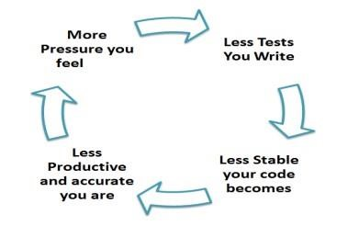
Levels of testing
Testing Myth about Unit Testing:
It requires time, and
I am always overscheduled
My code is rock solid!
I do not need unit tests.
Myths by their very nature are false assumptions.
Truth is Unit testing increase the speed of development.
Programmers think that Integration Testing will catch all errors and do not execute the unit test. Once units are integrated, very simple errors which could have very easily found and fixed in unit tested take very long time to be traced and fixed

Slide 36
Levels of testing
Unit testing Testing Benefits and Advantage
Unit allows the programmer to refactor code at a later date, and make sure the module still works correctly (i.e. Regression testing). The procedure is to write test cases for all functions and methods so that whenever a change causes a fault, it can be quickly identified and fixed.
Due to the modular nature of the unit testing, we can test parts of the project without waiting for others to be completed.
Unit Testing Limitations
Sometime it is difficult to test the function or module due to dependency.
Unit testing can't be expected to catch every error in a program. It is not possible to evaluate all execution paths even in the most trivial programs
Unit testing by its very nature focuses on a unit of code. Hence it can't catch integration errors or broad system level errors.
It's recommended unit testing be used in conjunction with other testing activities.

Slide 37
Levels of testing
Unit Testing Techniques
Structural Techniques
Functional Testing Techniques
Error Based Techniques
Unit Testing Best Practices
Unit Test cases should be independent. In case of any enhancements or change in requirements, unit test cases should not be affected.
Test only one code at a time.
Follow clear and consistent naming conventions for your unit tests
In case of a change in code in any module, ensure there is a corresponding unit Test Case for the module, and the module passes the tests before changing the implementation
Bugs identified during unit testing must be fixed before proceeding to the next phase in SDLC
Adopt a "test as your code" approach. The more code you write without testing, the more paths you have to check for errors.

Slide 38
THANKYOU
☺

