Slide 1

WELCOME TO EIGHTH LECTURE OF
Software Testing Techniques and Strategies
COURSE CODE :SE-483

Slide 2
Levels of testing
2. What is Integration Testing?
Once all the individual units are created and tested, we start combining those “Unit
Tested” modules and start doing the integrated testing. So the meaning of
Integration testing is quite straightforward- Integrate/combine the unit tested module one by one and test the behaviour as a combined unit
A typical software project consists of multiple software modules, coded by different programmers.
Integration Testing focuses on checking data communication amongst these modules.
Hence it is also termed as 'I & T' (Integration and Testing), 'String Testing' and sometimes 'Thread Testing'.
Definition by ISTQB
Integration testing: Testing performed to expose defects in the interfaces
and in the interactions between integrated components or systems.
Component integration testing: Testing performed to expose defects in the interfaces and
interaction between integrated components.
System integration testing: Testing the integration of systems and packages; testing interfaces to
external organizations (e.g. Electronic Data Interchange, Internet).

Slide 3
Levels of testing
2.Integration Testing?
Why do Integration Testing?
Although each software module is unit tested, defects still exist for various reasons like
Interfaces of the software modules with the database could be erroneous
• External Hardware interfaces, if any, could be erroneous
• Inadequate exception handling
• At the time of module development, there are wide chances of change in requirements by the clients. These new requirements may not be unit tested and hence system integration Testing becomes necessary.

Slide 4
Levels of testing
2.Integration Testing?
When To Start Integration Testing:
After Unit Testing
Method
▪ Any of Black Box Testing, White Box Testing, and Gray Box Testing methods can be used.
Goal Of Integration Testing:
✓ The main function or goal of Integration testing is to
✓ To test the interfaces between the units/modules.
✓ To check the combinational behavior,
Validate whether the requirements are implemented correctly or not.
Priority is to be given for the integrating links rather than the unit functions
which are already tested.
Note:
Here we should understand that Integration testing does not happen at the end of the cycle, rather it is conducted simultaneously with the development.
So in most of the times, all the
modules are not actually available to test and here is what the challenge comes to test something which does not exist!

Slide 5
Levels of testing
DYNAMIC UNIT TESTING
Defining Stubs: In this approach, the upper modules are prepared first and are ready for testing. While the bottom modules are not yet prepared by the developers. So in order to form the complete application we create dummy programs for the lower modules in the application. Hence all the functionalities can be tested.
The main purpose of a stub is to allow testing of the upper levels of the code. Hence, when the lower levels of the code are not yet developed.
Stubs are used to test modules and are created by the team of testers during the process of Top-Down Integration Testing. With the assistance of these test stubs testers are capable of stimulating the behaviour of the lower level modules that are not yet integrated with the software. Moreover, it helps stimulates the activity of the missing components.
Types of Stubs:
There are basically four types of stubs used in top-down approach of integration testing, which are mentioned below:
Displays the trace message.
Values of parameter is displayed.
Returns the values that are used by the modules.
Returns the values selected by the parameters that were used by modules being tested.

Slide 6
Levels of testing
DYNAMIC UNIT TESTING
Defining Drivers:
.Drivers can be utilized to test the lower levels of the code, when the upper level of codes or modules are not developed. Drivers act as pseudo codes that are mainly used when the stub modules are ready, but the primary modules are not ready.
Drivers are basically called in Bottom Up testing approach.
In bottom up testing approach the bottom level modules are prepared but the top level modules are not prepared.
Testing of the bottom level modules is not possible with the help of main program. So we prepare a dummy program or driver to call the bottom level modules and perform its testing.
The main purpose of drivers is to allow testing of the lower levels of the code, when the upper levels of the code are not yet developed.
Drivers, like stubs, are used by software testers to fulfil the requirements of missing or incomplete components and modules. These are usually complex than stubs and are developed during Bottom-Up approach of Integration Testing. Drivers can be utilized to test the lower levels of the code, when the upper level of codes or modules are not developed. Drivers act as pseudo codes that are mainly used when the stub modules are ready, but the primary modules are not ready.

Slide 7
Levels of testing
Are Stubs and Drivers, Same?
Yes, basically the features and purpose of stubs and drivers are same. Both of them work as a substitute for the missing or unavailable module. However, the difference between them can be visualized during the integration testing and unit testing.
Stubs are commonly referred to as "called programs" and are being used in top bottom approach of the integration testing, whereas drivers are "calling program" and they are used in bottom-up integration testing.
Stubs are similar to the components, which are under test, in a very simple and basic form, whereas driver is used to invoke the component that needs to be tested.
Stubs, are usually, considered for low level modules, whereas drivers represents the high level modules.
Key Points: Stubs and Drivers
Stubs and Drivers works as a substitute for the missing or unavailable module.
They are specifically developed, for each module, having different functionalities.
Generally, developers and unit testers are involved in the development of stubs and drivers.
Although, it provides ease to carry out of individual components, without concerning the availability of other modules, but it is a time-consuming process, as it requires to develop dummy for each missing module.
Their most common use may be seen in the integration incremental testing, where stubs are used in top bottom approach and drivers in a bottom up approach.

Slide 8
Levels of testing
DYNAMIC UNIT TESTING
Importance of Stubs and Test Drivers
The test driver should have the capability to automatically determine the success or failure of the unit under test for each input test data. If appropriate, the driver should also check for memory leaks and problems in allocation and deallocation of memory. If the module opens and closes files, the test driver should check that these files are left in the expected open or closed state after each test. The test driver can be designed to check the data values of the internal variable that
The test driver and stubs are tightly coupled with the unit under test and should accompany the unit throughout its life cycle.
A test driver and the stubs for a unit should be reusable and maintainable.
Every time a unit is modified, the programmer should check whether or not to modify the corresponding driver and stubs.
Whenever a new fault is detected in the unit, the corresponding test driver should be updated with a new set of input data to detect that fault and similar faults in the future.
If the unit is expected to run on different platforms, the test driver and stubs should also be built to test the unit on new platforms.
Finally, the test driver and stubs should be reviewed, cross referenced with the unit for which these are written, and checked in to the version control system as a product along with the unit.

Slide 9
Levels of testing
Integration Test Case:
Integration Test Case differs from other test cases in the sense it focuses mainly on the interfaces
& flow of data/information between the modules. Here priority is to be given for the integrating links rather than the unit functions which are already tested.
Sample Integration Test Cases for the following scenario: Application has 3 modules say
'Login Page',
'Mail box' and
'Delete mails' and each of them are integrated logically.
Here do not concentrate much on the Login Page testing as it's already been done in Unit Testing.
But check how it's linked to the Mail Box Page.
Similarly Mail Box: Check its integration to the Delete Mails Module.
Test Case ID | Test Case Objective | Test Case Description | Expected Result
1 | Check the interface link between the Login and Mailbox module | Enter login credentials and click on the Login button | To be directed to the Mail Box
2 | Check the interface link between the Mailbox and Delete Mails Module | From Mail box select the an email and click delete button | Selected email should appear in the Deleted/Trash folder

Slide 10
Levels of testing
2. Integration Testing?
Approaches/Methodologies/Strategies of Integration Testing:
The Software Industry uses variety of strategies to execute Integration testing
Big Bang Approach :
Incremental Approach: which is further divided into following
Top Down Approach
Bottom Up Approach
Sandwich Approach –
Combination of Top Down and Bottom Up
Below are the different strategies, the way they are executed and their limitations as well advantages.

Slide 11
Levels of testing
2.Integration Testing?
I. Big Bang Approach:
Here all component are integrated together at once, and then tested.
Advantages:
• Convenient for small systems.
Disadvantages:
• Fault Localization is difficult.
• Given the sheer number of interfaces that need to be tested in this approach, some
interfaces links to be tested could be missed easily.
• Since the integration testing can commence only after "all" the modules are designed,
testing team will have less time for execution in the testing phase.
Since all modules are tested at once, high risk critical modules are not isolated and tested on priority. Peripheral modules which deal with user interfaces are also not isolated and tested on priority

Slide 12
Levels of testing
2. Integration Testing?
II. Incremental Approach
:
In this approach, testing is done by joining two or more modules that are logically related. Then the other related modules are added and tested for the proper functioning.
Process continues until all of the modules are joined and tested successfully.
This process is carried out by using dummy programs called Stubs and Drivers. Stubs and Drivers do not implement the entire programming logic of the software module but just simulate data communication with the calling module.
Stub: Is called by the Module under Test.
Driver: Calls the Module to be tested.
Incremental Approach in turn is carried out by two different Methods:
• Bottom Up
• Top Down

Slide 13
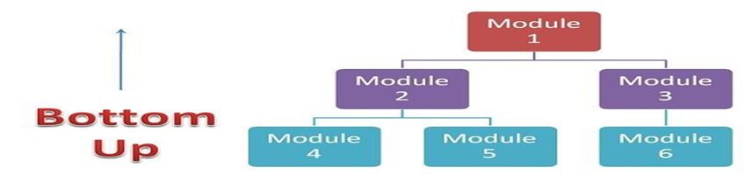
Levels of testing
Integration Testing?
II. Incremental Approach
Bottom up Integration
In the bottom up strategy, each module at lower levels is tested with higher modules until all modules are tested. It takes help of Drivers for testing Diagrammatic Representation:
Advantages:
Fault localization is easier.
No time is wasted waiting for all modules to be developed unlike Big bang Approach Disadvantages:
• Critical modules (at the top level of software architecture) which control the flow of application are tested last and may be prone to defects.
• Early prototype is not possible

Slide 14
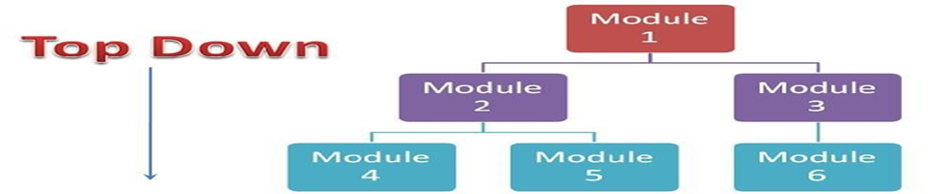
Levels of testing
Integration Testing?
II. Incremental Approach
B . Top down Integration:
In Top to down approach, testing takes place from top to down following the control flow of the software system.
Takes help of stubs for testing.
Diagrammatic Representation:
Advantages:
• Fault Localization is easier.
• Possibility to obtain an early prototype.
• Critical Modules are tested on priority; major design flaws could be found and fixed first.
Disadvantages:
• Needs many Stubs.
• Modules at lower level are tested inadequately.

Slide 15
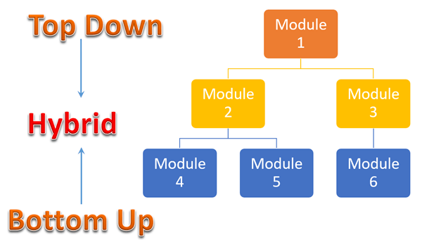

Levels of testing
Integration Testing
II. Incremental Approach
c. Sandwich/Hybrid
Sandwich Testing is the combination of bottom-up approach and top-down approach, so it uses the advantage of both bottom up approach and top down approach .
Its is also known as Mixed Integration testing or Hybrid Testing

Slide 16
Levels of testing
2. Integration Testing
C. Sandwich/Hybrid
Sandwich Testing is the combination of bottom-up approach and top-down approach, so it uses the advantage of both bottom up approach and top down approach
Sandwich testing is basically viewed as 3 layers:
A target layer is the middle.
A layer above the target called as the top layer.
A layer below the target called as the bottom layer.
In sandwich testing, testing is mainly focused for main target layer.
This testing is selected on the basis of system characteristics and structure’s code.
It tries to minimize the number of stubs and drivers when there are more than 3 Layers
Bottom-up testing starts from middle layer and goes upward to the top layer where as
Top-down testing starts from middle layer and goes downward.
Here, top modules are tested with lower modules at the same time lower modules are integrated with top modules and tested. This strategy makes use of stubs as well as drivers.
With the successful test coverage of the entire software application from both the directions, only the middle one or the target layer is left for the performance of the final set of tests.
Initially it uses the stubs and drivers where stubs simulate the behavior of missing component. It is also known as the Hybrid Integration Testing.
Sandwich Testing also can not be used for those systems which have a lot of interdependence between different modules and it allows parallel testing.

Slide 17
Levels of testing
2. Integration Testing
II. Incremental Approach
C. Sandwich/Hybrid
Advantage of Sandwich Testing:
Sandwich approach is useful for very large projects having several subprojects. When development follows a spiral model and the module itself is as large as a system, then one can use sandwich testing.
It allows parallel testing.
Sandwich testing is time saving approach.
sandwich testing performs more coverage with same stubs.
Both Top-down and Bottom-up approach starts at a time as per development schedule. Units are tested and brought together to make a system .
Disadvantage of Sandwich Testing:
It needs more resources and big teams perform both bottom-up and top-down methods of testing at a time or one after the other.
Sandwich Testing is very costly.
Sandwich Testing can not be used for such systems which have a lot of interdependence between different modules.
Sometimes In sandwich testing the need of stubs and drivers is very high.

Slide 18
Levels of testing
2.Integration Testing
Entry and Exit Criteria.
Entry and Exit Criteria to Integration testing phase in any software development model
Entry Criteria:
• Unit Tested Components/Modules
• All High prioritized bugs fixed and closed during unit testing .
• Required Test Environment to be set up for Integration testing
Exit Criteria:
• Successful Testing of Integrated Application.
All Modules coded completely and integrated successfully
All High prioritized integration bugs fixed and closed
Integration tests Plan, test case, scenarios to be signed off and documented
Technical documents to be submitted followed by release Notes.

Slide 19
Levels of testing
2.Integration Testing?
Best Practices/ Guidelines for Integration Testing
First, determine the Integration Test Strategy that could be adopted and later prepare the test cases and test data accordingly.
Study the Architecture design of the Application and identify the Critical Modules. These need to be tested on priority.
Obtain the interface designs from the Architectural team and create test cases to verify all of the interfaces in detail. Interface to database/external hardware/software application must be tested in detail.
After the test cases, it's the test data which plays the critical role.
Always have the mock data prepared, prior to executing. Do not select test data while executing the test cases.

Slide 20
Levels of testing
3.What is System Testing?
System testing is the type of testing to check the behaviour of a complete and fully integrated software product based on the software requirements specification (SRS) document.
The main focus of this testing is to evaluate Business / Functional / End-user requirements.
This is black box type of testing where external working of the software is evaluated with the help of requirement documents & it is totally based on Users point of view.
For this type of testing do not required the knowledge of internal design or structure or code.
This testing is to be carried out only after System Integration Testing is completed where both Functional & Non-Functional requirements are verified.
In the integration testing testers are concentrated on finding bugs/defects on integrated modules.
But in the Software System Testing testers are concentrated on finding bugs/defects based on software application behavior, software design and expectation of end user.

Slide 21
Levels of testing
3.System Testing
System Testing Is the Most critical and important phase of Software Testing
Testing the fully integrated applications including external peripherals in order to check how components interact with one another and with the system as a whole.
This is also called End to End testing scenario..
Verify through testing of every input in the application to check for desired outputs.
Testing of the user's experience with the application.
In Software Development Life Cycle the System Testing is perform as the first level of
testing where the System is tested as a whole.
In this step of testing check if system meets functional requirement or not.
System Testing enables you to test, validate and verify both the Application Architecture and
Business requirements.
Application/System is tested in an environment that particularly resembles the effective
production environment where the application/software will be lastly deployed.
Generally, a separate and dedicated team is responsible for system testing. And,
System Testing is performed on staging server which is similar to production server. So this means you are testing software application as good as production environment
A staging server is a type of server that is used to test a software, website or service in a production-similar environment before being set live. It is part of staging environment or staging site, where it serves as a temporary hosting and testing server for any new software or websites.

Slide 22
Levels of testing
How to Start System Testing?
In Software System Testing following steps needs to be executed
Entry Criteria for System Testing:
• Unit testing should be finished.
• Integration of modules should be fully integrated.
• As per the specification document software development is completed.
• Testing environment is available for testing (similar to Staging environment)

Slide 23
Levels of testing
3.System Testing
Step 1) First & important step is System Test Plan:
All points to be cover in System Test plan may vary from organization to organization as well as based on project plan, test strategy & main test plan.
Nevertheless, here is list of standard point to be considered while creating System Test Plan:
• Goals & Objective
• Scope
• Critical areas Area to focus
• Test Deliverable
• Testing Strategy for System testing
• Testing Schedule
• Entry and exit criteria
• Suspension & resumption criteria for system testing
• Test Environment
• Roles and Responsibilities

Slide 24
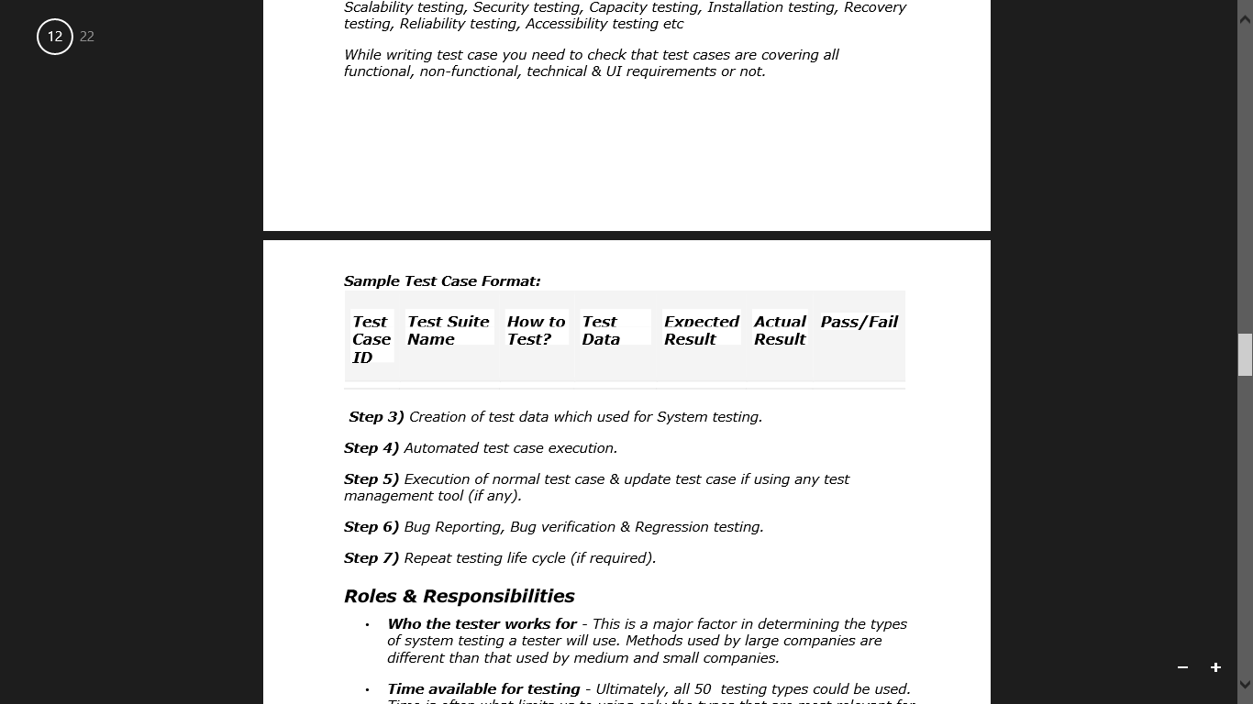
Levels of testing
3.System Testing
Step 2) Second step is Test Cases:
Here you should consider different type of testing like Functional testing, Regression testing, Smoke testing, Sanity testing, Ad-hoc testing, Exploratory testing, Usability testing, GUI software testing, Compatibility testing, Performance testing, Load testing, Stress testing, Volume testing, Error handling testing, Scalability testing, Security testing, Capacity testing, Installation testing, Recovery testing, Reliability testing, Accessibility testing etc
While writing test case you need to check that test cases are covering all functional, non-functional, technical & UI requirements
Step 3) Creation of test data which used for System testing.
Step 4) Automated test case execution.
Step 5) Execution of normal test case & update test case if using any test management tool (if any).
Step 6) Bug Reporting, Bug verification & Regression testing.
Step 7) Repeat testing life cycle (if required).

Slide 25
Levels of testing
3.System Testing
Roles & Responsibilities
• Who the tester works for - This is a major factor in determining the types of system testing a tester will use. Methods used by large companies are different than that used by medium and small companies.
• Time available for testing - Ultimately, all 50 testing types could be used. Time is often what limits us to using only the types that are most relevant for the software project.
• Resources available to the tester - Of course some testers will not have necessary resources to conduct a testing type. For example if you are a tester working for a large software development firm, you are likely to have expensive automated testing software not available to others.
• Software Tester's Education - There is a certain learning curve for each type of software testing available. To use some of the software involved, a tester has to learn how to use it.
• Testing Budget - Money becomes a factor not just for smaller companies and individual software developers but large companies as well

Slide 26
Levels of testing
Different Types of System Testing
There are more than 50 types of System Testing. Below listed the types of system testing a large software development company would typically use
Usability Testing - Usability Testing mainly focuses on the user's ease to use the application, flexibility
in handling controls and ability of the system to meet its objectives
Load Testing - Load Testing is necessary to know that a software solution will perform under
real-life loads.
Regression Testing- - Regression Testing involves testing done to make sure none of the
changes made over the course of the development process have caused new
bugs. It also makes sure no old bugs appear from the addition of new
software modules over time.
Recovery Testing - Recovery testing is done to demonstrate a software solution is reliable,
trustworthy and can successfully recoup from possible crashes.
Migration Testing - Migration testing is done to ensure that the software can be moved from
older system infrastructures to current system infrastructures without any issues.
Functional Testing - Also known as functional completeness testing, Testing involves trying to
think of any possible missing functions. Testers might make a list of
additional functionalities that a product could have to improve it during
functional testing.
Hardware/Software Testing - IBM refers to Hardware/Software testing as
"HW/SW Testing". This is when the tester focuses his/her attention on the
interactions between the hardware and software during system testing.

Slide 27
Levels of testing
4. Acceptance Testing OR User Acceptance Testing .
It is a level of software testing where a system is tested for acceptability.
After the system test has corrected all or most defects, the system will be delivered to the user or customer for Acceptance Testing or User Acceptance Testing (UAT)
The purpose of this test is to evaluate the system’s compliance with the business requirements and assess whether it is acceptable for delivery.
Definition by ISTQB :
• acceptance testing: Formal testing with respect to user needs, requirements, and business processes conducted to determine whether or not a system satisfies the acceptance criteria and to enable the user, customers or other authorized entity to determine whether or not to accept the system.
There are various forms of acceptance testing:
• User acceptance Testing
• Business acceptance Testing
Contract Acceptance Testing
Regulations/Compliance Acceptance Testing (RAT)
• Alpha Testing
• Beta Testing

Slide 28
Levels of testing
4. Acceptance Testing OR User Acceptance Testing
When is it performed?
Acceptance Testing is the fourth and last level of software testing performed after System Testing and
before making the system available for actual use.
Who performs it?
Acceptance testing is basically done by the
User or Customers’ customers
stakeholders
tester (rarely), management,
Sales, Support teams performs acceptance testing depending on the type of test carried out
Strategy /Approach Acceptance Testing OR User Acceptance Testing
Internal Acceptance Testing
External Acceptance Testing

Slide 29
Levels of testing
4. Strategy /Approach Acceptance Testing OR User Acceptance Testing
Internal Acceptance Testing (Also known as Alpha Testing) is performed by members of the organization that developed the software but who are not directly involved in the project (Development or Testing). Usually, it is the members of Product Management, Sales and/or Customer Support.
External Acceptance Testing is performed by people who are not employees of the organization that developed the software, consist of two types
Customer Acceptance Testing is performed by the customers of the organization. They are the ones who asked the organization to develop the software. [This is in the case of the software not being owned by the organization that developed it.] .
User Acceptance Testing (Also known as Beta Testing) is performed by the end users of the software. They can be the customers themselves or the customers’ customers.

Slide 30
Levels of testing
4. Strategy /Approach Acceptance Testing OR User Acceptance Testing
Internal Acceptance Testing (Also known as Alpha Testing) is performed by members of the organization that developed the software but who are not directly involved in the project (Development or Testing). Usually, it is the members of Product Management, Sales and/or Customer Support.
External Acceptance Testing is performed by people who are not employees of the organization that developed the software, consist of two types
Customer Acceptance Testing is performed by the customers of the organization. They are the ones who asked the organization to develop the software. [This is in the case of the software not being owned by the organization that developed it.] .
User Acceptance Testing (Also known as Beta Testing) is performed by the end users of the software. They can be the customers themselves or the customers’ customers.

Slide 31
Levels of testing
4. Acceptance Testing OR User Acceptance Testing
Alpha & Beta Testing
Alpha Testing normally takes place in the development environment and is usually done by internal staff. Long before the product is even released to external testers or customers. Also potential user groups might conduct Alpha Tests, but the important thing here is that it takes place in the development environment.
• Based on the feedback – collected from the alpha testers – development teams then fix certain issues and improve the usability of the product.
Beta Testing, also known as “field testing”, takes place in the customer’s environment and involves some extensive testing by a group of customers who use the system in their environment. These beta testers then provide feedback, which in turn leads to improvements of the product.
• Alpha and Beta Testing are done before the software is released to all customers

Slide 32
Levels of testing
4. Acceptance Testing OR User Acceptance Testing Analogy
During the process of manufacturing a ballpoint pen,
the cap,
the body,
the tail and
clip,
the ink cartridge
ALL the units of ballpoint are produced separately, and unit tested separately.
When two or more units are ready, they are assembled and Integration Testing is performed.
When the complete pen is integrated, System Testing is performed.
Once System Testing is complete, Acceptance Testing is performed so as to confirm that the ballpoint pen is ready to be made available to the end-users.
Method Usually, Black Box Testing method is used in Acceptance Testing.
Testing does not normally follow a strict procedure and is not scripted but is rather ad-hoc.

Slide 33
Types of Acceptance Testing OR User Acceptance Testing
Few of them are listed below:
1) User Acceptance Testing (UAT) is to assess whether the Product is working for the user, correctly for the usage. Specific requirements which are quite often used by the end-users are primarily picked for the testing purpose. This is also termed as End-User Testing.
The term “User” here signifies the end-users to whom the Product/application is intended and hence, testing is performed from the end-users perspective and from their point of view.
#2) Business Acceptance Testing (BAT)
This is to assess whether the Product meets the business goals and purposes or not.
BAT mainly focuses on business benefits (finances) which are quite challenging due to the changing market conditions/advancing technologies so that the current implementation may have to undergo changes which result in extra budgets.
Even the Product passing the technical requirements may fail BAT due to these reasons.
#

Slide 34
Types of Acceptance Testing OR User Acceptance Testing
#3) Contract Acceptance Testing (CAT)
This is a contract which specifies that once the Product goes live, within a predetermined period, the acceptance test must be performed and it should pass all the acceptance use cases.
Contract signed here is termed as Service Level Agreement (SLA), which includes the terms where the payment will be made only if the Product services are in-line with all the requirements, which means the contract is fulfilled.
Sometimes, this contract may happen before the Product goes live. Either the ways, a contract should be well defined in terms of the period of testing, areas of testing, conditions on issues encountered at later stages, payments, etc.

Slide 35
Types of Acceptance Testing OR User Acceptance Testing
#4) Regulations/Compliance Acceptance Testing (RAT)
This is to assess whether the Product violates the rules and regulations that are defined by the government of the country where it is being released. This may be unintentional but will impact negatively on the business.
Usually, the developed Product/application that is intended to be released all over the world, has to undergo RAT, as different countries/regions have different rules and regulations defined by its governing bodies.
If any of the rules and regulations are violated for any country, then that country or the specific region in that country will not be allowed to use the Product and is considered as a Failure. Vendors of the Product will be directly responsible if the Product is released even though there is a violation.
#5) Operational Acceptance Testing (OAT)
This is to assess the operational readiness of the Product and is a non-functional testing.
It mainly includes testing of recovery, compatibility, maintainability, technical support availability, reliability, fail-over, localization etc.
OAT mainly assures the stability of the Product before releasing it to the production.

Slide 36
Levels of testing
4. Acceptance Testing OR User Acceptance Testing
Acceptance Criteria: Acceptance criteria are defined on the basis of the following attributes
• Functional Correctness and Completeness
• Data Integrity
• Data Conversion
• Usability
• Performance
• Timeliness
• Confidentiality and Availability
• Installability and Upgradability
• Scalability
• Documentation

Slide 37
Levels of testing
4. Acceptance Testing OR User Acceptance Testing
Exit Criteria::
• The User Acceptance test: focuses mainly on the functionality thereby validating the fitness-for-use of the system by the business user. The user acceptance test is performed by the users and application managers.
• The Operational Acceptance test: also known as Production acceptance test validates whether the system meets the requirements for operation. In most of the organization the operational acceptance test is performed by the system administration before the system is released. The operational acceptance test may include testing of backup/restore, disaster recovery, maintenance tasks and periodic check of security vulnerabilities.
• Contract Acceptance Testing means that a developed software is tested against certain criteria and specifications which are predefined and agreed upon in a contract. The project team defines the relevant criteria and specifications for acceptance at the same time when the team agrees on the contract itself. Acceptance should be formally defined when the contract is agreed.
• Compliance/Regulation acceptance testing: It is also known as regulation acceptance testing is performed against the regulations which must be adhered to, such as governmental, legal or safety regulations.
.

Slide 38
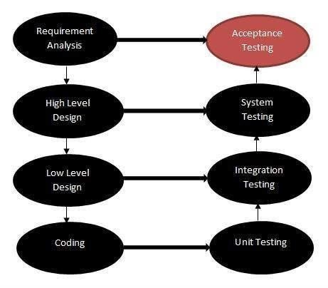
Levels of testing
The following diagram explains the fitment of acceptance testing in the software development life cycle.

Slide 39
Levels of testing
SUMMARY
DIFFERENCE BETWEEN SYSTEM TESTING AND INTEGRATION TESTING
But apart from that before you take a look at differences first of all take a brief look at above than go for differences
System Testing | Integration Testing
1. In system testing we test the complete system as a whole to check whether the system is properly working or not means as per the requirements or not | 1. In integration testing we test the modules to see whether they are integrating properly or not by combining the modules and tested as a group.
2. In system testing testers always have to | 2. In integration testing testers have to
concentrate on both functional and non- | concentrate on functional testing means main
functional testing like performance, load, | focus on how two modules are combined and
stress, security, recovery testing and so on. | tested as a group.
3. For performing this testing system must be integrated tested. | 3. For performing this testing system must be unit tested before.
4. It starts from the requirements specifications. | 4. It starts from the interface specification.
5. System Testing does not test the visibility | 5. Integration Testing test the visibility of the
of code. | integration structure.
7 In System Testing Tester pays attention to the system functionality. | 7. In Integration Testing Tester pays attention to the functionality of integrated units
8. It is always only the kind of Black Box | 8. It is a kind of both White Box Testing and
Testing. | Black Box Testing.

Slide 40
Levels of testing
BEST DIFFERENCE BETWEEN ALPHA AND BETA TESTING
Alpha Testing | Beta Testing (Field Testing)
1. It is always performed by the developers/ Independent Testing Team at the software development site. | 1. It is always performed by the customers / Independent Testing team at their own site
2. Alpha Testing is not open to the market and public | 2. Beta Testing is always open to the market and public (not all).
73.Alpha Testing is not known by any other different name | .3. Beta Testing is also known by the name Field Testing means it is also known as field testing
4.It is always performed in Virtual Environment. | 4. It is performed in Real Time Environment.
5.It is the form of Acceptance Testing. | 5. It is also the form of Acceptance Testing.
6. It comes under the category of both White Box Testing and Black Box Testing. | 6. It is only a kind of Black Box Testing.
7. It is considered as the User Acceptance Testing (UAT) which is done at developer’s area. | 7. It is also considered as the User Acceptance Testing (UAT) which is done at Customers or users area.
8. It is always performed at the developer’s premises in the absence of the users. | 8. It is always performed at the user’s premises in the absence of the development team

Slide 41
THANKYOU ☺

