Slide 1

WELCOME TO NINETH LECTURE OF
Software Testing Techniques and Strategies
COURSE CODE :SE-484

Slide 2
Levels of testing
SUMMARY
DIFFERENCE BETWEEN SYSTEM TESTING AND INTEGRATION TESTING
But apart from that before you take a look at differences first of all take a brief look at above than go for differences
System Testing | Integration Testing
1. In system testing we test the complete system as a whole to check whether the system is properly working or not means as per the requirements or not | 1. In integration testing we test the modules to see whether they are integrating properly or not by combining the modules and tested as a group.
2. In system testing testers always have to | 2. In integration testing testers have to
concentrate on both functional and non- | concentrate on functional testing means main
functional testing like performance, load, | focus on how two modules are combined and
stress, security, recovery testing and so on. | tested as a group.
3. For performing this testing system must be integrated tested. | 3. For performing this testing system must be unit tested before.
4. It starts from the requirements specifications. | 4. It starts from the interface specification.
5. System Testing does not test the visibility | 5. Integration Testing test the visibility of the
of code. | integration structure.
7 In System Testing Tester pays attention to the system functionality. | 7. In Integration Testing Tester pays attention to the functionality of integrated units
8. It is always only the kind of Black Box | 8. It is a kind of both White Box Testing and
Testing. | Black Box Testing.

Slide 3
Levels of testing
BEST DIFFERENCE BETWEEN ALPHA AND BETA TESTING
Alpha Testing | Beta Testing (Field Testing)
1. It is always performed by the developers/ Independent Testing Team at the software development site. | 1. It is always performed by the customers / Independent Testing team at their own site
2. Alpha Testing is not open to the market and public | 2. Beta Testing is always open to the market and public (not all).
73.Alpha Testing is not known by any other different name | .3. Beta Testing is also known by the name Field Testing means it is also known as field testing
4.It is always performed in Virtual Environment. | 4. It is performed in Real Time Environment.
5.It is the form of Acceptance Testing. | 5. It is also the form of Acceptance Testing.
6. It comes under the category of both White Box Testing and Black Box Testing. | 6. It is only a kind of Black Box Testing.
7. It is considered as the User Acceptance Testing (UAT) which is done at developer’s area. | 7. It is also considered as the User Acceptance Testing (UAT) which is done at Customers or users area.
8. It is always performed at the developer’s premises in the absence of the users. | 8. It is always performed at the user’s premises in the absence of the development team

Slide 4
Regression Testing
Regression Testing is a type of testing that is done to verify that a code change in the software does not impact the existing functionality of the product.
This is to make sure the product works fine with new functionality, bug fixes or any change in the existing feature.
Previously executed test cases are re-executed in order to verify the impact of change.
Regression Testing is a Software Testing type in which test cases are re-executed in order to check whether the previous functionality of the application is working fine and the new changes have not introduced any new bugs.
This test can be performed on a new build when there is a significant change in the original functionality that too even in a single bug fix.
Regression means retesting the unchanged parts of the application.

Slide 5
Regression Testing
Regression test should be a test, and not merely a check
In the simplest terms, regression testing is a form of software testing that confirms or denies the functionality of software components after changes to a system
A defect that emerges after a change to the software is known as a regression bug
In the event that a change is made to a software component and a
regression bug is discovered and fixed, more regression testing is
required to confirm that resolving this issue does not in turn cause other issues

Slide 6
RETESTING VS REGRESSUION TESTING”
Regression testing is to ensure that changes have not affected unchanged part.
Retesting is done to make sure that the tests cases which failed in last execution are passed after the defects are fixed.
Regression testing is not carried out for specific defect fixes.
Retesting is carried out based on the defect fixes.
They can therefore occur in one and the same testing process, where:
Change in requirements and code is modified according to the requirement
You update your software with a new feature
You detect a bug in your existing functionality
You fix the bug.
You test the existing functionality
Regression | Retesting
Involves testing a general area of the software. | Involves testing a specific feature of the software.
Is about testing software which was working, but now, due to updates, might not be working. | Is about testing software which you know was not working, but which you believe to have been fixed. You test it to confirm that it is now in fact fixed.
Should always be a part of the testing process and performed each time code is changed and a software update is about to be released. | Is only a part of the testing process if defect or bug is found in the code.

Slide 7
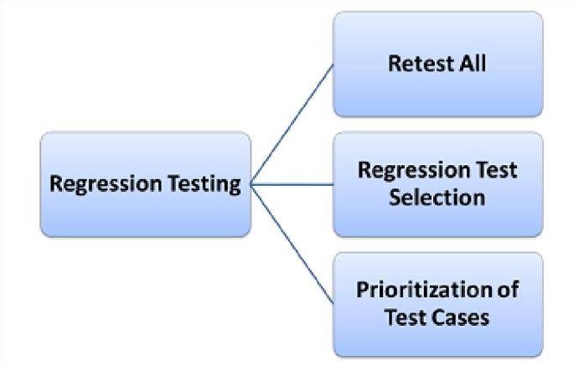
How is Regression Testing Best Implemented?
There are typically three different methods for approaching regression testing on a project:

Slide 8
Regression Testing
Retest All: This method of regression testing simply re-tests the entirety of the software, from top to bottom. This is one of the methods for Regression Testing in which all the tests in the existing test bucket or suite should be re-executed. This is very expensive as it requires huge time and resources. In many cases, the majority of these tests are performed by automated tools, but often that is neither feasible nor necessary.
Regression Test Selection: Rather than a full re-test process, this method allows the team to choose a representative selection of tests that will approximate a full testing of the test suite, but require far less time or cost to do so.
Instead of re-executing the entire test suite, it is better to select part of test suite to be run
Test cases selected can be categorized as
1) Reusable Test Cases 2) Obsolete Test Cases 3). New test case
Test Case Prioritization: With a set of limited test cases, it is ideal to prioritize those tests.
Try to prioritize tests which could impact both current and future builds of the software.
Prioritize the test cases depending on business impact, critical & frequently used functionalities.
Selection of test cases based on priority will greatly reduce the regression test suite.
Hybrid Regression Testing:
The hybrid technique is a combination of Regression test selection and Test case Prioritization. Rather
than selecting the entire test suite, select only the test cases which are re-executed depending on their
priority.

Slide 9
Selecting test cases for Regression Testing:
It was found from industry data that good number of the defects reported by customers were due to last minute bug fixes creating side effects and hence selecting the Test Case for regression testing is an art and not that easy.
Effective Regression Tests can be done by selecting following test case -
Test cases which have frequent defects
Functionalities which are more visible to the users
Test cases which verify core features of the product
Test cases of Functionalities which has undergone more and recent changes
All Integration Test Cases
All Complex Test Cases
Boundary value test cases
Sample of Successful test cases
Sample of Failure test cases

Slide 10
Regression Test Overview
Regression test is like a verification method. Test cases are generally automated as test cases are required to execute again and again and running the same test cases again and again manually is time-consuming and tedious one too.
For Example, Consider a product X, in which one of the functionality is to trigger confirmation, acceptance, and dispatched emails when Confirm, Accept and Dispatch buttons are clicked.
Some issue occurs in the confirmation email and in order to fix the same, some code changes are done. In this case, not only the Confirmation emails need to be tested but Acceptance and Dispatched emails also needs to be tested to ensure that the change in the code has not affected them.
It is a testing method which is used to test the product for modifications or for any updates being done. It verifies that any modification in a product does not affect the existing modules of the product.
Verifying that the bugs are fixed and the newly added features have not created any problem in the previous working version of the software.
Testers perform Functional Testing when a new build is available for verification. The intent of this test is to verify the changes made in the existing functionality and the newly added functionality as well.
When this test is done, the tester should verify whether the existing functionality is working as expected and the new changes have not introduced any defect in functionality that was working before this change.
Regression test should be a part of the Release Cycle and must be considered in the test estimation.

Slide 11
What is Adhoc Testing?
Adhoc testing is an informal testing type with an aim to break the system.
Ad hoc Testing does not follow any structured way of testing and it is randomly done on any part of application.
This testing is usually an unplanned activity.
It does not follow any test design techniques to create test cases.
In fact is does not create test cases altogether!
This testing is primarily performed if the knowledge of testers in the system under test is very high.
Testers randomly test the application without any test cases or any business requirement document.
Main aim of this testing is to find defects by random checking. Adhoc testing can be achieved with the testing technique called Error Guessing. Error guessing can be done by the people having enough experience on the system to "guess" the most likely source of errors.

Slide 12
Adhoc Testing Disadvantages
This testing requires no documentation/ planning /process to be followed.
One of the main disadvantages of ad hoc testing is that the actual testing process is not documented since it does not follow a particular test case. This makes it more difficult for the tests to regenerate an error. Because, in order to get that error, the tester will need to remember the exact steps he/she took to get there, which is not always possible.
Since this testing aims at finding defects through random approach, without any documentation, Defects will not be mapped to test cases. Hence, sometimes, it is very difficult to reproduce the defects as there are no test steps or requirements mapped to it.
The test scenarios executed during the ad-hoc testing are not documented so the tester has to keep all the scenarios in their mind which he/she might not be able to recollect in future
.
Ad hoc testing will be effective only if the tester is knowledgeable and experienced of the System Under Test. . If the tester does not have prior knowledge about the functionality of the application under test, ad hoc testing will not be useful and won’t be able to identify any errors.
Occasionally, as a result of invalid test cases that are developed by the tester, invalid errors are reported. This can become an issue in the following error fixing processes
Ad hoc testing also does not guarantee that all errors will be found. The success of ad hoc testing relies on the skill and knowledge of the tester. Since there are no previously created or documented test cases, the amount of time, effort and resources that go into these tests remains unspecified. Finding one error could take anything from a few minutes to a few hours or longer.

Slide 13
Advantages Of Ad Hoc Testing
One of the main advantages of ad hoc testing is that it is able to identify any errors that would usually go unnoticed during formal testing methods. This can save a lot of time as it requires none of the planning that structured testing does.
Another advantage is that testers get to explore the application freely, according to their own knowledge and understanding of the application.
They can then execute various tests as they go along, helping identify errors throughout the process.
Thirdly, testers and developers of the application can easily test the app themselves, as it does not require test cases. This allows the developers to create more efficient and bug-free code easily.
Ad hoc testing can also be combined with other testing techniques and executed thereafter to produce more effective and informative results overall

Slide 14
When And When Not To Conduct Ad hoc testing
Ad hoc testing is commonly conducted when there is a lack of time to perform longer and more exhaustive testing processes.
The more thorough testing method includes preparing test requirements documents, test cases, and test case designs.
The ideal time to conduct ad hoc testing is after the completion of all formal testing techniques.
However, ad hoc testing can also be conducted in the middle of the software development, after the complete development of the software, or after a few modules have already been developed.
When Not To Conduct Ad hoc testing
It is important to take note of the few scenarios when ad hoc testing is not recommended. A few conditions when ad hoc testing should not be conducted include:
When Beta testing is being conducted
In test cases which already have existing errors

Slide 15
Types of Adhoc testing
There are different types of Adhoc testing and they are listed as below:
Buddy Testing
This type of ad hoc testing is conducted with a minimum of two people. It takes place after unit testing of a module has been conducted and completed. This type of testing can also be considered a combination of both system and unit testing.
Two buddies mutually work on identifying defects in the same module. Mostly one buddy will be from development team and another person will be from testing team.
Buddy testing helps the testers develop better test cases and development team can also make design changes early. This testing usually happens after Unit Testing completion.
Pair testing Similar to ‘buddy testing’ in some ways, ‘pair testing’ involves a pair of testers working together on the modules for testing.
The two testers will share ideas, knowledge, and opinions over the same machine in order to identify defects or errors.
This method of testing involves using testers who are paired according to their expertise and knowledge levels, allowing for different insights to any problem they identify.
The two testers will share the same setup, also sharing the work of testing and documenting all observations between them.
This method of testing also allows for one tester to execute the tests, while the other can take notes on the findings. One person can execute the tests and another person can take notes on the findings. Roles of the persons can be a tester and scriber during testing.

Slide 16
Types of Adhoc testing
Comparison Buddy and Pair Testing:
Buddy testing is combination of unit and System Testing together with developers and testers but Pair testing is done only with the testers with different knowledge levels. (Experienced and non-experienced to share their ideas and views)
Monkey Testing
Randomly test the product or application without test cases with a goal to break the system.
Due to the random nature of the testing, this method has earned the name ‘monkey testing’.
Monkey testing is most commonly done in the unit testing level.
Here, testers randomly test the application or product without test cases.
The tester’s main goal is to analyze the data or tests in completely random ways, ensuring that the system is able to withstand any crash.
Testers provide the software with random inputs and observe their corresponding outputs. Based on the output data, they can determine any errors, inconsistencies or system crashes better.

Slide 17
Best practices to follow Adhoc testing
Following best practices can ensure effective Adhoc Testing.
✓ Good business knowledge
Testers should have good knowledge of the business and clear understanding of the requirements- Detailed knowledge of the end to end business process will help find defects easily. Experienced testers find more defects as they are better at error guessing.
✓ Test Key Modules
Key business modules should be identified and targeted for ad-hoc testing. Business critical modules should be tested first to gain confidence on the quality of the system.
✓ Record Defects
All defects need to be recorded or written . Defects must be assigned to developers for fixing. For each valid defect, corresponding test cases must be written & must be added to planned test cases.
These Defect findings should be made as lesson learned and these should be reflected in our next system while we are planning for test cases.
Conclusion:
The advantage of Ad-hoc testing is to check for the completeness of testing and find more defects than planned testing. The defect catching test cases are added as additional test cases to the planned test cases.
Ad-hoc Testing saves lot of time as it doesn't require elaborate test planning, documentation and Test Case design.

Slide 18
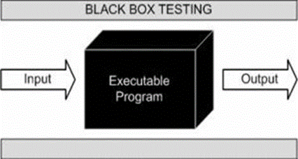
Dynamic Testing Techniques
What is Black Box Testing?
Black box testing is a software testing techniques in which functionality of the software under test (SUT) is tested without looking at the internal code structure, implementation details and knowledge of internal paths of the software. This type of testing is based entirely on the software requirements and specifications.
In Black Box Testing we just focus on inputs and output of the software system without bothering about internal knowledge of the software program.
Definition by ISTQB
Black box testing: Testing, either functional or non-functional, without reference to the internal structure of the component or system.
Black box test design technique: Procedure to derive and/or select test cases based on an analysis of the specification, either functional or non-functional, of a component or system without reference to its internal structure.
 

Slide 19
Dynamic Testing Techniques
Black Box Testing
Example
A tester, without knowledge of the internal structures of a website, tests the web pages by using a browser; providing inputs (clicks, keystrokes) and verifying the outputs against the expected outcome.
Levels Applicable To
Black Box testing method is applicable to the following levels of software testing:
Integration Testing
System Testing
Acceptance Testing
The higher the level, and hence the bigger and more complex the box, the more black box testing method comes into use.

Slide 20
Dynamic Testing Techniques
WORKING PROCESS OF BLACK BOX TESTING TECHNIQUE
Below are the steps which explain the working process of Black Box Testing
Step 1 Input: Requirement and functional specification of the system are examined. High level design documents and application block source code are also examined. Tester chooses valid input and rejects the invalid inputs.
Step 2 Processing Unit: Do not concern with the internal working of the
system. In processing unit tester constructs test cases with the selected input and execute them.
Tester also performs Invalid and Valid inputs
Partitions Output load testing, stress testing, security review and globalization testing. If any defect is detected it will be fixed and re-tested.
Step 3 Output: After all these testing, tester gets desired output and prepares final report

Slide 21
Dynamic Testing Techniques
Black Box Testing –Perform by the Tester
Here are the generic steps followed to carry out any type of Black Box Testing.
Initially requirements and specifications of the system are examined.
Tester chooses valid inputs (positive test scenario) to check whether SUT processes them correctly. Also some invalid inputs (negative test scenario) are chosen to verify that the SUT is able to detect them.
Tester determines expected outputs for all those inputs.
Software tester constructs test cases with the selected inputs.
The test cases are executed.
Software tester compares the actual outputs with the expected outputs.
Defects if any are fixed and re-tested.

Slide 22
Dynamic Testing Techniques
Black Box Testing Advantages
Tests are done from a user’s point of view and will help in exposing discrepancies in the specifications.
Tester need not know programming languages or how the software has been implemented.
Tests can be conducted by anyone independent from the developers, allowing for an objective perspective and the avoidance of developer-bias.
Test cases can be designed as soon as the specifications are complete.
Black Box Testing Disadvantages
It is difficult to identify all possible inputs
Only a small number of possible inputs can be tested and possibility of many program paths will be left untested.
Chances of having unidentified paths during this testing
Without clear specifications, which are the situation in many projects, test cases will be difficult to design.
Tests can be redundant if the software designer/ developer has already run a test case.

Slide 23
Dynamic Testing Techniques
Tools used for Black Box Testing:
Tools used for Black box testing largely depends on the type of black box testing you are doing.
For Functional/ Regression Tests you can use - QTP, Selenium
For Non-Functional Tests, you can use - Loadrunner, Jmeter
Types of Black Box Testing
There are many types of Black Box Testing but following are the prominent ones -
Functional testing - This black box testing type is related to functional requirements of a system; it is done by software testers.
Non-functional testing - This type of black box testing is not related to testing of a specific functionality, but non-functional requirements such as performance, scalability, usability.
Regression testing - Regression Testing is done after code fixes, upgrades or any other system maintenance to check the new code has not affected the existing code

Slide 24
Dynamic Testing Techniques
I. Black Box Testing Techniques
Following are some techniques that can be used for designing black box tests.
Equivalence partitioning: It is a software test design technique that involves dividing input values into valid and invalid partitions and selecting representative values from each partition as test data.
Boundary Value Analysis: It is a software test design technique that involves determination of boundaries for input values and selecting values that are at the boundaries and just inside/ outside of the boundaries as test data.
Cause Effect Graphing: It is a software test design technique that involves identifying the cases (input conditions) and effects (output conditions), producing a Cause-Effect Graph, and generating test cases accordingly
Decision Table Testing: A decision table puts causes and their effects in a matrix. There is unique combination in each column.
Error Guessing:
This is purely based on previous experience and judgment of tester. Error Guessing is the art of guessing where errors can be hidden. For this technique there are no specific tools, writing the test cases that cover all the application paths.
State Base Testing

Slide 25
Dynamic Testing Techniques
BLACK BOX TESTING - I
i. EQUIVALENCE CLASS PARTITIONING:
Equivalence Class Partitioning is a test case design techniques in black box testing. Equivalence partitioning is a Test Case Design Technique to divide the input data of software into different equivalence data classes.
Test cases are designed for equivalence data class. The equivalence partitions are frequently derived from the requirements specification for input data that influence the processing of the test object.
A use of this method reduces the time necessary for testing software using less and effective test cases
Equivalence Partitioning = Equivalence Class Partitioning = ECP
It can be used at any level of software for testing and is preferably a good technique to use first. In this technique, only one condition to be tested from each partition. Because we assume that, all the conditions in one partition behave in the same manner by the software. In a partition, if one condition works other will definitely work. Likewise we assume that, if one of the conditions does not work then none of the conditions in that partition will work.

Slide 26
Dynamic Testing Techniques
BLACK BOX TESTING
i. EQUIVALENCE CLASS PARTITIONING:
Equivalence partitioning is a testing technique where input values set into classes for testing.
Valid Input Class = Keeps all valid inputs.
Invalid Input Class = Keeps all Invalid inputs
How is this partitioning performed while testing:
1. If an input condition specifies a range, one valid and one two invalid classes are defined.
2. If an input condition requires a specific value, one valid and two invalid equivalence classes are defined.
3.If an input condition specifies a member of a set, one valid and one invalid equivalence class is defined.
4. If an input condition is Boolean, one valid and one invalid class is defined.

Slide 27

Dynamic Testing Techniques
BLACK BOX TESTING - I
1. EQUIVALENCE CLASS PARTITIONING EXAMPLE:
Let's consider the behavior of tickets in the Flight reservation application, while booking a new flight.
Ticket values 1 to 10 are considered valid & ticket is booked. While value 11 to 99 is considered invalid for reservation and error message will appear, "Only ten tickets may be ordered at one time".
Here is the test condition
1.Any Number greater than 10 entered in the reservation column (let say 11) is considered invalid.
Any Number less than 1 that is 0 or below, then it is considered invalid.
Numbers 1 to 10 are considered valid
Any 3 Digit Number say -100 is invalid We cannot test all the possible values because if done, number of test cases will be more than 100.To address this problem, we use equivalence partitioning hypothesis where we divide the possible values of tickets into groups or sets as shown below where the system behavior can be considered the same

Slide 28
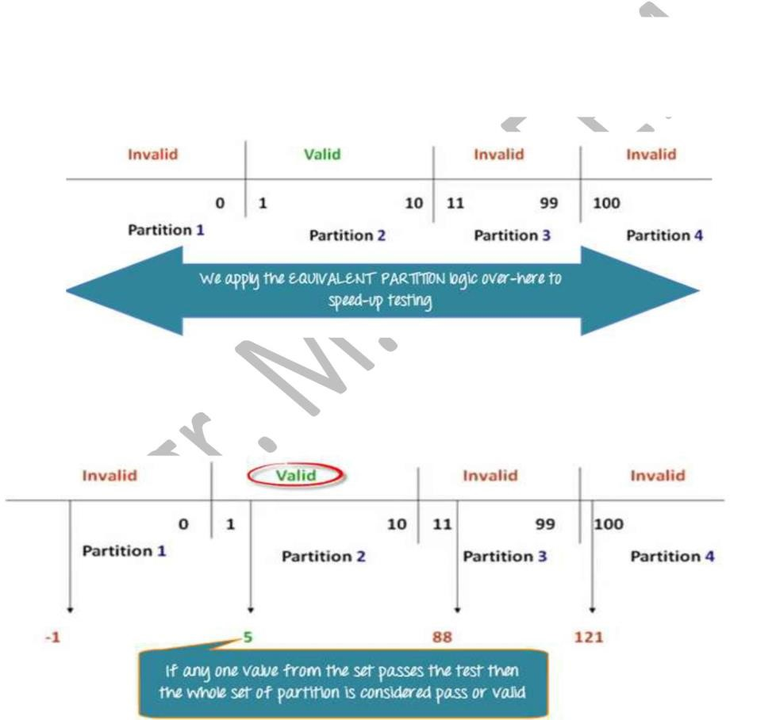
Dynamic Testing Techniques
BLACK BOX TESTING - I
The divided sets are called Equivalence Partitions or Equivalence Classes. Then we pick only one value from each partition for testing. The hypothesis behind this technique is that if one condition/value in a partition passes all others will also pass. Likewise, if one condition in a
partition fails, all other conditions in that partition will fail.

Slide 29
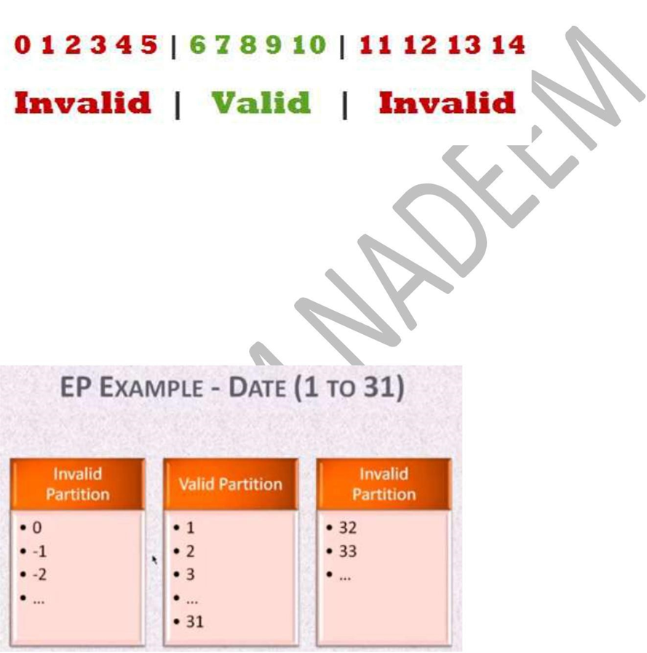
Dynamic Testing Techniques
BLACK BOX TESTING - I
1. EQUIVALENCE CLASS PARTITIONING:
Example 2
§ A text field permits only numeric characters
§ Length must be 6-10 characters long
At the time of testing, test 4 and 12 as invalid values and 7 as valid one.
It is easy to test input ranges 6–10 but harder to test input ranges 2-600. Testing will be easy in the case of lesser test cases but you should be very careful. Assuming, valid input is 7. That means, you belief that the developer coded the correct valid range (6-10).

Slide 30
Dynamic Testing Techniques
BLACK BOX TESTING - I
1. EQUIVALENCE CLASS PARTITIONING:
Example 2
§ A text field permits only numeric characters
§ Length must be 6-10 characters long
At the time of testing, test 4 and 12 as invalid values and 7 as valid one.
It is easy to test input ranges 6–10 but harder to test input ranges 2-600. Testing will be easy in the case of lesser test cases but you should be very careful. Assuming, valid input is 7. That means, you belief that the developer coded the correct valid range (6-10).

Slide 31
THANKYOU ☺

