Slide 1

convia
KOGNIVERA HACKATHON 2026 · PS-11 WANDERMATCH
Convia
Travel together
without becoming
the average.
A live group-travel product: plan, vote, branch, and remember — with every client in sync.
Team pacmen · Y Kabeer · Harsh Himanshu Trivedi · Akhin S

Slide 2
convia
What is Convia?
A multiplayer travel-planning layer for groups that need agreement, not more chat.
What it is
A shared trip room where calendars, maps, votes, branches, AI suggestions and photos all point back to one accepted plan.
Who we built for
Friend groups planning together, solo travellers joining compatible public trips, and organizers who need decisions to actually stick.
Why it matters
Group travel breaks at commitment: people vote “yes/no”, but timing, budget and preference conflicts stay hidden until the plan fails.
POSITIONING
North Star: more groups reach a committed itinerary without flattening everyone into an average traveller.
Convia is not a solo itinerary chatbot. It is a decision system for travelling together.

Slide 3
convia
The MVP we built
A short, judgeable product slice that covers the PS-11 requirements and adds the mandatory lock proof.
01
02
03
04
05
Trip + invite + join
Users can create a trip, invite members, and collaborate inside one shared room.
Calendar + map planning
Google Calendar-style agenda with locations and map context for the planned route.
Proposal + vote + lock
A passed proposal auto-applies, updates everyone live, and locks the item.
Trippy agent drafts
Searches, suggests places, updates the itinerary as draft proposals, never bypasses votes.
Trip memories
YuNet + SFace CPU face pipeline for per-person clustering and collage generation.
Trip + invite + join
Calendar + map planning
Proposal + vote + lock
Trippy agent drafts
Trip memories
MVP outcome: the plan does not change because someone dragged a card. It changes only when the group decision commits.

Slide 4
convia
The demo flow is the product story
We keep the deck short so the live system does the convincing.
Landing
sign up / login
Trip room
join the shared trip
Calendar + map
plan the itinerary
Proposal
add or change activity
Vote
quorum reached
Commit + lock
live in both browsers
History
who voted + when
Landing
Trip room
Calendar + map
Proposal
Vote
Commit + lock
History
What judges will see
Two authenticated browsers. One shared trip. A proposal reaches quorum, auto-applies, locks the affected item, refuses direct edit, and shows vote history.
Then we show why this is more than voting: alternate branches, Trippy-drafted suggestions, matching/preferences, and trip memories.

Slide 5
convia
Vote-to-Commit & Lock
The mandatory enhancement is implemented as authority, not just UI state.
1
2
3
4
Immutable proposal
Exact change payload + base version are frozen.
Frozen electorate
Eligible voters and majority threshold are recorded.
Atomic commit
Passing vote applies the change, increments version and writes history.
Decision lock
Direct edits are refused; future changes need a new proposal.
Direct edit attempt on a locked item returns: “This item is locked. Raise a proposal to change it.”
Why it scales: idempotency, expected revision checks, transaction-owned state, and replayable history keep clients as caches — not sources of truth.

Slide 6
convia
Disagreement becomes a plan, not a deadlock
Fork & Rejoin handles “we want different things” without forcing the average option.
FORK & REJOIN
Adventure branch
TRIPPY AGENT
Main plan
08:00 trek
AI with guardrails
Google search, place suggestions, preference extraction and itinerary drafts. Trippy can propose; people vote; Core commits.
Rejoin
10:00 café
13:00 lunch
Relaxed branch
11:00 market
Key product belief: a group is not an average person.
Branch organizer roles, RBAC, attendance, nested branches and proposal-based shared edits make this feel like a real planning surface, not a demo trick.

Slide 7
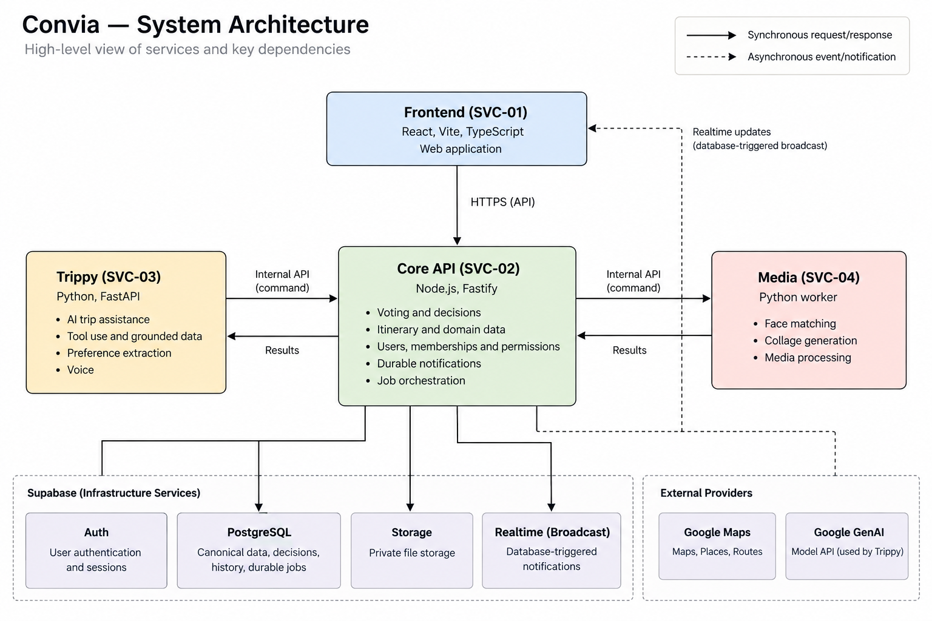
convia
Architecture: microservices with one decision authority
Frontend, Core, Trippy and Media deploy independently; Core owns durable writes.
SCALABILITY POSTURE
Clients are caches
Realtime notifies; clients refetch authoritative state.
Core is the gate
Votes, locks, histories and jobs commit transactionally.
AI is bounded
Tool outputs are validated contracts, not direct mutations.
Media is separate
CPU face processing stays off the request path.

Slide 8
convia
How we built it in the sprint
A fast build, but with corporate-grade operating language: owners, gates, KPIs and deterministic checks.
Pre-lunch
Data model + contracts
Supabase schema, permissions, decision tables, API contracts
Post-lunch
Core API + agents
Trip flows, proposals, votes, Trippy tools, draft operations
Night sprint
Depth features
Fork & Rejoin, calendar polish, map context, media pipeline
Morning freeze
Demo truth
Two-browser proof, live deployment, fallback rehearsal
Pre-lunch
Post-lunch
Night sprint
Morning freeze
SUCCESS METRICS
North Star
Committed trips
Groups reach a locked, shared plan
Activation
Invite → first vote
New member participates in a decision
Quality
Accepted proposal rate
Suggestions become plan changes
Reliability
Stale-write rejection
No silent overwrite under conflict
Trust
Direct-edit refusal
Locked items only change by proposal
Evaluation style: deterministic contract checks for LLM tool calls, API integration tests, fixture replays, and real two-browser acceptance tests.

Slide 9

convia
LIVE DEMO
Now we show it working.
01
Two browsers, one shared trip
02
Create proposal on the calendar
03
Vote reaches quorum
04
Auto-commit + lock appears live
05
Direct edit is refused
06
History shows the vote
07
Fork & Rejoin + Trippy + memories
PLAN TOGETHER · DECIDE TOGETHER · REMEMBER TOGETHER

