Slide 1
Analysis and Evaluation of GPU Utilization During Training of Deep-Filter-Net and Wave-U-Net Models for Edge Transfer Learning
Jashwanth Meganathan
Kabhilesh Giri

Slide 2

Preface
Today's consumers are increasingly seeking Active Noise Cancellation (ANC) in audio devices, driven by their growing reliance on these products for work, education, and entertainment
Machine Learning (ML) is essential in developing effective ANC solutions. It involves training algorithms that identify, predict, and eliminate unwanted noise in real-time, enhancing audio clarity for the user. ANC systems actively filter out common everyday noises such as commuting or environmental sounds. These ML algorithms learn through extensive training on large sets of collected audio samples, enabling accurate noise cancellation once integrated into consumer devices
GPUs play a key role by significantly speeding up ML-based ANC development. GPUs accelerate the training of complex neural network models and efficiently handle extensive audio datasets through parallel processing. This results in ANC products that are more responsive, adaptive, and deliver superior audio quality to users.

Slide 3
Overview
Building on the previous preface, this study aims to evaluate and compare the GPU utilization of V100 and P100 GPUs during the training of two models — DeepFilterNet and WaveUNet — using selected standard datasets. The performance assessment will focus on key GPU-related metrics such as,
GPU Utilization (%) | to identify potential bottlenecks and assess hardware-model compatibility
GPU Memory Usage (%) | Measures VRAM utilization, indicating memory-bound behavior
Power Consumption (W) | Tracks power used per training instance, reflecting compute load
Clock Speed (MHz) | Monitors GPU and memory clock rates to detect performance-limiting factors
Batch Size | Evaluates how different batch sizes impact GPU utilization and efficiency
Temperature | GPU temperature every interval

Slide 4
Key GPU Performance Metrics for Evaluating Deep Learning Models
Training Throughput – Number of samples processed per second
Performance State (P-State) – Indicates current GPU clock state (P0 = max performance)
Clock Speeds – Current and maximum clock rates for SM, graphics, and memory
Memory Usage – Total, used, free, and reserved GPU memory
Utilization – SM activity (%) and memory controller activity (%) over time
Temperature – Real-time core temperature and thermal throttle threshold
Power Consumption – Current power draw, power limit, and management mode

Slide 5
Hardware Configuration & Compute Resources
Test Environment: Explorer Cluster Nodes with Tesla P100 & V100 GPUs
Specification | Tesla P100 | Tesla V100
Form Factor | PCIe | SXM2
Total Memory | 12 GB | 32 GB
CUDA Version | 12.2 | 12.3
Interface | PCIe | SXM2

Slide 6
DeepFilterNet
DeepFilterNet (DFN) is a deep learning-based model designed for speech enhancement, noise suppression, and general audio improvement. It leverages a combination of spectral feature extraction, recurrent neural network layers, and mask estimation to effectively isolate clean speech from noisy input. Trained in a supervised fashion using paired clean and noisy datasets, DFN is capable of generalizing across diverse real-world noise environments. Its architecture strikes a balance between efficiency and accuracy, making it well-suited for resource-constrained edge devices—an ideal match for the deployment and optimization goals discussed previously. DFN3 model is currently used for training and evaluation. The information of the dataset is attached below,
Aspect | MS DNS Dataset | MS SNSD Dataset | DFN –Aspect Compatibility
Content Type | Clean speech + noise (separate or mixed) | Clean speech, noise, and pre-mixed noisy speech | Fully compatible with DFN’s supervised training setup
Noise Source | Wide range: babble, office, traffic, etc. | 10 common real-world noise classes | Rich noise diversity helps generalization
Sampling Rate | 16 kHz and 48 kHz (wideband & fullband) | 16 kHz | DFN supports both — compatible
File Format | .wav | .wav | Parse-able to DFN’s HDF5 converter
Data Format | Clean/noisy pairs, optionally pre-mixed | Clean, noise, and noisy in separate folders | Aligns with DFN’s expected HDF5 group structure

Slide 7
Progress & Insights - DeepFilterNet
Experiment Setup
Proceeded with setting up the models and cloned, labelled and categorized the necessary data for model training
Developed few python scripts to launch training and store logs generated as part of training process
Preprocessing
Converted audio files in (.wav) format into HDF5 files which were required for training the model
Created separate config files to launch training with custom parameters and dataset paths
Model Training
Batch sizes of 1 and 2 were used to reflect the limited memory and compute capabilities of edge devices, making them ideal for evaluating DFN’s performance under realistic deployment constraints. This setup simulates low-latency, on-device learning scenarios such as quick personalization or fine-tuning using small local datasets.
Corresponding logs were generated and analyzed to gather necessary training insights
Training Directory Structure,
DNS/
clean-DNS.HDF5
noise-DNS.HDF5
SNSD/
clean-SNSD.HDF5
noise-SNSD.HDF5
- This framework to use to perform model training on V100 and G100 GPUs for different epoch and batch size configurations

Slide 8
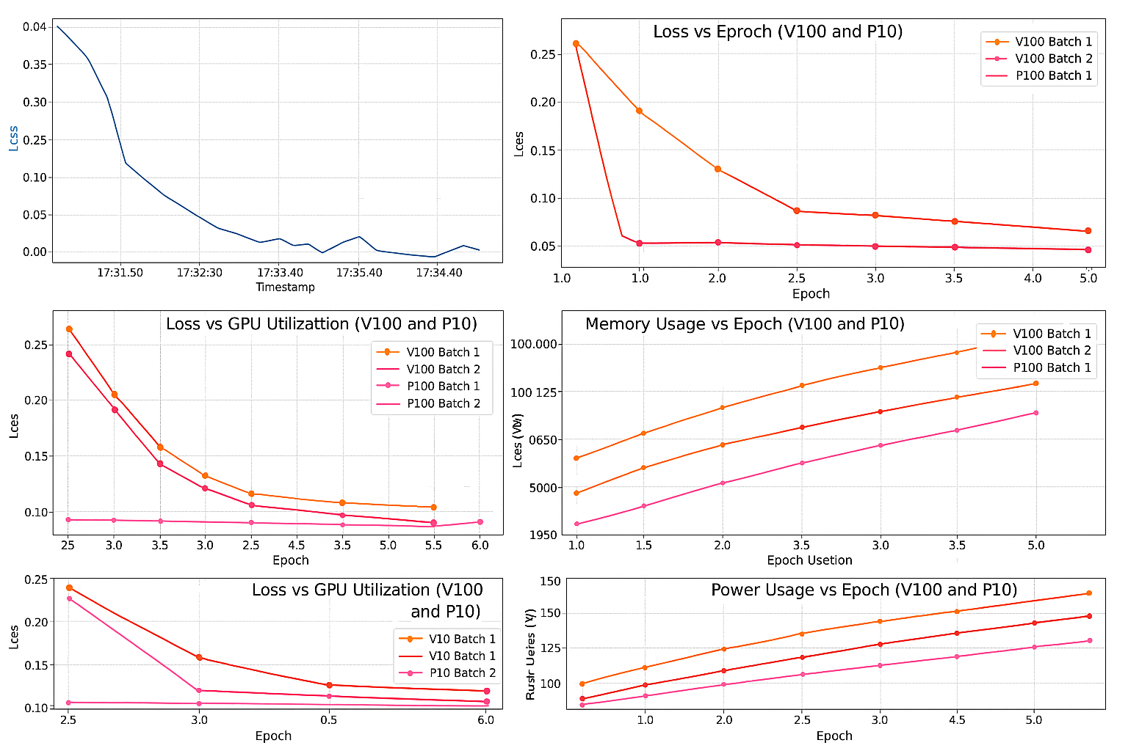
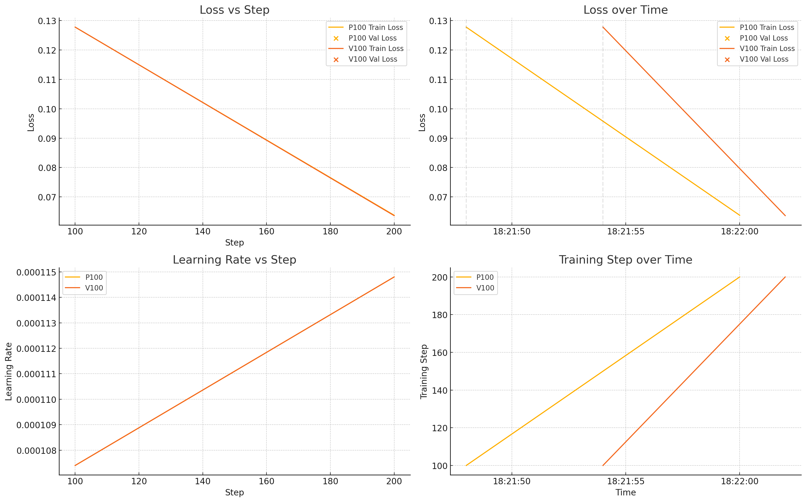
Continued ..
Fig(1). Training DFN with MS-DNS Dataset
Fig(2). Training DFN with MS-SNSD Dataset

Slide 9
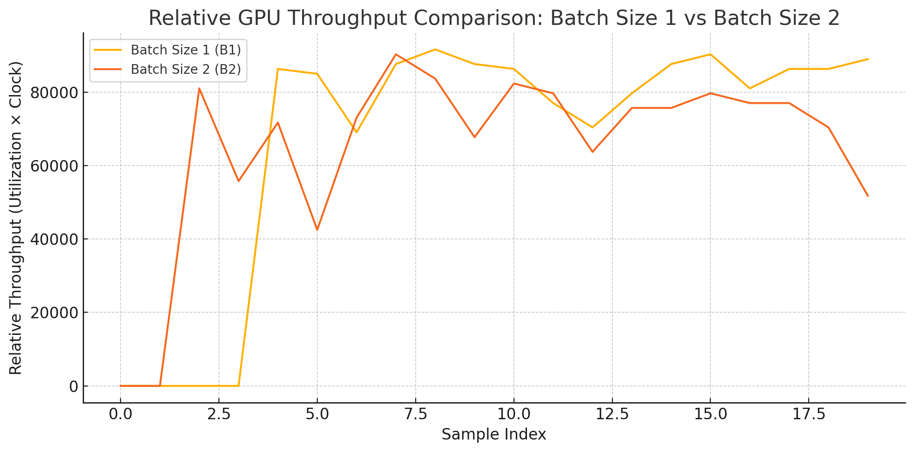
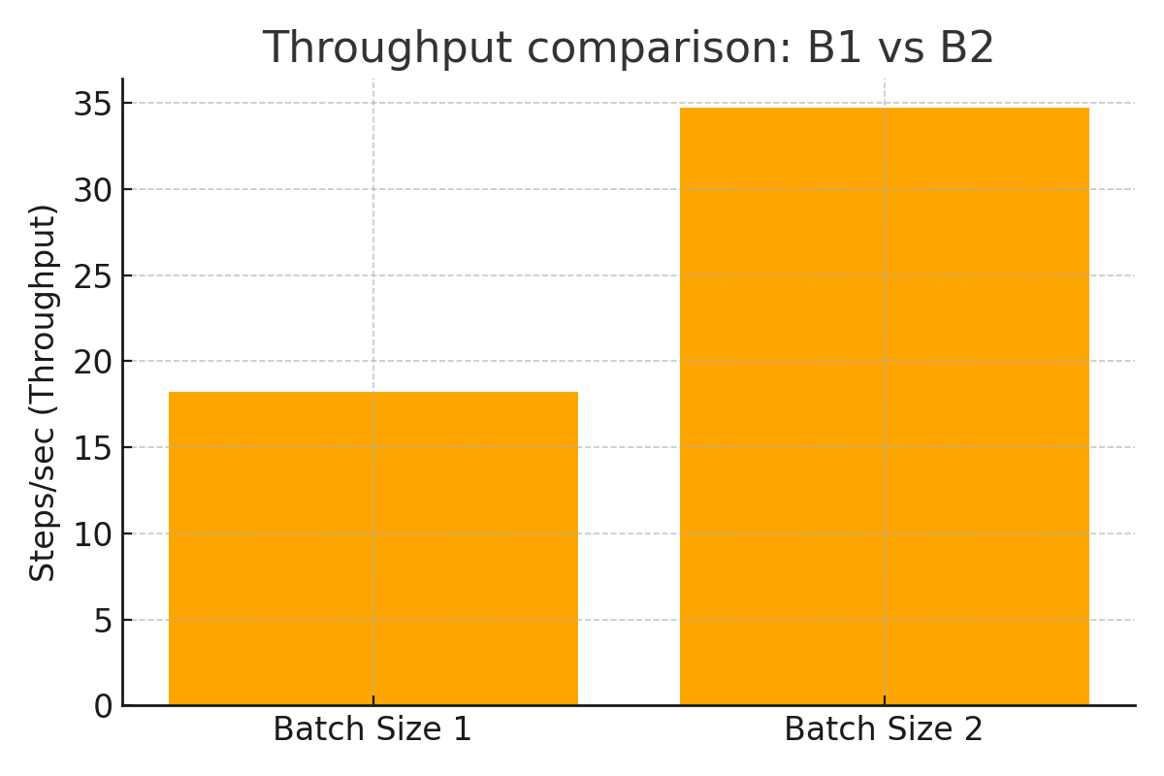
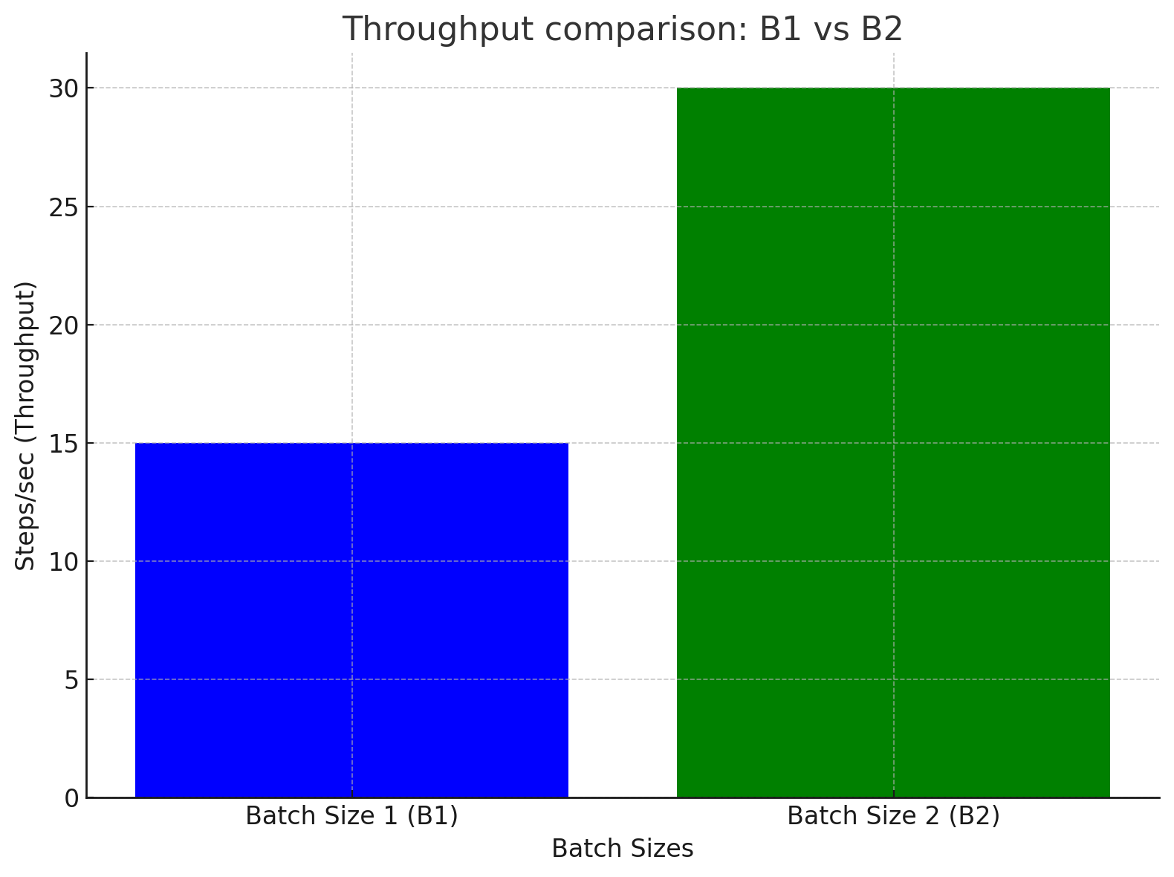
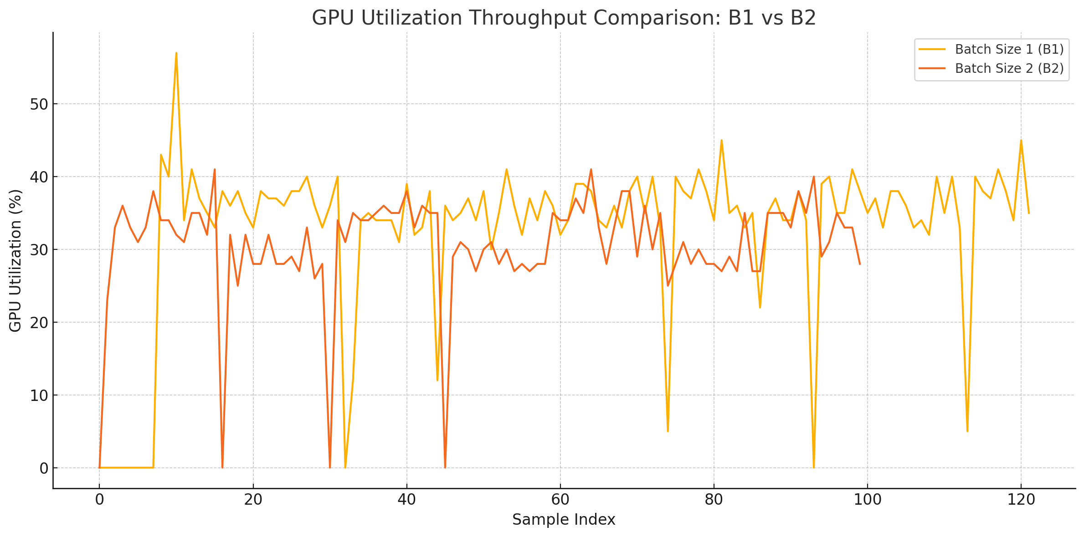
Continued ..
Fig(1). Throughput on P100 for SNSD
Fig(3). Throughput on P100 for DNS
Fig(2). Throughput on V100 for SNSD
Fig(4). Throughput on V100 for DNS

Slide 10
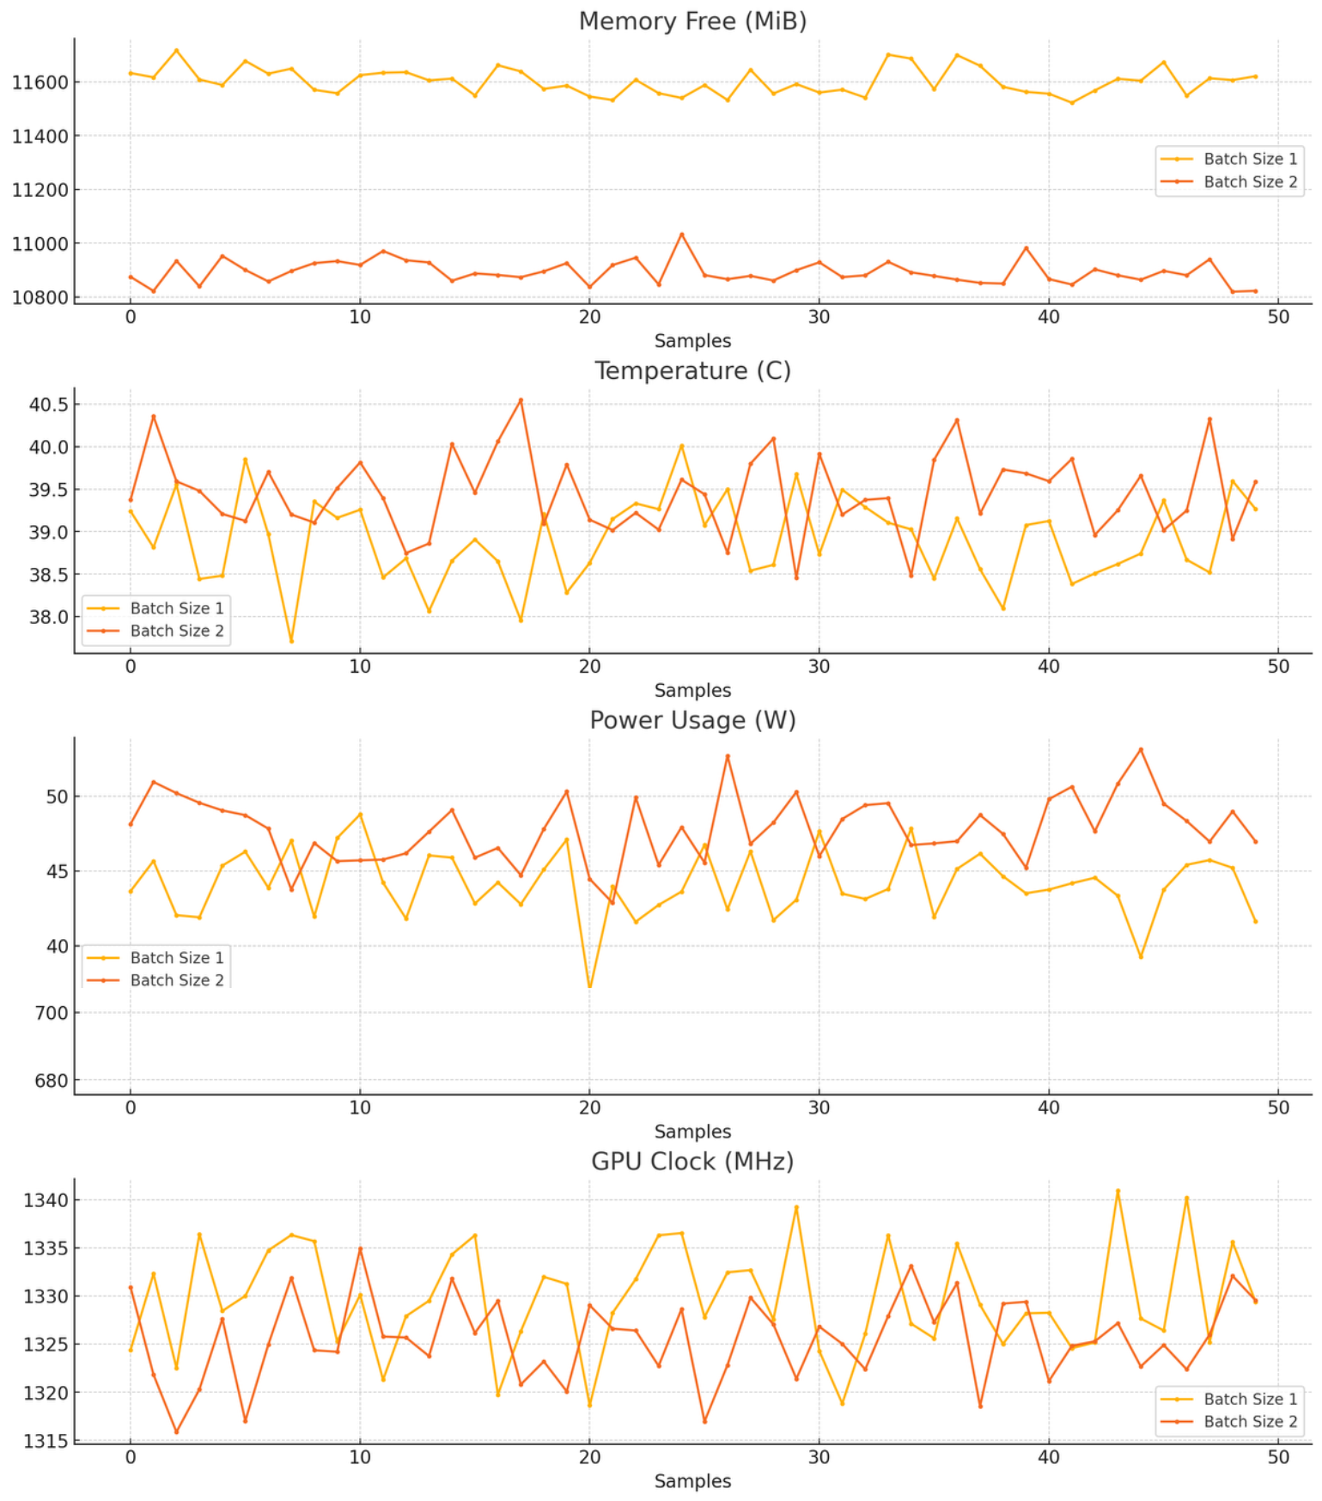
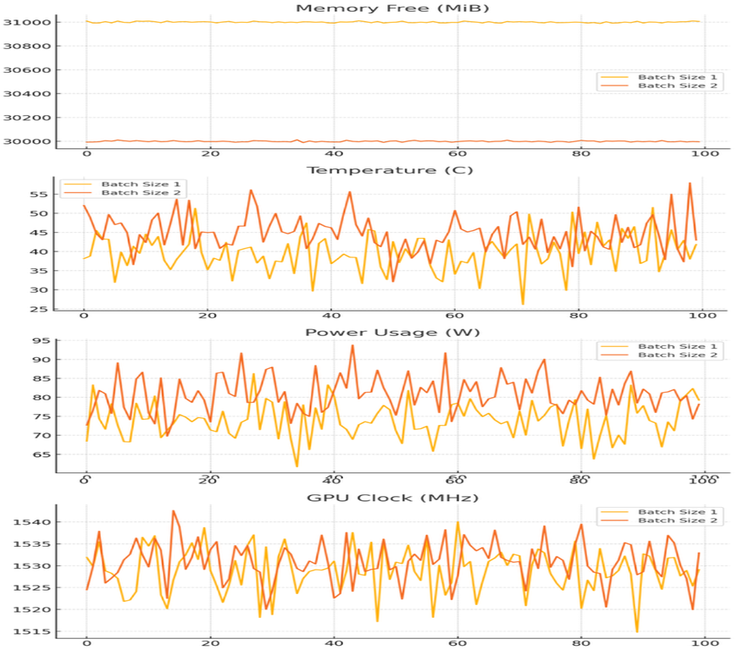
Continued ..
Fig (1) P100 Utilization graph (DNS)
Fig (2) V100 Utilization graph (DNS)

Slide 11
DFN GPU Utilization Summary
V100 outperformed P100 across all metrics, showing higher GPU utilization, faster throughput, and more stable power and temperature profiles during DFN training, especially when scaling from batch size 1 to 2.
Batch size 1 offered stable, low-memory training suitable for both GPUs, while batch size 2 improved efficiency on V100 but caused utilization drops and thermal variability on P100.
P100 showed performance degradation at batch size 2, with increased power draw and reduced throughput, highlighting its limitations under heavier batch processing.
MS-SNSD proved more demanding than MS-DNS, especially at batch size 2, where P100 struggled with longer samples, while V100 maintained consistent performance.
V100 is ideal for production-scale or high-throughput DFN training with larger batch sizes, whereas P100 is better suited for lightweight, batch size 1 training or edge simulation tasks.

Slide 12
Wave U Net
What is Wave-U-Net ?
Wave-U-Net: An End-to-End Audio Separation Model
Operated on direct waveforms (1D audio)
Avoids STFT – learns phase + magnitude
Based on U-Net architecture, adapted for 1D
Uses down sampling & up sampling with skip connections
Captures both local patterns and global context
Why Wave-U-Net?
Handles raw waveforms directly
Learns both magnitude and phase
minimal preprocessing

Slide 13
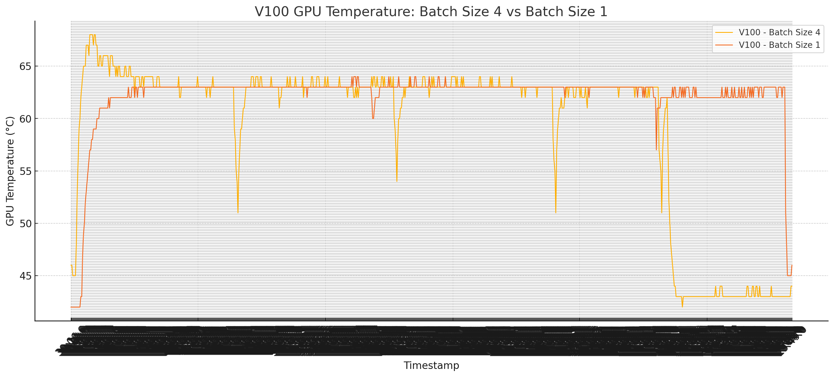
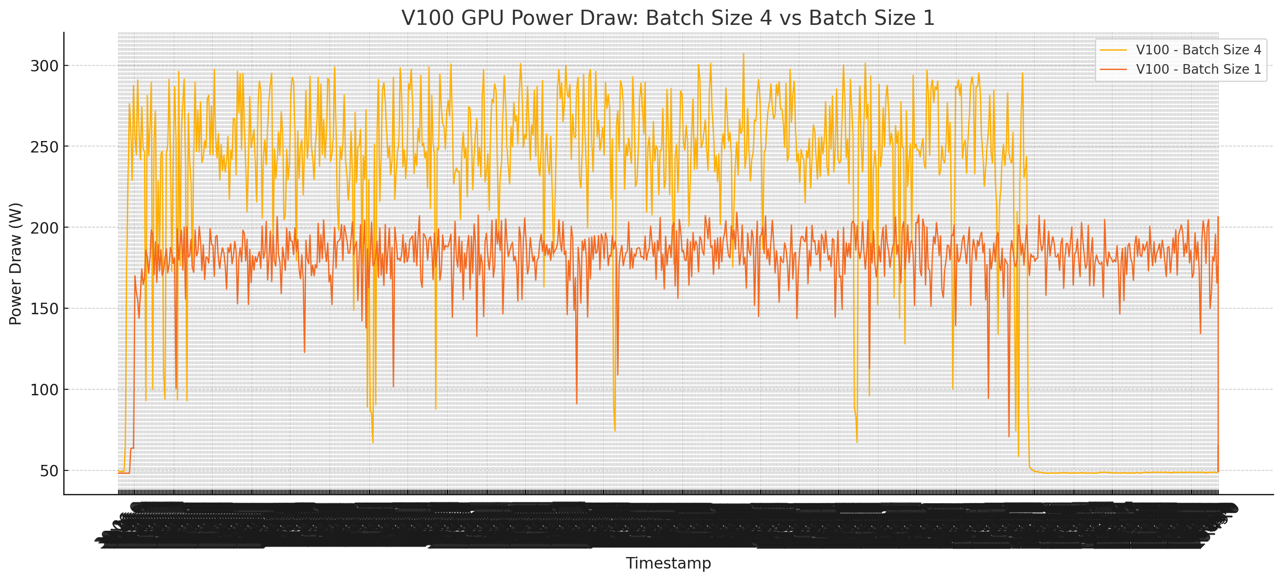
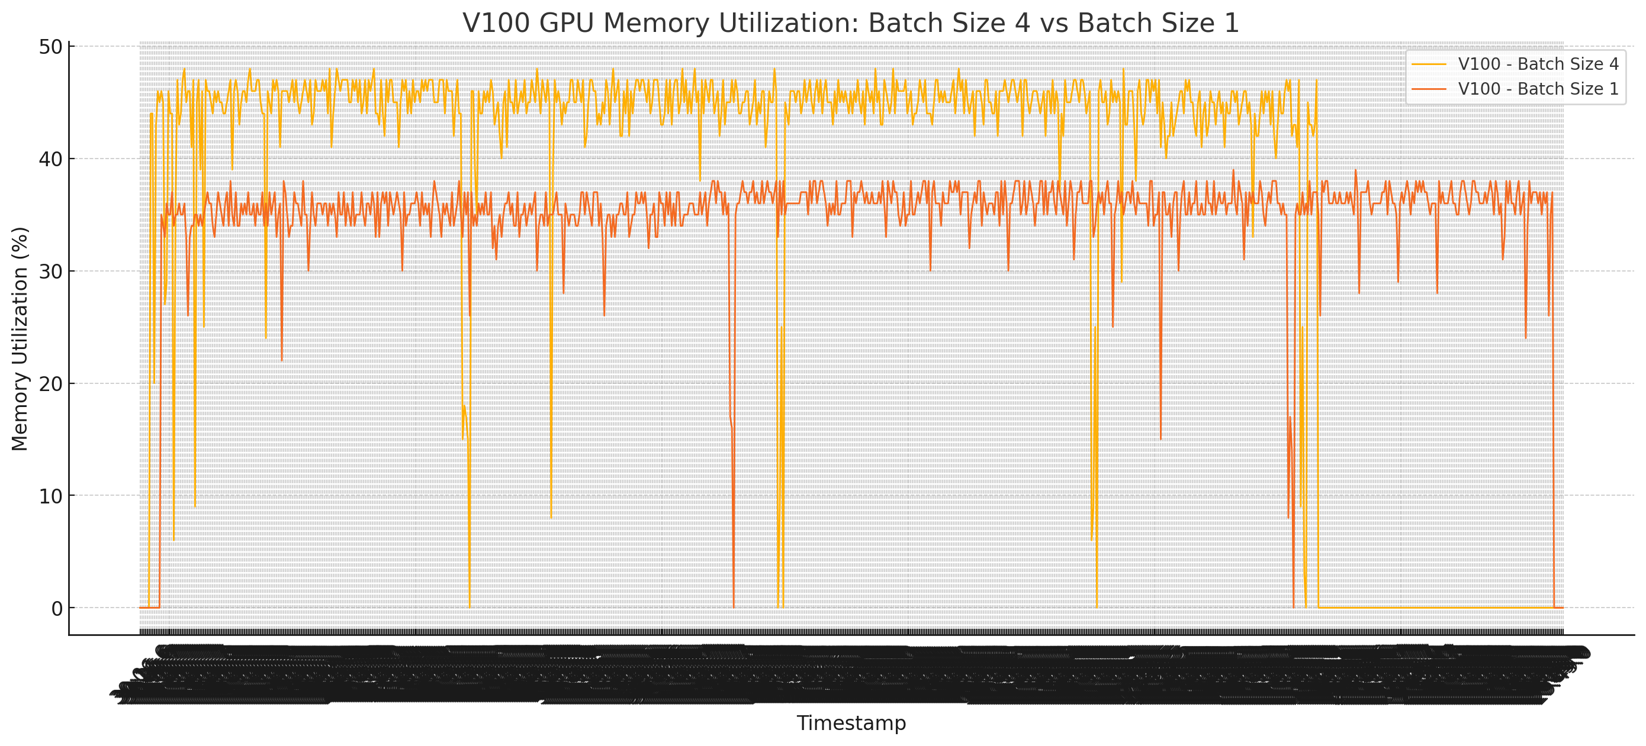
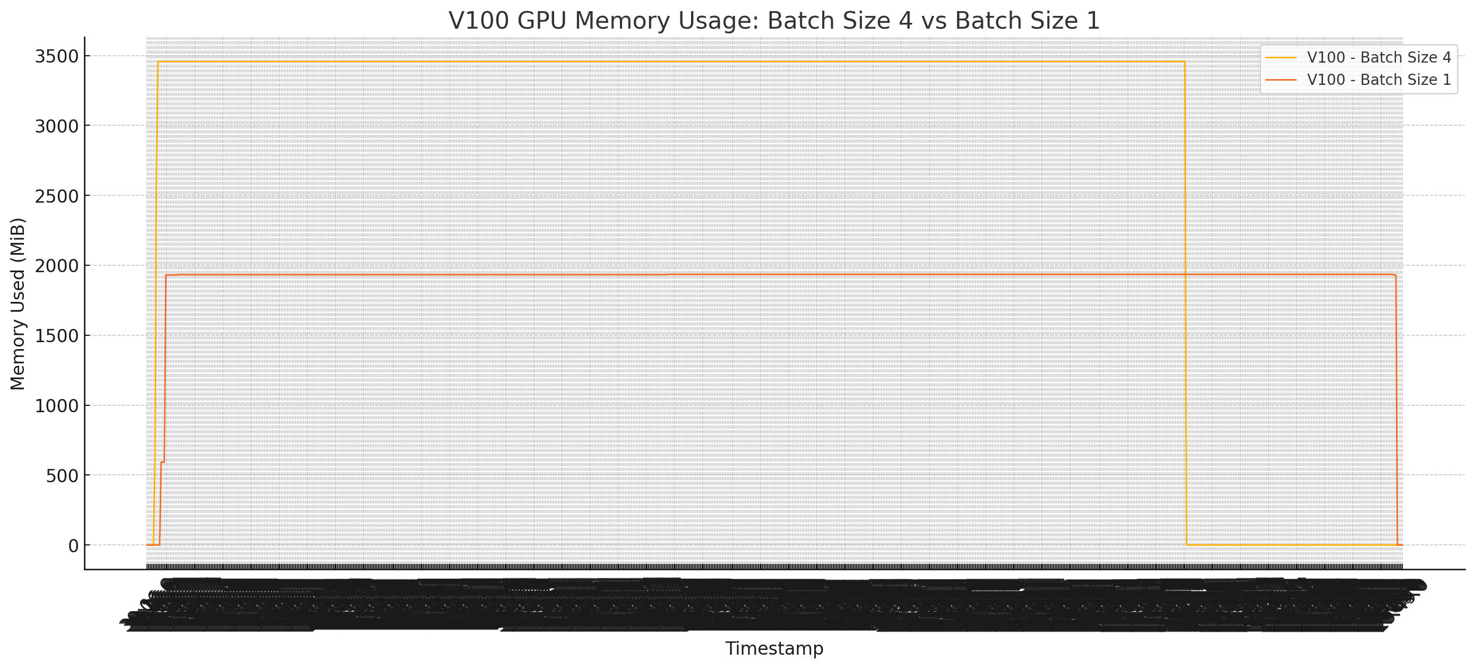
Continued .. V100 Analysis
Fig(1). Throughput on P100 for SNSD
Fig(3). Throughput on P100 for DNS
Fig(2). Throughput on V100 for SNSD
Fig(4). Throughput on V100 for DNS

Slide 14
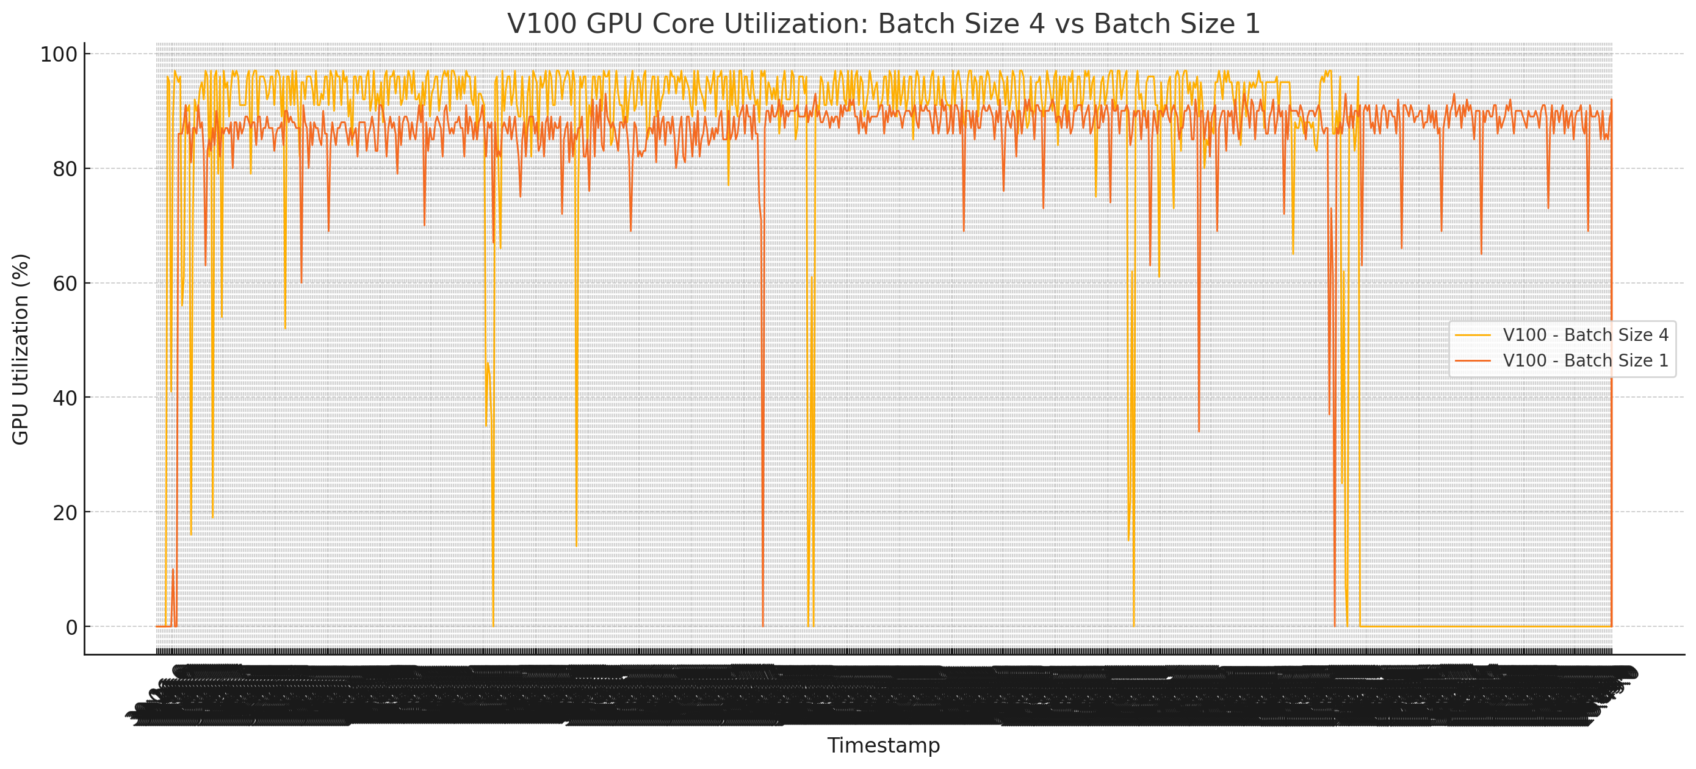
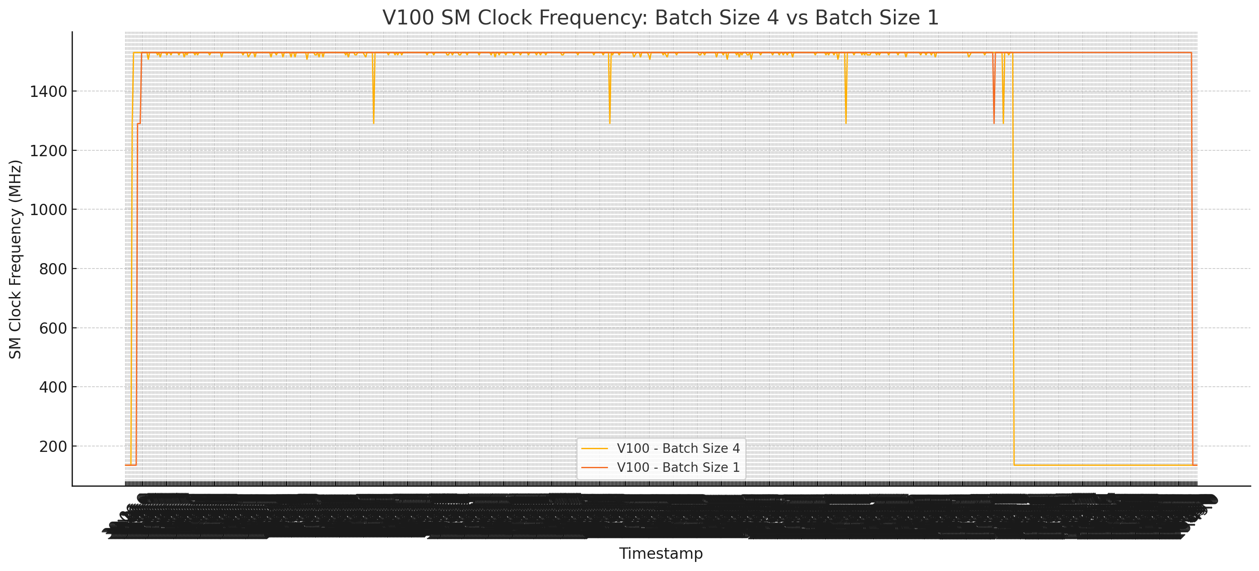
Continued ..
Fig(1). Throughput onP100 for SNSD
Fig(3). Throughput on P100 for DNS
V100 | B1 | B4
Temperature | 63 - 64 °C stable | 64 - 66 °C fluctuating
Power | 170 - 190 W, more stable | 250 - 300W, more spikes
Memory Utilization | 35 - 37% | 44 - 46%
Memory Used | 1900 MiB | 3400 MiB
GPU Utilization | 85 - 90%, fewer drops | 92 - 95%, frequent spikes
Clock | 1530 MHz, slightly lower | 1530 MHz, stable at max

Slide 15
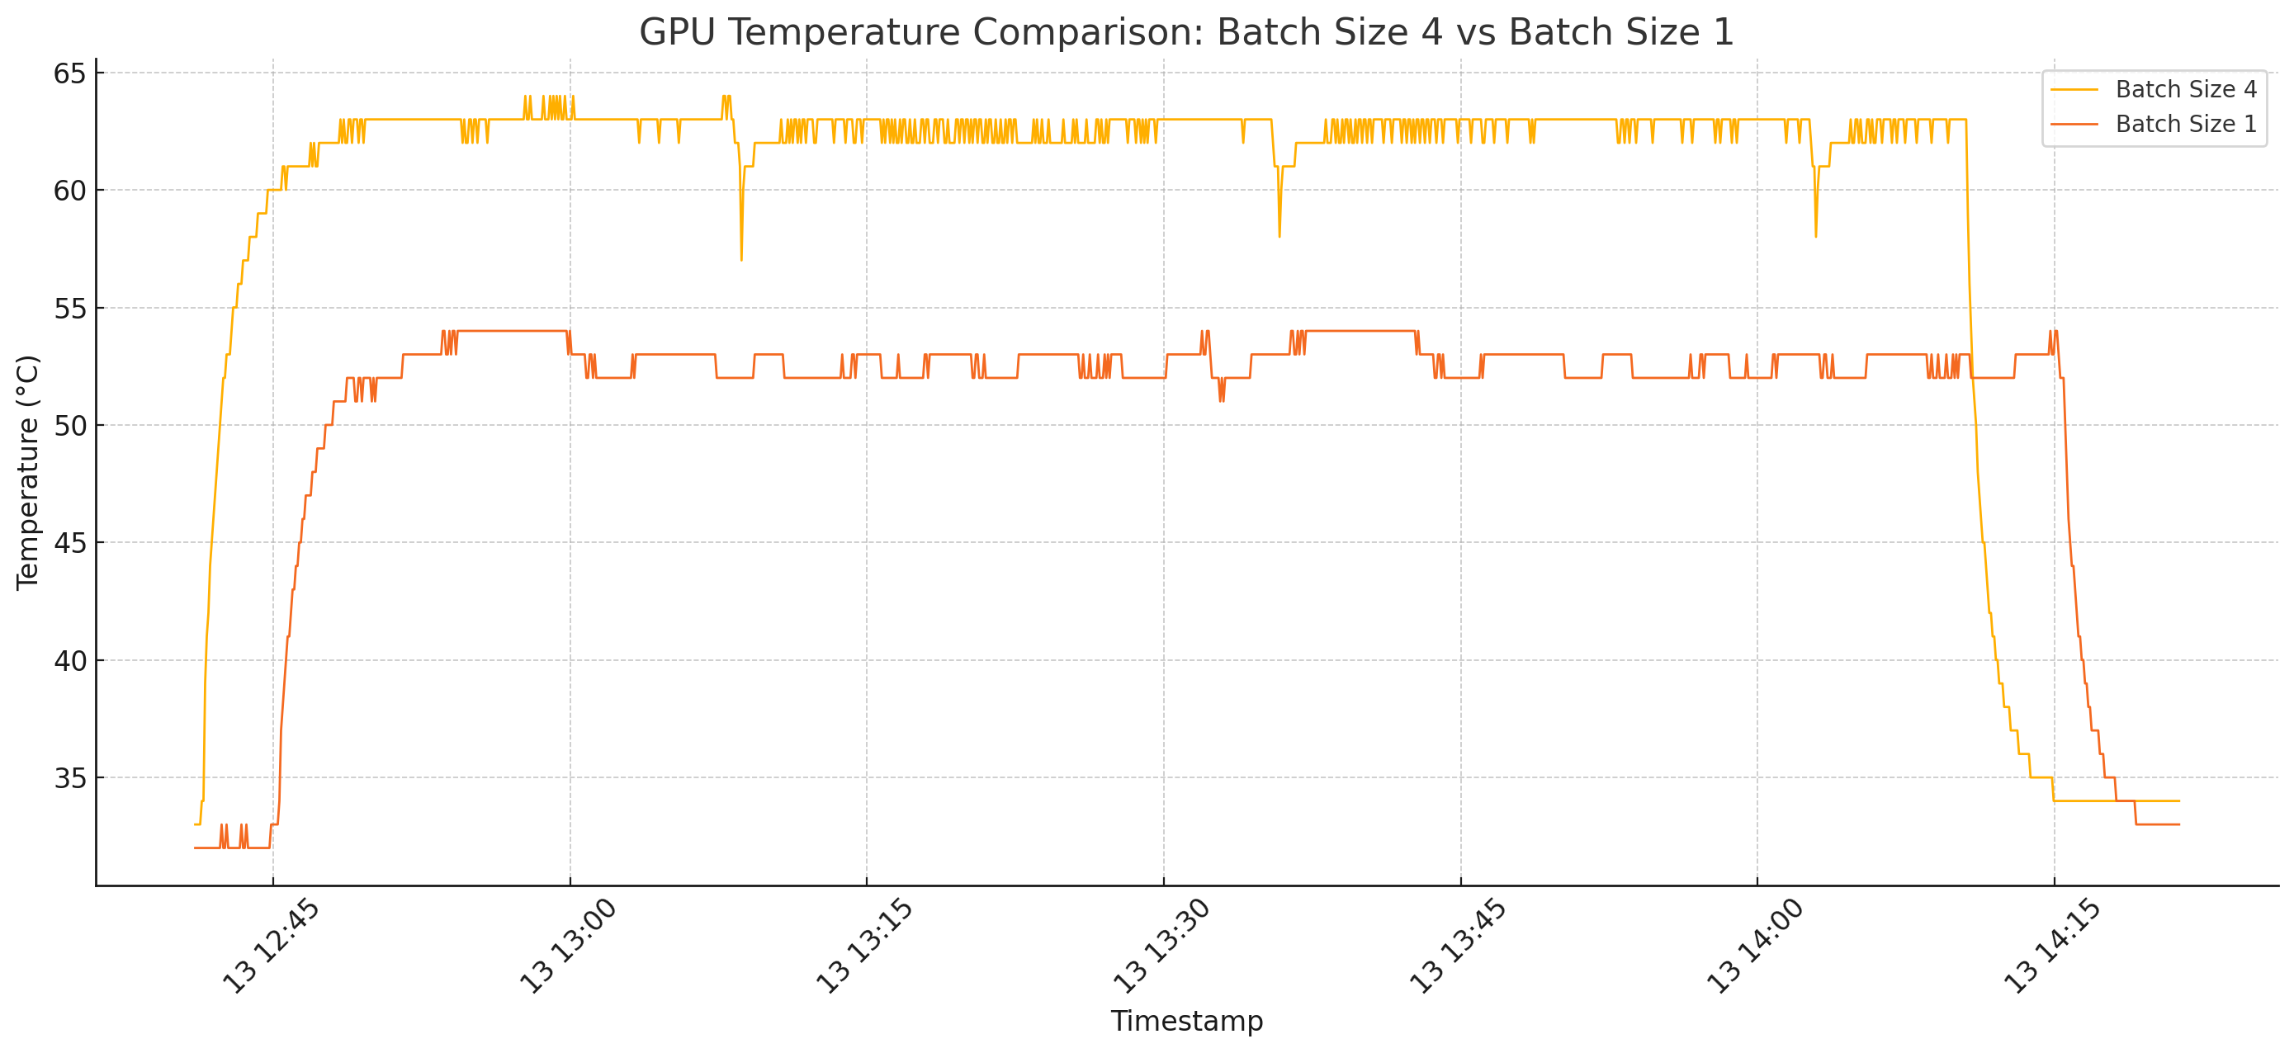
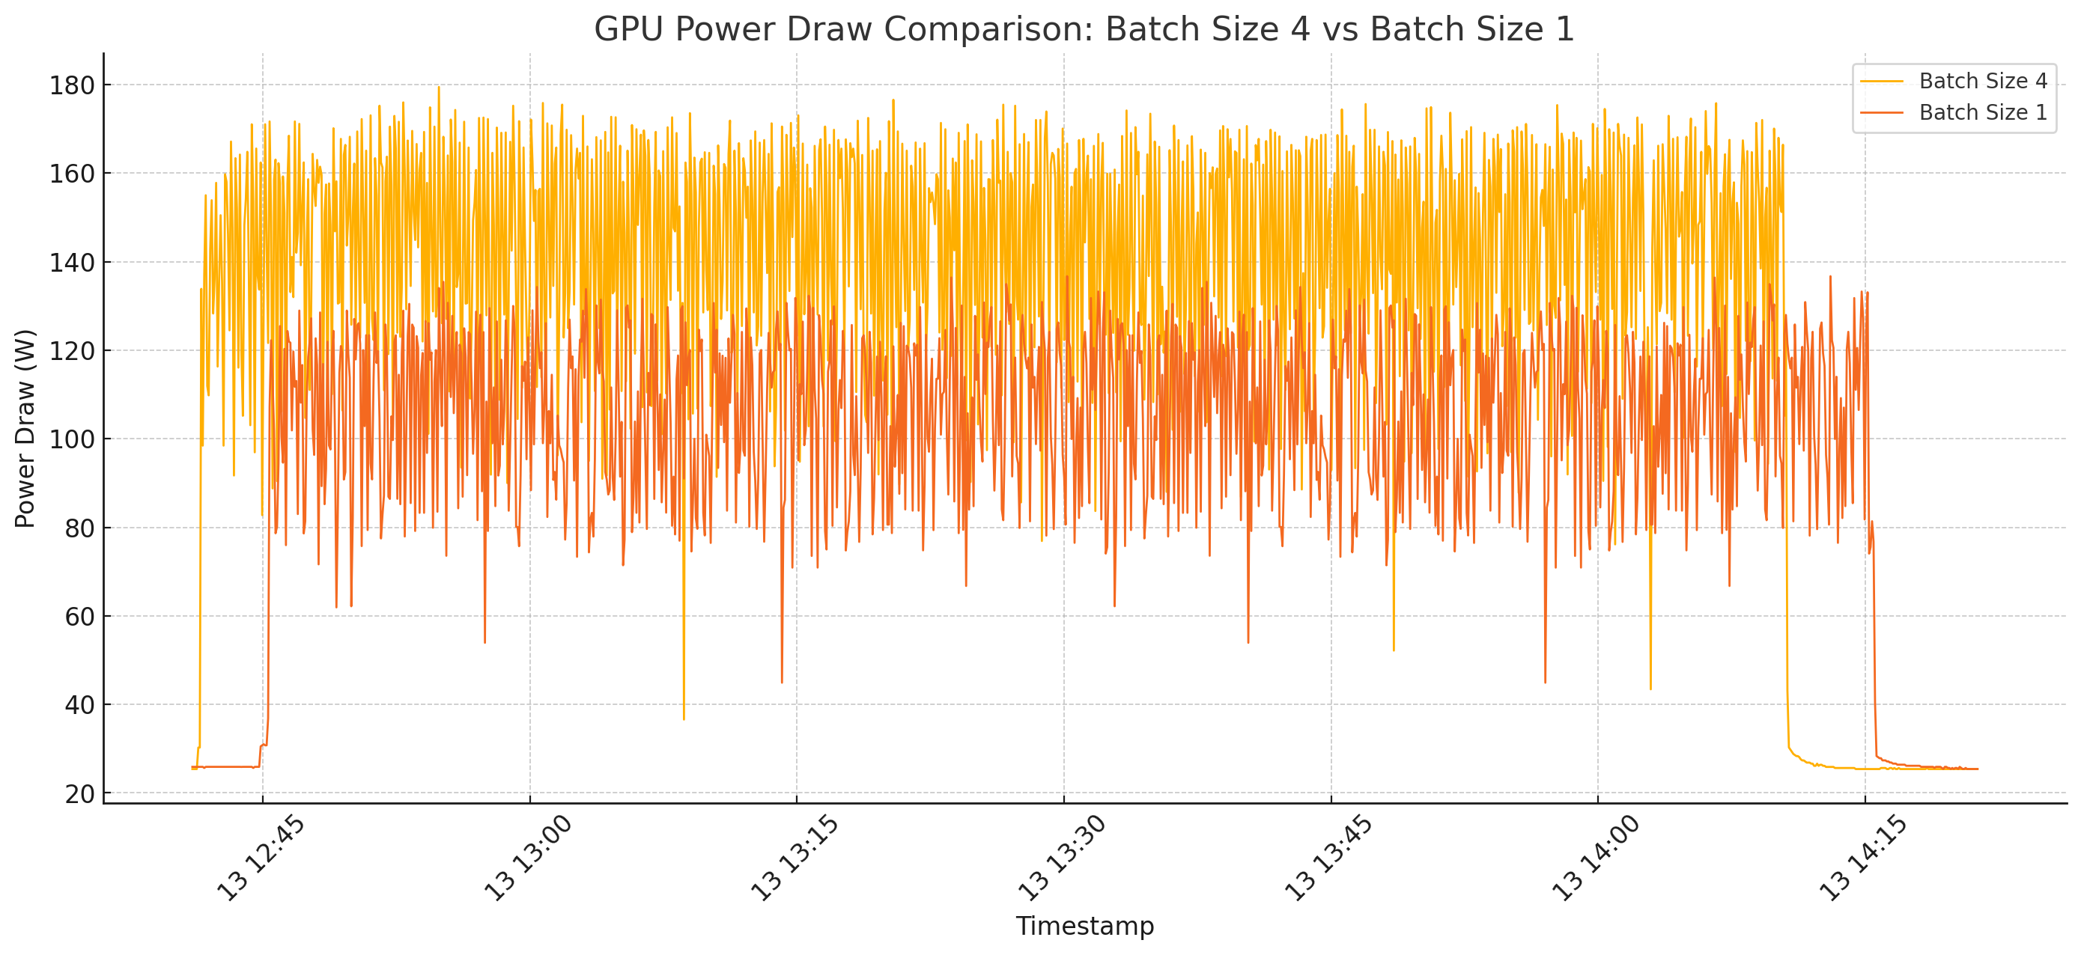
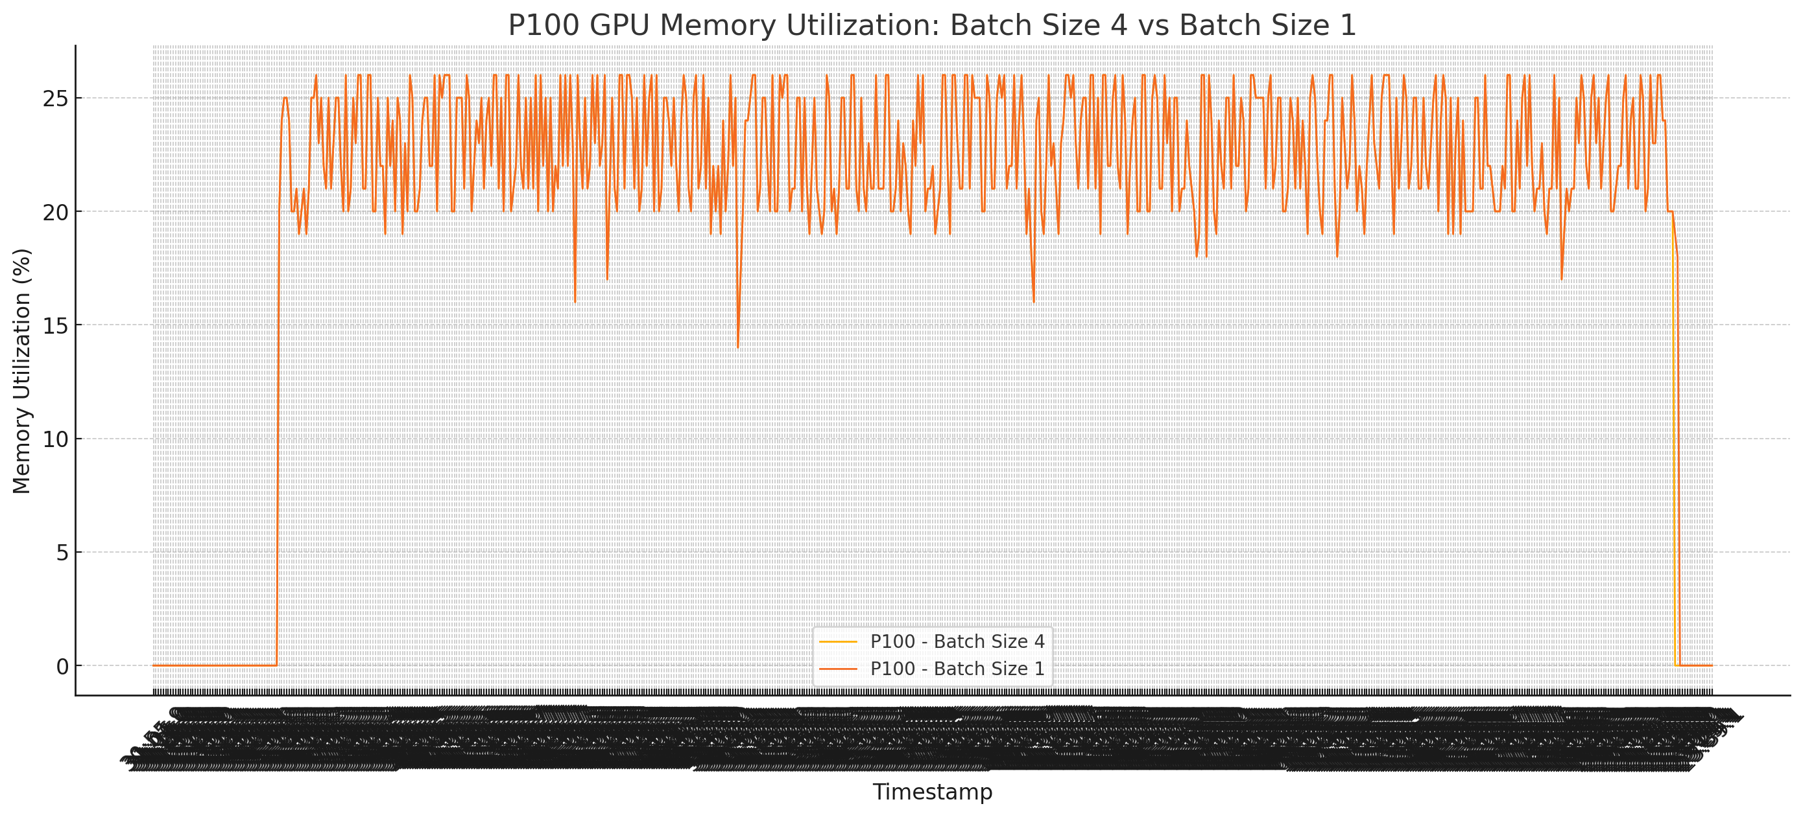
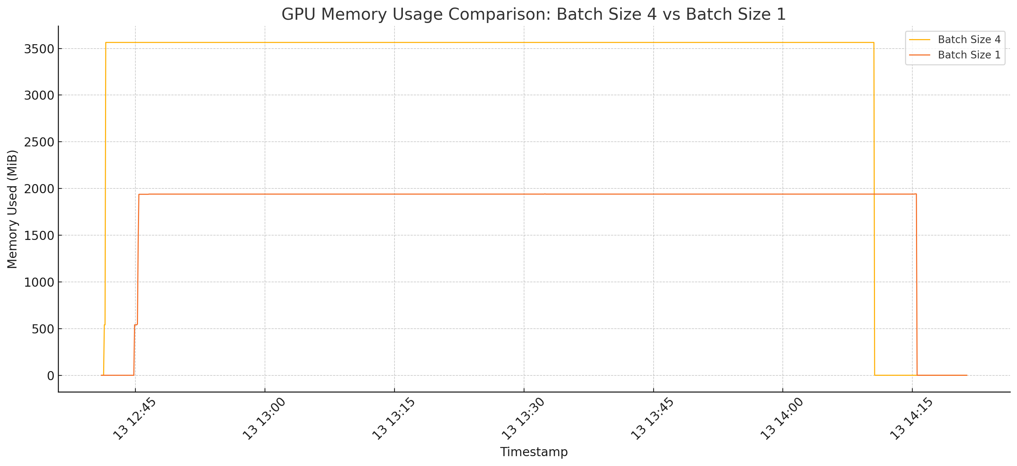
Continued .. P100 Analysis

Slide 16
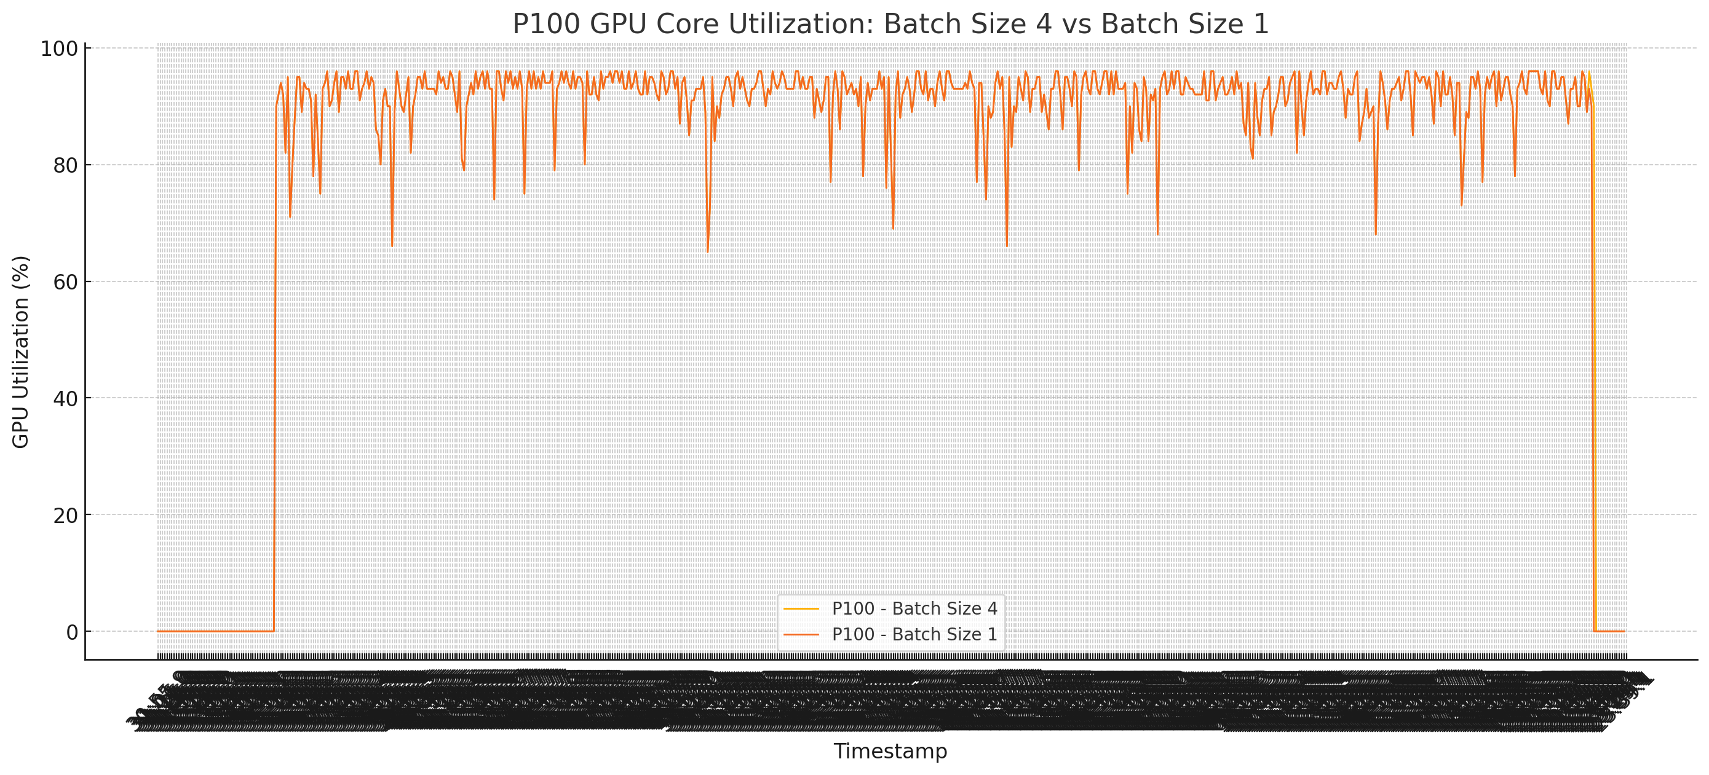
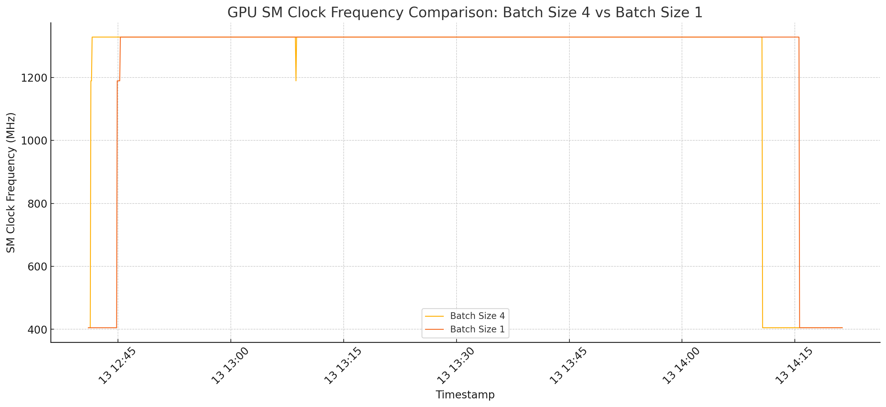
Continued .. P100 Analysis
P100 | B1 | B4
Temperature | 52 - 54 °C stable | 63 - 64 °C stable
Power | 100 - 130W, lower overall | 140 - 170W, more power draw
Memory Utilization | 22 - 26% | 26 - 27%
Memory Used | 1900 MiB | 3600 MiB
GPU Utilization | 90 - 95% | 92 - 96%
Clock | 1300 MHz, stable | 1300 MHz, stable

Slide 17
Final Comparison : P100 vs V100
P100 | B1 | B4
Temperature | 52 - 54 °C stable | 63 - 64 °C stable
Power | 100 - 130W, lower overall | 140 - 170W, more power draw
Memory Utilization | 22 - 26% | 26 - 27%
Memory Used | 1900 MiB | 3600 MiB
GPU Utilization | 90 - 95% | 92 - 96%
Clock | 1300 MHz, stable | 1300 MHz, stable
V100 | B1 | B4
Temperature | 63 - 64 °C stable | 64 - 66 °C fluctuating
Power | 170 - 190 W, more stable | 250 - 300W, more spikes
Memory Utilization | 35 - 37% | 44 - 46%
Memory Used | 1900 MiB | 3400 MiB
GPU Utilization | 85 - 90%, fewer drops | 92 - 95%, frequent spikes
Clock | 1530 MHz, slightly lower | 1530 MHz, stable at max

