Slide 1
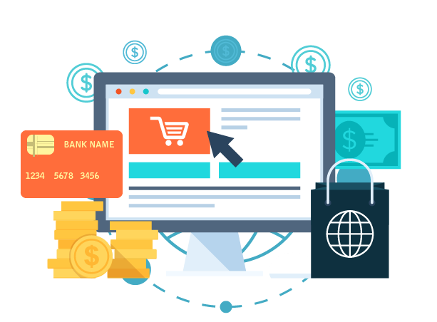



E-shop
…………………………
Presentation By:
Bisheshwor Neupane
Umesh Shrestha
Gaurab Shrestha
Prajwol Manandhar
…………………………
Easy shopping

Slide 2
introduction
ECOMMERCE
ABOUT ESHOP

Slide 3



WHAT IS ECOMMERCE?
Stands for Electronic Commerce
Refers to the buying and selling of goods or services using the internet
Describe any kind of commercial transaction that is facilitated through the internet

Slide 4

About eshop
Ecommerce site of B2C(Business to Consumer) model

Slide 5
features
Shopping cart
Online payment
Order tracking
Search option
Customer authentication(register , login and logout system)

Slide 6
objectives
To make a skeleton for easy-to-handle and easy-to-use B2C model of e-commerce site
Use least no. of module to build an e-commerce site
Increasing our proficiency with other programming languages like python, java-script, etc.

Slide 7





METHODS
The project can be divided into two parts:
Frontend
Backend

Slide 8
Backend
Django
A high level Python Web Framework
Encourages rapid development and clean and pragmatic design

Slide 9
Why Django?
Batteries included
Ridiculously fast
Reassuringly Secure
Exceedingly Scalable
Incredibly Versatile

Slide 10

FRONTEND
HTML
Bootstrap
CSS
jQuery

Slide 11
HTML
Hyper Text Markup Language
Markup language for creating web pages
Describes the structure of a web page
Tells the browser how to display elements

Slide 12
bootstrap
Open source toolkit for developing with HTML, CSS and JS
Popular framework for building responsive design

Slide 13

css
Stands for Cascading Styling Sheets
Describes the styles of an HTML documents
Can control the layout of multiple web pages

Slide 14
Fast, small and feature rich JavaScript library
Greatly simplifies JS programming
Enables HTML document traversal and manipulation
Helps for event handling and animations

Slide 15



PROBLEMS FACED DURING DEVELOPMENT
Could not debug backend of the cart
Adding search option was quite difficult at the beginning
Could not debug while adding the payment gateways
Could not link react.js with Django

Slide 16




FUTURE ENHANCEMENTS
Changing design pattern
adding online payment API like e-sewa
Implementing AI
Launching it to the market

Slide 17

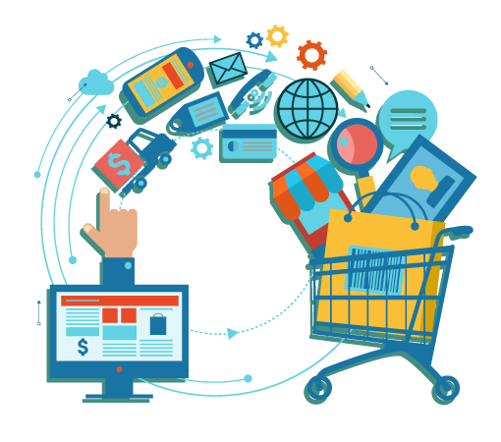
Thank you!

