Slide 1
Neurocritical Care Patient Outcome Predictor
BMES 550 - Advanced Computational Languages
Zack Goldblum
Josh Miller
Kevin Ramirez Chavez
MIMIC IV database: Johnson, A., Bulgarelli, L., Pollard, T., Horng, S., Celi, L. A., & Mark, R. (2022). MIMIC-IV (version 2.1). PhysioNet. https://doi.org/10.13026/rrgf-xw32.
Notes:
Kevin
- Title, your name(s) (last names are recommended/optional).
- If your project is based on a publication, include its reference.

Slide 2
Introduction
Problem Description
Patients at Neurocritical Care Units (NICU)s present a combination of unique conditions (predictors) which makes it hard for physicians to treat them with the appropriate action plan
In this work, some predictors are used and compared with the MIMIC database
Based on past, similar patient’s results a risk of mortality can be predicted
Motivation
Provide an alternative screening, predictive tool to predict the patient’s outcome after neurocritical care (Physicians can determine the appropriate action plan based on the outcome)
Notes:
Kevin
- Why are we studying this problem? What is the biomedical need? Public health stats, if available.

Slide 3

Introduction - Biology/Physiology
Patient data is collected in electronic medical records at hospitals
Age
Sex
Medication
Diagnoses
ICD code
Source: https://newsdailypaper.com/five-best-uses-of-emr-ehr-in-hospitals/
Notes:
Zack
- Describe the underlying biology/physiology/physics/computerScience.
- Find figures illustrating the system (remember to cite the sources).

Slide 4
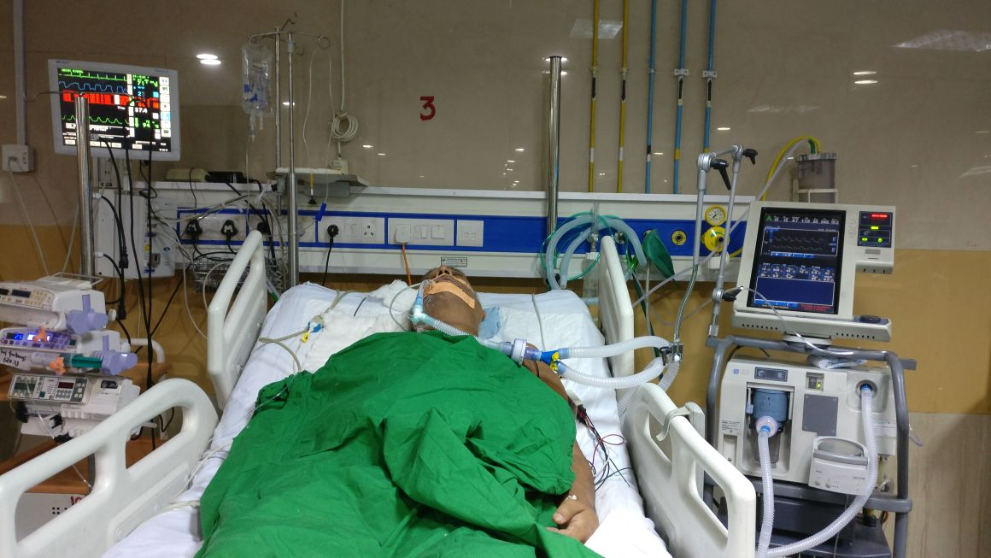
Introduction - Biology/Physiology
Neuro-ICUs use a number of devices to record physiological measurements
EEG, PbtO2, ICP, vital signs, etc.
No device gives the clinician a prediction of patient outcome
Source: https://currents.neurocriticalcare.org/blogs/currents-editor/
2018/09/18/current-status-of-neurocritical-care-in-india
Notes:
Zack
- Describe the underlying biology/physiology/physics/computerScience.
- Find figures illustrating the system (remember to cite the sources).

Slide 5
Introduction - Goals
The goal of our project is to develop a GUI application that will allow the physicians to predict the patient's good functional long-term outcome after neurocritical care (patients with brain injury).
The significance of this application is based on helping the decision-making for physicians to take pre-existing variables and results of a data-rich environment and provide alternatives to improve the risk of mortality as the final outcome after neurocritical care.
Notes:
Josh
- What do you/authors hope to find/accomplish with this study?
- Who are the target end users and use cases?
- If successful, how will your findings/result influence our understanding or medical practice?

Slide 6
Experiments and Methods
Utilized the Medical Information Mart for Intensive Care (MIMIC)-IV database
Sourced from two in-hospital database systems
~300,000 unique patients from 2008-2019
~70,000 ICU stays
> 300 million chartered observations
All data de-identified, stored in compressed CSV files
Notes:
Zack
- Describe the experiments/surveys that produced the datasets you are analyzing in your project.
- Describe your analysis workflow. e.g, normalization, types of statistical tests, thresholds, etc.
- Describe the methods and software you used. Describe any third party library/tool/module you utilized. If we covered it in the course, you do not need to go into detail.

Slide 7
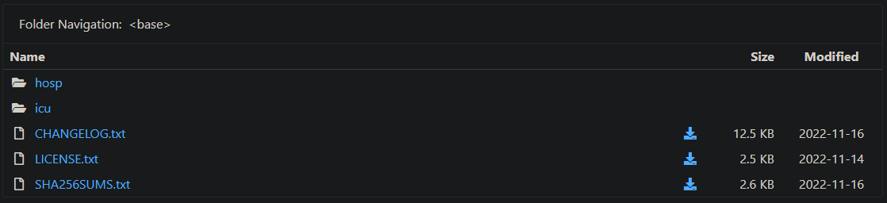
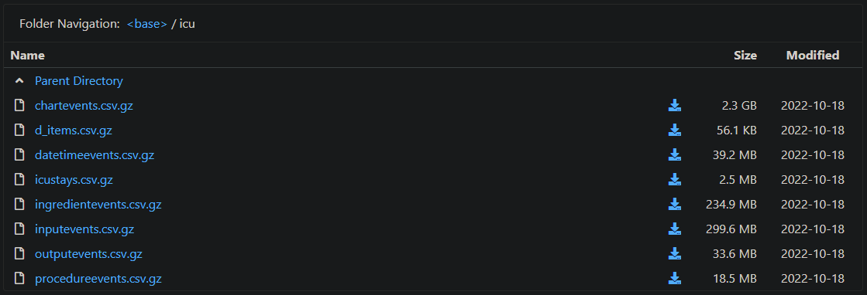
Experiments and Methods
hosp: hospital-wide electronic health records
icu: ICU-specific clinical information system
Notes:
Zack
- Describe the experiments/surveys that produced the datasets you are analyzing in your project.
- Describe your analysis workflow. e.g, normalization, types of statistical tests, thresholds, etc.
- Describe the methods and software you used. Describe any third party library/tool/module you utilized. If we covered it in the course, you do not need to go into detail.

Slide 8
Database Schema
This is a simplified version from the original database. This schema includes our targeted datasets and variables for this project. The simplification was made to avoid having issues with memory or during its processing. However, additional datasets and/or variables can be integrated for future work.
patients
subject_id INTEGER
gender VARCHAR (1)
anchor_age INTEGER
pharmacy
subject_id INTEGER
medication TEXT
admissions
subject_id INTEGER
deathtime VARCHAR (30)
d_icd_diagnoses
icd_code INTEGER
long_title TEXT
diagnoses_icd
subject_id INTEGER
icd_code INTEGER
icustays
subject_id INTEGER
first_careunit VARCHAR (60)
Original database: https://physionet.org/content/mimiciv/2.1/
Notes:
Kevin
- Using an ER diagram, show and describe the database schema.

Slide 9
Experiments and Methods - Workflow
MIMIC-IV
SQL databases
Centralized patient database
Clinician inputs patient info in the GUI
Predict patient outcome
Downloaded and decompressed selected MIMIC-IV CSV files
Converted the selected CSV files into SQL databases
Combined the SQL databases into one SQL database where each row has a unique subject ID and all applicable information for that subject
A clinician enters the current patient’s info into the GUI
Compare the entered patient information to our database using k nearest neighbors and return the averaged outcome of the 100 most similar patients
Notes:
Josh
- Say how we weighted the variables. We ranked it on the relative predictive power.

Slide 10
Experiments and Methods - Software
7zip: decompressing the MIMIC-IV database gzip files
SQL: centralized patient database
wxFormBuilder: GUI design
Python: processing, analysis, and implementation
pandas
numpy
wxPython
Jupyter notebook
Notes:
Zack
- Describe the experiments/surveys that produced the datasets you are analyzing in your project.
- Describe your analysis workflow. e.g, normalization, types of statistical tests, thresholds, etc.
- Describe the methods and software you used. Describe any third party library/tool/module you utilized. If we covered it in the course, you do not need to go into detail.

Slide 11
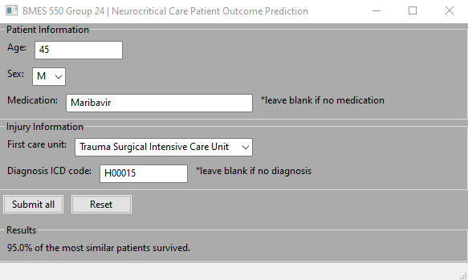
Results - Demonstration time!
Notes:
Zack
- Demonstrate your application.
- If this is a data analysis project, show your main findings.
- Use figures (e.g., bar charts) instead of tables to present your results.
- If applicable, compare your results to those from related publications.

Slide 12
Results - Comparison to other neurocritical care studies
Our method typically predicts a 5%-10% chance of death
Other large-scale neurocritical care surveys found:
12% mortality rate¹
9% mortality rate²
Note, these do not use the MIMIC-IV dataset
Sources: [1] https://doi.org/10.1007/s12028-019-00835-z
[2] https://doi.org/10.1097/01.ccm.0000146132.29042.4c
Notes:
Zack
- Describe the experiments/surveys that produced the datasets you are analyzing in your project.
- Describe your analysis workflow. e.g, normalization, types of statistical tests, thresholds, etc.
- Describe the methods and software you used. Describe any third party library/tool/module you utilized. If we covered it in the course, you do not need to go into detail.

Slide 13
Discussion
Limitations
For each variable that has the potential of multiple entries (i.e. diagnosis or medications) our GUI only provides the option for one diagnosis and one medication entry at a time
Since the dataset is not specific to one type of diagnosis, the less critical diagnoses may inflate the survival rate of the sample entry above the normal survival rate for those diagnosed with a specific condition
The similarity_search function may take an unreasonable amount of time with larger databases
Future Improvements/Work
Include the option in our GUI and similarity_search function to take multiple arguments for medication and diagnosis inputs and adjust the similarity score accordingly
Test the methodology on different neurocritical care datasets to see if the survival rate calculated is comparable to real-world survival rates
Include physical measurements typical in neurophysiology examinations into our methodology
Notes:
Josh
- If this is an analysis project, do your results make sense biologically? Find studies that support your findings. (E.g., you found 10 genes in your Alzheimer's dataset analysis, check literature to see if these genes are known for their involvement in Alzheimer's).
- What are the limitations of your study?
- What follow up studies can be performed to improve upon your findings or to extend your method/application?

Slide 14
Thank you!
All comments, suggestions and/or questions are welcome
Notes:
Everyone

