Slide 1
Predicting Crohn's Disease using Terminal Ileum Tissue Samples
Group 10: Daniel, Dhwanil, Radiyana

Slide 2
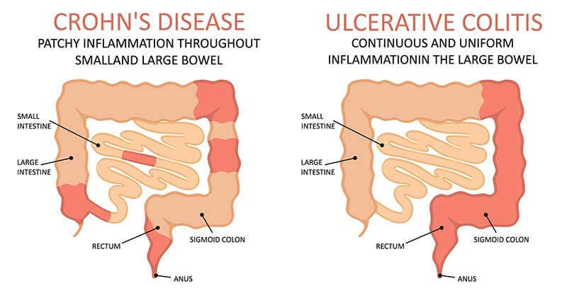
Need
Chronic gastrointestinal inflammatory condition that can result in lesions throughout the gastrointestinal tract [1]
More than half million in US have Crohn’s disease [2]
Becoming more common
Symptoms: diarrhea, abdominal pain, rectal bleeding, fever, fatigue, and weight loss
Not deadly but could lead to anemia, pulmonary embolism or colorectal cancer [1,3]
Estimated annual economic burden to U.S. health care is $6.3 billion

Slide 3
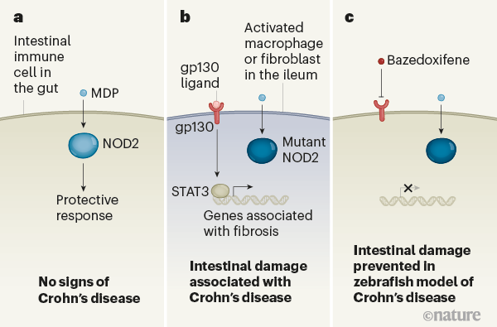
Biology/ Physiology
Increase in immune response by macrophages
Phagocytosis, antigen presentation, and cytokines production
Genetic factors
Mutations in genes involved in immune system functions such as NOD2, ATG16L1, IL23R, IRGM
Environmental and lifestyle factors
Smoking, oral contraceptive use, antibiotic use, regular use of nonsteroidal anti-inflammatory drugs, and urban environment

Slide 4
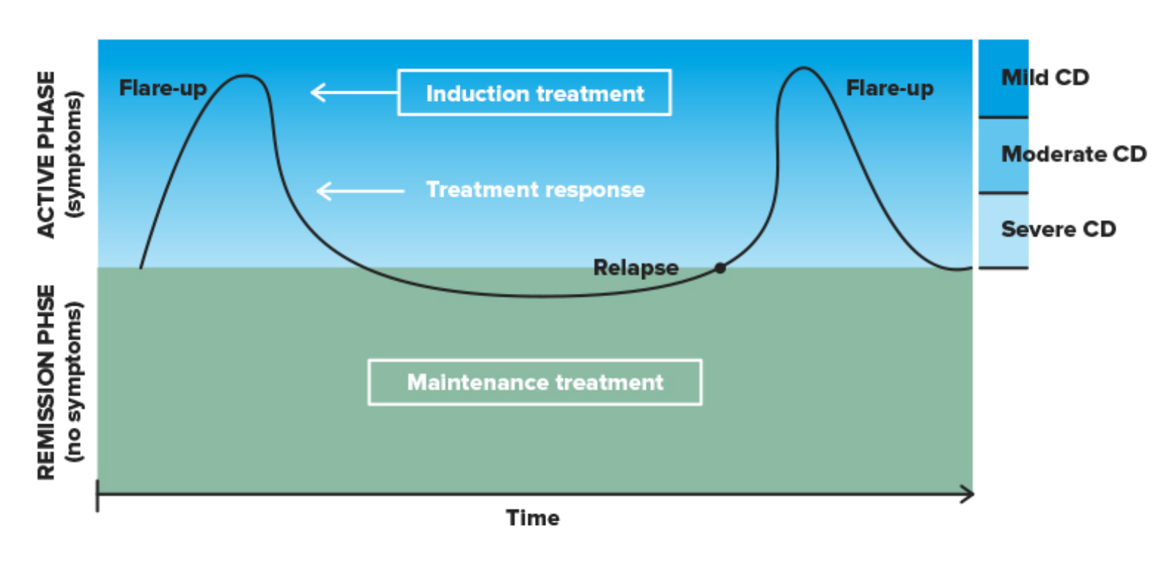
Goals
Identity gene of interest used to identify Crohn’s disease
Evaluate different feature selection methods
Evaluate different machine learning models
Inflammatory pathways that are regulated can be used to determine which drug to administer to improve remission

Slide 5
The Datasets
Treatment medications include corticosteroids, immunomodulators, and Biologics (anti-TNF or anti-interleukin agents)
Ustekinumab: anti-interleukin; targets IL-12 and IL-23
Anti-tumour necrosis factor α (TNFα) therapy: targets TNF
Train
GSE112366 - 141 W0 patients with CD, 28 control patients
GSE179285 - 177 patients with CD, 58 control patients
Test
GSE112366 - 132 W8 patients with Ustekinumab
GSE112366 - 89 W44 patients with Ustekinumab
GSE52746 - 12 CD patients with anti-TNFα, 10 CD patients without anti-TNFα, 17 control patients

Slide 6
Methods
SVM
All Gene - Feat Selection/ No FS - Validation Set and Drug Sets
Sig genes - FS / No FS - Validation Set
Perform Target Enrichment
Download and Import Data
Perform Z-Norm GSE52746
Save to Pickle Format
Random Forest
All Gene - No FS - Validation Set and Drug Sets
Sig genes - No FS - Validation Set
Create Models
Split GSE112366 Into 3 Sets: Wk 0, 8, 44
Perform DGE Analysis:
P-Value = 0.05
Fold Change = 1.5
Apply Variance Filter (Top 100) to All Genes
Logistic Regression
All Gene - Feat Selection/ No FS - Validation Set and Drug Sets
Sig genes - FS / No FS - Validation Set
Perform Z-Norm 112366 and 179285
Aggregate Data
All Genes (14,796) vs Sig Genes (82)
Perform Target Enrichment

Slide 7
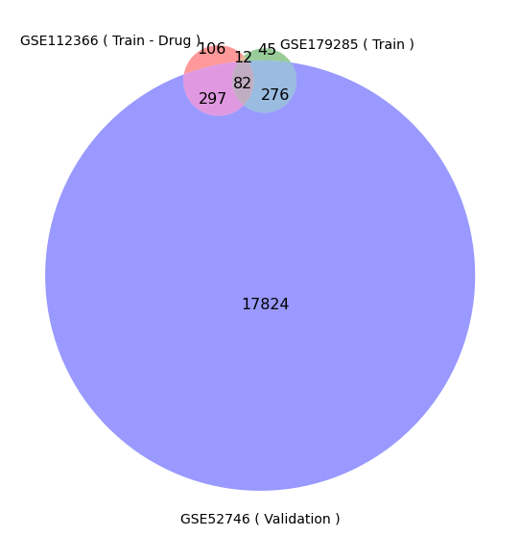
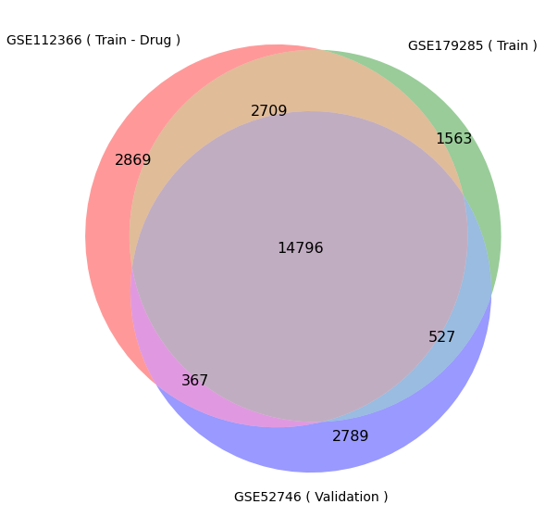
Results
Similar Genes Between All GSE
Similar Significant Genes Between All GSE

Slide 8
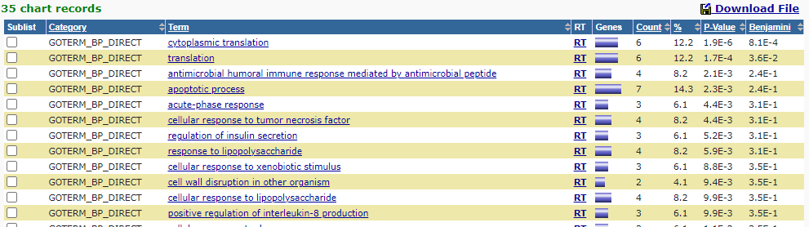
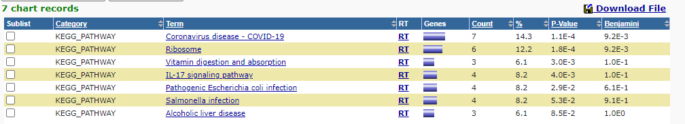
Target Enrichment Using DAVID- Feat Selection

Slide 9
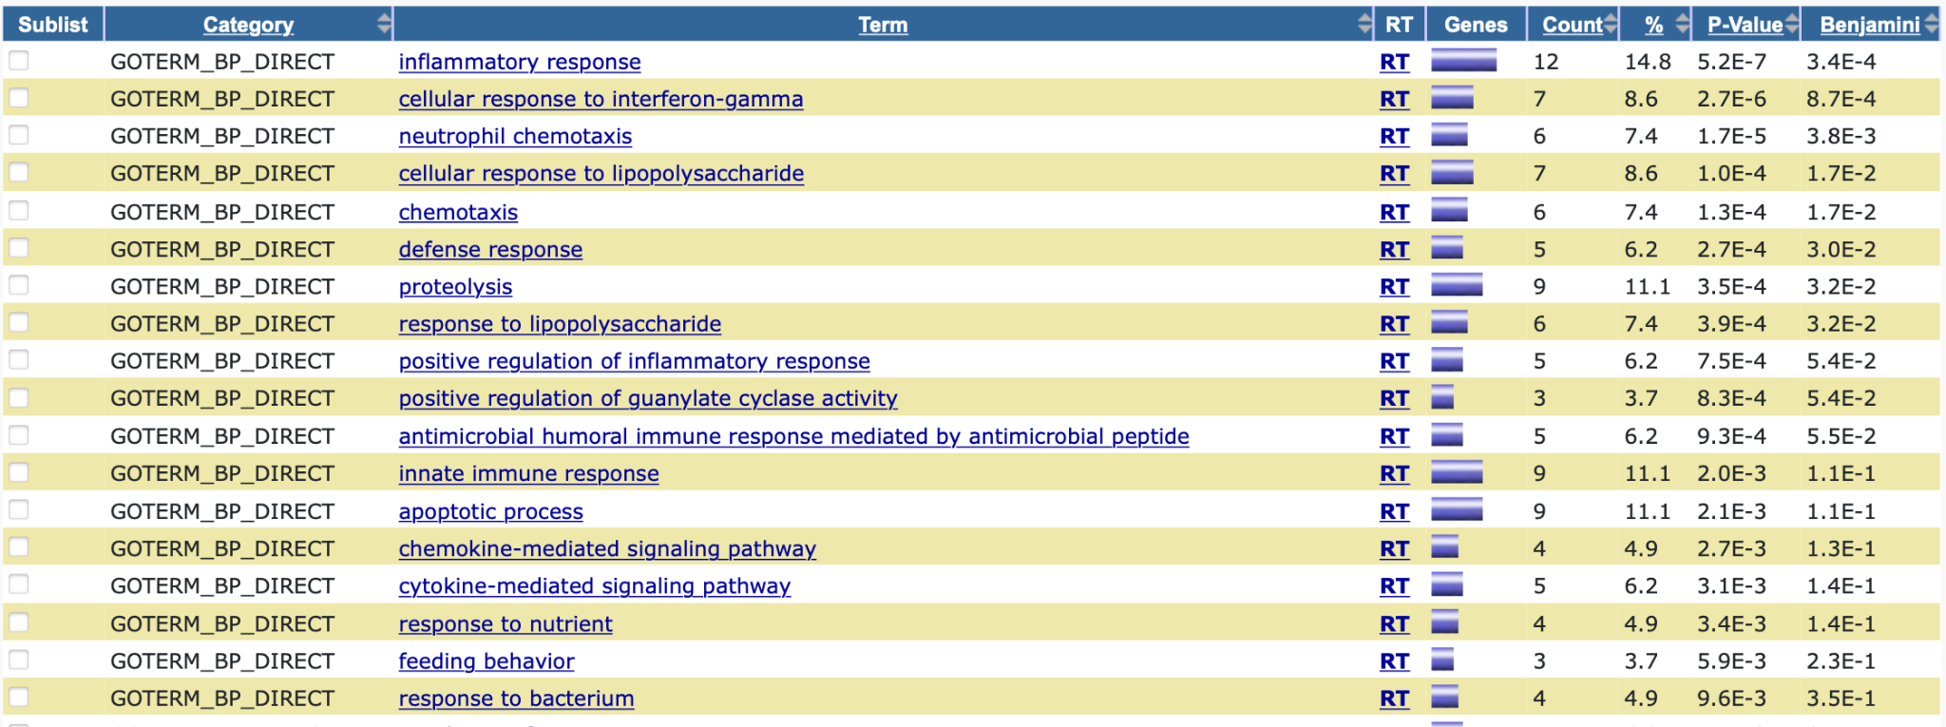
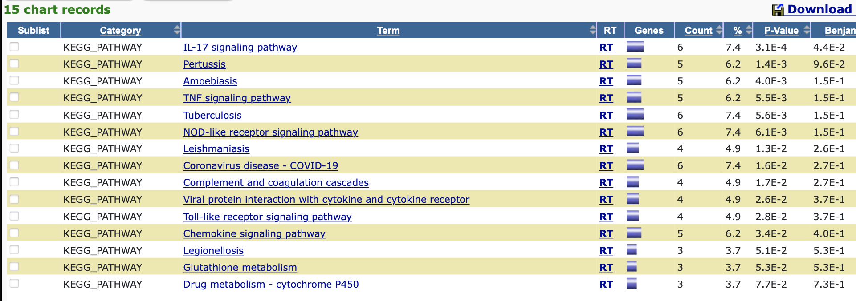
Target Enrichment Using DAVID- Sig Genes

Slide 10
Results - Compare Significant Genes to Feature Selection Genes
Significant genes found in All Gene set after variance filter
Significant genes found in feature selection for SVM All Gene set
Significant genes found in feature selection for log reg All Gene set
Significant genes found in feature selection for SVM Sig Gene set
Significant genes found in feature selection for log reg Sig Gene set
NOS2
CHP2
KCNJ13
SLC10A2
LCN2
FOLH1
CEACAM6
NOS2
LCN2
FOLH1
NOS2
CHP2
LCN2
FOLH1
NOS2
CHP2
LCN2
FOLH1
NOS2
Within Random Forest Feature Selection Top 10
NOS2
LCN2
FOLH1

Slide 11
Results - Feature Selection
NOS2 - Higher Activity of the Inducible Nitric Oxide Synthase Contributes to Very Early Onset Inflammatory Bowel Disease
LCN2 - Lipocalin-2 Is a Disease Activity Marker in Inflammatory Bowel Disease Regulated by IL-17A, IL-22, and TNF-α and Modulated by IL23R Genotype Status
FOLH1 - FOLH1/GCPII is elevated in IBD patients, and its inhibition ameliorates murine IBD abnormalities

Slide 12
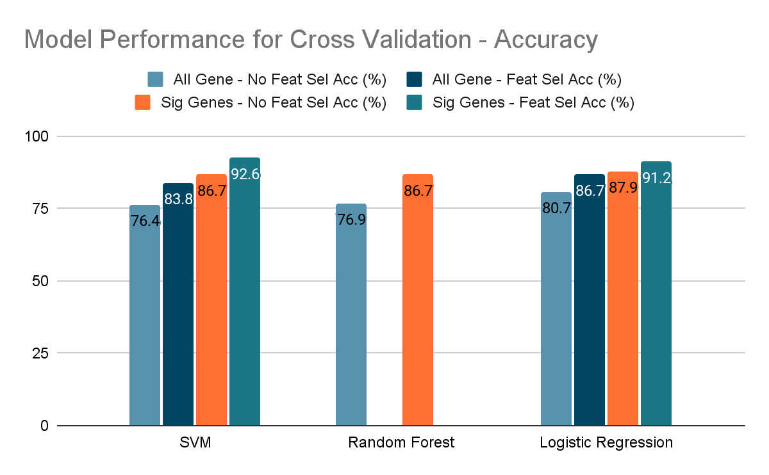
Results - Cross Validation Results

Slide 13
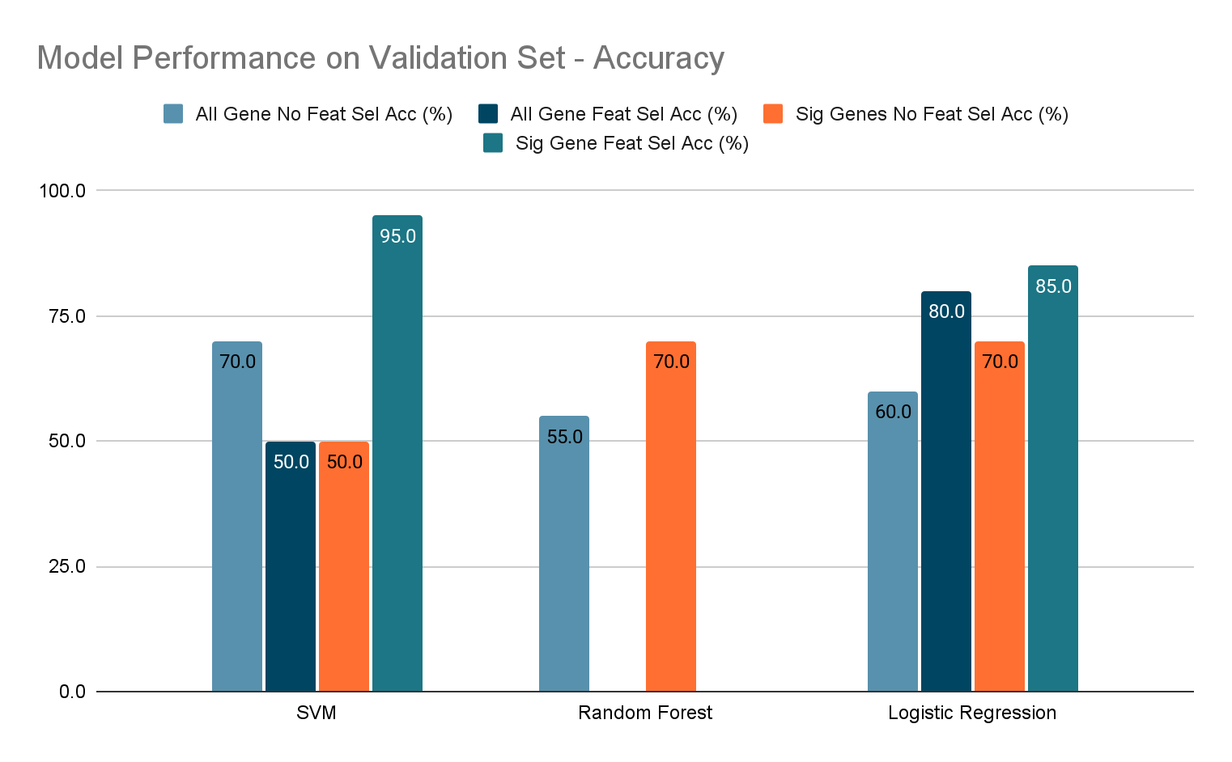
Results - Validation Set Results

Slide 14
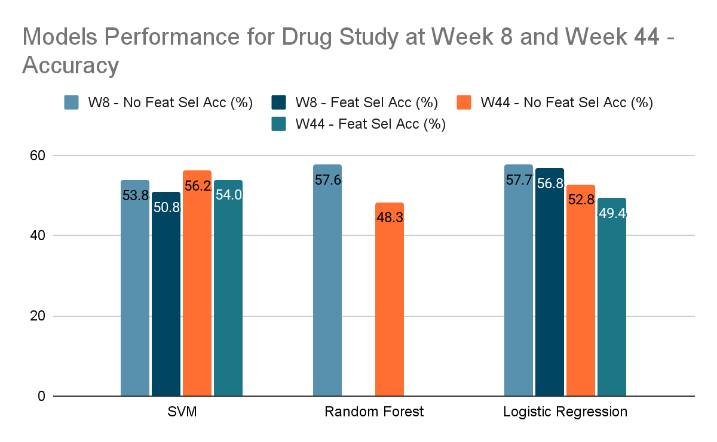
Results - Drug Study

Slide 15
Discussion
Conclusion:
3 significant genes found similar in all feature selection methods
Top genes FOLH1, LCN2, NOS2
Same three genes have been linked to Crohn’s but are not typically used as markers [5] [6] [7]
TNF and Interleukins commonly attributed to Crohn’s inflammation are not significant due to the treatment being effective
Eliminating genes used as features allows for models to perform better
Limitations:
All models showed poor prediction accuracy for WK8 and WK44 samples
No context for Crohn's disease activity index ≥100
Limited sample and control size
Multiple inflammatory pathways are available, each with different cytokine markers
Future Work:
Apply LASSO regression used in original paper and attempt to reproduce results
Optimize ML algorithm parameters

Slide 16
References
[1] Veauthier, B., & Hornecker, J. R. (2018). Crohn's disease: Diagnosis and management. American family physician, 98(11), 661-669.
[2] Kappelman MD, Moore KR, Allen JK, Cook SF. Recent trends in the prevalence of Crohn’s disease and ulcerative colitis in a commercially insured U.S. population. Digestive Diseases and Sciences. 2013;58:519–525.
[3] M D Wewer, M Zhao, A Nordholm-Carstensen, P Weimers, J B Seidelin, J Burisch, The Incidence and Disease Course of Perianal Crohn’s Disease: A Danish Nationwide Cohort Study, 1997–2015, Journal of Crohn's and Colitis, Volume 15, Issue 1, January 2021, Pages 5–13, https://doi.org/10.1093/ecco-jcc/jjaa118
[4] Liu, J. Z., & Anderson, C. A. (2014). Genetic studies of Crohn's disease: past, present and future. Best practice & research. Clinical gastroenterology, 28(3), 373–386. https://doi.org/10.1016/j.bpg.2014.04.009
[5] Rais, Rana et al. “FOLH1/GCPII is elevated in IBD patients, and its inhibition ameliorates murine IBD abnormalities.” JCI insight vol. 1,12 (2016): e88634. doi:10.1172/jci.insight.88634
[6] He, Manrong et al. “Machine learning gene expression predicting model for ustekinumab response in patients with Crohn's disease.” Immunity, inflammation and disease vol. 9,4 (2021): 1529-1540. doi:10.1002/iid3.506
[7] Dhillon, Sandeep S et al. “Higher activity of the inducible nitric oxide synthase contributes to very early onset inflammatory bowel disease.” Clinical and translational gastroenterology vol. 5,1 e46. 16 Jan. 2014, doi:10.1038/ctg.2013.17
[8] Jimenez, I. O., & Barrero, M. G. (2018, February 20). Inflammatory Bowel Disease Treatment | Hospital. Clínic Barcelona. https://www.clinicbarcelona.org/en/assistance/diseases/inflamatory-bowel-disease/treatment

Slide 17
References
[9] Kuno, Reiko et al. “Notch and TNF-α signaling promote cytoplasmic accumulation of OLFM4 in intestinal epithelium cells and exhibit a cell protective role in the inflamed mucosa of IBD patients.” Biochemistry and biophysics reports vol. 25 100906. 11 Jan. 2021, doi:10.1016/j.bbrep.2020.100906
[10]Lin, Ritian et al. “Clinical significance of soluble immunoglobulins A and G and their coated bacteria in feces of patients with inflammatory bowel disease.” Journal of translational medicine vol. 16,1 359. 17 Dec. 2018, doi:10.1186/s12967-018-1723-0
[11]Eder P, Łykowska-Szuber L, Krela-Kaźmierczak I, et al. Disturbances in apoptosis of lamina propria lymphocytes in Crohn's disease. Arch Med Sci. 2015;11(6):1279-1285. doi:10.5114/aoms.2015.54203
[12]Grimm, M C et al. “Interleukin 8: cells of origin in inflammatory bowel disease.” Gut vol. 38,1 (1996): 90-8. doi:10.1136/gut.38.1.90
[13]Schmitt, Heike et al. “Role of the IL23/IL17 Pathway in Crohn's Disease.” Frontiers in immunology vol. 12 622934. 30 Mar. 2021, doi:10.3389/fimmu.2021.622934
[14]Kilby, Kyle et al. “Micronutrient Absorption and Related Outcomes in People with Inflammatory Bowel Disease: A Review.” Nutrients vol. 11,6 1388. 20 Jun. 2019, doi:10.3390/nu11061388
[15] Sanchez-Munoz, Fausto et al. “Role of cytokines in inflammatory bowel disease.” World journal of gastroenterology vol. 14,27 (2008): 4280-8. doi:10.3748/wjg.14.4280

Slide 18
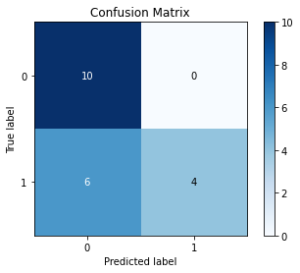
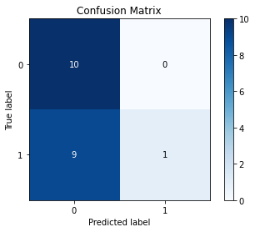
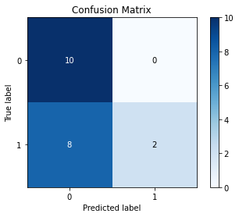
Appendix - Validation using GSE52746
Logistic Regression
SVM
Random Forest

Slide 19
Appendix - All Gene Accuracy
 | No Feature Selection |  | Feature Selection
Model | Cross Validation Accuracy (%) | Final Dataset Accuracy (%) | Cross Validation Accuracy (%) | Final Dataset Accuracy (%)
SVM | 76.4 | 70.0 | 83.8 | 50.0
Random Forest | 76.9 | 55.0 | NA | NA
Logistic Regression | 80.7 | 60.0 | 86.7 | 80.0

Slide 20
Appendix - Significant Genes Accuracy
 | No Feature Selection |  | Feature Selection
Model | Cross Validation Accuracy (%) | Final Dataset Accuracy (%) | Cross Validation Accuracy (%) | Final Dataset Accuracy (%)
SVM | 86.7 | 50.0 | 92.6 | 95.0
Random Forest | 86.7 | 70.0 | NA | NA
Logistic Regression | 87.9 | 70.0 | 91.2 | 85.0

Slide 21
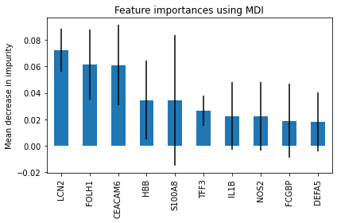
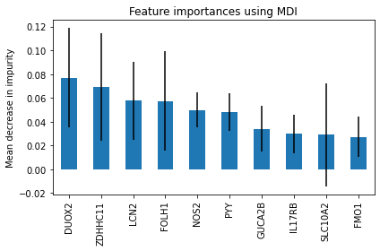
Appendix - Random Forest Features
All Gene Dataset
Significant Gene Dataset

