Slide 1
Metastatic Potential of Pancreatic Cancer Cells
Ahsan Sarwar, Nathan Ona, Sarthak Sharma

Slide 2
Problem description, Motivation
About 62,210 people will be diagnosed with Pancreatic Cancer every year [1]
Roughly 50,000 people die every year as a result every year [1]
Accounts for 70% of all cancer deaths[1]
Pancreatic ductal adenocarcinoma (PDAC) accounts for 90% of all Pancreatic Malignancies[2]

Slide 3
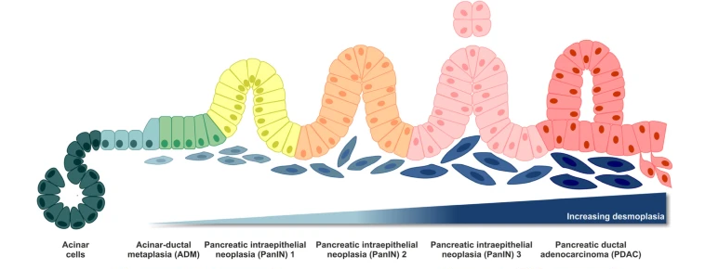
Introduction – PDAC Formation
Acinar cells from pancreas transform into pancreatic intraepithelial neoplasias (PanINs)
Drive uncontrollable cell growth, causing tumor formation
Occurs due to plasticity of the pancreas, which makes it more susceptible to mutations

Slide 4
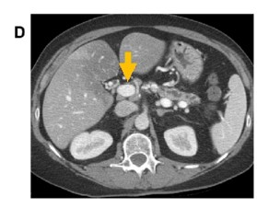
Introduction - Biology/Physiology
Main analysis is of pancreatic ductal adenocarcinoma (PDAC)
Current treatment plans:
Surgical resection – usually locally advanced, non resectable tumors
Chemotherapy – generally ineffective due to high radioresistance

Slide 5
Introduction - Goals
Identify
Identify significant biomarkers of metastasis in pancreatic cancer cells
Determine
Determine potential drug reposition frameworks to down-regulate most expressed genes between various data sets
Preform
Preform gene enrichment to discover relevant pathways and ontology terms
Notes:
What do you/authors hope to find/accomplish with this study?
If successful, how will your findings/result influence our understanding or medical practice?

Slide 6
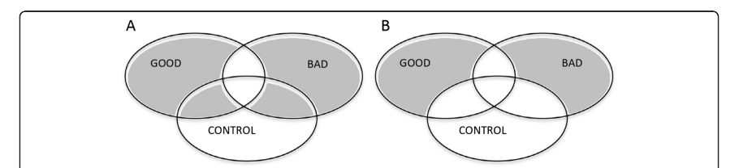
Dataset 1 GSE 42952
Microarray analysis on human pancreatic ductal adenocarcinoma
Three experimental groups : Good Outcome vs Bad Outcome vs Control
Outcome determined by Kaplan-Meir life table
Data was normalized using RMA normalization
4 control samples, 6 bad outcomes, 6 good outcomes
Total 54675 genes tested

Slide 7
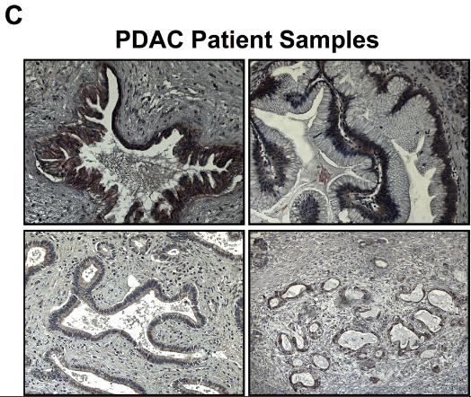
Dataset 2
Determine extent of chemoresistance and metastatic potential of PDAC stem cells
Evaluating side population (SP) tissue cells
Using Hoechst 33342 dye
Data was not publicly available, accessed upon special request of author
56 control samples, 135 cancer patients diagnosed with PDAC

Slide 8
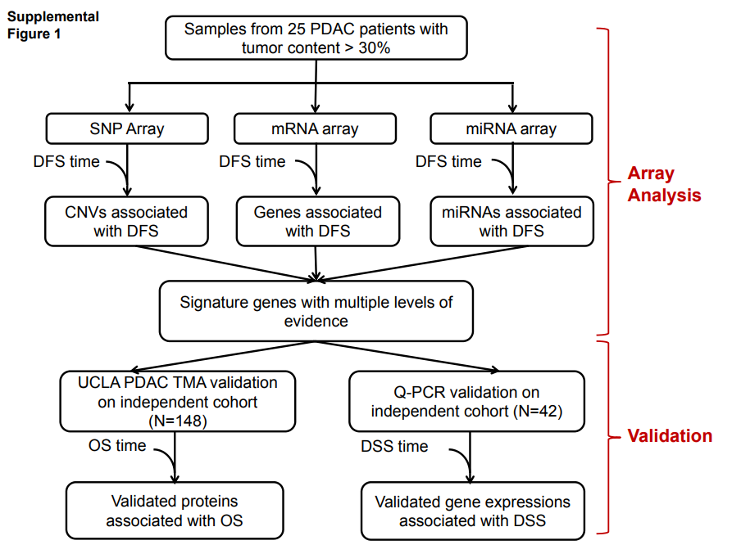
Dataset 3 GSE 32676
Better understand PDAC’s related pathways and ontology
Microarray analysis using Affymetrix HGU133 Plus 2
Mostly computational analysis, some later in vitro studies
Normalized using RMA normalization
7 control samples, 42 cancer patient samples

Slide 9
Methods
Data from all 3 datasets was normalized, and we confirmed that all data was in log scale
Cancer and Control data was segmented
Fold Change calculated (This provides the significantly different genes in cancer cells vs control)
Ttest to find significantly expressed genes in cancer cells
Additional analysis done on Dataset 1 to check the significantly differently expressed genes between good and bad outcome data
Notes:
Give an overview of your analysis workflow. What statistical tests / visualation / analysis methods did you use?
Briefly describe the methods. If you used the methods we covered in class, you can skip their description. Describe any modifications you made or options you had to set to make these methods work for your specific dataset.
You can tell us more about the method: if we did not cover the method(s) in class or if you used a variant of the method we covered.
Mention how these methods were implemented. Did you implement them yourself? Which programming library/tool/modules did you utilize?. If we covered it in the course, you do not need to go into detail.

Slide 10
Methods
Conducted a Hypergeometric test on datasets 1 & 3 to find most significant biological processes.
Most significant genes in Dataset 2 were run through DAVID Bioinformatic
Used Clue.io to find drugs that target the 100 most significant genes from each dataset
Notes:
Give an overview of your analysis workflow. What statistical tests / visualation / analysis methods did you use?
Briefly describe the methods. If you used the methods we covered in class, you can skip their description. Describe any modifications you made or options you had to set to make these methods work for your specific dataset.
You can tell us more about the method: if we did not cover the method(s) in class or if you used a variant of the method we covered.
Mention how these methods were implemented. Did you implement them yourself? Which programming library/tool/modules did you utilize?. If we covered it in the course, you do not need to go into detail.

Slide 11
Results
Dataset 1:
Their results: ITGB1 gene regulation increases chances of good outcome
Our result: EIFA – involved in tumor necrosis factor-mediated signaling pathway (immune response)
Dataset 2:
Their result: verapamil increases gene regulation of SP cells, could be used as a potential therapeutic
Our results: Marimastat – targets matrix metalloproteinases (MMPs) that are thought to be essential for angiogenesis and tumor metastasis
Dataset 3
Their result: p85α expression was associated with higher survival
Our result: HLA-DQA1 – provides instruction for making critical immune response proteins (Celiac disease research)

Slide 12
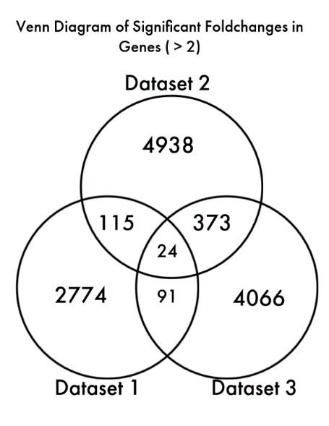
Results - Venn Diagram
Notes:
After calculating gene fold change, there was a questions about how many of these genes from one dataset overlapped with the other datasets. The answer to this questions would guide our data analysis. So we created a Venn diagram of the three datasets and found that across the three datasets each containing over 5,000 significant genes based on fold change, only 24 were shared across the three of them.

Slide 13
Results –Top Prospects for Drug Repurposing
Drug Name | Mechanism of Action | Target Gene(s) | Stage
marimastat | matrix metalloprotease inhibitor | MMP1, MMP10, MMP14, MMP7 | Phase 3
niflumic-acid | cyclooxygenase inhibitor | KCNQ1, PLA2G1B, UGT1A9 | Launched
bardoxolone-methyl | Nuclear factor erythroid-derived, like (NRF2) activator | PPARG, STAT3 | Phase 3
cholic-acid | bile acid | COX7A1, PLA2G1B | Launched
dexfosfoserine | membrane integrity inhibitor | CFTR, REG1A | Preclinical
Notes:
With the fold change data, we collected the top 100 genes from each data set and input them into Clue.io's drug repurposing tool. IT returend a list of drugs that targeted any of our entries. To rank the most effective drug for repurposing , we matched how many listed targets under that drug matched ones in the query and this table is the results.
Marimastat targets matrix metalloproteinases (MMPs) that are thought to be essential for angiogenesis and tumor metastasis
niflumic-acid is an anti-inflammatory agent used in the treatment of rheumatoid arthritis
bardoxolone-methyl studies on it have shown that it has caabilites to activate a regulator in cell response to oxidants and inhibit transcription factor NF-κB regulates multiple aspects of innate and adaptive immune functions and serves as a pivotal mediator of inflammatory responses

Slide 14
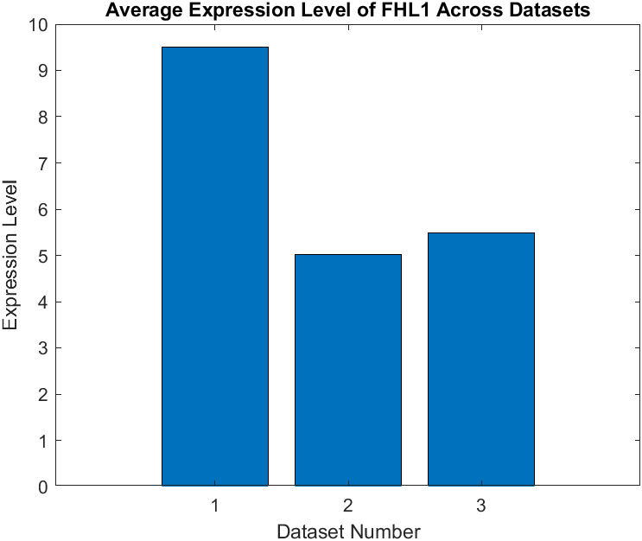
Results – Most Significant Gene Across Datasets
Notes:
There were 24 genes that were shared between the three datasets, so a search was conducted to find the first most regulated gene among all datasets. This shows the average expression of that gene, which is FHL1, a gene that provides instructors for the creation of skeletal and cardiac muscle.

Slide 15
Results - Hypergeometric Test
Pathway | P-Value
gene expression | 1.1E-06
response to stimulus | 5.8E-05
mRNA metabolic process | 1.1E-05
viral life cycle | 1.3E-05
nuclear-transcribed mRNA catabolic process, nonsense-mediated decay | 2.0E-05
SRP-dependent co-translational protein targeting to membrane | 3.7E-05
pattern specification process | 2.0E-04
cell morphogenesis | 2.4E-04
nucleic acid phosphodiester bond hydrolysis | 4.2E-04
detection of chemical stimulus involved in sensory perception of smell electronic annotation' | 7.3E-04
Notes:
A hypergeometric test was conducted using datasets 1 and 3 to see what biological processes are most significant in pancreatic cancer given the significant genes found between control and patient pancreatic cells. This image shows the top 10 pathways that these genes are likely to affect. Most of the pathways presented affect the function of individual cells from the formation of the cell to how the cells communicate and proliferate (mRNA).

Slide 16
Discussion
We were able to identify/repurpose a drug Marimastat
Our analysis was much different from any of the experimental data we used
We were unable to run a hypergeometric test on Dataset 2, and DAVID Bioinformatics suggested that the list of genes was referencing multiple species
Future improvements could include finding studies conducted with similar methods, larger sample size, and studies using the same gpl probes.
Notes:
(e.g. Dataset 2 used mice in a small part of their study while we focused on humans
All data sets rom invitro studies and used tools like flow cytometry and cell staining

Slide 17
References
1. “Key statistics for pancreatic cancer,” American Cancer Society. [Online]. Available: https://www.cancer.org/cancer/pancreatic-cancer/about/key-statistics.html. [Accessed: 29-May-2022].
2. M. Orth, P. Metzger, S. Gerum, J. Mayerle, G. Schneider, C. Belka, M. Schnurr, and K. Lauber, “Pancreatic ductal adenocarcinoma: Biological hallmarks, current status, and future perspectives of combined modality treatment approaches - radiation oncology,” BioMed Central, 08-Aug-2019. [Online]. Available: https://ro-journal.biomedcentral.com/articles/10.1186/s13014-019-1345-6. [Accessed: 04-Jun-2022].
3. M. Orth, P. Metzger, S. Gerum, J. Mayerle, G. Schneider, C. Belka, M. Schnurr, and K. Lauber, “Pancreatic ductal adenocarcinoma: Biological hallmarks, current status, and future perspectives of combined modality treatment approaches - radiation oncology,” BioMed Central, 08-Aug-2019. [Online]. Available: https://ro-journal.biomedcentral.com/articles/10.1186/s13014-019-1345-6. [Accessed: 29-May-2022].
4.L. T. Senbanjo and M. A. Chellaiah, “CD44: A multifunctional cell surface adhesion receptor is a regulator of progression and metastasis of cancer cells,” Frontiers in cell and developmental biology, 07-Mar-2017. [Online]. Available: https://www.ncbi.nlm.nih.gov/pmc/articles/PMC5339222/. [Accessed: 04-Jun-2022].
5.“Molecular organisation and assembly in cells,” RMA and GC-RMA Normalisation. [Online]. Available: https://warwick.ac.uk/fac/sci/moac/people/students/2003/sam_robson/usergroups/rmavsmas5/. [Accessed: 04-Jun-2022].
6.V. J. Bhagwandin, J. M. Bishop, W. E. Wright, and J. W. Shay, “The metastatic potential and chemoresistance of human pancreatic cancer stem cells,” PLOS ONE. [Online]. Available: https://journals.plos.org/plosone/article?id=10.1371%2Fjournal.pone.0148807#sec002. [Accessed: 05-Jun-2022].
7.“Hoechst 33342, trihydrochloride, trihydrate - 10 mg/ML solution in water,” Thermo Fisher Scientific - US. [Online]. Available: https://www.thermofisher.com/order/catalog/product/H3570#:~:text=Hoechst%2033342%20nucleic%20acid%20stain,studies%20in%20combination%20with%20BrdU. [Accessed: 05-Jun-2022].

