Slide 1
GUI for Registration of Brains and Neuron Detection
By Liangyu Tao and Jamie Trinh

Slide 2
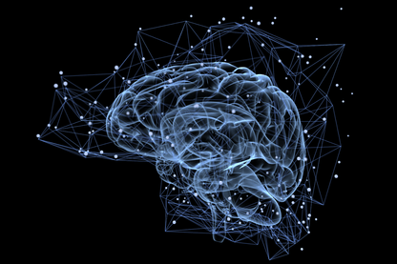
Neuroanatomy is important for comparison between experiments
Experiment 3
Experiment 1
How do we compare across experiments?
(https://www.gettyimages.com/photos/human-brain?
sort=best&mediatype=photography&phrase=human%20brain)
Experiment 2

Slide 3
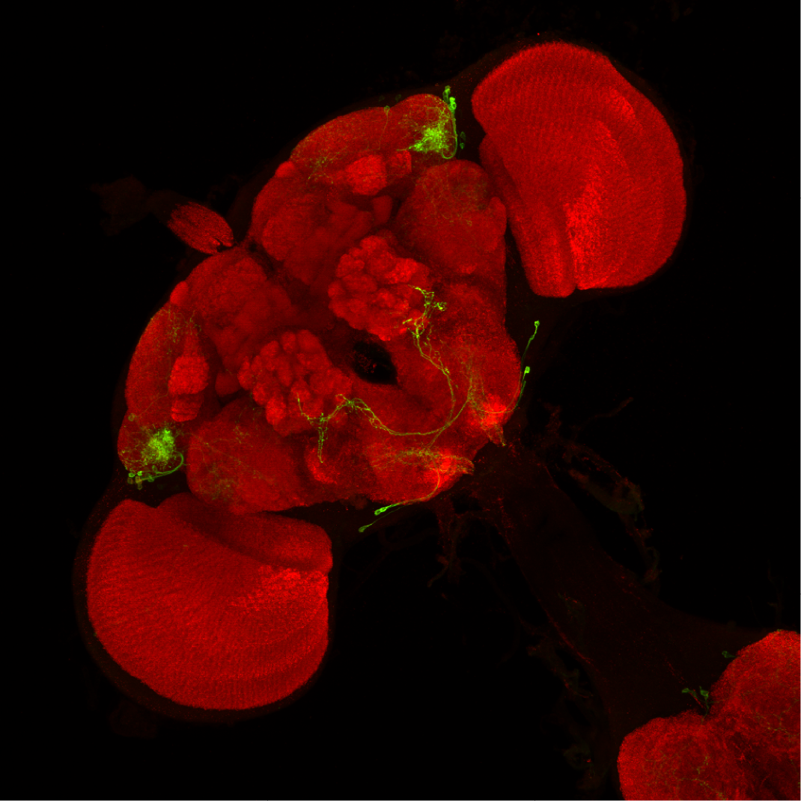
Confocal imaging affords us high resolution images of neuroanatomy
The monoclonal antibody NC82 labels presynaptic active zone in Drosophila. This effectively allows us visualize the architecture of the Drosophila brain.
Neurons and their projections are labeled using green fluorescent protein
(http://splitgal4.janelia.org/cgi-bin/splitgal4.cgi)

Slide 4
Why MATLAB?
Similar pipelines/methods have been developed in R [1,2]
MATLAB provides:
Improved functionality for graphical visualization
Better documentation and debugging methods
In house toolboxes, especially image processing

Slide 5
Roadmap moving forward
Pipeline of methods
Overview of GUI
Data format
Image Registration
Cell Detection
Database
Example Run
Discussion

Slide 6
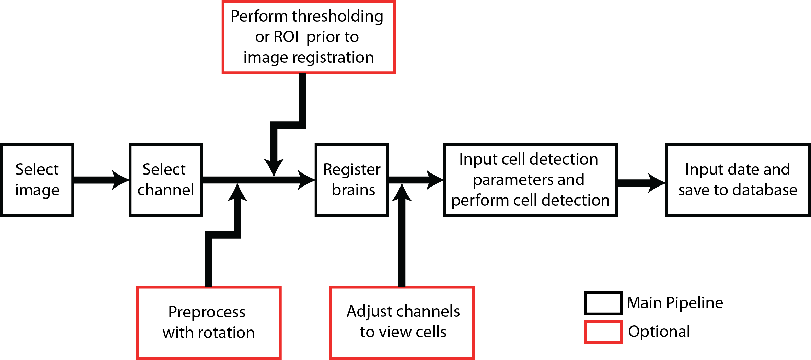
Experiment and methods

Slide 7
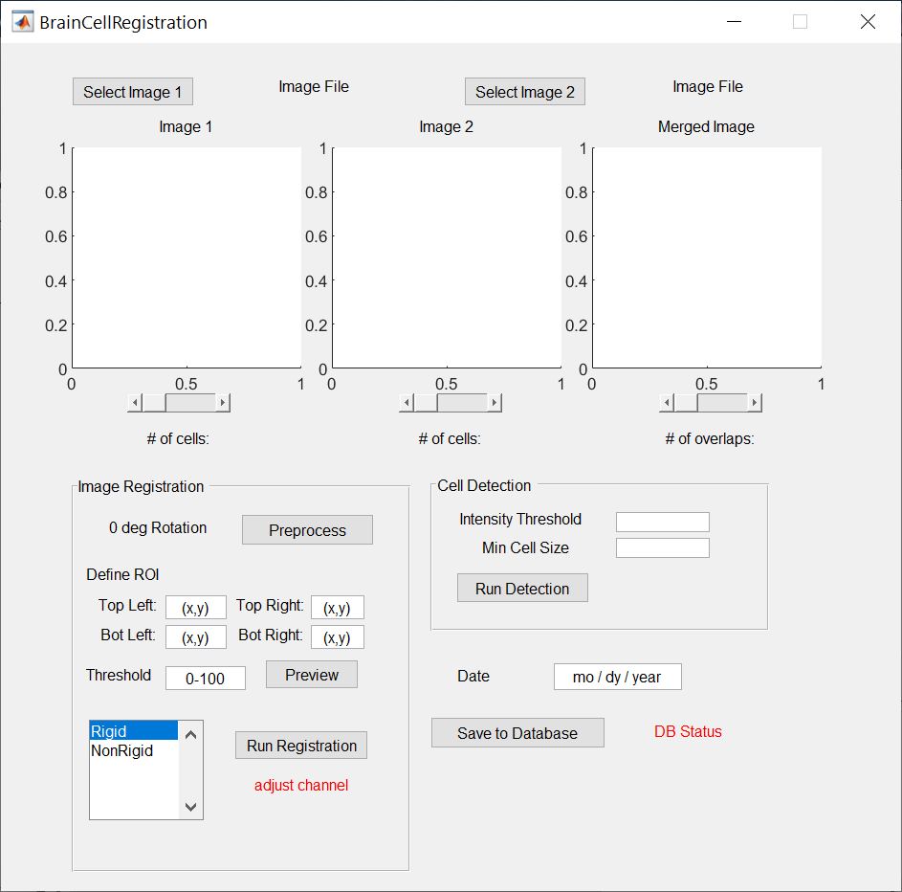
Overview of GUI
Select images
Select channels
Preprocess with rotation
Cell detection
Threshold and ROI selection
Saving to database
Image Registration

Slide 8
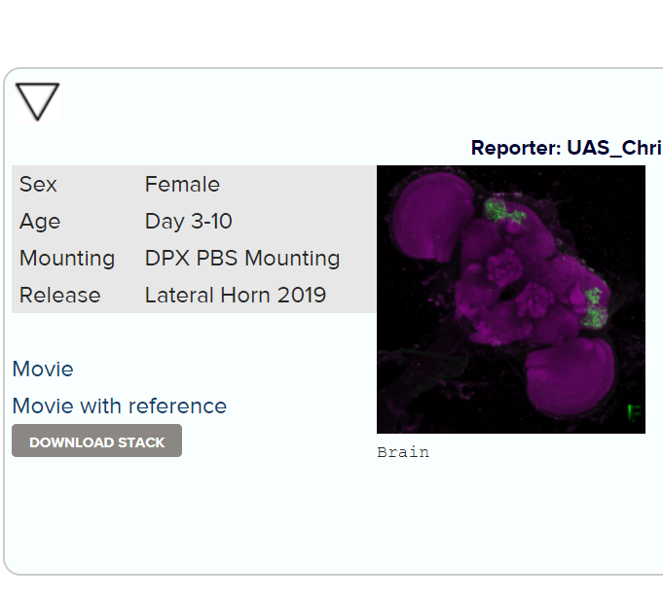
Data overview
Download data from (http://splitgal4.janelia.org/cgi-bin/splitgal4.cgi)
The example images are: http://splitgal4.janelia.org/cgi-bin/view_splitgal4_imagery.cgi?line=LH1000 and http://splitgal4.janelia.org/cgi-bin/view_splitgal4_imagery.cgi?line=LH1046
Unzip into temporary folder (unfortunately don’t have access to link for use with bmes.downloadurl)
Click here to download

Slide 9
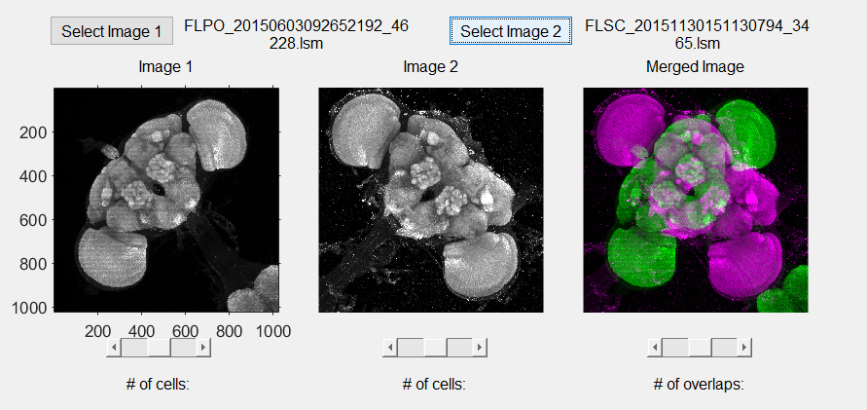
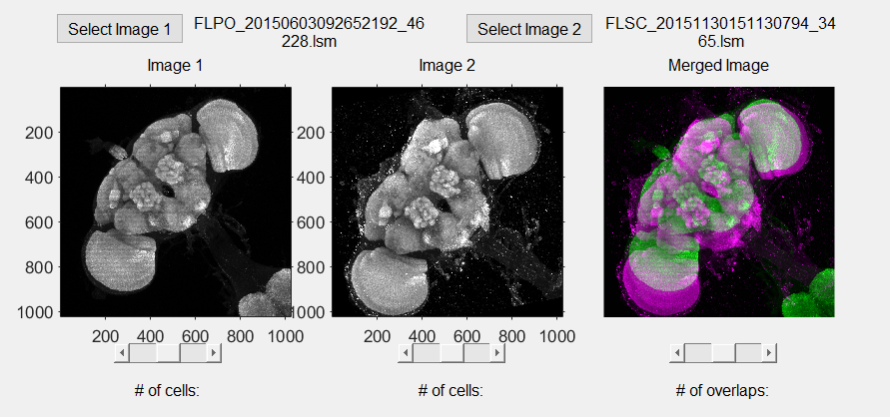
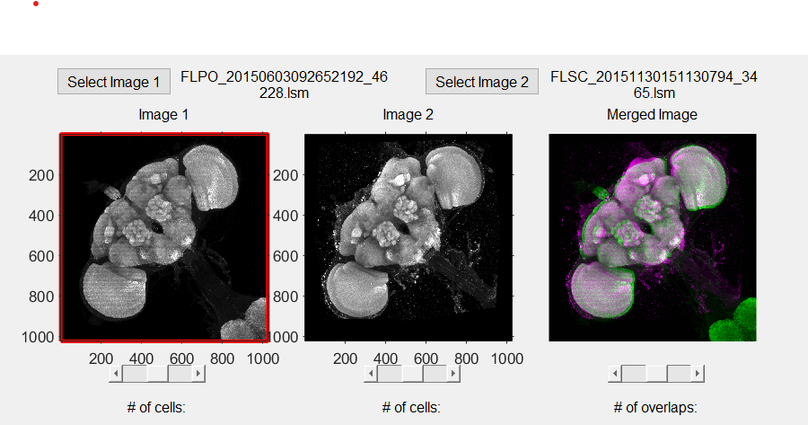
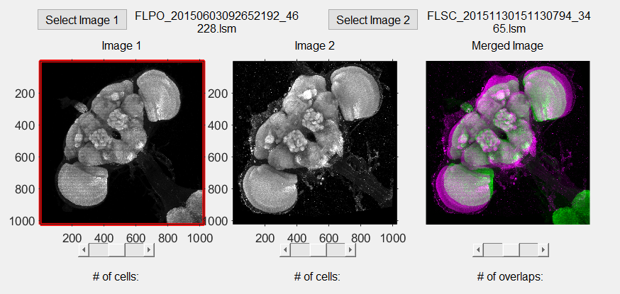
Image Registration
1. Before Processing
2. After rotation
3. After rigid registration
4. After nonrigid registration

Slide 10
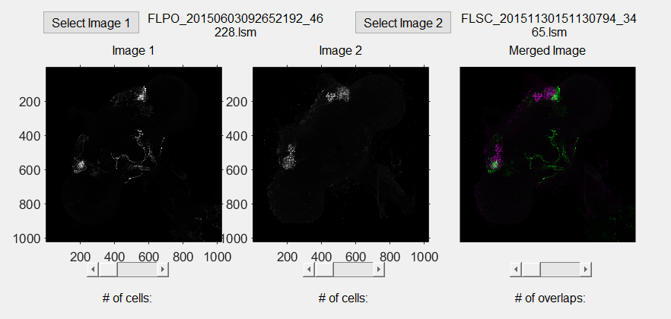
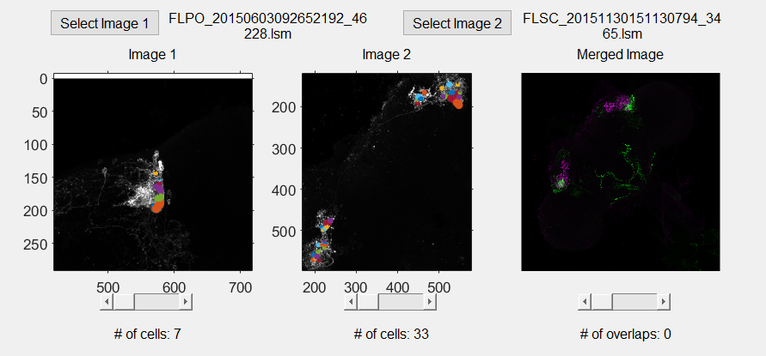
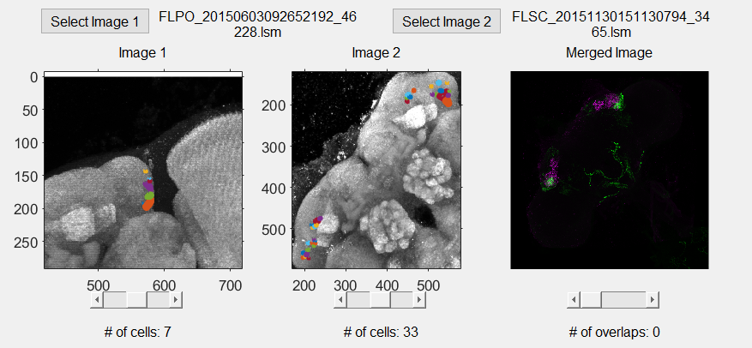
Cell Detection
1. Move to cell channel
2. Perform cell detection
3. View the
cells in the
brain channel
*Note that only
the merge image
need to be in the
cell channel

Slide 11
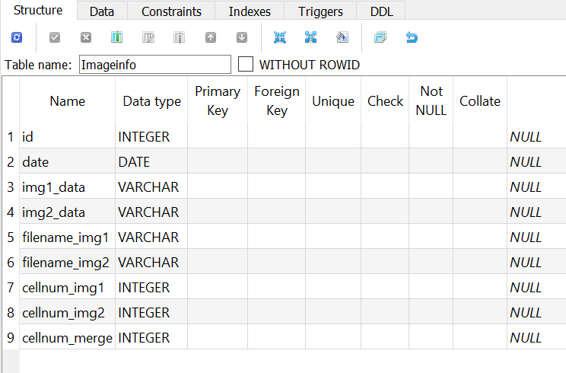
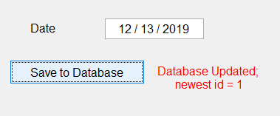
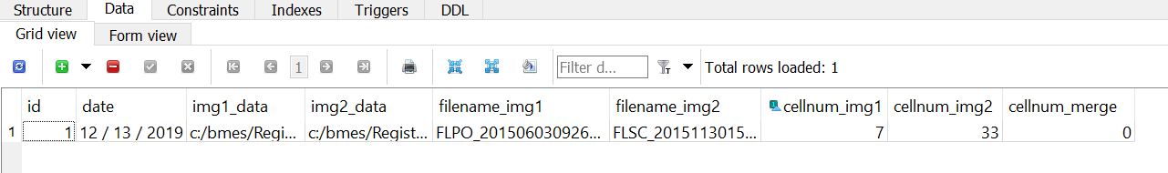
Database
2. Database variable types
Saving to
database in GUI
3. Saved fields

Slide 12
Discussion
Extend to 3d registration
Improve cell detection
Faster computation using GPU

Slide 13
References
Jefferis, G.S., et al., Comprehensive maps of Drosophila higher olfactory centers: spatially segregated fruit and pheromone representation. Cell, 2007. 128(6): p. 1187-203.
Cachero, S., et al., Sexual dimorphism in the fly brain. Curr Biol, 2010. 20(18): p. 1589-601.
Dolan, M.-J., et al., Neurogenetic dissection of the Drosophila lateral horn reveals major outputs, diverse behavioural functions, and interactions with the mushroom body. eLife, 2019. 8: p. e43079.

