Slide 1
Differential gene expression analysis and machine learning model classification for pancreatic ductal adenocarcinoma
Sara Chung, Khang Duong, Colette Trouillot

Slide 2
Agenda
Introduction/Background
Biology and Physiology
Goals
Dataset overview
Method of analysis
Results
Discussion

Slide 3
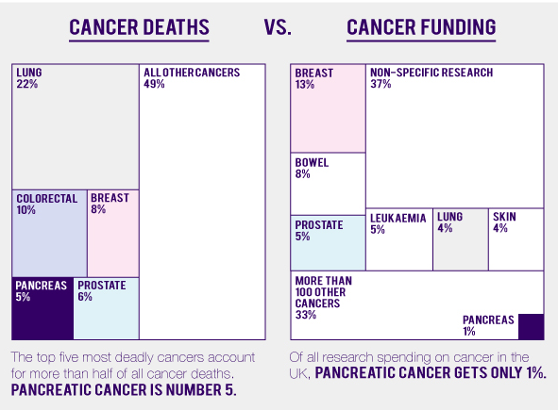
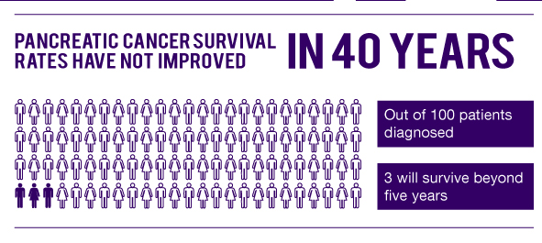
Pancreatic Ductal Adenocarcinoma Prevalence
Pancreatic ductal Adenocarcinoma (PDAC) is a highly aggressive cancer, with an average 5-year survival rate of less than 10%
High lethality due to lack of early diagnosis, extensive heterogeneity, rapid metastasis and limited response to treatments
Classical treatments such as chemotherapy, surgery and radiation have not shown significant improvement in clinical outcomes
Surgical resection with chemotherapy provides best treatment outcome
According to the American Cancer Society
About 62,210 people (32,970 men and 29,240 women) will be diagnosed with pancreatic cancer
About 49,830 people (25,970 men and 23,860 women) will die of pancreatic cancer
https://www.cancer.org/cancer/pancreatic-cancer/about/key-statistics.html
Notes:
It is the most common type of pancreatic cancer, accounting for more than 90% of PC diagnoses
To date it is the 5th most prevalent, some argue 4th, most frequent cause of cancer related deaths worldwide with a 5-year overall survival rate of less than 10%
It is highly lethal due to the lack of early diagnosis.
It is difficult to diagnose early due to its extensive heterogeneity of genetic mutations and the tumor microenvironment
*** indicate year and if its national or world statistics
yet only 10-20% of PDAC patients present with resectable PDAC stages, while the residual 80-90% show locally advanced, non-resectable stages or – in the majority
Those that have non resectable or distant metastases undergo systemic chemotherapy that has been largely associated with higher toxicity so is limited to a subset of the population ( no elderly or immunocompromised)

Slide 4
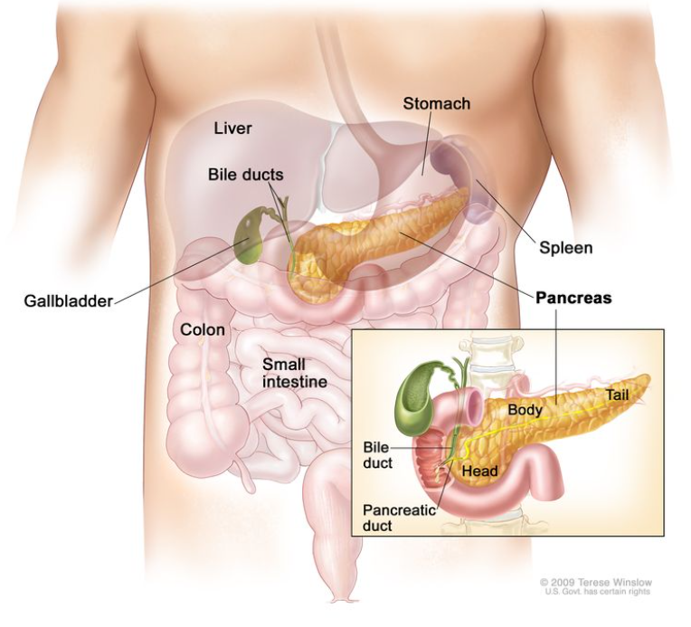
Tumor formation in the pancreas can lead to pancreatitis, abdominal pain, and digestive problems, and sugar diabetes
Most common PC risk factors include smoking, obesity, diabetes, chronic pancreatitis, and exposure to carcinogens
Main functions of the pancreas include:
Exocrine (digestion)
Endocrine (blood sugar)
https://www.cancer.gov/types/pancreatic/patient/pancreatic-treatment-pdq
Notes:
Main functions of the pancreas are digestion and controlling blood sugar
Exocrine cells make the bulk of the pancreas that produce enzymes to help with the digestion of food
Endocrine cells are formed as islands within the pancreas and scattered throughout the pancreas also known as islets of Langerhans, release hormones such as insulin and glucagon into the blood stream to maintain blood sugar levels
Exocrine based tumor formations where tumors essentially block the exocrine system can cause pancreatitis and pain from abnormal release of digestive enzymes into the pancreas instead of the bowel, and can develop digestive poblems such as diarrhea from incomplete digestion of food
Endocrine based tumor formations destroy the endocrine functions of the pancreas that can lead patients to developing sugar diabetes (abonormally high blood sugar levels)
In this particular study, we will be looking at pancreatic ductal adenocarcinoma which is exocrine based cancer that accounts for roughly 95% of pancreatic cancer
Pancreatic cancer can be inherited or acquired (gene mutations)
Pancreas Function - Pancreatic Cancer | Johns Hopkins Pathology (jhu.edu)

Slide 5
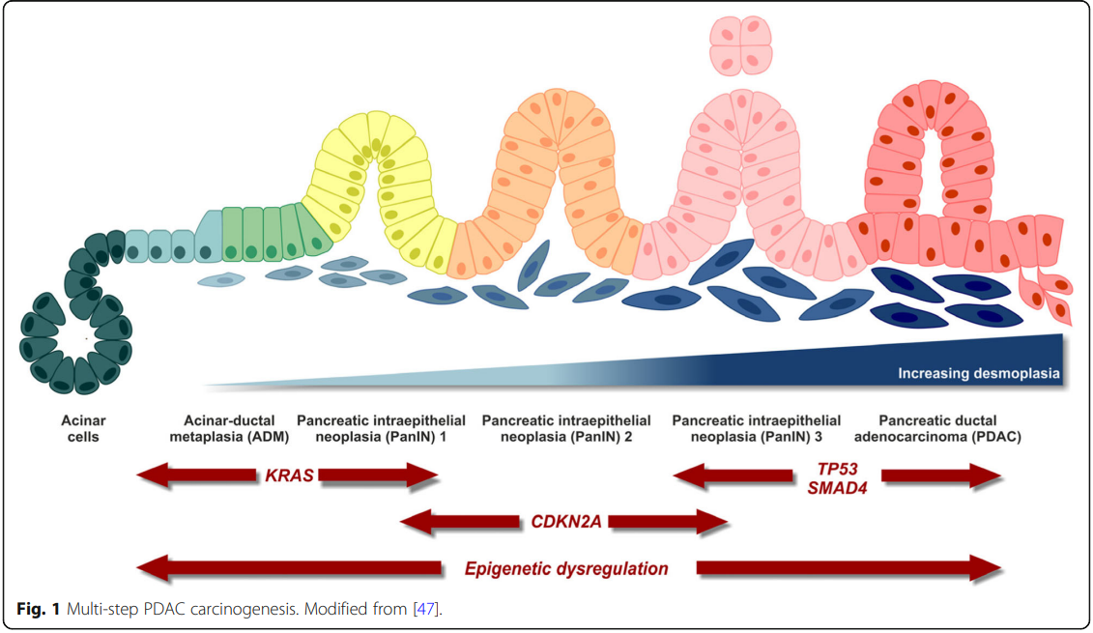
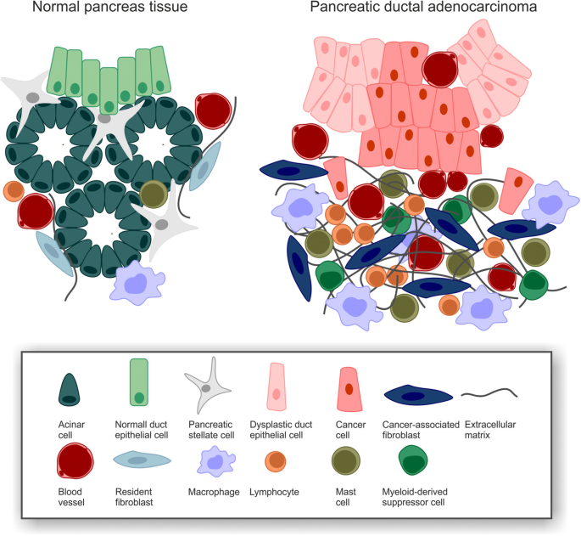
Biology/Physiology
Hallmark of PDAC is the extensive desmoplastic stroma
(FAK1) expression is a key marker in the formation of desmoplasia
Dominating cytokines in the microenvironment are TGFb, IL6, Il8, Il10, Il35, GM-CSF, CLL2, CXCL1, and CXCL13.
Orth, M., Metzger, P., Gerum, S. et al. Pancreatic ductal adenocarcinoma: biological hallmarks, current status, and future perspectives of combined modality treatment approaches. Radiat Oncol 14, 141 (2019). https://doi.org/10.1186/s13014-019-1345-6
Notes:
The pancreas is made up of exocrine, epithelial, and endocrine cells. PDAC is caused by a process called acinar (exocrine) to ductal metaplasia where the acinar cells differentiate to epithelial (ductal-like) phenotypes when experiencing macro- and microtumor environment (e.g. tissue damage, inflammatory, or stress conditions) during which these cells acquire ‘progenitor cell-like’ characteristics and so susceptible to pro-oncogenic hits such as activating mutations in the proto-oncogene KRAS, eventually transforming these cells into pancreatic intra-epithelial neoplasias (PanINs). And then followed by a sequential progression involving additional genetic hits in several tumor suppressor genes.
KRAS, TP53, CDKN2A, and SMAD4 exhibit most frequent mutations/alterations in PDAC
These key tumor suppressor genes are described to be caused by epigenetic mutations such as DNA methylation, histone PTMs, and non coding RNAs.
It has also been reported that focal adhesion kinase 1(FAK1) expression is a key marker in the formation of desmoplasia and so it a attractive target for therapeutic intervention.
Hallmark of PDAC is the extensive desmoplastic stroma that is caused tumor microenvironment traits such as hypoxia.
This in turn causes a strong accumulation of myeloid cells that could block CD4 and CD8 t cells into the PDAC tumor microenvironment. Additionally immunosuppressive T and B cell subpopulations have been detected in the microenvironment that can block T cell activation and infiltrate effector T cells.
Dominating cytokines in the microenvironment are TGFb, IL6, Il8, Il10, Il35, GM-CSF, CLL2, CXCL1, and CXCL13.

Slide 6
Goal #1: Identify the overlapping differentially expressed genes in the 3 datasets and determine their biological significance
Goal #2: Develop machine learning models as tools to predict the malignancy of unknown samples
Notes:
Due to strong desmoplastic (growth of fibrous tissue around cancer) reaction and neoplastic epithelial cells representing minority population of cancer cells, current PDAC microarray studies have been limited.
Our findings using this model may address the limitations in characterizing PDAC to improve early diagnosis, therapeutic efficacy and clinical outcomes
There is insufficient information on the pathogenesis of pancreatic ductal adenocarcinoma
Due to its strong desmoplastic reaction (that is the cause of forming adhesions or fibrous connective tissue within the tumor that makes it incredibly difficult to study using microarrays. The connective tissue essentially masks the neoplastic epithelial cells
Whole tissue studies cannot distinguish b/w overexpressed genes in tumor epithelia vs those differentially expressed b/w various cell types present in normal and tumor samples, however laser microdissection study can detect genes specific in over-expressed genes in tumor epithelia and so it is difficult to differentiate which genes that have been found differentially expressed between normal and tumor tissues is due to the tumor epithelia or it is differences in cellular composition.
And so in this study the goal was to combine both methods/studies of large whole tissue study with a previously published smaller sample microdissection study to identify genes that are specifically overexpressed in PDAC tumor epithelia
Combine large whole tissue study with previously published laser microdissection studies which may enable more reliable detection of genes that are differentially expressed between normal and tumor tissues
**this should be OUR goal, not paper goal– machine learning model to identify if these genes are normal/ tumor tissue
Another goal: Using 3 datasets to see if machine learning model is robust platform to cover multiple datasets ***
Combination studies may provide a more precise determination of overexpressed genes in tumor epithelia
Whole tissue study may identify over-expressed genes in cell types that are too difficult to isolate with microdissection
WORK ON LAST PART
The reason why we are using ML is because we want to see if we can use them as tools to predict future samples based on their gene expression alone.

Slide 7
Datasets
Series GSE15471
Title: Whole-Tissue Gene Expression Study of Pancreatic Ductal Adenocarcinoma
Series GSE16515
Title: Expression data from Mayo Clinic Pancreatic Tumor and Normal samples
Transformation: None
Series GSE22780
Title: Affymetrix Arrays Interrogated with Tumor/Normal Pancreatic Samples
Description: Microarray analysis using 8 frozen tumor and adjacent normal tissue to identify genes in the chromosome 3p12 pathway to tumorigenesis
# of samples: 78
Transformation: log2
# of samples: 52
# of samples: 16
Transformation: None
Description: Expression analysis using pairs of normal and tumor tissue samples obtained from 36 pancreatic cancer patients, 3 of which were carried out in replicate to gauge technical errors
Description: Microarray analysis using RNA isolated from 36 tumor and 16 normal samples to identify expression differences of FKBP5 gene between tumor and normal samples
Notes:
GSE15471 – came from patients with PDAC at time of surgery. The gene expression was analyzed on Affymetrix U1333 + whole genome microarrays and then the data was normalized
GSE16515 – used microarrays to identify the expression differences of FKBP5 gene between the pancreatic tumor and normal samples. There were 16 samples with both tumor and normal expression data and 20 samples only had tumor data. Genotype-phenotype association study to identify biomarkers.
GSE22780 -

Slide 8
Methods- Analysis Workflow
Perform T-test for tumor vs normal samples and obtain p-values
Identify significant genes via p-value and fold change threshold
Use gene expression analysis for biological interpretation
Perform differential expression gene analysis
Calculate fold change for tumor vs normal samples
Retrieve GSE datasets
Z-Normalize and Log2 Transform Data
Decision Tree
Create machine learning models to classify normal vs tumor tissue
Remove genes that are not present across all 3 datasets
Support Vector Machine
Sequential Feature Selection
K-Nearest neighbors
Notes:
Methods Analysis Workflow:
- We retrieved the GSE datasets from the NIH database
- Took the data and normalized and log transformed the data (some data was already log transformed and some was not so we made sure all were)
- After that we performed two main tasks one being the differential gene expression analysis and the second is the machine learning models used to identify significant genes in PDAC
For differential gene expression analysis
We performed a t-test to compare the significance of normal vs tumor data for each gene and obtained the p-values. We also calculated the fold changes and chose the most significant genes based on the p-value and fold change threshold. We found the intersection of genes between the three datasets and the used did gene expression analysis for biological interpretation; Used Python (pandas, numpy, scipy, matplotlib, and math)
Khang:
For our machine learning analysis, we first pre-processed the data by normalizing and log transforming the values as well as removing the genes that are not present across all 3 datasets to ensure that the models are trained and tested with the same features.
We then created three machine learning models (Decision tree, support vector machine, and k nearest neighbors) to see which one performs the best at classifying the samples as normal or tumor tissue.
Then, we trained the models on the first dataset as it contained the most amount of samples.
We also did a 5-fold cross validation on the first dataset to determine the parameters of the models that would yield the best performance.
Next, we tested the models on the other 2 datasets to determine how accurate and robust the models are with data coming from different labs.
For the support vector machine and k nearest neighbors, we also did sequential forward feature selection to reduce the irrelevant features in order to create more accurate models. All of these analyses are in Python using the scikit learn module.

Slide 9
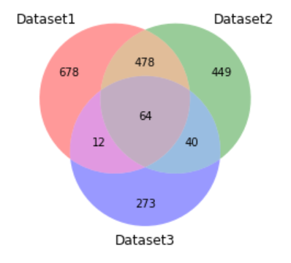
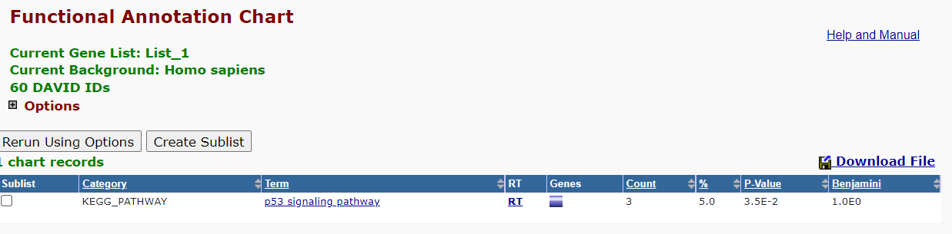
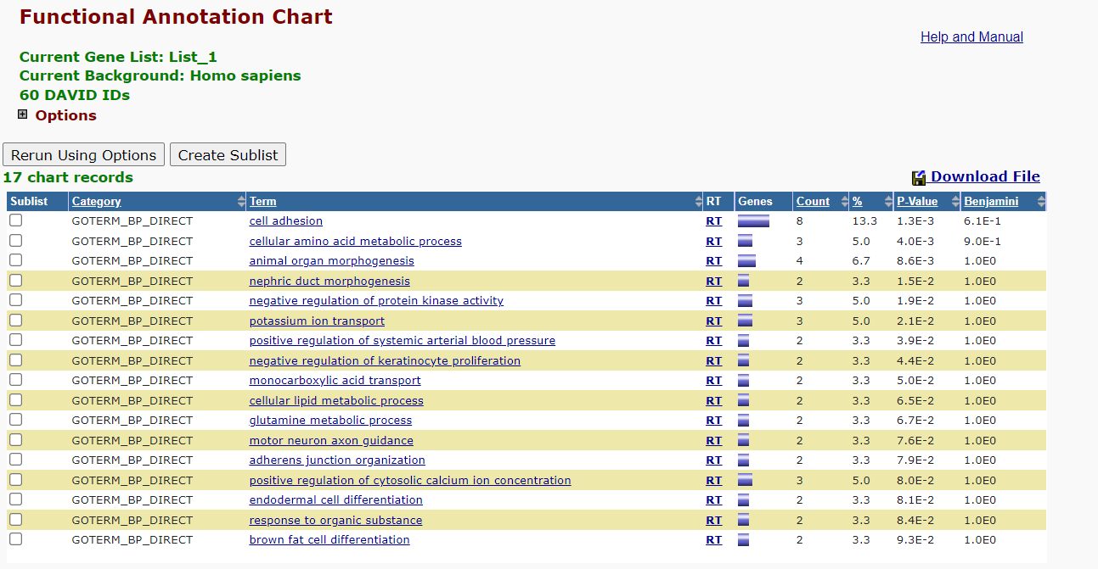
Results – Differential Expression Analysis
Notes:
Using a p-value threshold of 0.02 and a fold change threshold of 1.5, we get the above venn diagram as a result. We see that the three datasets have about 64 genes in common that we then used to perform gene set enrichment analysis using David.
Using David, we can really visualize the issue that comes up whenever research on pancreatic cancer is done.
While the pathway analysis does give us a very important pathway – the p53 pathway –a pathway which is well known to drive pancreatic cancer metastasis (see: paper from 2014 published in cell), we see no other functional annotation pathways because DAVID couldn’t find like 59 of the genes
https://www.ncbi.nlm.nih.gov/pmc/articles/PMC4001090/
Importance of p53 pathway
In terms of the GO enrichment analysis, other studies have seen ion transport, cell adhesion, morphogenesis including papers He et al in 2019 and Long et al in 2015.
https://www.ncbi.nlm.nih.gov/pmc/articles/PMC4734321/pdf/ol-11-02-1391.pdf
https://www.ncbi.nlm.nih.gov/pmc/articles/PMC6403508/pdf/ol-17-04-3751.pdf
Some interesting terms to note include negative regulation of keratinocyte proliferation—keratinocyte is associated with an expansion of a cell population (see Iotzova-Weiss et al in 2017). But another thing, cellular amino acid metabolic process would be expected to increase in cancer as amino acid metabolism has many links in cancer and metabolic reprogramming is a hallmark of cancer (see Wei et al 2021).
https://www.frontiersin.org/articles/10.3389/fcell.2020.603837/full#:~:text=Amino%20acid%20metabolism%20has%20extremely,precursors%20of%20nitrogen%2Dcontaining%20metabolites%2C
https://www.ncbi.nlm.nih.gov/pmc/articles/PMC5628845/pdf/pone.0185668.pdf
https://ar.iiarjournals.org/content/29/8/3417

Slide 10
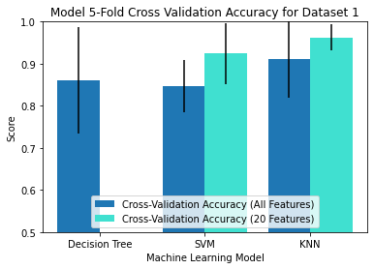
Results – Machine Learning Analysis
Notes:
Here are the results for our machine learning analysis.
First off, we cross validated and trained all three models on dataset 1 in order to determine model parameters.
The bar graph is showing the cross validation accuracies for the three models.
The support vector machine and k nearest neighbors models were also cross validated and trained with only the 20 features selected by the forward selection algorithm. Overall, the three models had similar cross validation accuracies.
The models that were trained with less features performed slightly better, but its not significantly different.

Slide 11
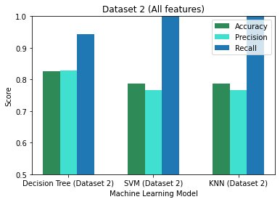
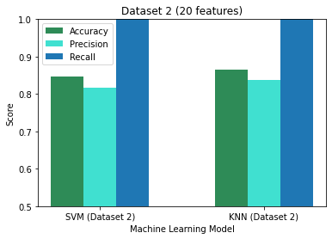
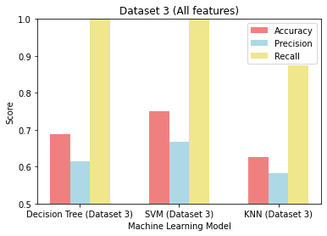
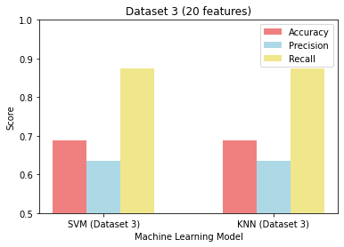
Results – Machine Learning Analysis
Notes:
We then tested the three models' performance on datasets 2 and 3 and reported the accuracy, precision, and recall metrics. Each bar graph represents a dataset and the number of features that were used.
From the graphs, we found that all three models performed better on Dataset 2 than dataset 3.
Also, the support vector machine and k nearest neighbors models performed just as well as the Decision tree model when trained on the selected 20 features from feature selection. However, they performed worse when we used all of the features to train the models.
Again, we see that the three models had similar performance for a given dataset.
*OPTIONAL
First off, the decision tree model had a high cross validation accuracy of 0.861 for dataset 1. We found that cutting the decision tree at one level had the best performance across all three datasets. It was also interesting to see that the SULF1 gene is the feature that is used to split the samples up into normal or tumor tissue. In some publications, it was found that overexpression of SULF1 is associated with PDAC

Slide 12
Discussion
>66% of overlapping significant genes findings from the gene expression analysis have been identified and published from previous studies
Known biomarkers for PDAC such as CEACAM1, CEACAM5, CTNND2, and HOXC6 were captured in this analysis
Many of these are precursors or regulators in the PI3K/Akt and RAS/MAPK signaling pathway, hallmarks of pancreatic cancers
Machine learning models resulted in >85% cross validation accuracy for high volume samples
Machine learning models had similar performance when it comes to classifying normal vs tumor tissues and was translatable at classifying samples coming from different datasets
Feature Selection improved the performance of the machine learning models and should be used to eliminate genes that are not useful in helping the models classify samples
Notes:
Lower accuracy for smaller sample datasets (dataset3 in this analysis contained only 16 samples, 8 paired)
“The reason for this is that the functional annotation of genomes is incomplete and the types of annotation that any given gene may have can differ. For example, when using DAVID, you may find a gene that has GO classifications and no functional summary text, while another gene has functional summary text and no GO classifications, and still others will have no annotation whatsoever. This is why the database behind DAVID is continually updated, giving researchers access to the current state of functional annotation, which indeed is always changing. Another reason is that some user input identifiers cannot be mapped to any known genes in the DAVID Knowledgebase.”

Slide 13
Discussion
Limitations
High accuracy applicable for GSE datasets that have paired tumor vs normal sample data but analysis may be skewed for unpaired, random datasets
Machine learning model parameters are not well optimized
DAVID is incomplete
Improvements
For machine learning model, optimize parameters
Include additional functional annotation tools such GSEA, GOstat, and Onto-express for analysis
Follow up studies
Perform meta-analysis using more datasets
Notes:
Lower accuracy for smaller sample datasets (dataset3 in this analysis contained only 16 samples, 8 paired)
“The reason for this is that the functional annotation of genomes is incomplete and the types of annotation that any given gene may have can differ. For example, when using DAVID, you may find a gene that has GO classifications and no functional summary text, while another gene has functional summary text and no GO classifications, and still others will have no annotation whatsoever. This is why the database behind DAVID is continually updated, giving researchers access to the current state of functional annotation, which indeed is always changing. Another reason is that some user input identifiers cannot be mapped to any known genes in the DAVID Knowledgebase.”

Slide 14
References
Orth, M., Metzger, P., Gerum, S. et al. Pancreatic ductal adenocarcinoma: biological hallmarks, current status, and future perspectives of combined modality treatment approaches. Radiat Oncol 14, 141 (2019)
Javadrashid, D.; Baghbanzadeh, A.; Derakhshani, A.; Leone, P.; Silvestris, N.; Racanelli, V.; Solimando, A.G.; Baradaran, B. Pancreatic Cancer Signaling Pathways, Genetic Alterations, and Tumor Microenvironment: The Barriers Affecting the Method
Sarantis P, Koustas E, Papadimitropoulou A, Papavassiliou AG, Karamouzis MV. Pancreatic ductal adenocarcinoma: Treatment hurdles, tumor microenvironment and immunotherapy. World J Gastrointest Oncol 2020; 12(2): 173-181
Pei H, Li L, Fridley BL, Jenkins GD et al. FKBP51 affects cancer cell response to chemotherapy by negatively regulating Akt. Cancer Cell 2009 Sep 8;16(3):259-66
Badea L, Herlea V, Dima SO, Dumitrascu T et al. Combined gene expression analysis of whole-tissue and microdissected pancreatic ductal adenocarcinoma identifies genes specifically overexpressed in tumor epithelia. Hepatogastroenterology 2008 Nov-Dec;55(88):2016-27
PDQ® Adult Treatment Editorial Board. PDQ Pancreatic Cancer Treatment (Adult). Bethesda, MD: National Cancer Institute. Updated <12/11/2020>
Mehra S, Deshpande N, Nagathihalli N. Targeting PI3K Pathway in Pancreatic Ductal Adenocarcinoma: Rationale and Progress. Cancers (Basel). 2021;13(17):4434. Published 2021 Sep 2. doi:10.3390/cancers13174434
Hammond E, Khurana A, Shridhar V, Dredge K. The Role of Heparanase and Sulfatases in the Modification of Heparan Sulfate Proteoglycans within the Tumor Microenvironment and Opportunities for Novel Cancer Therapeutics. Front Oncol. 2014;4:195. Published 2014 Jul 24. doi:10.3389/fonc.2014.00195

