Slide 1
ODE Examples
Ahmet Sacan
Some figures are from Wikipedia.

Slide 2
ODEs in Biology
Most biological reactions are modeled with the following reaction kinetics:
Law of mass action
Irreversible Reaction
Reversible Reaction
Michaelis-menten enzyme kinetics

Slide 3
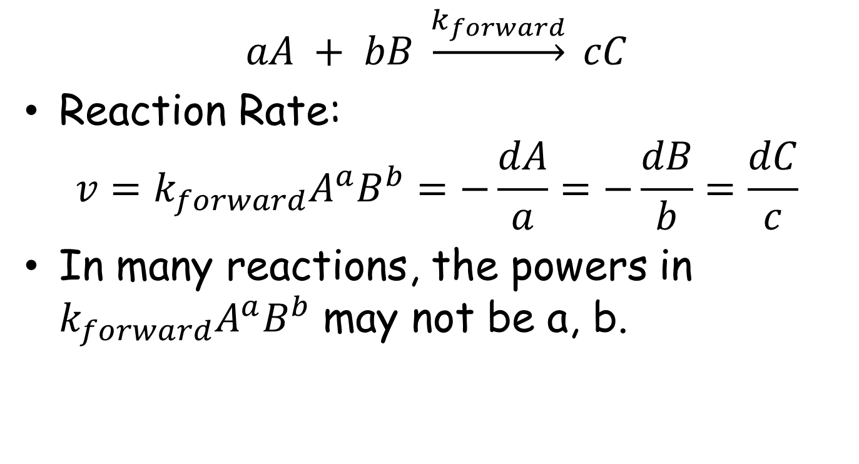
Ir-reversible Reactions
$$aA + bB \underset{→}{k_{forward}} cC$$
Reaction Rate:
$$v=k_{forward}A^{a}B^{b}=−\frac{dA}{a}=−\frac{dB}{b}=\frac{dC}{c}$$
In many reactions, the powers in $k_{forward}A^{a}B^{b}$ may not be a, b.

Slide 4
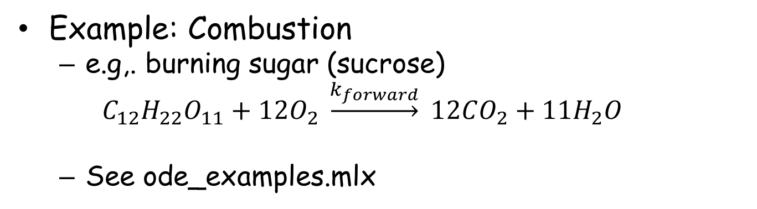
Ir-reversible Reactions
Example: Combustion
e.g,. burning sugar (sucrose)
$$C_{12}H_{22}O_{11}+12O_{2} \underset{→}{k_{forward}} 12CO_{2}+11H_{2}O$$
See ode_examples.mlx
https://www.acs.org/content/dam/acsorg/education/resources/highschool/chemmatters/archive/chemmatters-december-2010-sugar-an-unusual-explosive.pdf

Slide 5
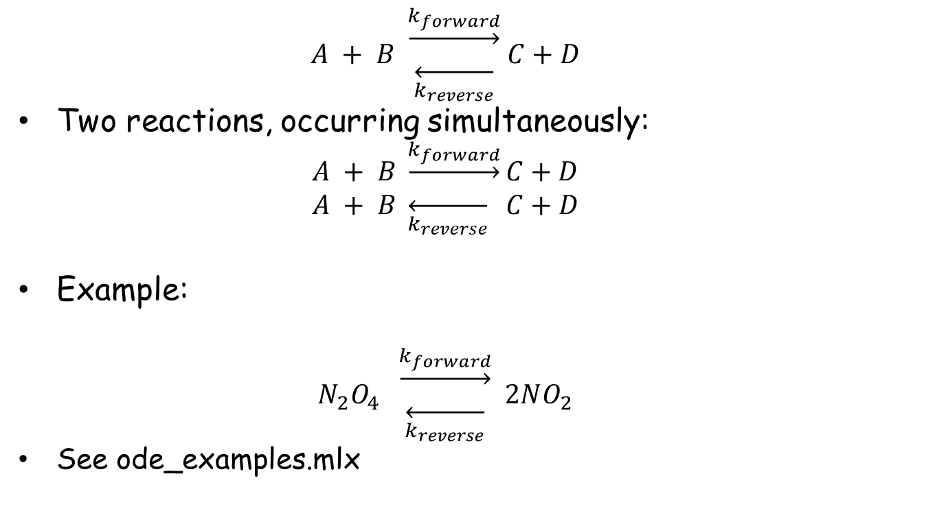
Reversible Reactions
$$A + B \begin{matrix}\underset{→}{k_{forward}} \\ \overset{←}{k_{reverse}}\end{matrix} C+D$$
Two reactions, occurring simultaneously:
$$A + B \underset{→}{k_{forward}}C+D$$
$$A + B \overset{←}{k_{reverse}} C+D$$
Example:
$$N_{2}O_{4} \begin{matrix}\underset{→}{k_{forward}} \\ \overset{←}{k_{reverse}}\end{matrix} 2NO_{2}$$
See ode_examples.mlx

Slide 6
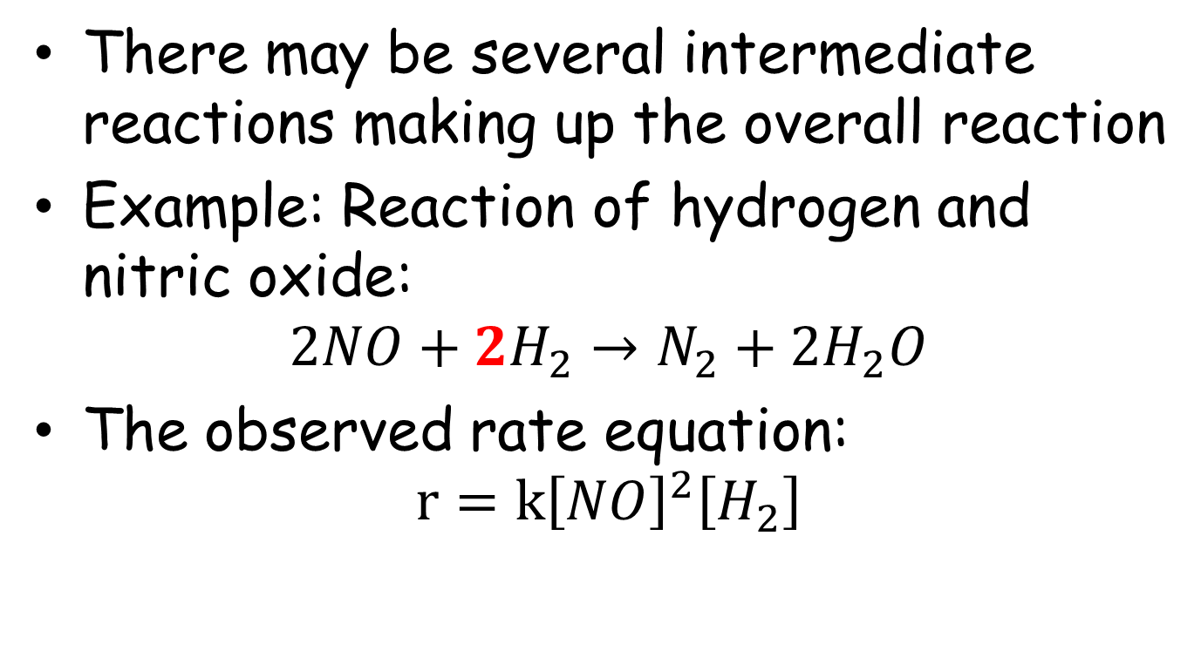
Intermediate Reactions
There may be several intermediate reactions making up the overall reaction
Example: Reaction of hydrogen and nitric oxide:
$$2NO+2H_{2}→N_{2}+2H_{2}O$$
The observed rate equation:
$$r=k{\left[NO\right]}^{2}\left[H_{2}\right]$$

Slide 7
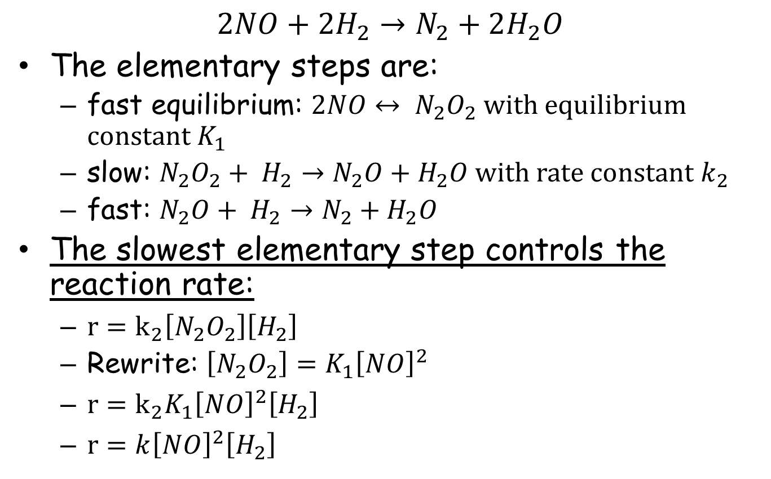
Intermediate Reactions
$$2NO+2H_{2}→N_{2}+2H_{2}O$$
The elementary steps are:
fast equilibrium: $2NO↔ N_{2}O_{2}$ with equilibrium constant $K_{1}$
slow: $N_{2}O_{2}+ H_{2}→N_{2}O+H_{2}O$ with rate constant $k_{2}$
fast: $N_{2}O+ H_{2}→N_{2}+H_{2}O$
The slowest elementary step controls the reaction rate:
$r=k_{2}\left[N_{2}O_{2}\right]\left[H_{2}\right]$
Rewrite: $\left[N_{2}O_{2}\right]=K_{1}{\left[NO\right]}^{2}$
$r=k_{2}K_{1}{\left[NO\right]}^{2}\left[H_{2}\right]$
$r=k{\left[NO\right]}^{2}\left[H_{2}\right]$

Slide 8
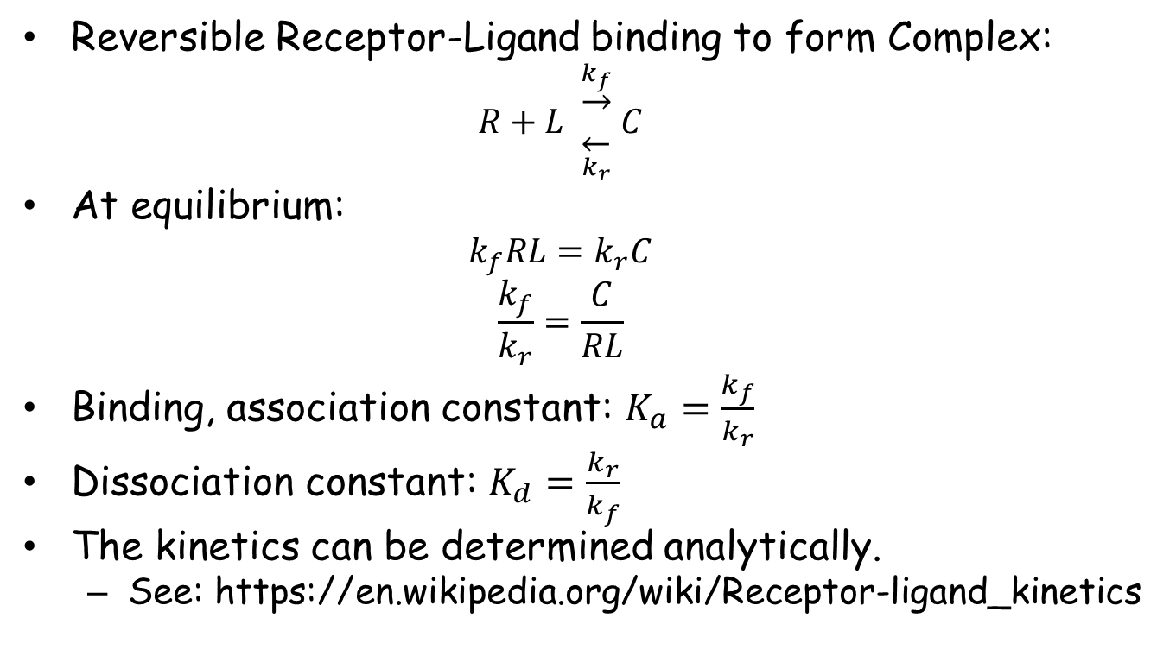
Binding Kinetics
Reversible Receptor-Ligand binding to form Complex:
$$R+L \begin{matrix}\underset{→}{k_{f}} \\ \overset{←}{k_{r}}\end{matrix} C$$
At equilibrium:
$$k_{f}RL=k_{r}C$$
$$\frac{k_{f}}{k_{r}}=\frac{C}{RL}$$
Binding, association constant: $K_{a}=\frac{k_{f}}{k_{r}}$
Dissociation constant: $K_{d}=\frac{k_{r}}{k_{f}}$
The kinetics can be determined analytically.
See: https://en.wikipedia.org/wiki/Receptor-ligand_kinetics

Slide 9
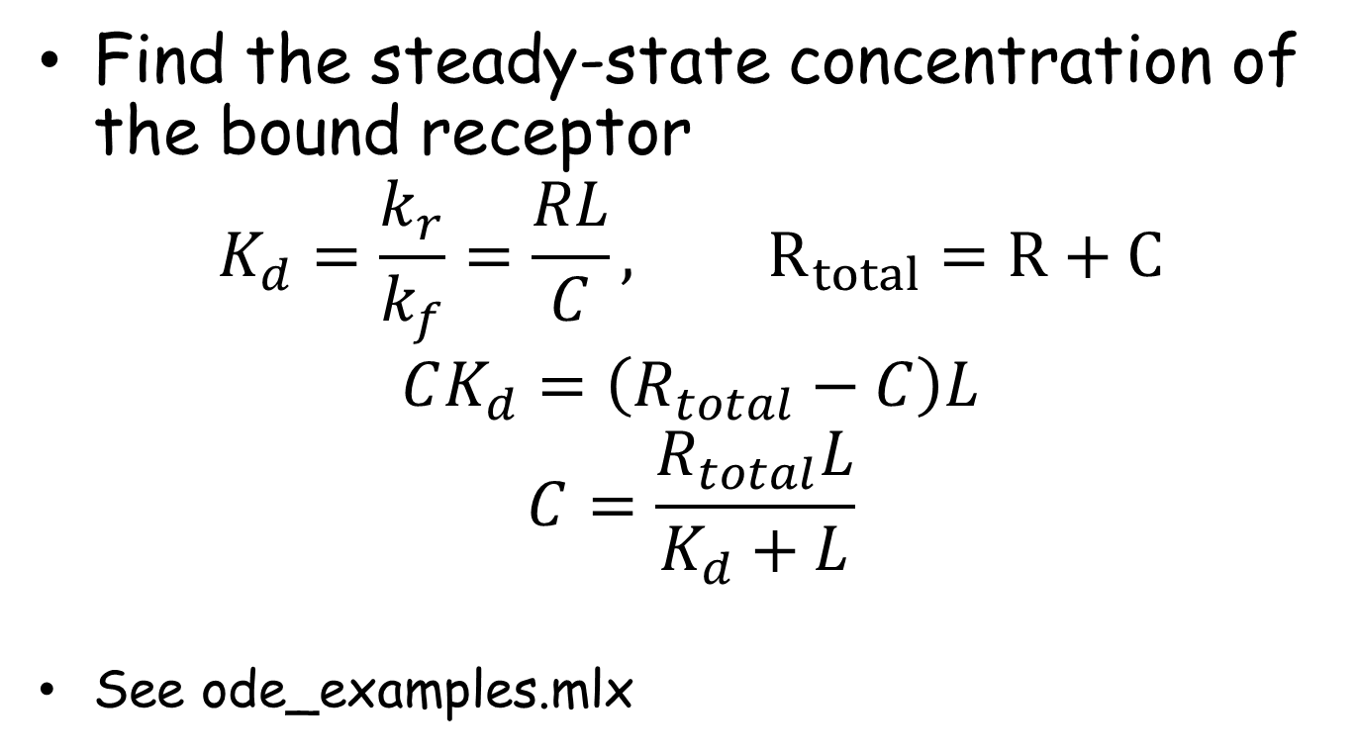
Binding Kinetics
Find the steady-state concentration of the bound receptor
$$K_{d}=\frac{k_{r}}{k_{f}}=\frac{RL}{C}, R_{total}=R+C$$
$$CK_{d}=\left(R_{total}−C\right)L$$
$$C=\frac{R_{total}L}{K_{d}+L}$$
See ode_examples.mlx

Slide 10
Binding Kinetics
Find the steady-state concentration of the bound receptor
$$K_{d}=\frac{k_{r}}{k_{f}}=\frac{RL}{C}, R_{total}=R+C$$
$$CK_{d}=\left(R_{total}−C\right)L$$
$$C=\frac{R_{total}L}{K_{d}+L}$$
See ode_examples.mlx

Slide 11
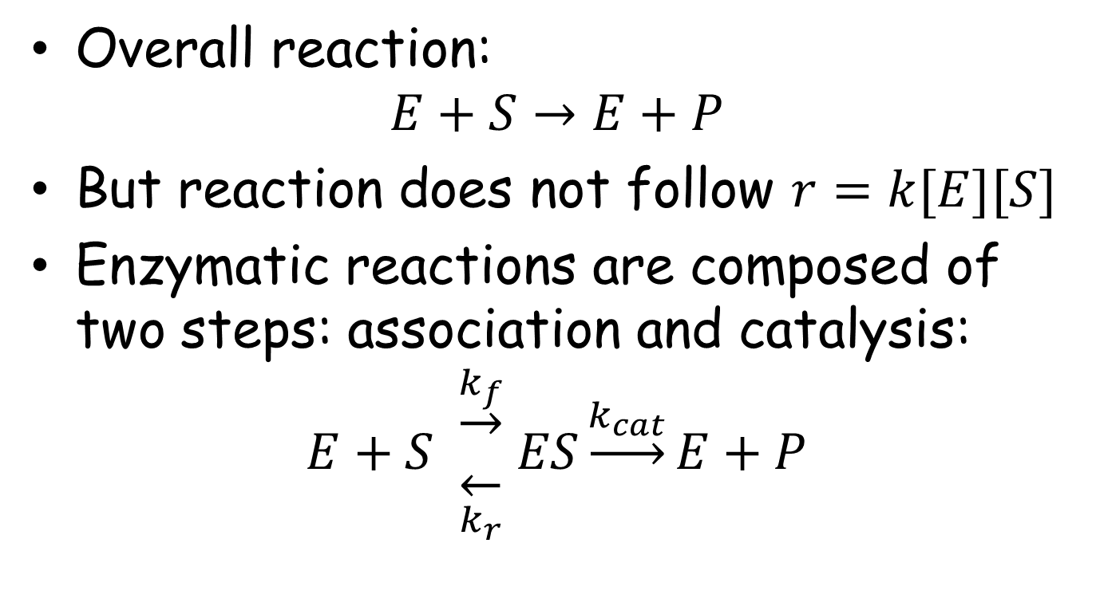
Enzyme Kinetics
Overall reaction:
$$E+S→E+P$$
But reaction does not follow $r=k[E][S]$
Enzymatic reactions are composed of two steps: association and catalysis:
$$E+S \begin{matrix}\underset{→}{k_{f}} \\ \overset{←}{k_{r}}\end{matrix} ES\underset{→}{k_{cat}}E+P$$

Slide 12
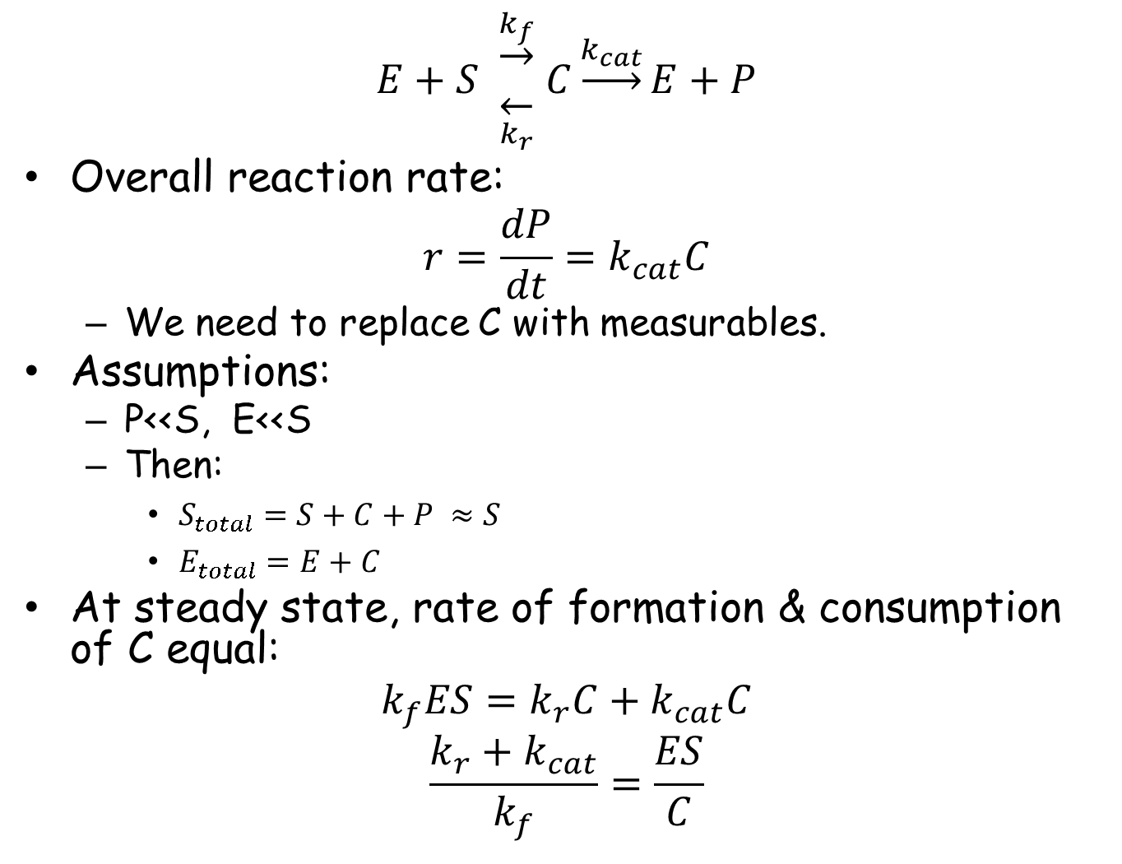
$$E+S \begin{matrix}\underset{→}{k_{f}} \\ \overset{←}{k_{r}}\end{matrix} C\underset{→}{k_{cat}}E+P$$
Overall reaction rate:
$$r=\frac{dP}{dt}=k_{cat}C$$
We need to replace C with measurables.
Assumptions:
P<<S, E<<S
Then:
$S_{total}=S+C+P ≈S$
$E_{total}=E+C$
At steady state, rate of formation & consumption of C equal:
$$k_{f}ES=k_{r}C+k_{cat}C$$
$$\frac{k_{r}+k_{cat}}{k_{f}}=\frac{ES}{C}$$

Slide 13
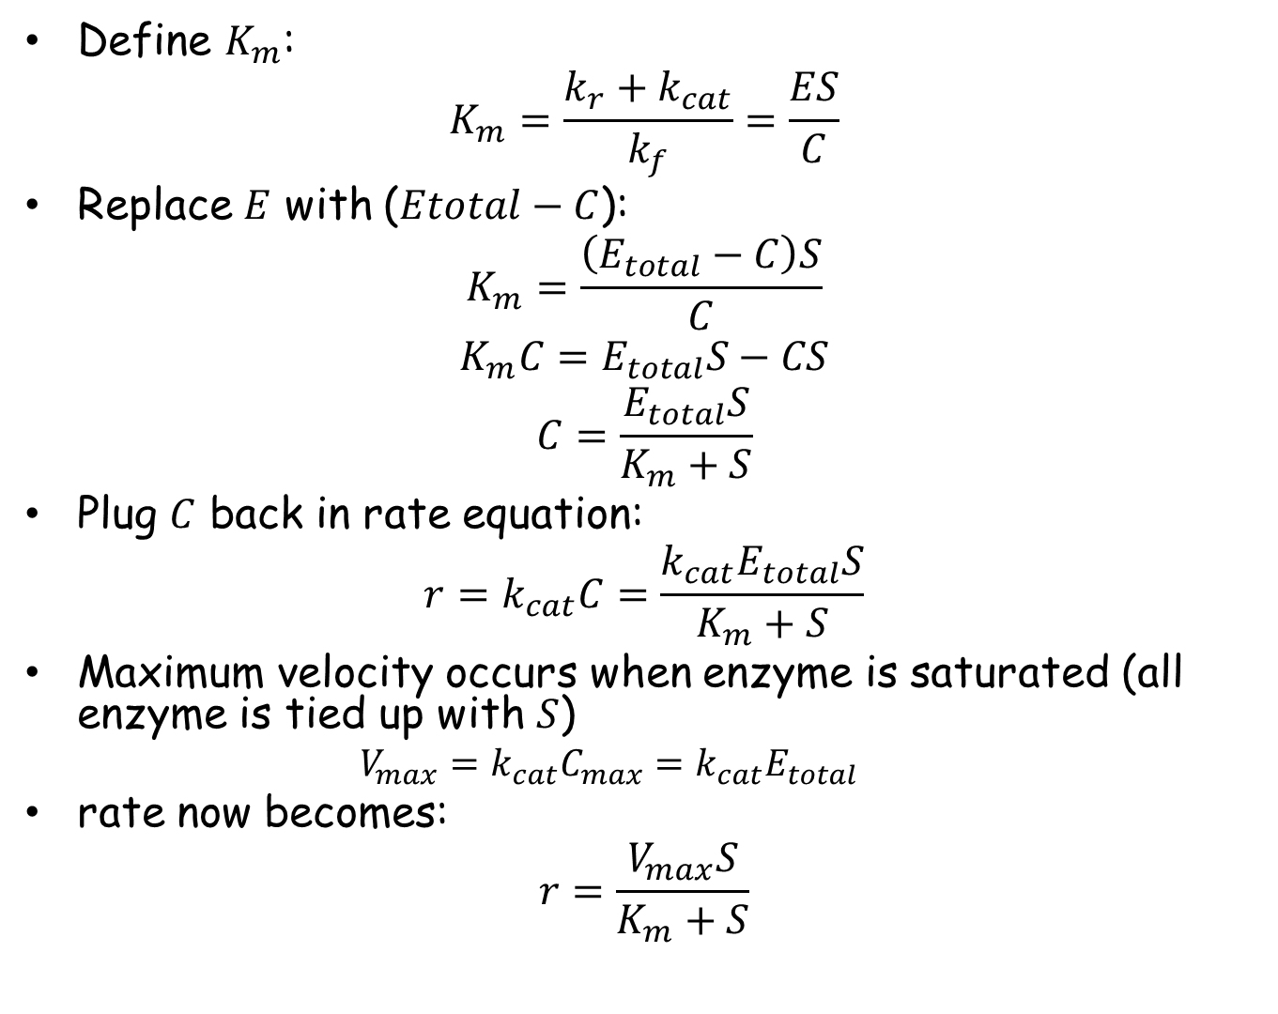
Define $K_{m}$:
$$K_{m}=\frac{k_{r}+k_{cat}}{k_{f}}=\frac{ES}{C}$$
Replace $E$ with ($Etotal−C$):
$$K_{m}=\frac{\left(E_{total}−C\right)S}{C}$$
$$K_{m}C=E_{total}S−CS$$
$$C=\frac{E_{total}S}{K_{m}+S}$$
Plug $C$ back in rate equation:
$$r=k_{cat}C=\frac{k_{cat}E_{total}S}{K_{m}+S}$$
Maximum velocity occurs when enzyme is saturated (all enzyme is tied up with $S$)
$${V_{max}=k}_{cat}C_{max}=k_{cat}E_{total}$$
rate now becomes:
$$r=\frac{V_{max}S}{K_{m}+S}$$

Slide 14
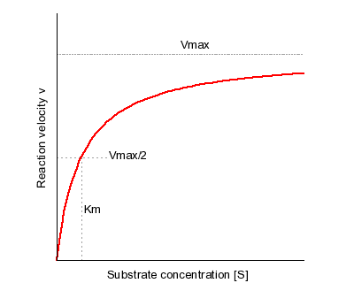
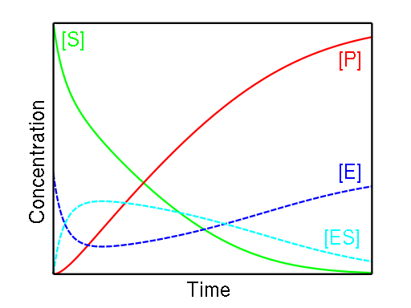

Michaelis-Menten Enzyme Kinetics
$$r=\frac{V_{max}S}{K_{m}+S}$$
There is a closed form solution.

Slide 15
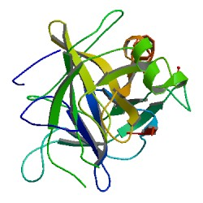
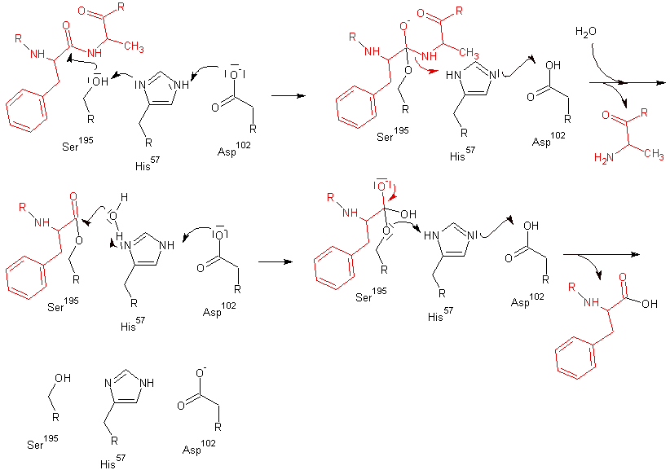
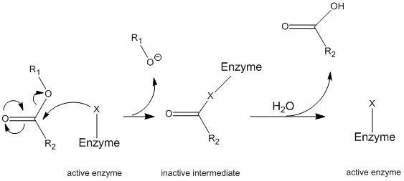
Example: Chymotrypsin
https://chem.libretexts.org/Core/Physical_and_Theoretical_Chemistry/Kinetics/Case_Studies%3A_Kinetics/Chymotrypsin_II
https://en.wikipedia.org/wiki/Chymotrypsin

Slide 16
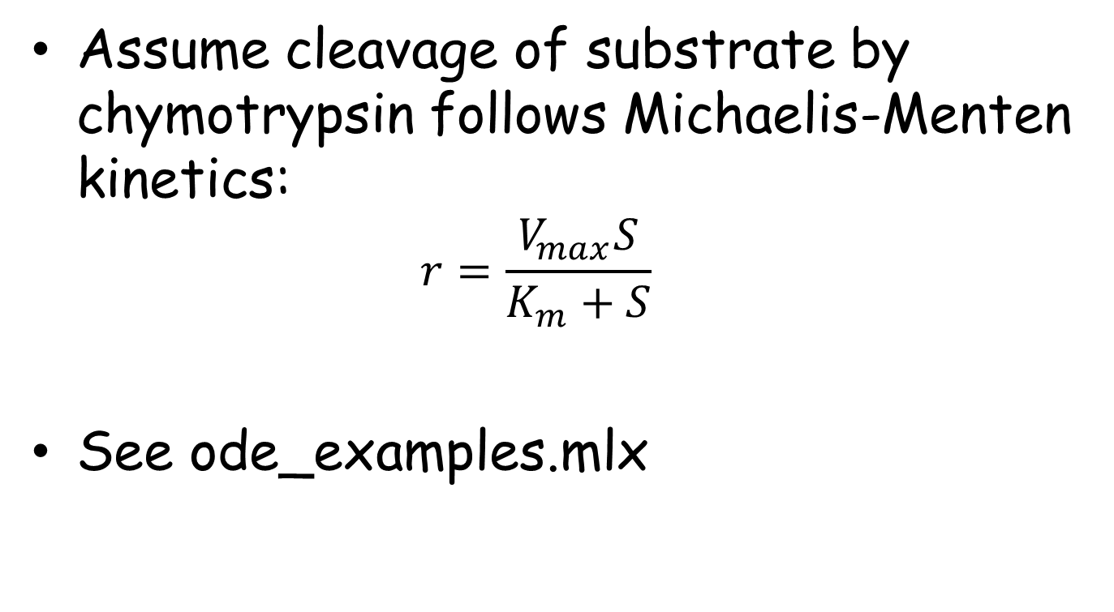
Example: Chymotrypsin
Assume cleavage of substrate by chymotrypsin follows Michaelis-Menten kinetics:
$$r=\frac{V_{max}S}{K_{m}+S}$$
See ode_examples.mlx

Slide 17
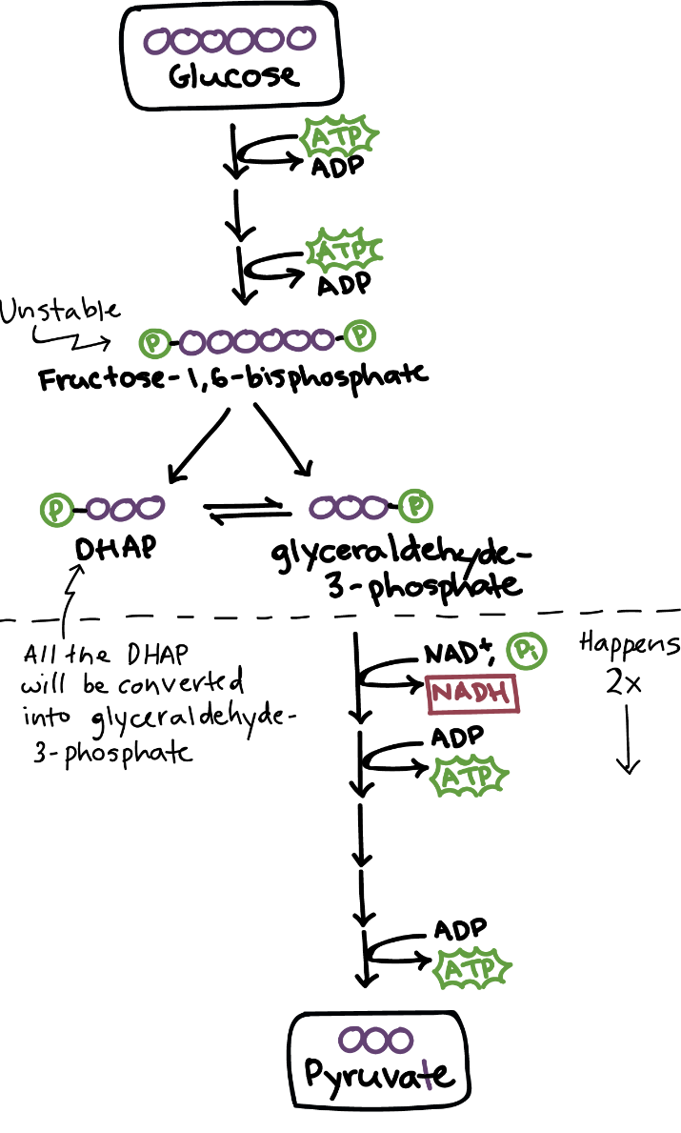
Network of Reactions: Glycolysis
https://www.khanacademy.org/science/biology/cellular-respiration-and-fermentation/glycolysis/a/glycolysis

Slide 18
Glycolytic Oscillations
Repetitive fluctuations in concentrations of metabolites (classical experiments in yeast and muscle)
G:intracellular glucose/hexose, T:ATP, I:triose phosphates, H:NADH, P:pyruvate, E:ethanol, A:acetate
http://citeseerx.ist.psu.edu/viewdoc/download?doi=10.1.1.158.5518&rep=rep1&type=pdf

Slide 19
Glycolytic Oscillations

Slide 20
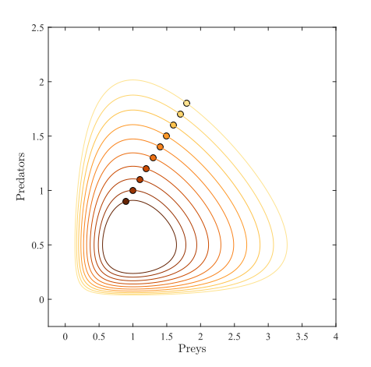
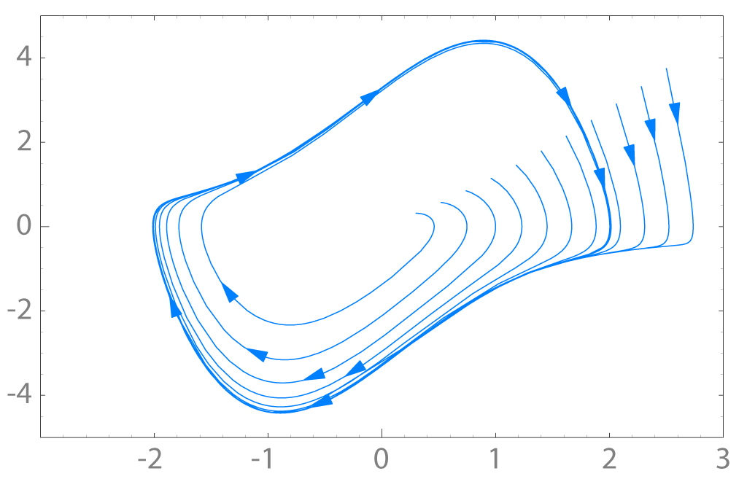
Glycolytic Oscillations
Limit Cycle in Glycolytic Oscillations is different than oscillations in Lotka-Volterra
Stable Limit Cycle: https://en.wikipedia.org/wiki/Limit_cycle
Lotka-Volterra
https://en.wikipedia.org/wiki/Lotka%E2%80%93Volterra_equations

Slide 21
Example
A generic three-component repressive network:
Mogilner et al., Developmental Cell 11:279–287, 2006.

