Slide 1

IPL Data Analysis
This project involves a comprehensive data analysis of IPL (Indian Premier League) matches from 2008 to 2022 using Power BI. The Power BI dashboard provides detailed insights into team performances, player statistics, match outcomes, and other key metrics.
Kabilan N

Slide 2

Features
1
Team Performance Analysis
Breakdown of wins, losses, and points across seasons.
2
Player Insights
Visual representation of player performance statistics, including runs, wickets, and strike rates.
3
Match Outcomes
Analysis of match results based on venues, toss decisions, and team head-to-head comparisons.
4
Trend Analysis
Graphical representation of trends over time, including season-wise performance.

Slide 3
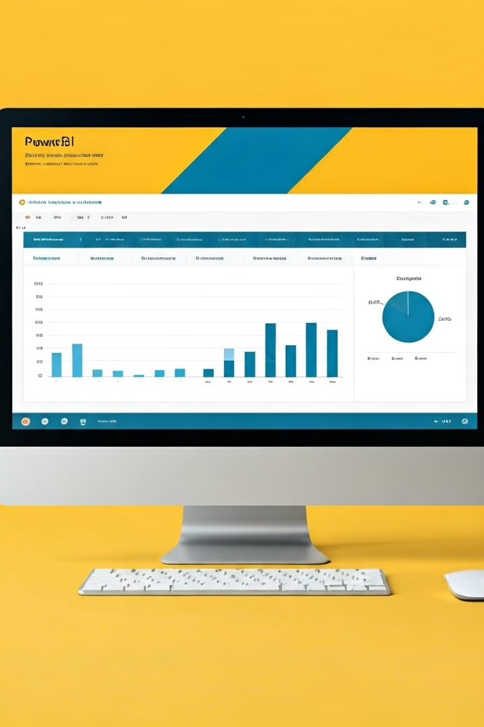
Tech Stack
Tool
Power BI
Data Source
IPL matches dataset (2008-2022)
Data Transformation
Power Query for cleaning and preprocessing raw data.
Visualizations
Bar charts, Donut charts, slicers and card visuals for dynamic data exploration.

Slide 4
Prerequisites
Power BI Desktop
IPL Dataset
Ensure Power BI Desktop is installed to open and interact with the dashboard.
The IPL dataset used for analysis is included in this repository.

Slide 5







Steps & DAX Measures
Import Raw Data
Import the IPL data from a local database or CSV file.
Data Exploration
Walk through the dataset to understand the structure and relationships.
Data Cleaning
Standardize values (e.g., replace "Bengaluru" with "Bangalore").
Data Processing
Create Calendar Table, Year Column, and establish relationships.
Design Dashboard
Add a background image and title. Include a slicer for selecting the season at the top.
KPI Design
Create KPIs like Title Winner, Economy, Batting Strike Rate, Batter Runs, Bowler Wickets, Average, Bowling Strike Rate, and Match Won or Loss Based Upon Toss.
Add Images
Include relevant images to visualize the data on respective cards for better understanding.

Slide 6
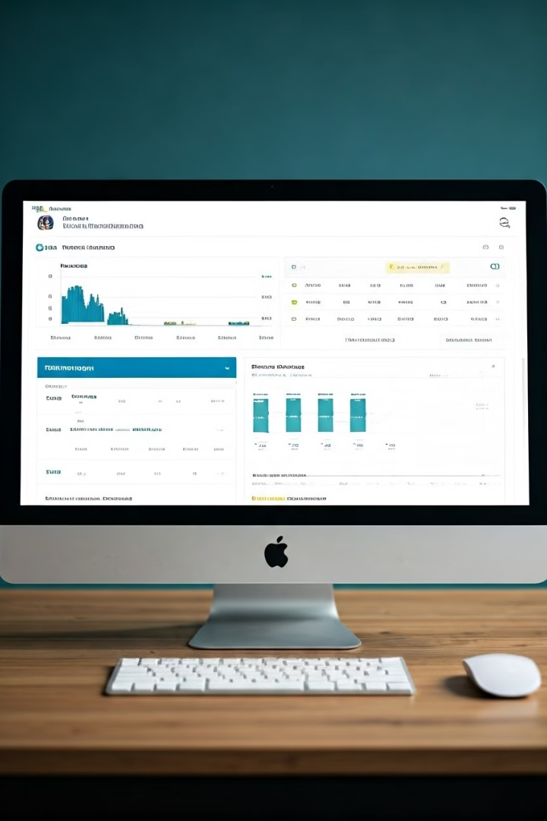




Dashboard Overview
Home Page
Provides an overview of the IPL season statistics, including total matches, teams, and top players.
Team Performance
Compare team performances across multiple seasons with detailed match outcomes.
Player Statistics
Analyze top performers in batting and bowling, with filters for specific players or teams.
Match Analysis
Insights into match results based on toss decisions, home and away performance, and venue-specific outcomes.

Slide 7

Customization
Data Source Update
You can update the data with new IPL seasons by refreshing the dataset and adjusting the visualizations accordingly.
Additional Metrics
Users can add new KPIs, custom measures, or adjust existing visualizations as per their needs.

Slide 8



Use Cases
Team Management
Fan Engagement
Broadcast Analysis
Evaluate team performance and player form to make strategic decisions.
Provide fans with insights into match outcomes, top performers, and team statistics.
Leverage the data for pre-match or post-match analysis on sports shows or digital platforms.

Slide 9

References
Power BI Service Link:
https://app.powerbi.com/reportEmbed?reportId=f17892d0-6dc8-44c4-8588-5d64cc61f6ff&autoAuth=true&ctid=2e16eeee-a116-4526-a9dd-8f93116f54c0

Slide 10

Thank You!
I appreciate everyone's patience and time to listen my IPL Analysis project.

