Slide 1


Supply Chain Analysis Power BI Dashboard
This project involves Supply Chain Analysis of raw data using Power BI. It offers insights into product performance, supplier relationships, and shipment metrics. The dashboard helps supply chain and procurement teams improve efficiency and reduce costs.
- Kabilan N
KN

Slide 2
Key Features
1
Product Performance
2
Supplier Insights
3
Geographic Analysis
Detailed breakdown of import volumes by supplier to assess performance.
Insights into shipment origins, including volume and value for each country.
Visualizations show import volumes and CIF values for key product categories.
4
Interactive Filters
Users can drill down into specific metrics for detailed analysis.

Slide 3
Tech Stack and Setup
Tools
Data Source
Power BI for visualization and Power Query for data transformation.
Supply Chain Import Data available in the excel file.

Slide 4
Data Preparation and Measures
1
Import Data
Import raw Supply Chain data from excel files.
2
Data Cleaning
Use Power Query to correct inconsistencies in supplier names and product descriptions.
3
Create Measures
Develop DAX necessary measures like total volume and total shipments.

Slide 5
Dashboard Overview
Home Page
Overview of total import volume, CIF value, and key metrics.
Product Analysis
Insights into product performance based on HS codes and costs.
Supplier Analysis
Detailed view of supplier performance and import volume.
Geographic Analysis
Visualization of import volumes from different countries and shipment modes.
Consignee Details
Visualization of imports volumes from Consignee State and City, along with details

Slide 6
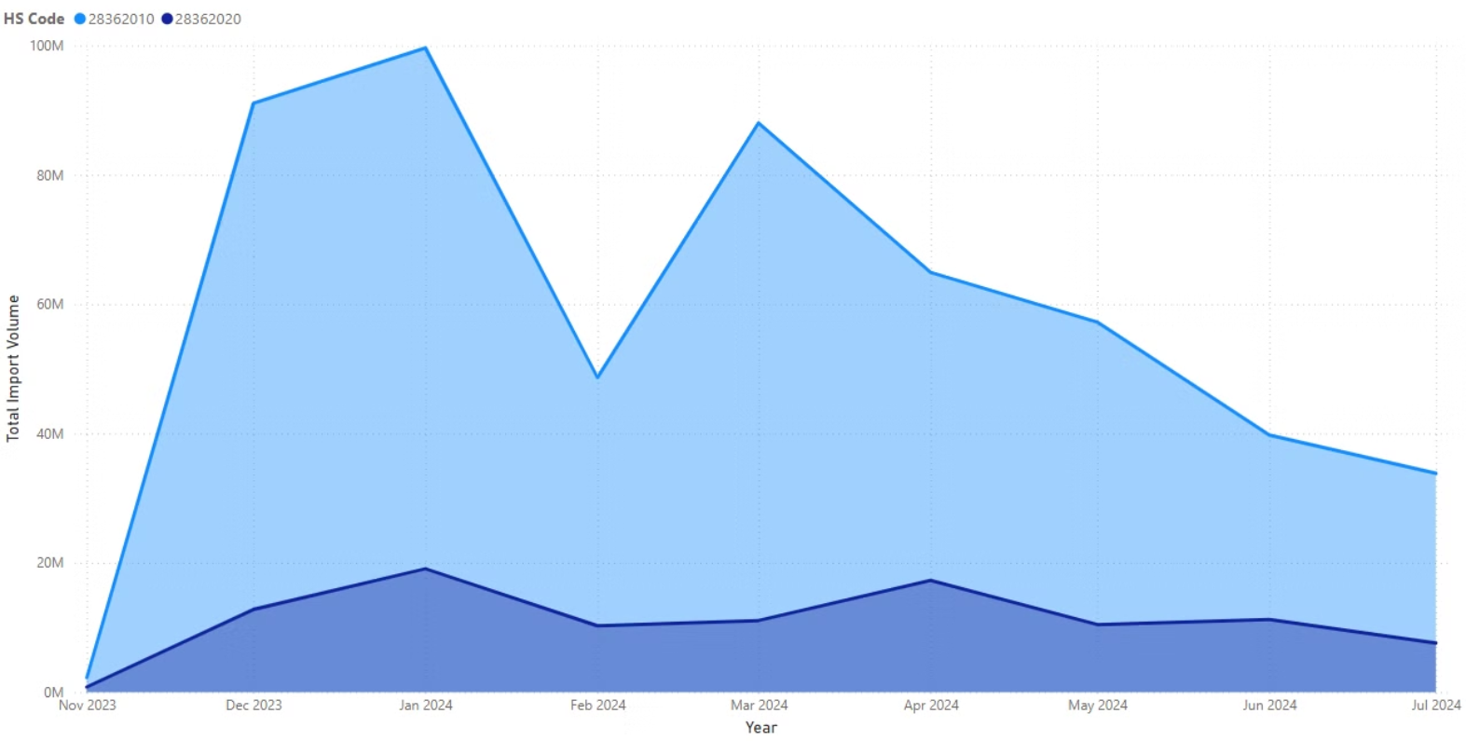
Key Insights: Product over volume.
HS Code 28362010 consistently leads in import volume, peaking in January 2024, followed by a sharp drop in February. After moderate fluctuations, both codes experience a decline towards July 2024, suggesting reduced demand or strategic import changes. HS Code 28362020 remains a smaller contributor.
The main products are HS 28362010 (83.94%) and HS 28362020 (16.06%), with HS 28362010 being the dominant import.

Slide 7
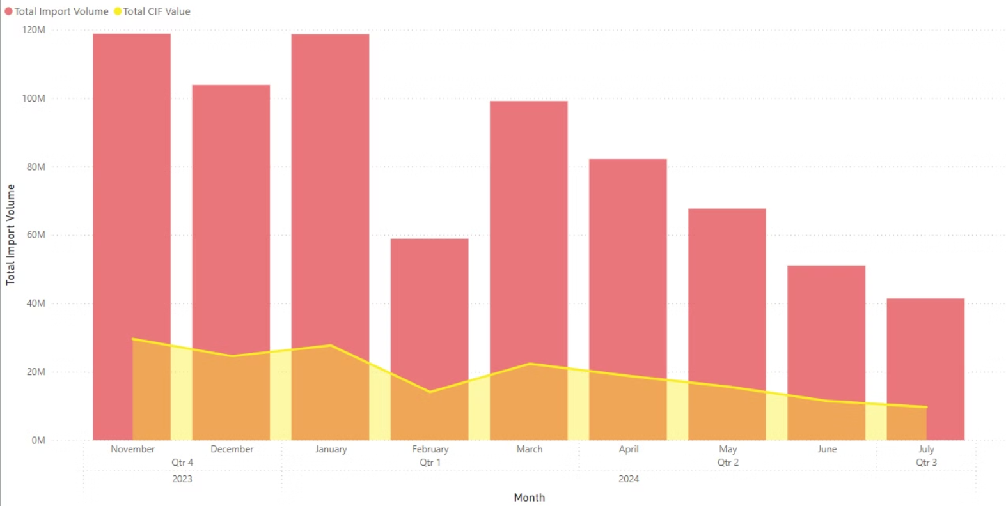
Volume and Value:
The overall trend shows decreasing import volumes, with stable CIF values, possibly indicating adjustments in pricing or product mix. February's dip could point to supply chain disruptions or market changes.

Slide 8



Geographic and Shipment Analysis
Geographic Focus
Shipment Modes
Volume & Value Trend
Turkey leads with over 300M units, followed by Russia (~150M) and the U.S. (~100M).
Air transport is the primary mode for most countries, including Turkey, Russia, and the U.S..
Steady growth from Nov 2023 to Jul 2024, indicating increasing demand.
Countries like the UAE, Kenya, and Uzbekistan also have significant volumes, while others like Bulgaria, China, and Bosnia contribute less.
Japan uses a mix (80% air, 20% sea), while Belgium relies solely on sea shipments
Turkey dominates overall import volumes.

Slide 9




Recommendations
Diversify Suppliers
Optimize Costs
Geographic Expansion
Market Analysis
Reduce risk and improve bargaining power by expanding supplier base.
Negotiate better terms, improve logistics, and explore bulk discounts.
Monitor raw material prices closely to protect margins.
Source from regions like Southeast Asia or Africa to reduce geopolitical risk.

Slide 10

Reference Links:
https://imagecolorpicker.com/ https://lordicon.com/ https://www.daxformatter.com/

