Slide 1
ADA23DLU02 - Computer Vision Laboratory
PROJECT PRESENTATION
CrickSense - Ball-by-Ball Analysis of a Cricket Broadcast from a Single Camera Feed
Presented By:
KABILASH S (E0323036)
PAVITRA P (E0323038)

Slide 2
CONTENT OVERVIEW
1. Problem Statement
2. Introduction
3. Objectives
4. Basic Research Survey
5. System Architecture
6. Proposed Methodology
7. Tools and Techniques
8. Results
9. Future Scope
10. Conclusion
11. Timeline
12. References

Slide 3
PROBLEM STATEMENT
A cricket broadcast shows one camera behind the bowler, a score bar and sometimes a radar speed; where the ball pitched, its line and speed are measured only by multi-camera installations at top matches.
The ball is 6-15 pixels across and moves 3-6 m between frames at 25 fps; the camera pans and zooms through every delivery, and the picture cuts to replays for most of each ball.
Runs, wickets and extras follow the Laws of Cricket and often happen off screen, so they cannot be seen in the picture alone.
Language models that write commentary state facts that are not in their input, so automated commentary cannot be trusted without checks.
Therefore there is a need for a system that measures each ball from the broadcast alone, keeps a checked match state, and speaks fact-checked commentary - offline and live.

Slide 4
INTRODUCTION
CrickSense is a computer-vision system that analyses a cricket match from its television broadcast alone - one camera feed, no sensors and no access to the broadcaster's data. It calibrates the pitch automatically from its painted creases, reads the broadcaster's score bar, detects and tracks the players and names them by role, and finds each delivery's bounce, length, line and speed.
A score engine keeps the match state by the Laws of Cricket and checks it against the score bar after every ball. From these measured facts, a language model writes ball-by-ball commentary in which every line is fact-checked, spoken by a local text-to-speech model over the crowd. A live mode runs the time-critical parts as the video plays, on one laptop GPU.

Slide 5
OBJECTIVES
To calibrate the broadcast camera to the pitch automatically, every frame, without hand-clicked points.
To read the score bar reliably over a whole match and use it as the source of outcomes.
To detect and track the players and give them roles and names.
To find each delivery's bounce, length, line and speed, and measure their accuracy against radar.
To keep score, strike and bowler figures by the Laws, checked against the bar after every ball.
To generate fact-checked commentary and speech and render the annotated video.
To run outcomes, speed and named players live, and measure the latency.

Slide 6
BASIC RESEARCH SURVEY
S.No | Paper Title & Year | Author & Publication | Technique / Methodology | Advantages | Limitations
1 | Deep-learning-based segmentation of ball deliveries and tracking in cricket (2022) | K. Abbas et al., arXiv | YOLO and MobileNet for delivery segmentation; RetinaNet for ball localisation | Robust delivery segmentation; curated cricket dataset | No pitch calibration, so no length, line or speed
2 | Hawk-Eye tennis system (2003) | N. Owens, C. Harris, C. Stennett, IEE VIE | Calibrated high-speed cameras; 3D ballistic reconstruction | Broadcast-grade bounce and trajectory accuracy | Needs an installation at the venue; expensive
3 | TrackNet: tracking high-speed and tiny objects in sports (2019) | Y.-C. Huang et al., IEEE AVSS | Heatmap CNN over consecutive frames | Finds tiny, blurred balls; handles short occlusions | Fixed camera; needs labelled sequences
4 | TTNet: real-time temporal and spatial video analysis of table tennis (2020) | R. Voeikov et al., IEEE/CVF CVPR Workshops | Multi-task network: ball detection, event spotting, segmentation | Real-time; detects events as well as the ball | Fixed camera; another sport

Slide 7
BASIC RESEARCH SURVEY
S.No | Paper Title & Year | Author & Publication | Technique / Methodology | Advantages | Limitations
5 | Sports field localization via deep structured models (2017) | N. Homayounfar et al., IEEE CVPR | Field-line segmentation with a structured model of camera parameters | Calibrates broadcast frames with no clicks | Needs a large field with many lines in view
6 | Sports camera calibration via synthetic data (2019) | J. Chen, J. J. Little, IEEE/CVF CVPR Workshops | Learned from synthetic views of the field; feature retrieval and refinement | Works on broadcast football | Needs a field model and training data
7 | BoT-SORT: robust associations multi-pedestrian tracking (2022) | N. Aharon et al., arXiv | Kalman tracking with camera-motion compensation and re-identification | Strong multi-object tracking accuracy | Camera motion from image features; no roles
8 | CricShotClassify: classifying batting shots from cricket videos (2021) | A. Sen et al., Sensors | CNN with a gated recurrent unit on shot clips | Good accuracy on labelled shot clips | Needs a labelled shot set; no pitch geometry

Slide 8
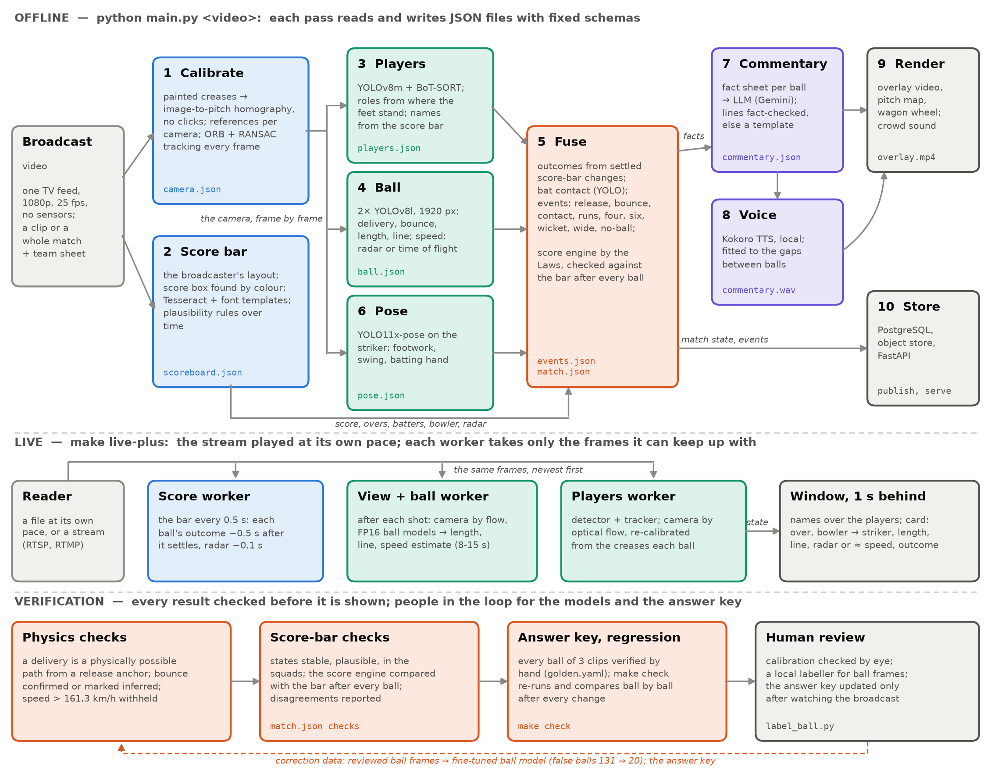
SYSTEM ARCHITECTURE

Slide 9
PROPOSED METHODOLOGY
Video → Calibrate → Score bar → Players → Ball → Pose → Fuse → Commentary → Voice → Render → Live
Input: a broadcast clip or a whole match (MP4, 1080p, 25 fps) or a live stream, with the match's team sheet.
Calibration: white-line candidates from the painted creases give hypotheses for the crease corners; each defines a homography from image pixels to pitch metres, scored by how much of the regulation creases lands on paint. A camera view is accepted only with two strong agreeing frames.
Camera tracking: every frame is registered to the reference views with ORB features and RANSAC, and smoothed with a Savitzky-Golay filter.
Score bar: the broadcaster's layout fields and the score box found by colour, read with Tesseract and font templates; a state is trusted only if stable and plausible.

Slide 10
TOOLS AND TECHNIQUES
Tools
Python, OpenCV, PyTorch, Ultralytics YOLOv8 / YOLO11, BoT-SORT, Tesseract OCR, Gemini API, Kokoro TTS, Demucs, FFmpeg, PostgreSQL, FastAPI
Techniques
Homography calibration from the painted creases, ORB + RANSAC camera tracking, optical flow, multi-object tracking with role assignment, physically constrained ball tracking and time-of-flight speed, OCR with font templates, a rule-based score engine, fact-checked language generation, FP16 inference
Datasets
ICC Men's T20 World Cup 2024 broadcasts (the final and a Super 8 match); three hand-verified answer-key clips; 20 random benchmark clips; 94 hand-reviewed frames for fine-tuning the ball model

Slide 11
RESULTS
Measure | Result
Calibration vs hand-clicked crease corners | 7 of 8 corners within 3.3 px
20 random clips of the final, no clicks | 14 calibrated, none wrongly
Score bar over two whole matches | all 4 final scores exact (176-7, 169-8, 205-5, 181-7)
Deliveries on three answer-key clips | 21 / 21 found, 21 / 21 outcomes right
Score engine against the score bar | 230 / 230 checks agree
Our speed estimate vs radar | 5.7% median error on the final (8.3% over both matches)
Player identities (development clip) | 51 identities for 51 appearances
TV commentators removed (Demucs, 2 passes) | voice between our lines: 213 s → 0 s

Slide 12
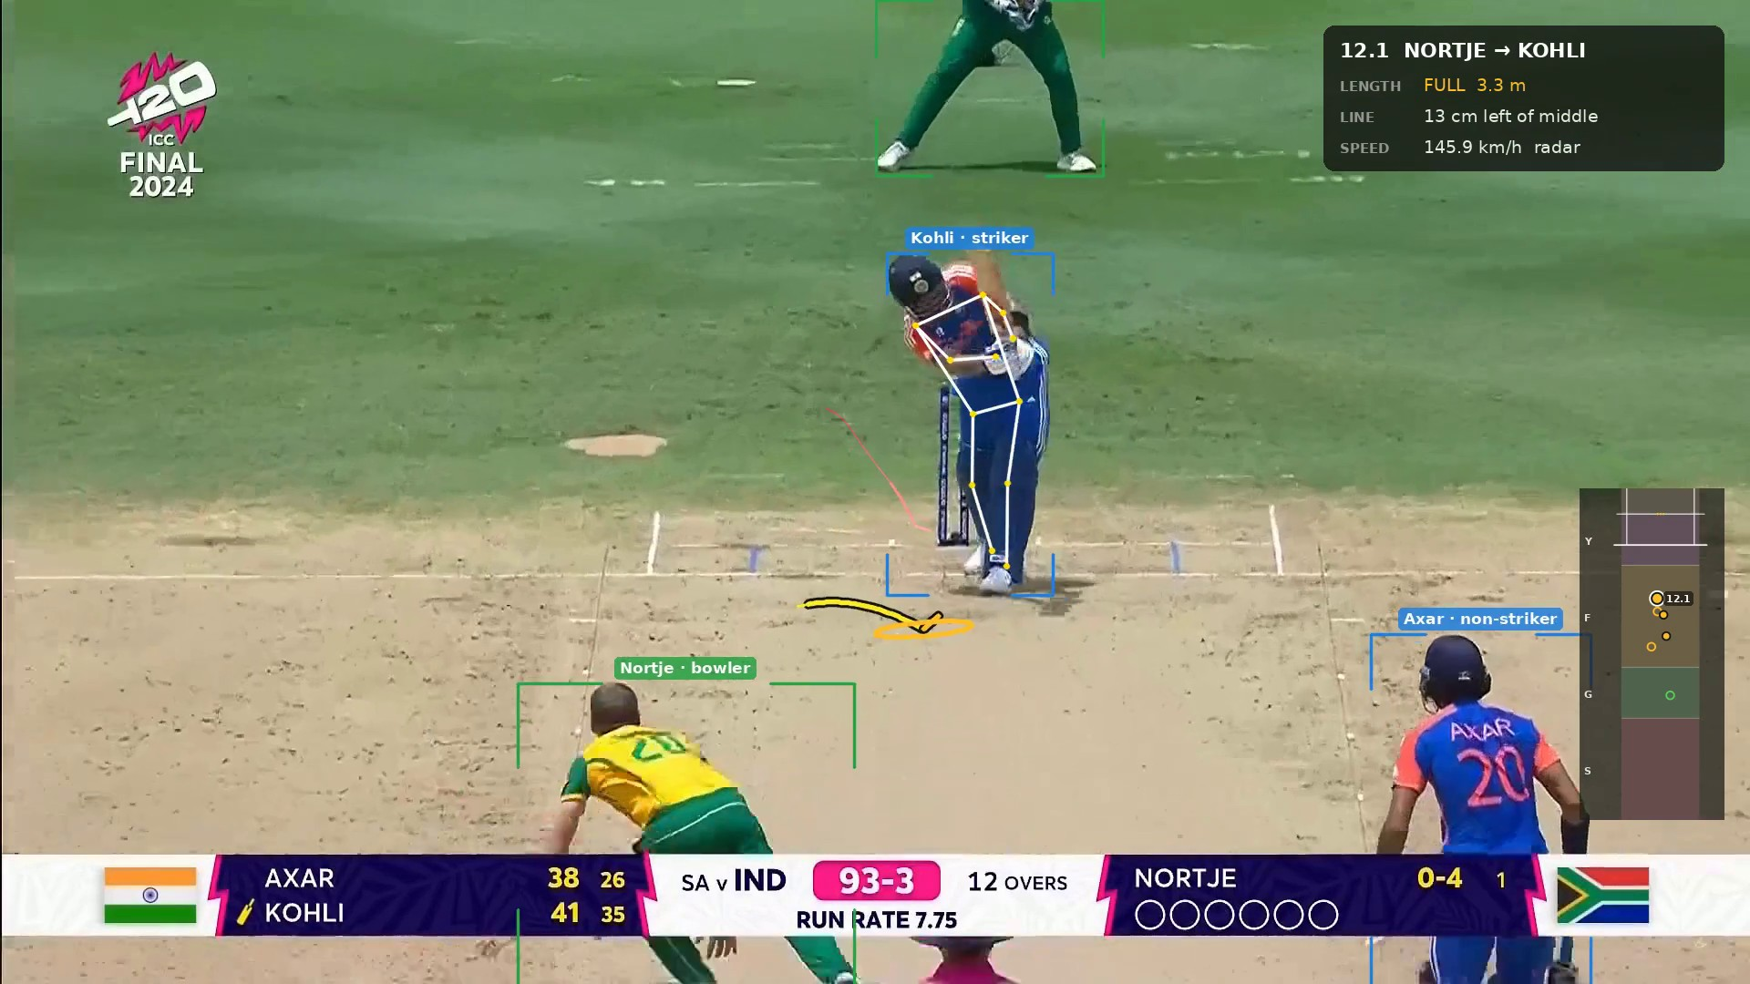
RESULTS
Ball 12.1, Nortje to Kohli: named players, the striker's pose, the ball's path and bounce, and the delivery card

Slide 13
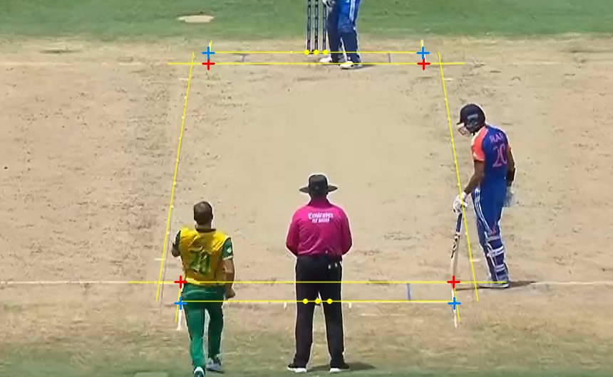
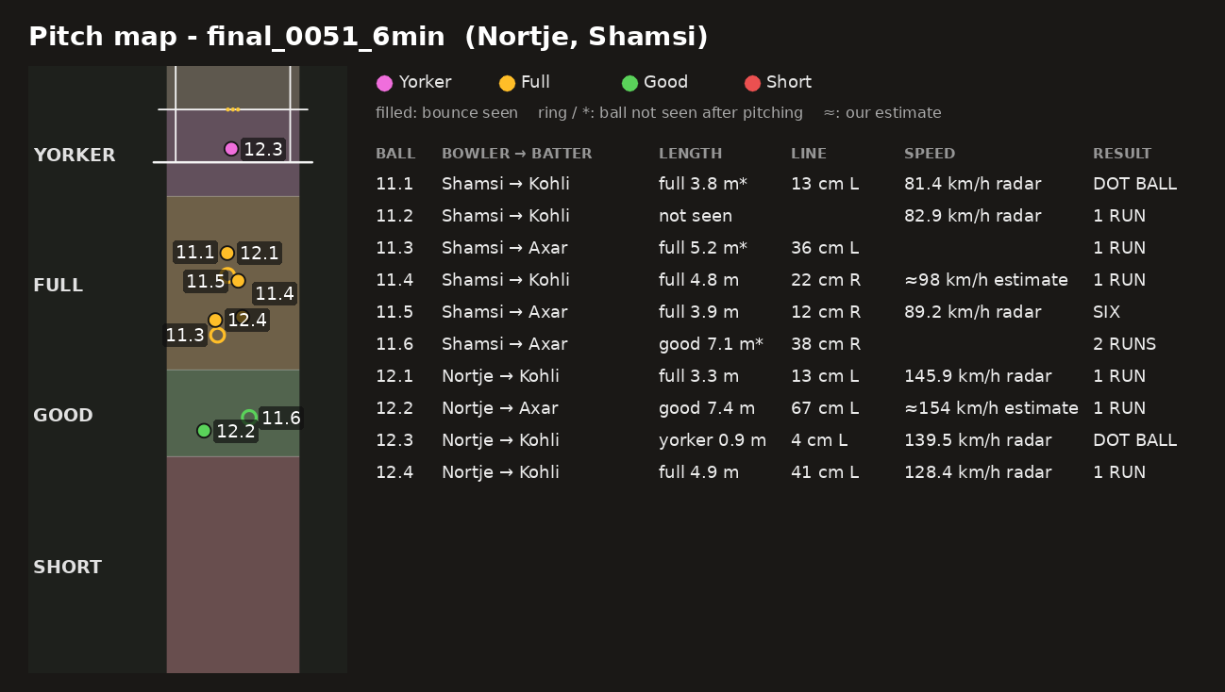
RESULTS
Automatic calibration: creases projected through the homography
Pitch map: bounce, length, line, speed and result per ball
Score-bar fields read every 0.5 s

Slide 14
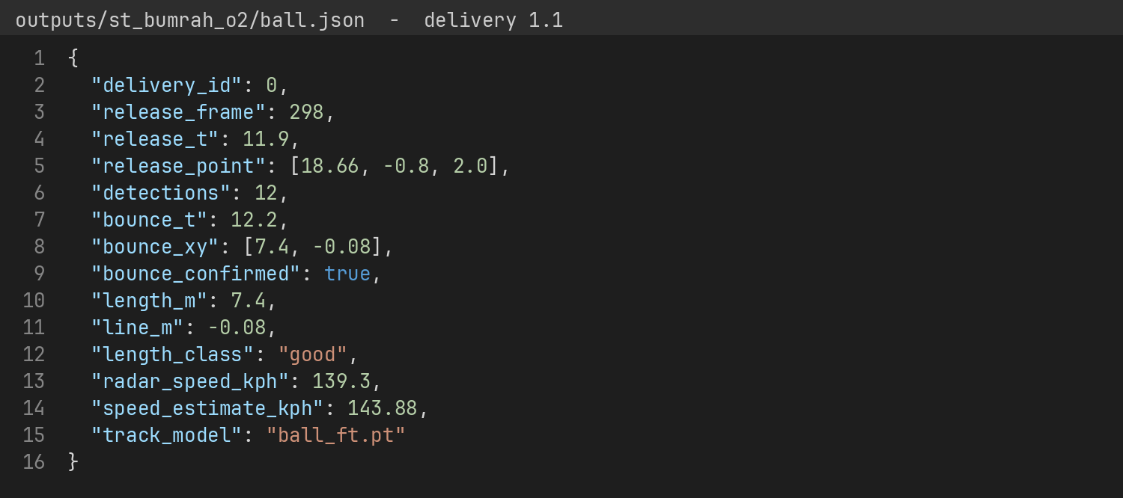
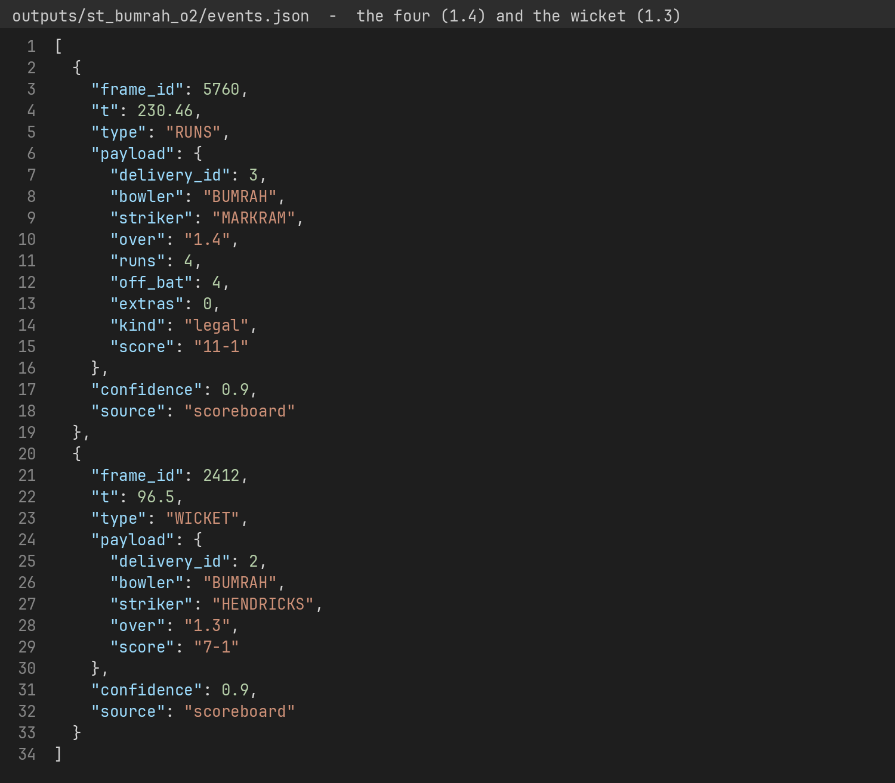
RESULTS
ball.json: a delivery's geometry and speed
Every pass writes JSON with a fixed schema; the next pass reads it.
ball.json: release, bounce, length 7.40 m, line, radar 139.3 vs our 143.9 km/h.
events.json: each ball's events, with their source and confidence.
events.json: the four and the wicket

Slide 15
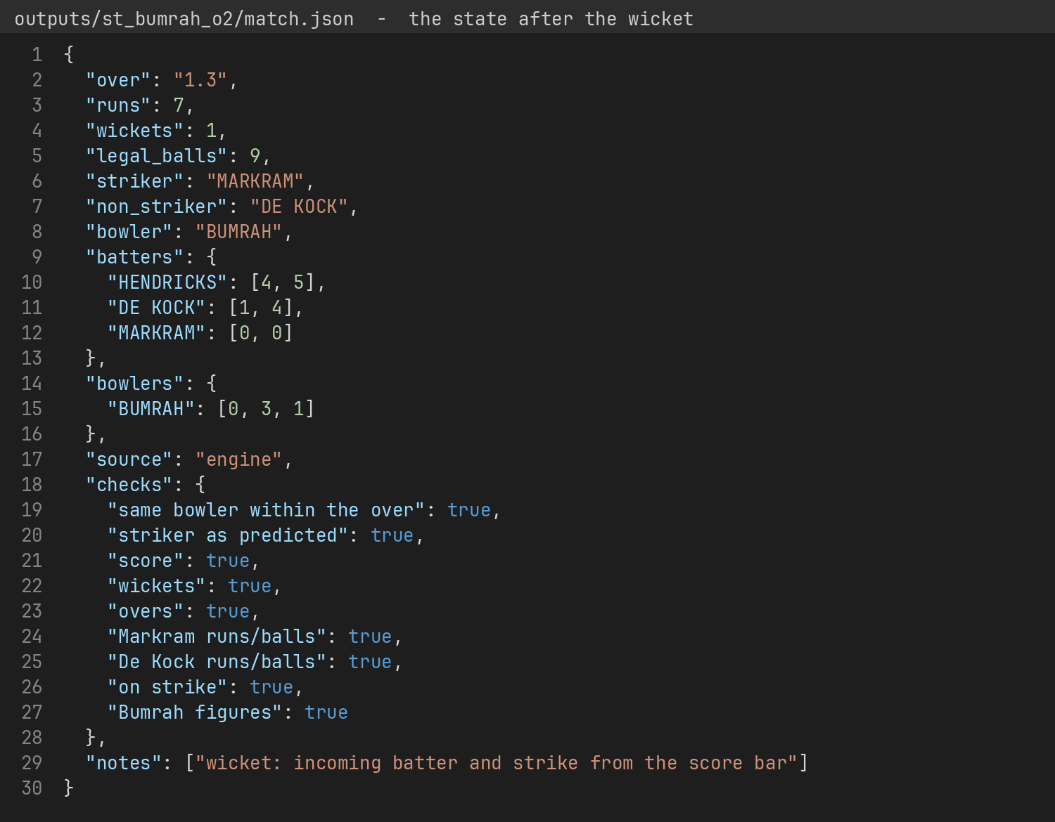
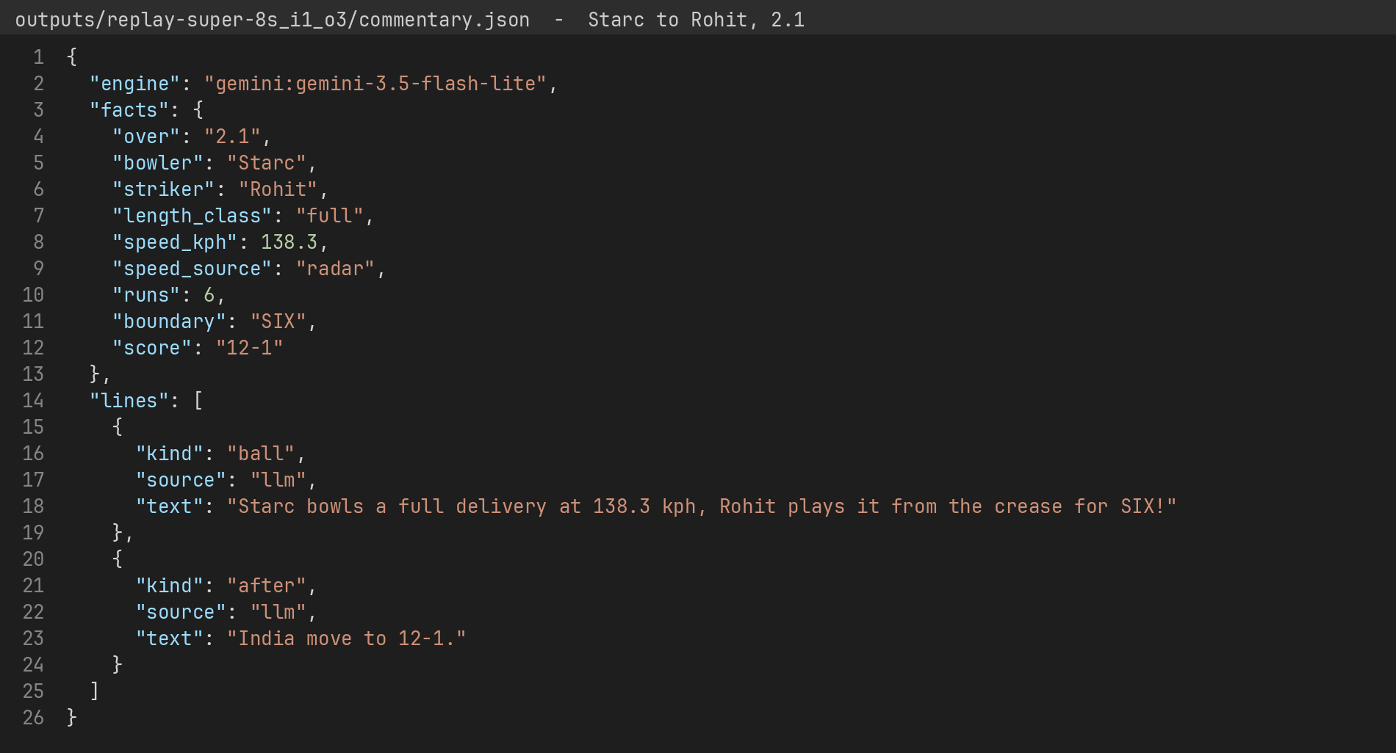
RESULTS
commentary.json: the facts and the line written from them
match.json is checked against the broadcaster's score bar after every ball - here all true.
commentary.json: the line passed the fact check - every number and name is in the facts.
match.json: the state after the wicket, every check true

Slide 16
RESULTS

Slide 17
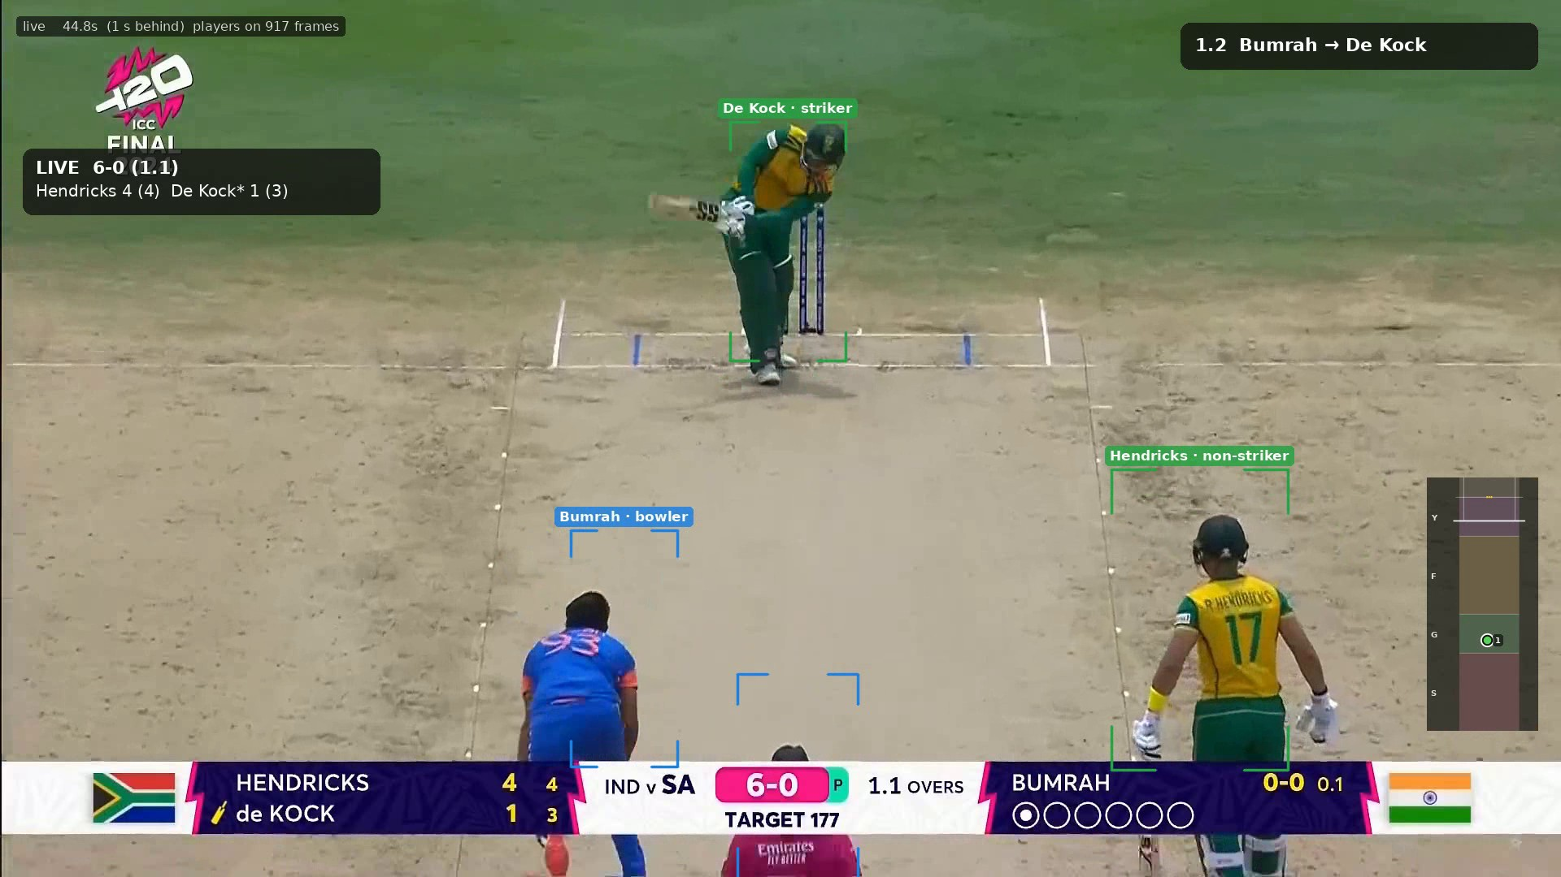
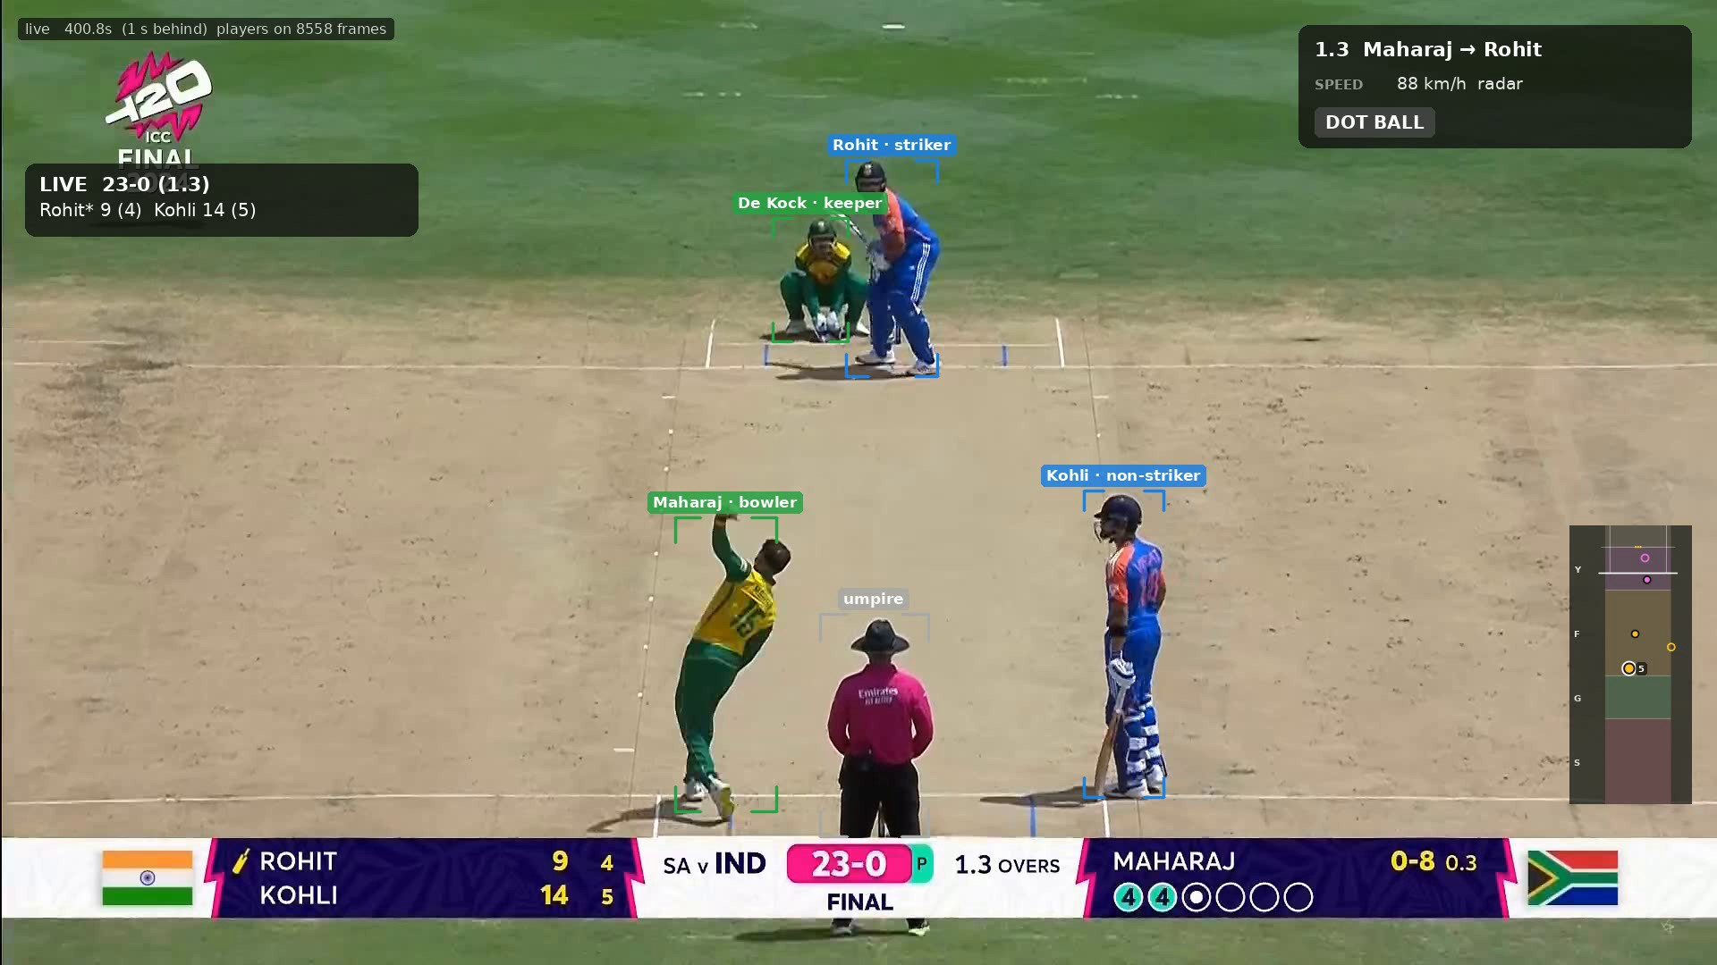
RESULTS
Live, Bumrah's over: striker, non-striker, bowler and umpire named
Live, the whole final: names re-calibrated from the creases
Live on one laptop GPU: each ball's outcome 0.5 s after the score bar, radar 0.1 s, length, line and our speed 12-23 s after the ball.
FP16 made the ball model 3.3× faster; the optical-flow camera stays within 0.25 m of the offline calibration.

Slide 18
FUTURE SCOPE
Use 50 fps footage and labelled frames of the ball's first flight to improve pace-bowling speed and recover missed deliveries.
Make crease calibration faster so that players are named live through a whole match.
Build a labelled answer key for shot types, so that a vision-language model can be scored before it is used.
Add score-bar layouts for other broadcasters and a short ball-labelling round for each new broadcast.
Use multi-camera input where available for 3D ball trajectories.

Slide 19
CONCLUSION
In conclusion, CrickSense measures a cricket match from its broadcast alone. It calibrates the pitch from its painted creases, reads the score bar over whole matches, names the players by role, and finds each delivery's length, line and speed, keeping a match state by the Laws of Cricket.
On held-out clips all 21 deliveries and outcomes were right, the score engine agreed with the bar on 230 of 230 checks, both matches' final scores were read exactly, and our speed estimate was within 5.7% of radar on the final. With fact-checked commentary and a live mode on one laptop GPU, CrickSense turns a broadcast into verified ball-by-ball analysis.

Slide 20
TIMELINE
27/09/26 - 29/09/26 (3 days) | Package skeleton, calibration and camera tracking; players pass with roles and names; ball pass
30/09/26 - 01/10/26 (2 days) | Fuse and score engine, overlay, commentary and voice; automatic calibration; storage, API and live mode
02/10/26 - 14/10/26 (13 days) | Pace (Bumrah's over), multi-reference calibration, score-bar font templates, answer-key regression check
15/10/26 - 20/10/26 (6 days) | Live mode re-measured, voice options, the second match (Super 8), the one-command pipeline
21/10/26 - 28/10/26 (8 days) | Commentary on Gemini, TV commentators removed with Demucs, live-plus with named players
29/10/26 (1 day) | Live naming over a whole match (crease re-calibration); project report

Slide 21
GUIDE DETAILS
Guide
Dr. Nirmala B
Assistant Professor
Department of Artificial Intelligence and Data Analytics
Sri Ramachandra Faculty of Engineering and Technology
SRIHER, Porur, Chennai - 600 116

Slide 22
REFERENCES
[1] G. Thomas, R. Gade, T. B. Moeslund, P. Carr and A. Hilton, "Computer vision for sports: Current applications and research topics," Comput. Vis. Image Underst., vol. 159, pp. 3-18, 2017.
[2] N. Owens, C. Harris and C. Stennett, "Hawk-eye tennis system," in Proc. Int. Conf. Visual Information Engineering, 2003, pp. 182-185.
[3] K. Abbas et al., "Deep-learning-based computer vision approach for the segmentation of ball deliveries and tracking in cricket," arXiv:2211.12009, 2022.
[4] Y.-C. Huang et al., "TrackNet: A deep learning network for tracking high-speed and tiny objects in sports applications," in Proc. IEEE AVSS, 2019.
[5] R. Voeikov, N. Falaleev and R. Baikulov, "TTNet: Real-time temporal and spatial video analysis of table tennis," in Proc. IEEE/CVF CVPR Workshops, 2020.
[6] N. Homayounfar, S. Fidler and R. Urtasun, "Sports field localization via deep structured models," in Proc. IEEE CVPR, 2017.
[7] J. Chen and J. J. Little, "Sports camera calibration via synthetic data," in Proc. IEEE/CVF CVPR Workshops, 2019.
[8] R. Hartley and A. Zisserman, Multiple View Geometry in Computer Vision, 2nd ed. Cambridge, U.K.: Cambridge Univ. Press, 2004.
[9] N. Aharon, R. Orfaig and B.-Z. Bobrovsky, "BoT-SORT: Robust associations multi-pedestrian tracking," arXiv:2206.14651, 2022.
[10] E. Rublee, V. Rabaud, K. Konolige and G. Bradski, "ORB: An efficient alternative to SIFT or SURF," in Proc. IEEE ICCV, 2011.
[11] A. Sen, K. Deb, P. K. Dhar and T. Koshiba, "CricShotClassify: An approach to classifying batting shots from cricket videos using a CNN and gated recurrent unit," Sensors, vol. 21, no. 8, p. 2846, 2021.
[12] Z. Ji et al., "Survey of hallucination in natural language generation," ACM Comput. Surv., vol. 55, no. 12, 2023.
[13] S. Rouard, F. Massa and A. Défossez, "Hybrid transformers for music source separation," in Proc. IEEE ICASSP, 2023.

Slide 23
THANK YOU

