Slide 1
Predicting the success of marketing campaign
Kumararatnam Kabilesh

Slide 2
Introduction
Companies use direct marketing when targeting segments of customers by contacting them to meet a specific goal.
The banking sector is one of those industries that exercise direct marketing campaigns, in this case phone calls.
Sometimes even though many marketing calls are made, only some of them may result in success.
Therefore, predicting if the calls made result in success can help the marketing team to arrive at a conclusion of success of the campaign and adjust the number of calls accordingly.

Slide 3
Data
The dataset was picked from UCI Machine Learning Repository
Input variables:
Attributes about bank client data
age, job, marital, education, default, housing, loan,
Attributes related with the last contact of the current campaign
Contract, month, day_of_week, duration, campaign, pdays, previous, poutcome
Social and economic context attributes
emp.var.rate, cons.price.idx, cons,.conf.idx, Euribor3m, nr.employed
Output variable (desired target):
y - has the client subscribed a term deposit? (binary: 'yes', 'no')

Slide 4
Methodology
This is a binary classification problem. Our two classes are “yes” denoting that the customer subscribed to a term deposit, and “no” denoting that the customer did not subscribe.
Shape of data - (41188, 21)
The missing values had value as ‘unknown’ instead of ‘Nan’ or ‘null’. Records with missing values were either removed, or ‘unknown’ wasa used as a value.
Categorical attributes that are ordinal were encode with OrdinalEncoder and categorical attributes that are not ordinal were encoded with LabelEncoder.

Slide 5

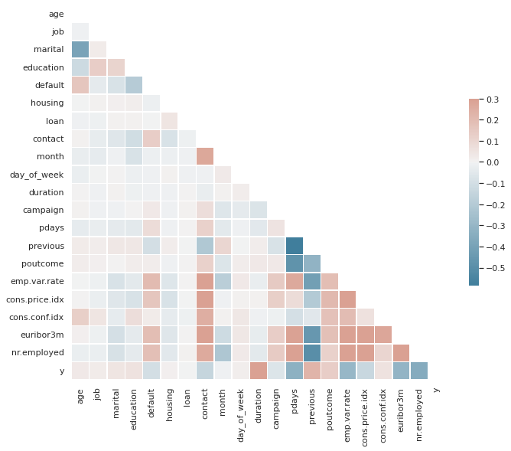



Methodology
Correlation between attributes

Slide 6
Methodology
Models Trained
Logistic Regression
SVM
Naïve Bayes
Random Forest
XgBoost

Slide 7
Results
Model | Accuracy | Precision | Recall | F1-score
Logistic Regression | 0.9077 | 0.7881 | 0.6853 | 0.6853
Naïve Bayes | 0.8493 | 0.6697 | 0.7455 | 0.6951
Support Vector Machine | 0.8870 | 0.6941 | 0.5058 | 0.4830
Random Forest | 0.9136 | 0.7960 | 0.7326 | 0.7590
Random Forest with feature selection | 0.9136 | 0.7921 | 0.7456 | 0.7660
XgBoost | 0.9049 | 0.8380 | 0.6097 | 0.6503

Slide 8
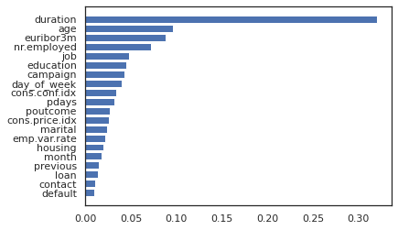
Feature Importance

Slide 9
Conclusion
As it can be seen from the above table, ensemble based models and xgBoost perform the best. Random Forest with feature selection gave better performance than the one without feature selection.
The obtained results are credible for the banking domain and provide valuable knowledge for the telemarketing campaign manager.

