Slide 1
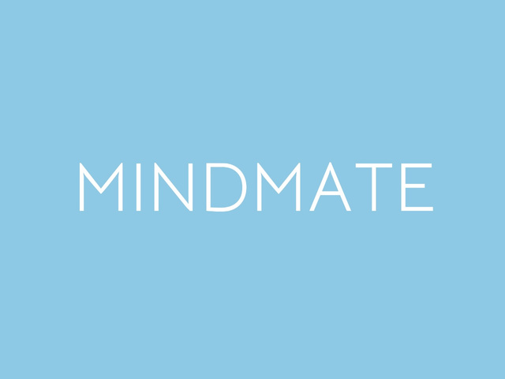

YOUR PATH TO CLARITY AND CALM STARTS HERE
Mental Health and Well Being

Slide 2
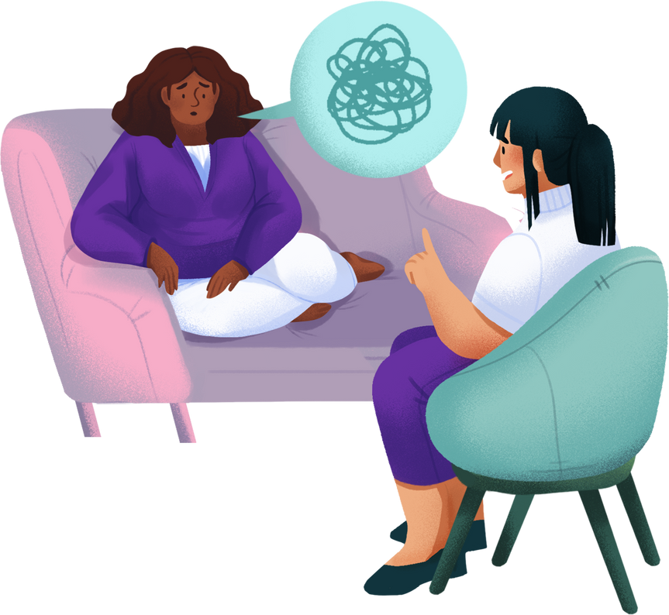
Connect to Therapists Anonymously
Users can find and connect with therapists without having to disclose any personal information. No more uncomfortable data sharing—just seamless, private interactions powered by the solidity blockchain.

Slide 3
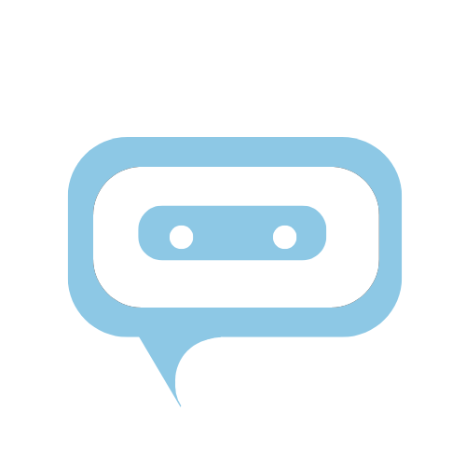
AI Chatbot
Secure AI Chatbot: The AI chatbot provides a safe and confidential environment for users to chat and seek preliminary support. No personal data is required to engage with the chatbot, maintaining user anonymity at all times.

Slide 4


Blockchain and Smart Contracts
Blockchain Integration: Utilizing blockchain technology to ensure secure and transparent transactions. This feature enhances the trust and reliability of the platform.
Smart Contracts: Implementing smart contracts for automating agreements between users and therapists. This ensures that all terms are met without requiring intermediary involvement, maintaining privacy and efficiency.

Slide 5
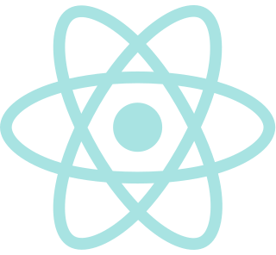
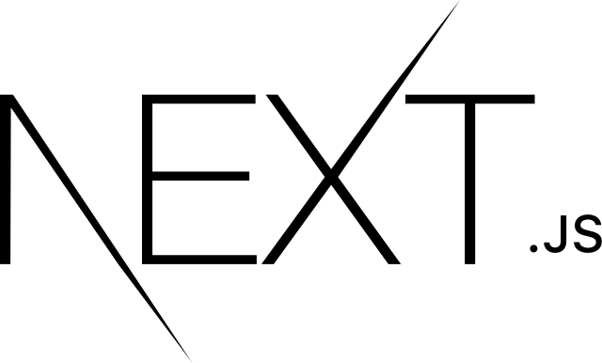
Technology Stack
Next.js and React.js: For building a robust and dynamic front-end interface, ensuring a seamless user experience.
Flask: To handle the back-end services, offering a lightweight and efficient framework for API development.
Generative AI: Used to power the AI chatbot, providing personalized and insightful interactions.

Slide 6
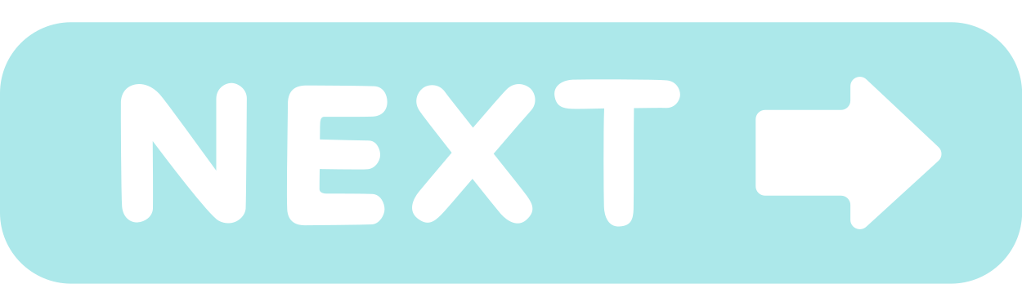
User Flow
Pictures showing the user journey from interacting with the AI chatbot to finding a therapist

Slide 7
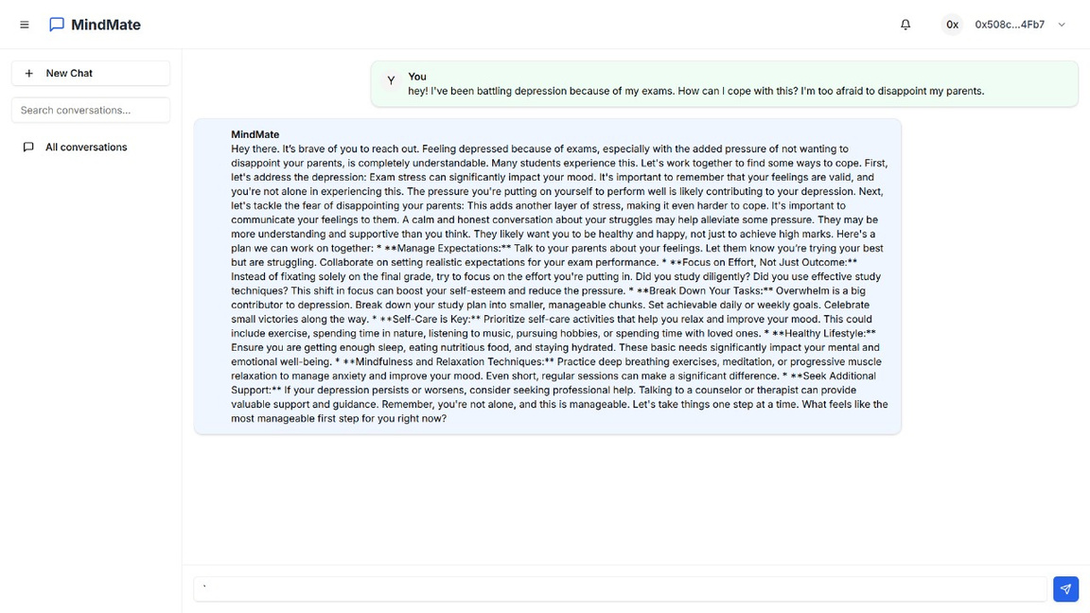
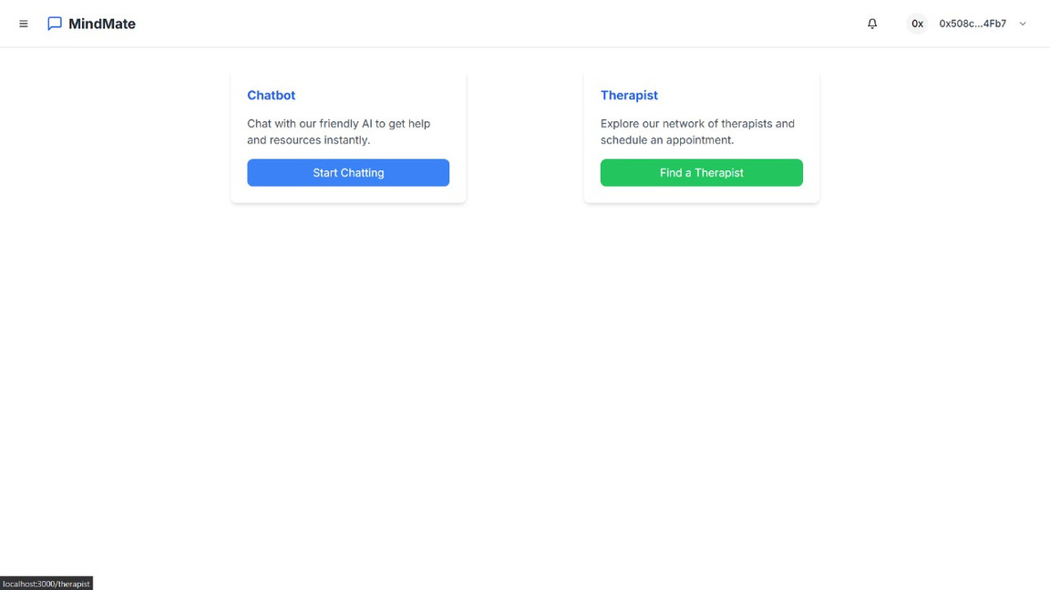
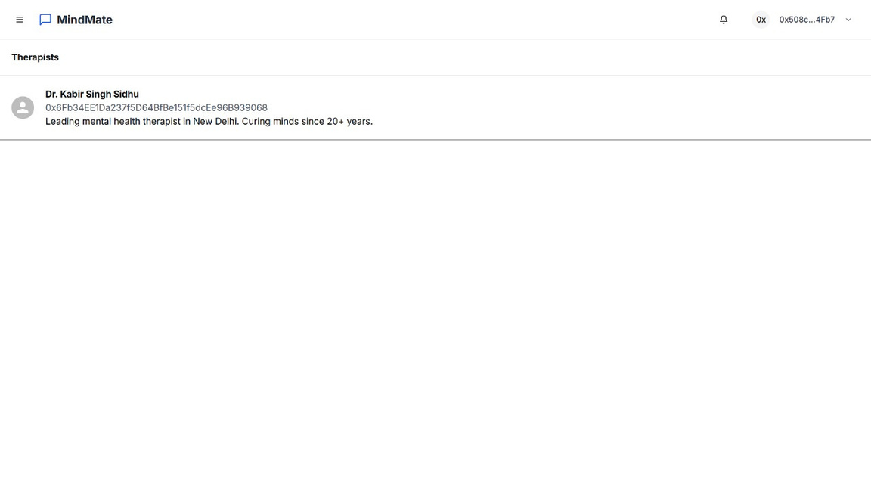
MINDMATE

Slide 8
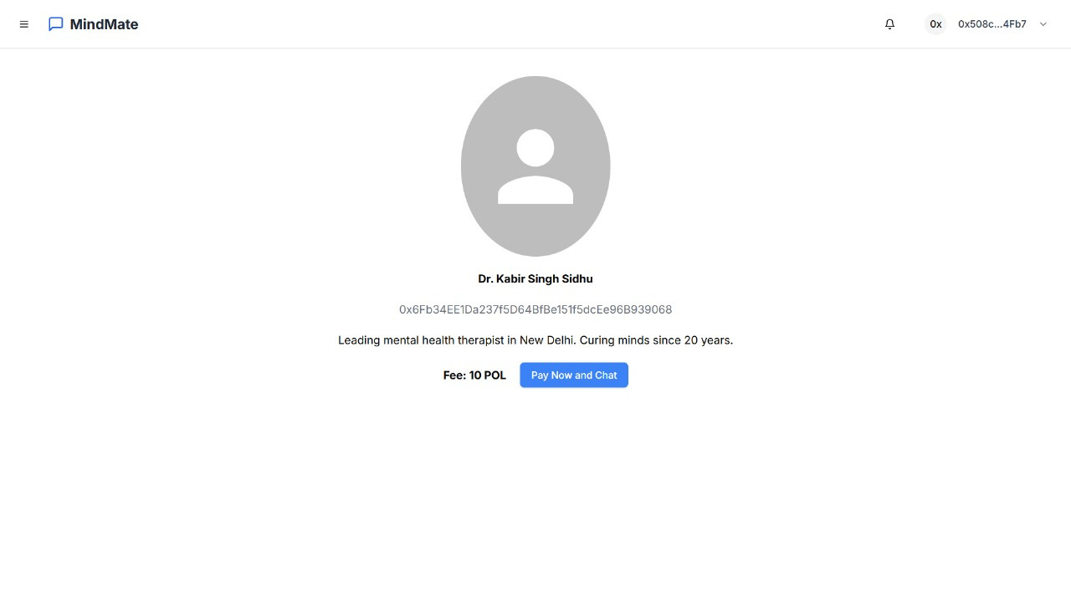
Seamless Payments
Powered by Solidity and the Polygon blockchain,. Users can pay therapists directly through a decentralized payment system, ensuring transactions are trustful and free from traditional financial barriers.

Slide 9
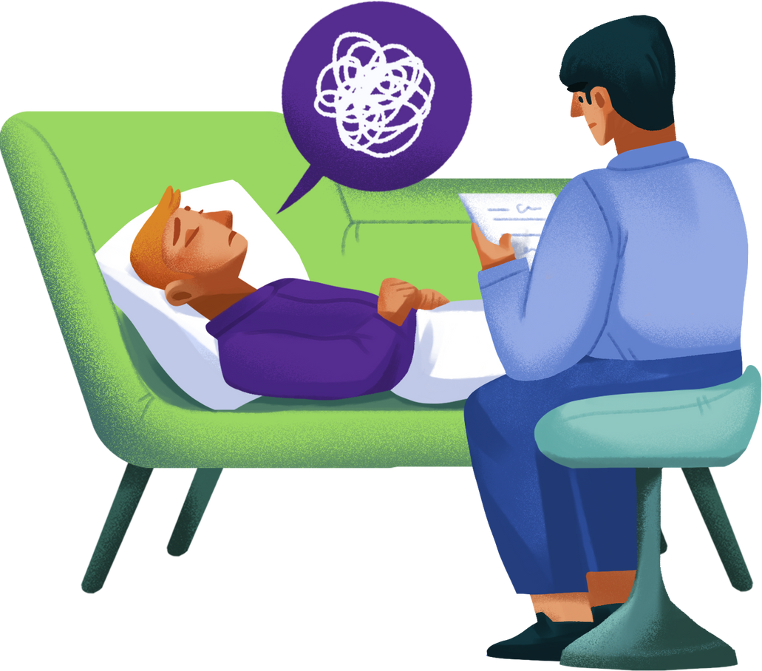
Benefits Summary
Advanced Personalization
Accessibility and Inclusivity
Integration with advanced tech
Anonymous connection with therapists
AI Powered Chatbot

