Slide 1


PROJECT 4 :
MACHINE
LEARNING
Catherine, Gita, Kabir, Wisdom

Slide 2
DATA : SEATTLE WEATHER (2012 - 2015)
Source : Kaggle (--- LINK ---)
PANDAS
MATPLOTLIB
Clean Data
Visualize with Matplotlib
TABLEAU
Deeper visualization in Tableau to gain more understanding about the data.
MACHINE LEARNING
Random Forest
Linear Regression
Vector
Logistic Regression

Slide 3

ANALYSIS QUESTIONS
TREND ANALYSIS
WEATHER IMPACT
Average precipitation, temperature, wind speed.
Identifying days with extreme weather conditions (highest precipitation, coldest temperatures. highest wind speeds).
Does higher wind speed correlate with snow or rain?
Are sunny days consistently warmer thatn rainy/snowy days?
Does rpecipitation tend to be higher on certain days of the week?
EXTREME EVENTS IDENTIFICATION
Hottest and coldest days.
Days with highest and lowest precipitation levels.
Windy days classification.

Slide 4


VISUALIZATION : PANDAS & MATPLOTLIB
VARIABLES CORRELATION
WEATHER FREQUENCY
AVERAGE VARIABLES BY MONTH

Slide 5
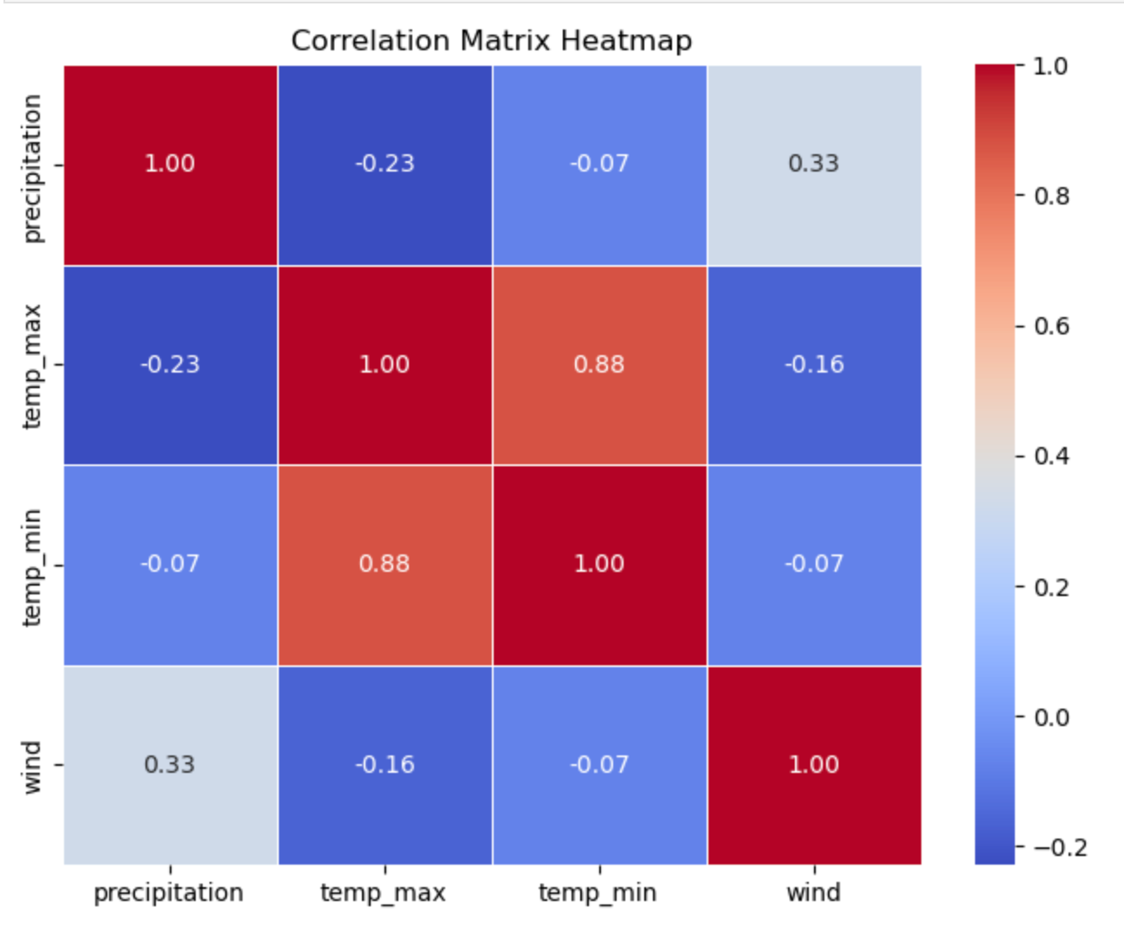
Close to 1: Strong positive correlation.
Close to -1: Strong negative correlation.
Close to 0: No correlation.

Slide 6
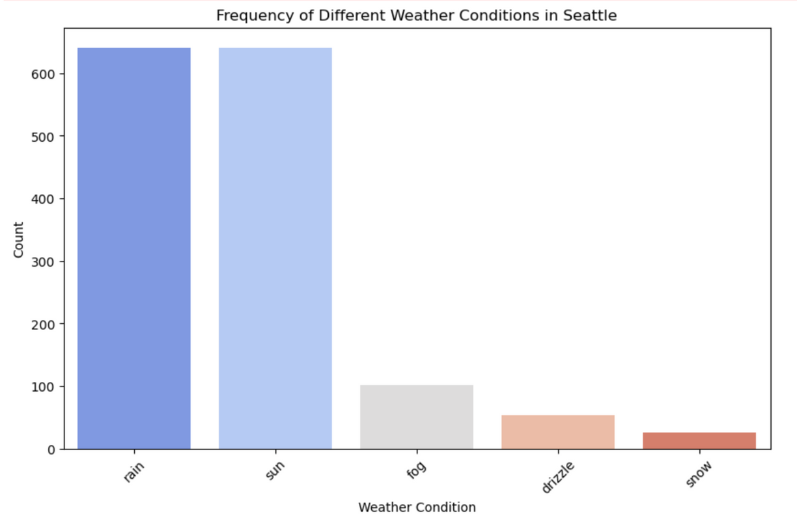
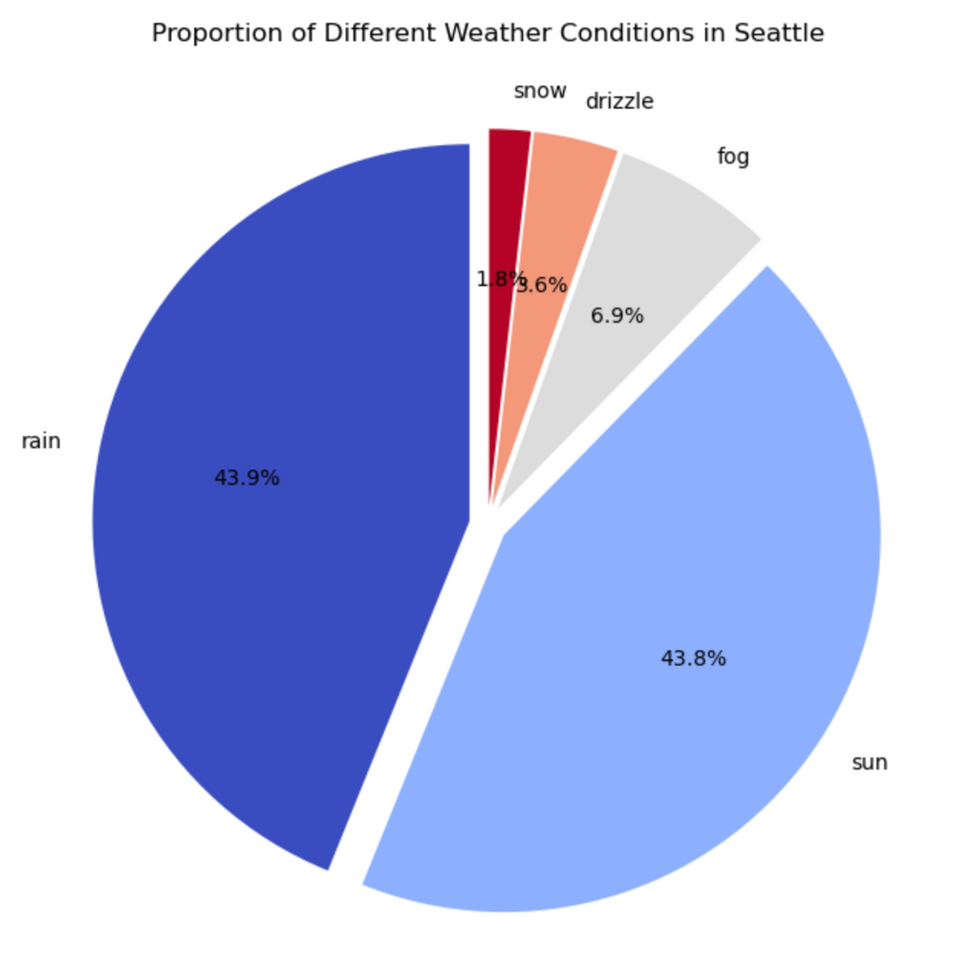
WEATHER FREQUENCY

Slide 7
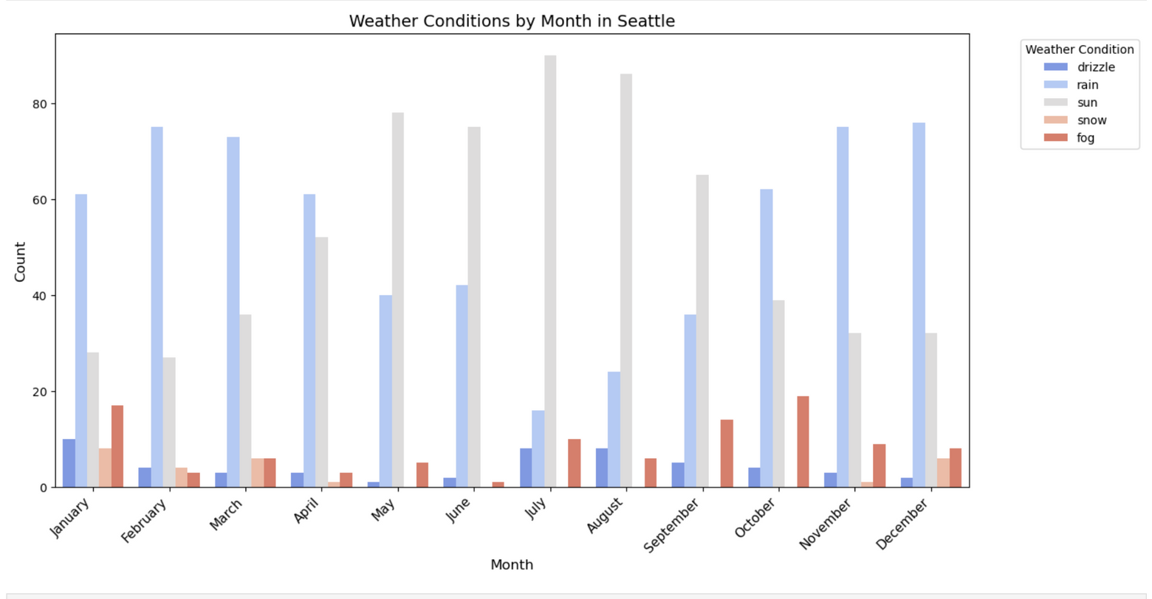
MONTHLY WEATHER CONDITION

Slide 8
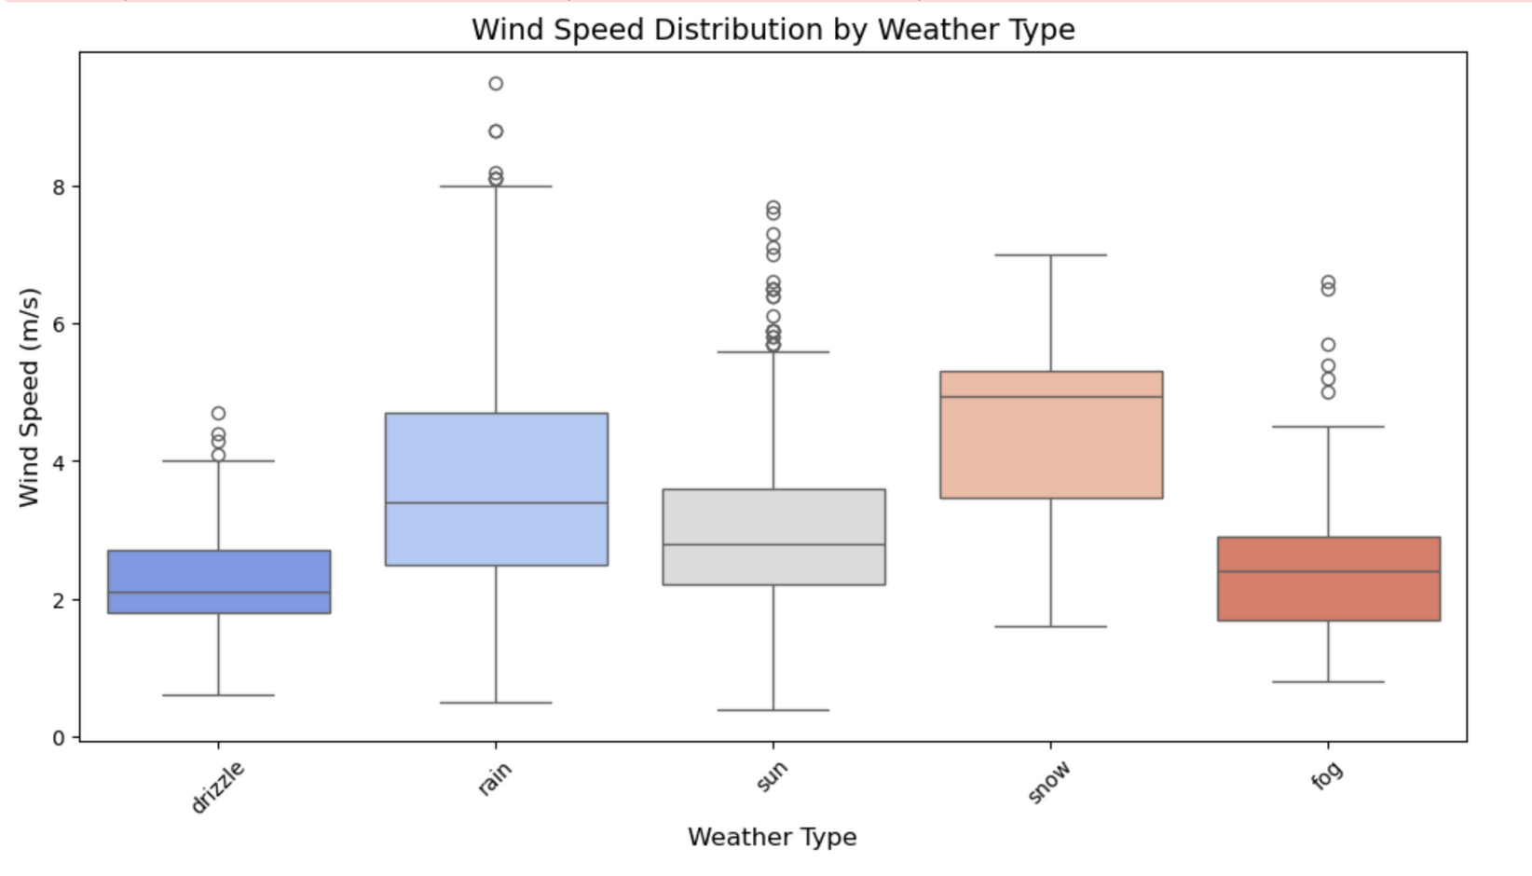
WIND SPEED BY WEATHER TYPE

Slide 9
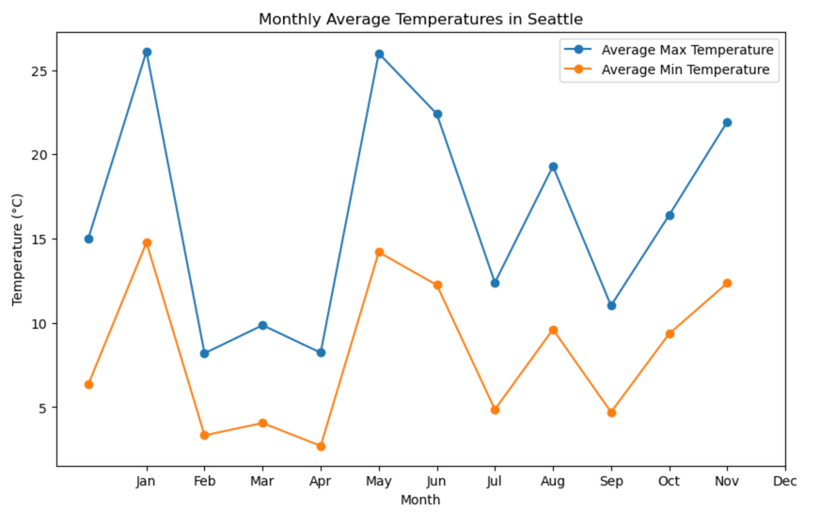
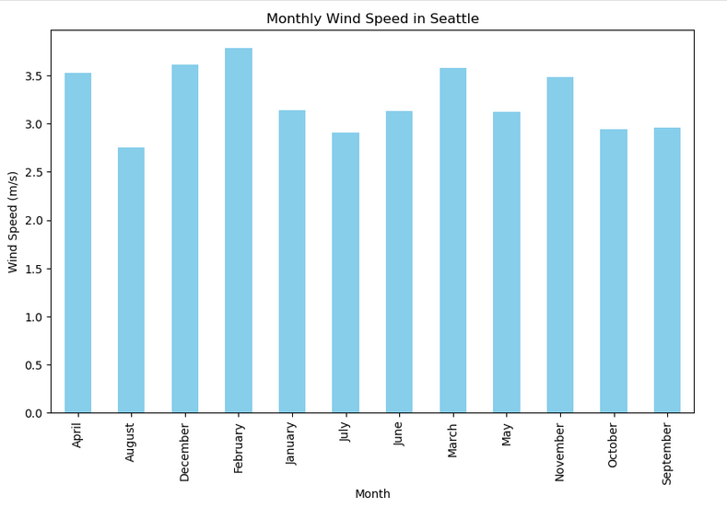
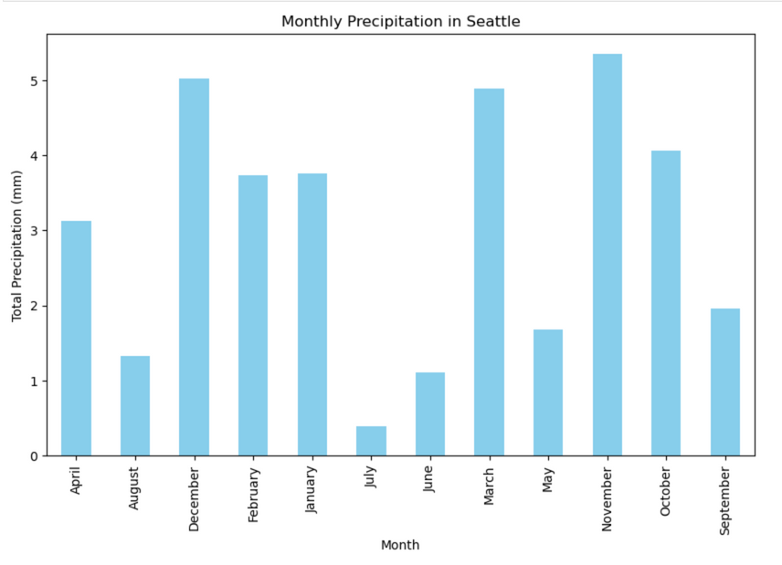
AVERAGE VARIABLES BY MONTH

Slide 10
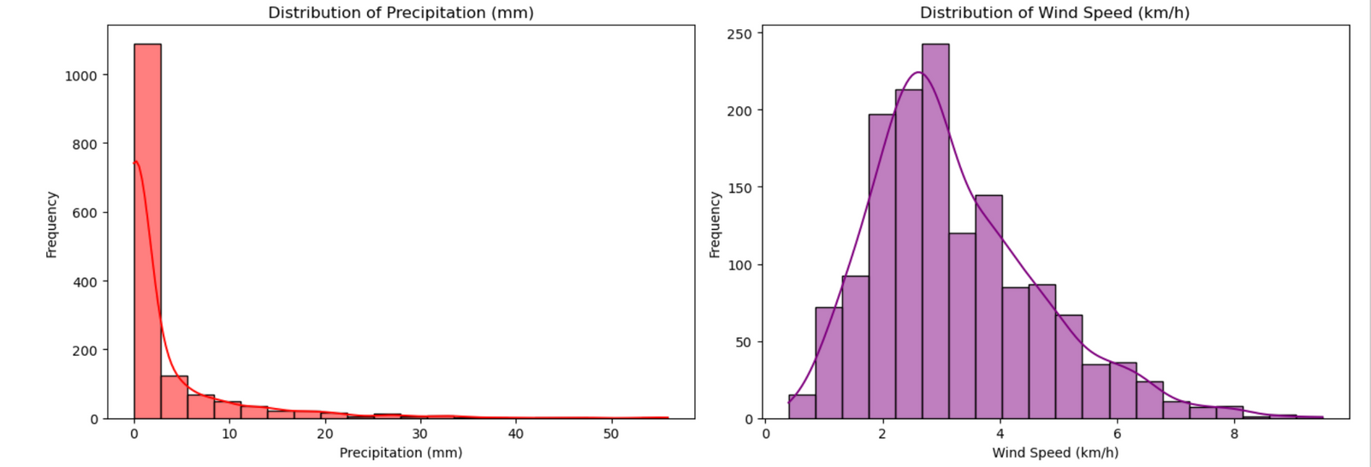
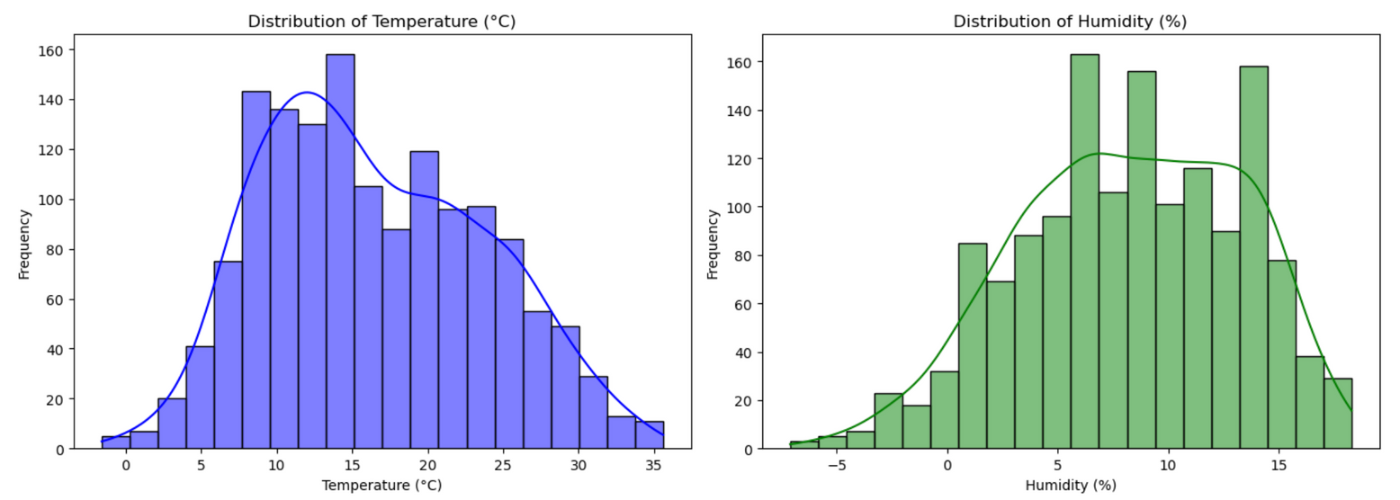
VARIABLES DISTRIBUTION

Slide 11

VISUALIZATION : TABLEAU
The future of AI and ML holds immense promise, with continued advancements expected in areas like natural language processing, computer vision, and robotics. As these technologies evolve, they will further transform our lives, leading to new innovations, increased efficiency, and a more interconnected world.

Slide 12
MACHINE LEARNING
RANDOM FOREST
LINEAR REGRESSION
VECTOR
LOGISTIC REGRESSION

Slide 13
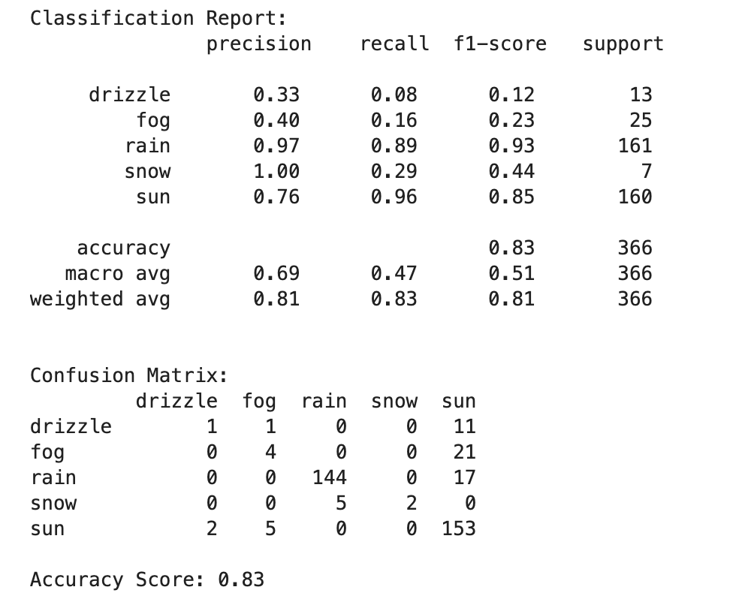
RANDOM FOREST
Interpretation based on the data :
Rain: Precision = 0.97, Recall = 0.89, F1-Score = 0.93 * The model correctly classifies rainy days 97% of the time (Precision).
* It captures 89% of actual rainy days (Recall). * F1-score of 0.93 shows overall strong performance.
Drizzle: Precision = 0.33, Recall = 0.08, F1-score = 0.12 * The model struggles to classify drizzle, it might be many drizzle days are misclassified. * This suggests that drizzle is hard to differentiate from other conditions.
Accuracy Score = 0.83 (83%)
Meaning: The model correctly predicts 83% of weather conditions.
Limitation: Accuracy does not consider class imbalance (some weather types might be rare).

Slide 14
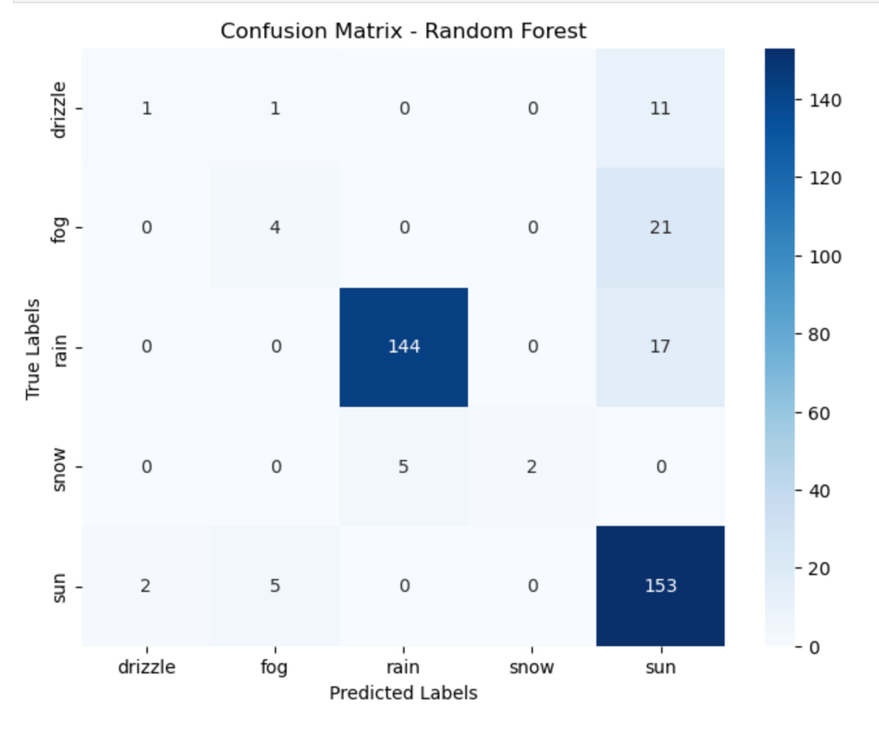
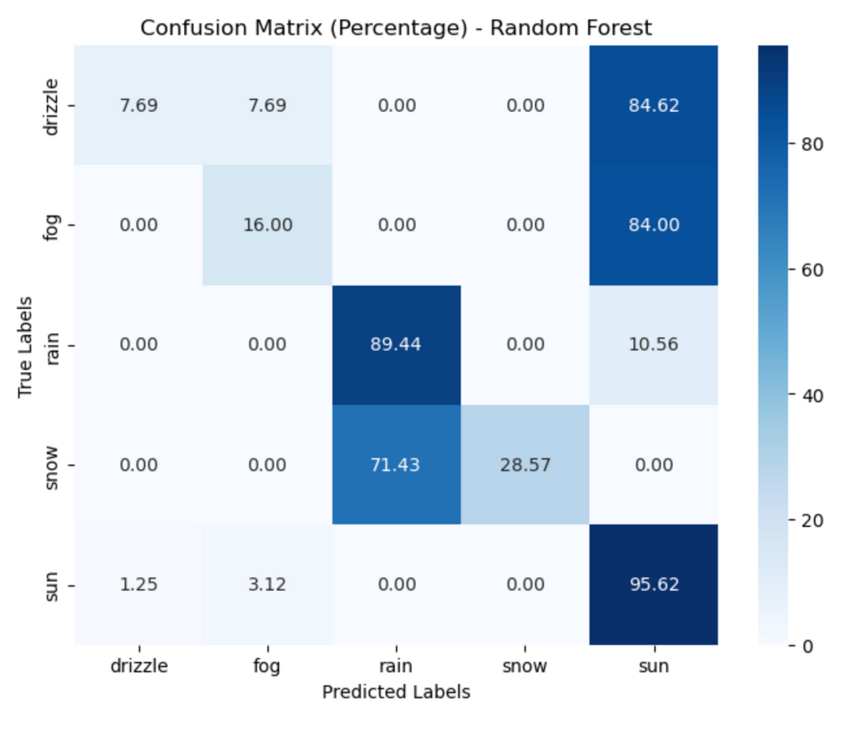
RANDOM FOREST EVALUATION : CONFUSSION MATRIX
The agent estimates the expected reward for taking a particular action in a given state.

Slide 15
Interpretation based on the data :
If Rain has 144 in its row under the Rain column, it means 144 rainy days were correctly classified.
If Rain has 17 under Sun, it means 17 rainy days were misclassified as sunny days.
* “Sun → Sun” = 95.62% → The model correctly predicts sunny weather 95.62% of the time.
* “Snow → Rain” = 71.43% → The model misclassifies 71.43% of snowy days as rainy.
* “Drizzle → Sun” = 84.62% → Most drizzle days are incorrectly classified as sunny.
Conclusion
* Rainy and Sunny days are well-classified, based on high precision and recall.
* Drizzle and Fog show weaker performance, meaning they might need more feature engineering.
* Improvement Suggestions:
* Use more features (e.g., humidity, pressure) to differentiate conditions.
* Use a balanced dataset to improve classification of rare weather types.
* Retrieve more data using open API (e.g., Open Weather Data)

