Slide 1


Project 4-
MACHINE LEARNING AND TABLEAU VISUALIZATION
BY: WISDOM CHIMEZIE

Slide 2
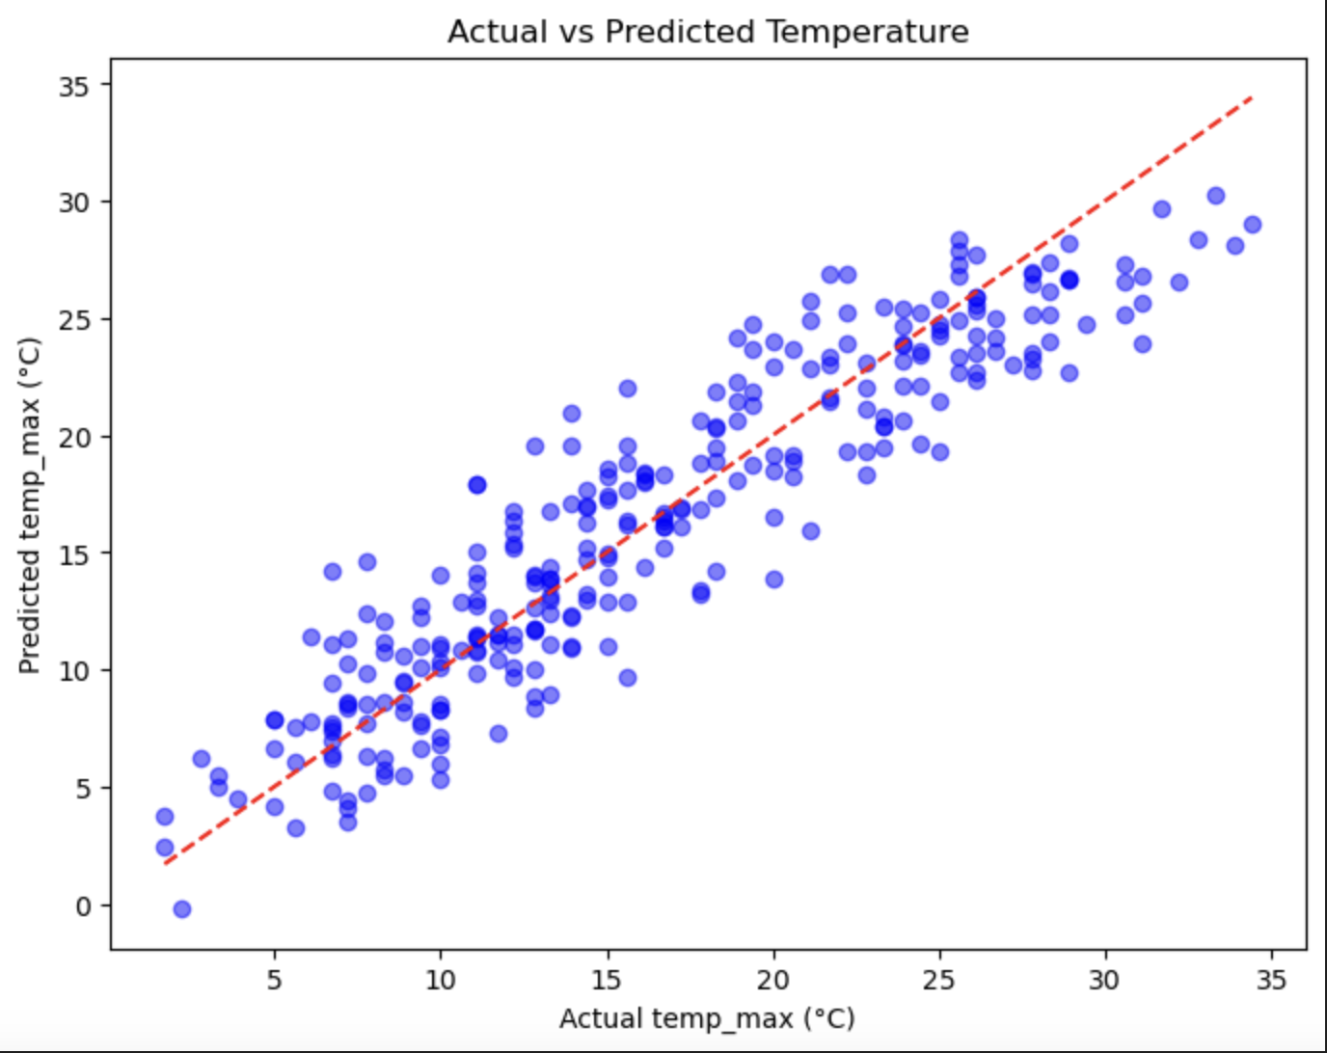
Scatter Plot to Visually Compare Actual vs. Predicted Temperatures
Interpretation of the plot
The blue points follow a diagonal pattern, suggesting that the model is reasonably accurate.
Many points are close to the ideal fit line, indicating that the model’s predictions are generally correct.
The current spread suggests only slight prediction errors.
Predictions follow the general trend of actual values.

Slide 3
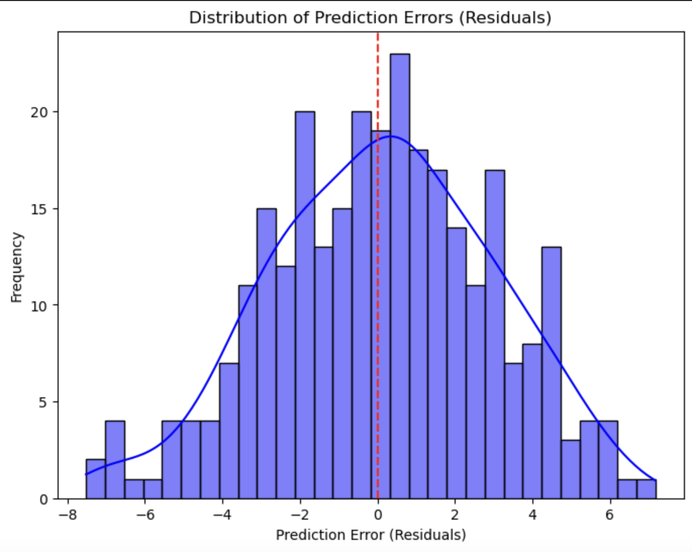
Error Distribution Plot
Interpretation of the plot
The symmetrical shape of residuals suggests the model is not biased toward over or under-prediction.
The distribution follows a normal pattern, which aligns with the assumption of linear regression.

Slide 4
Seattle Weather Visualization
Using Tableau
The numbers are hyperlinks. Select each one, right click, and click on “open hyperlink”. The link opens a new tab in a browser.
01
Dashboard showing Seattle weather visualization
02
Average Monthly Min and Max Temp Trend
03
Total Monthly Precipitation in Seattle
04
Distribution of weather conditions in Seattle

