Slide 1
Web Application Firewall
2021-CS-04 Kabir Ahmed
2021-CS-06 Mahnoor Fatima

Slide 2
Agenda
Introduction
04
Tools and Techniques
01
05
Problem Identification
02
Features
06
Interview Insights
03
Visualization

Slide 3
Agenda
Future directions
07
08
Conclusion

Slide 4
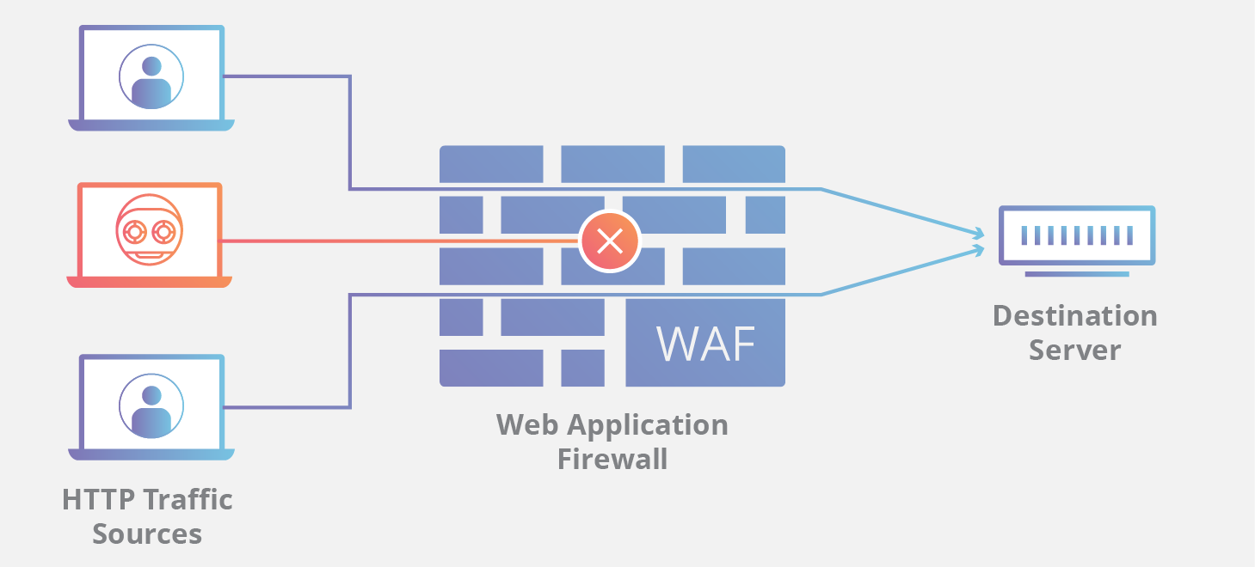
Introduction
Purpose: A Web Application Firewall (WAF) is a security solution designed to protect web applications from a variety of online threats and attacks.
Common Threats: WAFs address vulnerabilities such as Cross-Site Scripting (XSS), SQL Injection, Cross-Site Request Forgery (CSRF), and other injection attacks commonly associated with web applications.
Integration: They can integrate with other security tools and systems to provide comprehensive protection for web applications against evolving cyber threats.

Slide 5
Features
Protection Against Attacks
SQL Injection: Preventing unauthorized SQL injection attacks through parameterized queries and input validation.
Cross Site Scripting (XSS): Mitigating XSS vulnerabilities with output encoding and input validation.
Authorization
User Registration Approval: Admin approval process for new user registrations.
Account Blocking: Temporarily blocking accounts after multiple failed login attempts.

Slide 6
Features
Authentication
Tokenization: Secure user session management with token-based authentication.
.
Encryption & Decryption: Securing sensitive data with encryption and decryption techniques.
.
Authentication
Password Hashing: Enhancing password security with cryptographic hashing.
.
Entity Framework Integration: Implementing secure data access with Entity Framework's features.
.

Slide 7
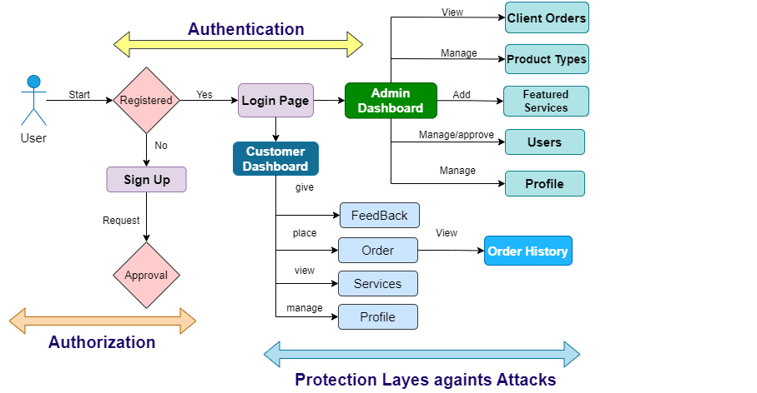
Visualizations

Slide 8
Visualizations
Password Hashing
Encryption & Decryption
Admin Account Approval
Security & Concurrency Stamp
Audit Table (Backend Database Security)
Email Service

Slide 9
Visualizations
Account Blocking
Pre-processing on Inputs Fields
Audit Tables (Backend Database Security )
Security Stamp

Slide 10
Visualizations
Account Blocking
Pre-processing on Inputs Fields
Audit Tables (Backend Database Security )
Security Stamp

Slide 11
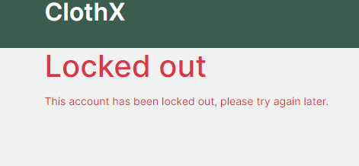
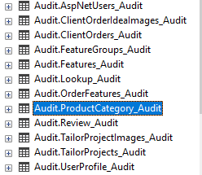
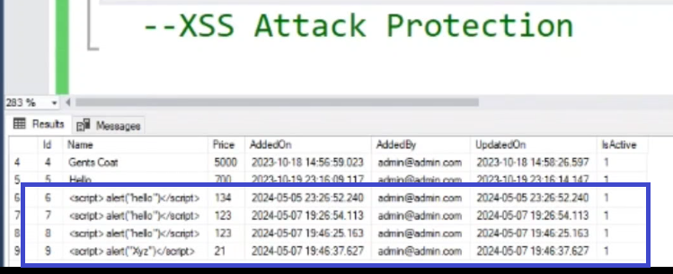
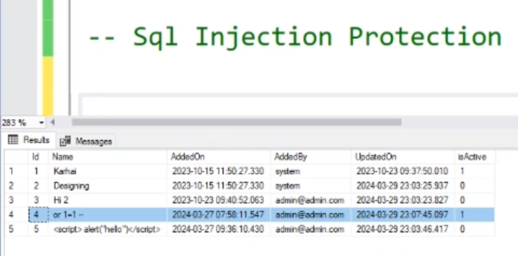
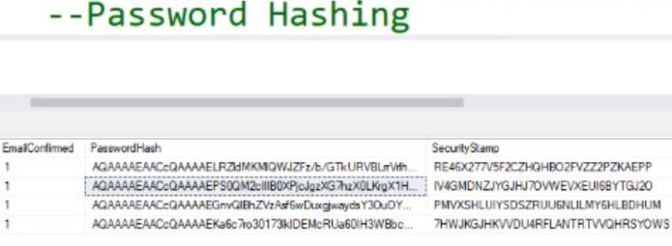
Visualizations
Account Blocking
Audit Tables

Slide 12
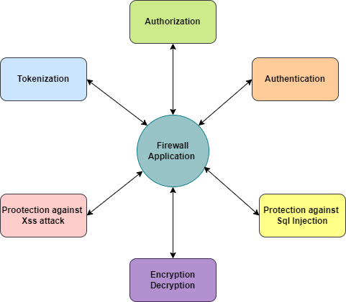
Visualizations

Slide 13
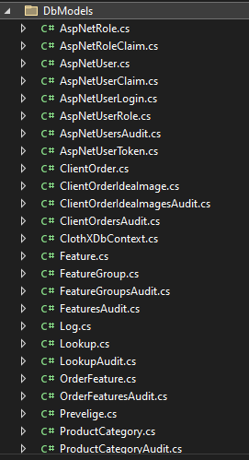
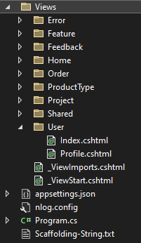
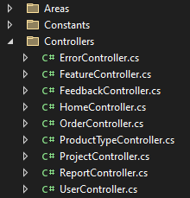
Visualizations- MVC
Controller
View
Model

Slide 14
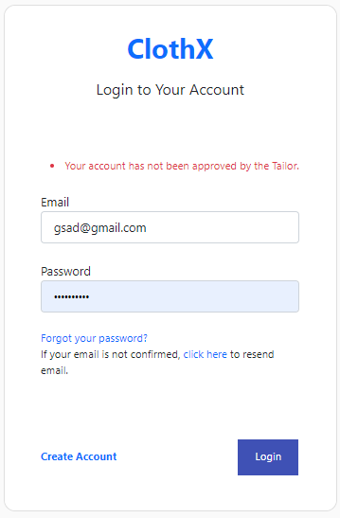
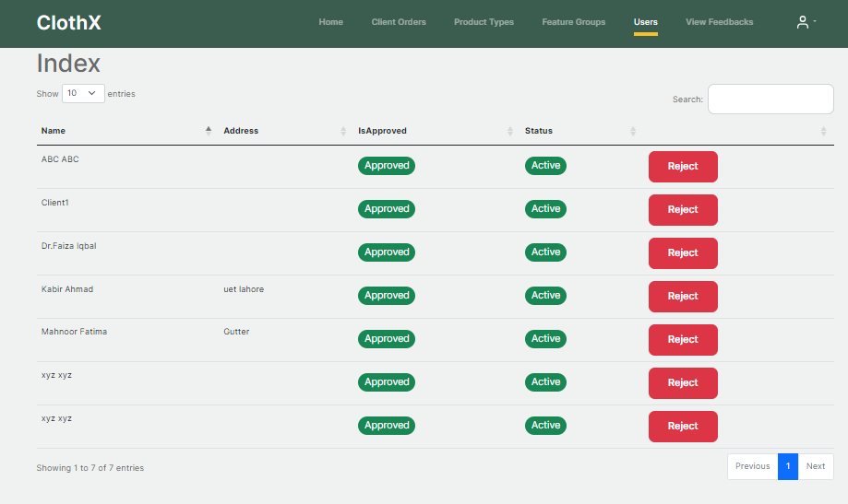
Visualizations
Account approval

Slide 15
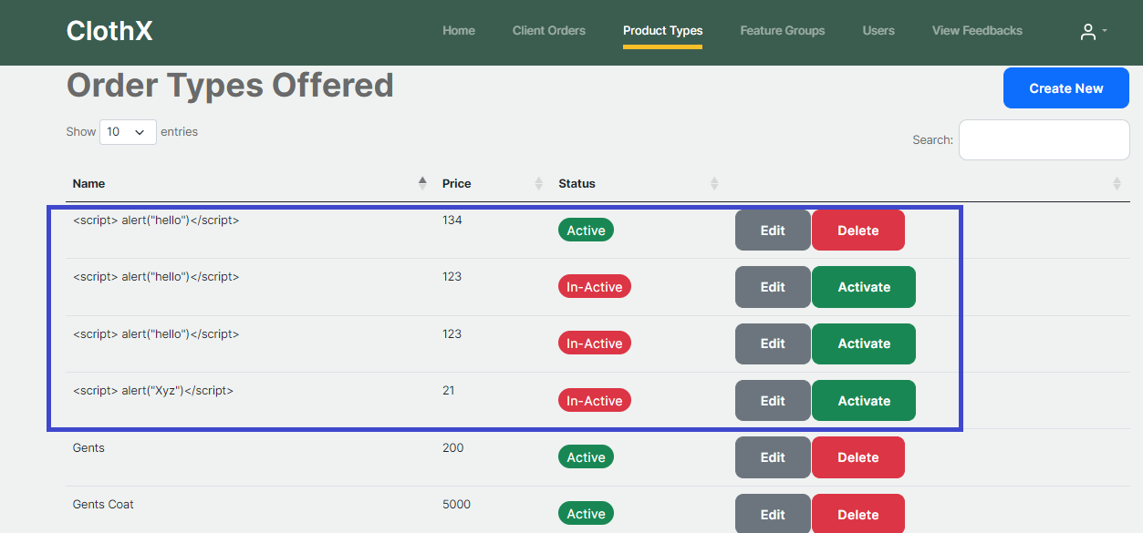
Visualizations
Attack protection

Slide 16

Tools and Techniques
Tools
Visual Studio (2022)
HTML (HTML5)
CSS (Tailwind)
Database (SQL Server)
Draw.io Flow Diagram
Creatlily Services Diagram
Techniques
Entity Framework (Use):
MVC (Model View Controller):

Slide 17
Problem Identification
Cyber Security Problems
Cross-Site Scripting (XSS) Vulnerabilities
SQL Injection Attacks
Insecure Authentication and Authorization
Inadequate Access Controls
Encryption and Data Protection
Secure Configuration and Hardening
During Working Problems
Error Vulnerabilities
Email and Google Service Integration
Authentication and Two-Factor
Account Blocking
Stack Making

Slide 18
Interview Insights
Senior Software Engineer @Educative
Muhammad Zubair
For our Professional Interview Insights we engage the meeting with Muhamad Zubair Senior Software Developer at Educative.
Approach
We professionally approach Muhammad Zubair through Google Mails.

Slide 19
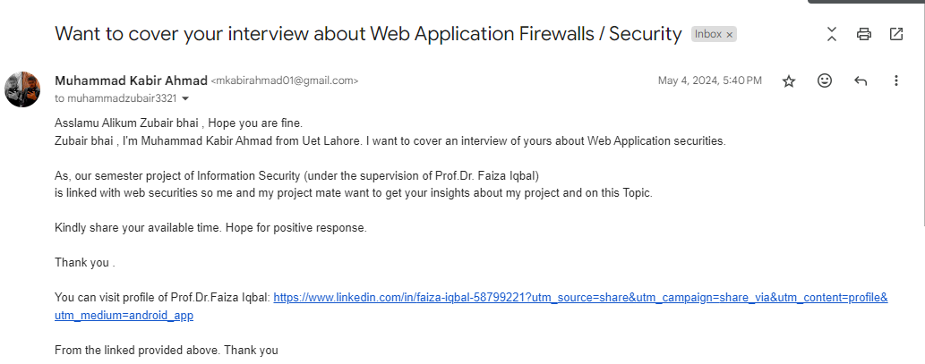
Interview Insights

Slide 20
Interview Insights
Mail:

Slide 21
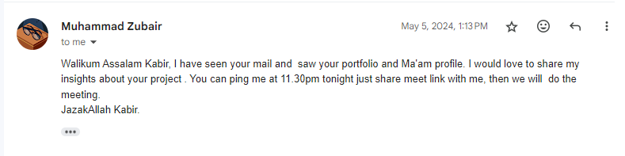
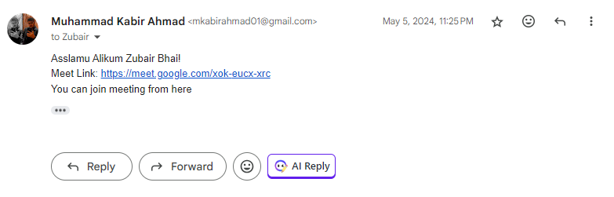
Interview Insights
Mail:
https://youtu.be/x3umH3fJD5o?feature=shared

Slide 22
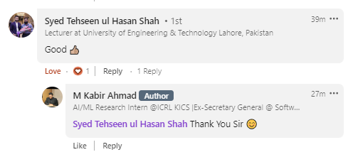
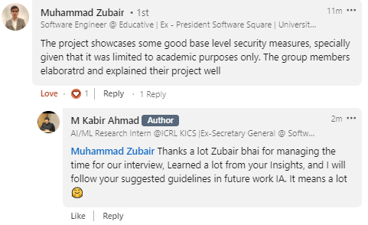
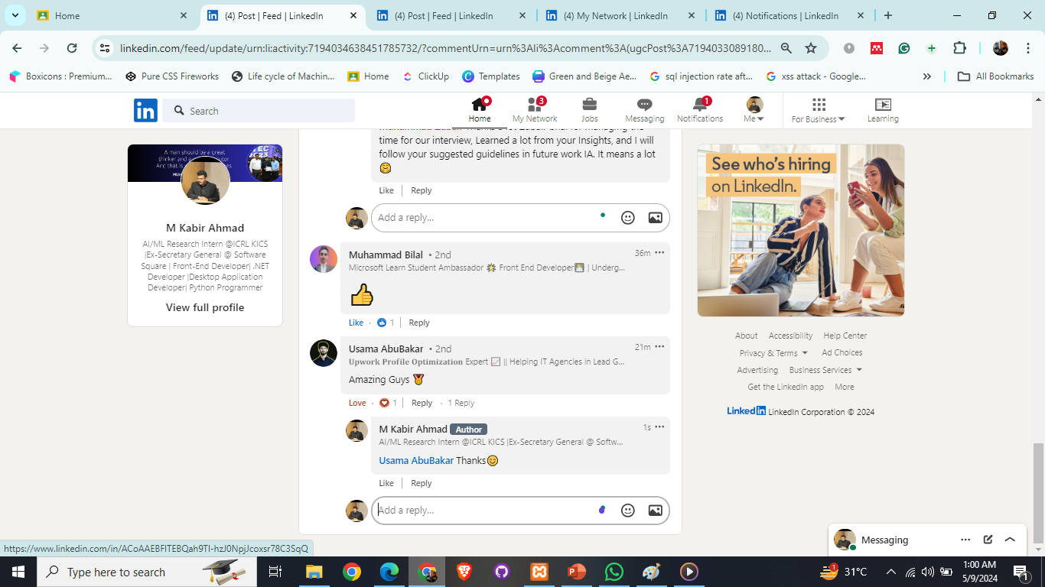
Interview Insights
Review of Interviewer in LinkedIn Post:

Slide 23
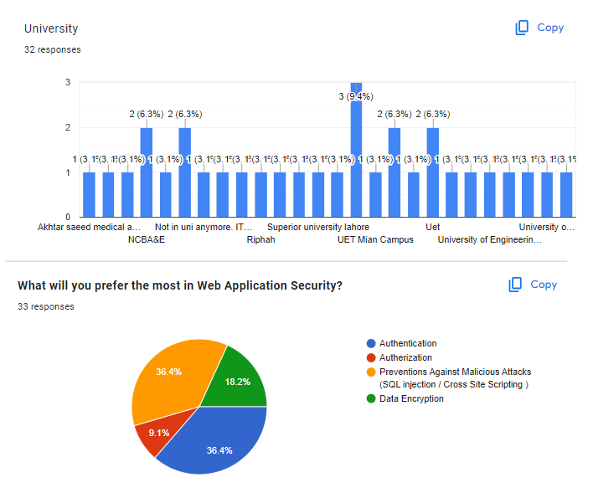
Google Form Insights

Slide 24
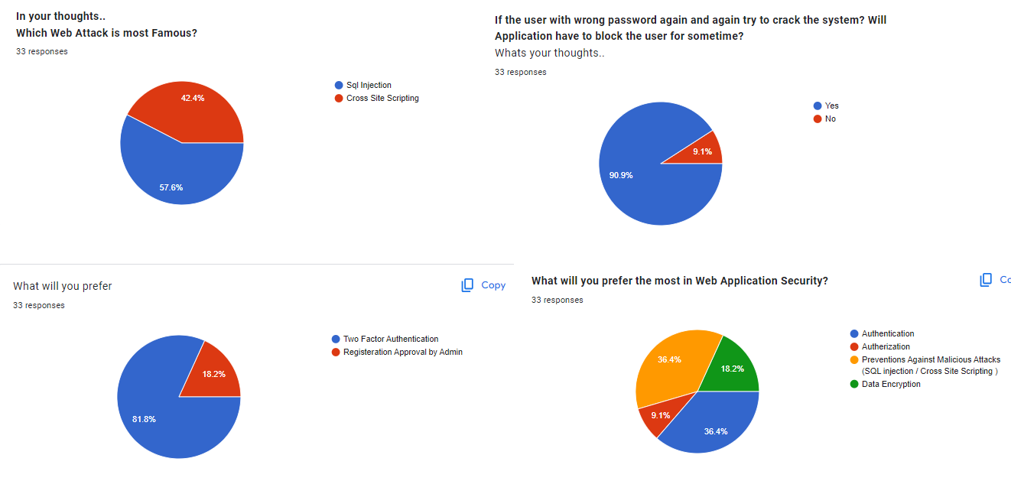
Google Form Insights

Slide 25
Interview Insights
What we Learn from Interview
We learn some new techniques and get the information of some new tools from this interview that was described below:
Use of API’s can make you work easy and more headed towards your goal in a concise way rather than making the whole function from zero (whose APIs exist already).
Use of Google services, as we know it was paid but worthful to use.
Email Services also can be done through API’s.
Web applications must use cloud services rather than databases if application run on big level.

Slide 26
Future Direction
Monitoring: Implement continuous security monitoring mechanisms to detect and respond to security incidents or suspicious activities in real-time.
Google OAuth Integration: Implement Google OAuth for user authentication, allowing users to sign in using their Google accounts. This enhances security by leveraging Google's robust authentication infrastructure and reducing the risk of password-related security issues.
Enhanced Authentication: Explore the implementation of advanced authentication methods such as biometric authentication or multi-factor authentication (MFA) to further strengthen user authentication and access controls.
Incident Response Plan: Develop and regularly update an incident response plan outlining the steps to be taken in the event of a security breach or incident, including communication protocols and recovery procedures.
External Security Testing: Engage third-party security experts to conduct external security testing, including penetration testing and vulnerability assessments, to identify potential security gaps and validate the effectiveness of existing security measures.

Slide 27
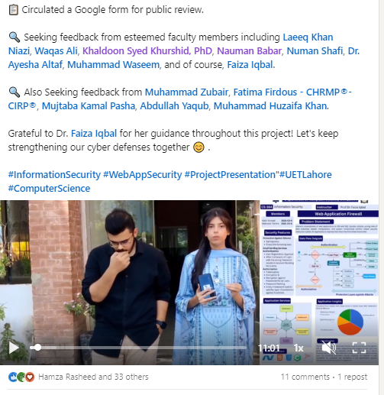
Linked Post

Slide 28
Conclusion
Key Findings and Achievements:
Robust Security Measures: Enhanced security with encryption, input validation, access controls, account blocking, and two-factor authentication.
Streamlined User Experience: Improved interface with Visual Studio, HTML5, CSS (Tailwind), and Entity Framework MVC.
Efficient Database Management: Ensured data integrity and security using SQL Server and SSMS.
Clear Visualization: Enhanced understanding of architecture with Draw.io and Creatlily Services Diagram.
Adoption of MVC Architecture: Improved code organization, maintainability, and scalability with MVC.
Continuous Security Enhancement: Proactive approach to security through monitoring, updates, and training.

Slide 29
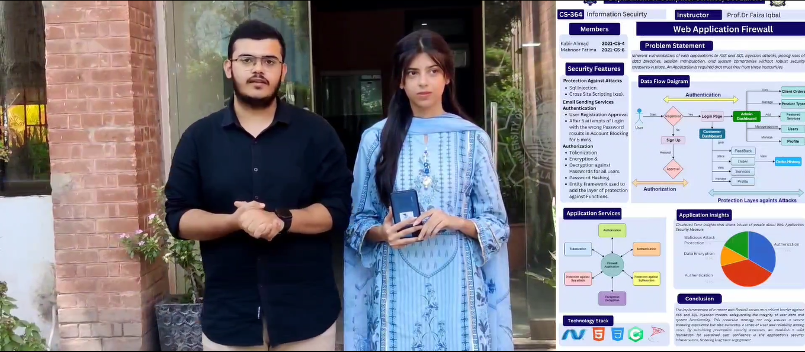
Video Presentation
Information Security

Slide 30
Thank you

