Slide 1
Codeflix 25' - Codezilla
Name: Hasan Rupawalla FY CS (12414068) and Kabir Khanuja FY CS (12413584)
Track : 3
Sponser : 1 (pi-labs.ai)
Speakers Separation

Slide 2

Vocal Vault: The Future of Audio Separation

Slide 3
The Problem We're Solving
Problem
Solution
Speaker diarization involves separating and identifying individual speakers from a single audio file, even in challenging conditions like overlapping speech and noise.
Using the LibriCSS dataset, a system can be designed to optimize accuracy, speed, and memory efficiency, enabling robust applications in transcription, virtual assistants, and audio analytics.

Slide 4
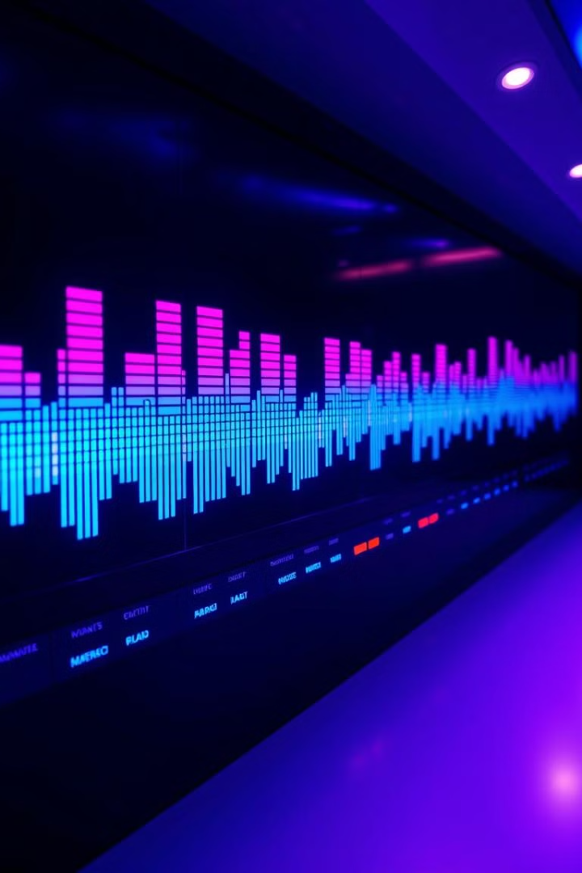
Idea and Approach
Leveraging LibriCSS
Optimized for Speed and Efficiency
We utilize the powerful LibriCSS dataset to train our models, achieving high accuracy in speaker separation.
Our solution is designed for rapid processing, minimizing wait times for users and delivering results quickly.
User-Friendly Interface
We prioritize a simple and intuitive interface, making Vocal Vault accessible to users of all technical backgrounds.

Slide 5



Diagram and Flow Chart
User Interface
1
Upload audio or YouTube links, select separation options.
Processing
2
Real-time diarization and separation of voices.
Output
3
Download separated tracks in high-quality audio formats.

Slide 6





Key Features of Our Solution
Real-Time Diarization
Upload and Separate
Audio Storage
Downloadable Tracks
Identify and separate speakers in real-time, providing immediate feedback.
Paste links of audios from YouTube or Spotify or upload local audio.
Get to store audios of your friends and family members in personalized folders.
Output separated audio tracks with minimal loss in quality.

Slide 7
Methodology
1
Frontend
2
Backend
Developing intuitive screens for audio file uploads, YouTube link processing, and displaying separated tracks.
Using Firebase for backend services, including secure user authentication, file storage for uploaded audio files and separated tracks, and database management to store user profiles and processing history.
3
Database
4
ML Model
Storing user profiles, uploaded audio files, separated tracks, and processing history.
Training a speaker diarization model using the LibriCSS dataset, optimized for accuracy, speed, and memory efficiency.
5
Audio Processing
6
Cloud Integration
Utilizing libraries like PyTorch/TensorFlow for voice separation and post-processing to enhance audio quality.
Host the application and model on a scalable cloud platform to ensure efficient processing and storage for diverse user needs.

Slide 8

Our User Interface

Slide 9

The Tech Stack Behind Vocal Vault
1
2
React.js and Tailwind
Firebase
A JavaScript library and CSS frame work for building user interfaces.
A backend-as-a-service platform for database and storage.
3
4
Python
LibriCSS
A programming language for machine learning models.
A large dataset used for training our speech models.

Slide 10
Thank You !!!
Revolutionizing voice processing, one file at a time!

