Slide 1
TITLE: Aviation Risk Analysis Project
By: Kabira Timothy
Date: April 2025
LinkedIn Profile:
https://www.linkedin.com/in/timothy-kabira-aa2430219?utm_source=share&utm_campaign=share_via&utm_content=profile&utm_medium=android_app

Slide 2
Overview
Analyse aircraft accident data.
Identify safer aircraft types.
Recommend best models for risk reduction.

Slide 3
Business Understanding
The company is entering the aviation market and wants to avoid high risk aircrafts. My analysis addresses:
Which aircrafts have the lowest accidents and fatality rates?
What are most common causes of accidents?
What recommendations can guide safe investments?

Slide 4
Data Understanding
Source: National Transportation Safety Board(1962 – 2023).
Description: Civil aviation accidents, aircraft model, date, fatalities accidents cause are some of the areas of consideration in this data set.

Slide 5
Data Analysis
Common accident causes identified:
Pilot error.
Mechanical failure.
-Adverse weather conditions.

Slide 6
Data Analysis
Number of accidents per aircraft:
Cessna had the highest number of accidents by make with over 8000 accidents followed by piper with 5000 accidents beech, boeing,and mooney with less than 2000 accidents.
Average Fatalities By make:
TUPOLEV top the list with highest fatalities by make, VIKING AIR LIMITED had slightly over 20 fatalities with the rest of the companies having fatalities below 20.

Slide 7
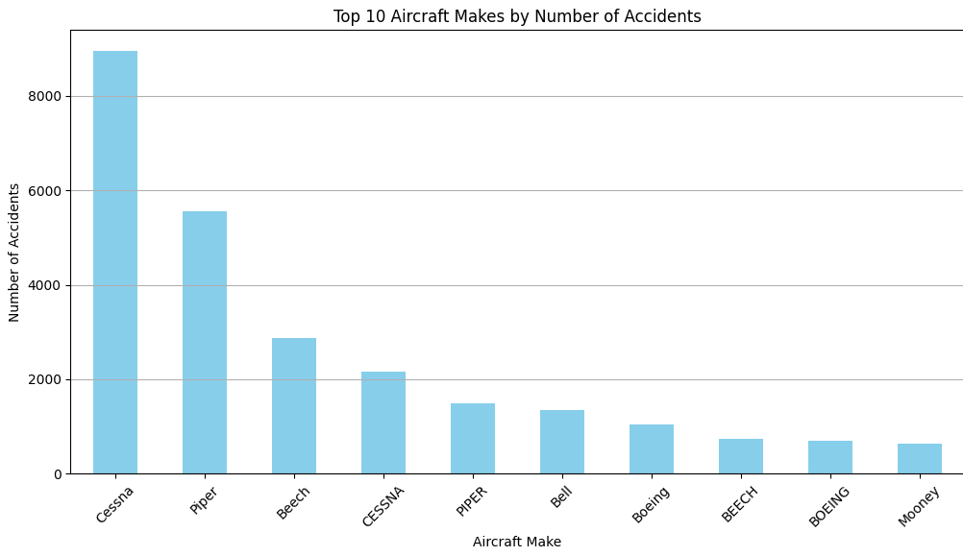
Number of accidents per aircraft make

Slide 8
Data Analysis
Number of accidents under different weather conditions:
Visual meteorological weather conditions had the highest number of accidents followed by instruments meteorological conditions(poor visibility, bad weather)
Number of accidents per phase of flight
A significant number of accidents takes place during take off phase of flight.

Slide 9
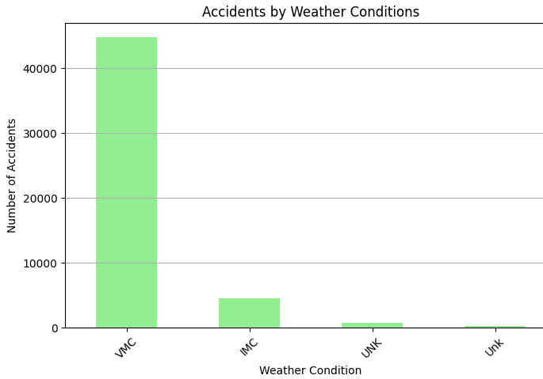
Number of accidents under different weather conditions

Slide 10
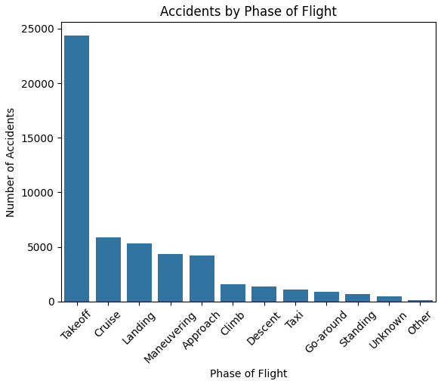
Group the data by 'Phase of Flight' and count accidents

Slide 11
Recommendations
Aircraft Type Selection:
Based on accident rates, Boeing 737, Airbus A320, and Cessna 172 show lower accident frequencies.
Prioritize acquisition of aircraft types with proven safety records to minimize accident risks.

Slide 12
Recommendations
Invest in advanced pilot training and weather navigation skills.
Choose aircraft with a record of mechanical reliability.
Implement strict weather-related flight operation protocols.

