Slide 1
Predicting Customer Churn to Drive Retention and Growth Optimized, Transparent, Scalable Customer Retention.
Presenter: Tim Kabira Date: 23rd July 2025

Slide 2
Business Problem
Customer retention is a critical challenge, as acquiring new customers is far more costly than retaining existing ones. Without a proactive approach, businesses risk losing valuable customers due to unnoticed dissatisfaction or disengagement. This project develops a machine learning model to predict churn, enabling timely, data-driven interventions that reduce revenue loss, enhance customer lifetime value, and improve overall retention strategy.

Slide 3
Project Objectives
Predict Customer Churn: Build a reliable machine learning model to identify customers likely to leave.
Enable Timely Retention Efforts: Support proactive outreach to at-risk customers before they churn.
Reduce Revenue Loss: Minimize the financial impact of customer attrition.
Enhance Customer Lifetime Value: Retain loyal customers and maximize long-term profitability.
Improve Marketing Efficiency: Target retention campaigns more accurately using data-driven insights.
Support Strategic Decision-Making: Provide interpretable results to guide business strategies on customer loyalty.

Slide 4
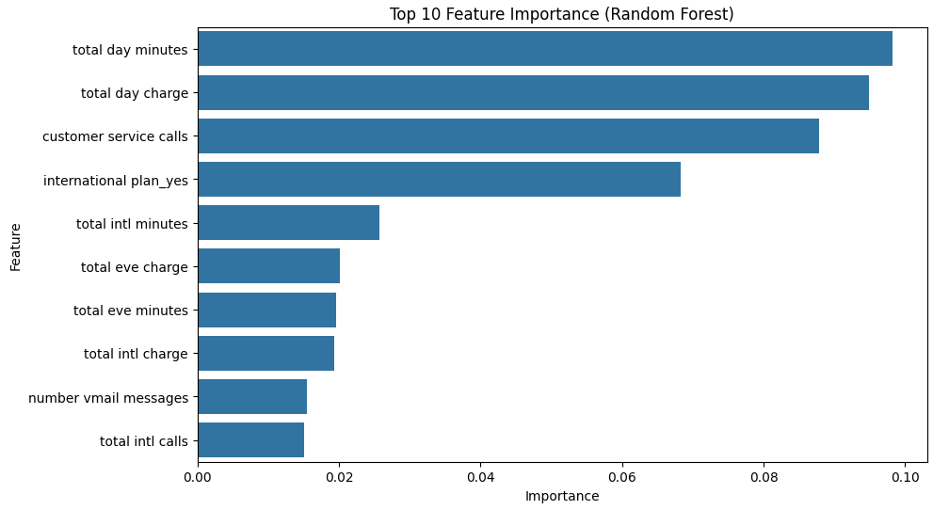
Features derived from historical customer data were leveraged to train a high-accuracy model capable of predicting churn risk with confidence

Slide 5
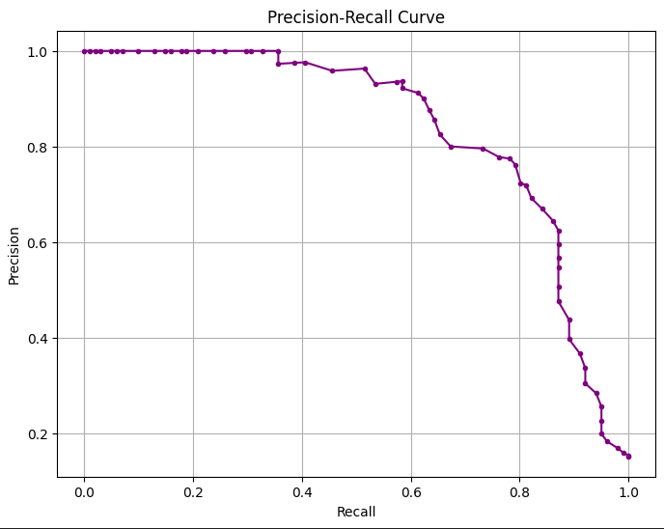
Model Performance: Identifying High-Risk Churn Customers

Slide 6
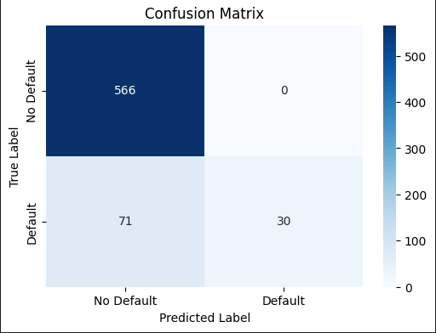
Customer Churn Prediction: Model Classification Performance

Slide 7
Interpreting the Confusion Matrix for Churn Prediction
The ROC curve evaluates the performance of the churn classification model by plotting the True Positive Rate against the False Positive Rate across various thresholds. With an AUC of 0.93, the model demonstrates strong predictive power, effectively distinguishing customers likely to churn from those who will stay, while minimizing false positives.

Slide 8
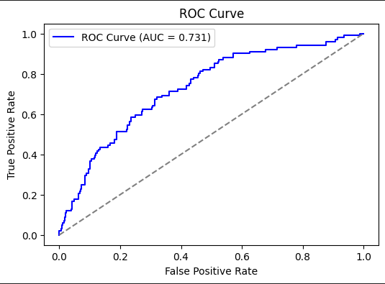
Churn Prediction Models: Logistic Regression vs Random Forest

Slide 9
Interpretation
This ROC (Receiver Operating Characteristic) curve evaluates the performance of a binary classifier in predicting customer churn.
The x-axis shows the False Positive Rate (non-churners wrongly classified), while the y-axis shows the True Positive Rate (correctly identified churners).
The blue curve reflects the model’s ability to distinguish between churners and non-churners at various thresholds. The diagonal line (AUC = 0.5) represents random guessing.
An AUC of 0.731 indicates the model performs reasonably well in separating churners from non-churners.

Slide 10
Key Insights
Model Performance: The Random Forest Classifier, optimized using RandomizedSearchCV, demonstrates strong performance across accuracy, precision, recall, and ROC AUC. SMOTE enhances the detection of churn in an imbalanced dataset.
Key Predictors: The Feature Importance Plot identifies key drivers such as tenure, monthly charges, and contract type—factors strongly associated with customer retention behavior.
Churn Risk: The use of SMOTE(Synthetic Minority Over-sampling Technique) and the recommended Precision-Recall Curve improves the model’s sensitivity to churn cases, helping minimize customer loss and associated revenue impact.
Fairness: Encoded demographic features (e.g., gender, senior citizen status) allow for analysis of potential model bias, supporting ethical and balanced decision-making.

Slide 11
Key Recommendations for Churn Model
Address Imbalance: Use SMOTE(Synthetic Minority Over-sampling Technique) on training data; consider class weights.
Fairness: Evaluate model bias across demographics.
Threshold Tuning: Optimize with precision-recall balance.
Cross-Validation: Ensure model generalizes well.
Telecom Insights: Include usage, billing, and complaints data.
Model Deployment: Enable real-time churn prediction & retraining.
Transparency: Communicate churn drivers clearly.
Integration: Automate with CRM(Customer Relation Management) systems for actionability.

