Slide 1
10,000
Predictive Maintenance
sensor snapshots
28:1
Smart Manufacturing Rig
class imbalance
HETA Take-Home Task
Rigs fail unpredictably — disrupting training and leaving apprentices reactive rather than diagnostic. The task: use existing sensor data to predict failure before it happens and make that prediction explainable enough to teach with.
0.929
ROC-AUC achieved
87%
Recall achieved
Notes:
Good morning — thank you for having me. The problem I was asked to solve is this — manufacturing rigs fail. When they fail unexpectedly it causes downtime, damage, and in a training environment it disrupts learning. The question is: can we use the sensor data the rig is already producing to predict failure before it happens, rather than reacting after the fact? That shift — from reactive maintenance to predictive maintenance — is what this entire task is about.
The value of this system is not in catching 34 failures — it is in producing apprentices who understand why the rig failed, which sensors told the story first, and what to look for next time. A black box alarm teaches nothing. An explainable one teaches everything.
So every decision I made — the model I chose, the features I built, the alert design — was filtered through that question: will this help an apprentice understand the machine, or just react to it?
The four numbers on the right are the headline. Ten thousand sensor readings. A 28-to-1 class imbalance — which makes this statistically hard. A ROC-AUC of 0.929 and 87% recall — meaning the model catches 87 in every 100 genuine failures.
What I am presenting today is a proof of concept on historical data. What I want to leave you with is a clear picture of how that becomes a live system — and what my role in getting it there would look like.

Slide 2
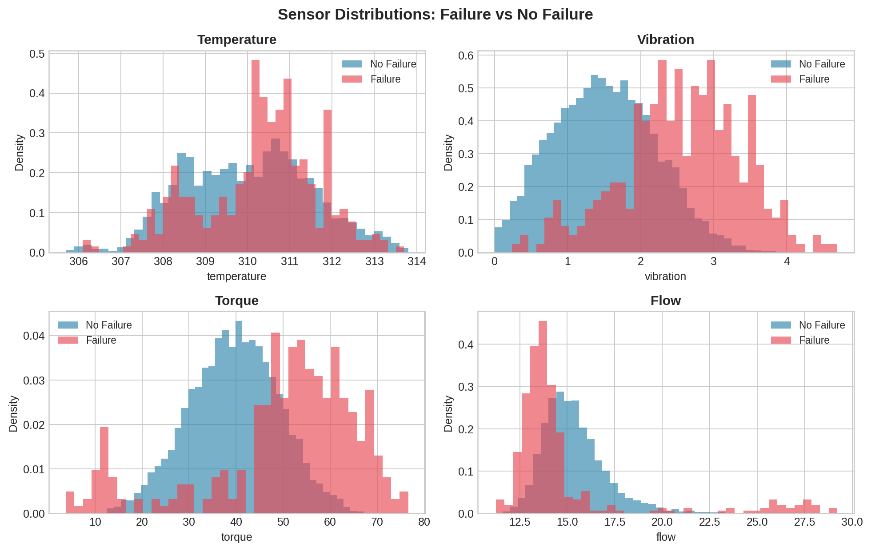
1. What We Found
Key Findings
Vibration leads with Pearson r=0.265, torque at r=0.191 — both confirm strong class separation
Their product (vib×torque) is one of the strongest engineered features
Temperature (r=0.036) & flow (r=-0.041) are weak predictors individually
Failures cluster in time — justifies temporal split, not random shuffle
Data loaded, labelled (1=failure, 0=normal) and sorted chronologically — no missing values
80/20 temporal split applied — train on past, test on future, no shuffling
Notes:
Before writing a single line of model code I spent time understanding what the data was actually telling me — because the data should dictate the approach, not the other way around.
The four charts on the left show sensor readings split by failure and normal. The story is immediate. Look at vibration — the red failure bars are shifted well to the right of the blue normal bars. That separation is confirmed by the correlation of 0.265. Torque is similar at 0.191. These two sensors are where the signal lives.
Temperature and flow are almost identical between failure and normal — correlations of 0.036 and minus 0.041. Individually they tell you almost nothing. I say individually because that changes when you combine them — which the feature engineering on the next slide addresses.
The 28-to-1 imbalance is the most consequential single fact in the dataset. A model predicting no failure on every row would be 96% accurate and completely useless. From the start I knew I needed ROC-AUC and Precision-Recall AUC, not accuracy.
When I plotted failures over time they clustered around the 4th and 5th of January — not scattered randomly. That told me immediately I cannot shuffle the data before splitting. I have to train on the past and test on the future. That is exactly how this model would be used in deployment, so it is exactly how it must be validated. Data was clean — no missing values — sorted chronologically, 80/20 temporal split applied.

Slide 3
4
5
2. What We Built
1
Feature engineering
17 features including vib×torque interaction
Rolling means at 10 and 60 min separate sustained elevation from spikes
Rolling std and rate-of-change flag erratic behaviour
Models Evaluated
Model | ROC-AUC | Verdict
Rule-Based | 0.768 | Too many alarms
Logistic Regression | 0.936 | Strong fallback
Random Forest | 0.924 | Solid, marginal gain
Gradient Boosting | 0.929 | Selected ✓
2
Gradient Boosting
Chosen over LR (0.936 AUC) — GBM produced 37 fewer false alarms at same recall
0.007 AUC gap not meaningful on 39 failures
Sample-weighted to handle 28:1 class imbalance
3
Threshold tuning
Default 0.5 threshold wrong for imbalanced data
Tuned to 0.1337 — catches 34 of 39 failures in test set
262 false alarms directly motivate the AMBER/RED two-tier system
Test Set Results (39 failures)
34
Caught
True Positives
5
Missed
False Negatives
262
False Alarms
→ justify 2-tier alerts
Notes:
Three decisions built the model.
First, feature engineering. Raw sensor readings only tell you what is happening right now. I built 17 additional features to give the model memory and context. The most important is vibration multiplied by torque — capturing combined mechanical stress. A rig vibrating hard under heavy load is far more dangerous than either condition alone. The SHAP analysis on the next slide confirms the model learned exactly that. I also added rolling averages over 10 and 60 minutes to separate sustained trends from momentary spikes, rolling standard deviation to flag erratic behaviour, and rate-of-change to catch sudden shifts.
Second, model selection. I tested four approaches. The rule-based system caught every failure but produced so many false alarms it is operationally useless — and that result matters, because it shows alert fatigue is a real problem even before we get to machine learning.
I selected Gradient Boosting at 0.929 ROC-AUC over Logistic Regression at 0.936. The gap is 0.007 across 39 failures — not meaningful. What is meaningful is that GBM produced 37 fewer false alarms at the same recall. In an environment where engineer and apprentice trust in the system is essential, that difference is the one that matters. GBM also runs in under a minute on standard hardware with no GPU — which matters for deployment.
Third, threshold tuning. The default 0.5 threshold is calibrated for balanced data — wrong here. I tuned it to 0.1337 to catch 34 of 39 failures. The 262 false alarms that produces are not a failure. They are the reason the two-tier alert system on slide 5 exists.

Slide 4
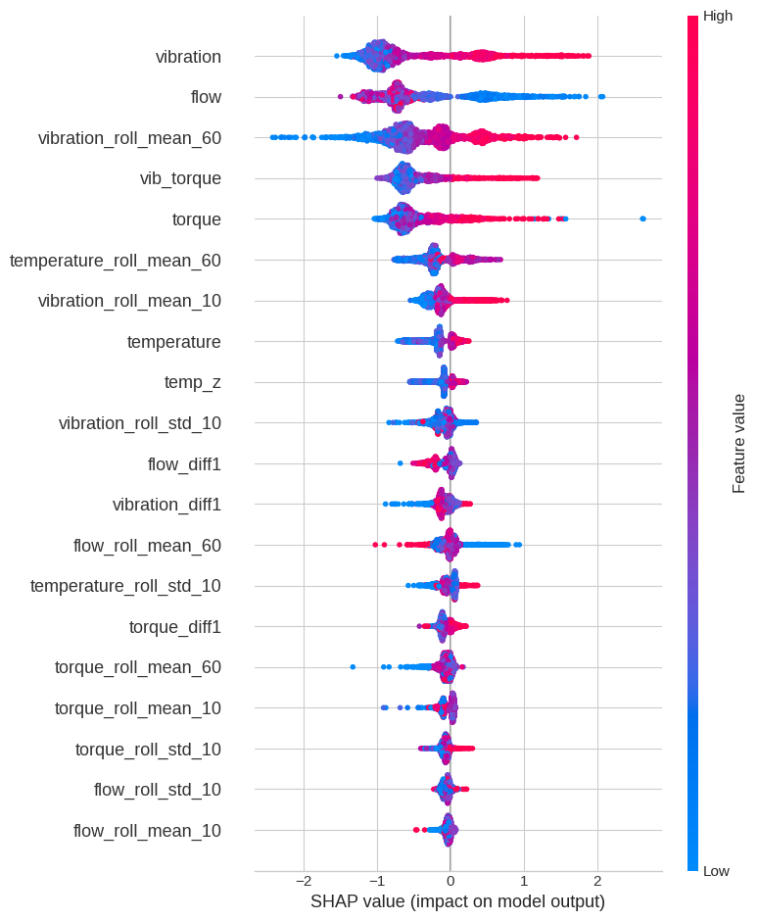
3. SHAP Analysis: What Drives Failure
What SHAP Tells Us
Top 5 Features by Mean |SHAP| Value
1. vibration — When vibration is high, failure probability rises sharply. It is the single clearest precursor — a rig vibrating hard is already under stress, even before other sensors respond.
2. flow — It is low flow that predicts failure, not high. Restricted flow signals upstream blockage or pump degradation — a leading indicator, not a consequence of failure.
3. vibration_roll_mean_60 — Sustained elevation over 60 min predicts failure more strongly than any single spike. The rig doesn't fail from one bad reading — it fails after prolonged stress builds.
4. vib_torque — High vibration under high load is more dangerous than either alone. The model learned this from the data — validating the feature engineering decision to build this interaction term.
5. torque — Even without high vibration, heavy mechanical load signals elevated failure risk — giving the model a second independent signal, improving robustness when vibration is ambiguous.
Notes:
A model that outputs a probability score is a black box. That is a problem in any context — but it is a particular problem here, where the whole point is to teach apprentices to understand the machine they are working on. An alarm that says 78% failure risk teaches nothing. An alarm that says vibration has been building for an hour and the rig is under heavy load — now what does that tell you — that is a lesson.
SHAP solves this. For every prediction it calculates how much each sensor reading contributed — how much it pushed the score towards failure and how much it pulled it back. The dot plot on the left shows every test prediction.
The five features on the right tell a clear physical story. Vibration is dominant — when the rig vibrates hard, failure probability rises sharply, and it responds before other sensors catch up. It is the earliest warning signal. Flow ranking second is the most instructive finding: it is low flow that predicts failure, not high. Restricted flow signals upstream blockage or pump degradation — a leading indicator, not a consequence.
The 60-minute rolling average of vibration coming third tells us the rig does not fail from one bad reading. It fails after sustained stress builds over time. A momentary spike is not the same signal as an hour of elevated vibration.
The vib-torque interaction term ranks fourth — above raw torque alone — validating the feature engineering decision with the data itself.
For an apprentice, this is the slide that turns an alarm into a lesson. Instead of "something is wrong" you can say: vibration has been elevated for an hour, torque is high, and flow is dropping. Now where would you look?

Slide 5
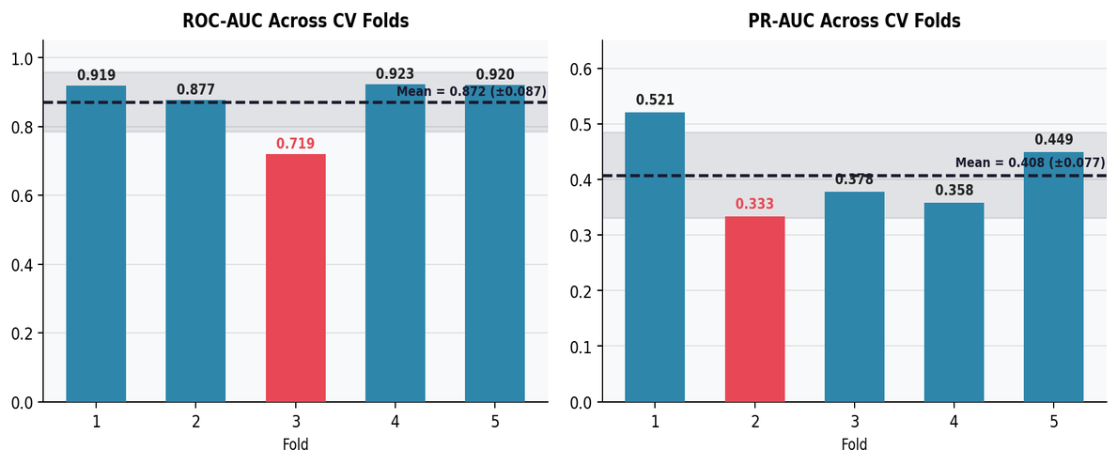
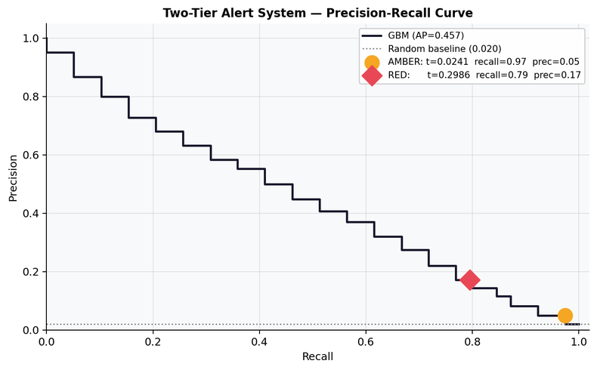
4. Robustness & Alert Design
Time-Series Cross-Validation (5 folds)
Two-Tier Alert System
0.872
±0.087
Problem: 262 false alarms per 34 real failures → alert fatigue. Engineers start ignoring warnings.
Mean ROC-AUC
Std dev
🟡 AMBER
🔴 RED
t=0.0241 Recall 97%
TP=38 FP=737 FN=1
Elevated risk — monitor closely
t=0.2986 Recall 79%
TP=31 FP=149 FN=8
High confidence — stop & inspect
Fold 3 dips to 0.719: contains 139 failures vs ~35 in other folds. Model struggles with dense folds with more failures because this period represents an unusual sustained stress event, reflecting a harder prediction window
Notes:
A single train-test split on 39 failures is too narrow to trust. I ran five-fold time-series cross-validation — training on progressively larger windows and testing on the next unseen period each time. Mean ROC-AUC of 0.872, standard deviation of plus or minus 0.087.
Fold 3 drops to 0.719. I want to be transparent about that. Fold 3 contains 139 failures against around 35 in every other fold — a concentrated stress event. When the failure pattern shifts that dramatically from training, performance drops. I flagged this because it tells you something real: the model needs retraining when rig conditions change significantly, and monitoring for that drift is part of the plan.
Now — 262 false alarms for 34 genuine failures means roughly one real fault in every eight callouts. In any environment that causes alert fatigue. Engineers hear the alarm, find nothing, hear it again, find nothing, and eventually stop responding. The one time it is real, they have learned to ignore it. That is the problem the two-tier system solves.
AMBER fires at a low threshold — catches 38 of 39 failures, misses only one. It does not mean stop the rig. It means pay attention, watch the trend, be ready.
RED fires at higher confidence — 31 of 39 failures, only 149 false alarms, precision of 17%. Nearly one in six RED alerts is a genuine fault. When RED fires, people act — because they trust it.
Together the two tiers do what a single threshold cannot.

Slide 6
5. How It Would Be Used
Apprentices & Trainers
Keeping It Working
24-Month Project Plan
Apprentices
Live 0–100% failure risk gauge on simulator dashboard
AMBER / RED tiered alerts instead of a single alarm
Real-time feedback as they adjust rig parameters
Builds intuition for condition-based monitoring
Trainers
Inject known fault conditions as exercises
Ask apprentices to diagnose which sensors triggered each tier
Replay failures with probability trace overlay
Feature importances as a classroom discussion tool
Keeping It Working
Monitor sensor drift using rolling statistical tests
Retrain when ROC-AUC on rolling validation window drops below 0.85
Engineers log whether each alarm was genuine
Version-controlled retraining pipeline
What I Bring
Python ML, GBM, SHAP, threshold tuning — built from scratch here
Temporal splits, leakage prevention, rolling features
SHAP into classroom language; comfortable running workshops
Git, risk registers, milestones — OPC UA & AR/VR via HETA & Hull
M1
M7
M13
M19
M24
1. Discovery
Rig audit, stakeholders
2. IoT & Data
OPC UA, InfluxDB
3. ML Model
Feature eng, SHAP
4. Platform
AR/VR, curriculum, handover
Limitations & Next Steps
Single rig, 7 days — generalisation to other rigs untested; rig-specific calibration may be needed
Model flags failure at occurrence — next step: shift target label N minutes ahead so engineers can intervene before damage
Probability scores not fully calibrated — Platt scaling would make AMBER / RED thresholds more meaningful to engineers
Notes:
Everything so far has been the proof of concept — what the model does on historical data. This slide is about what my role would look like turning that into something live at HETA over two years.
For apprentices — there is a live risk gauge on the simulator dashboard updated with every reading. As they adjust the rig they watch the score move. AMBER means pay closer attention. RED means stop and inspect. The SHAP breakdown shows them which sensors drove the alert. Before a session they can predict which sensor they think will trigger failure first — then compare against what the model actually flagged. After a session they can replay the full probability trace and see exactly how the risk built up over time. The goal is not that they become dependent on the gauge — it is that over time they stop needing it. They start recognising the signature of a developing fault because they have seen it build, session after session.
For trainers — they can inject known fault conditions and ask apprentices to diagnose which sensors triggered the alert before they look at the dashboard. For more advanced apprentices they can disable the SHAP explanation entirely, so the apprentice has to diagnose without hints. Failure replays become assessment tools — here is a recorded session, at what point should you have intervened? Feature importances become a classroom discussion. These are exactly the questions that build practical diagnostic judgement rather than checklist dependency.
The Gantt on the right shows how this gets built. Phase 1 is connecting the proof of concept to a live rig. The sensors feed into the PLC, the PLC exposes the data over OPC UA, and from there it flows through a pipeline into InfluxDB where the model reads it. I have experience on the hardware side — operating PLCs and monitoring SCADA systems — so I understand how that data is generated. The integration work in Phase 1 would be done collaboratively with HETA's engineering team. My primary contribution is the ML layer that sits on top of it, and the Grafana dashboard that brings the risk score back to the apprentice in real time.
Phase 2 — months six to eighteen — is validation and iteration. Running live, collecting real alarm data, retraining on labelled outcomes, adjusting thresholds based on what trainers and apprentices tell us about how the alerts land in practice.
Phase 3 — the final stretch — is moving from one rig to a framework that can be applied more broadly. Calibration methodology for different rig types, a retraining governance process, documentation that lets HETA maintain the system independently after the KTP ends.
To be clear about what this is — a proof of concept on seven days of data from one rig. It has not been tested on other rigs, and the probability scores are not yet fully calibrated. These are not flaws in the approach — they are the starting point for Phase 1. Real rig access is where this moves from a prototype to a production system.
I am not here to hand over a model. I am here to work embedded at HETA for two years, alongside the engineers and trainers, to build something they own and trust long after the KTP ends.

