Slide 1
Battle Tanks on FPGA: Overview + Scope
Problem: RV32I has no multiply/divide, so game math is slow.
System: Two-player tank game on a Nexys A7. A 3-stage RV32IM CPU runs game rules in C; hardware handles buttons, timers, collisions and VGA. Our modification: RV32M unit (MUL/DIV/REM) with pipeline stall.
System Scope
Commitment
RV32M unit (MUL/DIV/REM) verified and integrated with stall
C program on CPU moves two tanks on a VGA maze using buttons
Goal
Bullets with wall reflection, collision flags, cooldowns
Health hearts on screen; damage logic in C; full FPGA demo
Stretch
Single-player mode: software-controlled enemy tank
1 / 7
Notes:
1-1.5 min. Problem: base RV32I has no hardware multiply/divide; our game needs cos/sin x speed and bullet reflection. System: CPU runs game rules in C, everything per-pixel / per-cycle is hardware. Our modification is the RV32M unit. Commitment = must-have; Goal = planned; Stretch = only if time remains.

Slide 2
System Architecture
RV32IM CPU (3 stages)
Instr. Mem
(BRAM)
1 · IF/ID
Decode · RegFile
2 · EX
ALU · Branch
3 · WB
Load/Store · Result
Data Memory
(BRAM)
base CPU
CPU modification
game hardware
pipeline_stall
NEW: RV32M unit
WB forwarding
MMIO bus (addr · wdata · we → registered read mux)
Collision
(hit flags)
Sprite/HUD
registers
Maze Tile
RAM
Input
controller
Cooldown
timers
positions, angles, health
maze tiles
VGA timing
(x, y, sync)
Sprite engine · Maze renderer · HUD
Pixel mixer
(priority)
VGA out
Monitor
Modification: RV32M unit plugs into the EX stage; ALU gets its result
Control: divider asserts pipeline_stall; PC and IF/ID freeze
Data: CPU writes sprite regs over MMIO; video reads them every pixel
2 / 7
Notes:
2 min. Left to right: CPU with three stages IF/ID, EX, WB. Red block = our modification: RV32M unit attached to EX. When a divide runs, it raises pipeline_stall and freezes the front of the pipeline; write-back forwarding feeds results back to the register-file read. Data side goes through the MMIO bus to the game peripherals. C code writes sprite/HUD registers and maze RAM; the VGA engine reads them per pixel and the pixel mixer outputs RGB to the monitor. Collision flags are computed in hardware, C reads them and applies damage/reflection. Branch redirect (EX -> PC) is omitted for clarity; shown in the timing slide. Full diagram: backup slide.

Slide 3
Timing Diagram: 28 cycles, instruction sequence
cycle
0
1
2
3
4
5
6
7
8
9
10
11
12
13
14
15
16
17
18
19
20
21
22
23
24
25
26
27
clk_sys
IF/ID
NOP
A
B
C
D
E
F
G
H
J
K×
L
M
N
O
P
Q
R
S
T
U
V
W
NOP
EX
NOP
A
B
C
D
E
F
G
H
J×
K×
L
M
N
O
P
Q
R
S
T
U
V
W
NOP
WB
NOP
A
B
C
D
E
F
G
H
J×
K×
L
M
N
O
P
Q
R
S
T
U
V
W
stall_read_i
1
1
branch_taken
1
fwd_sel1
1
1
1
1
fwd_sel2
1
1
1
m_ext_EX (MUL)
1
Instructions: A addi · B add · C lw · D add · E sw · F mul · G bne (not taken) · H beq (taken) · J, K wrong path · L sw · M lw · N addi (uses M) | orange = held/stalled, red = squashed
Forwarding: B takes A's result in cycle 4; D takes lw data in cycle 7
Load stall: lw waits 1 cycle (6, 16); pipeline holds, single write
Taken branch H (11): J, K squashed; fetch resumes at target L
Multi-cycle: MUL 1 clock; DIV/REM stalls pipeline ≈33 clocks
3 / 7
Notes:
2 min. Real sequence: addi, add, lw, add, sw, mul, bne, beq, ... Cycle 4: B reads A result through write-back forwarding (fwd_sel1/2). Cycle 6: lw C is waiting for data (stall_read_i); D is held in EX, resumes at 7 and gets the loaded value forwarded. mul F executes in one clock (m_ext_EX at cycle 9). beq H is taken in cycle 11: the two younger instructions J and K are squashed (no store, no register write), PC jumps to 64 so L enters. Cycle 16: lw from the input register (MMIO) waits one cycle, N gets forwarded data. Multi-cycle: DIV/REM runs 32 iterations; pipeline_stall stays high from start through done (~33 clocks), then the result is written back once; divide-by-zero and INT_MIN/-1 bypass the iterations (backup slide). NOTE: diagram is an illustrative sequence derived from the block diagrams; replace with a real simulation waveform when available.

Slide 4
Design + Verification Plan
Implementation Plan
Verification Plan
1. MUL unit → mul.v + testbench
2. DIV/REM unit → div_rem.v + testbench
3. RV32M in pipeline (stall, bubble) → integrated simulation
4. MMIO + VGA + game.c → full simulation, then FPGA
Module level: self-checking testbenches vs. golden results
Edge cases: signed/unsigned MULH variants, ÷0, INT_MIN ÷ −1, REM sign
Processor level: C programs in simulation: mul/div test, then game.c
4 / 7
Notes:
1.5-2 min. Each step ends with something we can show: steps 1-2 are module + testbench, step 3 is an integrated simulation running assembly with mul/div between dependent instructions, step 4 is the full system in simulation and then on the board. Verification: testbenches compare against expected values (directed + random vectors). Edge cases: MULH/MULHSU/MULHU sign handling, divide by zero returns all ones (REM returns the dividend), INT_MIN / -1 returns INT_MIN with remainder 0 and no exception. Processor level: compile C with rv32im, run in simulation, check registers/memory, then game.c.

Slide 5
Timeline
When | Milestone (concrete deliverables)
By 25 Oct | mul.v + div_rem.v pass their testbenches (incl. ÷0, INT_MIN ÷ −1)
By 1 Nov | Minimum system: CPU + RV32M runs a C test in simulation; VGA shows maze + tanks
Final phase | Integration: game.c with bullets, collision, health; timing closed; FPGA demo on Nexys A7
Dependencies: modules first, then pipeline integration, then game software, then bitstream
5 / 7
Notes:
1-1.5 min. Three milestones. 25 Oct: at least one module tested - we plan both the multiplier and divider with testbenches. 1 Nov: minimum working system = CPU with RV32M running a C test, and VGA showing maze and tanks. Final phase: integration of the full game and the FPGA demo. TODO: insert exact final-phase date.

Slide 6
Team Responsibilities
Member | Responsibility
A | MUL / MULH / MULHSU / MULHU + testbench
B | DIV / DIVU / REM / REMU + stall control + testbench
C | Pipeline integration + hazards + C test programs
D | MMIO peripherals, VGA, game.c, FPGA build + demo
Interfaces: A/B → C: result + pipeline_stall; C ↔ D: MMIO register map
6 / 7
Notes:
1 min. Four non-overlapping areas. A owns the multiplier, B the divider and its stall control, C the pipeline and hazard logic plus C test programs, D the game hardware (MMIO, VGA), game.c and the FPGA demo. Interfaces are fixed early: m_result / pipeline_stall between A,B and C; MMIO register map between C and D. TODO: replace A-D with real names.

Slide 7
Demo Plan + Challenges
Demo Plan
Input
Player buttons + game.c in instruction memory
Processing
CPU runs game in C; hardware checks collisions and renders
Output
VGA monitor: maze, tanks, bullets, health hearts
Challenges
Stalls: 32-clock divide must freeze pipeline, no double write
Signed/unsigned: MULH variants, ÷0, INT_MIN ÷ −1 overflow
Hazards: load wait + forwarding + branch squash together
FPGA timing: 33×33 multiplier path at 50 MHz; VGA sync alignment
7 / 7
Notes:
1-1.5 min. Demo: Input = player buttons plus the compiled game program in instruction memory. Processing = CPU polls buttons, moves tanks, spawns bullets, reads hardware collision flags; the VGA engine renders per pixel. Output = visible on a VGA monitor connected to the FPGA. Challenges: stalls, signed/unsigned and corner cases, hazard combinations, FPGA timing closure. Be ready: Nexys A7 has only 5 buttons, so 12 game inputs need external buttons/PMOD wiring.

Slide 8
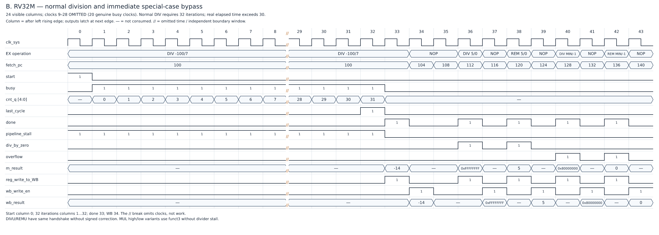
Backup: DIV/REM multi-cycle timing
Start → 32 busy clocks (pipeline_stall = 1) → done → write-back
÷0 and INT_MIN ÷ −1 bypass the iterations, no exception
Notes:
Backup for Q&A. Sheet B of the timing diagrams (illustrative, derived from block diagrams).

Slide 9
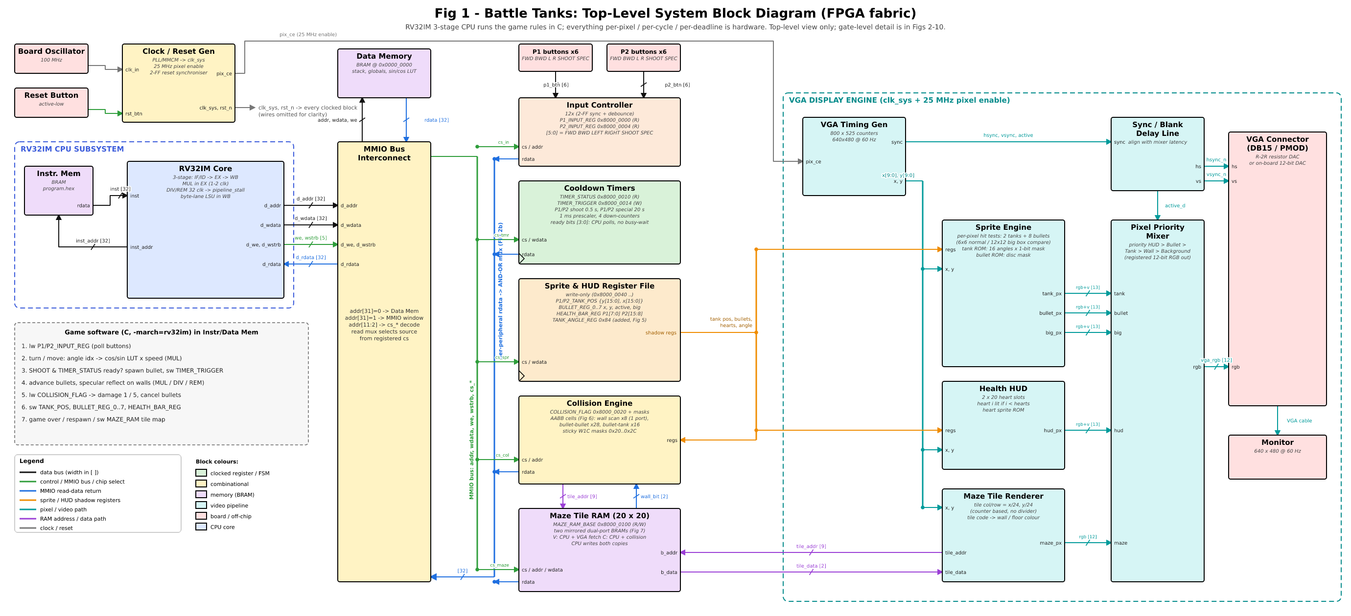
Backup: full system block diagram
Notes:
Backup for Q&A: gate-level top-level diagram (Fig 1).

