Slide 1
Student Performance Predictor
“Predicting Students' CGPA Based on Academic and Behavioral Factors"
Presented by: Kabir Rajkumar Patil
Date:- 21/01/2025

Slide 2
Introduction:
Using the Students Performance in Exams Dataset we will try to understand what affects the exam scores. The dataset will present a good source to spot the relations.
The Student Performance Predictor Project aims to assess and analyze key metrics influencing academic success. Through comprehensive data collection and analysis, it seeks to identify trends and factors impacting student performance.
This project serves as a vital tool for educators and policymakers to enhance educational outcomes and support student achievement. The student ranking system fosters a competitive environment by assessing and comparing academic performance among students.
Problem Statement
Objective:
- To develop a machine learning model that predicts students' CGPA based on their marks and daily routine.
Significance:
- Helps educators identify areas where students may need additional support.
- Enables targeted interventions for improving academic performance.

Slide 3
Methodology
Data Collection:
- Gathered data on student marks and daily routines through surveys and institutional records.
Feature Selection:
- Key features included academic scores, study hours, extracurricular involvement, and sleep patterns.
Model Development:
- Implemented machine learning algorithms to train the model.
Evaluation Metrics:
- Used metrics such as Mean Absolute Error (MAE) and R-squared for evaluation.

Slide 4
Data Insights
Exploratory Data Analysis:
- Visualized the relationship between study hours and academic performance.
- Observed trends linking sleep patterns with CGPA.
Key Observations:
- Consistent study habits and adequate sleep positively correlated with higher CGPA.
Machine Learning Model
Selected Model:
- Specify the algorithm used, e.g., Linear Regression, Random Forest.
Model Training:
- Split the data into training and testing sets (e.g., 80-20 split).
- Optimized hyperparameters for improved performance.
Model Accuracy:
- Achieved [100%] accuracy.

Slide 5
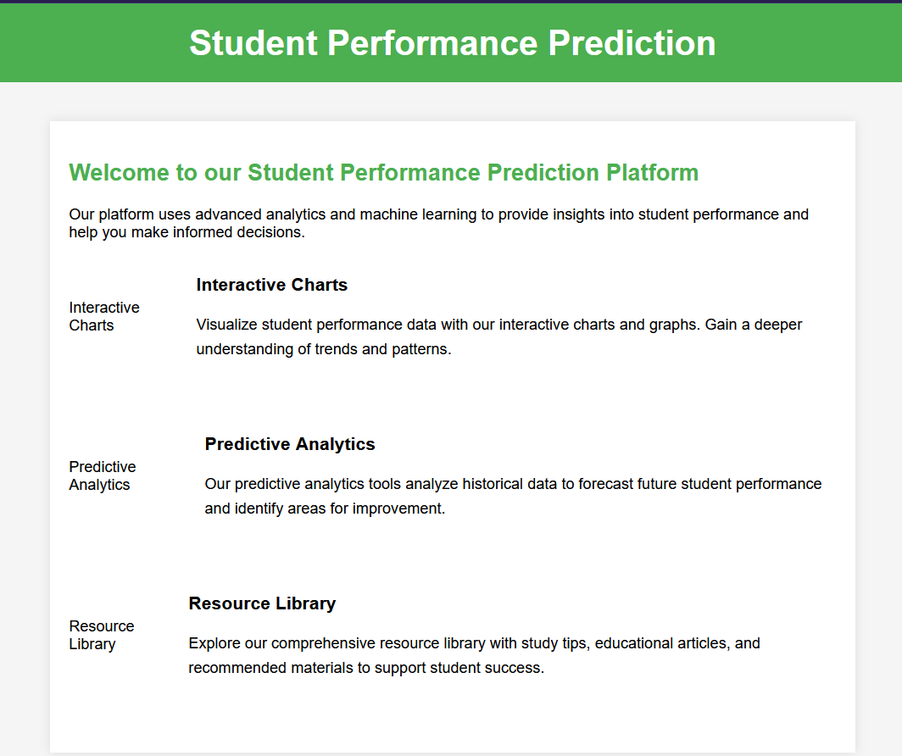
Front-END:
This is the basic front-end for our student performance prediction.
This front end can be modified based on the different business requirements and usage.

Slide 6
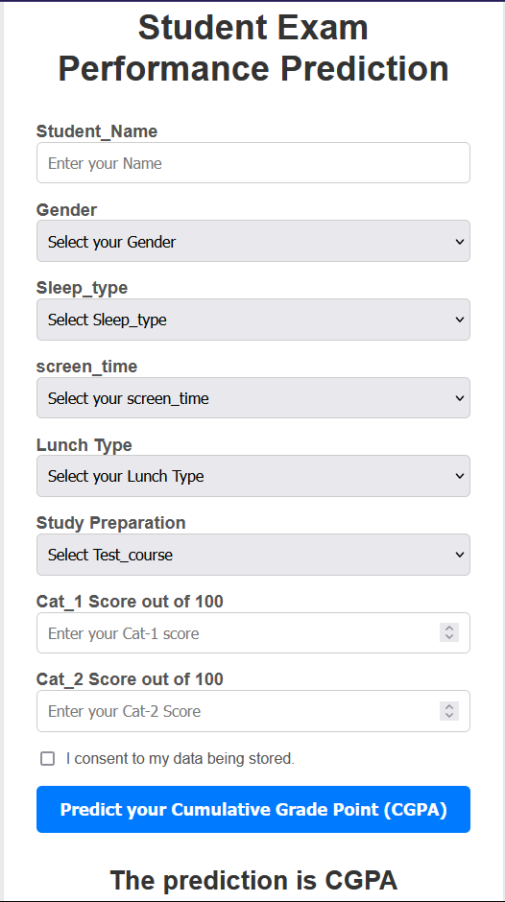
Student Data Input Form:
In this form we can take input of the student data.
Based on that input the machine-learning model will predict the CGPA.
The CGPA will be shown below.

Slide 7
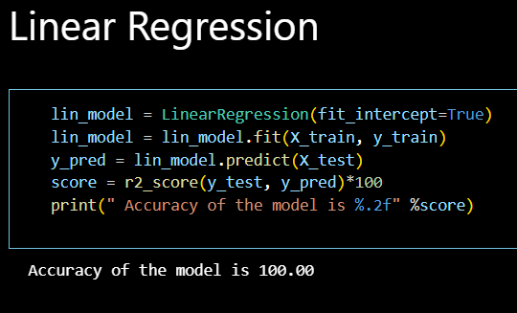
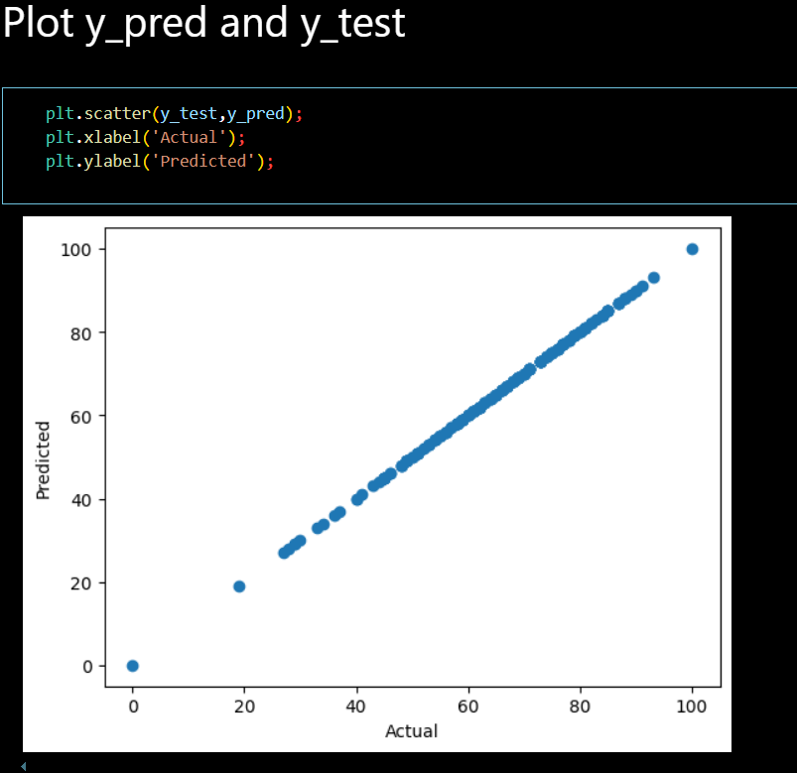
Machine learning model:

Slide 8
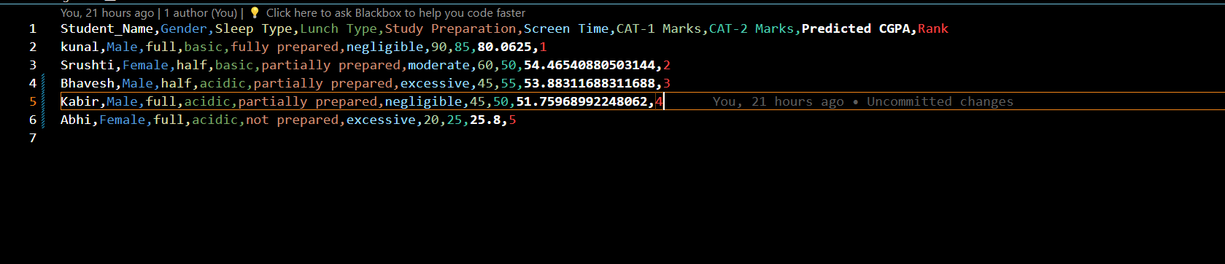
RANKING:
After predicting the CGPA the ranking system automatically ranks the student.

Slide 9
Challenges and Limitations
Challenges Faced:
- Data collection was time-consuming.
- Balancing the influence of subjective factors like 'daily routine.'
Limitations:
- Model performance may vary with different datasets.
- Limited generalizability due to sample size.
Future Scope
Improvements:
- Integrating more diverse datasets for better generalization.
- Enhancing the model with advanced algorithms like Neural Networks.
- We can add the role-base login for different users.
Applications:
- Developing an interactive dashboard for educators.
- Scaling the model for institutional use.

Slide 10
Conclusion
Summary:
- Successfully developed a linear regression model to predict CGPA based on academic and behavioral factors.
-The Student Performance Predictor Project uses data analysis to understand factors like gender, sleep, diet, and past scores affecting academic success.
-It helps tailor strategies for fair learning opportunities and maximized outcomes. While the student ranking system encourages competition, it also faces criticism.
-Yet, when used effectively, it drives academic excellence and prepares students for success. Efforts to refine the system should continue, recognizing its positive impact on motivation and achievement.
-This project represents a significant step in improving education by providing insights and interventions to support student success.

Slide 11

THANK YOU

