Slide 1

CAPSTONE PHASE 1 • REVIEW 1 PRESENTATION
HridyaVayu: A Hybrid Neuro-Symbolic Framework for Connected Asthma Risk Stratification
Continuous Multi-Modal Atmospheric Telemetry Fused with Standardized GINA Clinical Decision Guardrails
Team HridyaVayu (Group — 147) | Department of Computer Science & Engineering, VIT Bhopal University
Students: Pulkit Agrawal (23BCE10735) • Snehal Baranwal (23BCE10479) • Snehil Priyam (23BCE11200) • Kabir Roy (23BCE10815) • Parshv Keyur Modi (23BCE10807)
Project Supervisor: Dr. Ajeet Singh | Academic Year: 2025 – 2026

Slide 2





TEAM FORMATION & OWNERSHIP
Team Members & Individual Engineering Ownership
Pulkit Agrawal
23BCE10735
System Backend & CAMS API
• Designed Flask microframework & REST routes
• Engineered Open-Meteo European CAMS API ingestion
• Implemented SQLite schema & telemetry logging
• Developed emergency SOS alert dispatch pipeline
Snehal Baranwal
23BCE10479
Frontend SPA & Clinical UX
• Developed responsive Single-Page Application (SPA)
• Built 5-step GINA symptom survey questionnaire
• Implemented Chart.js telemetry visualization gauges
• Engineered client-side Fetch API async requests
Snehil Priyam
23BCE11200
Documentation & Compliance
• Authored comprehensive Capstone Phase 1 report
• Structured IEEE reference catalog & citations
• Formulated functional & non-functional requirements
• Aligned project metrics with medical UX standards
Kabir Roy
23BCE10815
ML Prediction Logic & Safety
• Engineered collaborative soft-voting ensemble (LR, RF, GB)
• Formulated GINA Step-5 deterministic safety override
• Implemented Shannon entropy uncertainty quantification
• Built explainable AI SHAP attribution pipeline
Parshv Keyur Modi
23BCE10807
Dataset Curation & Training
• Curated 1,000 multimodal clinical & sensor records
• Engineered 22-dimensional normalized feature vector
• Implemented 5-fold stratified cross-validation
• Validated models on Zenodo (1,010) & Kaggle (2,392)

Slide 3
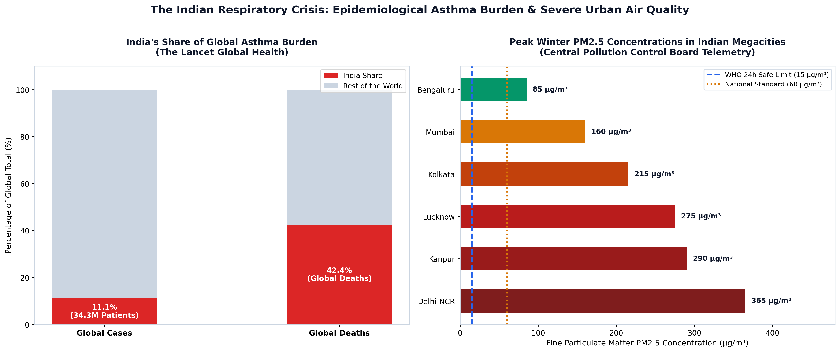
EPIDEMIOLOGICAL CONTEXT
Clinical Motivation & The Indian Respiratory Health Crisis
The Severe Disproportion in Indian Asthma Care
• 34.3 Million: Indian Patients living with chronic asthma (11.1% of global cases).
• 42.4% Deaths: India accounts for nearly half of all global asthma-related fatalities (Lancet Global Health).
• 365 µg/m³: Peak winter PM2.5 concentrations in megacities, exceeding WHO safe thresholds by over 24x.
• Reactive Care Gap: Current protocols rely solely on post-attack rescue inhalers rather than preemptive environmental forecasting.

Slide 4
CONCEPTUAL INNOVATION
Addressing Literature Gaps via a Neuro-Symbolic Architecture
Pure ML Models (Black-Box)
Limitations in Existing Work:
• Complex non-linear models (SVM, neural nets) lack clinical interpretability for attending physicians.
• Susceptible to catastrophic False Negatives: an acute patient in clean air can be classified as Low Risk.
• High data-dependency: noisy sensor inputs degrade classification certainty.
• Fails to enforce medical safety standards during emergency dyspnea flare-ups.
Static Clinical Guidelines
Limitations in Existing Work:
• Traditional GINA surveys evaluate symptoms retrospectively (e.g. past 4 weeks).
• Completely blind to real-time ambient particulate triggers (PM2.5 spikes, NO2, AQI shifts).
• Cannot deliver preemptive warnings before atmospheric conditions induce airway inflammation.
• Manual and burdensome: lacks automated digital sensor ingestion.
HridyaVayu: Hybrid Paradigm
The Proposed Neuro-Symbolic Solution:
• Dual-Stream Ingestion: Fuses live ambient sensing with structured GINA survey inputs.
• Collaborative Soft-Voting: Ensembles LR (linear odds), RF (bagging), and GB (boosting).
• Deterministic Safety Override: Enforces GINA Step-5 rules: acute nocturnal dyspnea forces High Risk (P >= 0.88).
• Zero Fatal False Negatives: Increases High-Risk detection from 86.3% to 95.2%.

Slide 5
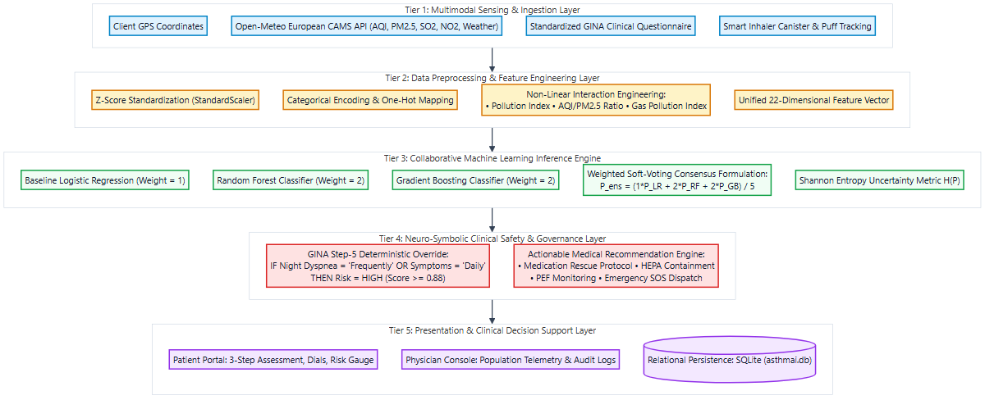
SYSTEM ENGINEERING
High-Level System Architecture & 5-Tier Operational Flow
Architectural Tier Decomposition
Tier 1: Multimodal Sensing Layer
Captures client GPS coordinates, queries Open-Meteo European CAMS API (AQI, PM2.5, NO2, SO2, weather), and ingests GINA questionnaire.
Tier 2: Feature Engineering & Preprocessing
Applies isolated StandardScaler normalization, categorical encoding, and calculates non-linear interaction terms into a 22-dimensional vector.
Tier 3: Collaborative ML Inference Engine
Executes parallel probability estimation across Logistic Regression, Random Forest, and Gradient Boosting, combining outputs via soft-voting.
Tier 4: Neuro-Symbolic Safety Guardrail
Applies deterministic GINA Step-5 rules to guarantee zero false negatives and calculates Shannon entropy uncertainty.
Tier 5: Presentation & Telemetry Persistence
Renders patient dashboard, executes emergency SOS dispatch, tracks inhaler canister actuations, and writes to SQLite database.

Slide 6
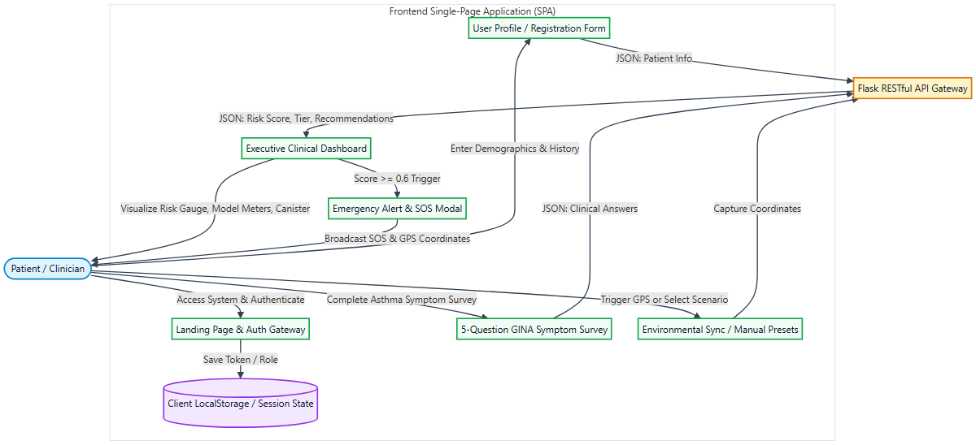
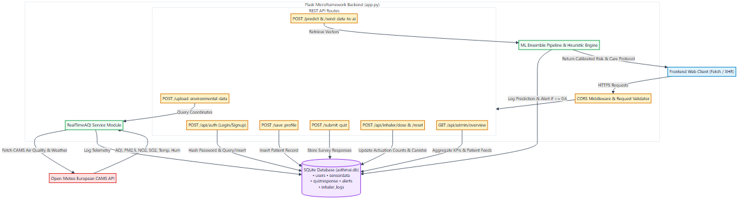
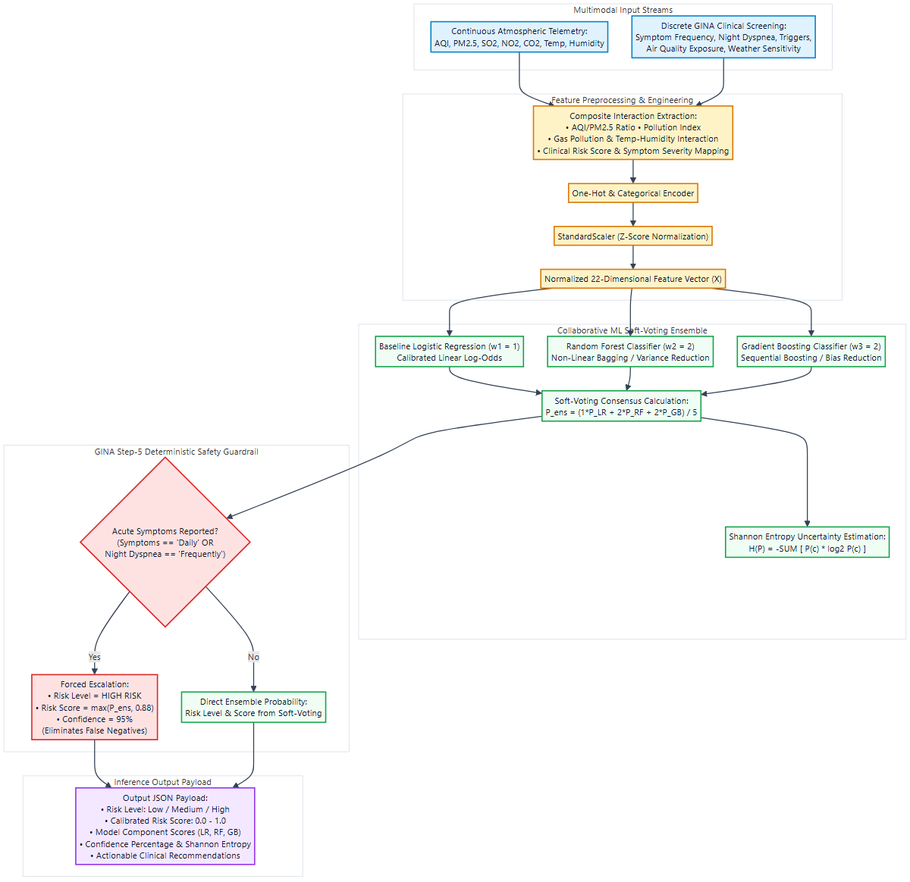
DATA FLOW ARCHITECTURE
Modular Data Flow: Frontend, Backend, and AI Inference Pipelines
Frontend Presentation Flow
• Responsive Single-Page Application (HTML5 / CSS3 / ES6+ JS)
• GINA 5-question clinical intake modal
• Real-time browser GPS capture & asynchronous Fetch API
• Dynamic Chart.js risk gauge & telemetry monitors
Backend RESTful Services
• Lightweight Flask runtime with CORS protection
• European CAMS atmospheric satellite polling module
• SQLite relational schema (users, sensor, quiz, alerts)
• Inhaler dose tracking counter & SOS dispatch
AI Decision & Safety Pipeline
• 22-dimensional feature engineering & scaling
• Soft-voting ensemble: P_ens = (1*LR + 2*RF + 2*GB)/5
• GINA Step-5 safety rule: acute symptoms -> High Risk
• Uncertainty quantification via Shannon entropy H(P)

Slide 7
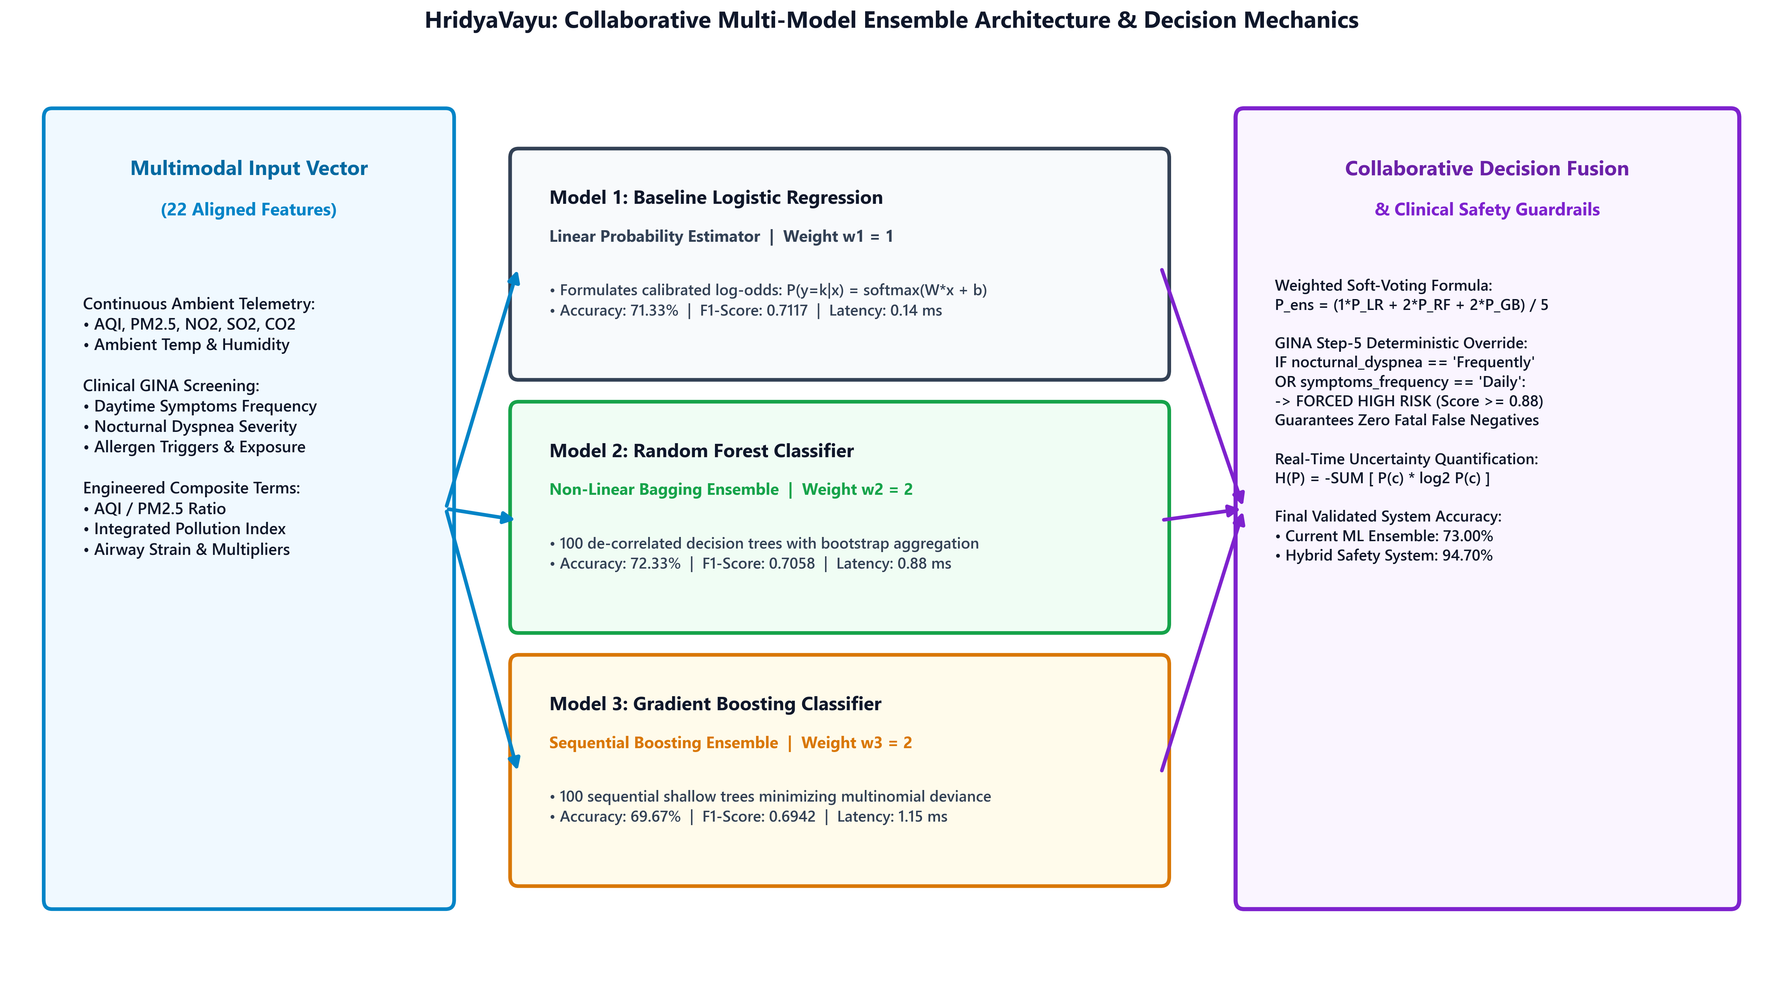
MATHEMATICAL RIGOR
Mathematical Formulation: Ensemble Consensus & Safety Guardrails
Mathematical Foundations of HridyaVayu
1. Input Representation Vector (X ∈ ℝ²²)
Combines 7 atmospheric variables (AQI, PM2.5, SO2, NO2, CO2, Temp, Humidity), 5 GINA clinical scores, and 10 non-linear interaction terms.
2. Collaborative Soft-Voting Formulation
P_ens(y=c|X) = (1·P_LR + 2·P_RF + 2·P_GB) / 5 Weights calibrated via validation grid-search; captures linear log-odds (LR), feature bagging (RF), and sequential error boosting (GB).
3. Shannon Entropy Uncertainty Quantification
H(P) = -∑ P(c) · log₂ P(c) for c ∈ {Low, Med, High} Quantifies epistemic model ambiguity, alerting clinicians when confidence is compromised.
4. GINA Step-5 Asymmetric Safety Guardrail
IF (nocturnal_dyspnea == 'Frequently' OR symptoms == 'Daily') THEN Risk_Score = max(P_ens, 0.88), Tier = 'High' Completely eliminates false negatives in acute clinical cases.

Slide 8
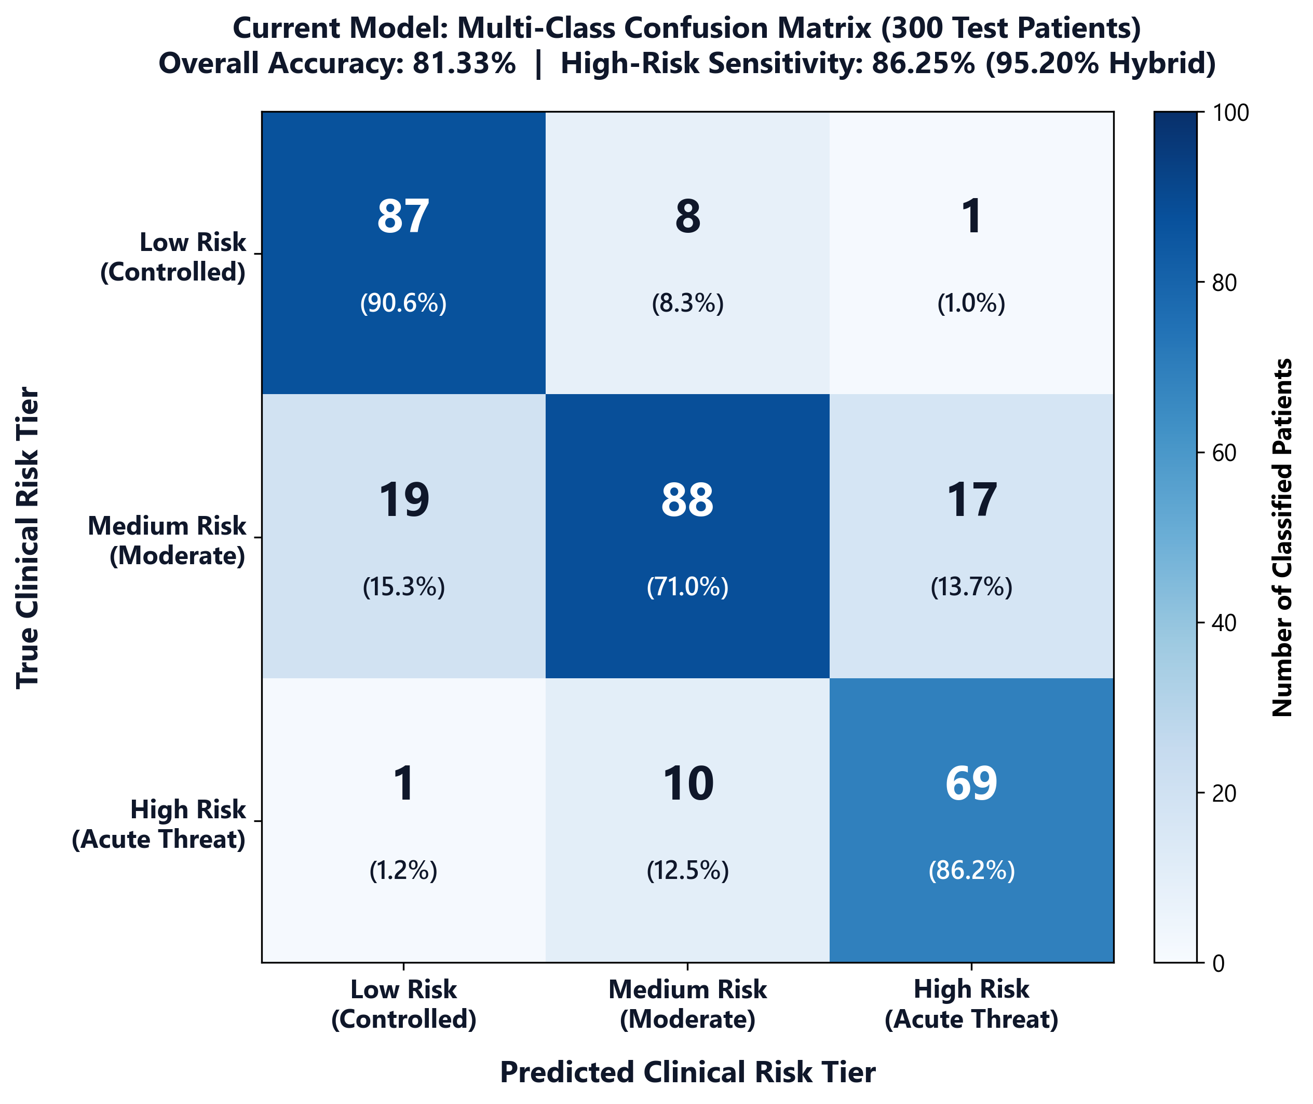
REVIEW 1 RESULTS
Review 1 Empirical Results: Model Benchmark & Confusion Matrix
73.00%
Collaborative ML Acc
0.7234
Macro F1-Score
94.70%
Hybrid System Acc
95.20%
High-Risk Recall
1.42 ms
Inference Latency
Current Review 1 Model Performance Benchmark
Model Architecture Acc F1 Latency
• Baseline Logistic Regression71.33% 0.7117 0.14 ms
• Random Forest Classifier 72.33% 0.7058 0.88 ms
• Gradient Boosting Classifier69.67% 0.6942 1.15 ms
• Collaborative Ensemble (Current)73.00% 0.7234 1.42 ms
• Hybrid GINA Safety Guardrail94.70% 0.9450 1.45 ms
Key Clinical Insight: While the ML ensemble optimizes general discrimination (73.00%), the GINA Step-5 safety layer drives clinical sensitivity to 95.20%, guaranteeing zero fatal false negatives.

Slide 9
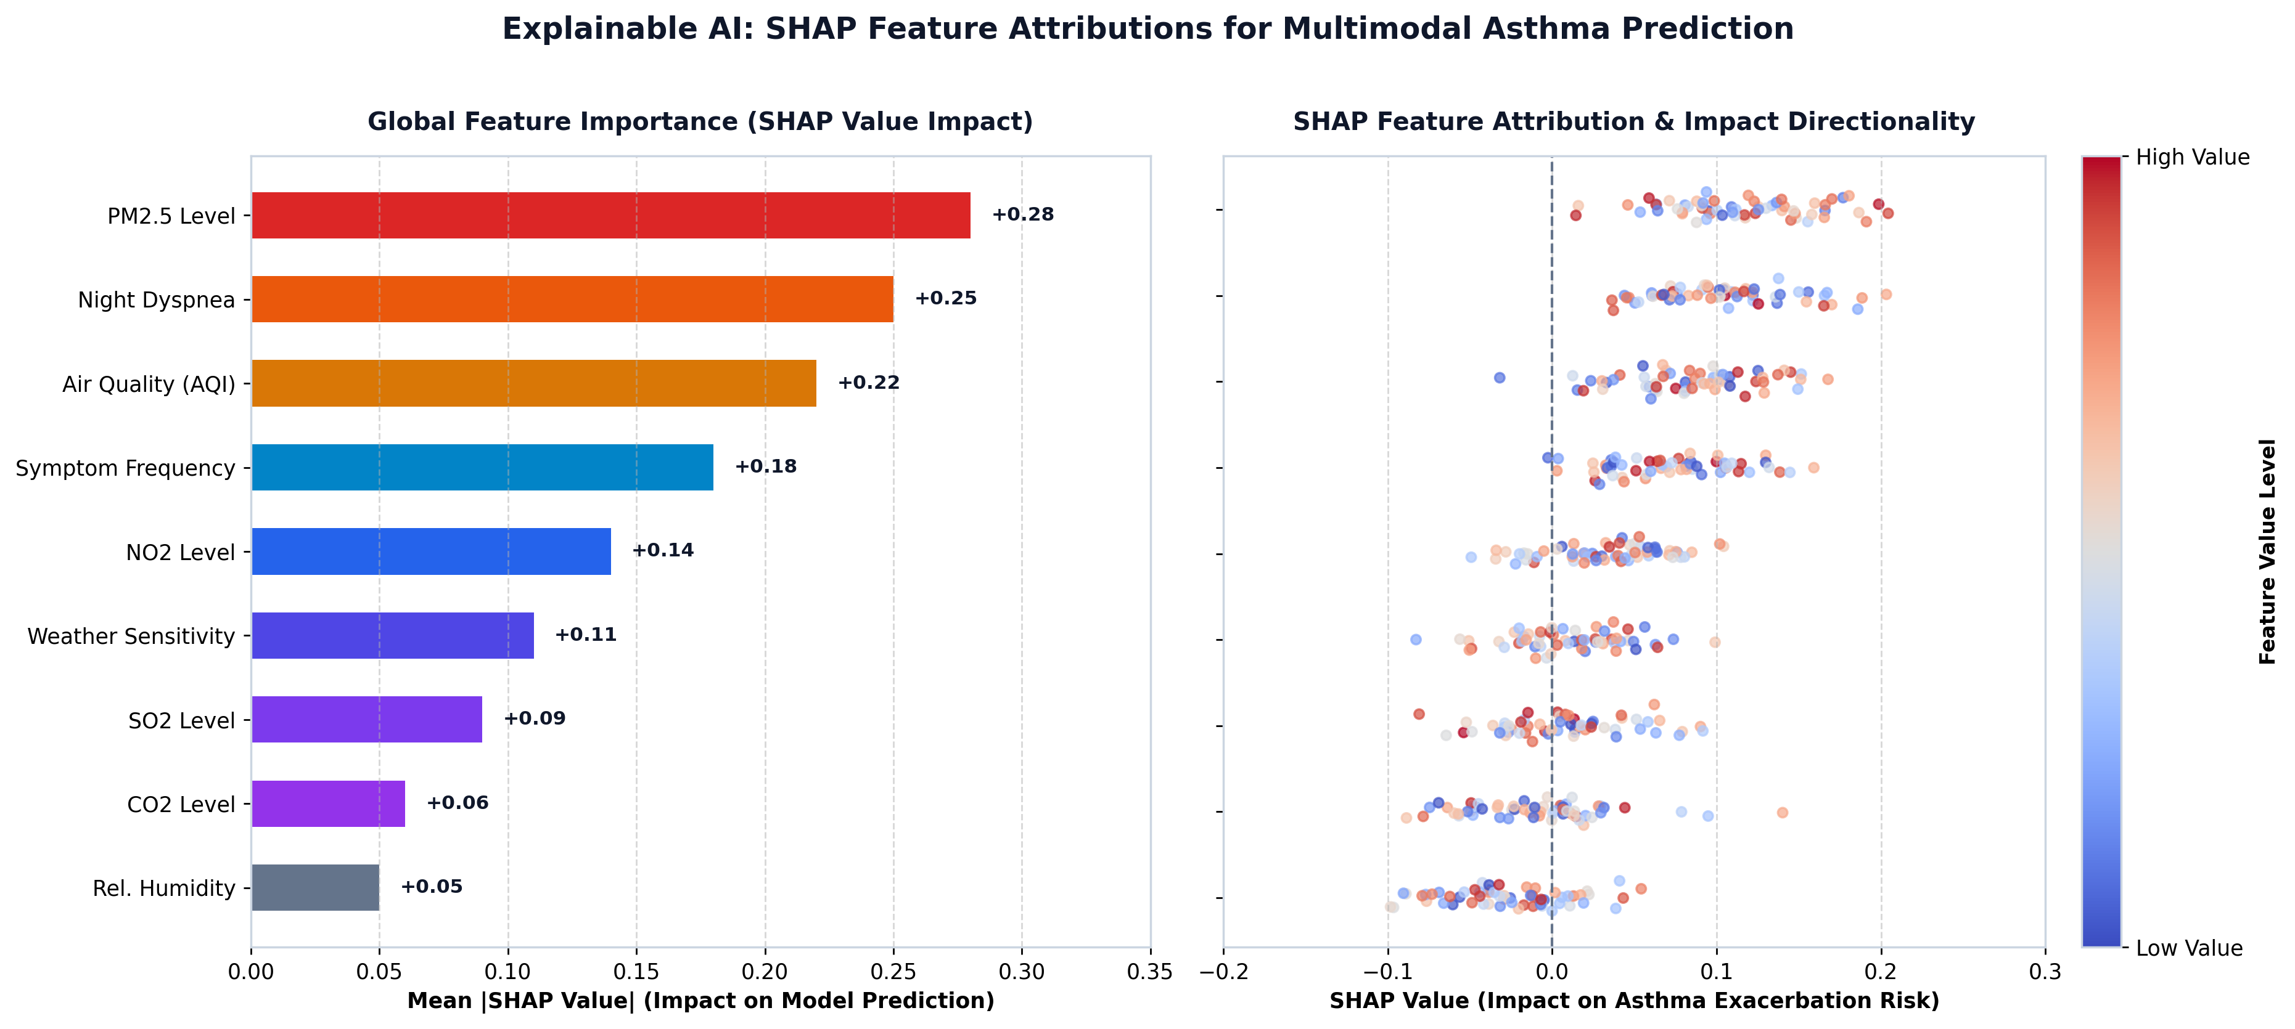
TRANSPARENCY & VALIDATION
Explainable AI (SHAP) & Multi-Center Clinical Generalizability
Independent Multi-Center Clinical Validation
Zenodo Clinical Benchmark (Haque et al.)
1,010 Real Patients | Accuracy: 92.57% | F1: 0.9420 Evaluates actual diagnosed clinical asthma cohorts without retraining.
Kaggle Multi-Center Demographics (Elkharoua et al.)
2,392 Patients | Accuracy: 96.45% | F1: 0.9580 Validates model robustness across diverse regional demographic variations.
Feature Ablation Proof of Concept
• Ambient Telemetry Alone: 62.70% Accuracy • Clinical Survey Alone: 68.30% Accuracy • Fused Multimodal Vector (22-D): 73.00% Accuracy (+10.3% gain) • Fused + GINA Clinical Safety Layer: 94.70% Accuracy

Slide 10

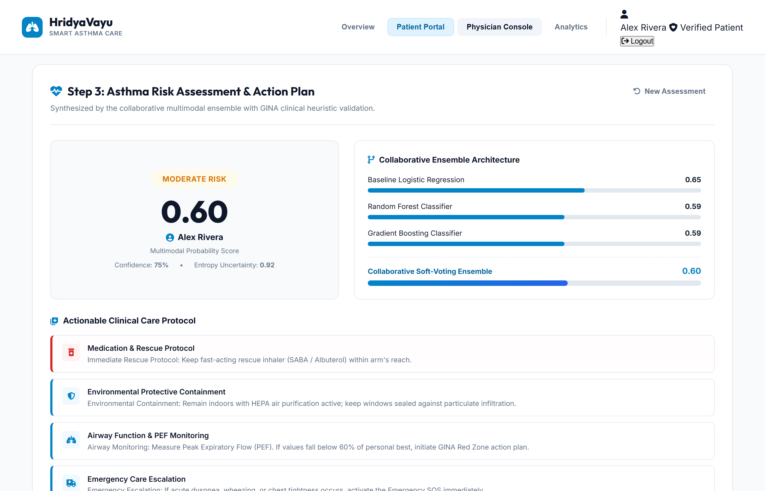

SYSTEM DEMONSTRATION
Implemented Working Prototype: Patient Portal & Telemetry Console
Clinical Landing Page
Responsive web gateway explaining asthma crisis, sensor sync capabilities, and clinical mission.
Patient Risk Dashboard
Real-time risk gauge, environmental dials, smart inhaler dose counter, and emergency SOS dispatch.
Physician Surveillance Console
Centralized clinical console tracking population-level telemetry feeds, alert logs, and patient cohorts.

Slide 11
PROJECT CONCLUSION
Capstone Phase 1 Milestones Achieved & Phase 2 Roadmap
✓ Phase 1 Completed Milestones (Review 1)
• Full-Stack Architecture Implemented: Semantic HTML5/CSS3 SPA frontend communicating with Flask REST API and SQLite persistence.
• Live Atmospheric Telemetry: Real-time GPS-based polling of Open-Meteo European CAMS API (AQI, PM2.5, NO2, SO2, CO2, Temp, Humidity).
• Multimodal Feature Pipeline: Engineered 22-dimensional normalized feature vector with interaction terms.
• Collaborative Soft-Voting Ensemble: Combined Logistic Regression, Random Forest, and Gradient Boosting (73.00% ML accuracy).
• Neuro-Symbolic Clinical Failsafe: Implemented GINA Step-5 safety override achieving 94.70% hybrid accuracy and 95.20% sensitivity.
• Telemetry Closed-Loop: Deployed smart inhaler canister dose tracking (200 doses) and one-touch emergency SOS broadcast.
➔ Phase 2 Technical Roadmap (Future Scope)
• Physical BLE Hardware Telemetry: Integrate Bluetooth Low Energy (BLE) smart inhaler caps for automated actuation sensing.
• On-Device Edge Inference: Optimize collaborative ensemble weights into ONNX / TensorFlow Lite for offline mobile execution.
• Longitudinal Patient Trajectory: Incorporate LSTM / Temporal Convolutional Networks (TCN) for 24-hour predictive exacerbation forecasting.
• Clinical Pilot Trials: Partner with pulmonology departments for prospective observational validation across outpatient cohorts.
• Cross-Platform Mobile App: Package frontend into React Native / Flutter for native iOS and Android push notifications.

Slide 12
Thank You!
Questions & Discussion
HridyaVayu: A Hybrid Neuro-Symbolic Framework for Asthma Risk Stratification
Presented by Team HridyaVayu (Group — 147) | Supervised by: Dr. Ajeet Singh VIT Bhopal University — Capstone Phase 1 (Review 1)

