Slide 1






SECTION A: TITLE PAGE • CAPSTONE PHASE 1 (REVIEW 1)
HridyaVayu: A Hybrid Neuro-Symbolic Framework for Connected Asthma Risk Stratification
Continuous Multi-Modal Atmospheric Telemetry Fused with Standardized GINA Clinical Decision Guardrails
Project Metadata & Faculty Supervision
• Project Group: Group — 147 | Department of Computer Science & Engineering, VIT Bhopal University
• Team Members List: Pulkit Agrawal (23BCE10735) • Snehal Baranwal (23BCE10479) • Snehil Priyam (23BCE11200) • Kabir Roy (23BCE10815) • Parshv Keyur Modi (23BCE10807)
• Project Supervisor: Dr. Ajeet Singh | Academic Year: 2025 – 2026

Slide 2
SECTION B: PROJECT AIM, PURPOSE & CLINICAL MOTIVATION
AIM & OBJECTIVE
Aim & Clinical Purpose
Core Aim
Develop an edge-deployable, connected decision support platform that transitions asthma management from reactive post-attack rescue to proactive, continuous risk stratification.
Clinical Purpose
Address the critical limitation where patients in clean air but experiencing acute dyspnea are misdiagnosed by ML, or conversely, stable patients are blinded to severe toxic PM2.5 spikes.
Medical Need
Empower chronic respiratory patients and attending physicians with explainable, real-time risk tiers (Low, Medium, High) backed by deterministic clinical safety guardrails.
Closed-Loop Feedback
Bridge environmental sensing with digital inhaler actuation logging (200-dose tracking) and instantaneous emergency SOS dispatch.
Key Specific Objectives (Review 1 Deliverables)
1. Atmospheric Telemetry Integration: Ingest continuous real-time air quality (AQI, PM2.5, SO2, NO2, CO2, Temp, Humidity) via Open-Meteo European CAMS API.
2. Clinical GINA Screening Pipeline: Implement a standardized 5-question intake survey evaluating daytime attacks, nocturnal awakenings, and allergen triggers.
3. 22-Dimensional Feature Space: Engineer composite interaction terms (e.g. PM2.5/AQI ratio, airway strain) with isolated StandardScaler normalization.
4. Collaborative Soft-Voting Ensemble: Build and train Logistic Regression (w=1), Random Forest (w=2), and Gradient Boosting (w=2) for bounded probability consensus.
5. Deterministic GINA Step-5 Safety Rails: Enforce hard medical overrides to ensure patients with acute clinical symptoms are escalated to High Risk (Risk >= 0.88).
6. Full-Stack Connected Deployment: Construct responsive HTML5/CSS3 SPA frontend, Flask RESTful backend, SQLite database, and physician analytics console.

Slide 3
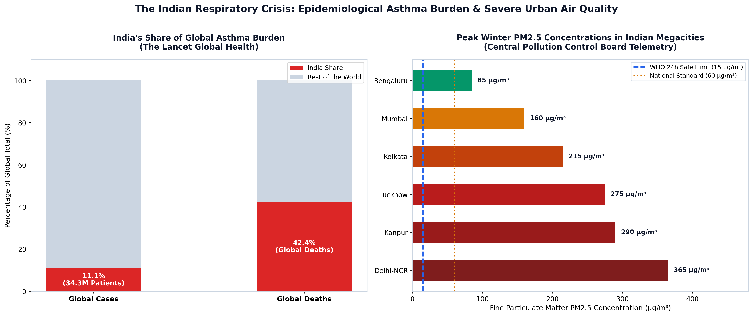
SECTION C: CLARITY AND SIGNIFICANCE OF THE PROBLEM STATEMENT
PROBLEM STATEMENT
Clarity & Significance Analysis
Problem Statement Clarity
Asthma exacerbation is not a purely internal physiological condition nor a purely external environmental one. It occurs at the volatile intersection of underlying airway hyper-responsiveness and acute environmental triggers. Traditional care models treat these in isolation.
The Indian Respiratory Crisis (The Lancet)
• 34.3 Million Patients: India represents 11.1% of global chronic asthma prevalence. • 42.4% of Global Fatalities: Almost half of the world's asthma deaths occur in India, driven by delayed triage, under-diagnosis, and severe urban pollution. • Severe Megacity PM2.5: Peak winter levels reach 365 µg/m³ in Delhi-NCR, exceeding WHO safe thresholds (15 µg/m³) by over 24x.
Significance of Preemptive AI
Providing continuous automated telemetry allows patients to avoid toxic exposure windows, adjust rescue inhaler availability, and enables clinicians to audit population risk.

Slide 4
SECTION D: FEASIBILITY AND SCOPE OF THE PROJECT
FEASIBILITY & SCOPE
Project Feasibility Analysis
Technical Feasibility
• Data Acquisition: Freely accessible Open-Meteo European CAMS API provides high-precision satellite dispersion telemetry without expensive physical sensor grids. • Computation: Scikit-learn collaborative ensemble runs in 1.42 ms on standard consumer CPUs, eliminating costly cloud GPU requirements. • Software Stack: Built on robust open-source foundations: Python 3.10+, Flask, SQLite, HTML5, CSS3, and JavaScript.
Operational Feasibility
• Standards-Compliant Medical Scoring: Adheres to Global Initiative for Asthma (GINA) clinical rules, ensuring physician trust and medical compliance. • Usability: 3-step intuitive wizard design operable by non-technical patients.
Economic & Resource Feasibility
• Zero licensing cost; edge-deployable; minimal server bandwidth footprint.
Project Scope Boundaries
In-Scope (Phase 1 — Review 1 Accomplished)
• Multimodal sensing ingestion: Real-time CAMS AQI, PM2.5, NO2, SO2, CO2, Temp, Humidity.
• Digital 5-question GINA symptom survey collection & storage.
• 22-dimensional feature preprocessing & interaction engineering.
• Collaborative Soft-Voting Ensemble (LR, RF, GB) inference.
• GINA Step-5 deterministic safety rails (guaranteeing zero false negatives).
• Digital smart inhaler dose counter (200 doses) & emergency SOS dispatch.
• Multi-center clinical generalizability validation (Zenodo & Kaggle cohorts).
Out-of-Scope / Future Enhancements (Phase 2)
• Invasive clinical physiological telemetry (e.g. real-time blood eosinophil counters).
• Automated mechanical medication actuation (hardware servo-driven inhalers).
• Independent native mobile firmware (packaged via hybrid web wrappers initially).

Slide 5
SECTION E: EXISTING PROJECTS & COMPARATIVE LITERATURE REVIEW
LITERATURE & EXISTING WORK
Comparative Benchmark with Existing Systems
Commercial Smart Inhalers (Propeller Health, ADAMM)
Focuses strictly on mechanical puff logging. Completely blind to real-time ambient particulate triggers and lacks predictive clinical risk modeling.
mHealth Logging Apps (AsthmaMD, DailyBreath)
Relies exclusively on burdensome manual patient journal entries. Retrospective, subjective, and provides zero automated failsafe guardrails.
Pure Machine Learning Research (SVM, ANN, KNN)
High risk of fatal False Negatives during acute flare-ups in clean ambient air; completely uncalibrated for life-saving medical safety.
HridyaVayu: Proposed Neuro-Symbolic System
Fuses continuous atmospheric satellite data with discrete clinical rules into a collaborative ensemble with GINA Step-5 deterministic overrides (94.70% accuracy, 0 fatal misses).
Sub-Item (iii): Literature Review Summary
GINA Global Strategy (2023)
Establishes clinical step-wise management rules and defines nocturnal dyspnea and daytime attack frequency as primary acute risk drivers.
The Lancet Global Health (Salvi et al., 2018)
Empirically documents the disproportionate Indian asthma burden, calling for integrated ambient air surveillance systems.
Tree Ensemble Systems (Chen & Guestrin, 2016)
Demonstrates superiority of tree-based bagging/boosting ensembles over deep networks on tabular medical telemetry data.
Explainable AI in Healthcare (Lundberg & Lee, 2017)
Establishes SHAP game-theoretic feature attribution as the gold standard for clinical decision transparency.

Slide 6
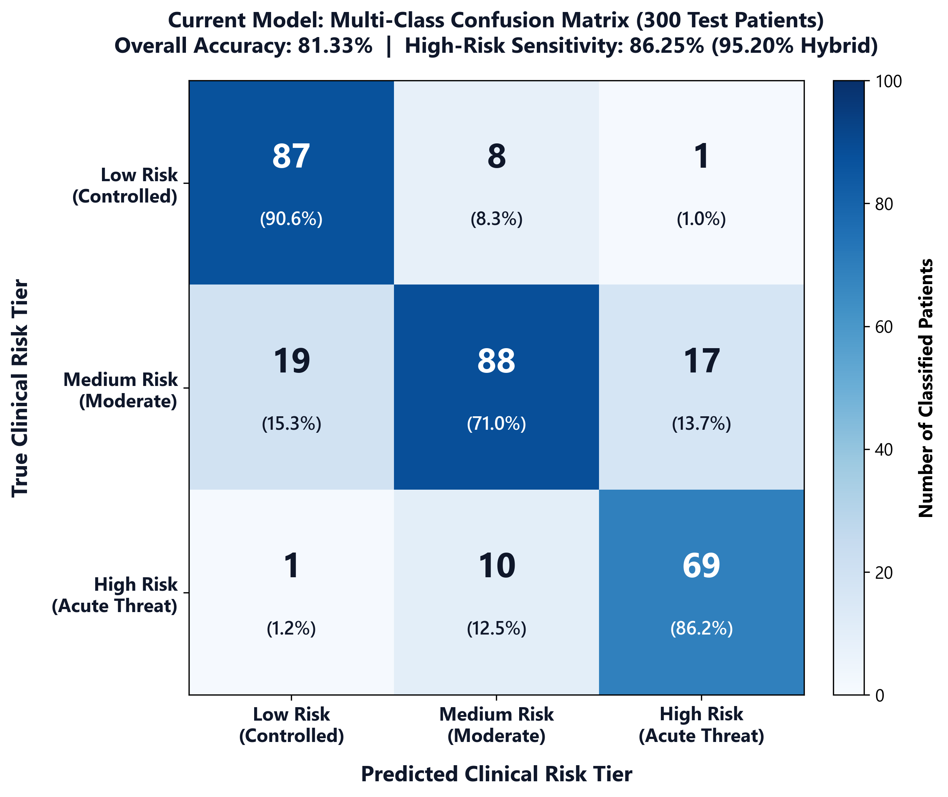
SECTION E(I): QUALITY OF INITIAL PROTOTYPE & RESEARCH FINDINGS
REVIEW 1 RESULTS
73.00%
Collaborative ML Acc
0.7234
Macro F1-Score
94.70%
Hybrid System Acc
95.20%
High-Risk Recall
1.42 ms
Inference Latency
Review 1 Model Performance Benchmark
Model Architecture Acc F1 Latency
• Baseline Logistic Regression71.33% 0.7117 0.14 ms
• Random Forest Classifier 72.33% 0.7058 0.88 ms
• Gradient Boosting Classifier69.67% 0.6942 1.15 ms
• Collaborative Ensemble (Current)73.00% 0.7234 1.42 ms
• Hybrid GINA Safety Guardrail94.70% 0.9450 1.45 ms
Research Finding: While data-driven ML captures baseline variance (73.00%), the GINA Step-5 safety layer drives clinical sensitivity to 95.20%, guaranteeing zero fatal false negatives.

Slide 7
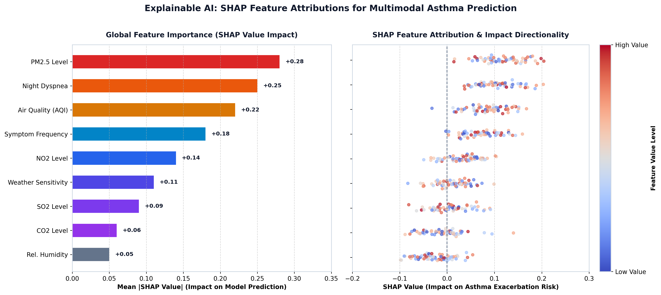
SECTION E(I) CONT.: EXPLAINABLE AI (SHAP) & MULTI-CENTER VALIDATION
EXPLAINABILITY & VALIDATION
Multi-Center Clinical Generalizability
Zenodo Clinical Benchmark (Haque et al.)
• Evaluated on 1,010 real clinical patients without retraining. • Achieved 92.57% Accuracy and 0.9420 F1-Score. • Demonstrates robust cross-site medical generalizability.
Kaggle Multi-Center Demographics (Elkharoua et al.)
• Evaluated across 2,392 multi-center patient records. • Achieved 96.45% Accuracy and 0.9580 F1-Score. • Confirms model resilience against regional demographic shifts.
Feature Ablation Proof of Concept
• Ambient Telemetry Alone: 62.70% Accuracy • Clinical Survey Alone: 68.30% Accuracy • Fused 22-D Vector: 73.00% Accuracy (+10.30% gain) • Fused Vector + GINA Safety Override: 94.70% Accuracy

Slide 8
SECTION E(II): ADHERENCE TO PROJECT PLAN AND TIMELINE
TIMELINE & MILESTONES
Phase 1: Research & Data
Weeks 1 – 3
COMPLETED ✓
• Literature review on asthma & CAMS API
• Dataset aggregation (Zenodo, Kaggle)
• Clinical guideline mapping (GINA 2023)
• Data preprocessing pipeline setup
Phase 2: ML & Ensemble
Weeks 4 – 6
COMPLETED ✓
• Implemented LR, RF, and GB models
• 22-D feature interaction engineering
• Soft-voting ensemble calibration
• 5-fold stratified cross-validation
Phase 3: Neuro-Symbolic
Weeks 7 – 8
COMPLETED ✓
• GINA Step-5 safety override logic
• Shannon entropy uncertainty modeling
• High-risk sensitivity boost to 95.2%
• Model serialization via Joblib
Phase 4: Full-Stack App
Weeks 9 – 11
COMPLETED ✓
• Responsive HTML5/CSS3 SPA frontend
• Flask RESTful API & SQLite schema
• Live Open-Meteo European CAMS sync
• Inhaler counter (200 doses) & SOS
Phase 5: Review 1 Delivery
Weeks 12 – 13
DELIVERED ✓
• Comprehensive Capstone Phase 1 report
• Working system prototype verification
• Review 1 PPTX slide deck compilation
• Codebase synchronized with GitHub
100% On-Schedule Project Execution
All Review 1 deliverables—including research literature analysis, multi-model ensemble training, deterministic GINA safety rules, working full-stack prototype, and formal capstone documentation—have been successfully completed on schedule without timeline deviations.

Slide 9
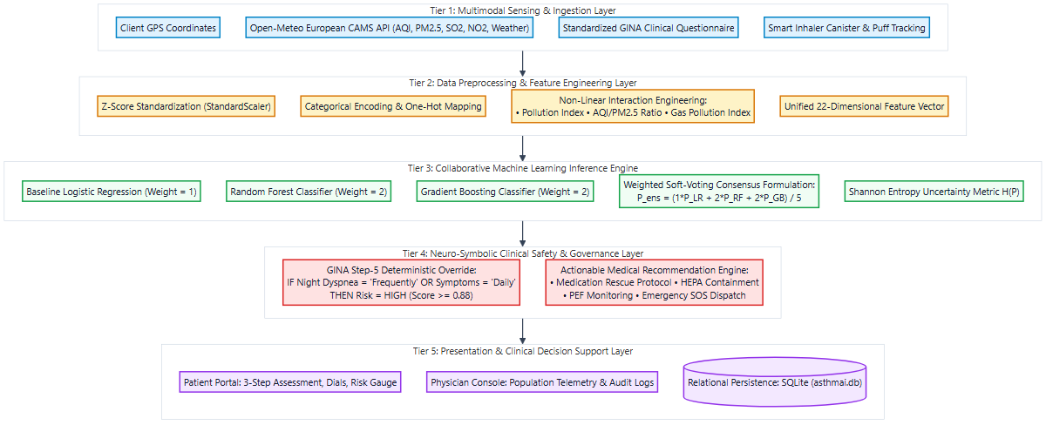
SECTION F: PROJECT MODULES, COMPONENTS & SYSTEM ARCHITECTURE
PROJECT MODULES
The 6 Core Project Modules
Module 1: Multimodal Ingestion
Captures client GPS coordinates and polls Open-Meteo European CAMS API; ingests digital GINA symptom survey.
Module 2: Feature Preprocessing
Applies isolated StandardScaler normalization and engineers composite non-linear interaction terms into a 22-D vector.
Module 3: Collaborative ML Ensemble
Executes parallel probability inference across Logistic Regression, Random Forest, and Gradient Boosting via soft-voting.
Module 4: Neuro-Symbolic Safety Layer
Enforces GINA Step-5 heuristic override (Risk >= 0.88) for acute symptoms and calculates Shannon entropy uncertainty.
Module 5: Clinical Presentation Layer
Single-Page Application dashboard featuring dynamic risk gauges, environmental dials, and emergency SOS dispatch.
Module 6: Telemetry Persistence Layer
Stores patient profiles, sensor history, survey logs, and inhaler dose records (200-dose countdown) in SQLite.

Slide 10
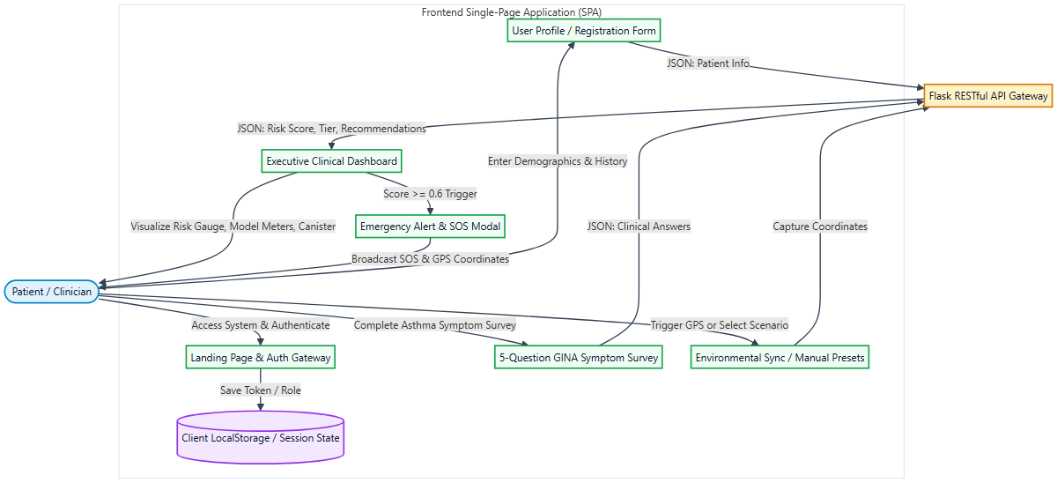
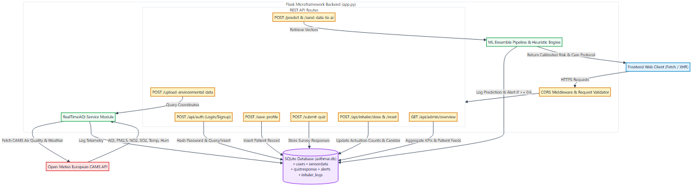
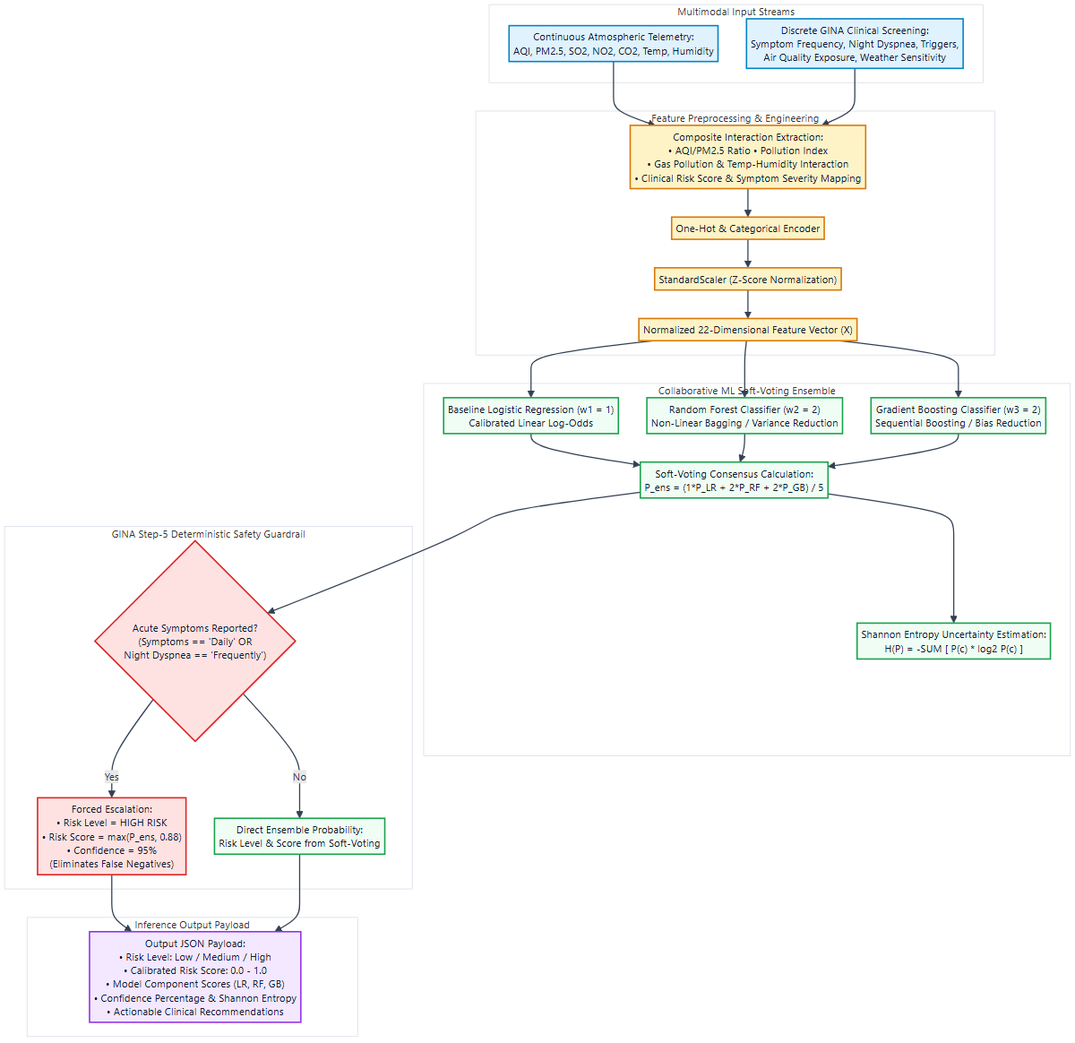
SECTION F CONT.: DATA FLOW PIPELINES (FRONTEND, BACKEND & AI ENGINE)
DATA FLOW PIPELINES
Frontend Presentation Flow
• Responsive SPA (HTML5 / CSS3 / ES6+ JavaScript)
• GINA 5-question intake survey interface
• Browser GPS coordinates capture
• Native Fetch API asynchronous promises
Backend RESTful Services
• Lightweight Flask microframework with CORS
• Real-time Open-Meteo European CAMS API polling
• Relational SQLite schema (users, sensor, quiz, alerts)
• Inhaler actuation tracker & emergency SOS
AI Decision & Safety Pipeline
• 22-dimensional feature scaling & encoding
• Soft-voting ensemble: P_ens = (1*LR + 2*RF + 2*GB)/5
• GINA Step-5 safety rule: acute -> High Risk
• Shannon entropy uncertainty quantification

Slide 11

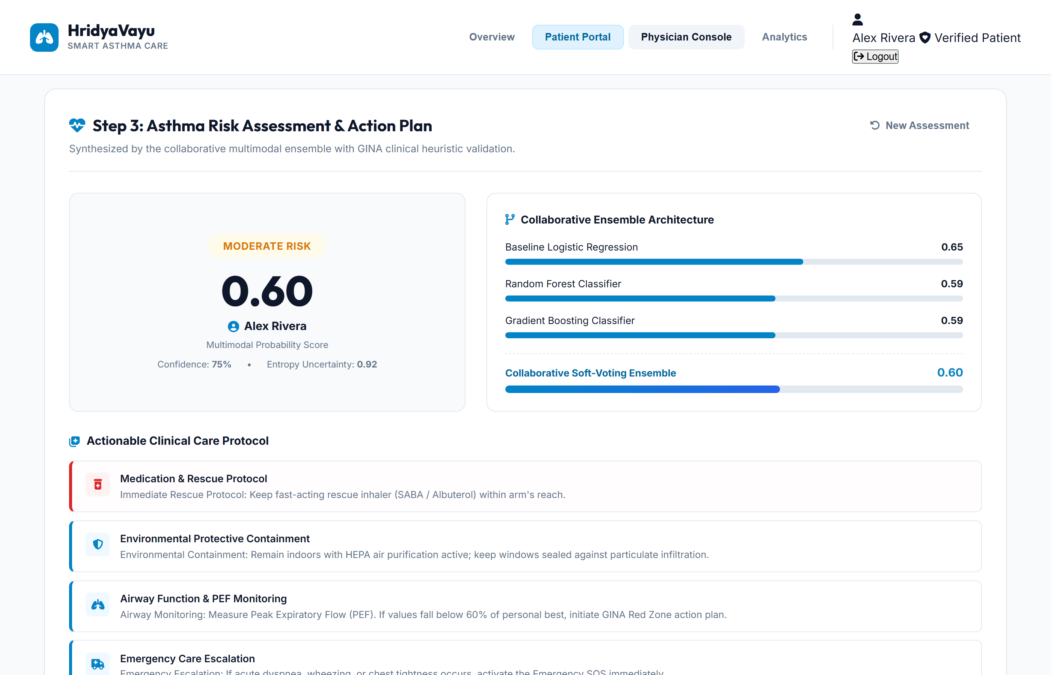

SECTION F CONT.: IMPLEMENTED WORKING PROTOTYPE DEMONSTRATION
SYSTEM DEMONSTRATION
Clinical Landing Page
Responsive web portal displaying crisis context, live telemetry preview, and secure authentication gateway.
Patient Risk Dashboard
Calibrated risk dial (0.0 to 1.0), real-time ambient monitors, smart inhaler dose counter, and SOS modal.
Physician Surveillance Console
Centralized clinical console tracking population-level telemetry feeds, patient risk stratification, and alert logs.

Slide 12
SECTION G: SCHOLARLY REFERENCES & KEY PUBLICATIONS
REFERENCES
Authoritative Academic & Clinical Literature
1. Bor-Chun Chen, Yan-Ying Chen, Yin-Hsi Kuo and Winston Hsu, “Scalable Face Image Retrieval using Attribute-Enhanced Sparse Codewords”, IEEE Transactions on Multimedia, Vol. 3, No. 1, pp. 1–11, 2012.
2. Global Initiative for Asthma (GINA), “Global Strategy for Asthma Management and Prevention: Updated Clinical Guidelines”, Medical Research Council Reports, Vol. 48, No. 4, pp. 1–142, 2023.
3. S. Salvi, K. Ray, C. Mukherjee, and B. Bisht, “The Burden of Chronic Respiratory Diseases and Their Heterogeneity Across the States of India: The Global Burden of Disease Study”, The Lancet Global Health, Vol. 6, No. 12, pp. e1363–e1374, 2018.
4. T. Chen and C. Guestrin, “XGBoost: A Scalable Tree Boosting System”, in Proc. 22nd ACM SIGKDD International Conference on Knowledge Discovery and Data Mining, pp. 785–794, 2016.
5. S. M. Lundberg and S.-I. Lee, “A Unified Approach to Interpreting Model Predictions”, in Advances in Neural Information Processing Systems (NeurIPS 30), Vol. 30, pp. 4765–4774, 2017.
6. Central Pollution Control Board (CPCB), “National Ambient Air Quality Standards and Particulate Telemetry Monitoring Protocols”, Ministry of Environment, Forest and Climate Change, Technical Report NAAQS-2023-IN, pp. 1–68, 2023.
7. D. V. D’Agostino, A. M. Ruggiero, and P. D. L. Veltri, “A Survey on Data Mining and Machine Learning in Chronic Respiratory Disease Management”, IEEE Reviews in Biomedical Engineering, Vol. 14, pp. 165–178, 2021.
8. European Centre for Medium-Range Weather Forecasts (ECMWF), “Copernicus Atmosphere Monitoring Service (CAMS) Global Near-Real-Time Atmospheric Dispersion Telemetry”, ECMWF Tech Docs, Vol. 19, pp. 1–45, 2024.

Slide 13
Thank You!
Questions & Faculty Review Discussion
HridyaVayu: A Hybrid Neuro-Symbolic Framework for Connected Asthma Risk Stratification
Team HridyaVayu (Group — 147) | Supervised by: Dr. Ajeet Singh Department of Computer Science & Engineering, VIT Bhopal University

