Slide 1
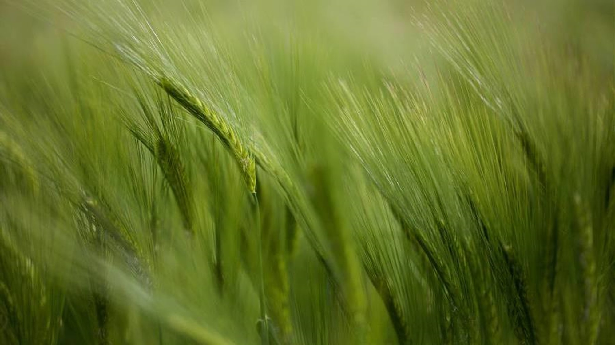
Analyzing Factors Affecting Crop Production in Rwanda (2000–2027)
Kabucye Kelly 27113
Institution: Adventist University of Central Africa (AUCA) FINAL-EXAM CAPSTONE PROJECT Academic Year: 2024–2025, Semester III Course Code and Name: INSY 8413 | Introduction to Big Data Analytics Assistant Lecturer: Eric Maniraguha Group: E
Date: 3rd August 2025

Slide 2
Project Introduction & Key Findings
Problem Statement
Rwanda’s staple crop yields (maize, beans, rice) are subject to environmental and input fluctuations. This project investigates how rainfall, fertilizer usage, and land area have influenced production from 2000–2021, and generates forecasts through 2027 to guide evidence-based planning
Objectives
Analyze historical trends in crop production, rainfall, fertilizer use, and land area
Model the relationships between inputs and yields using linear regression
Forecast future production (2022–2027) for maize and beans
Recommend data-driven strategies to improve food security
Key Findings
Maize: High fertilizer efficiency—projected to peak in 2024 (~697,900 t)
Beans: Strong sensitivity to rainfall—highest yield predicted in 2023 (~1.42 M t)
Rainfall & Fertilizer: Primary drivers; years with higher inputs align with stronger production
Total Forecast: ~6.82 M t predicted across both crops (2022–2027), averaging 568.7 K t/yr
Data Sources
FAOStat: Crop production, area harvested, fertilizer consumption
World Bank: Annual rainfall data for Rwanda (2000–2021)
“These insights can help policymakers and farmers optimize input allocation, anticipate dry-year risks, and plan for sustainable yield improvements.”

Slide 3
Methodology
1. Data Cleaning (Python)
Combined four datasets: Production, Area, Fertilizer, and Rainfall
Filtered for Rwanda (2000–2021), handled missing values, reshaped and normalized data
Merged on common keys (Year, Item)
2. Exploratory Data Analysis (Power BI)
Analyzed trends in crop production, rainfall, fertilizer use, and land efficiency
Created visual comparisons across crops and years
3. Regression Modeling (Python)
Applied Linear Regression to model crop production
Trained model on 3 input features:
Rainfall (mm)
Fertilizer (tonnes)
Area Harvested (ha)
Used model to forecast production (2022–2027)
4. Dashboard Development (Power BI)
Designed a 4-page interactive dashboard:
Trends, Inputs, Yield Insights, Predictions & KPIs
Added slicers, filters, and clear visual storytelling
Approach Overview
This project followed a structured data science workflow, combining Python for preprocessing and modeling, with Power BI for data exploration and dashboard creation.
Tools Used
Python (Jupyter Notebook): Data cleaning, merging, and regression modeling using pandas, scikit-learn
Power BI: Interactive dashboard creation, visual analysis, and presentation

Slide 4
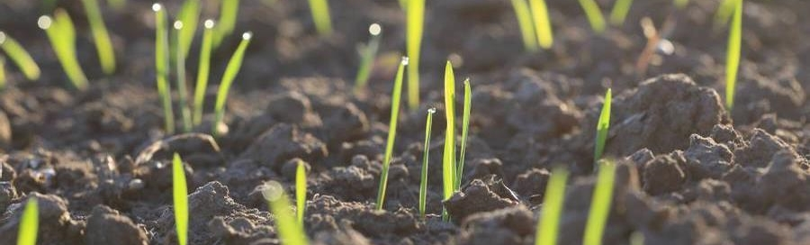
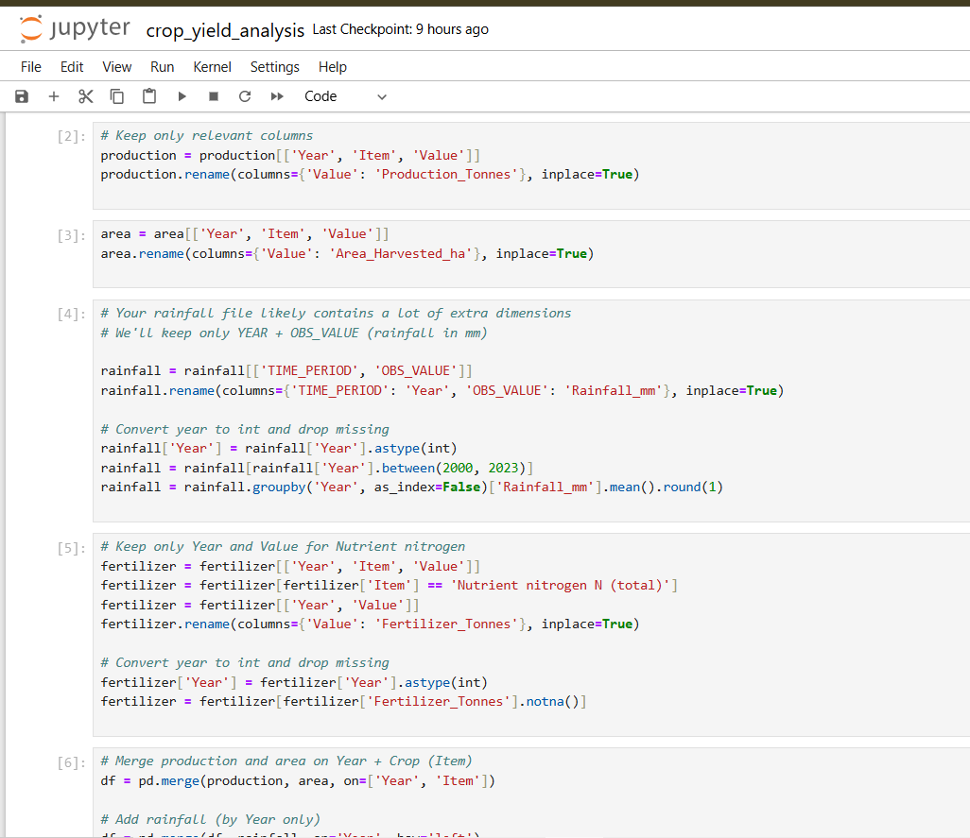
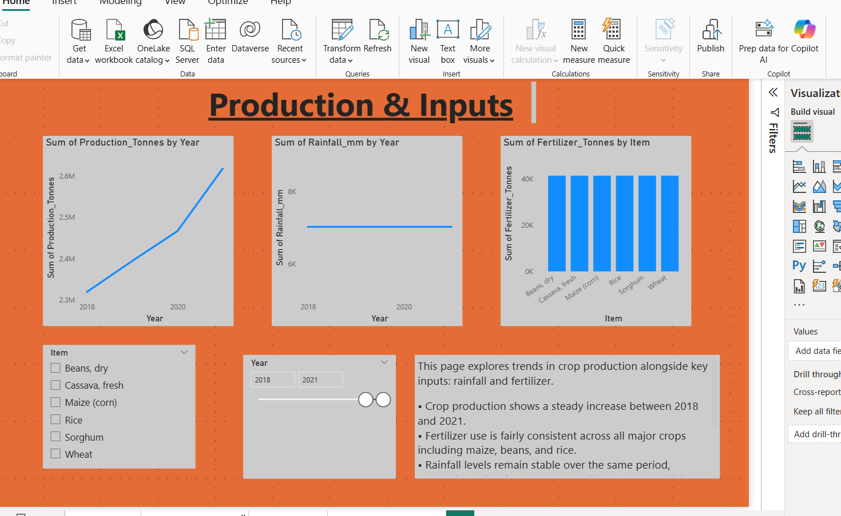
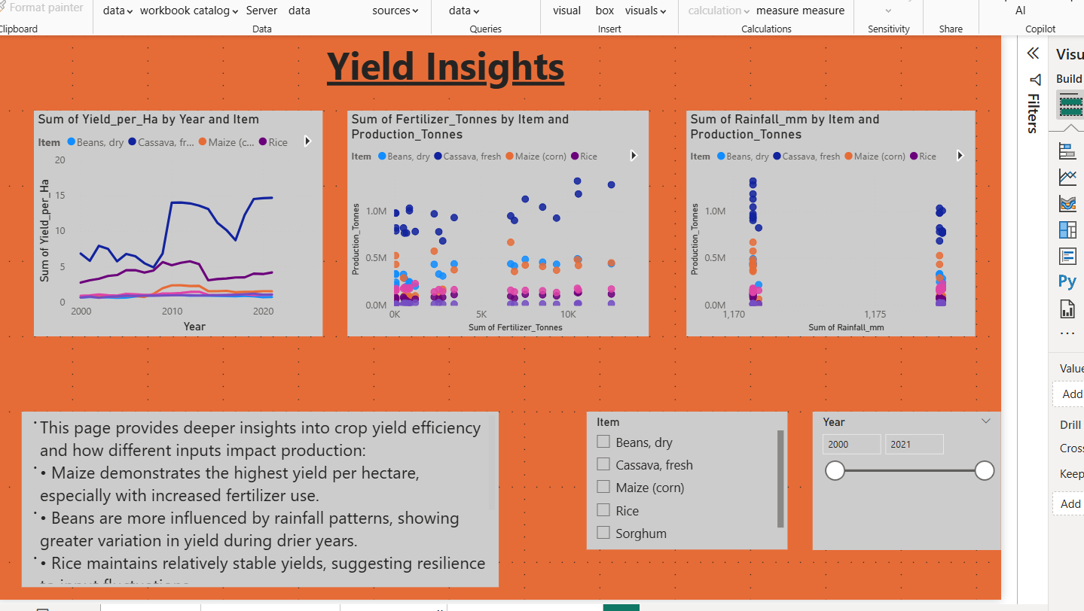
Methodology
1.Data Cleaning
2.Exploratory Data Analysis

Slide 5
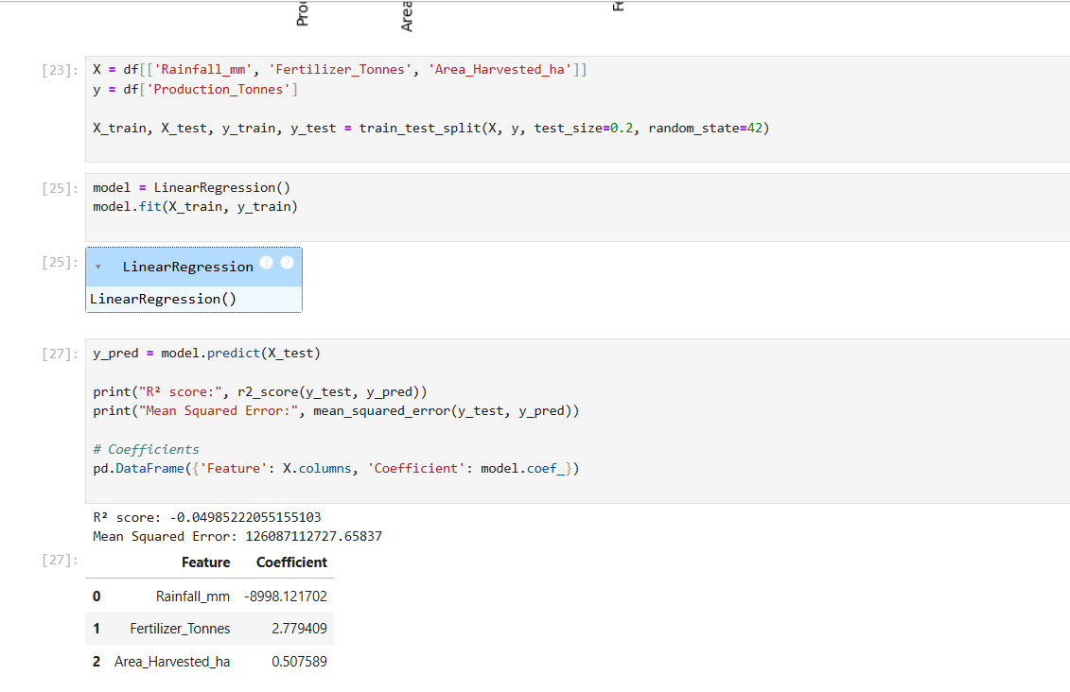
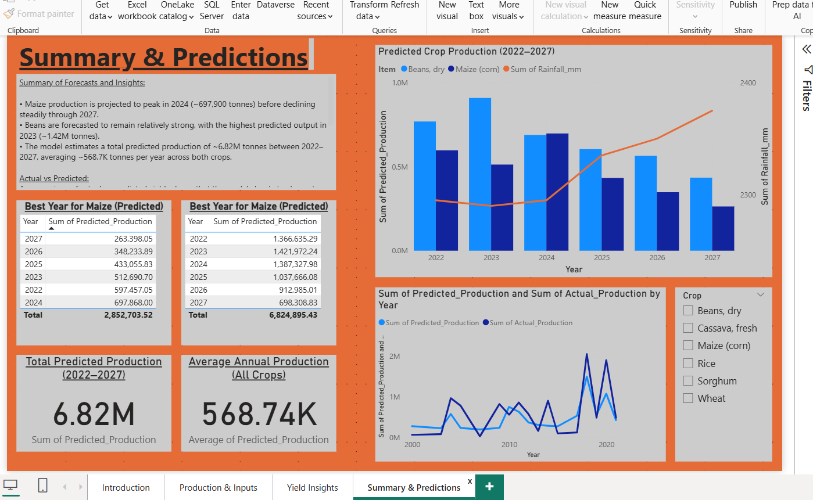
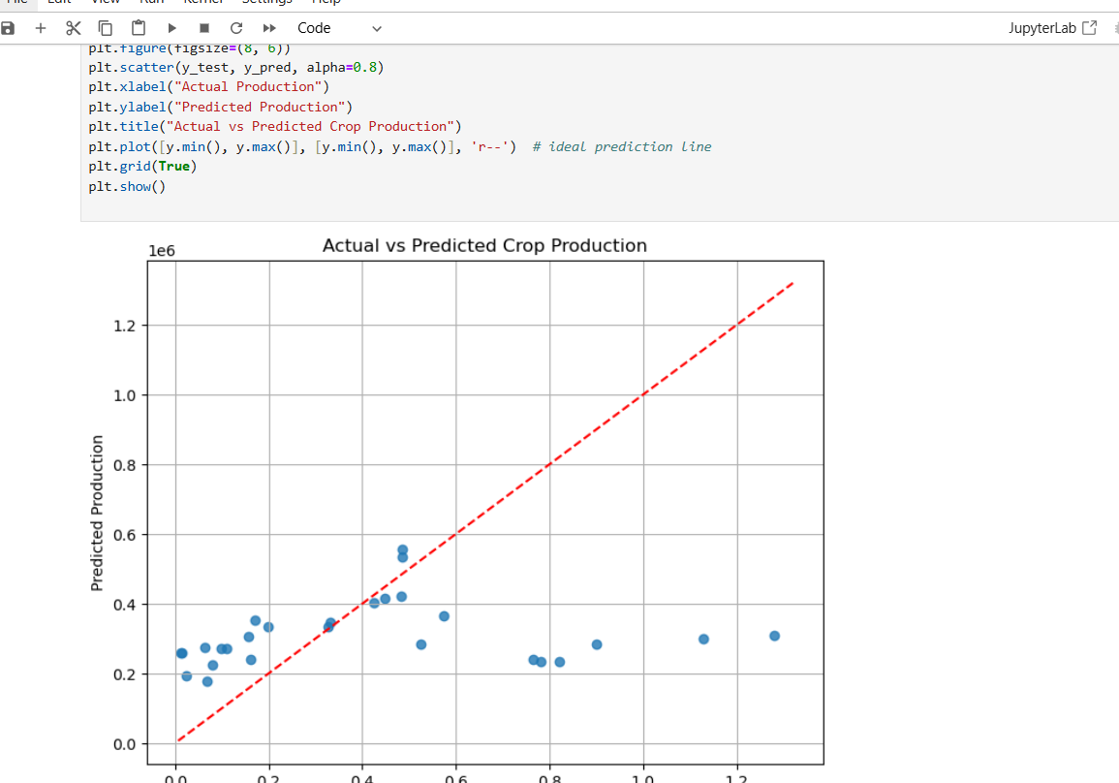
Methodology
Regression Model
Interactive Dashboard

Slide 6
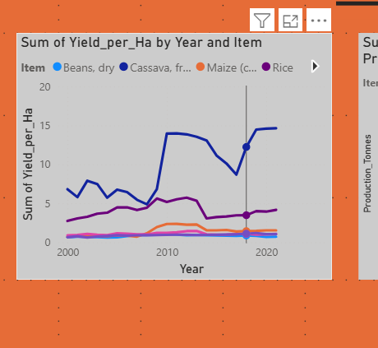
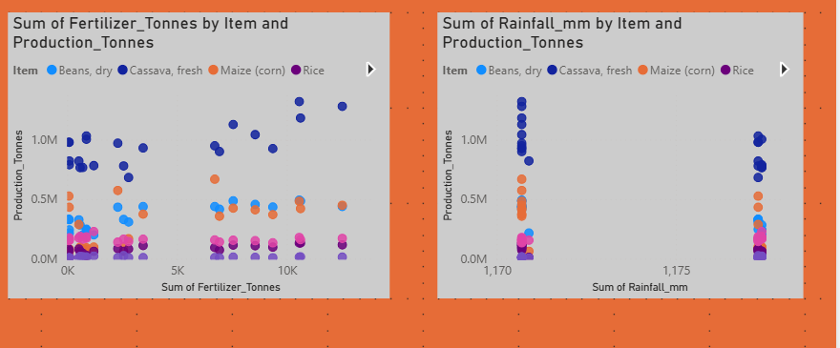
Key Results – Yield Efficiency & Input Relationships
• Maize production showed strong correlation with fertilizer usage – making it fertilizer-efficient.
• Bean production was more influenced by rainfall variation, confirming its climate sensitivity.
• Rainfall had less consistent impact on maize, especially in years with good fertilizer input.
• Maize consistently showed higher yield per hectare than beans or rice.
• Overall yield improved from 2015 to 2021, suggesting better land-use efficiency.

Slide 7
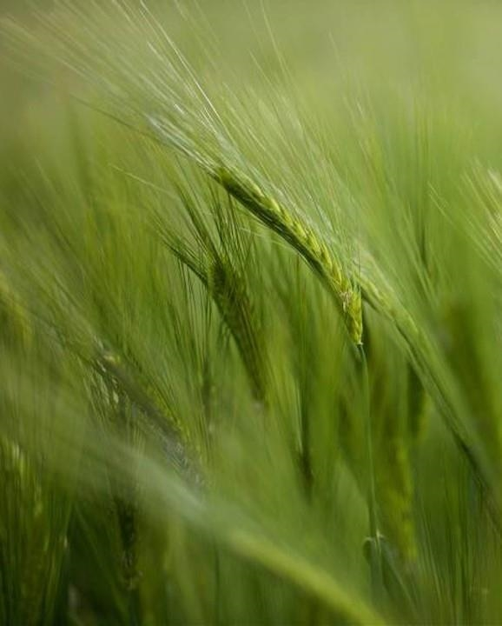
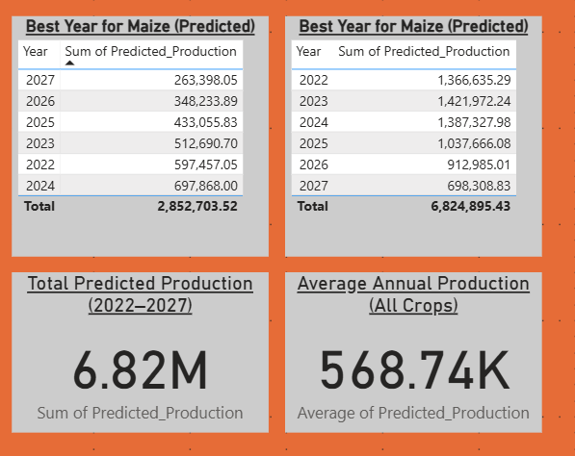
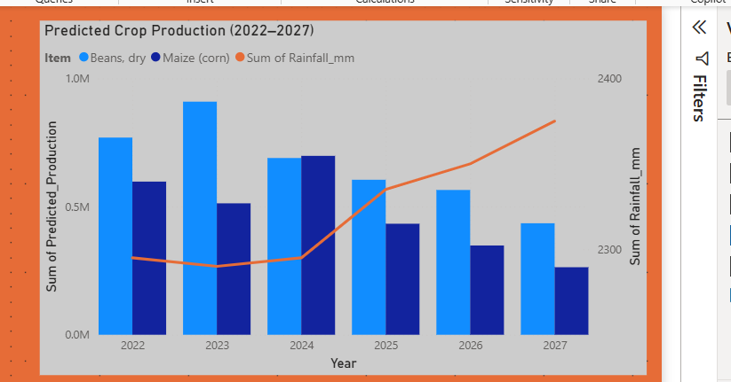
Predicted Crop Production (2022–2027)
Figure: Forecasted Crop Production (Maize & Beans)
• Total predicted production (2022–2027): ~6.82 million tonnes
• Average yearly output: ~568,700 tonnes
• Maize predicted to peak in 2024 (~697,900 t), then decline
• Beans expected to remain strong with highest yield in 2023 (~1.42M t)
• Model reflects how rainfall and fertilizer trends impact output

Slide 8
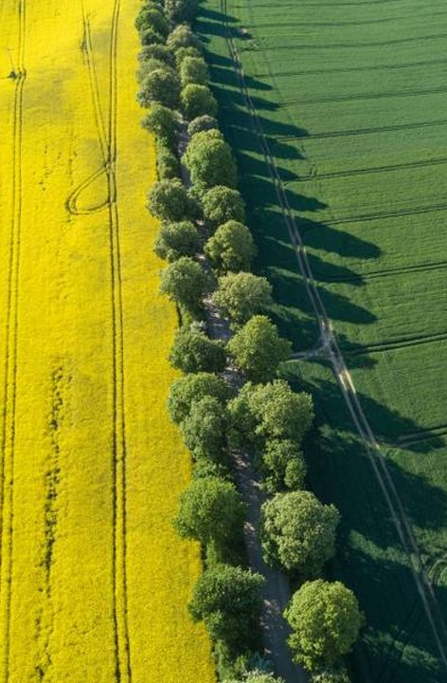
Strategic Recommendations
Maintain or increase fertilizer investment for maize cultivation, especially through 2024, where the highest yields are forecasted.
Closely monitor rainfall trends in bean-growing regions — production is highly sensitive to rainfall variability.
Use predictive data to inform resource allocation, planting schedules, and crop planning at the regional level.
Focus on improving yield per hectare rather than simply expanding cultivated land.
Integrate rainfall forecasting tools and early warnings into agricultural decision-making.
Promote sustainable land and input use to ensure long-term productivity and food security.
"Turning analysis into actionable strategies for improved food security."

Slide 9

Recommendations
Continue investing in fertilizer distribution and farmer training, especially for maize.
Monitor rainfall-sensitive regions to improve bean yield predictability.
Use forecasting tools to support early planning and resource allocation.
Challenges Faced:
Difficulty accessing high-quality, recent datasets that fit the project scope.
Missing values and mismatched structures across different sources (FAO, World Bank).
Complexity merging fertilizer data accurately due to format inconsistencies.
Required careful data cleaning and filtering for Rwanda and the correct time range (2000–2021).
This project shows the value of combining data science with agricultural planning.
With better data and continued modeling, Rwanda can enhance food security, optimize inputs, and prepare for climate challenges.

Slide 10

Thank you
KABUCYE KELLY​​ 27113
Kel.kabucye@gmail.com
Intro to Big Data Final Capstone Project
“Whatever you do, work at it with all your heart, as working for the Lord, not for human masters.” — Colossians 3:23 (NIV)

