Slide 1

Market Outlook &
Strategic Priorities
An analytical overview of emerging trends, shifting investor sentiment, and the key decisions shaping the next growth cycle.
Q2 2026 · Confidential

Slide 2
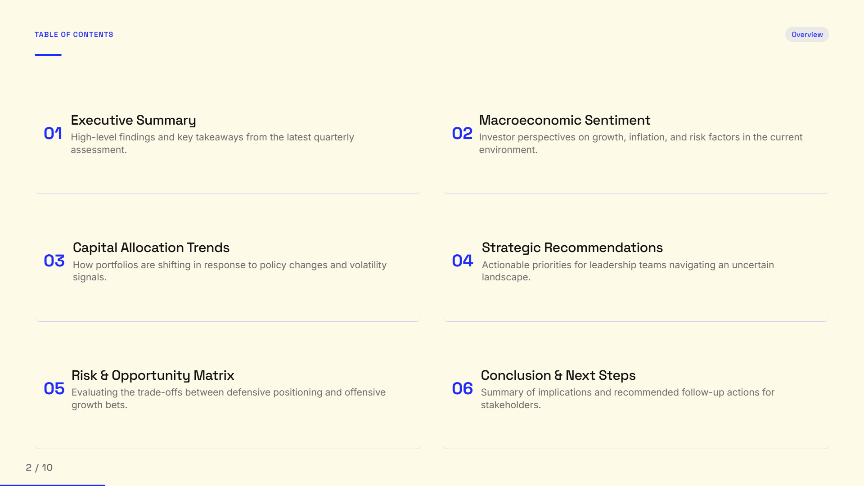
Table of Contents
Overview
Executive Summary
Macroeconomic Sentiment
01
High-level findings and key takeaways from the latest quarterly assessment.
02
Investor perspectives on growth, inflation, and risk factors in the current environment.
Capital Allocation Trends
Strategic Recommendations
03
How portfolios are shifting in response to policy changes and volatility signals.
04
Actionable priorities for leadership teams navigating an uncertain landscape.
Risk & Opportunity Matrix
Conclusion & Next Steps
05
Evaluating the trade-offs between defensive positioning and offensive growth bets.
06
Summary of implications and recommended follow-up actions for stakeholders.

Slide 3
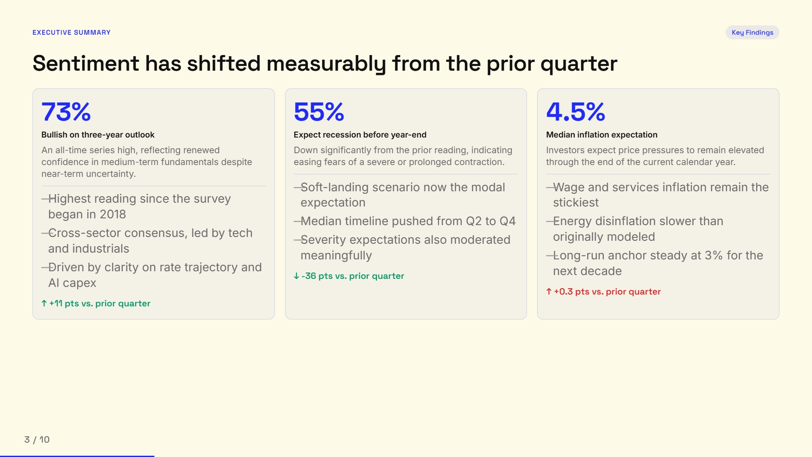
Executive Summary
Key Findings
Sentiment has shifted measurably from the prior quarter
73%
55%
4.5%
Bullish on three-year outlook
Expect recession before year-end
Median inflation expectation
An all-time series high, reflecting renewed confidence in medium-term fundamentals despite near-term uncertainty.
Down significantly from the prior reading, indicating easing fears of a severe or prolonged contraction.
Investors expect price pressures to remain elevated through the end of the current calendar year.
Soft-landing scenario now the modal expectation
Wage and services inflation remain the stickiest
Highest reading since the survey began in 2018
Median timeline pushed from Q2 to Q4
Energy disinflation slower than originally modeled
Cross-sector consensus, led by tech and industrials
Severity expectations also moderated meaningfully
Long-run anchor steady at 3% for the next decade
Driven by clarity on rate trajectory and AI capex
↓
-36 pts vs. prior quarter
↑
+0.3 pts vs. prior quarter
↑
+11 pts vs. prior quarter

Slide 4
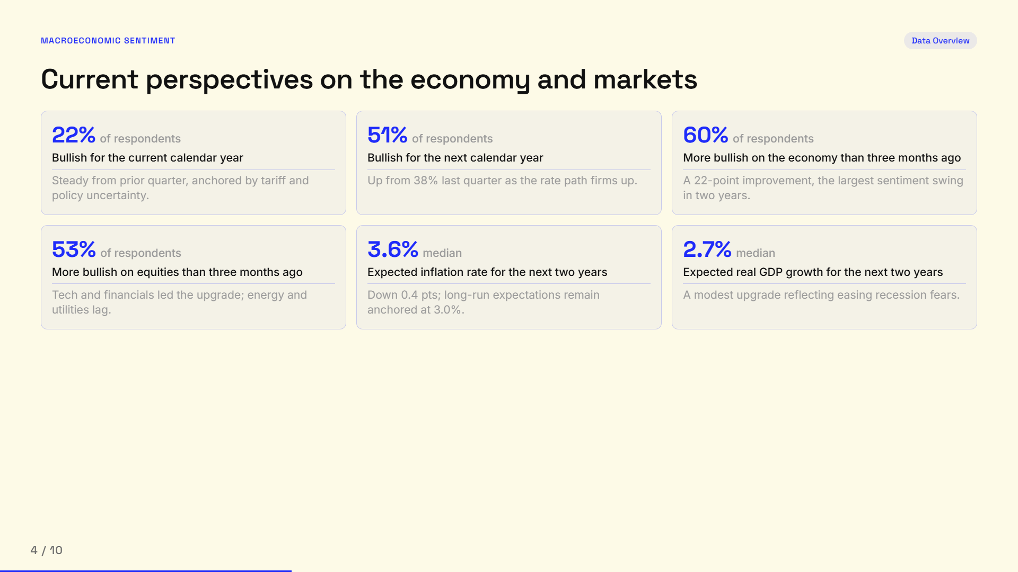
Macroeconomic Sentiment
Data Overview
Current perspectives on the economy and markets
22%
51%
60%
of respondents
of respondents
of respondents
Bullish for the current calendar year
Bullish for the next calendar year
More bullish on the economy than three months ago
Steady from prior quarter, anchored by tariff and policy uncertainty.
Up from 38% last quarter as the rate path firms up.
A 22-point improvement, the largest sentiment swing in two years.
53%
3.6%
2.7%
of respondents
median
median
More bullish on equities than three months ago
Expected inflation rate for the next two years
Expected real GDP growth for the next two years
Tech and financials led the upgrade; energy and utilities lag.
Down 0.4 pts; long-run expectations remain anchored at 3.0%.
A modest upgrade reflecting easing recession fears.

Slide 5
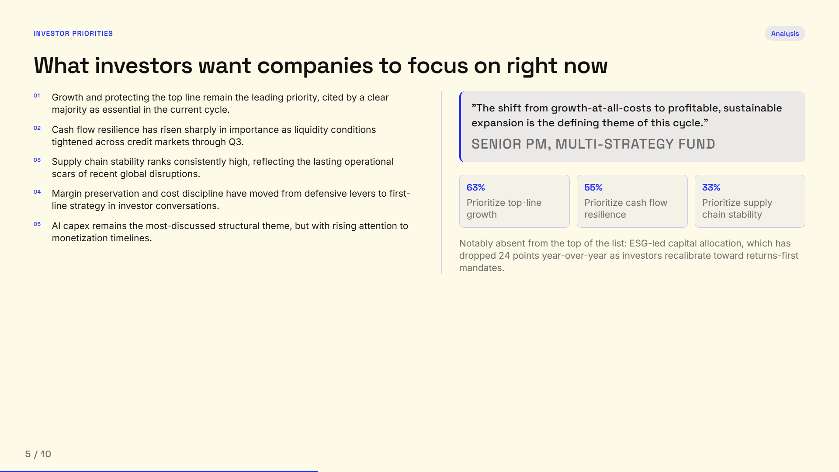
Investor Priorities
Analysis
What investors want companies to focus on right now
Growth and protecting the top line remain the leading priority, cited by a clear majority as essential in the current cycle.
"The shift from growth-at-all-costs to profitable, sustainable expansion is the defining theme of this cycle."
Cash flow resilience has risen sharply in importance as liquidity conditions tightened across credit markets through Q3.
Senior PM, multi-strategy fund
Supply chain stability ranks consistently high, reflecting the lasting operational scars of recent global disruptions.
Margin preservation and cost discipline have moved from defensive levers to first-line strategy in investor conversations.
63%
55%
33%
Prioritize top-line growth
Prioritize cash flow resilience
Prioritize supply chain stability
AI capex remains the most-discussed structural theme, but with rising attention to monetization timelines.
Notably absent from the top of the list: ESG-led capital allocation, which has dropped 24 points year-over-year as investors recalibrate toward returns-first mandates.

Slide 6
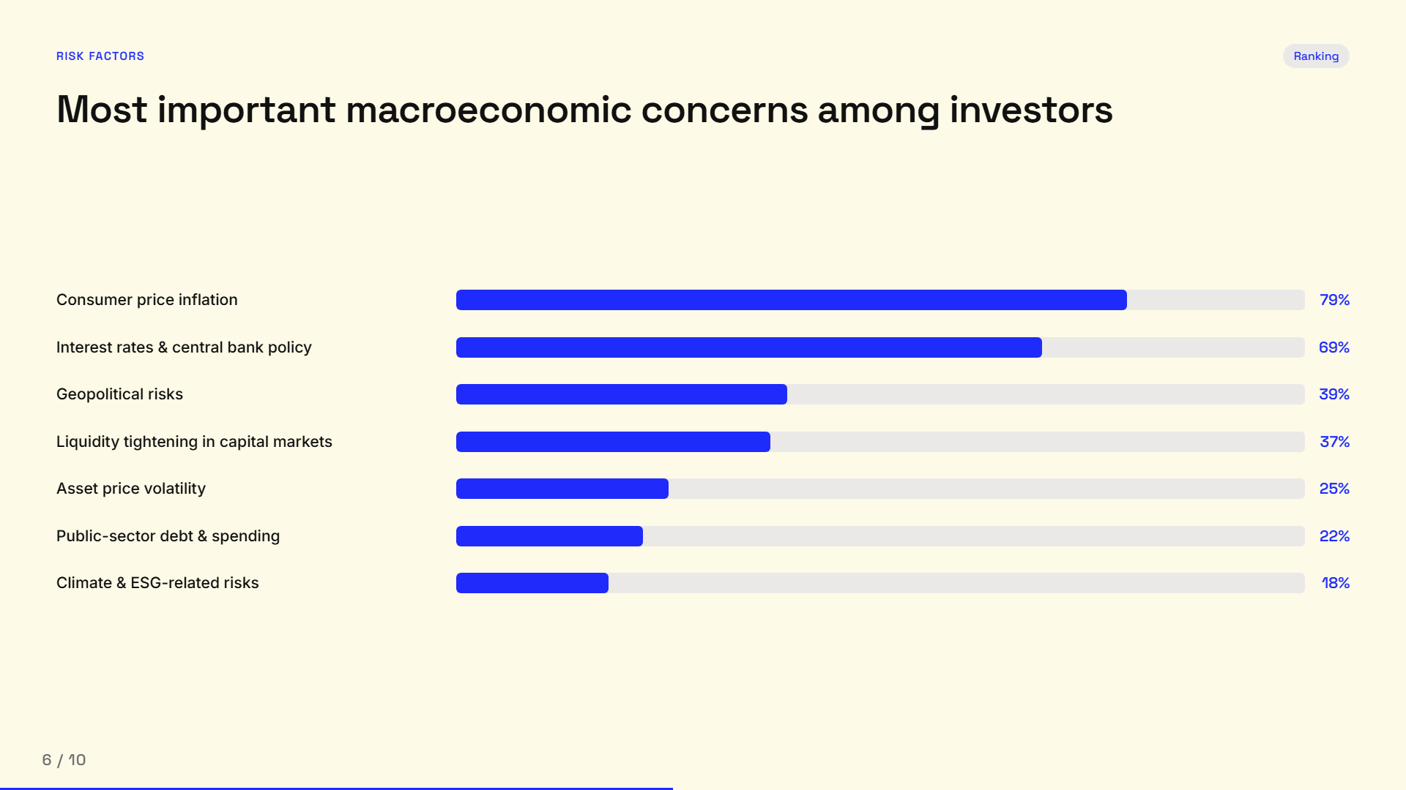
Risk Factors
Ranking
Most important macroeconomic concerns among investors
Consumer price inflation
79%
Interest rates & central bank policy
69%
Geopolitical risks
39%
Liquidity tightening in capital markets
37%
Asset price volatility
25%
Public-sector debt & spending
22%
Climate & ESG-related risks
18%

Slide 7
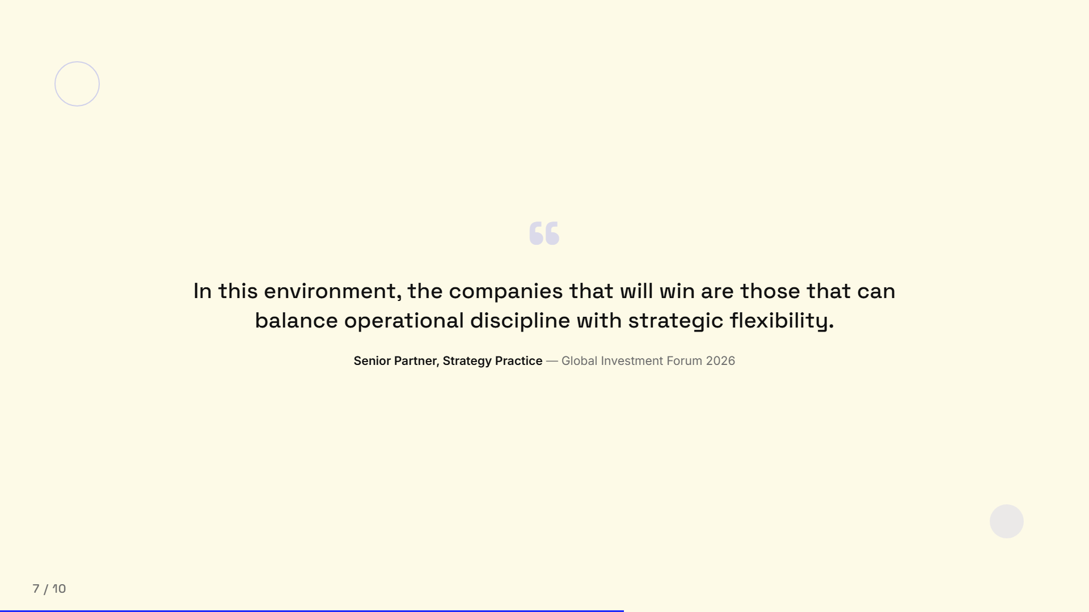
“
In this environment, the companies that will win are those that can balance operational discipline with strategic flexibility.
Senior Partner, Strategy Practice
— Global Investment Forum 2026

Slide 8
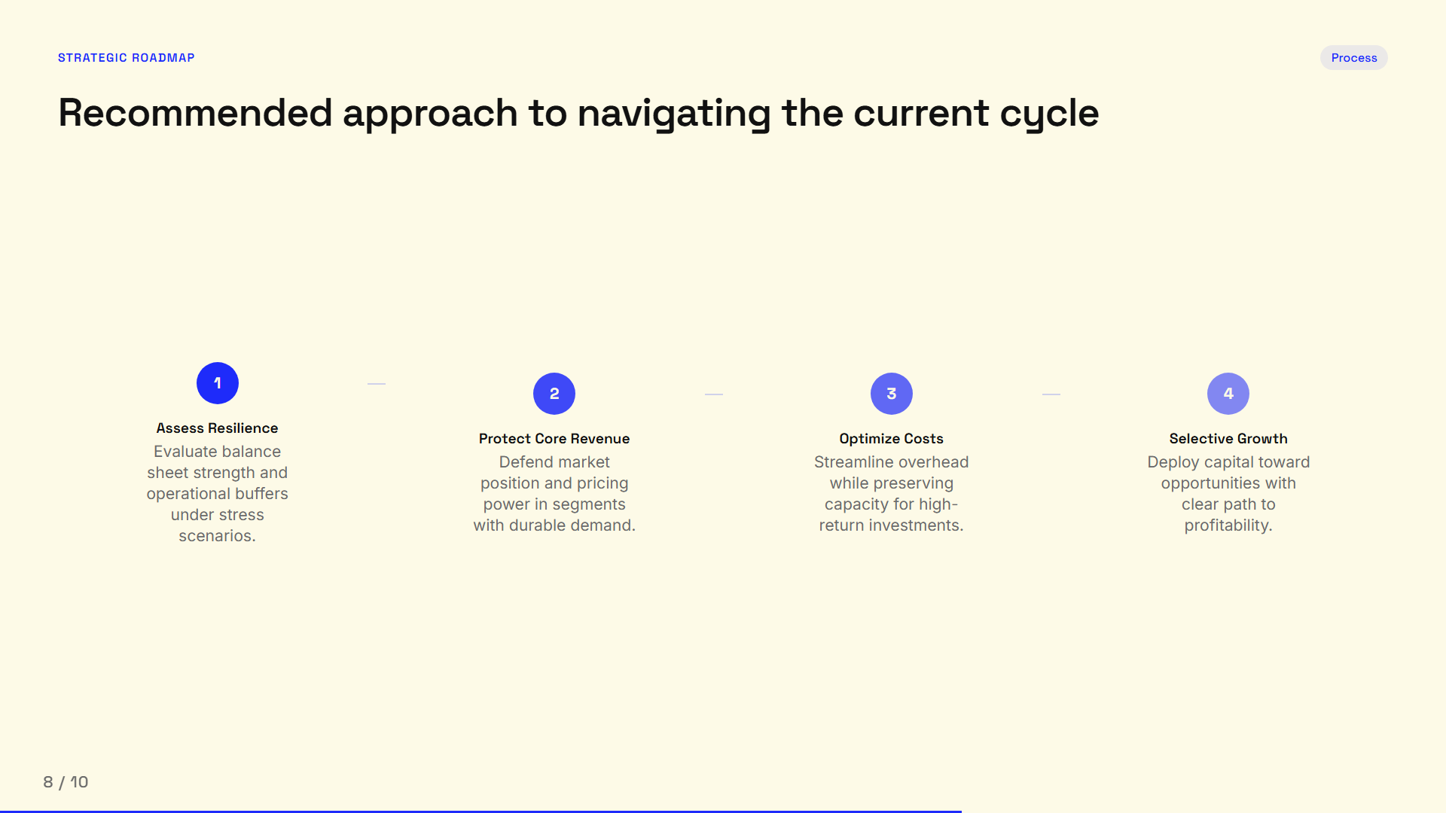
Strategic Roadmap
Process
Recommended approach to navigating the current cycle
1
2
3
4
Assess Resilience
Protect Core Revenue
Optimize Costs
Selective Growth
Evaluate balance sheet strength and operational buffers under stress scenarios.
Defend market position and pricing power in segments with durable demand.
Streamline overhead while preserving capacity for high-return investments.
Deploy capital toward opportunities with clear path to profitability.

Slide 9
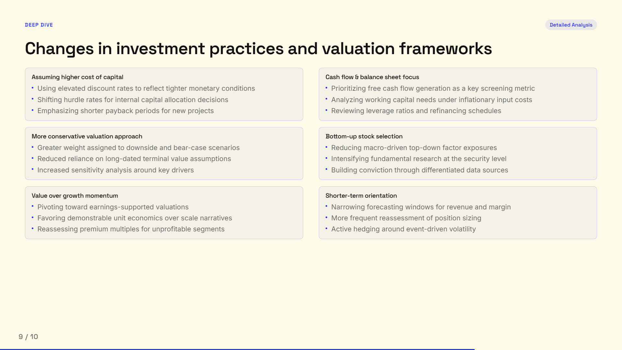
Deep Dive
Detailed Analysis
Changes in investment practices and valuation frameworks
Assuming higher cost of capital
Cash flow & balance sheet focus
Using elevated discount rates to reflect tighter monetary conditions
Prioritizing free cash flow generation as a key screening metric
Shifting hurdle rates for internal capital allocation decisions
Analyzing working capital needs under inflationary input costs
Emphasizing shorter payback periods for new projects
Reviewing leverage ratios and refinancing schedules
More conservative valuation approach
Bottom-up stock selection
Greater weight assigned to downside and bear-case scenarios
Reducing macro-driven top-down factor exposures
Reduced reliance on long-dated terminal value assumptions
Intensifying fundamental research at the security level
Increased sensitivity analysis around key drivers
Building conviction through differentiated data sources
Value over growth momentum
Shorter-term orientation
Pivoting toward earnings-supported valuations
Narrowing forecasting windows for revenue and margin
Favoring demonstrable unit economics over scale narratives
More frequent reassessment of position sizing
Reassessing premium multiples for unprofitable segments
Active hedging around event-driven volatility

Slide 10

Thank You
For questions or a deeper discussion of these findings, please reach out to the research team.
Download Full Report
research@company.com · www.company.com

