Slide 1

A Presentation Template
01
Quarterly
Review
2026
Studio Placeholder
Presented by Name Placeholder

Slide 2

Agenda.
Five topics · ninety minutes
01
02
03
Where
The big shift.
By the numbers.
we stand
today.
Insight
Data
04
05
How we’ll get there.
What it adds up to.
Context
Plan
Outcomes

Slide 3
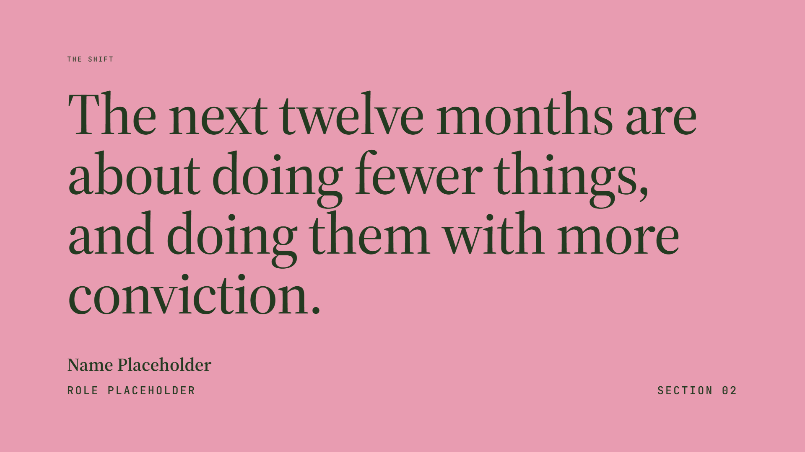
The shift
The next twelve months are about doing fewer things, and doing them with more conviction.
Name Placeholder
Role Placeholder
Section 02

Slide 4

The big shift
Fewer bets, stronger commitments.
[ image · 880 × 760 ]
Placeholder body copy sits here as a stand‑in for the supporting narrative. Open with the point you want the audience to remember when they walk out of the room.
Use the second paragraph to add proof — a customer, a moment in market, a number that earns the claim. Keep one idea per paragraph; trust the audience to follow.
Visual 01
Replace with photo
Owner
Timeframe
Status
Team Placeholder
Q2 — Q4
On track

Slide 5
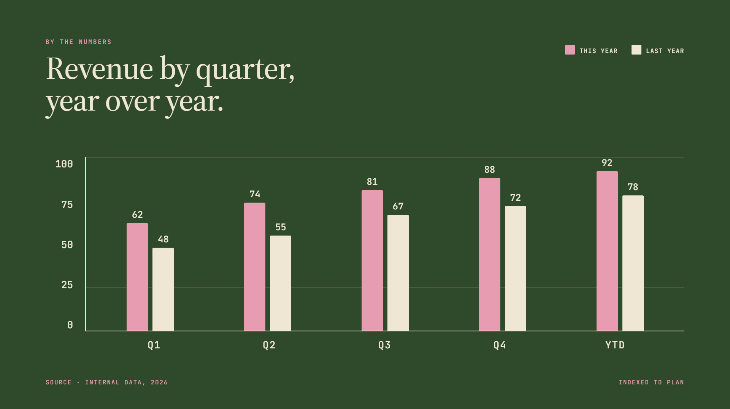
By the numbers
Revenue by quarter,
This year
Last year
year over year.
100
88
92
81
78
74
72
75
67
62
55
50
48
25
0
Q1
Q2
Q3
Q4
YTD
Source · Internal data, 2026
Indexed to plan

Slide 6

How we’ll get there
Four steps
A simple plan,
in four moves.
Step 01
Step 02
Step 03
Step 04
Listen
Align
Build
Ship
Open the quarter with structured conversations across teams. Capture what we hear without filtering.
Cluster signals into themes. Name them plainly so everyone uses the same language in every room.
Translate the themes into a short list of bets. Decide what we’re keeping, and what we’re cutting.
Put the work in market on a known cadence. Measure against the plan; adjust without losing the thread.
Weeks 1–2
Owner
Week 3
Owner
Weeks 4–6
Owner
Weeks 7–12
Owner

Slide 7
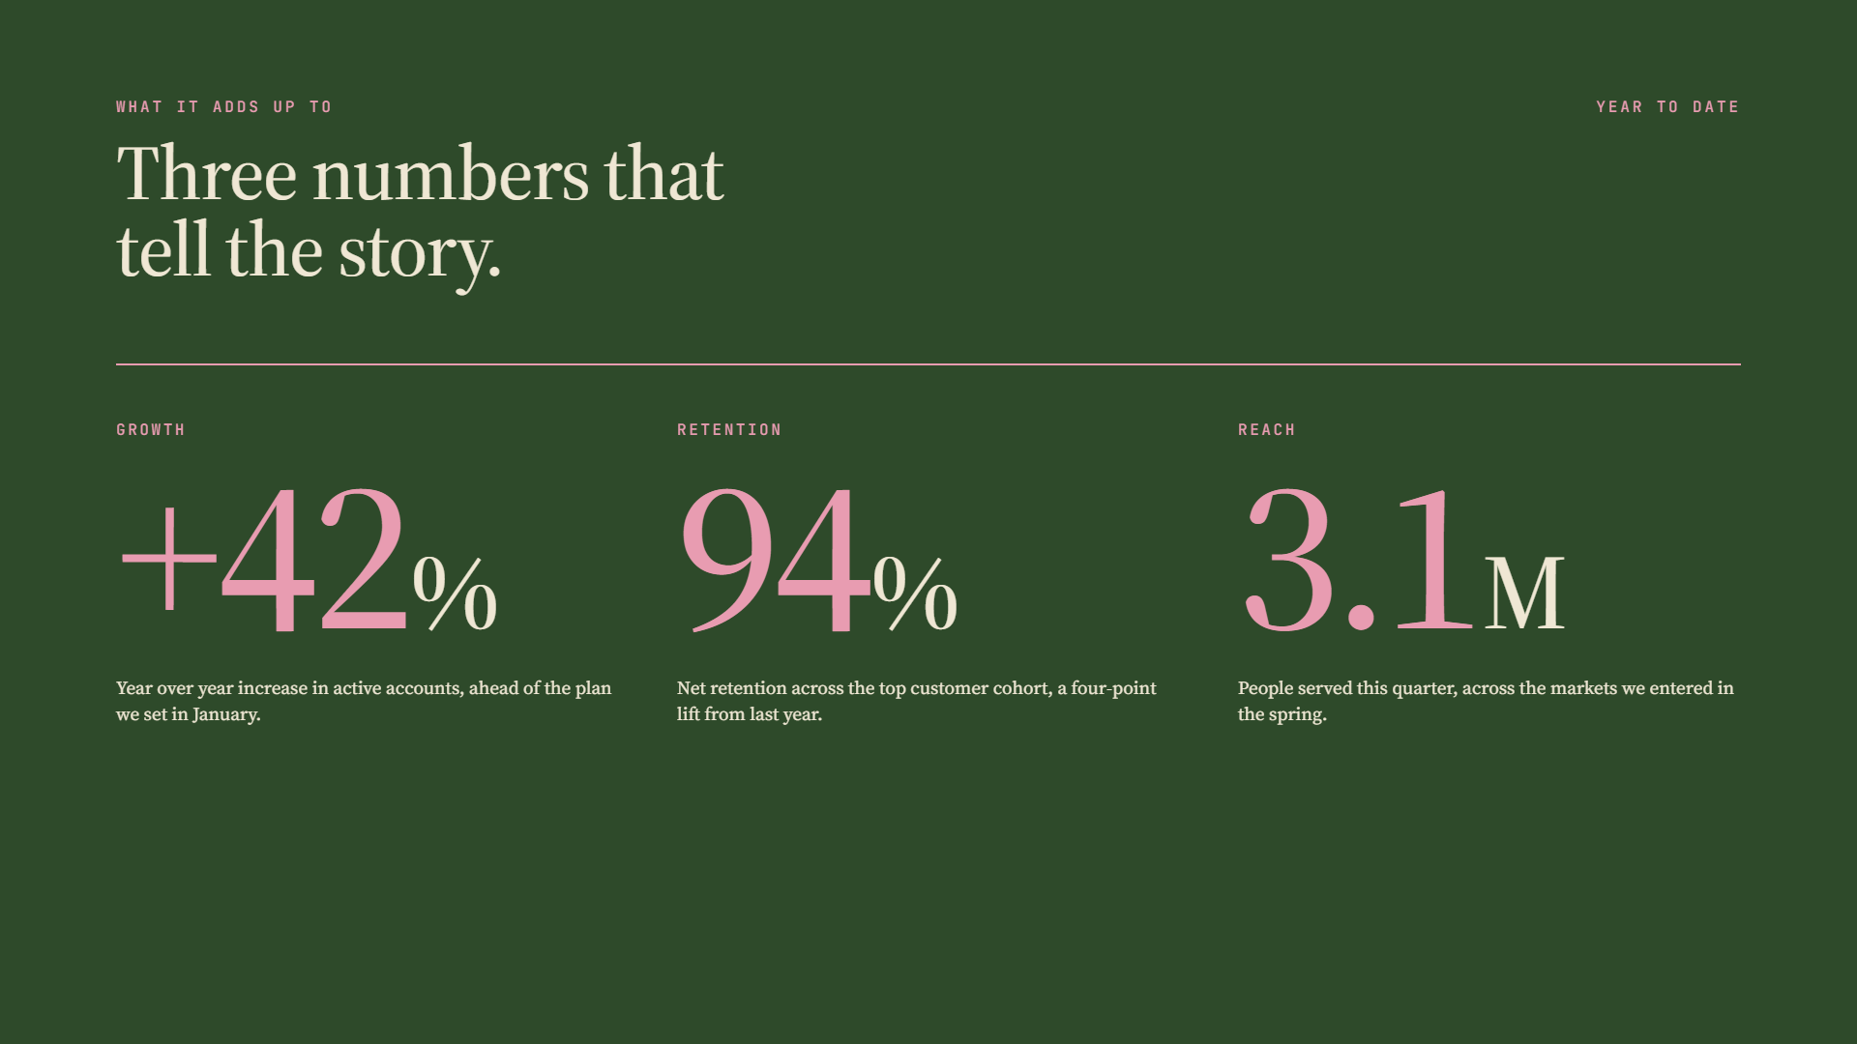
What it adds up to
Year to date
Three numbers that
tell the story.
+42
94
3.1
Growth
Retention
Reach
%
%
M
Year over year increase in active accounts, ahead of the plan we set in January.
Net retention across the top customer cohort, a four‑point lift from last year.
People served this quarter, across the markets we entered in the spring.

Slide 8

In summary
Thank you
Three
things to take.
One
Two
Three
The strategy holds. We are doing fewer things, and the right things.
The numbers back the bets. Growth, retention, and reach are all ahead of plan.
Next quarter, we keep the pace and add focus where the data points us.

