Slide 1

The future of
data-driven
finance
©2025 DIGITS
All rights reserved.
01 / 12

Slide 2
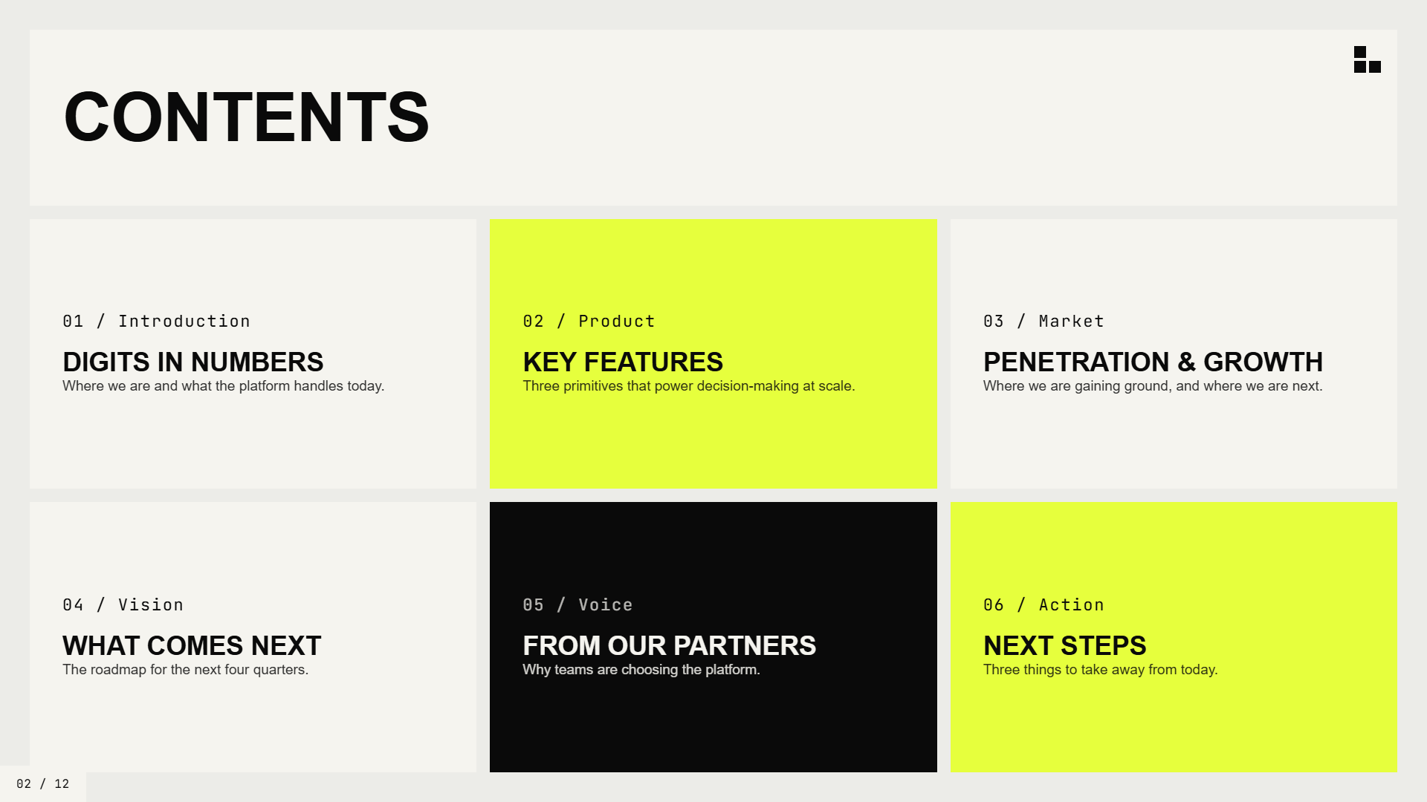
Contents
01 / Introduction
02 / Product
03 / Market
Digits in numbers
Key features
Penetration & growth
Where we are and what the platform handles today.
Three primitives that power decision-making at scale.
Where we are gaining ground, and where we are next.
04 / Vision
05 / Voice
06 / Action
What comes next
From our partners
Next steps
The roadmap for the next four quarters.
Why teams are choosing the platform.
Three things to take away from today.
02 / 12

Slide 3
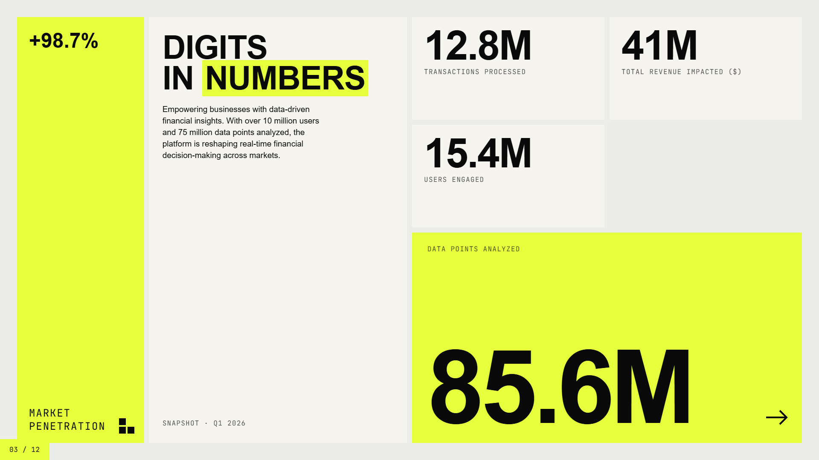
+98.7%
Digits
12.8M
41M
in
numbers
Transactions processed
Total revenue impacted ($)
Empowering businesses with data-driven financial insights. With over 10 million users and 75 million data points analyzed, the platform is reshaping real-time financial decision-making across markets.
15.4M
Users engaged
Data points analyzed
85.6M
Market penetration
Snapshot · Q1 2026
03 / 12

Slide 4
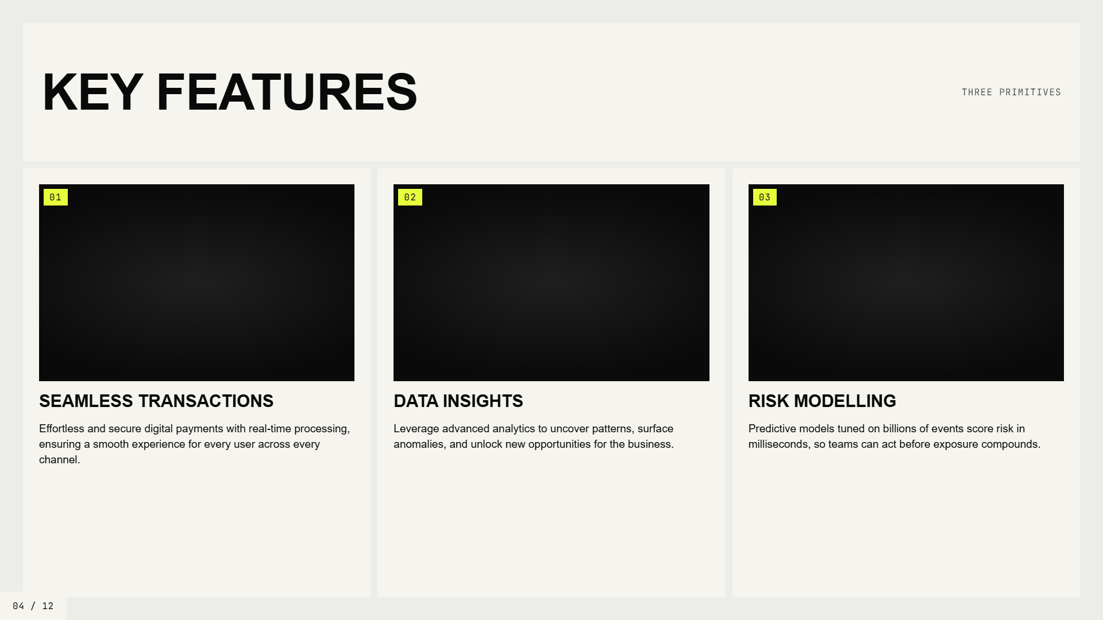
Key features
Three primitives
01
02
03
Seamless transactions
Data insights
Risk modelling
Effortless and secure digital payments with real-time processing, ensuring a smooth experience for every user across every channel.
Leverage advanced analytics to uncover patterns, surface anomalies, and unlock new opportunities for the business.
Predictive models tuned on billions of events score risk in milliseconds, so teams can act before exposure compounds.
04 / 12

Slide 5
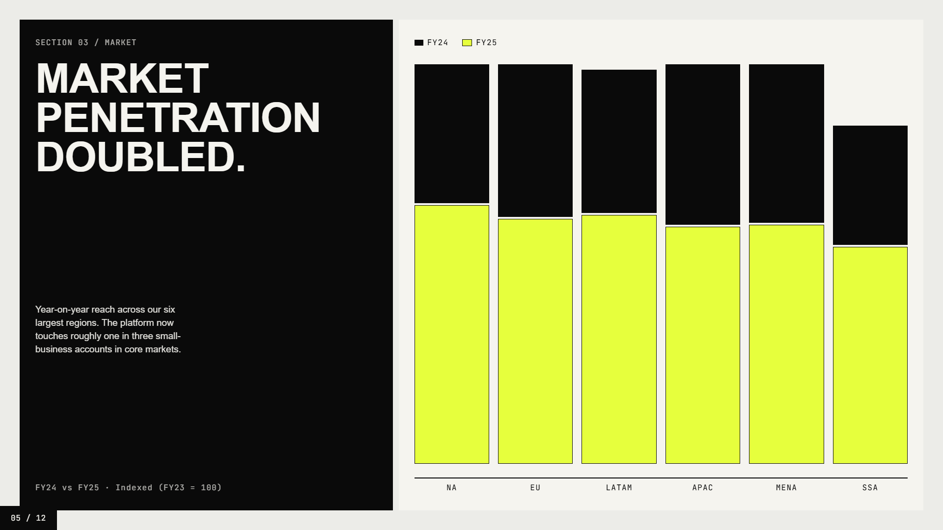
Section 03 / Market
FY24
FY25
Market
penetration
doubled.
Year-on-year reach across our six largest regions. The platform now touches roughly one in three small-business accounts in core markets.
FY24 vs FY25 · Indexed (FY23 = 100)
NA
EU
LATAM
APAC
MENA
SSA
05 / 12

Slide 6

Section · Vision
What comes next
Build the
engine of
modern money.
02
We are betting that the next decade of finance is owned by platforms that can model the world in real time, then act on it without a human in the loop.
06 / 12

Slide 7
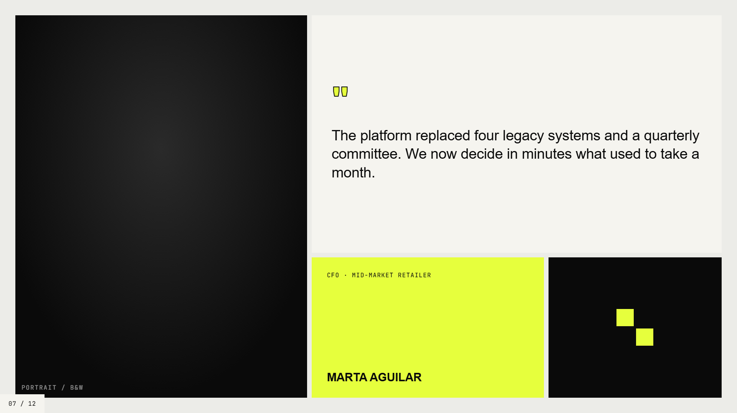
"
The platform replaced four legacy systems and a quarterly committee. We now decide in minutes what used to take a month.
CFO · Mid-market retailer
Marta Aguilar
PORTRAIT / B&W
07 / 12

Slide 8
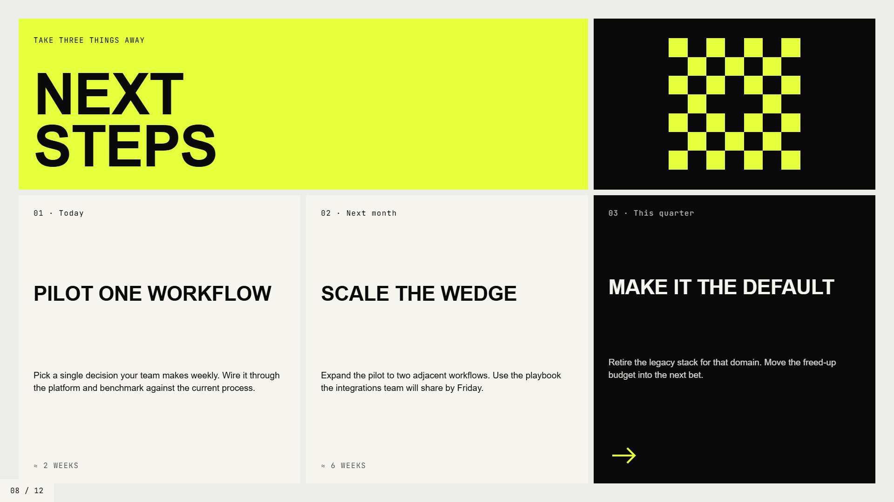
Take three things away
Next
steps
01 · Today
02 · Next month
03 · This quarter
Pilot one workflow
Scale the wedge
Make it the default
Retire the legacy stack for that domain. Move the freed-up budget into the next bet.
Pick a single decision your team makes weekly. Wire it through the platform and benchmark against the current process.
Expand the pilot to two adjacent workflows. Use the playbook the integrations team will share by Friday.
≈ 2 weeks
≈ 6 weeks
08 / 12

Slide 9
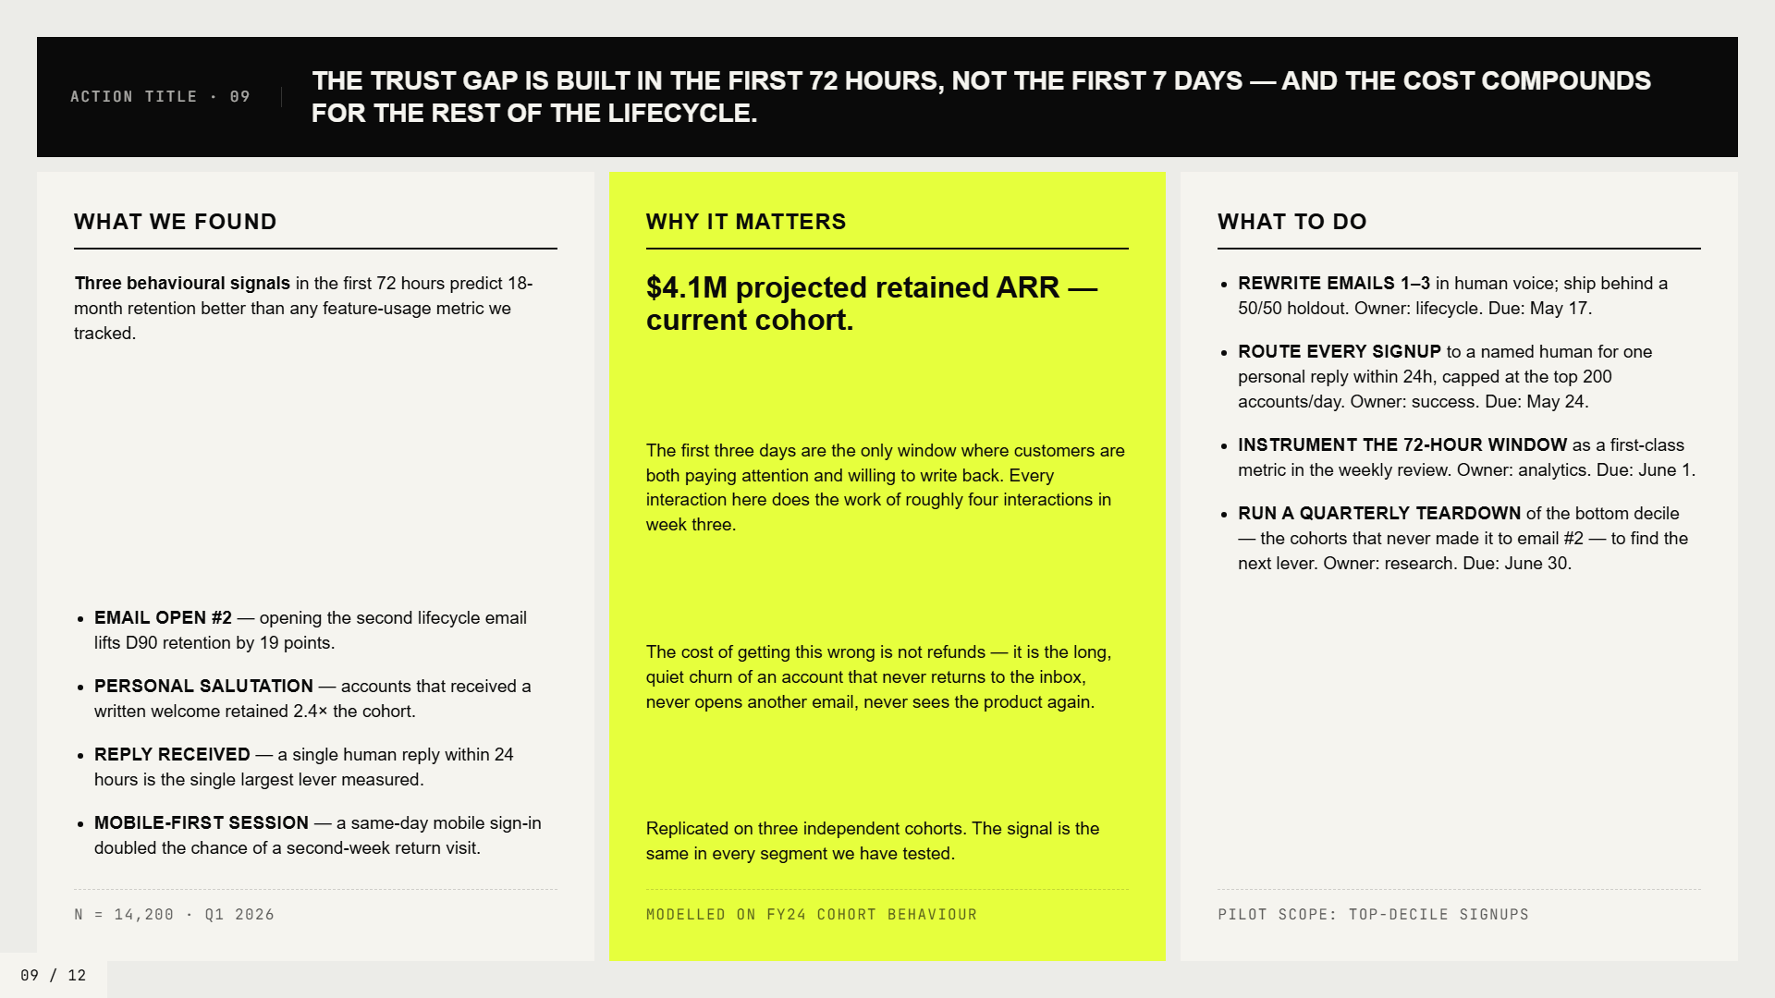
The trust gap is built in the first 72 hours, not the first 7 days — and the cost compounds for the rest of the lifecycle.
Action title · 09
What we found
Why it matters
What to do
Three behavioural signals
$4.1M projected retained ARR — current cohort.
in the first 72 hours predict 18-month retention better than any feature-usage metric we tracked.
Rewrite emails 1–3
in human voice; ship behind a 50/50 holdout. Owner: lifecycle. Due: May 17.
Route every signup
to a named human for one personal reply within 24h, capped at the top 200 accounts/day. Owner: success. Due: May 24.
Instrument the 72-hour window
The first three days are the only window where customers are both paying attention and willing to write back. Every interaction here does the work of roughly four interactions in week three.
as a first-class metric in the weekly review. Owner: analytics. Due: June 1.
Run a quarterly teardown
of the bottom decile — the cohorts that never made it to email #2 — to find the next lever. Owner: research. Due: June 30.
Email open #2
— opening the second lifecycle email lifts D90 retention by 19 points.
The cost of getting this wrong is not refunds — it is the long, quiet churn of an account that never returns to the inbox, never opens another email, never sees the product again.
Personal salutation
— accounts that received a written welcome retained 2.4× the cohort.
Reply received
— a single human reply within 24 hours is the single largest lever measured.
Mobile-first session
— a same-day mobile sign-in doubled the chance of a second-week return visit.
Replicated on three independent cohorts. The signal is the same in every segment we have tested.
N = 14,200 · Q1 2026
Modelled on FY24 cohort behaviour
Pilot scope: top-decile signups
09 / 12

Slide 10
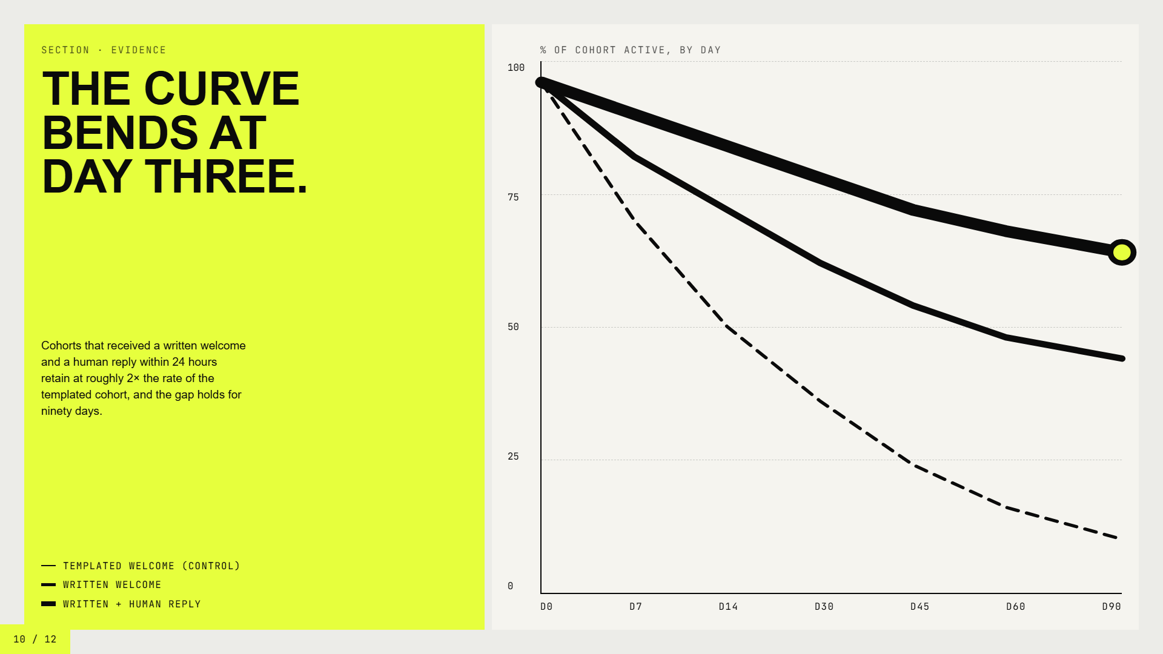
Section · Evidence
% of cohort active, by day
The curve
100
bends at
day three.
75
50
Cohorts that received a written welcome and a human reply within 24 hours retain at roughly 2× the rate of the templated cohort, and the gap holds for ninety days.
25
Templated welcome (control)
Written welcome
0
Written + human reply
D0
D7
D14
D30
D45
D60
D90
10 / 12

Slide 11
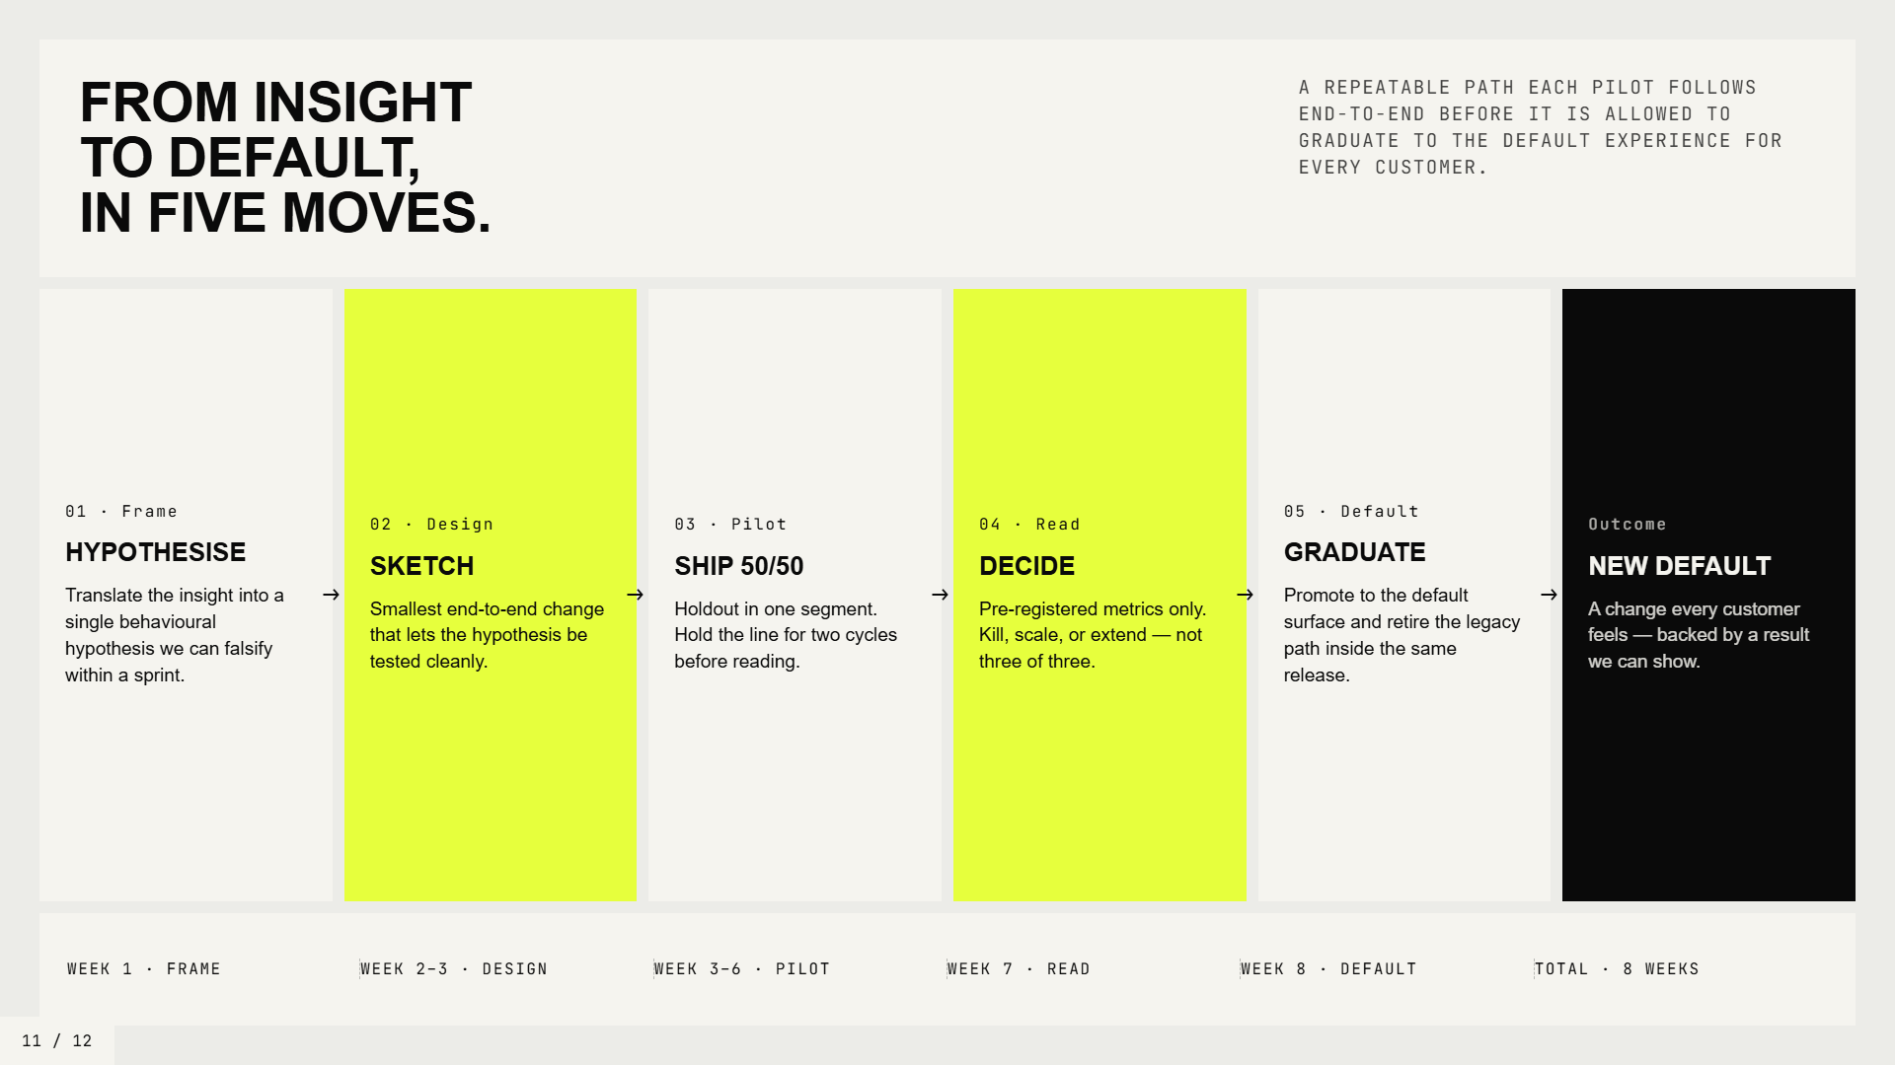
From insight
A repeatable path each pilot follows end-to-end before it is allowed to graduate to the default experience for every customer.
to default,
in five moves.
01 · Frame
02 · Design
03 · Pilot
04 · Read
05 · Default
Outcome
Hypothesise
Sketch
Ship 50/50
Decide
Graduate
New default
Translate the insight into a single behavioural hypothesis we can falsify within a sprint.
Smallest end-to-end change that lets the hypothesis be tested cleanly.
Holdout in one segment. Hold the line for two cycles before reading.
Pre-registered metrics only. Kill, scale, or extend — not three of three.
Promote to the default surface and retire the legacy path inside the same release.
A change every customer feels — backed by a result we can show.
Week 1 · Frame
Week 2–3 · Design
Week 3–6 · Pilot
Week 7 · Read
Week 8 · Default
Total · 8 weeks
11 / 12

Slide 12
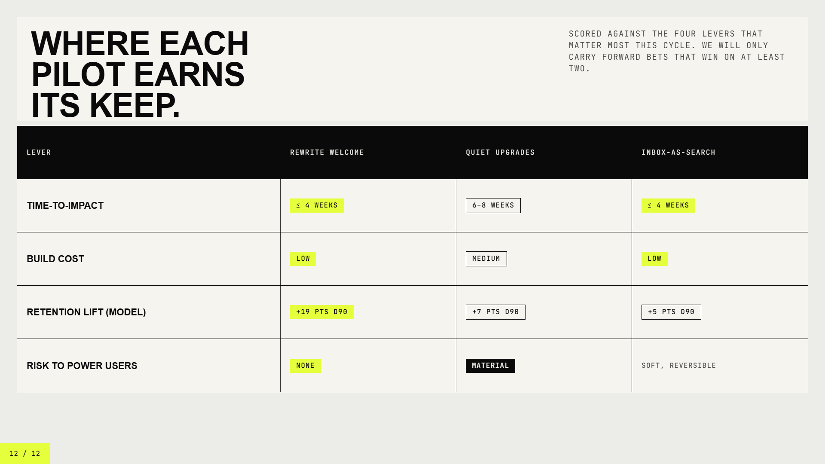
Where each
Scored against the four levers that matter most this cycle. We will only carry forward bets that win on at least two.
pilot earns
its keep.
Lever
Rewrite welcome
Quiet upgrades
Inbox-as-search
Time-to-impact
≤ 4 weeks
6–8 weeks
≤ 4 weeks
Build cost
Low
Medium
Low
Retention lift (model)
+19 pts D90
+7 pts D90
+5 pts D90
Risk to power users
None
Material
Soft, reversible
12 / 12

