Slide 1

[Period] · [Audience] · [Deck Type]
[Presentation]
Title
A short description of the deck, its purpose, and the decision it supports.
[Author Name] · [Role]
[Version] · [Status] · [Period]

Slide 2

01 · [Section]
Section headline with one emphasized idea
A brief setup sentence that explains what this section covers and why it matters.

Slide 3

[Slide Label]
03
[Kicker Label]
A concise statement that frames the main argument in one memorable sentence.
03 / 18

Slide 4

[Category] · [Topic]
04
[Kicker Label]
Main headline for a split-layout slide
Image Placeholder
Use this paragraph for the core explanation. Keep it short, specific, and easy to scan.
First supporting point with concise context
Second supporting point with concise context
[Caption for image]
Third supporting point with concise context
04 / 18

Slide 5
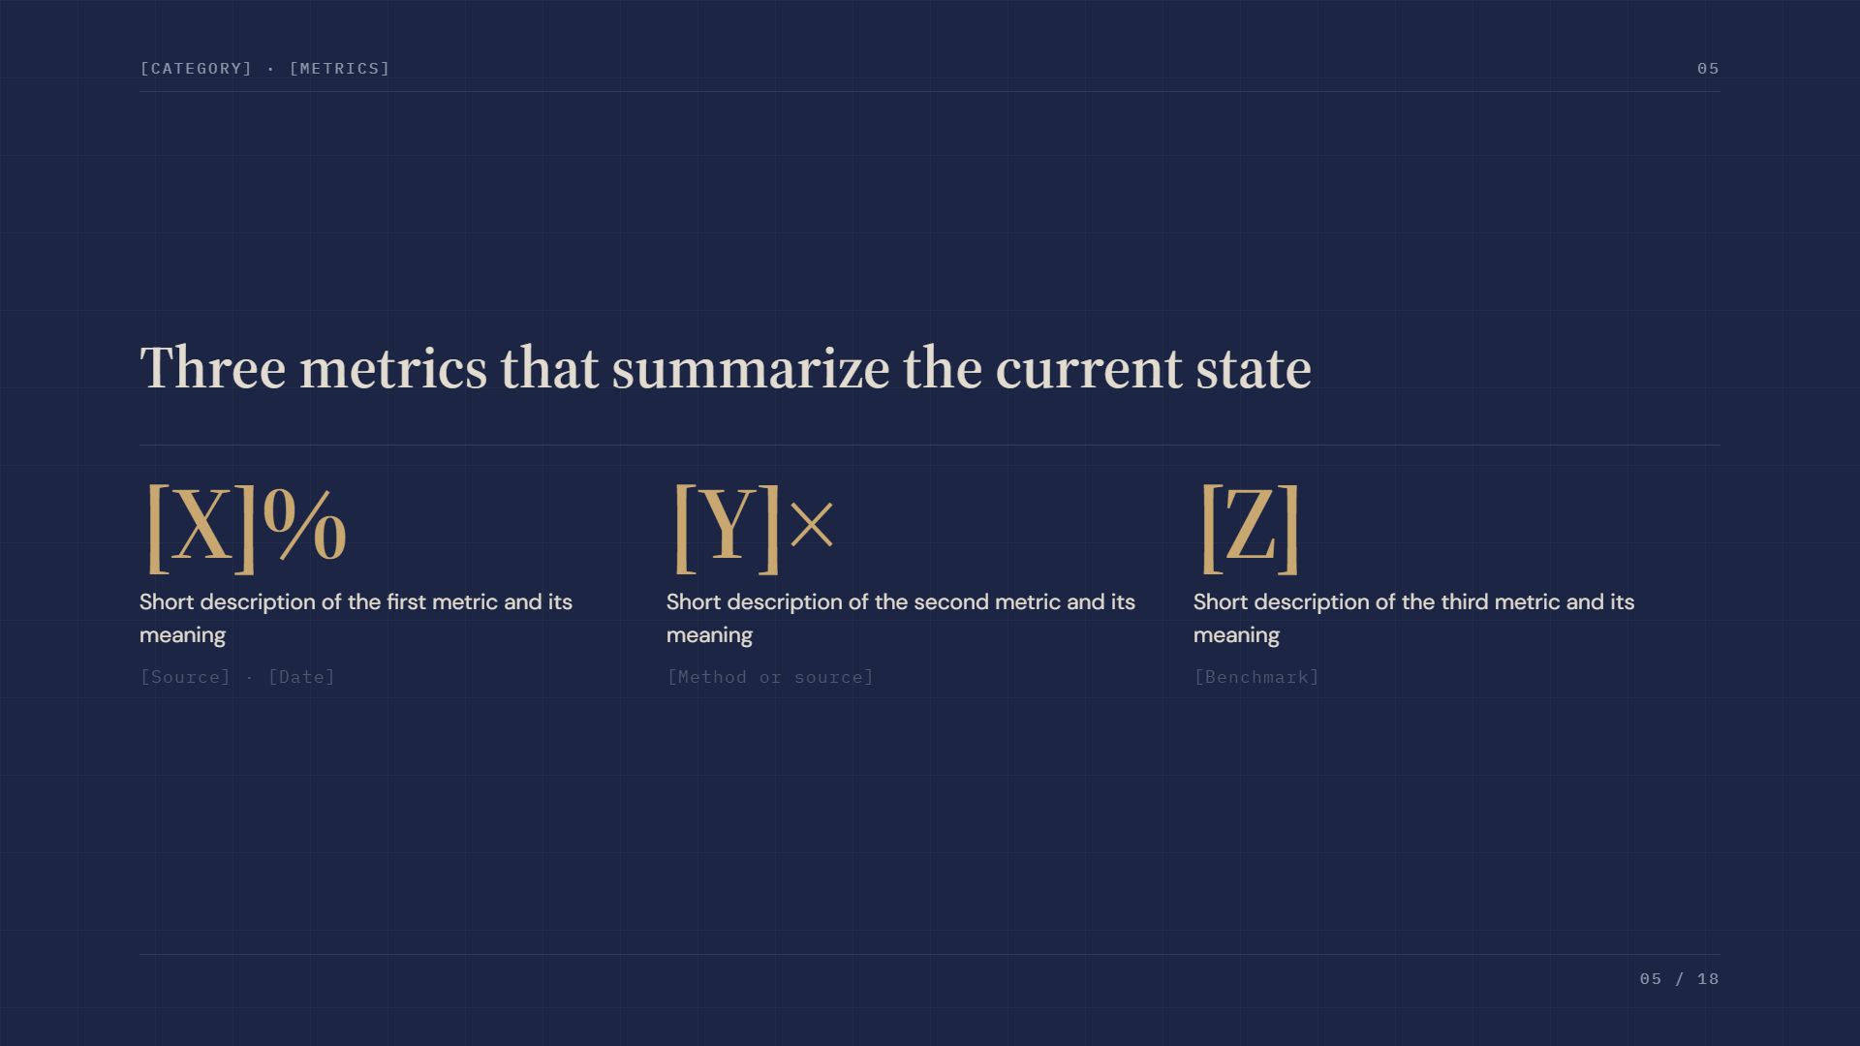
[Category] · [Metrics]
05
Three metrics that summarize the current state
[X]%
[Y]×
[Z]
Short description of the first metric and its meaning
Short description of the second metric and its meaning
Short description of the third metric and its meaning
[Source] · [Date]
[Method or source]
[Benchmark]
05 / 18

Slide 6

"
A short pull quote or highlighted observation can sit here.
[Source Name]
[Source Role] · [Context]

Slide 7
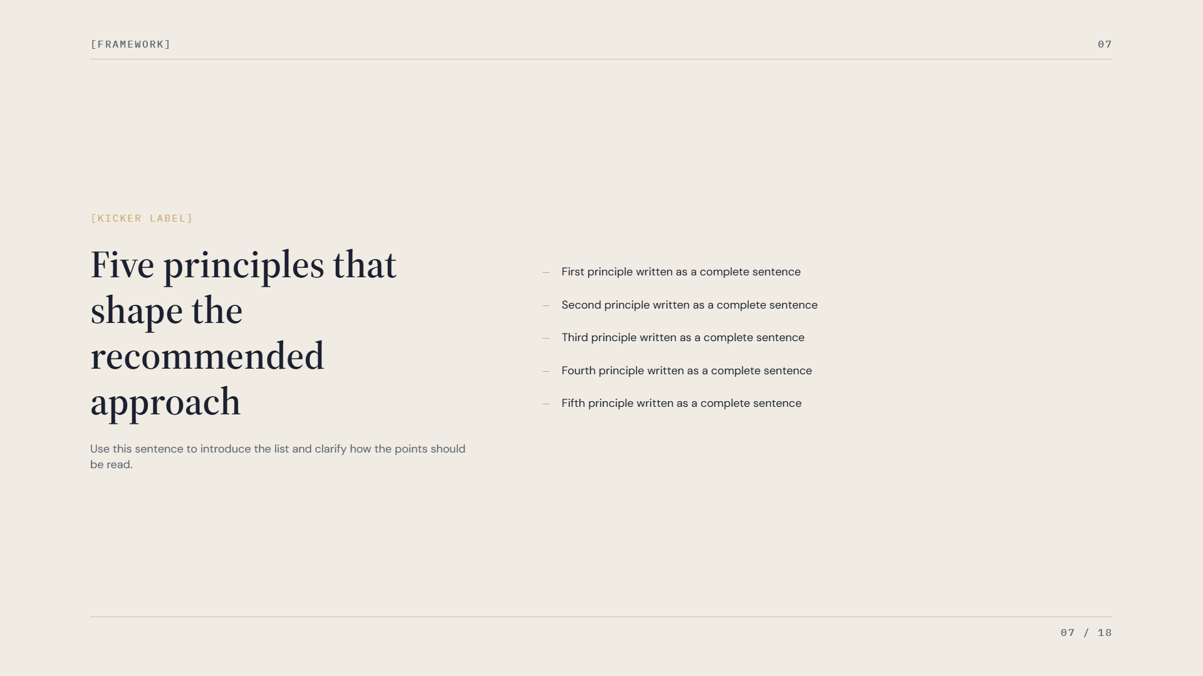
[Framework]
07
[Kicker Label]
Five principles that shape the recommended approach
First principle written as a complete sentence
Second principle written as a complete sentence
Third principle written as a complete sentence
Fourth principle written as a complete sentence
Fifth principle written as a complete sentence
Use this sentence to introduce the list and clarify how the points should be read.
07 / 18

Slide 8
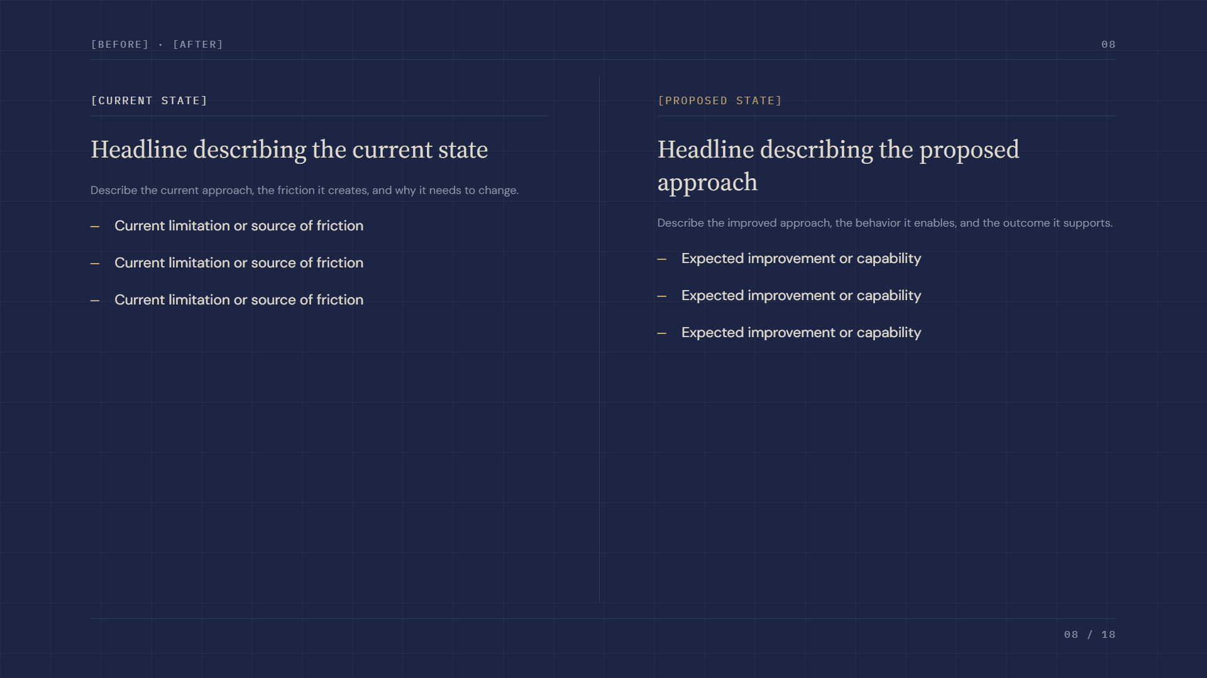
[Before] · [After]
08
[Current State]
[Proposed State]
Headline describing the current state
Headline describing the proposed approach
Describe the current approach, the friction it creates, and why it needs to change.
Current limitation or source of friction
Describe the improved approach, the behavior it enables, and the outcome it supports.
Current limitation or source of friction
Expected improvement or capability
Current limitation or source of friction
Expected improvement or capability
Expected improvement or capability
08 / 18

Slide 9
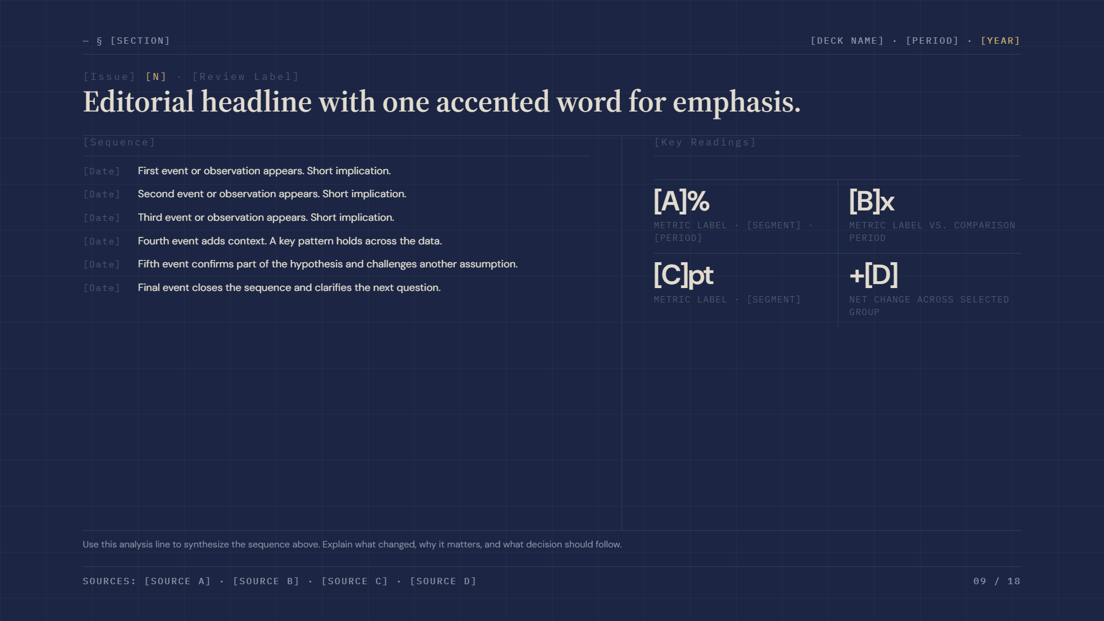
— § [Section]
[Deck Name] · [Period] ·
[Year]
[Issue]
[N]
· [Review Label]
Editorial headline with one accented word for emphasis.
[Sequence]
[Key Readings]
[Date]
First event or observation appears. Short implication.
[Date]
Second event or observation appears. Short implication.
[A]%
[B]x
[Date]
Third event or observation appears. Short implication.
Metric label · [Segment] · [Period]
Metric label vs. comparison period
[Date]
Fourth event adds context. A key pattern holds across the data.
[Date]
Fifth event confirms part of the hypothesis and challenges another assumption.
[C]pt
+[D]
[Date]
Final event closes the sequence and clarifies the next question.
Metric label · [Segment]
Net change across selected group
Use this analysis line to synthesize the sequence above. Explain what changed, why it matters, and what decision should follow.
Sources: [Source A] · [Source B] · [Source C] · [Source D]
09 / 18

Slide 10
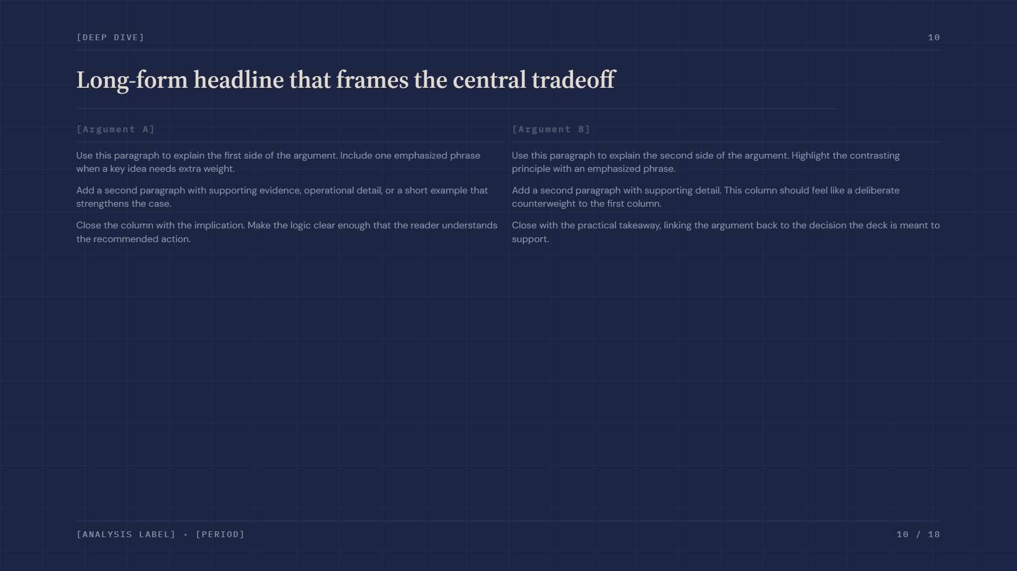
[Deep Dive]
10
Long-form headline that frames the central tradeoff
[Argument A]
[Argument B]
Use this paragraph to explain the first side of the argument. Include one emphasized phrase when a key idea needs extra weight.
Use this paragraph to explain the second side of the argument. Highlight the contrasting principle with an emphasized phrase.
Add a second paragraph with supporting evidence, operational detail, or a short example that strengthens the case.
Add a second paragraph with supporting detail. This column should feel like a deliberate counterweight to the first column.
Close the column with the implication. Make the logic clear enough that the reader understands the recommended action.
Close with the practical takeaway, linking the argument back to the decision the deck is meant to support.
[Analysis Label] · [Period]
10 / 18

Slide 11
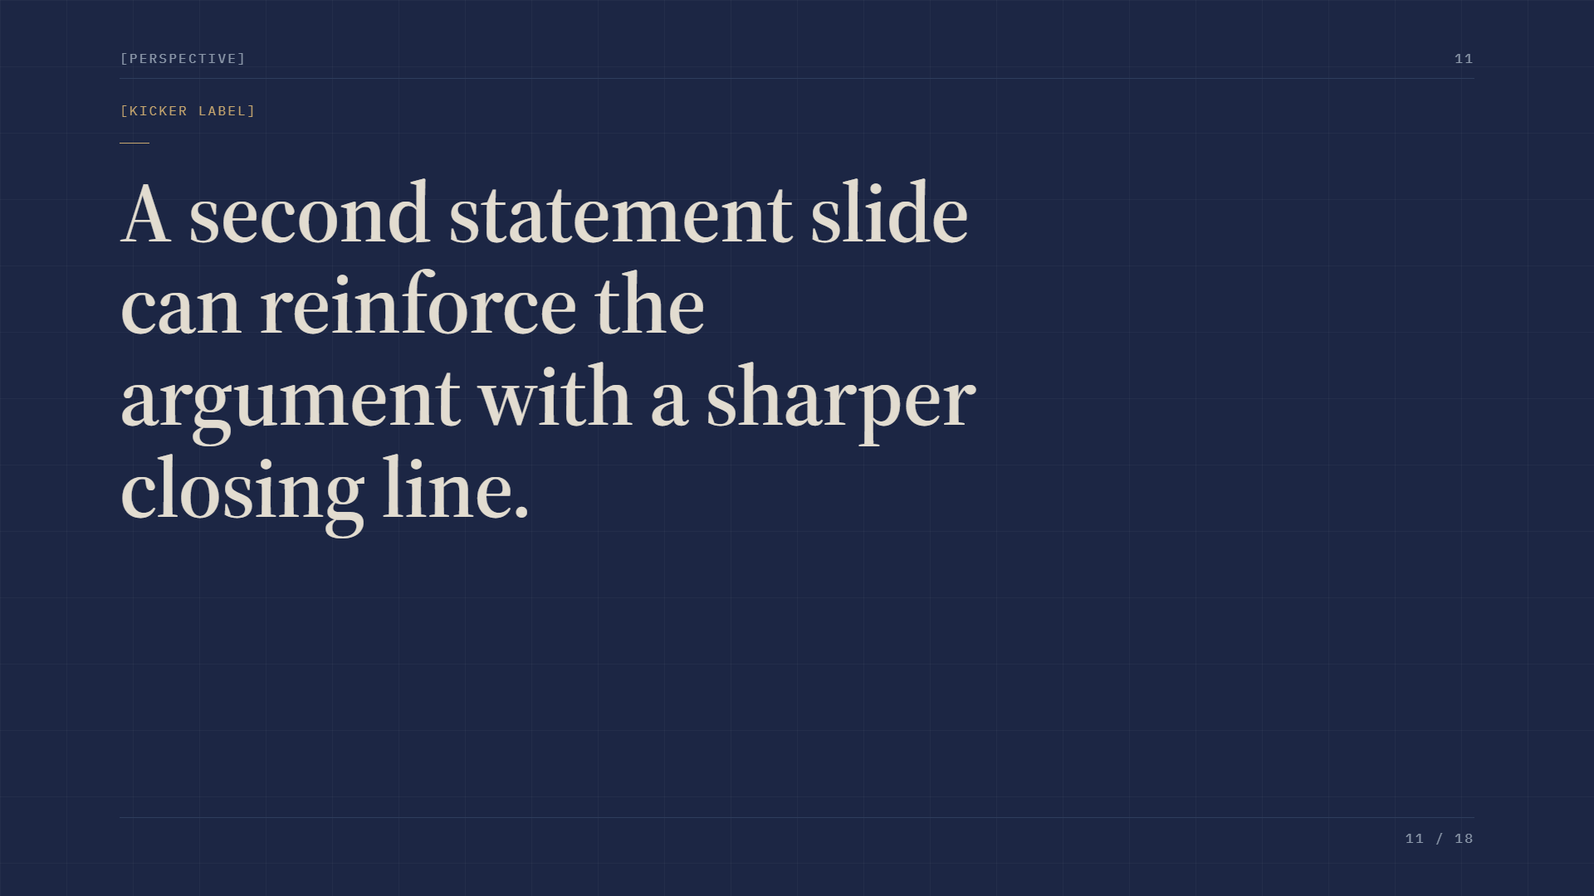
[Perspective]
11
[Kicker Label]
A second statement slide can reinforce the argument with a sharper closing line.
11 / 18

Slide 12

[Organization]
Closing headline with one emphasized phrase.
[Author Name] · [email@example.com] · [website.example]

Slide 13
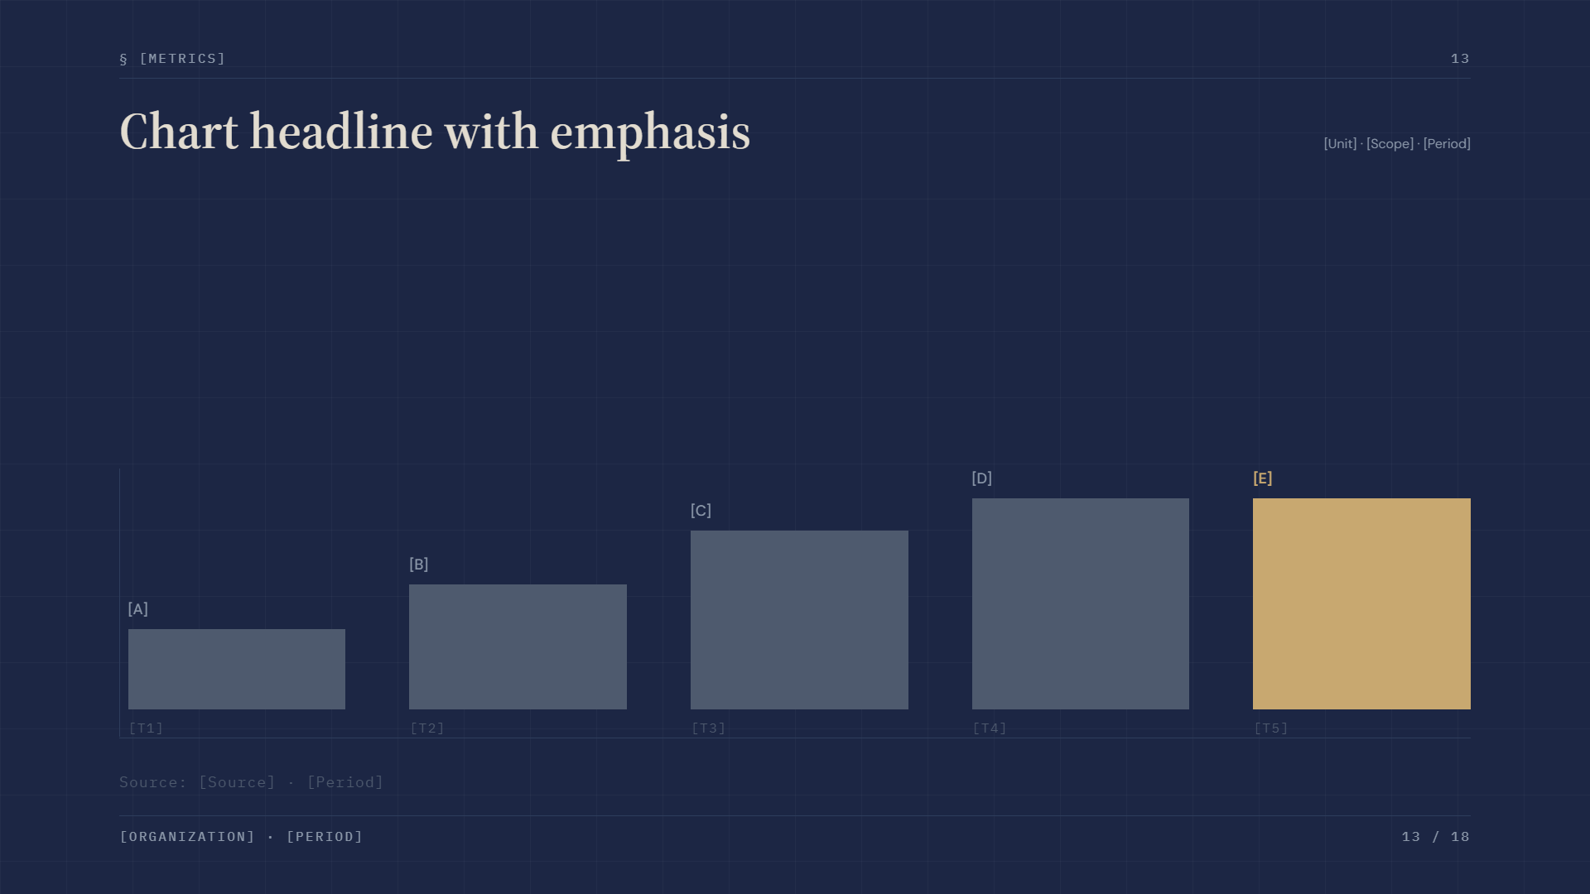
§ [Metrics]
13
Chart headline with emphasis
[Unit] · [Scope] · [Period]
[D]
[E]
[C]
[B]
[A]
[T1]
[T2]
[T3]
[T4]
[T5]
Source: [Source] · [Period]
[Organization] · [Period]
13 / 18

Slide 14
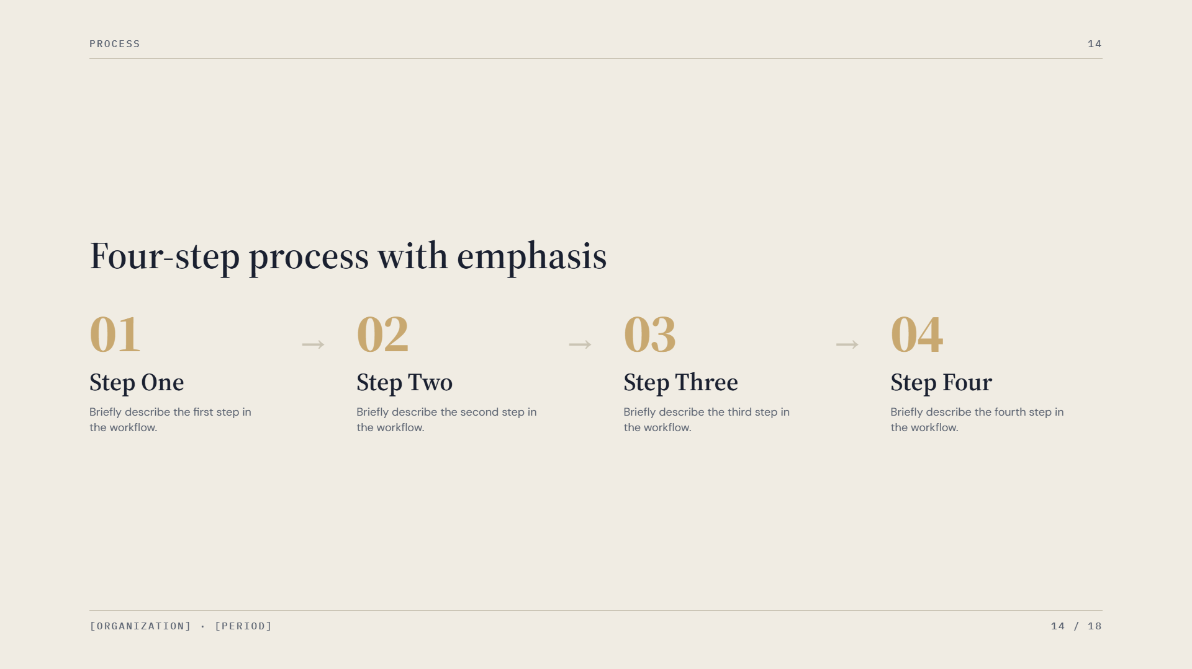
Process
14
Four-step process with emphasis
01
02
03
04
→
→
→
Step One
Step Two
Step Three
Step Four
Briefly describe the first step in the workflow.
Briefly describe the second step in the workflow.
Briefly describe the third step in the workflow.
Briefly describe the fourth step in the workflow.
[Organization] · [Period]
14 / 18

Slide 15
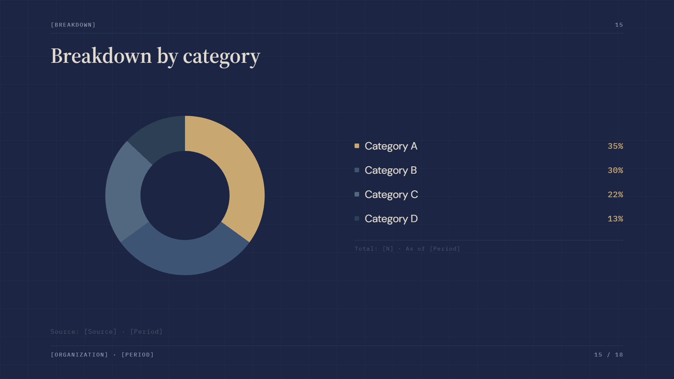
[Breakdown]
15
Breakdown by category
Category A
35%
Category B
30%
Category C
22%
Category D
13%
Total: [N] · As of [Period]
Source: [Source] · [Period]
[Organization] · [Period]
15 / 18

Slide 16
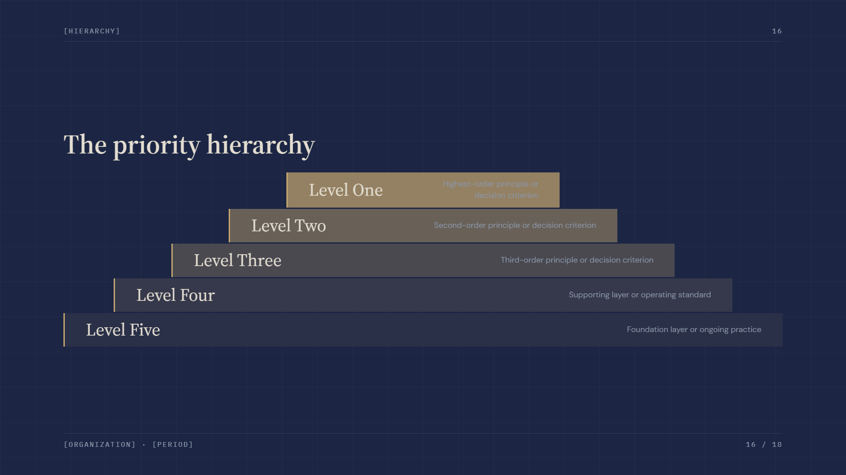
[Hierarchy]
16
The priority hierarchy
Level One
Highest-order principle or decision criterion
Level Two
Second-order principle or decision criterion
Level Three
Third-order principle or decision criterion
Level Four
Supporting layer or operating standard
Level Five
Foundation layer or ongoing practice
[Organization] · [Period]
16 / 18

Slide 17
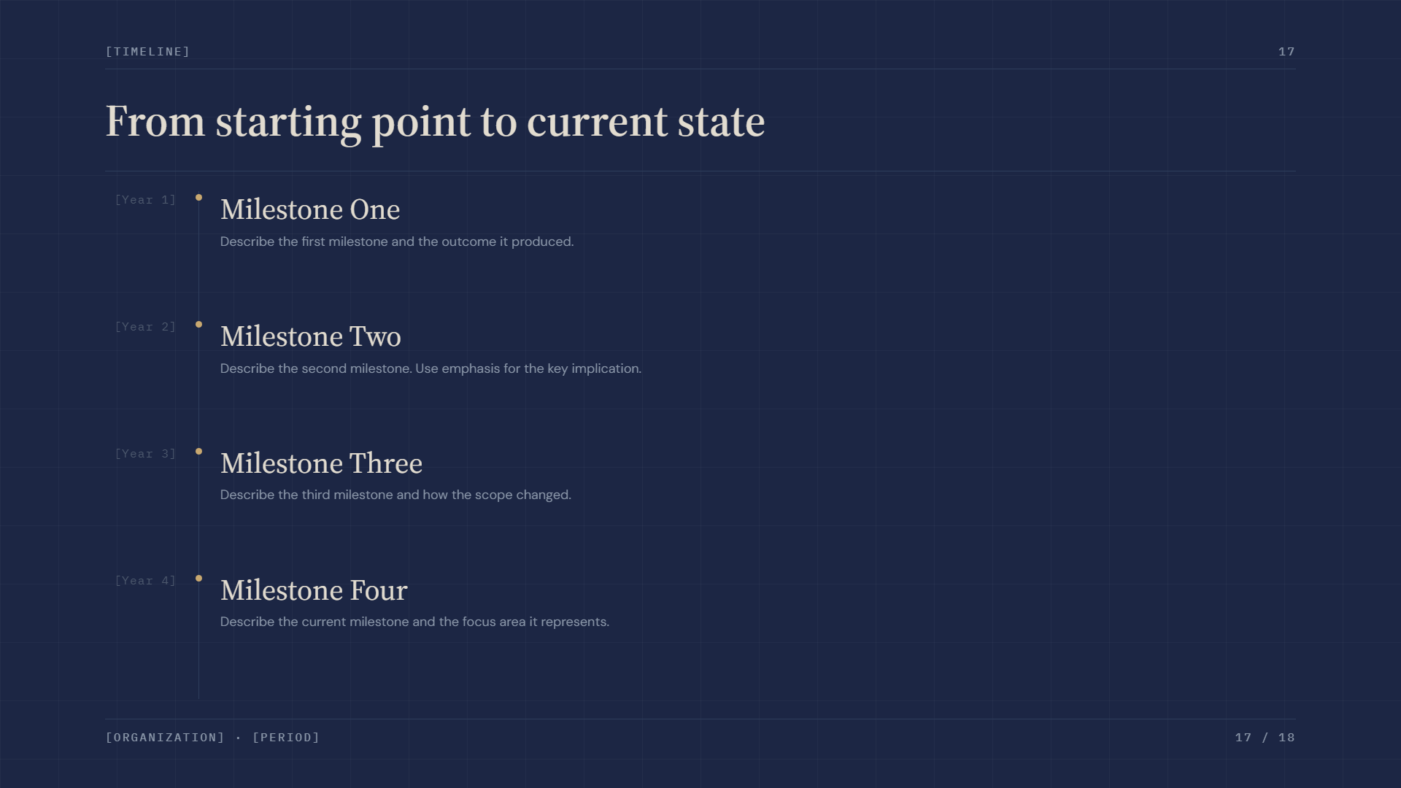
[Timeline]
17
From starting point to current state
[Year 1]
Milestone One
Describe the first milestone and the outcome it produced.
[Year 2]
Milestone Two
Describe the second milestone. Use emphasis for the key implication.
[Year 3]
Milestone Three
Describe the third milestone and how the scope changed.
[Year 4]
Milestone Four
Describe the current milestone and the focus area it represents.
[Organization] · [Period]
17 / 18

Slide 18
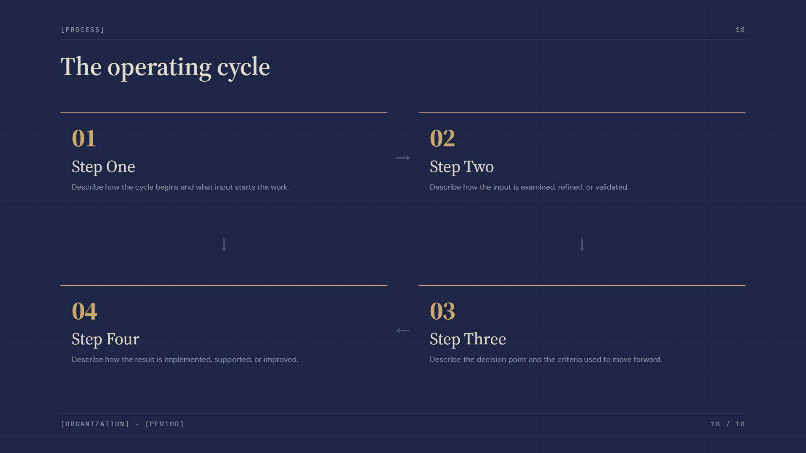
[Process]
18
The operating cycle
01
02
Step One
→
Step Two
Describe how the cycle begins and what input starts the work.
Describe how the input is examined, refined, or validated.
↓
↓
04
03
Step Four
←
Step Three
Describe how the result is implemented, supported, or improved.
Describe the decision point and the criteria used to move forward.
[Organization] · [Period]
18 / 18

