Slide 1
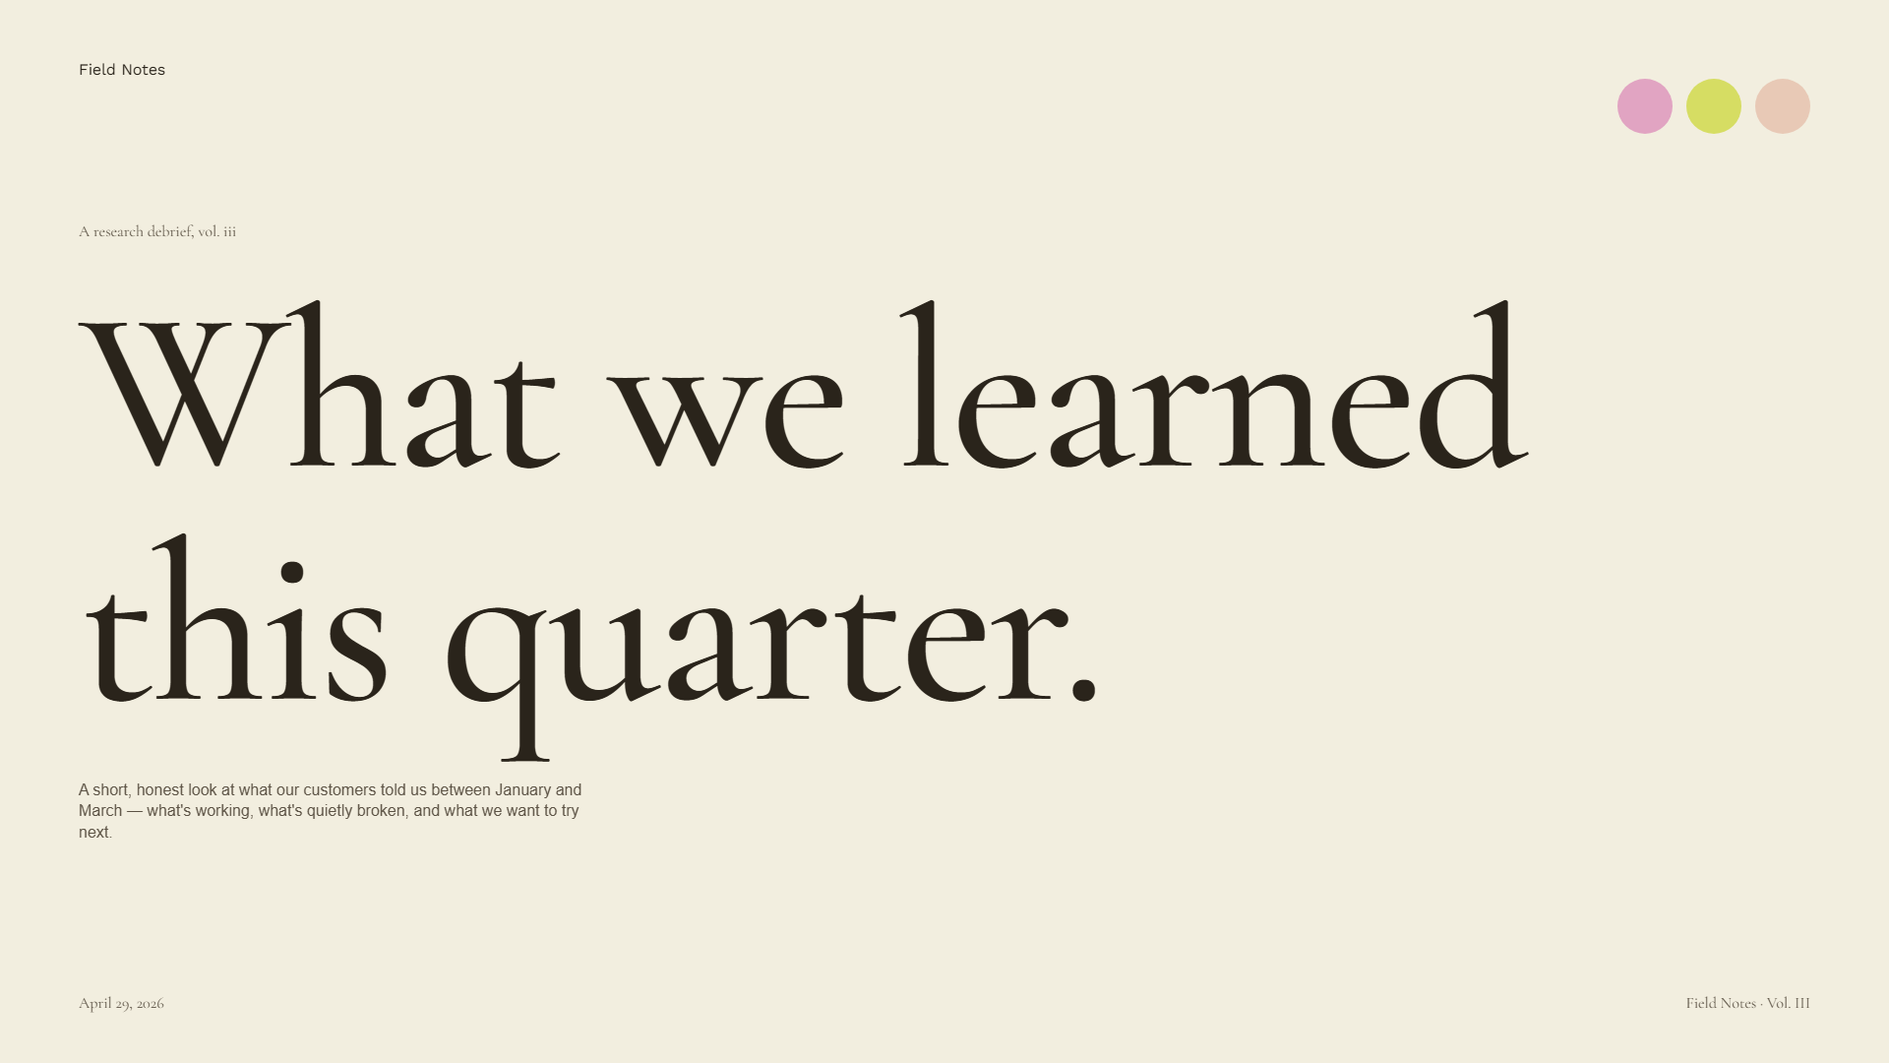
Field Notes
A research debrief, vol. iii
What we learned this quarter.
A short, honest look at what our customers told us between January and March — what's working, what's quietly broken, and what we want to try next.
April 29, 2026
Field Notes · Vol. III

Slide 2

Foreword
ii
We spent eight weeks listening, and what we heard surprised us in the kindest way.
The team ran twenty-eight long-form interviews, shadowed nine teams during their busiest week of the year, and sat with the support inbox for ten unbroken days.
The themes that emerged were not the ones we set out to find. The brief asked about onboarding; the answers we got were about trust. So we followed the thread.
This deck is the short version. Each insight is a door — open the ones that matter to your team this quarter, and let the others wait.
— The research desk
April 29, 2026
Field Notes · Vol. III

Slide 3
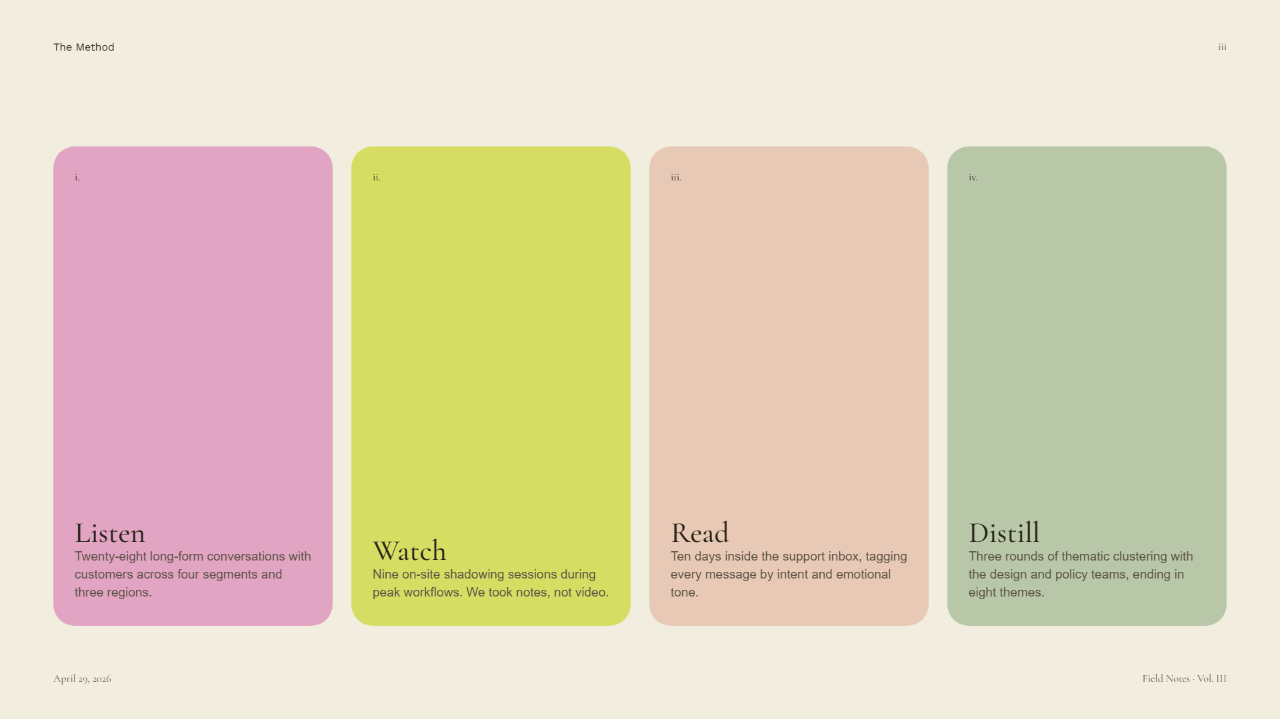
The Method
iii
i.
ii.
iii.
iv.
Listen
Read
Distill
Watch
Twenty-eight long-form conversations with customers across four segments and three regions.
Ten days inside the support inbox, tagging every message by intent and emotional tone.
Three rounds of thematic clustering with the design and policy teams, ending in eight themes.
Nine on-site shadowing sessions during peak workflows. We took notes, not video.
April 29, 2026
Field Notes · Vol. III

Slide 4
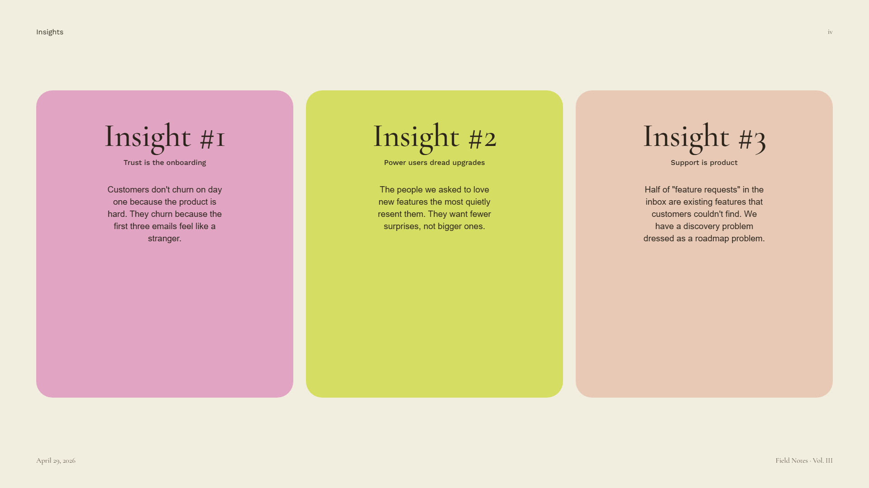
Insights
iv
Insight #1
Insight #2
Insight #3
Trust is the onboarding
Power users dread upgrades
Support is product
Customers don't churn on day one because the product is hard. They churn because the first three emails feel like a stranger.
The people we asked to love new features the most quietly resent them. They want fewer surprises, not bigger ones.
Half of "feature requests" in the inbox are existing features that customers couldn't find. We have a discovery problem dressed as a roadmap problem.
April 29, 2026
Field Notes · Vol. III

Slide 5

A closer look · 1 of 3
v
on insight #1
Trust is the onboarding.
The product can be perfect on day one, but if the welcome email reads like a contract, half of new accounts will never log in twice. The fix is small and writerly, not technical.
April 29, 2026
Field Notes · Vol. III

Slide 6
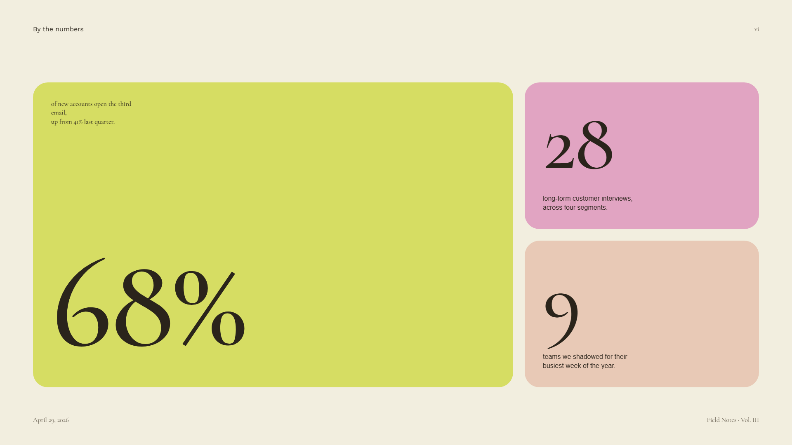
By the numbers
vi
of new accounts open the third email,
28
up from 41% last quarter.
long-form customer interviews, across four segments.
68%
9
teams we shadowed for their busiest week of the year.
April 29, 2026
Field Notes · Vol. III

Slide 7
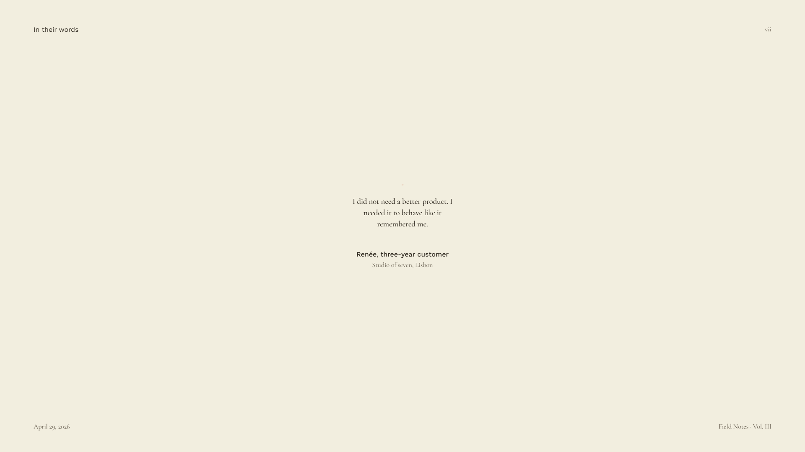
In their words
vii
"
I did not need a better product. I needed it to behave like it remembered me.
Renée, three-year customer
Studio of seven, Lisbon
April 29, 2026
Field Notes · Vol. III

Slide 8
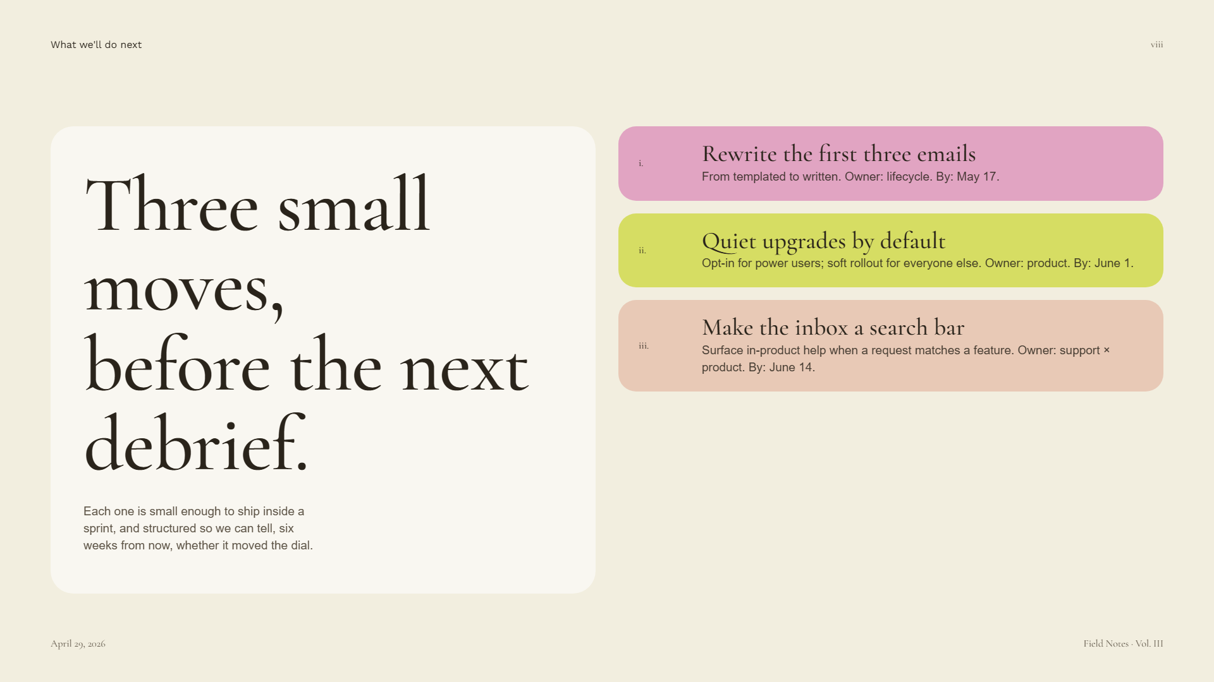
What we'll do next
viii
Rewrite the first three emails
Three small moves,
i.
From templated to written. Owner: lifecycle. By: May 17.
Quiet upgrades by default
ii.
Opt-in for power users; soft rollout for everyone else. Owner: product. By: June 1.
before the next debrief.
Make the inbox a search bar
iii.
Surface in-product help when a request matches a feature. Owner: support × product. By: June 14.
Each one is small enough to ship inside a sprint, and structured so we can tell, six weeks from now, whether it moved the dial.
April 29, 2026
Field Notes · Vol. III

Slide 9
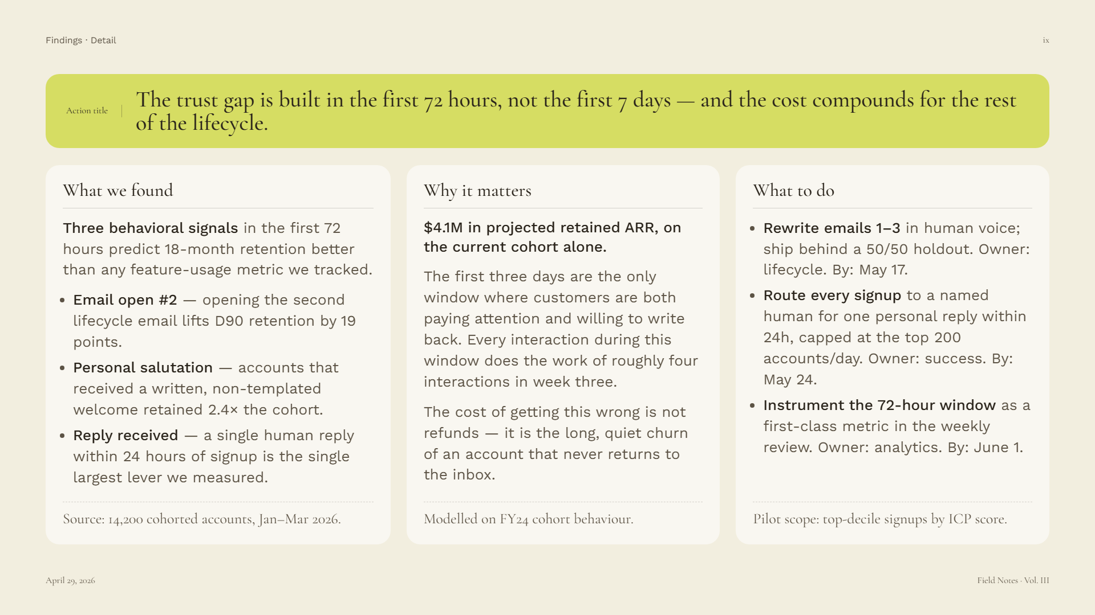
Findings · Detail
ix
The trust gap is built in the first 72 hours, not the first 7 days — and the cost compounds for the rest of the lifecycle.
Action title
What we found
Why it matters
What to do
Three behavioral signals
$4.1M in projected retained ARR, on the current cohort alone.
in the first 72 hours predict 18-month retention better than any feature-usage metric we tracked.
Rewrite emails 1–3
in human voice; ship behind a 50/50 holdout. Owner: lifecycle. By: May 17.
The first three days are the only window where customers are both paying attention and willing to write back. Every interaction during this window does the work of roughly four interactions in week three.
Route every signup
Email open #2
to a named human for one personal reply within 24h, capped at the top 200 accounts/day. Owner: success. By: May 24.
— opening the second lifecycle email lifts D90 retention by 19 points.
Personal salutation
— accounts that received a written, non-templated welcome retained 2.4× the cohort.
Instrument the 72-hour window
The cost of getting this wrong is not refunds — it is the long, quiet churn of an account that never returns to the inbox.
as a first-class metric in the weekly review. Owner: analytics. By: June 1.
Reply received
— a single human reply within 24 hours of signup is the single largest lever we measured.
Source: 14,200 cohorted accounts, Jan–Mar 2026.
Modelled on FY24 cohort behaviour.
Pilot scope: top-decile signups by ICP score.
April 29, 2026
Field Notes · Vol. III

Slide 10
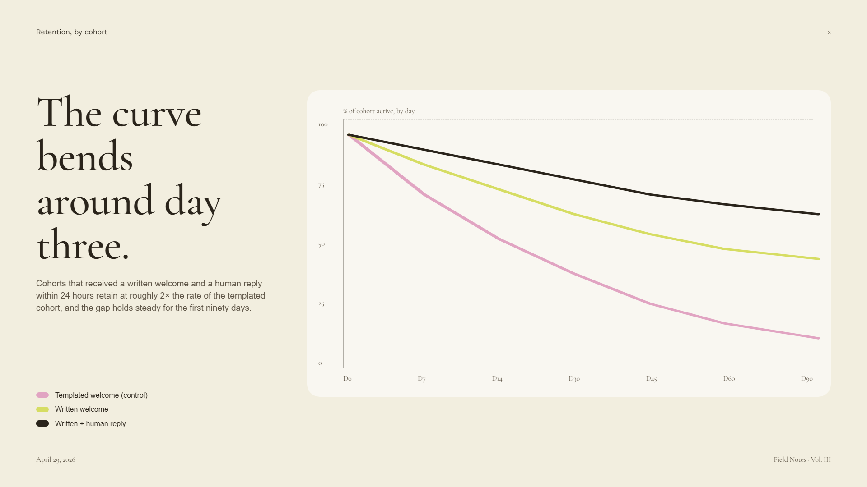
Retention, by cohort
x
The curve bends
% of cohort active, by day
100
around day three.
75
50
Cohorts that received a written welcome and a human reply within 24 hours retain at roughly 2× the rate of the templated cohort, and the gap holds steady for the first ninety days.
25
0
D0
D7
D14
D30
D45
D60
D90
Templated welcome (control)
Written welcome
Written + human reply
April 29, 2026
Field Notes · Vol. III

Slide 11
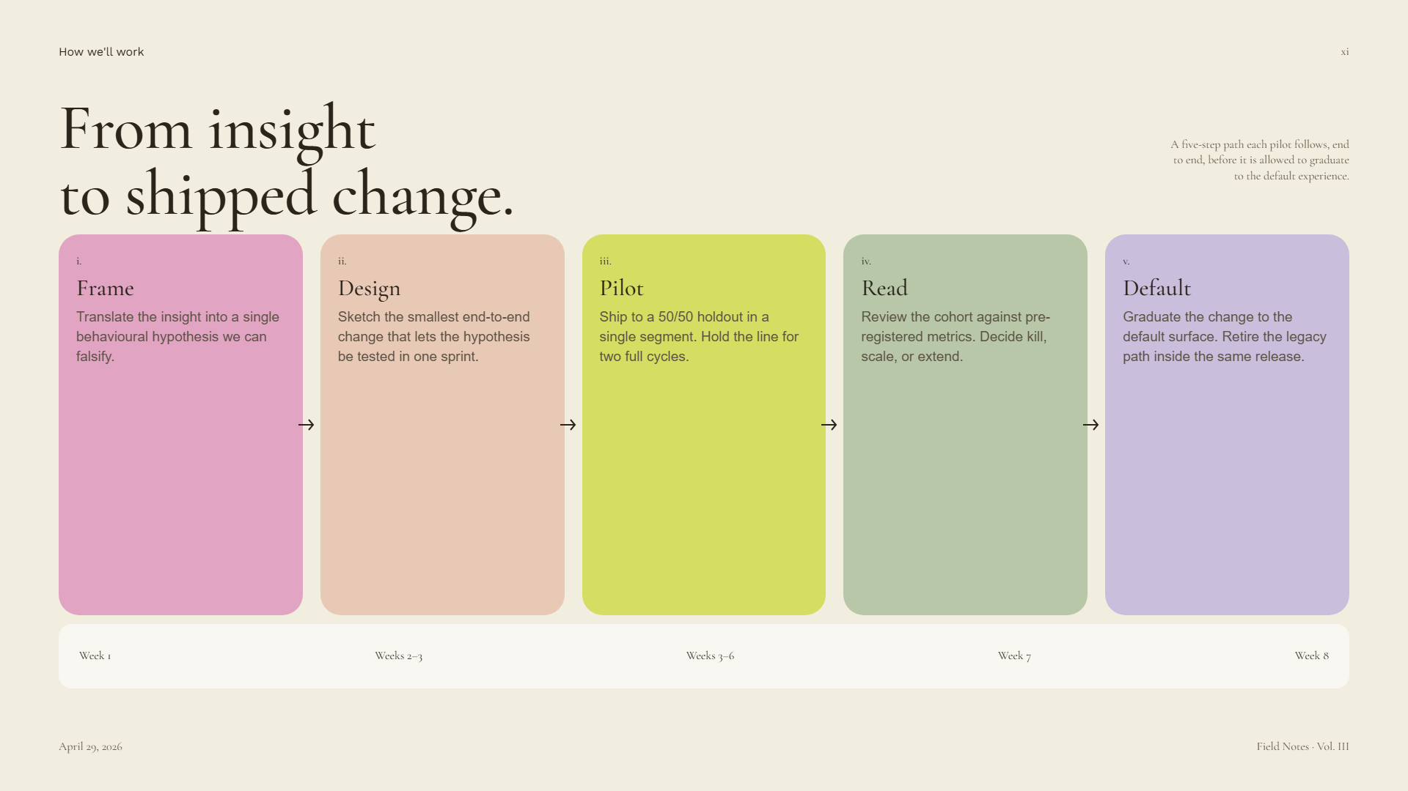
How we'll work
xi
From insight
A five-step path each pilot follows, end to end, before it is allowed to graduate to the default experience.
to shipped change.
i.
ii.
iii.
iv.
v.
Frame
Design
Pilot
Read
Default
Translate the insight into a single behavioural hypothesis we can falsify.
Sketch the smallest end-to-end change that lets the hypothesis be tested in one sprint.
Ship to a 50/50 holdout in a single segment. Hold the line for two full cycles.
Review the cohort against pre-registered metrics. Decide kill, scale, or extend.
Graduate the change to the default surface. Retire the legacy path inside the same release.
Week 1
Weeks 2–3
Weeks 3–6
Week 7
Week 8
April 29, 2026
Field Notes · Vol. III

Slide 12
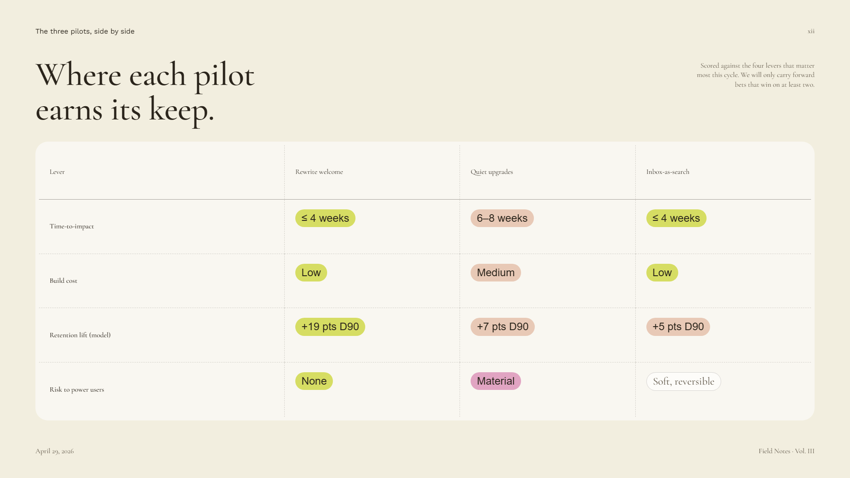
The three pilots, side by side
xii
Where each pilot
Scored against the four levers that matter most this cycle. We will only carry forward bets that win on at least two.
earns its keep.
Lever
Rewrite welcome
Quiet upgrades
Inbox-as-search
≤ 4 weeks
6–8 weeks
≤ 4 weeks
Time-to-impact
Low
Medium
Low
Build cost
+19 pts D90
+7 pts D90
+5 pts D90
Retention lift (model)
None
Material
Soft, reversible
Risk to power users
April 29, 2026
Field Notes · Vol. III

