Slide 1
Information Hiding
Yuqun Zhang

Slide 2
A Programmer’s Approach to Software Engineering
Skip requirements engineering and design phases… just start coding
Why?
Design is a waste of time.
We need to show something to the customer really quick.
I’m graded by the number of lines of code I write per unit time
I think the schedule is too tight

Slide 3
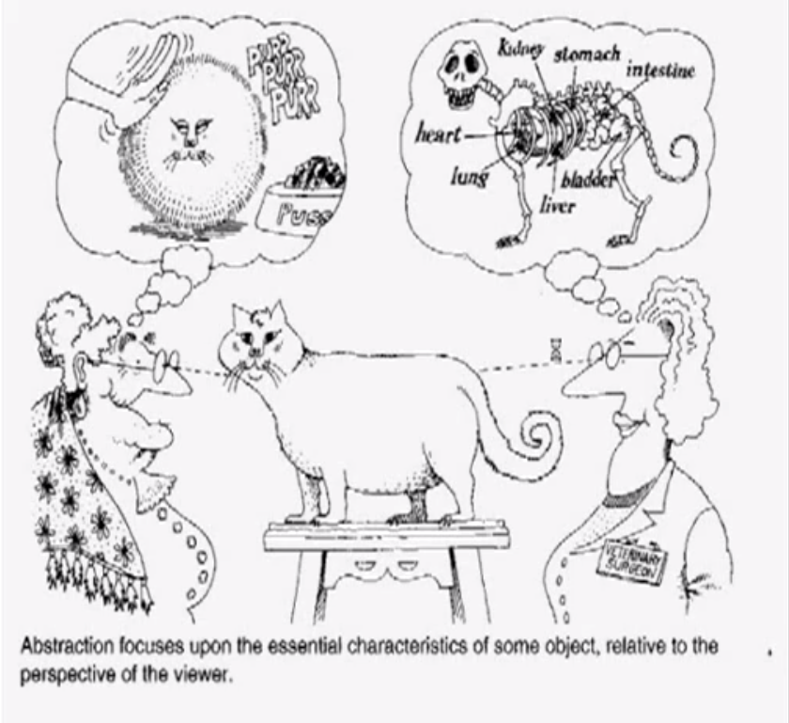
Abstraction
Procedural abstraction
A natural consequence of stepwise refinement
Name of procedure denotes the sequence of actions
Data abstraction
Goal is to find a hierarchy in the data (e.g., the range from general purpose data structures to application-oriented data structures)
(DRY: Don't repeat yourself
YAGNI: You aren't gonna need
it)

