Slide 1

Vehicle Type Classifier
Akademia Górniczo-Hutnicza im. Stanisława Staszica w Krakowie
AGH University of Krakow
Autorzy:
Kacper Bujak
Grzegorz Płonka
06.11.2025

Slide 2
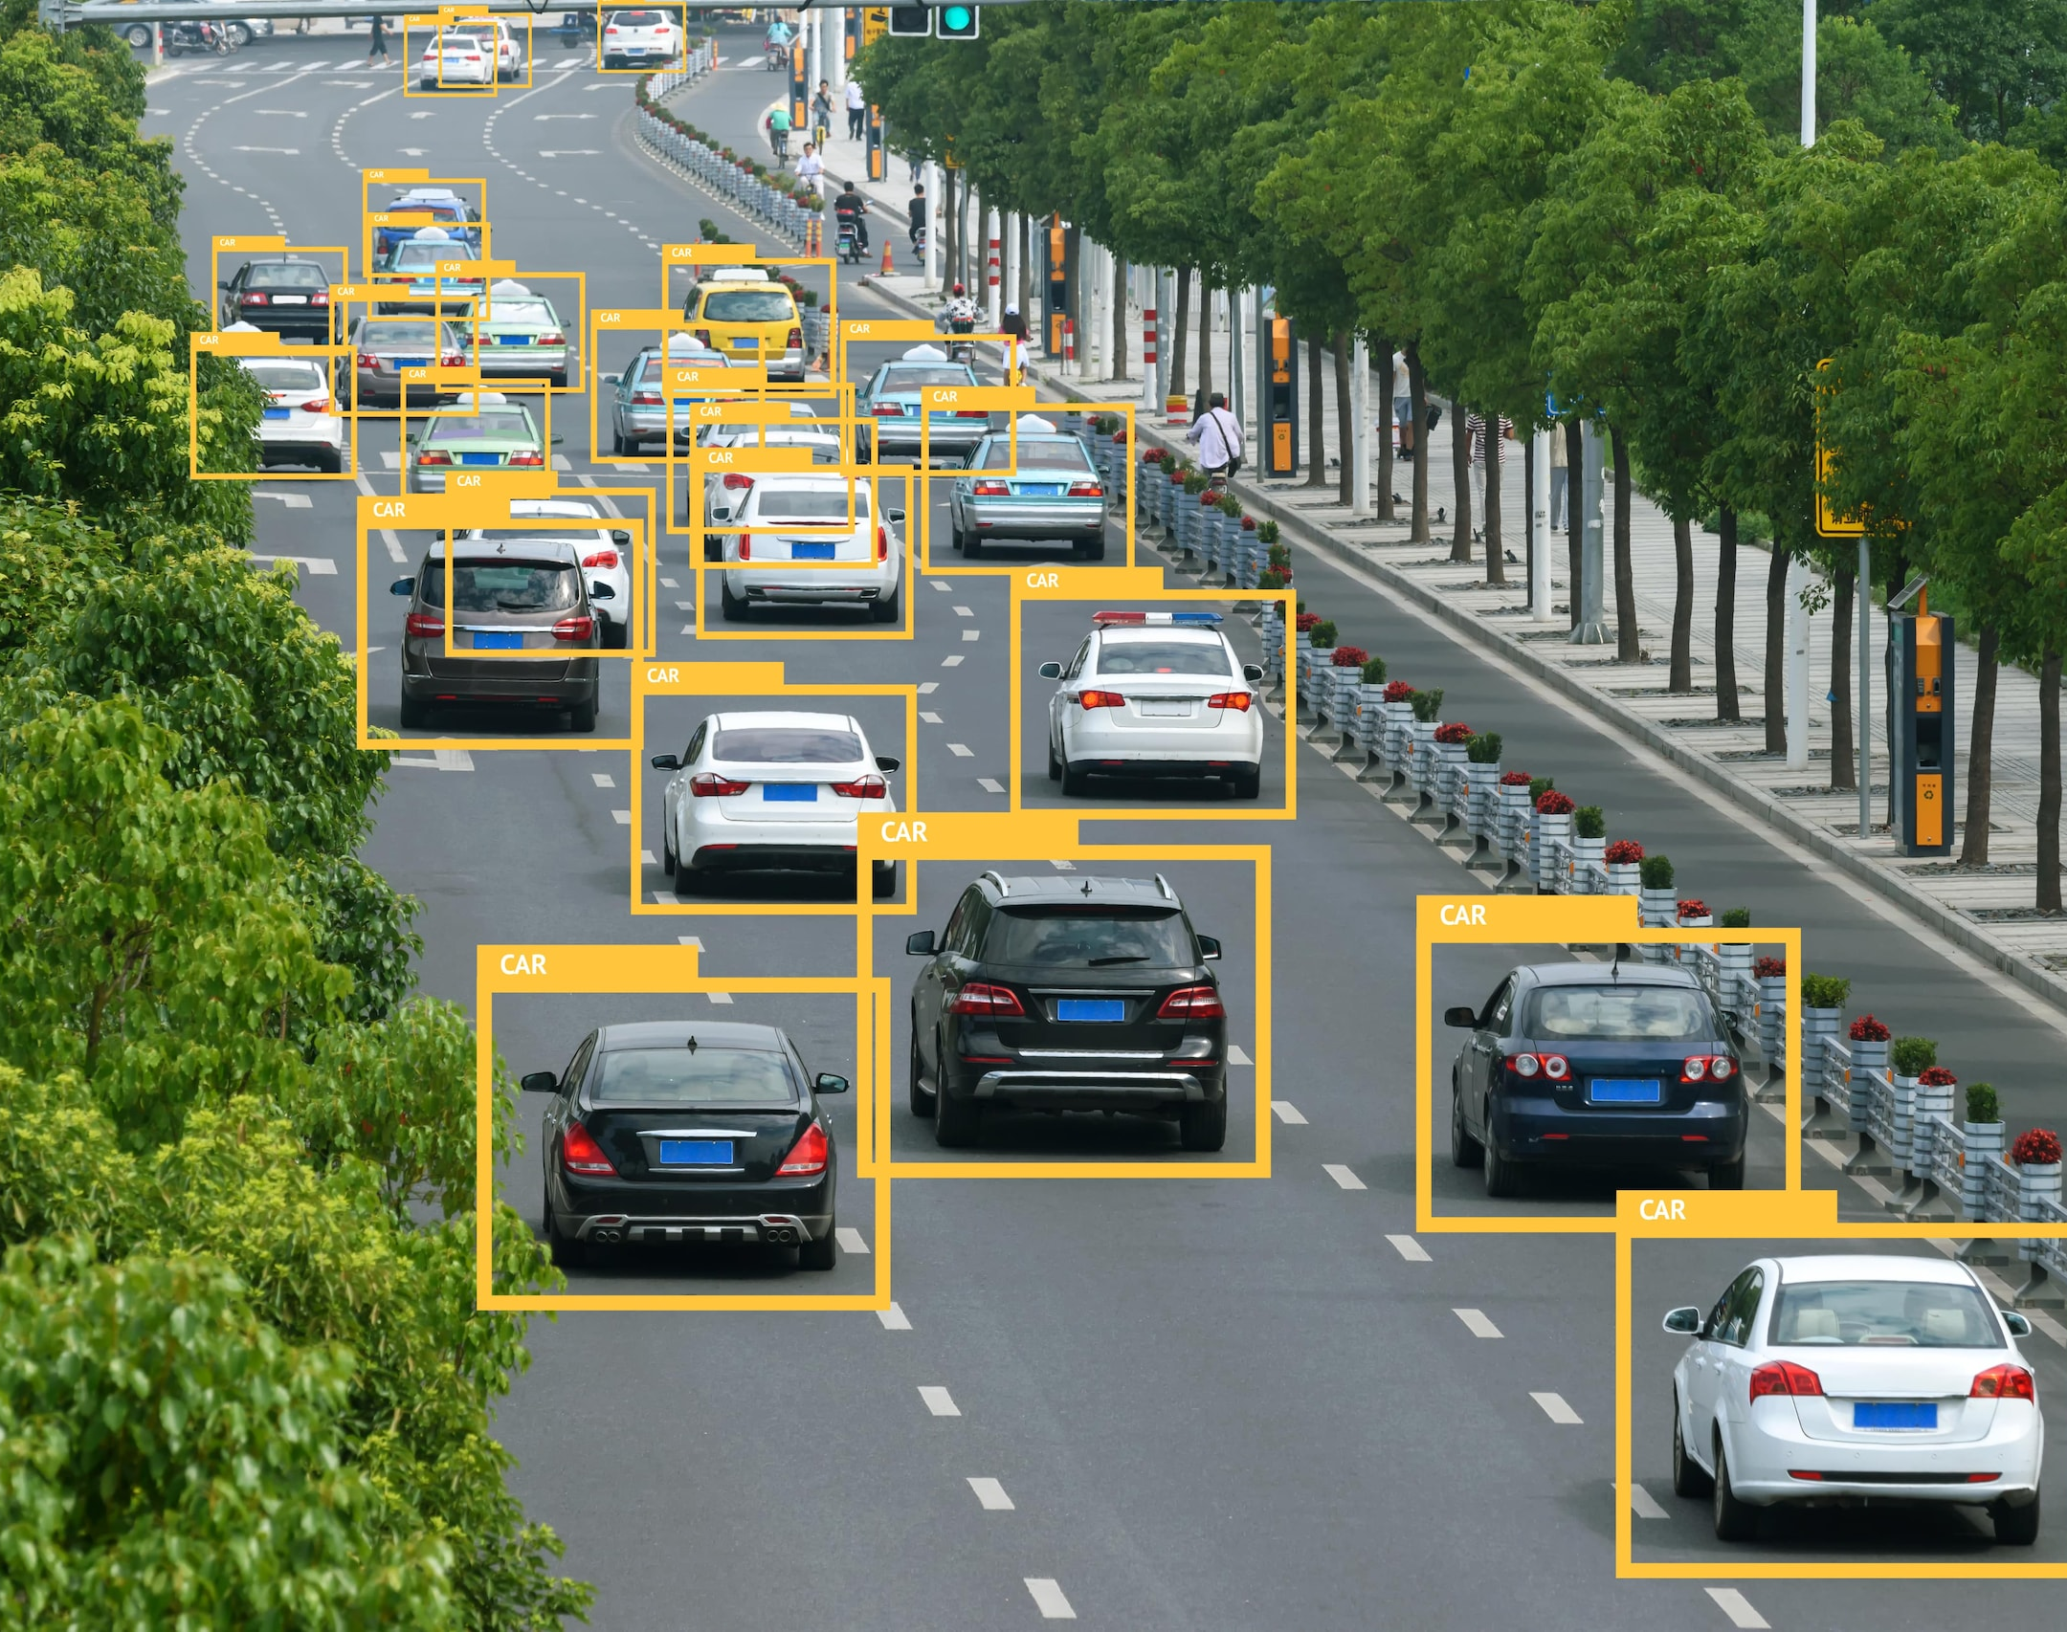
Problem
The main objective of the project is to create an effective, simple and lightweight tool for classifying vehicle types.
https://www.mouser.co.il/blog/mystery-of-vehicle-detection

Slide 3

Dataset
We decided to use Vehicle Images Dataset witch contains 15,645 color images with 7 classes of vechicles:
City Car
Sedan
Multi Purpose Vehicle
Sport Utility Vehicle
Van
Truck
Big Truck
https://drlee.io/unlock-the-power-of-kaggle-how-to-call-datasets-directly-with-python-and-rule-the-data-science-2303cbae4e8a

Slide 4
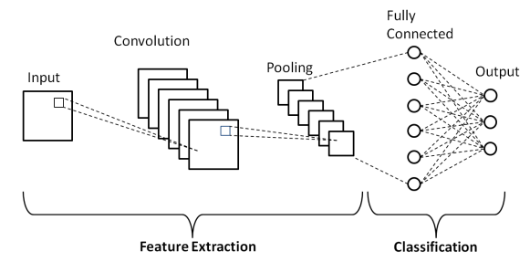
Model
The project will use a lightweight CNN designed for vehicle type classification, capable of extracting key image features and identifying vehicle categories efficiently.
https://learnopencv.com/understanding-convolutional-neural-networks-cnn/

Slide 5

Pipeline

Slide 6
Compression methods
As part of the project, the pruning method will be used and tested for model compression, which involves removing less important weights or neurons from the network and reducing its size, as well as the quantization method, which involves reducing precision by converting 32-bit floats to 8-bit integers.

