Slide 1

Note: The data and information in this document is reflective of a hypothetical situation and client. This document is to be used for KPMG Virtual Internship purposes only.
Sprocket Central Pty Ltd
Data analytics approach
[Division Name] - [Engagement Manager], [Senior Consultant], [Junior Consultant]

Slide 2
Note: The data and information in this document is reflective of a hypothetical situation and client. This document is to be used for KPMG Virtual Internship purposes only.
Agenda
Introduction
Data Exploration
Model Development
Interpretation
Recommendation

Slide 3
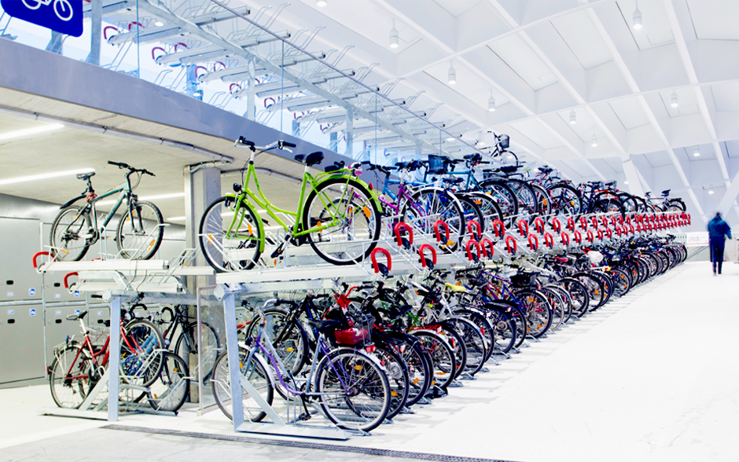
Note: The data and information in this document is reflective of a hypothetical situation and client. This document is to be used for KPMG Virtual Internship purposes only.
Introduction
Sprocket Central Pty Ltd specializes in high-quality bikes and accessible cycling accessories for riders. Our objective is to boost their business by analyzing their existing customer dataset to determine customer trends and behavior and give recommendation.
Our Approach
explore the provided dataset
Check for data relevant
Check for missing values
Check for duplication
Check for formatting inconsistencies and
Standardize the format
Identify customer trend patterns
What product do customers mostly buy
Where the customers are located
when do customers buy more
and give Recommendation

Slide 4
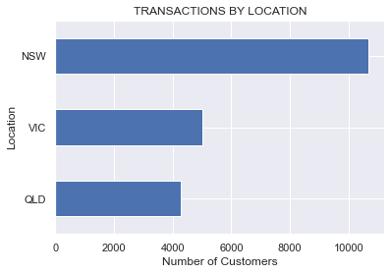
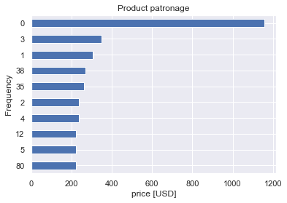
Note: The data and information in this document is reflective of a hypothetical situation and client. This document is to be used for KPMG Virtual Internship purposes only.
Data Exploration
We will explore the data from each demography to see how they purchase and what they’re purchasing, how they’re purchasing. We will create metrics from the data like age band and age of bicycle etc.

Slide 5
Note: The data and information in this document is reflective of a hypothetical situation and client. This document is to be used for KPMG Virtual Internship purposes only.
Model Development
We will use KMean clustering Model for customer segmentation
We are dealing with customer data which will be used to create a model that will assist the marketing team in targeting new customers.
1. We will clean our data and prepare it for modeling
2. We will standardize the data set to prevent errors due to different scales
3. We will fit the model, test and validate
4. We will used Principal component analysis to reduce dimensionality and increase model accuracy

Slide 6
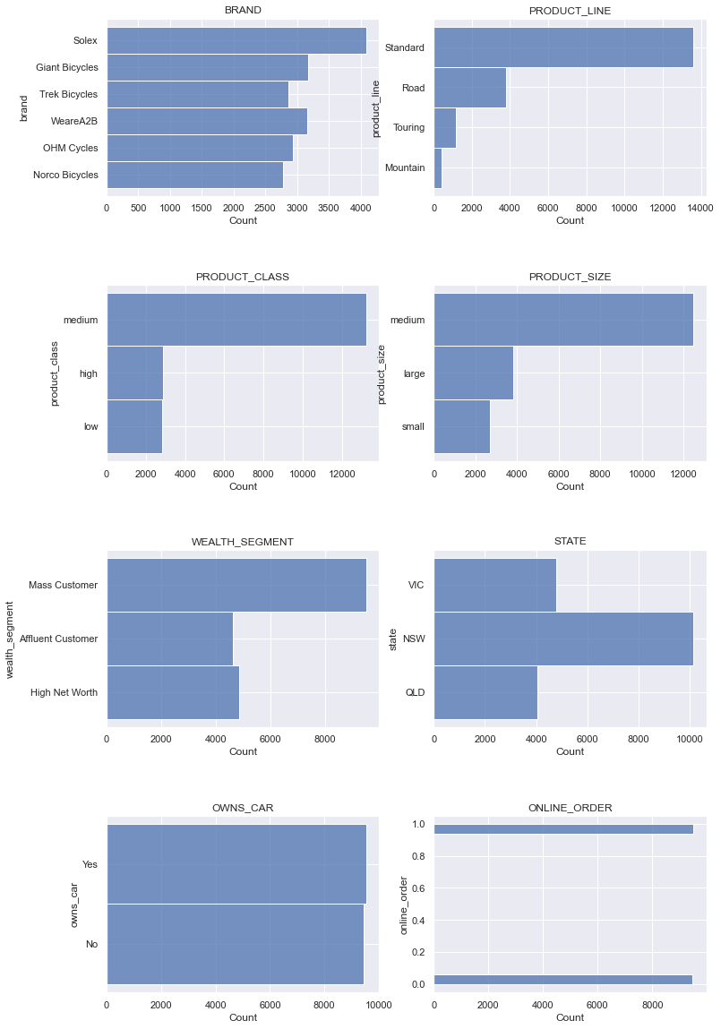
Note: The data and information in this document is reflective of a hypothetical situation and client. This document is to be used for KPMG Virtual Internship purposes only.
Interpretation
To interpret our data we will use power BI to visualize the historical data and deploy our findings for easy decision making.
We will use the created metrics for better explanation

Slide 7
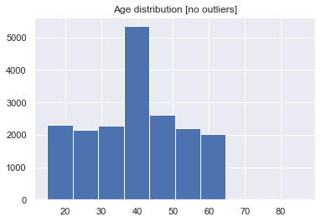
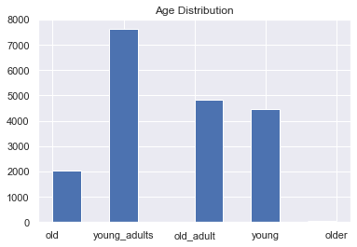
How we categorize the age
Note: The data and information in this document is reflective of a hypothetical situation and client. This document is to be used for KPMG Virtual Internship purposes only.
Appendix

