Slide 1
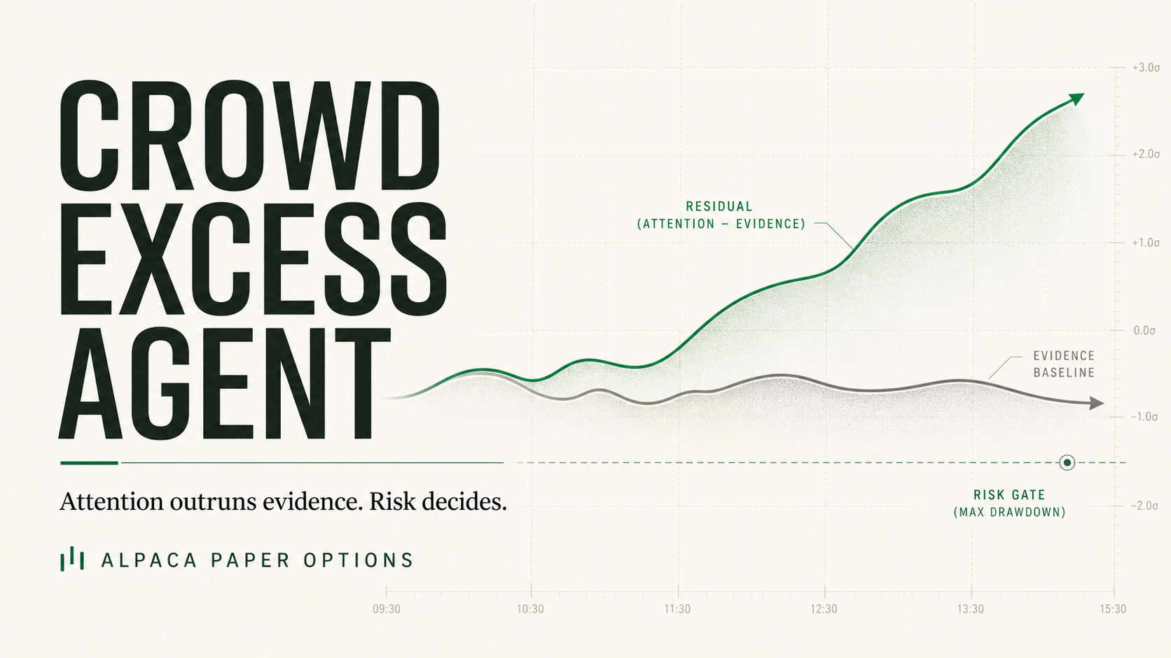
Notes:
Open with the thesis in one sentence. Stress that this is a paper-only agent and that risk—not the model—owns execution.
[Sources]
- https://lablab.ai/ai-hackathons/alpaca-ai-trading-agents-hackathon
- https://crowd-excess-lab.vercel.app/agent

Slide 2
THE THESIS
02
Markets can be loud. Evidence can be quiet.
The opportunity is the unexplained gap—not raw sentiment.
CROWD EXCESS
ATTENTION
moves first
EVIDENCE
The agent trades only when attention + price outrun objective news and every deterministic gate passes.
explains—or fails to
CROWD EXCESS AGENT / ALPACA PAPER OPTIONS
Notes:
Frame the insight as a measurable residual. Avoid claiming that attention alone predicts returns.
[Sources]
- https://crowd-excess-lab.vercel.app/strategy

Slide 3
AN HONEST DATA BOUNDARY
03
Three sources. Three distinct jobs.
Search attention is a proxy—not community sentiment.
01
02
03
NAVER
ALPACA
OPENAI
Complete-day cross-border search attention
Recent mean vs trailing median
60-day robust z-score
SPY-adjusted move, volume, news and option-chain liquidity
Official paper account + CLI boundary
Strict EvidenceAssessment only
Direction · materiality · confidence
Never contracts, size or orders
CROWD EXCESS AGENT / ALPACA PAPER OPTIONS
Notes:
State the limitation before the advantage: NAVER is relative attention, not post sentiment. Explain that OpenAI is evidence-only.
[Sources]
- https://guide.ncloud-docs.com/docs/apihub-searchtrend
- https://docs.alpaca.markets/us/docs/paper-trading
- https://developers.openai.com/api/reference/cli/resources/responses/methods/create

Slide 4
THE SIGNAL
04
The trade is the residual—not the headline.
SIGNED MOVE × ATTENTION
CROWD EXCESS
=
− NEWS DIRECTION × MATERIALITY × CONFIDENCE
POSITIVE
NEGATIVE
Upside enthusiasm looks excessive → bearish reversal candidate
Downside pessimism looks excessive → bullish reversal candidate
The model explains evidence. Deterministic code decides eligibility.
CROWD EXCESS AGENT / ALPACA PAPER OPTIONS
Notes:
Walk left to right. Emphasize that a large residual is only a candidate; risk still has veto power.
[Sources]
- https://crowd-excess-lab.vercel.app/strategy

Slide 5
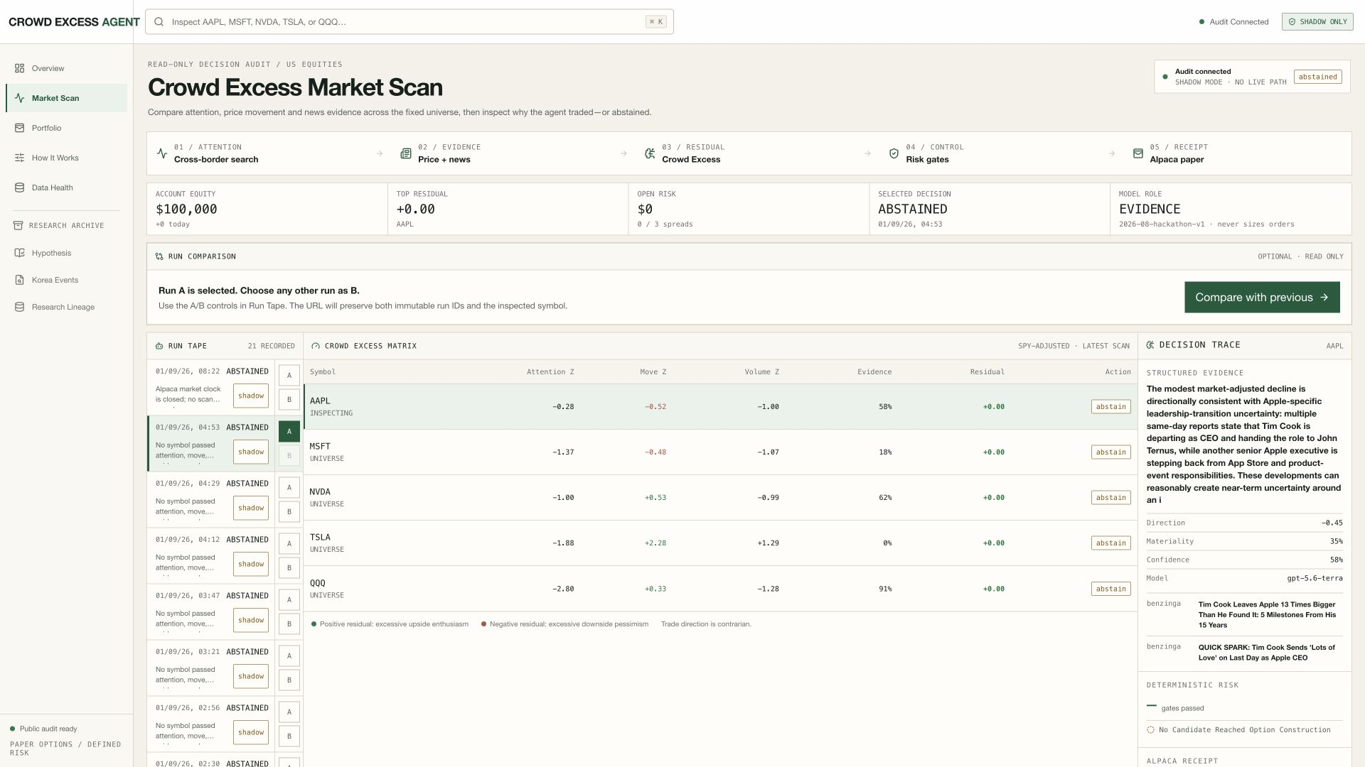
THE PRODUCT
05
The unexplained reaction is the product.
01
Measure attention + move
02
Test news evidence
03
Inspect the residual
CROWD EXCESS AGENT / ALPACA PAPER OPTIONS
Notes:
Show the public Market Scan. The matrix makes attention, market-adjusted move, supplied-news evidence, and the final residual inspectable in one view.
[Sources]
- https://crowd-excess-lab.vercel.app/decisions?run=20260831T195329Z-97994d47

Slide 6
EXECUTION AUTHORITY
06
Risk owns the order. The model never does.
1%
3%
1
14–30
MAX DEBIT
TOTAL RISK
NEW ATTEMPT
DTE
per position
open premium
per trading day
defined-risk vertical
NO LIVE ENDPOINT
NO NAKED OPTIONS
NO DUPLICATE RETRY
Wide quotes, missing Greeks, stale data, account mismatch, loss limits or freeze time → ABSTAIN.
CROWD EXCESS AGENT / ALPACA PAPER OPTIONS
Notes:
Show that the strategy can make no trade. Explain deterministic client IDs and timeout reconciliation.
[Sources]
- https://docs.alpaca.markets/us/docs/options-trading
- https://github.com/Kachii1020/crowd-excess-lab

Slide 7
VERIFIED RESULT
07
Two independent market sessions protected capital.
Competition evidence | 28 & 31 Aug 2026 US sessions
17 x 5
$100,000
SCANS x SYMBOLS
EQUITY | $0 P&L | 0 DRAWDOWN
85 signal snapshots | 78 model assessments
0 positions | 0 open risk
No forced trade
No candidate cleared every evidence, liquidity and risk gate. Thresholds stayed fixed.
CROWD EXCESS AGENT / ALPACA PAPER OPTIONS
Notes:
Seventeen sampled runs across two US market dates recorded 85 signal snapshots. Seventy-eight snapshots contain OpenAI response IDs and input hashes; seven are fail-closed evidence-unavailable records, not model assessments.
[Sources]
- https://crowd-excess-lab.vercel.app/api/v1/agent/runs
- https://crowd-excess-lab.vercel.app/api/v1/agent/runs/20260831T195329Z-97994d47
- https://crowd-excess-lab.vercel.app/api/v1/portfolio

Slide 8
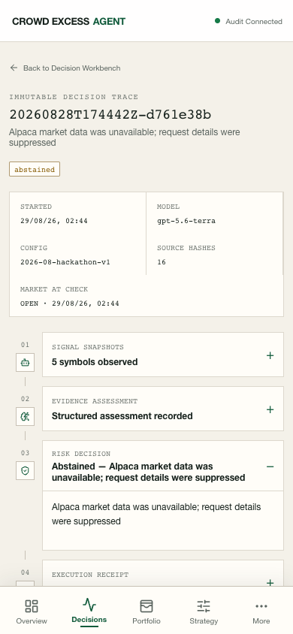
RELIABILITY
08
Failure safety is observable - not silent.
STRICT EVIDENCE
Strict schema; refusal, timeout or invalid output -> ABSTAIN
IDEMPOTENT
Deterministic ID; timeout -> lookup, never blind retry
WATCHED + DIAGNOSED
Stale-run watchdog; option-stage diagnostics implemented + tested
CROWD EXCESS AGENT / ALPACA PAPER OPTIONS
Notes:
Explain that new provider-boundary failures record sanitized stage/code diagnostics; this historical failure row predates those nullable fields.
[Sources]
- https://github.com/Kachii1020/crowd-excess-lab
- https://docs.github.com/en/actions/reference/workflows-and-actions/events-that-trigger-workflows#schedule
- https://crowd-excess-lab.vercel.app/agent/runs/20260828T174442Z-d761e38b

Slide 9
DIFFERENTIATION
09
The product is the unexplained reaction.
01
Attention: cross-border search measures when the crowd heats up
02
Reaction: SPY-adjusted price isolates what the market actually did
03
Residual: supplied news explains the move—or leaves Crowd Excess
AUDIT BEFORE ORDER
REPLAYABLE NO-TRADE
SEARCH, NOT SENTIMENT
PAPER-ONLY
crowd-excess-lab.vercel.app
CROWD EXCESS AGENT / ALPACA PAPER OPTIONS
Notes:
Close on the user value: inspectability before exposure and reproducible abstention when evidence is insufficient.
[Sources]
- https://lablab.ai/ai-hackathons/alpaca-ai-trading-agents-hackathon
- https://crowd-excess-lab.vercel.app/strategy
- https://crowd-excess-lab.vercel.app/research

