Slide 1





OurApp
iDigital Java FSD Batch 10
Presented By :
1.Sujit K Surannavar
2.Radha A Kadam
3.Ankita J Chavan
4.Pragati V Ghagi
5.Niharika Naik
6.Bhavana S Burla
7.Sweta S Nayak

Slide 2
Table of Contents
Introduction
Modules
Software
System Architecture

Slide 3
Introduction
Social media platforms allow users to have conversations, share information and create web content. There are many forms of social media, including blogs, micro-blogs, wikis, social networking sites, photo-sharing sites, instant messaging, video-sharing sites,virtual worlds.
Social media is a web‐based technology to facilitate social interaction between a large group of people through some type of network. In common widely used network is the Internet. But social media platforms are also for local networks as well.

Slide 4



Backend

Slide 5


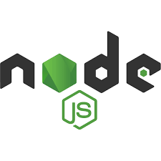
Frontend

Slide 6
Backend
Spring Framework-
Spring Boot is an open-source Java-based framework used to create a micro-service.Spring Boot makes it easy to create stand-alone, production-grade Spring based Applications that you can "just run". We take an opinionated view of the Spring platform and third-party libraries so you can get started with minimum fuss. Most Spring Boot applications need minimal Spring configuration.
JPA with Hibernate-
Object-Relational Mapping (ORM) is the process of converting Java objects to database tables. In other words, this allows us to interact with a relational database without any SQL. The Java Persistence API (JPA) is a specification that defines how to persist data in Java applications. The primary focus of JPA is the ORM layer.

Slide 7
Modules:
1.Registration and Login Module
2. Follow module
3.Post module

Slide 8
Software's
Java 1.8
Eclipse / STS 4.13.1
Node.js 8.1.2
Angular 8
Visual Studio
Postman
Database : Postgres SQL 13
Keyboard and a Mouse or some other compatible pointing device

Slide 9
THANK YOU…!!

