Slide 1

Content Intelligence Agency Progress Report
By: Kade, Aryan, and Michael

Slide 2
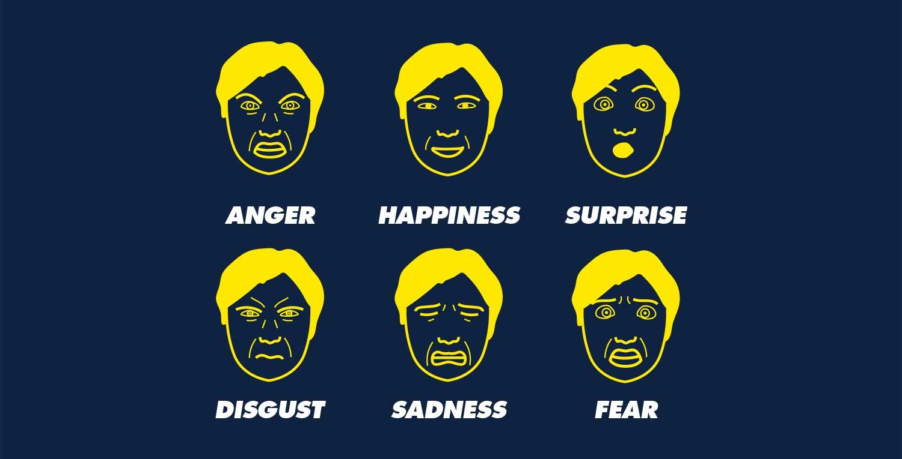
The Challenge
Our Solution
Content Intelligence Agency
Remove LLMs
Detect Emotions with Pipeline
Reduce Cost
Reduce Prediction Time
Eliminate Reliance on other Companies
Development of a robust emotion classification pipeline that:
Transcribes english video transcripts
Classify emotions (Happiness, Neutral, Surprise, Fear, Anger, Disgust, Sadness, The Paul Ekman 6) using Transformer
Strong generalization to all content types
Provides explainability and confidence metrics for business decision-making
Key Achievement
Current model achieves 0.59 macro F1 score with targeted improvements underway to reach the 0.75 objective.
[Content Intelligence Agency, 2025]
[Paul Ekman 6, 1999]
Notes:
Olivier
Explain trailing stops. Explain graphic last drawdown. Minimize losses

Slide 3
Pipeline Overview
YouTube link Data Preprocessing Accurate Classification
Transcription Using Whisper Transformer Model
Notes:
PEER - Scalability
Set up for improvements
Daily data update after market close.
Preprocessing → feature generation (~50 → 25).
LightGBM = main model, trained with Optuna (4000 trials).
Evaluation: RMSE, MAE, R².

Slide 4
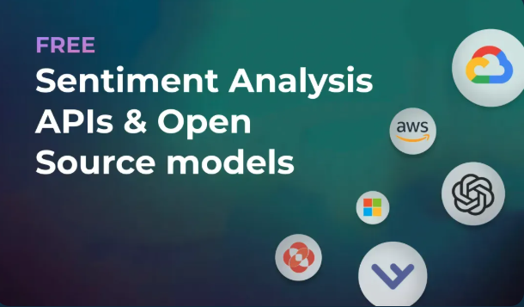
Industry Context
Growing demand: 82% of internet traffic will be video by 2025
Content moderation: Manual emotion tagging is expensive (~$50K/month for mid-size platforms)
Viewer insights: Emotion analysis drives 30% better content recommendations
[Eden AI, 2023]
Notes:
Add flow chart at beginning

Slide 5

Added Value for Content Intelligence Agency
Cost Reduction: 80% reduction in manual annotation costs
Scalability: Process 1000+ hours of content daily vs. 50 hours manually
Consistency: Eliminate human annotator disagreement (currently 25-30% variance)
Real-time Analysis: Enable live content moderation and recommendation
[Content Intelligence Agency, 2025]

Slide 6
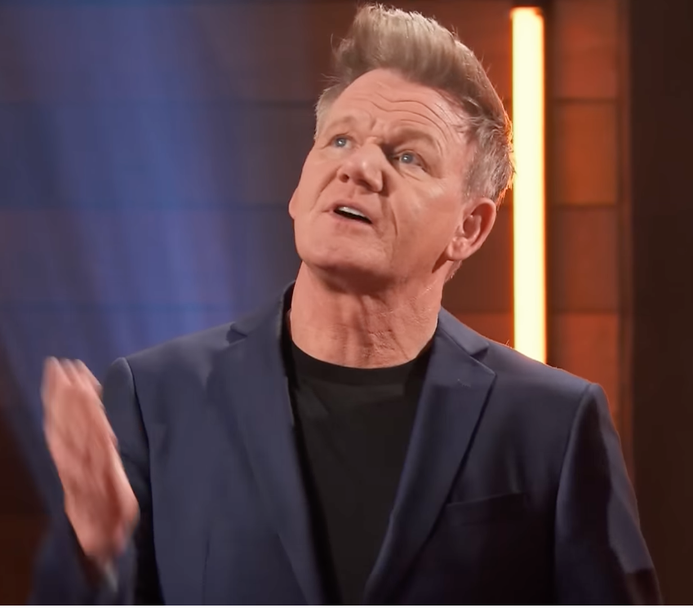
Use Case: MasterChef Kitchen USA
Test domain: Reality TV cooking competition
Rich emotional content: High-stress environment with diverse emotions
Business application: Understanding viewer engagement patterns for content optimization
[MasterChef USA, 2023]
Notes:
Understand the reasons why certain viewers enjoy the show. Such as strong emotional characters like gordon. The stress of cooking.

Slide 7

Transcription
Manually inspected first 180 sentences of transcriptions
  (1673 words)
Assembly AI: 0.9% WER
  (0.009 = less than 1 error per 100 words)
Whisper: 0.24% WER
  (0.002 = about 1 error per 400 words)
Industry standard:
  15-20% WER for spontaneous speech
[MasterChef USA, 2023]
Notes:
Shows very strong transcriptions through background noise, accents, and TV show sound effects. Word error rate

Slide 8
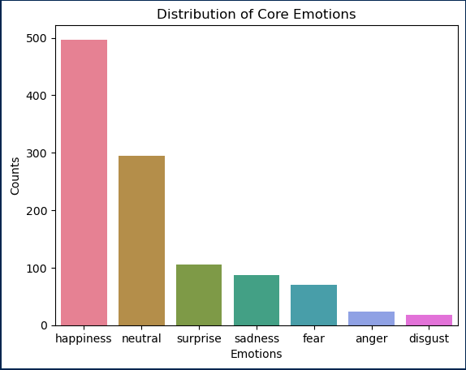
Test Set
80% short sentences
Speaker bias
Class imbalance
  50%: happy
  25%: neutral
  25%: five emotions
Specific domain
  Slang
  Vocabulary
Multiclass sentences
  Anticipation
Notes:
< 5 words Difficult to derive complex emotions with nuanced context, based on speaker more likely that a specific emotion is present, same sentences being labeled with differing emotion, Anticipation

Slide 9

Field Example: “I didn't come here to not get an apron”
[MasterChef USA (S12): Full Ep 1 | A Second Chance, 2023]

Slide 10
Test Set Inconsistencies
First Instance:
Sentence | Emotion_fine | Emotion_core
But this is the most important component on my... | priority | neutral
I didn't come here to not get an apron. | determination | anger
I got to just push, and I can do it. | anticipation | surprise
Energetic Season Opener
Forced Emotion for show understanding
“Let’s go”: happy appears 25x
Happy exclamations
Neutral responses to directions
Inconsistent Classifications
Second Instance:
Sentence | Emotion_fine | Emotion_core
But this is the most important component on my... | determination | neutral
I didn't come here to not get an apron. | resolve | happiness
I got to just push, and I can do it. | motivation | happiness

Slide 11
Final Dataset
Data shape before cleaning: (234,000, 2)
Sentence | Emotion
That game hurt. | Sadness
That is odd. | Confusion
Dark and funny, but not really nice guy. | Disgust
By far the coolest thing I've seen on this trip. | Admiration
Focus on generalizability
Go Emotions
  Vocabulary coverage
  Reddit
234,000 Sentences
27 emotions mapped to Ekman Six
Label Encoded
Sub-sampled to 21,000
3,000 per class
80:10:10 Data Split
Tokenized Sentences
Data shape after cleaning: (21,000, 2)
Tokens | Emotion
[that, game, hurt] | 1 (Sadness)
[that, odd] | 3 (Surprise)
[dark, funni, realli, nice, guy] | 5 (Disgust)
[by, far, coolest, thing, i'v, seen, on, this, trip] | 0 (Happiness)
Notes:
Reddit useful because it includes a lot of vocabulary and (casual language with slang),

Slide 12
Model Comparison
Model | Dataset | Macro Accuracy | Macro Precision | Macro Recall | Macro F1-Score | Weighted F1-Score | Train Time / Evaluate
Baseline Naive Bayes (7D) | Test | 0.417 | 0.61 | 0.55 | 0.420 | 0.52 | 2.1 sec
Transformer | Train | 0.589 | 0.625 | 0.588 | 0.589 | 0.71 | 12.4 hours
Transformer | Test | 0.615 | 0.51 | 0.469 | 0.475 | 0.628 | 1.2 sec
LLM | Test | 0.738 | 0.68 | 0.59 | 0.573 | 0.74 | 4.4 min or 55.2 min + explain

Slide 13
Transformer + Parameters
We picked the transformer model because it’s better at understanding contextual meanings in text compared to the other models.
Parameters:
RoBerta Base
No featuress
Learning_rate = 2e-5
Batch_size = 16
Num_train_epochs = 3
12.4 hour train time
High accuracy
Strong performance on dominant classes
Notes:
NSP (next sentence prediction) in BERT is not useful

Slide 14
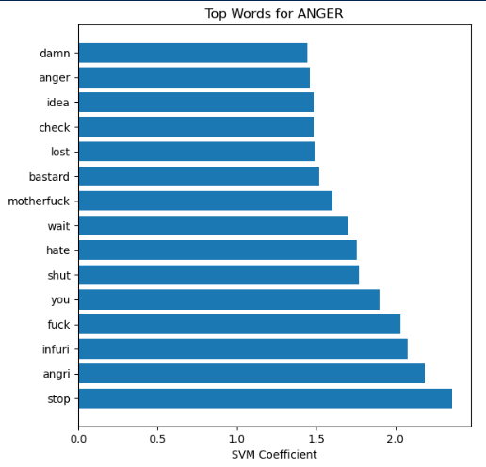
Model Evaluation
Macro Score: Class Importances
Precision: Over Classifications
Accuracy: Minority Classes
Strong Generalizability
Model Learning
  Important words
  Context
  Vocabulary comprehension
Train > Test
Notes:
Olivier
Explain trailing stops. Explain graphic last drawdown. Minimize losses

Slide 15
Strengths and Weaknesses
Happiness F1-Score: 0.782
Anger F1-Score: 0.214
Class performance correlated with class size
Nuanced Classes:
  Sadness
  Fear
Hard to Classify:
  Surprise
  DIsgust
Model is learning to over classify majority classes
Emotion | Precision | Recall | F1-Score | Support
Happiness | 0.931 | 0.674 | 0.782 | 497
Sadness | 0.691 | 0.437 | 0.535 | 87
Anger | 0.182 | 0.261 | 0.214 | 23
Surprise | 0.360 | 0.381 | 0.370 | 105
Fear | 0.571 | 0.400 | 0.471 | 70
Disgust | 0.368 | 0.389 | 0.378 | 18
Neutral | 0.468 | 0.742 | 0.574 | 295

Slide 16
Error Analysis: Difficult Classifications
Sentence: “The sauce is a little excessive”
Predicted label: anger
True label: disgust
Model thought that the word “excessive” might be associated with frustration or even annoyance
associated the sentence with anger, even though it’s more in line with disgust

Slide 17
Error Analysis: Fixation on Vocabulary
Sentence: “I went out there, I killed it”
Predicted label: anger
True label: happiness
Model thought that “I killed it” was used in a way that denotes anger
Sentence uses idiomatic expressions, such as “I killed it” which means “I did great”, which correlates with happiness / pride.

Slide 18
Error Analysis: Short Sentences
Sentence: “Welcome backstage.”
Predicted label: neutral
True label: happiness
The sentence “welcome backstage” is very difficult to distinguish between neutral and happiness. Very hard to tell without further context.
Model likely thought it was a simple greeting, or regular neutral statement.

Slide 19
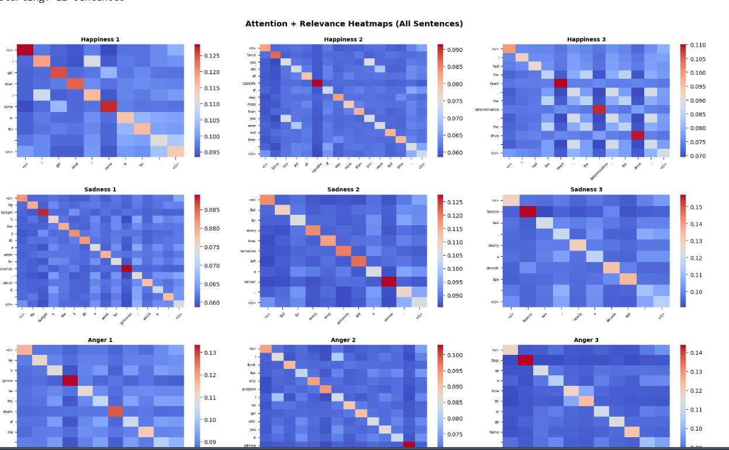
XAI
WHY
Our model is strong, but it is a black box
XAI lets us see which words the model used for emotions
METHOD USED
Conservative propagation with a self attention map
Conservative propagation shows which words drove the final score.

Slide 20
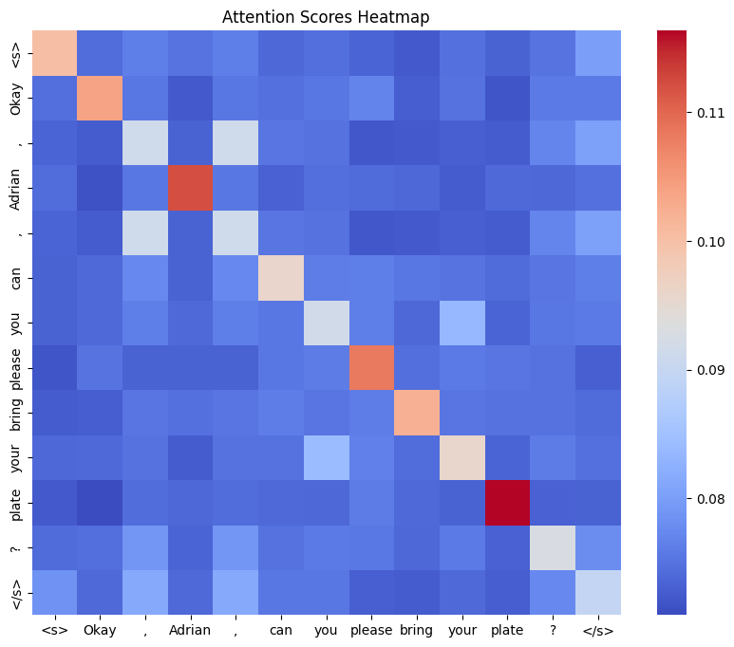
XAI
HEATMAP
Words on the left are rows. The same words at the bottom are columns.
A bright square means that row word is giving strong attention to the column word.
Blue is weak. Orange or red is strong.
The bright diagonal is a word looking at itself. That is normal.

Slide 21
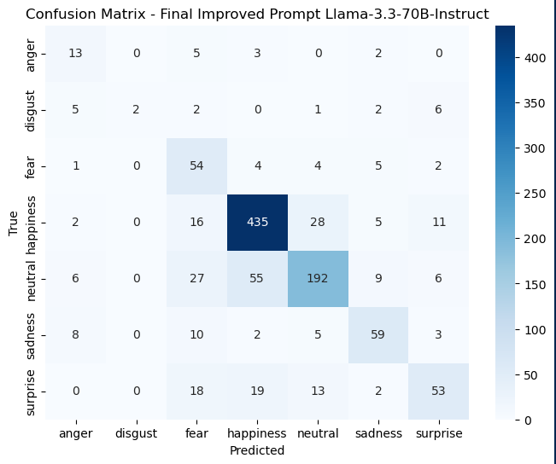
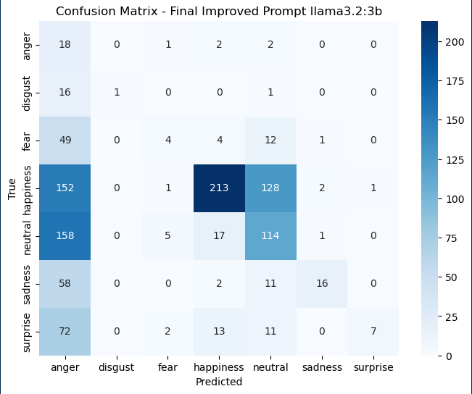
Prompt Engineering
Llama 3.3 vs 3.2
Structured Prompt
Definitions
Explicit Examples
Complications:
  Short Sentences
  Neutral vs. Happy
  Class Imbalance
Notes:
Include scores from the model, why you chose the model you did, why your pipeline is more useful

Slide 22
Why Modelling?
LLM
Transformer
Fear: Catches 81% but wrong half the time
Disgust: Only catches 22% but usually right
4.4 minutes for 1,095 samples
55.2 minutes for explainability
Full 60K dataset = 4 hours
Daily production runs = $900 to $11290/month in API costs
Predictable costs (not per-API-call pricing)
Consistent performance (not prompt-dependent)
Scalability (greater generalizability)
Optimizable metrics (fine-tune for our specific needs)
Fast inference (real-time classification)
Notes:
Predictions, scalability

Slide 23

Ethical Considerations
Consent from user data
English dominance
Used for job interviews, medical documents
Bias
  Text
  TV characters
Lacks human emotional understanding
[Ethic AI Considerations, 2024]

Slide 24
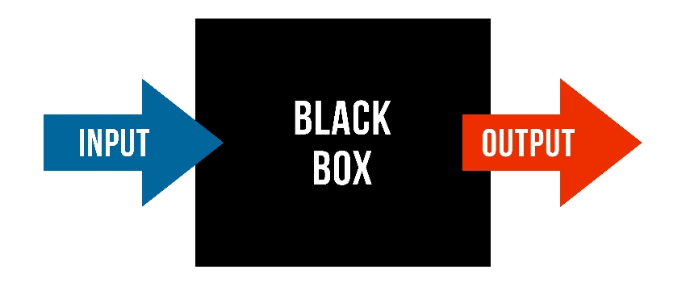
Pipeline Limitations
Black box model
Reddit data
  Not dialogue
  Emojis, punctuation etc.
Only English and Dutch
Lacks emotional variety
Heavy model
[Elder Research, 2024]

Slide 25
Next Steps
Train Set:
  Manually Inspected Emotion Mapping
  Larger dataset
Test Set:
  Classification Accuracy
  Balanced Classes
Future:
  More Emotions
  More Languages
  Emotion Intensity

Slide 26
Thank you!

