Slide 1
User Input
Random network design Specify network size, topological constraints (in-degree distribution, self-loops, strong connectivity, …), functional constraints (canalizing depth, layer structure, bias, …)
Biological network for matched null models Decide whether to preserve full wiring diagram, in- and/or out-degree distribution, canalizing depth, bias, …
Controlled Generation
Boolean Function Generators Function-uniform sampling under constraints: canalizing depth, layer structure, bias, ...
Boolean Network Generators Controlled topology and update-rule ensembles: degree distribution, function-level constraints
Matched null-model generators Preserve selected biological features while randomizing remaining network properties
Ensemble-based investigations
Function-level characterization (Fig. 3A) Compare 5,000+ biological Boolean functions with constraint-matched random ensembles to uncover structural design principles
Parameter space exploration (Fig. 3B) Systematically quantify how functional and topological parameters shape network dynamics and robustness
Null model hypothesis testing (Fig. 3C) Assess the statistical significance of structural and dynamical features in biological networks using ensembles of matched null models
refine constraints
Analysis
Function-level analysis canalization, collective canalization, redundancy, symmetry, sensitivity, monotonicity, …
Network structure analysis feedback and feed-forward loops, modularity, …
Dynamical analysis attractors, full trajectories, basin entropy, Derrida values, coherence, perturbation fragility, …
Notes:
New for revision

Slide 2
A
B

Slide 3
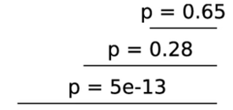
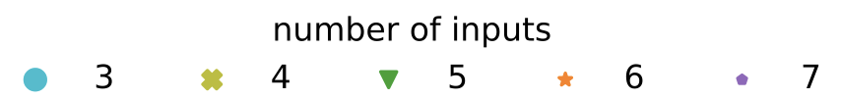
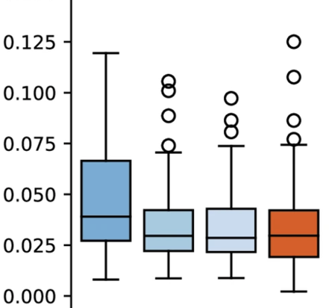
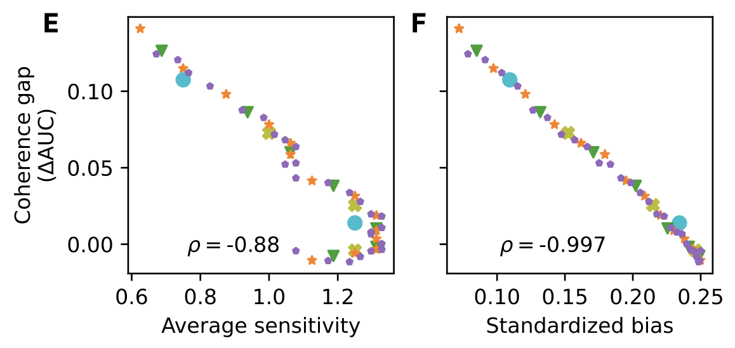
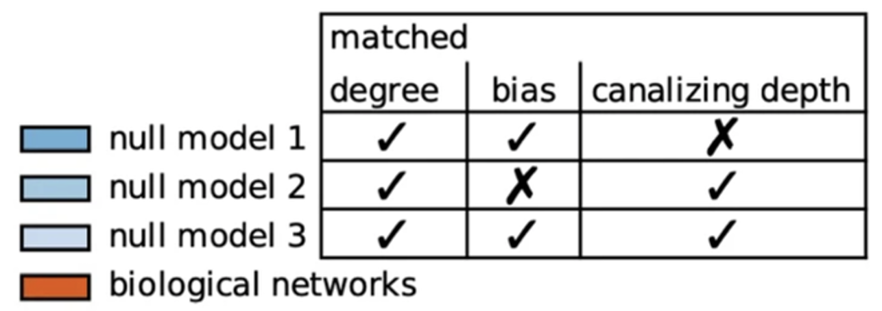
A
Function-level characterization
B
Parameter space exploration
C
Null model hypothesis testing
Network degree
biological networks
First-order approximation error
expectation (random functions)

Slide 4
A
Function-level characterization
B
Parameter space exploration
C
Null model hypothesis testing
constant in-degree
biological networks
First-order approximation error
expectation (random functions)

