Slide 1


Presented by Henrietta Kadi
A Regression-Based Investigation of Student- and Teacher-Level Influences on Math Performance on TIMSS 2023

Slide 2
TIMSS 2023 Data
TIMSS stands for Trends in International Mathematics and Science Study
Conducted every four years at the 4th and 8th grade levels
An international measure of math and science achievement of 4th and 8th grade students
Also collects information on school resources, teacher training/characteristics, home background and curriculum implementation
64 countries participated in the 2023 cycle
2 countries – U.S.A. and Canada are used in this analysis.

Slide 3

Research Goals and Questions
Research Goal
Explore factors influencing an individual student’s math score using:
Student-level factors
Home-level factors
Teacher-level factors.
.
Notes:
Explain what you mean by the various factors.

Slide 4
Research Goals and Questions
Research Goal
Explore factors influencing an individual student’s math score using:
Student-level factors
Home-level factors
Teacher-level factors.
Research Questions
What proportion of variation in the performance of a student on the math test is explained by factors such as gender, country, student confidence among others?
- Are there are any country-level and/or sex differences in math scores?
How do various teacher characteristics influence student’s score on the math test?
- Are they differences in students’ math percentage scores across levels of age or formal education completed by the teacher?
.

Slide 5
Methodology
Descriptive Statistics – Demographic and sample summaries, graphical representations.
Notes:
- Talk more about D-I-D: Give examples – In studying differences between males and females in the U.S, these differences significantly different between males in U.S and males in Canada.

Slide 6
Methodology
Descriptive Statistics – Demographic and sample summaries, graphical representations.
Step-wise Regression Analysis – Iteratively adding and removing variables from the multiple regression model based on their statistical significance.
- Student-Level analysis
- Teacher-level analysis
Notes:
- Talk more about D-I-D: Give examples – In studying differences between males and females in the U.S, these differences significantly different between males in U.S and males in Canada.

Slide 7
Methodology
Descriptive Statistics – Demographic and sample summaries, graphical representations.
Step-wise Regression Analysis – Iteratively adding and removing variables from the multiple regression model based on their statistical significance.
- Student-Level analysis
- Teacher-level analysis
Difference-in-Difference Analysis: Significant difference between the effects in various subgroup analyses including combinations of sex and country.
- For example, are gender differences in the U.S.A. significantly different from Canada?
Notes:
- Talk more about D-I-D: Give examples – In studying differences between males and females in the U.S, these differences significantly different between males in U.S and males in Canada.

Slide 8
Methodology
Descriptive Statistics – Demographic and sample summaries, graphical representations.
Step-wise Regression Analysis – Iteratively adding and removing variables from the multiple regression model based on their statistical significance.
- Student-Level analysis
- Teacher-level analysis
Difference-in-Difference Analysis: Significant difference between the effects in various subgroup analyses including combinations of sex and country.
- For example, are gender differences in the U.S.A. significantly different from Canada?
Marginal Contrast Analysis: A post-hoc analysis to compare the difference between estimated (marginal means) of the response variable across levels a specific predictor given average values of all ither predictors.
- For example, are there differences in the math score of students who had teachers under 25 vs those with teachers between 25 – 29?
Notes:
- Talk more about D-I-D: Give examples – In studying differences between males and females in the U.S, these differences significantly different between males in U.S and males in Canada.

Slide 9


Student-Level Analysis

Slide 10
Sample Information
. Country: Country of Participation (CAN = 1, USA = 2)
Sex: Sex/Gender (1 = Girl, 2 = Boy)Age : Age of student
Number_of_Home_Study_Supports: Derived from subscale measuring resources available to the student at home.
Disorderly_Behavior: Scale score from the subscale measuring disorderly behavior during math lessons.
Instructional_Clarity: Scale score from the subscale measuring instructional clarity in mathematics lessons.
Digital_Self_Efficacy: Scale score from the subscale measuring digital self-efficacy.
Sense_of_School_Belonging: Scale score from the subscale measuring students sense of school belonging.
Student_Bullying: Scale score from the subscale measuring student bullying.
Like_Learning_Math: Scale score from the subscale measuring if students like learning mathematics.
Confident_in_Math: Scale score from the subscale measuring students' confidence in mathematics.
Math_Percent_Correct: Students' percent correct on the 2023 TIMSS Math Achievement Test.

Slide 11
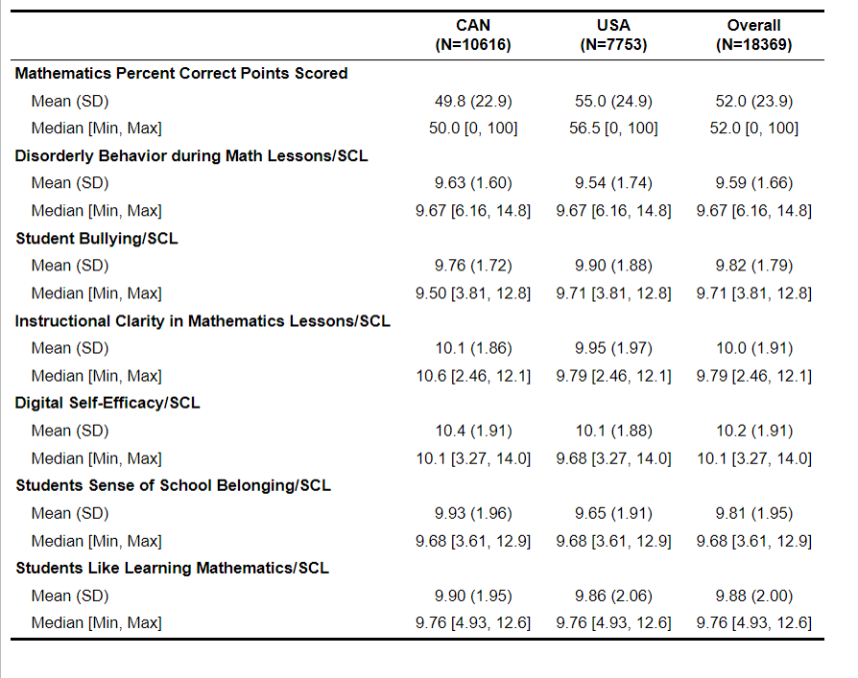
Descriptive Statistics

Slide 12
Descriptive Statistics

Slide 13
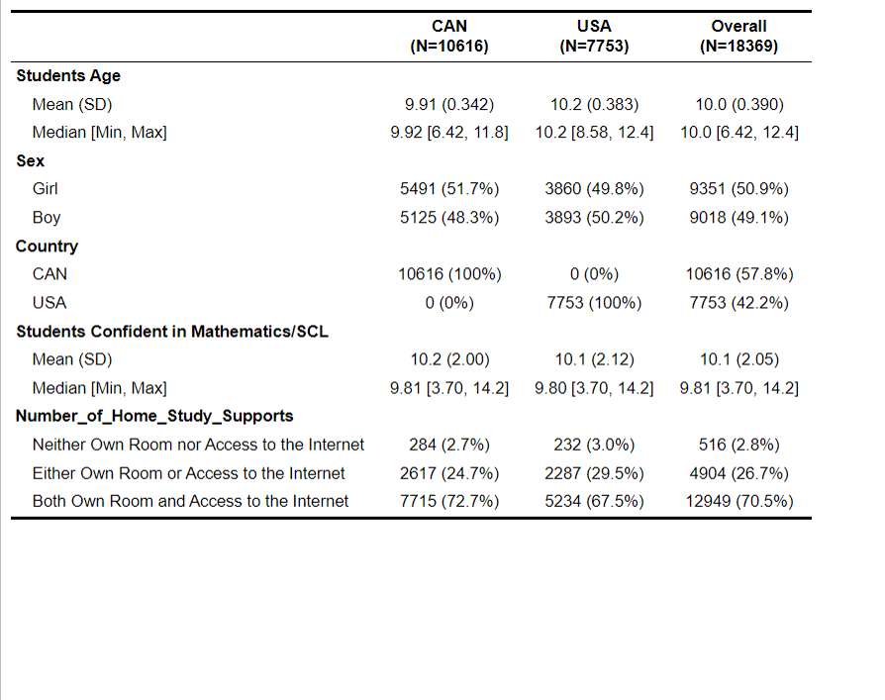
Descriptive Statistics

Slide 14
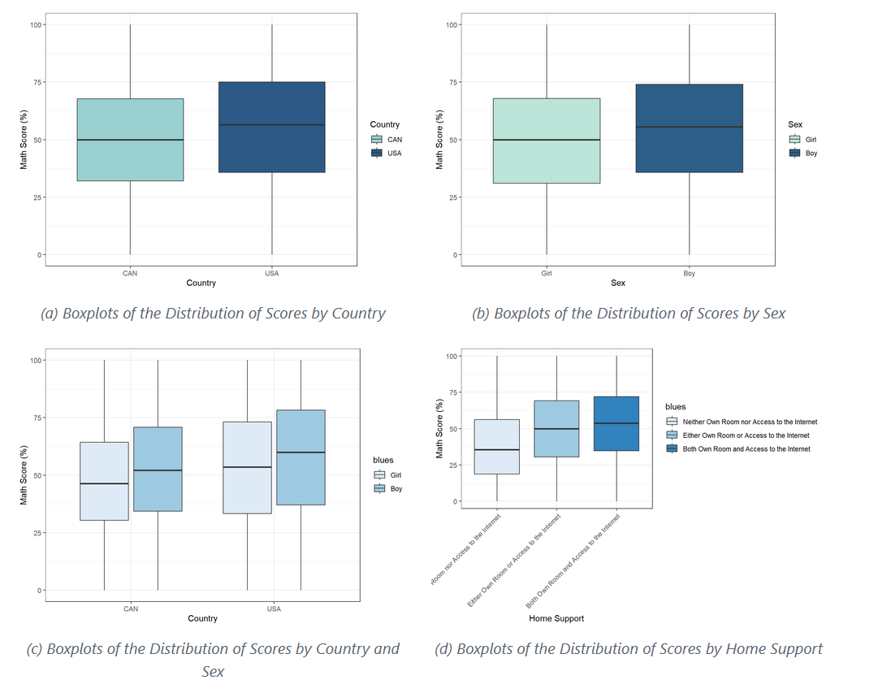
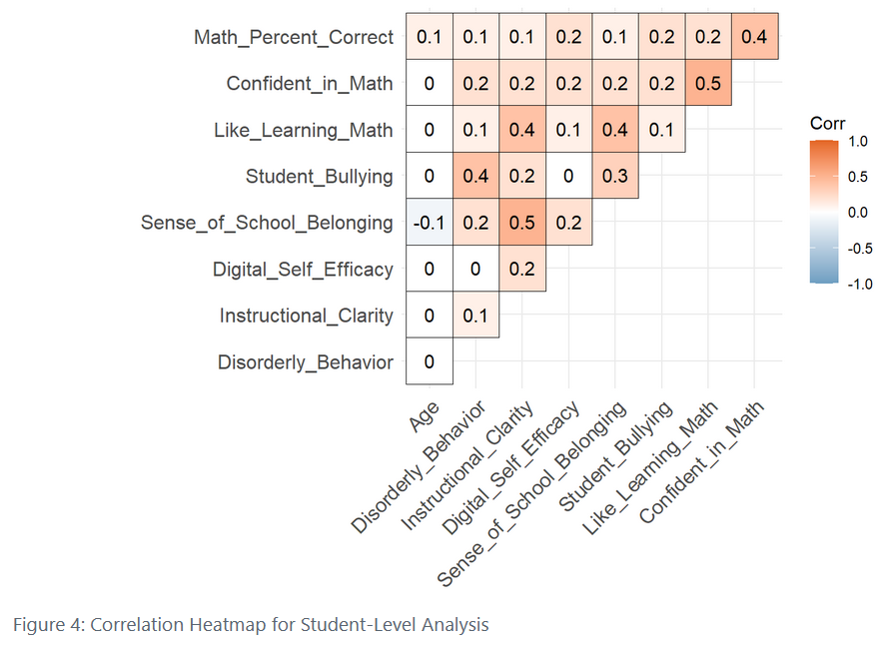
Descriptive Statistics
Notes:
- Figure 2 – Since the distributions of the countries appear to be similar, we look at overall gender distributions.

Slide 15
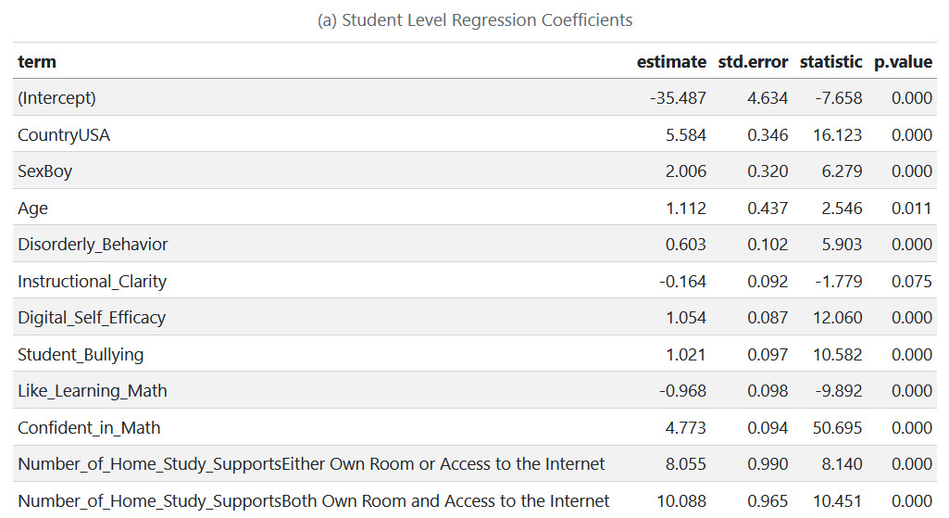
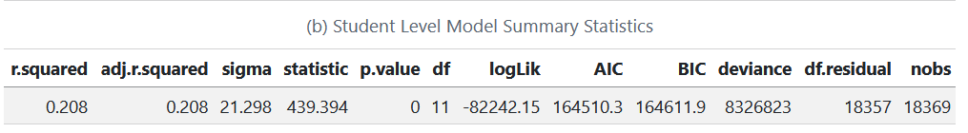
Step-wise Regression Analysis
Notes:
The Residuals vs. Fitted plot showed that residuals were approximately symmetrically distributed around zero across the range of fitted values, although there is a slight funnel shape, suggesting mild heteroscedasticity.
The red smoothing line was generally flat, indicating that the assumption of linearity was broadly supported.
The Q-Q plot showed some deviation from the diagonal line, particularly at both tails, indicating departures from normality in the residual distribution.
Despite this, the central portion of the distribution aligned reasonably well with the theoretical quantiles.
Slight curvature and spread at the extremes of the Scale-Location plot again suggest some heteroscedasticity.
The assumptions of linearity, normality, and independence of residuals are largely satisfied
There is some indication of mild heteroscedasticity.
A few potential influential cases exist but do not seem to severely distort the model.

Slide 16
Step-wise Regression Analysis
Notes:
The Residuals vs. Fitted plot showed that residuals were approximately symmetrically distributed around zero across the range of fitted values, although there is a slight funnel shape, suggesting mild heteroscedasticity.
The red smoothing line was generally flat, indicating that the assumption of linearity was broadly supported.
The Q-Q plot showed some deviation from the diagonal line, particularly at both tails, indicating departures from normality in the residual distribution.
Despite this, the central portion of the distribution aligned reasonably well with the theoretical quantiles.
Slight curvature and spread at the extremes of the Scale-Location plot again suggest some heteroscedasticity.
The assumptions of linearity, normality, and independence of residuals are largely satisfied
There is some indication of mild heteroscedasticity.
A few potential influential cases exist but do not seem to severely distort the model.

Slide 17
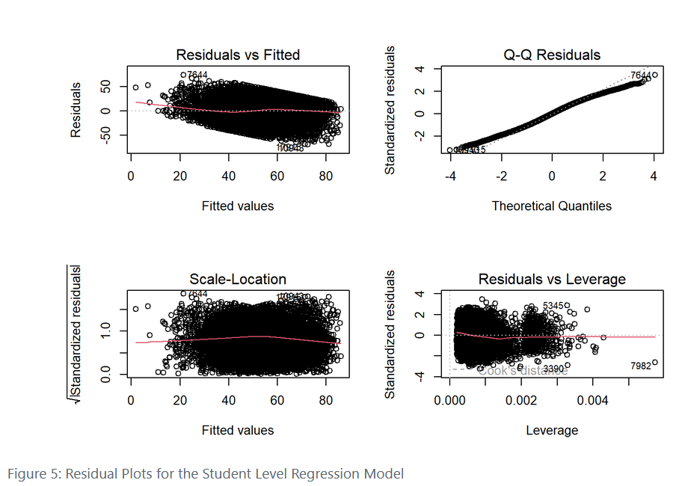
Step-wise Regression Analysis
Key-Takeaway
Despite most of the predictors being significant, they explain a relatively small proportion of variation in math scores suggesting that many additional factors (curriculum, school resources) are likely to contribute to students’ performances.
Notes:
The Residuals vs. Fitted plot showed that residuals were approximately symmetrically distributed around zero across the range of fitted values, although there is a slight funnel shape, suggesting mild heteroscedasticity.
The Q-Q plot showed some deviation from the diagonal line, particularly at both tails, indicating departures from normality in the residual distribution. Despite this, the central portion of the distribution aligned reasonably well with the theoretical quantiles.
The Scale-Location plot supported these findings, with a fairly consistent spread of √standardized residuals across the fitted values. However, slight curvature and spread at the extremes again suggest some heteroscedasticity.
In the Residuals vs. Leverage plot, a few cases exhibited high leverage, but the majority of observations clustered within an acceptable leverage range. Cook’s distance lines indicated that while these points should be reviewed, they were not highly influential individually.
the diagnostic plots support the general adequacy of the regression assumptions, with minor concerns regarding heteroscedasticity and normality that may warrant further exploration
The assumptions of linearity, normality, and independence of residuals are largely satisfied
There is some indication of mild heteroscedasticity.
A few potential influential cases exist but do not seem to severely distort the model.

Slide 18
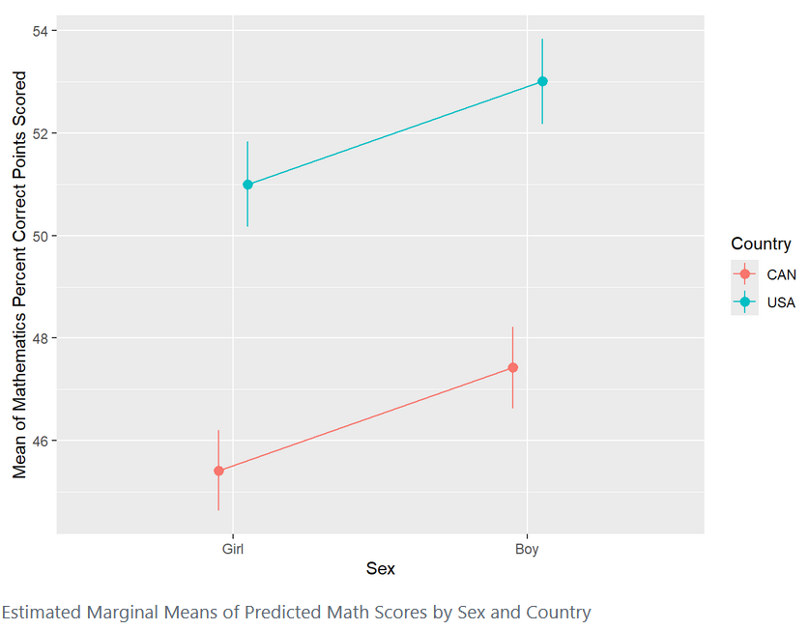
Differences-in-Difference Analysis
Notes:
- Explain what you mean by marginal – predicted score of an average person in the sample holding all other predictors constant.

Slide 19
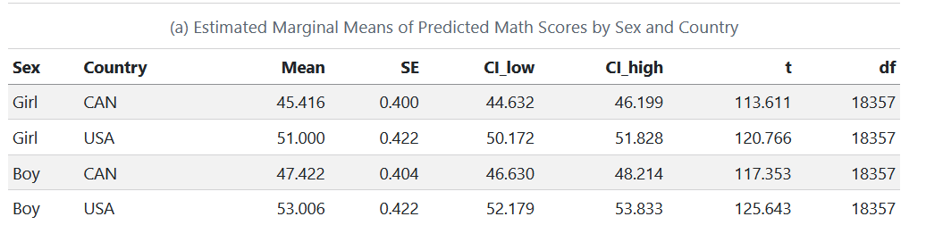
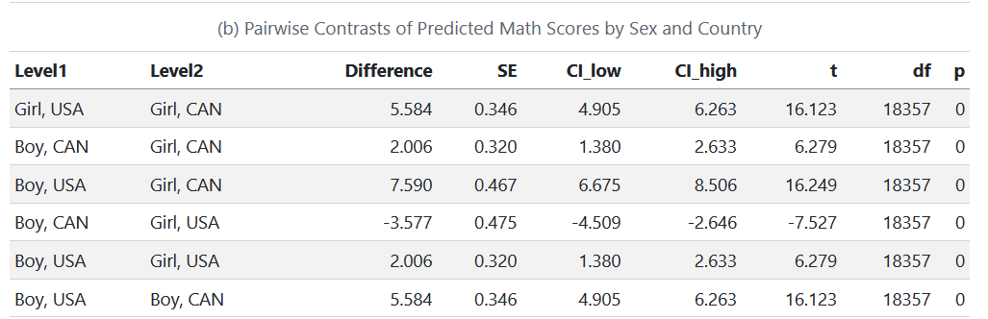
Differences-in-Difference Analysis
Key-Takeaway
While gender differences exist, the national level factors may play a more substantial role in the TIMSS math score of 4th grade students.
Further research should explore some potential national level contributors like curriculum standards.
Notes:
- Explain what you mean by marginal – predicted score of an average person in the sample holding all other predictors constant.

Slide 20
Teacher-Level Analysis

Slide 21
Sample Information
Years_Teaching: Years teacher has been teaching
Sex: Sex/Gender of teacher (1: Female; 2: Male; 3: Other)
Age: Age of Teacher (1: Under 25; 2: 25–29; 3: 30–39; 4: 40–49; 5: 50–59; 6: 60 or more)
Formal_Educ: Level of formal education teacher has completed (1: Did not complete Upper secondary education—ISCED Level 3; 2: Upper secondary education—ISCED Level 3 (have not completed postsecondary or tertiary education); 3: Post-secondary, non-tertiary education—ISCED Level 4; 4: Short-cycle tertiary education—ISCED Level 5; 5: Bachelor’s or equivalent level—ISCED Level 6; 6: Master’s or equivalent level—ISCED Level 7; 7: Doctor or equivalent level—ISCED Level 8)
Class_Size: Number of students in the class.
Homework_Freq: How often math homework is assigned (1: I do not assign mathematics homework; 2: Less than once a week; 3: 1 or 2 times a week; 4: 3 or 4 times a week; 5: Every day)
Academic_Success: Scale score from the subscale measuring school emphasis on academic success-teacher.
Safe_Orderly_Schools : Scale score from the subscale measuring safe and orderly schools-teacher.
Job_Satis : Scale score from the subscale measuring teachers job satisfaction.
Student_not_Ready: Scale score from the subscale measuring teaching limited by student not ready.
Math_Major : Teachers majored in education and mathematics (1: Major in Edu and Math; 2: Major in Edu but not Math; 3: Major in Math but not Edu; 4: All other Majors; 5: No Formal Edu Beyond Upper Secondary).
Instruction_Hours: Mathematics instruction hours per week
Math_Percent_Correct: Students' percent correct on the 2023 TIMSS Math Achievement Test.

Slide 22
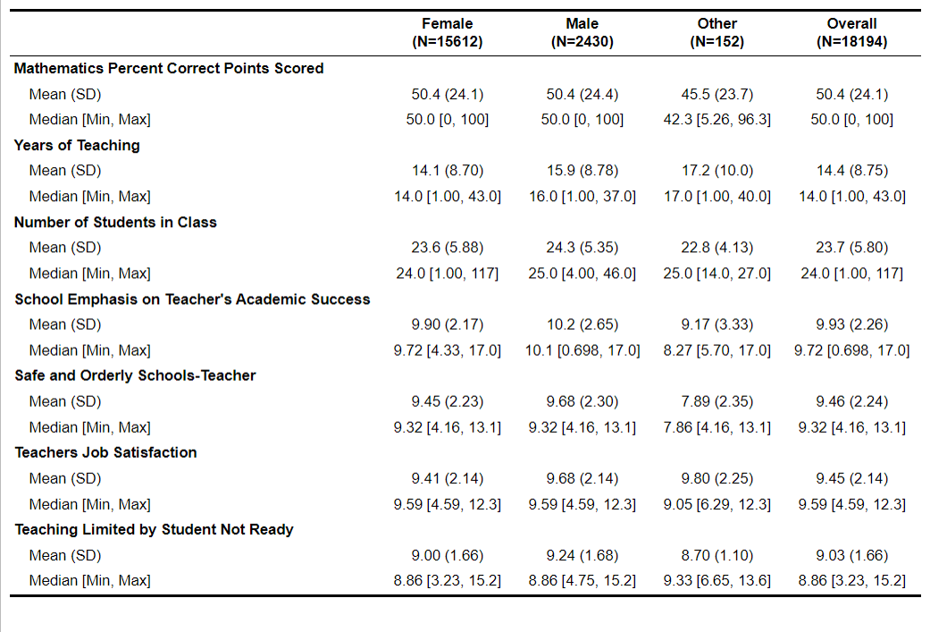
Descriptive Statistics

Slide 23
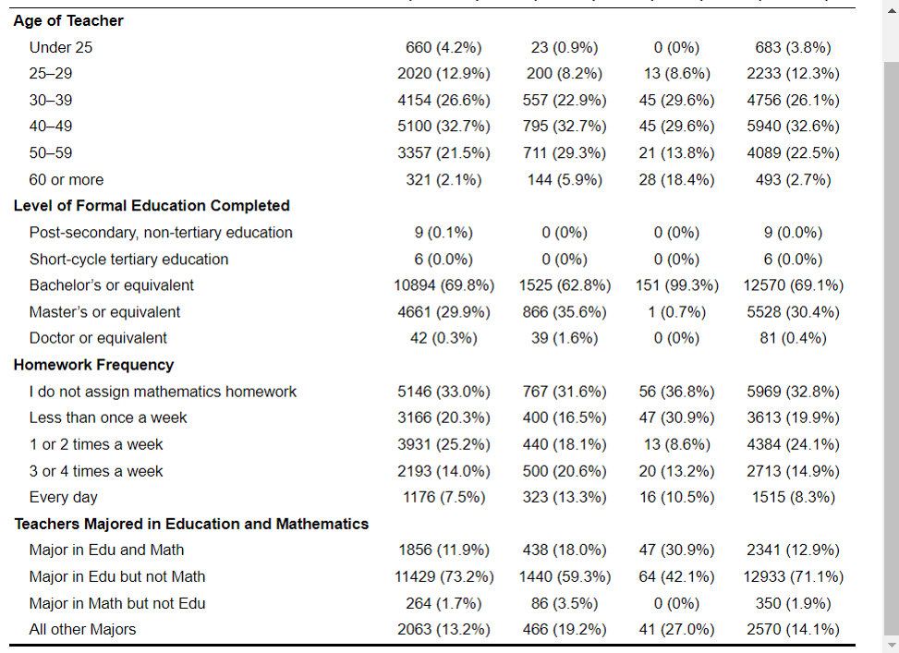
Descriptive Statistics

Slide 24
Descriptive Statistics

Slide 25
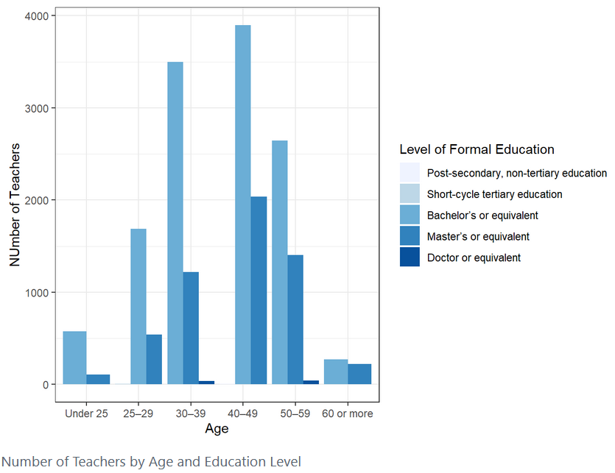
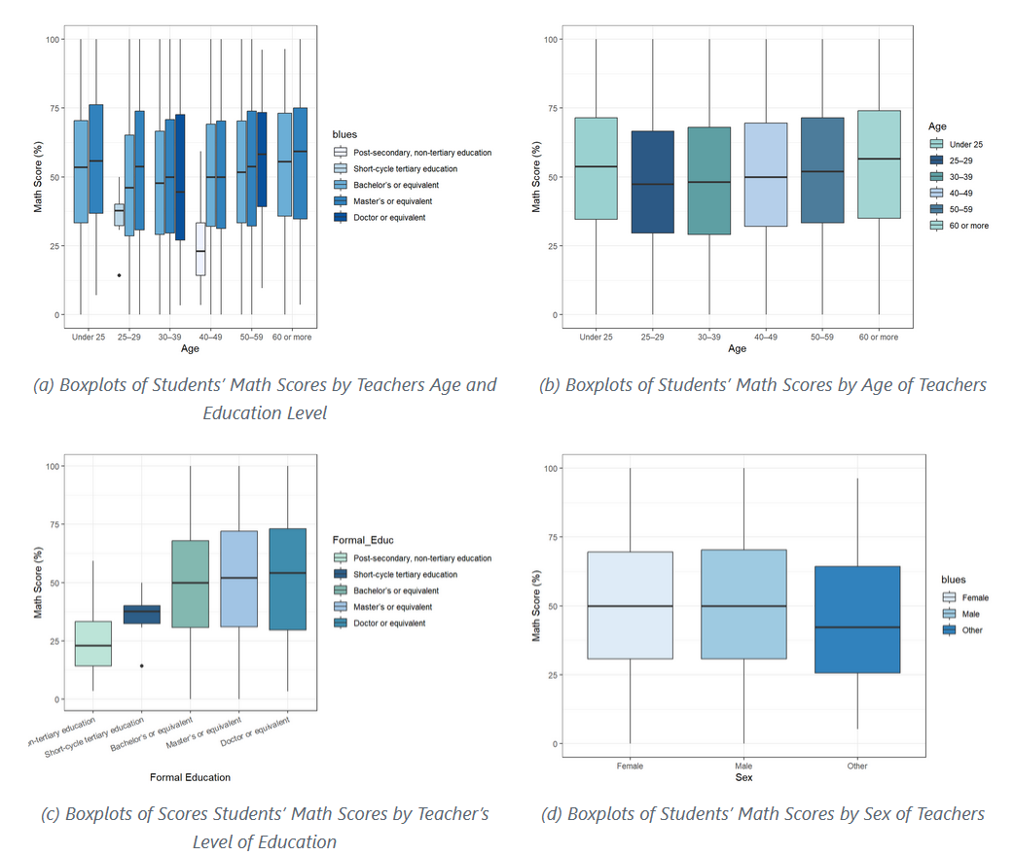
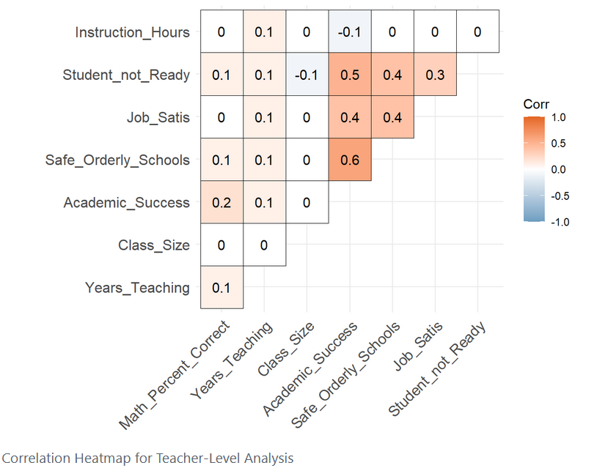
Descriptive Statistics

Slide 26
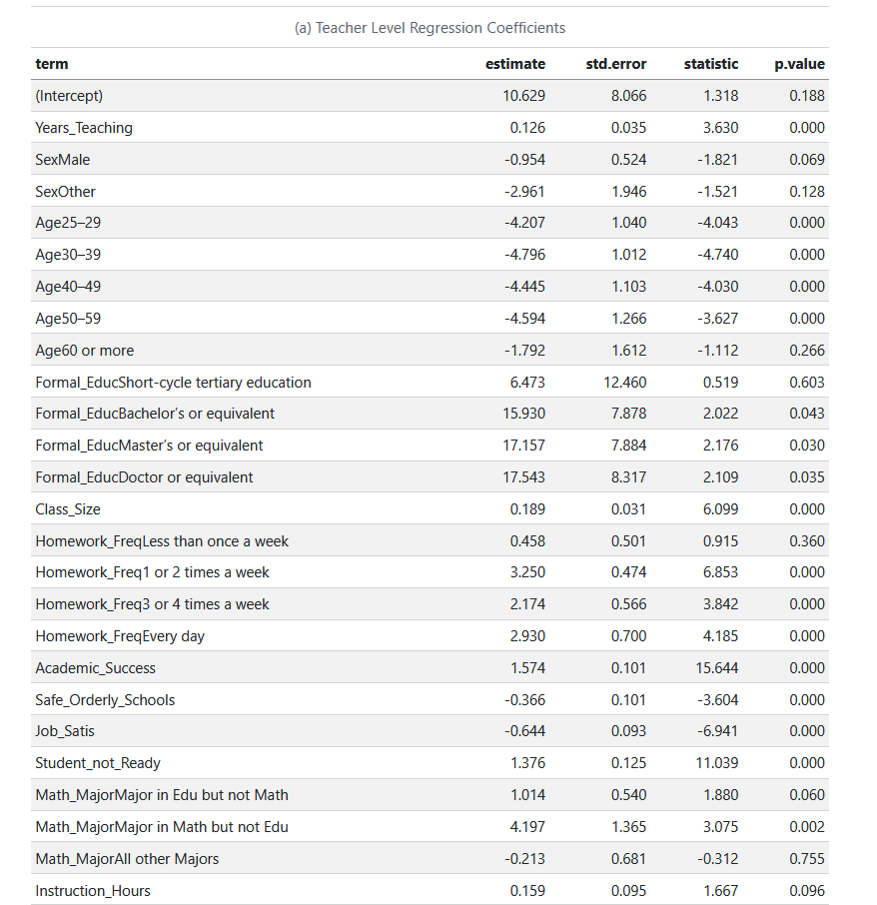
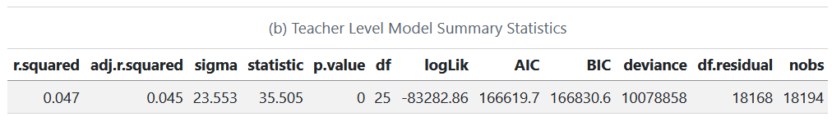
Step-wise Regression Analysis

Slide 27
Step-wise Regression Analysis

Slide 28
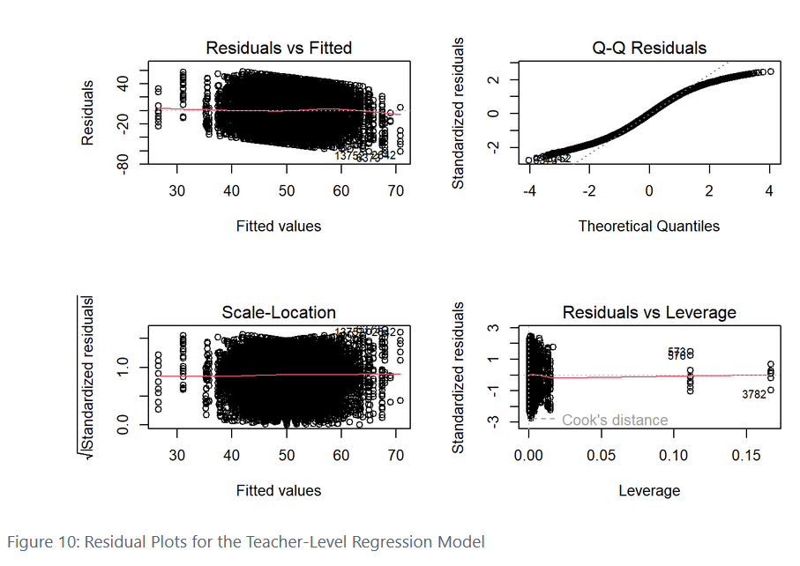
Step-wise Regression Analysis
Key-Takeaway
Despite most of the predictors being significant, they explain a relatively small proportion of variation in math scores suggesting that many additional factors (curriculum, school resources) are likely to contribute to students’ performances.
Notes:
The Residuals vs. Fitted plot indicated that the residuals were symmetrically distributed around zero, with no clear pattern or curvature, supporting the assumption of linearity and homoscedasticity.
The Scale-Location plot showed a relatively constant spread of √standardized residuals across fitted values, providing further evidence for homoscedasticity.
The Q-Q plot of standardized residuals revealed slight deviations from the diagonal line, particularly at the tails, suggesting some departure from normality. However, given the large sample size, minor violations of normality are unlikely to substantially impact the validity of statistical inferences
Finally, the Residuals vs. Leverage plot identified a small number of observations with high leverage indicating potentially influential points. However, most observations fell well within acceptable boundaries of Cook’s distance, suggesting that no individual cases unduly influenced the overall model estimates.
Overall, the residual diagnostics suggest that the assumptions of linear regression were reasonably met, with minor concerns regarding normality and influence, which are not uncommon in large datasets.
- Linearity and homoscedasticity are supported.
- Normality of residuals is slightly violated (minor issue with large samples).
A few influential points are present but not extreme.

Slide 29
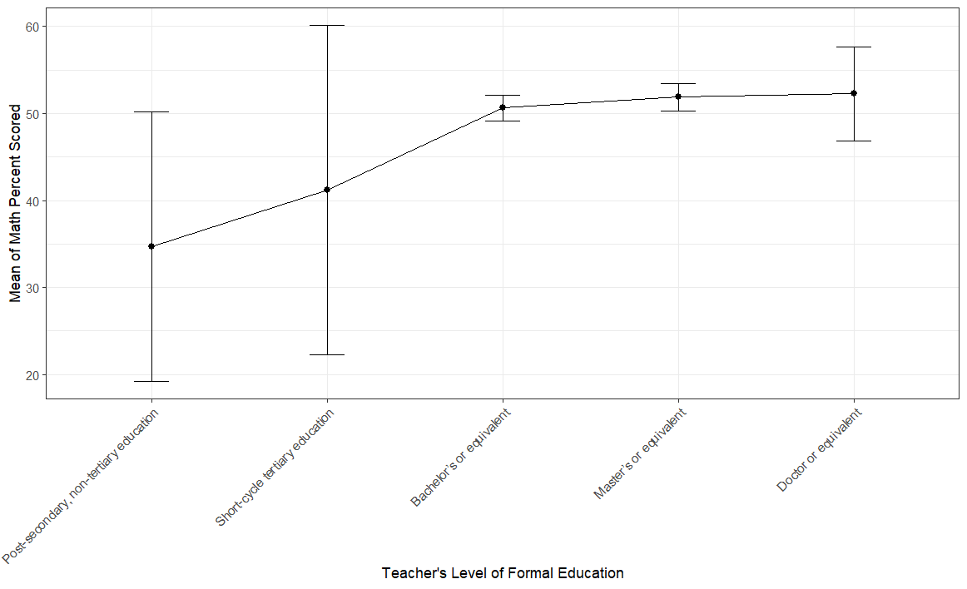
Pairwise Comparisons using Education Level
Notes:
- Do levels of formal education differ when it comes to student performance?

Slide 30
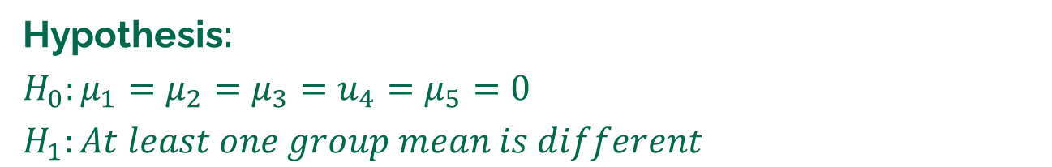
Pairwise Comparisons using Education Level
Hypothesis:
$$H_{0}:μ_{1}=μ_{2}=μ_{3}=u_{4}=μ_{5}=0$$
$$H_{1}:At least one group mean is different$$
Notes:
Testing if these differences are significant with a post-hoc test: Marginal Contrast Analysis

Slide 31
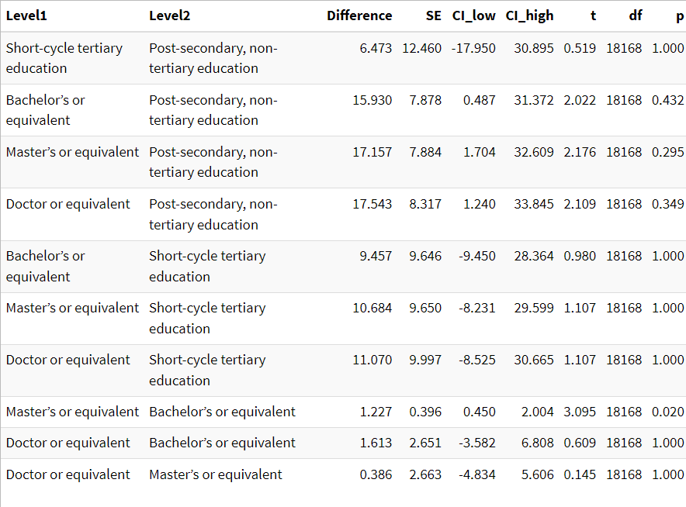
Pairwise Comparisons using Education Level
Hypothesis:
$$H_{0}:μ_{1}=μ_{2}=μ_{3}=u_{4}=μ_{5}=0$$
$$H_{1}:At least one group mean is different$$
Notes:
Are estimated student scores different for students with teachers who had bachelors or masters?
- Bonferroni adjusted p-values because we are conducting multiple pairwise tests.

Slide 32
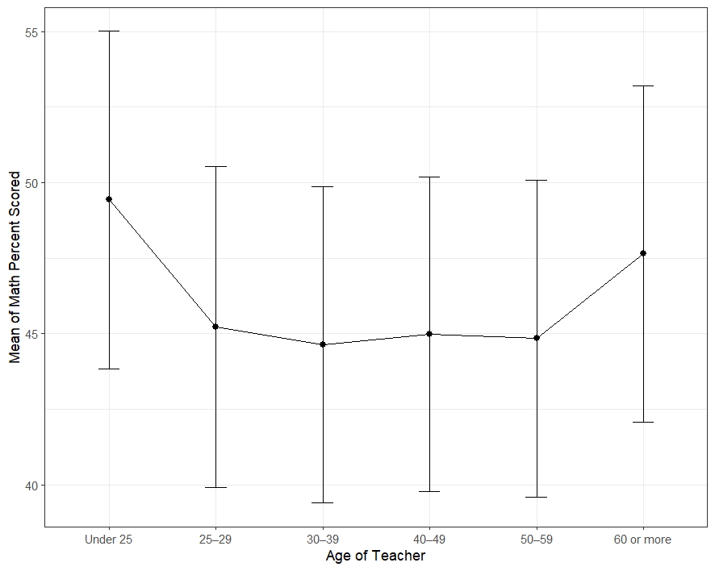
Pairwise Comparisons using Age

Slide 33
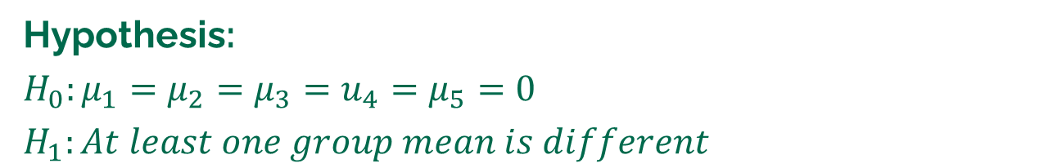
Pairwise Comparisons using Age
Hypothesis:
$$H_{0}:μ_{1}=μ_{2}=μ_{3}=u_{4}=μ_{5}=0$$
$$H_{1}:At least one group mean is different$$

Slide 34
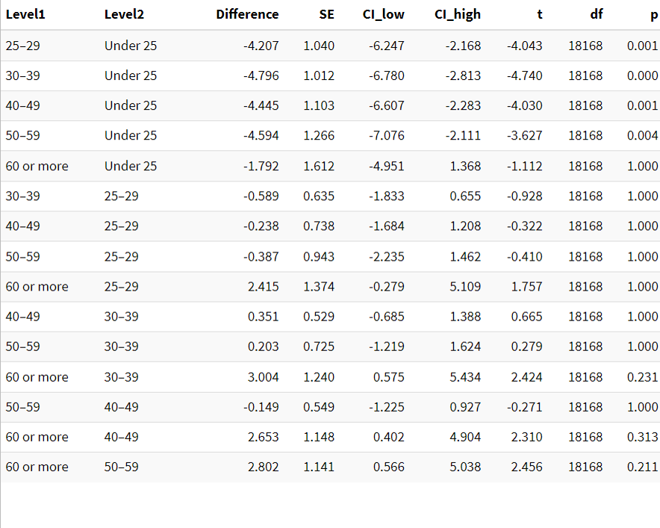
Pairwise Comparisons using Age
Hypothesis:
$$H_{0}:μ_{1}=μ_{2}=μ_{3}=u_{4}=μ_{5}=0$$
$$H_{1}:At least one group mean is different$$

Slide 35
Summary
01.
From student-level analysis, the model accounted for about 21% of the total variation in students’ scores.
Apart from, instructional clarity, all other variables had a statistically significant effect or scores.
Whether the student liked learning math or not had a negative effect their score.

Slide 36
Summary
01.
From student-level analysis, the model accounted for about 21% of the total variation in students’ scores.
Apart from, instructional clarity, all other variables had a statistically significant effect or scores.
Whether the student liked learning math or not had a negative effect their score.
02.
There were significant differences in estimated scores across gender and country.
Despite this, it seems country level differences play a bigger as an average 4th grade girl in the U.S.A is estimated to score higher than their male and female Canadian counterparts.

Slide 37
Summary
03.
01.
From student-level analysis, the model accounted for about 21% of the total variation in students’ scores.
Apart from, instructional clarity, all other variables had a statistically significant effect or scores.
Whether the student liked learning math or not had a negative effect their score.
From the teacher-level analysis, the model accounted for about 5% of the total variation in students’ scores.
Having an older teacher had a negative effect on a student’s score.
Having a teacher with a higher level of formal education had a large positive effect on scores.
02.
There were significant differences in estimated scores across gender and country.
Despite this, it seems country level differences play a bigger as an average 4th grade girl in the U.S.A is estimated to score higher than their male and female Canadian counterparts.

Slide 38
Summary
03.
01.
From student-level analysis, the model accounted for about 21% of the total variation in students’ scores.
Apart from, instructional clarity, all other variables had a statistically significant effect or scores.
Whether the student liked learning math or not had a negative effect their score.
From the teacher-level analysis, the model accounted for about 5% of the total variation in students’ scores.
Having an older teacher had a negative effect on a student’s score.
Having a teacher with a higher level of formal education had a large positive effect on scores.
02.
04.
There were significant differences in estimated scores across gender and country.
Despite this, it seems country level differences play a bigger as an average 4th grade girl in the U.S.A is estimated to score higher than their male and female Canadian counterparts.
Only students who had teachers with a masters’ vs bachelors degrees had significant difference in scores.
Students with teachers less than 25 seemed to have students who scored higher than all other age groups.

Slide 39

Presented by Henrietta Kadi
Thank you!

