Slide 1
The Game «TV-Tennis»
Developed by
Kadilenko Ivan
Kil Dmitriy
Semenov Daniil

Slide 2
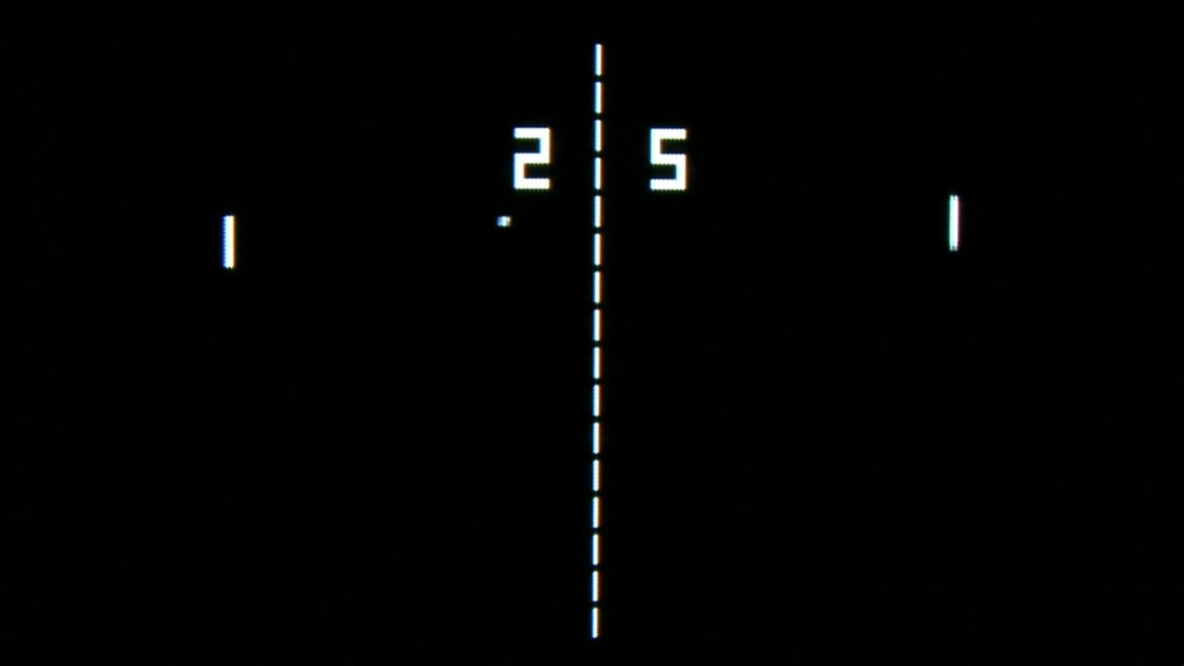
What is TV-Tennis?

Slide 3
The aim and the problems
the main goal of the project was the development and creation of the game "TV-Tennis" on logical circuits using the CdM-8 processor and its assembly language.
The problems:
To study examples of "TV-Tennis game"
To study and analyze the processor documentation
To study the programms for creating logical circuits and assebly language
To make Game based on the studied materials

Slide 4
The functional requirements
Video chip
Player bat controller
Robot bat control
Robot chip
Pause
Ball coordinates
UI
Changing the number of points to win, score and robot speed
Ball position prediction for robot (assembly code)

Slide 5
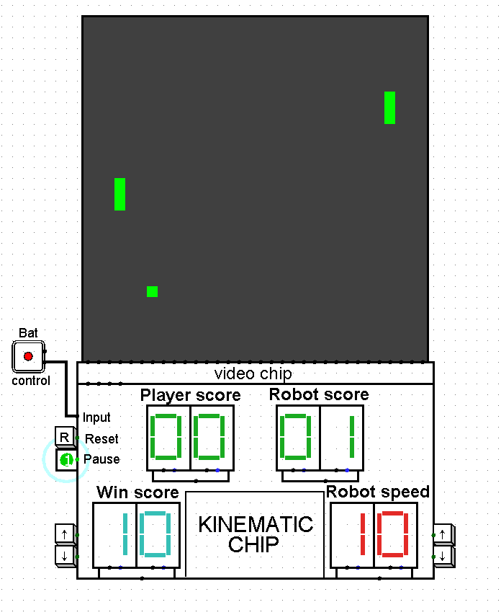
Main

Slide 6
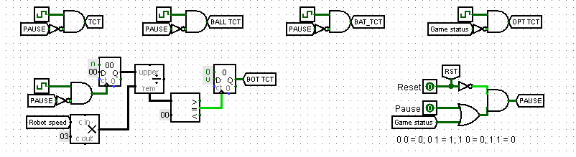
Clock generators

Slide 7
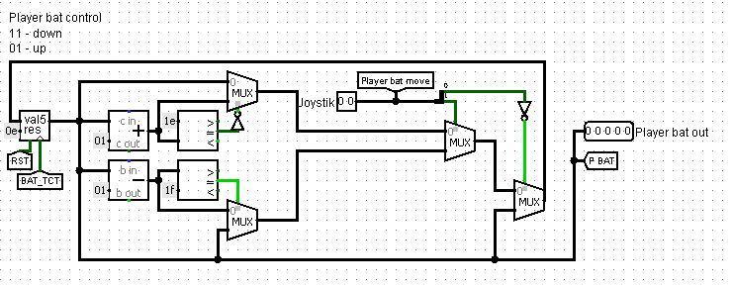
Player bat controller

Slide 8
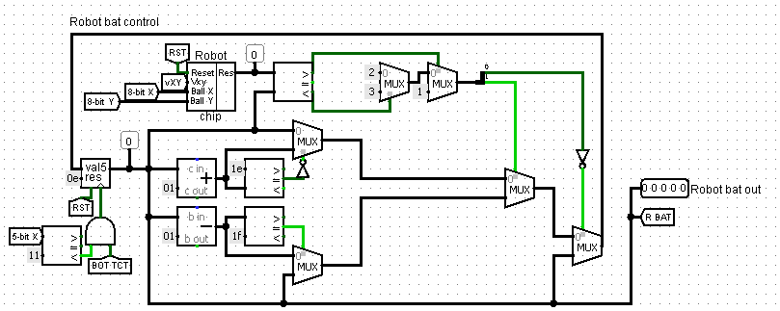
Robot bat control

Slide 9
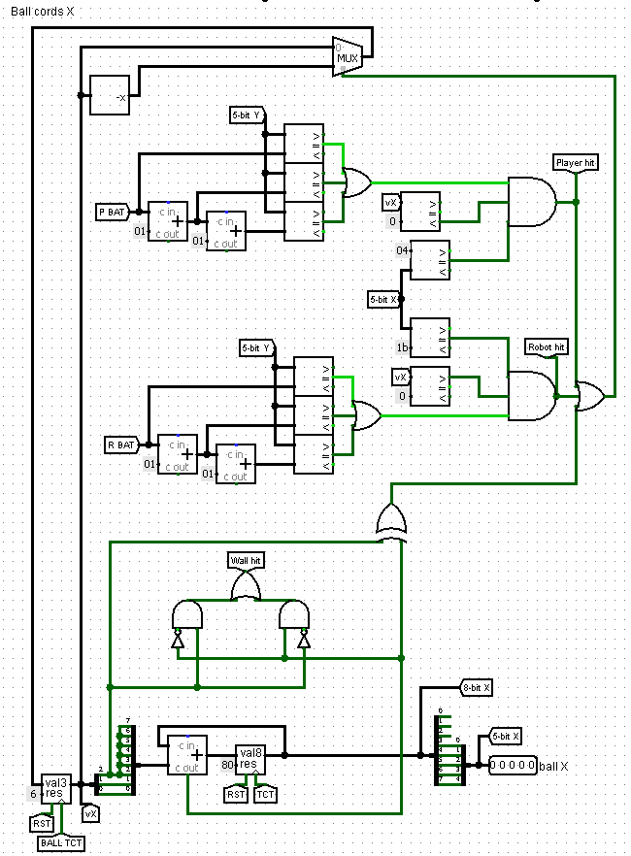
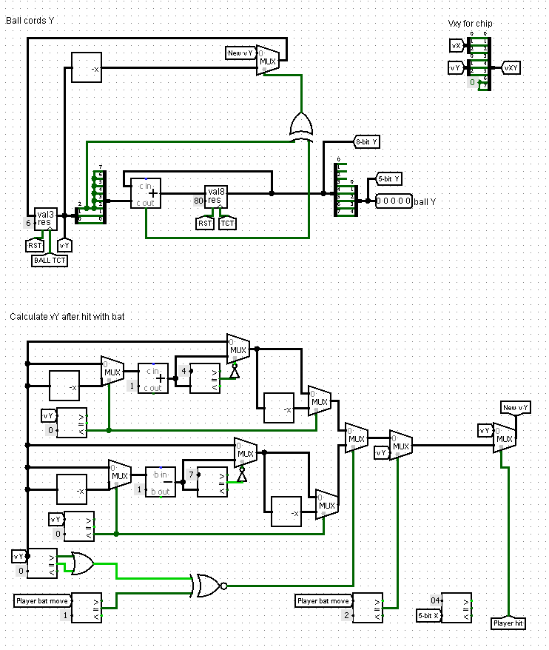
Ball coordinates

Slide 10
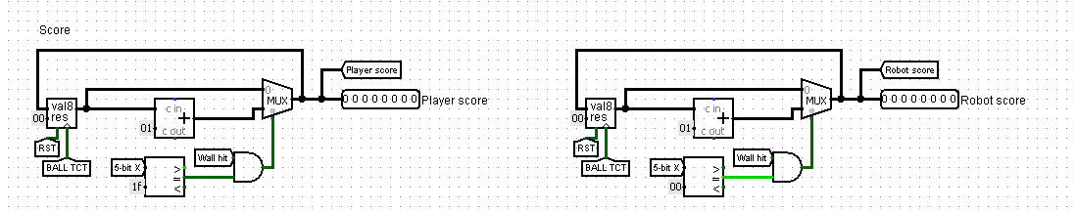
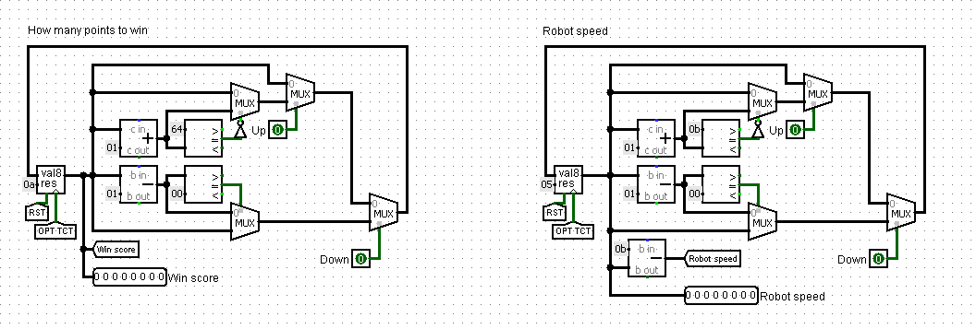
Changing the number of points to win, score and robot speed

Slide 11
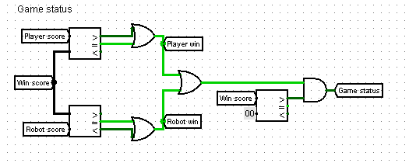
Game status

Slide 12
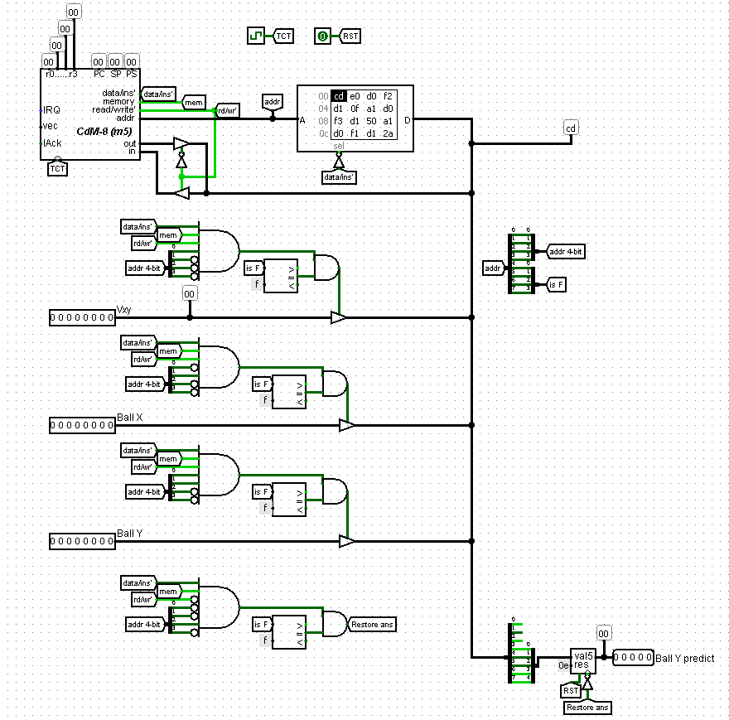
Robot chip

Slide 13
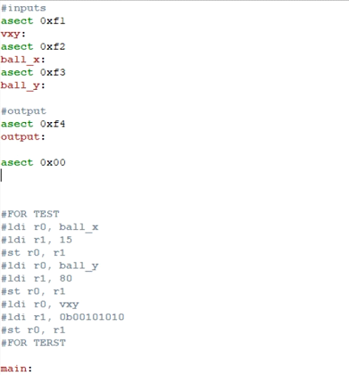
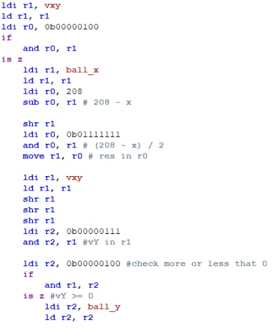
Ball position

Slide 14
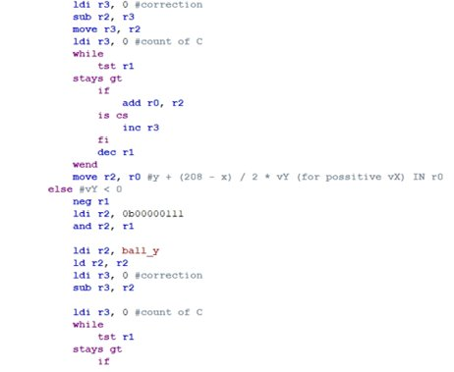
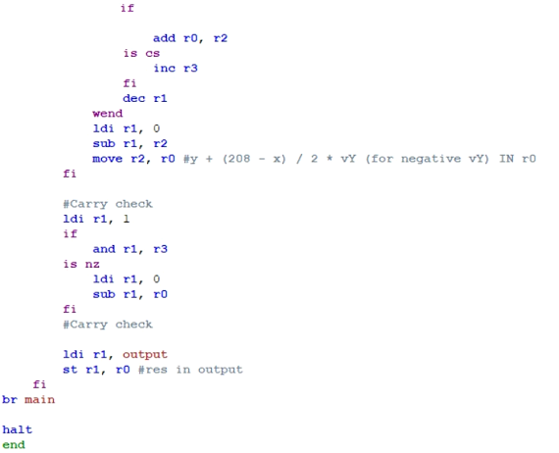

Slide 15
Сonclusion
As a result of the work done, we have created one of the first computer games in the world. The work was done by building diagrams and writing code for the processor. During the project, we gained knowledge on how to build circuits, write assembly code and work with the processor.

Slide 16
Thank you for your attention.

