Slide 1
InClassAssignementModule5
Kadin McWilliams and Morgan Hardin

Slide 2
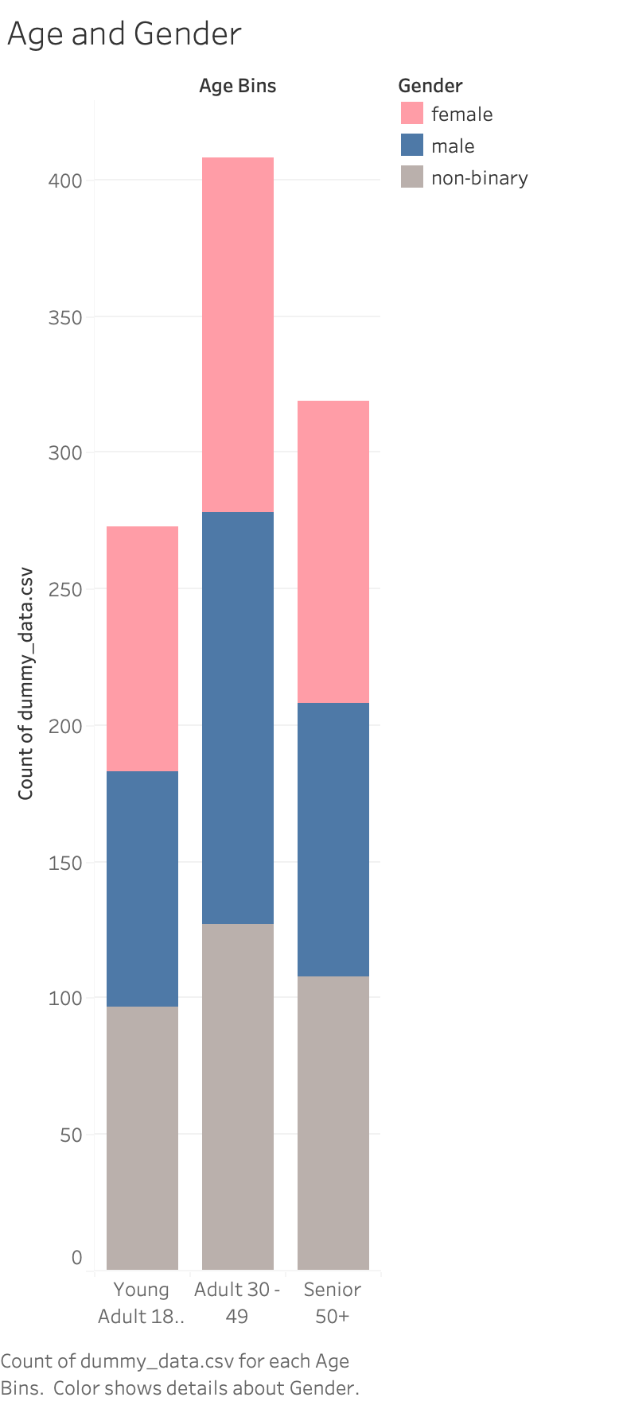
This is a graph comparing ages 18– 50+ and gender, Ages 30 to 49 have the largest presence on social media, Gender seems to be evenly spread.

Slide 3
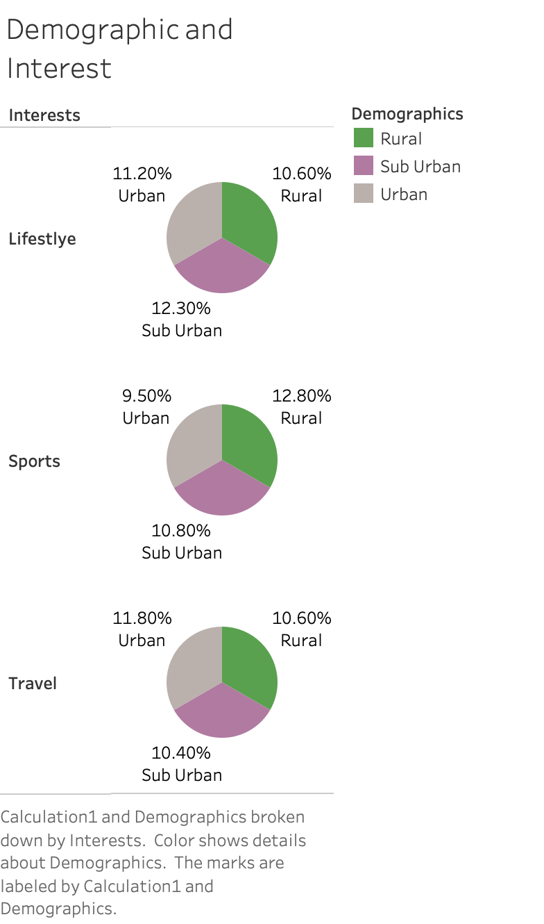
This is a pie chart of demographic location between Urban, Rural, and Sub Urban. There was not much variations between each of the demographics but each demographic had a most interested interest. Sub Urban’s was life style, Urban was Travel, and Rural was sports. Urban had the most even spread of interests.

Slide 4
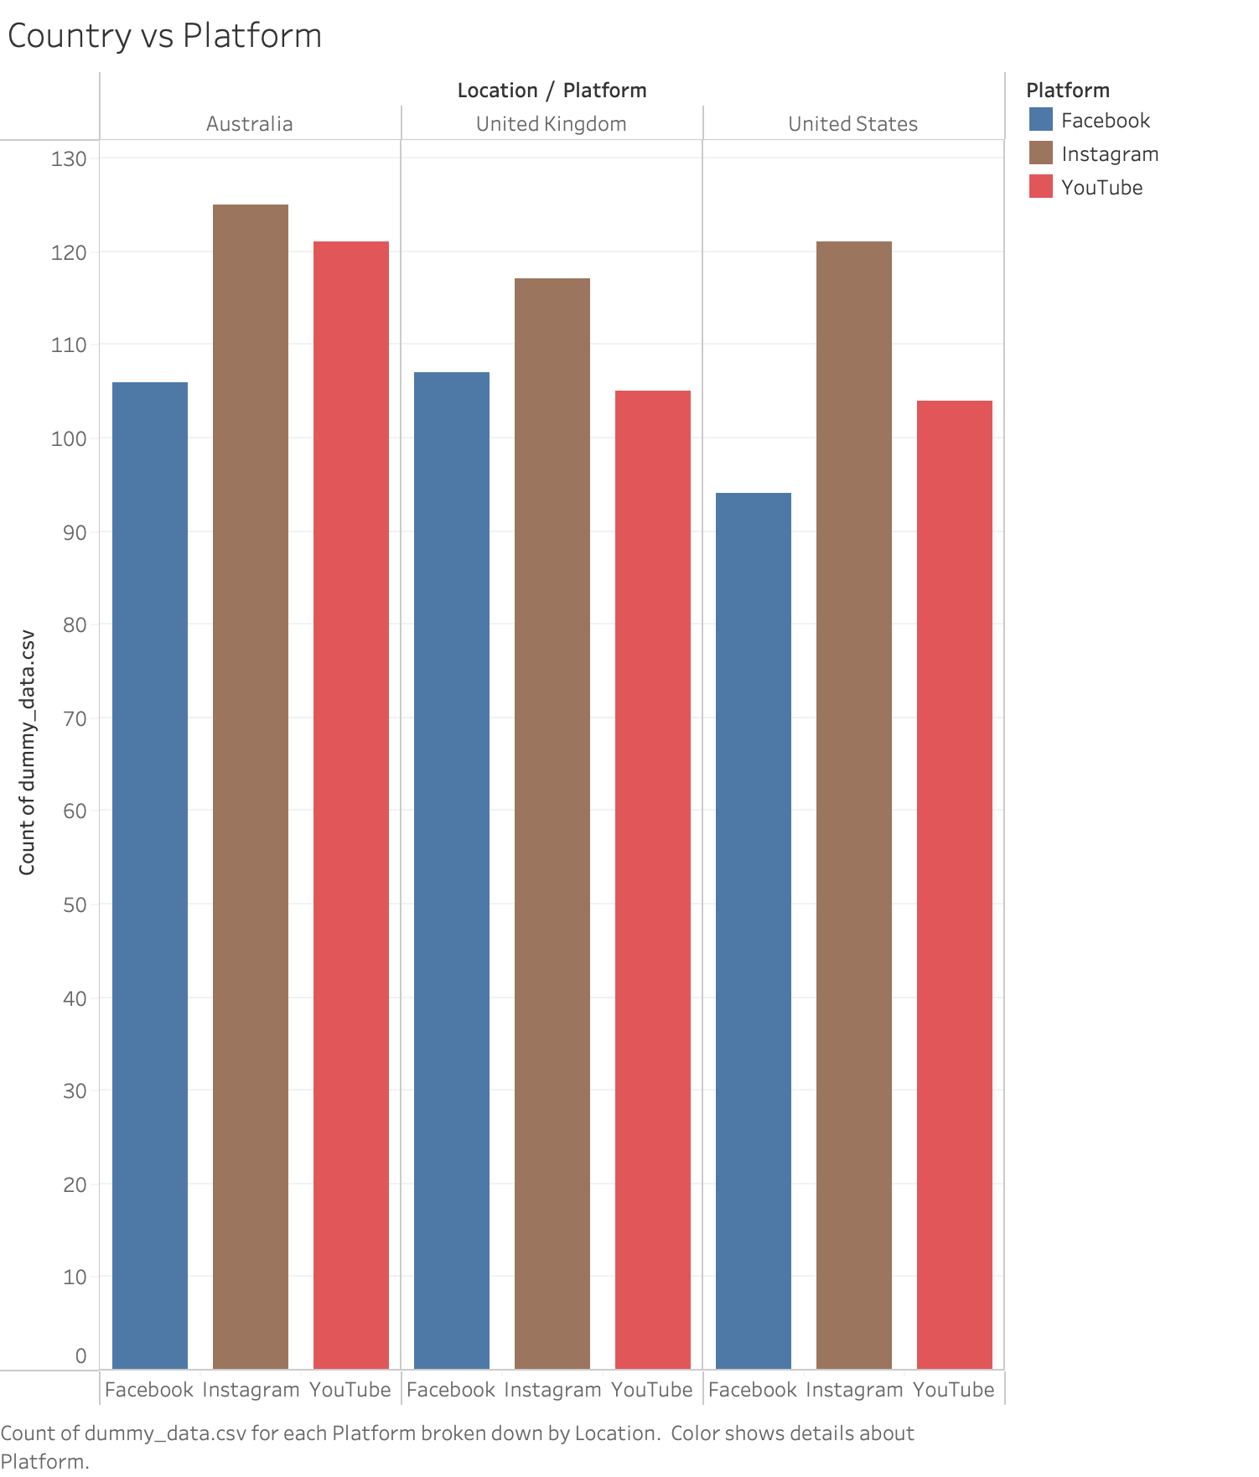
This graph shows a comparison of country and platform, over all countries Instagram was the most popular and in Australia and United States YouTube was the 2nd most popular and in the United Kingdom Facebook was the 2nd most popular.

Slide 5
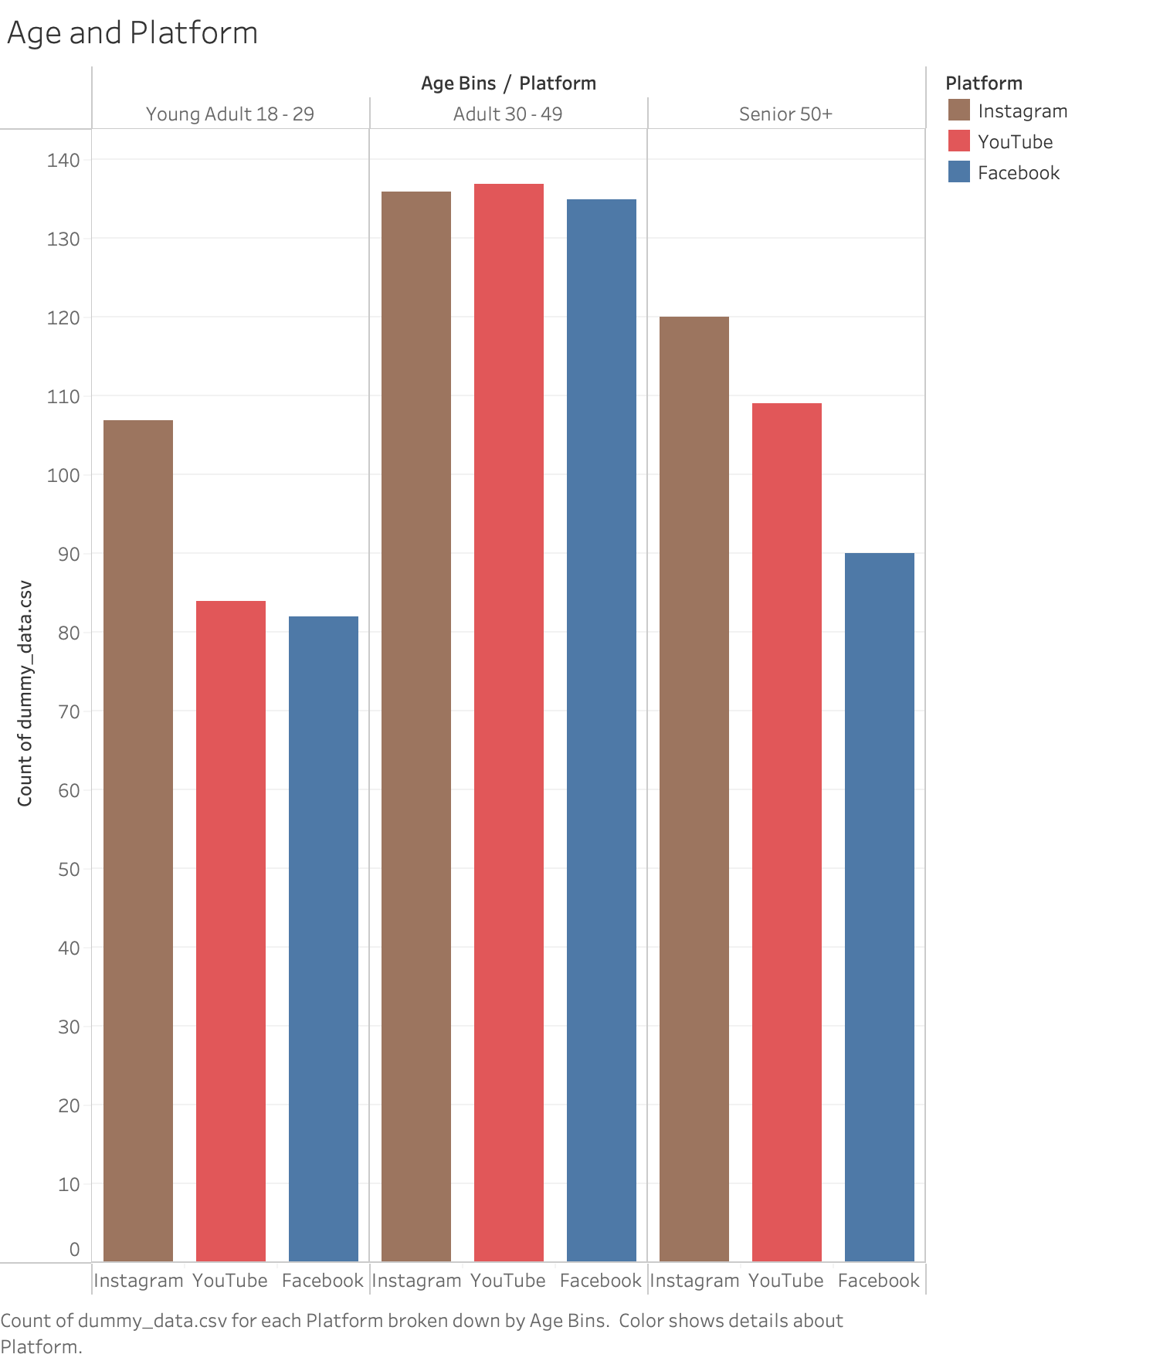
This compares age and platform which found that YouTube was the most popular for ages 30-49 and Instagram was the most popular for young adult and senior. It is interesting to point out that the Adult range was the largest amount of people yet Instagram still was the most popular used platform overall.

Slide 6
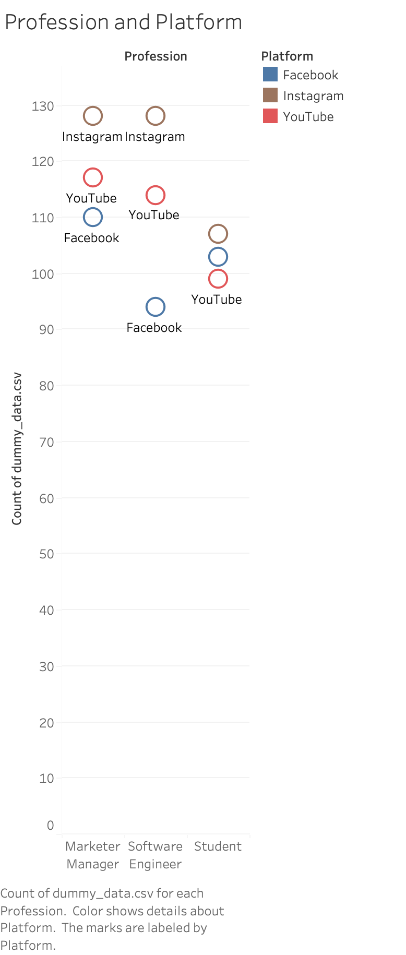
This is a graph of profession and platform and it was found to follow the general trends of the last few graphs. Across all three professions (Marketer Manager, Software Engineer, Student) Instagram was the most popular. With students Facebook was the second most popular and for the other two profession YouTube was the second most popular.

Slide 7
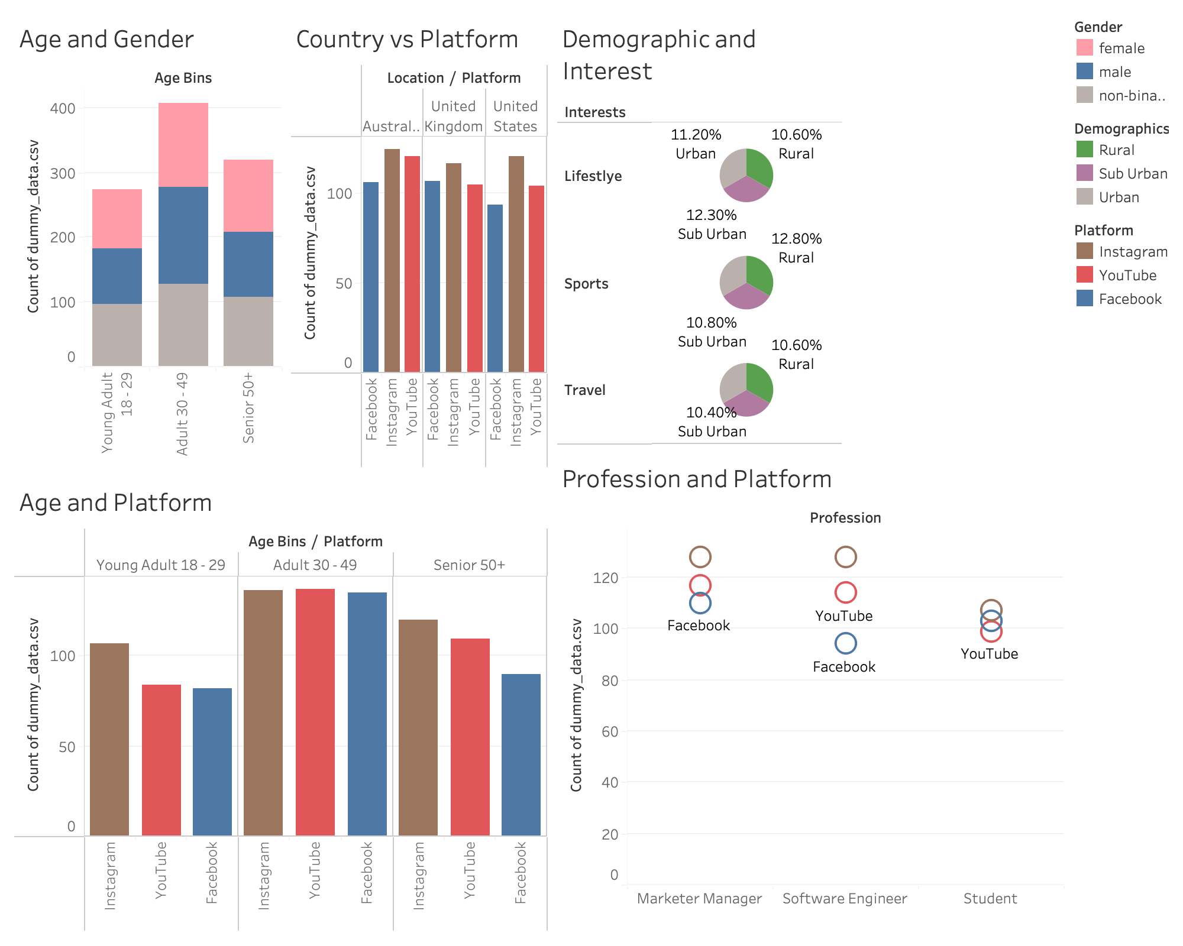
In conclusion Instagram was the most popular social media platform across all demographics and groups of people. YouTube was generally the second most popular plat form and Facebook tended to be the last. Facebooks lack of representation could be from the senior group not being as interested in Facebook as they are in YouTube. The factor that seems to be affecting social media use is age and as age changes I think that the trends will follow the change in age. Instagram seems to be the most dominating platform but if there is a shift in the younger generation Instagram might become second place.

