Slide 1
PATENTS
1
Notes:
The following slides provide a general introduction to the different types of intellectual property.

Slide 2
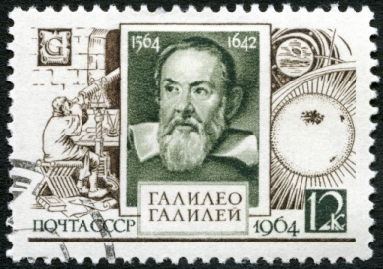
The patent system yesterday and today
Optional
Senate of Venice, 1474
"Any person in this city who makes any new and ingenious contrivance, not made heretofore in our dominion, shall, as soon as it is perfected so that it can be used and exercised, give notice of the same to our State Judicial Office, it being forbidden up to 10 years for any other person in any territory of ours to make a contrivance in the form and resemblance thereof".
Today:
New to the world
Up to 20 years of protection
Publication
Incentive to innovate and to share knowledge
EPO/OHIM Intellectual Property Teaching Kit – IP Advanced Part I Patents
4
Notes:
2
Under the Venice patent law of 1474, an invention had to be new to a certain region. The resulting patent was valid for up to 10 years. The details of the invention were not published.
Galileo Galilei obtained a patent on a water pump in 1594.
Today, patents must, according to European patent law, be new to the world. They last for up to 20 years. The details of the invention are published.
The main goals of today's patent system are to provide an incentive to innovate - protecting the results of innovation means that the inventor can reap the benefits, which in turn makes it easier to attract investment - and to provide an incentive to share knowledge. To get protection the inventor must publish the details of his invention.
This dual nature of the patent system is sometimes referred to as a contract between society, which gets the knowledge, and the patent applicant, who gets the exclusive rights.
2

Slide 3



The role of the patent system
To encourage technological innovation
To promote competition and investment
To provide information on the latest technical developments
To promote technology transfer
EPO/OHIM Intellectual Property Teaching Kit – IP Advanced Part I Patents
5
Notes:
3
This slide summarises the role of the patent system.
The patent system encourages technological innovation by rewarding intellectual creativity. In providing patent owners with protection for their inventions, patents offer them recognition for their creativity and the possibility of obtaining financial reward if they commercialise or exploit their inventions.
The patent system can also promote competition and investment in developing new or improved products or processes by encouraging research and development. Investors are more likely to provide financial backing if there is the potential for a return on their investment from inventions that can be patented.
Because the information disclosed in patents is published, the patent system encourages the dissemination of information that may be of benefit to society.
It can promote technology transfer by way of the publicly available information in patent databases. Thanks to these databases, anyone can find patented technologies that they may want to access and use themselves.

Slide 4


Patents as a social contract
Reveal
invention (disclosure)
Patent applicant
Get
exclusivity
(patent)
Public
EPO/OHIM Intellectual Property Teaching Kit – IP Advanced Part I Patents
6
Notes:
4
As we have already seen, patents are sometimes considered as a kind of contract between the applicant and society.
Applicants and patent owners are interested in benefiting from their inventions.
Owning a patent gives them the right to prevent others from making, using, offering for sale, selling or importing a product that infringes the patent, for a limited amount of time and the country for which the patent has been granted.
The exceptions to this are use of the patent for non-commercial purposes, including private use and academic research.
Society is interested in:
Encouraging innovation so that better products can be made and better production methods can be used for the benefit of all;
Protecting new and innovative companies so that they can compete with larger established companies, in order to maintain a competitive economy;
Finding out the details of new inventions so that other engineers and scientists can further improve them; and
Promoting technology transfer, that is from universities to industry.
In return for this protection, applicants must reveal their inventions to the public, so others can build on them. This takes the form of publication of the application by the relevant patent office.
This social contract is institutionalised in the form of patent law.
4

Slide 5




Rights conferred by patents
Right to prevent others from making, using, offering for sale, selling or importing infringing products in the country where the patent was granted
Exception: non-commercial purposes (private use, academic research)
Right to assign, sell or license these rights
These rights belong to the patent holder.
Notes:
Patent owners have the right to prevent others from making, using, offering for sale, selling or importing a product that infringes their patent, for a limited amount of time.
Exceptions include use for non-commercial purposes, such as private use or academic research.
Further options include licensing inventions to others, or allowing everybody to use the invention for free.
Many important technologies such as CDs, DVDs, mobile phone technology and digital TV are covered by numerous individual patents that companies license to each other in a process known as cross-licensing.
If commercialising your invention means using the intellectual property of others, then you need to have their permission!
5

Slide 6
What is a patent?
Does a patent give you the right to exploit an invention?
A patent is a negative right. It gives you the right to prevent others from exploiting the invention. It is not an enabling right.
Patents owned by others may overlap or encompass your own patent. -> Seek a licence before commercialising
For example:
- NO!
Patent A: Electric kettle
Your patent B: Electric kettle with
ceramic heating
elements
Notes:
The key concept of this slide is to show that a patent is a negative right, not a positive one.
For example, let us imagine that you have invented the first-ever electric kettle to have a ceramic heating element as its base-plate. This kettle has advantages over kettles which have a metal heating element upon which limescale forms. Such a kettle might be novel and inventive, and could get you a patent, which we will call patent B.
However, your patent does not grant you the right to use your invention, because it falls within the scope of an earlier patent for all electric kettles, which we will call patent A.
For you to make, use and sell your invention you need a licence from the owner of the earlier, broader patent, patent A.
But they in turn would need a licence from you to make kettles with ceramic heating elements.
This is where you could enter into a cross-licence agreement. Indeed, this is where the vast majority of industrial collaborations start.
Patents owned by others may overlap or encompass your own patent. In this case, you need to obtain the right to use other people’s inventions – for example by way of a licence – before you can start commercialising your own patented invention, and vice versa.

Slide 7
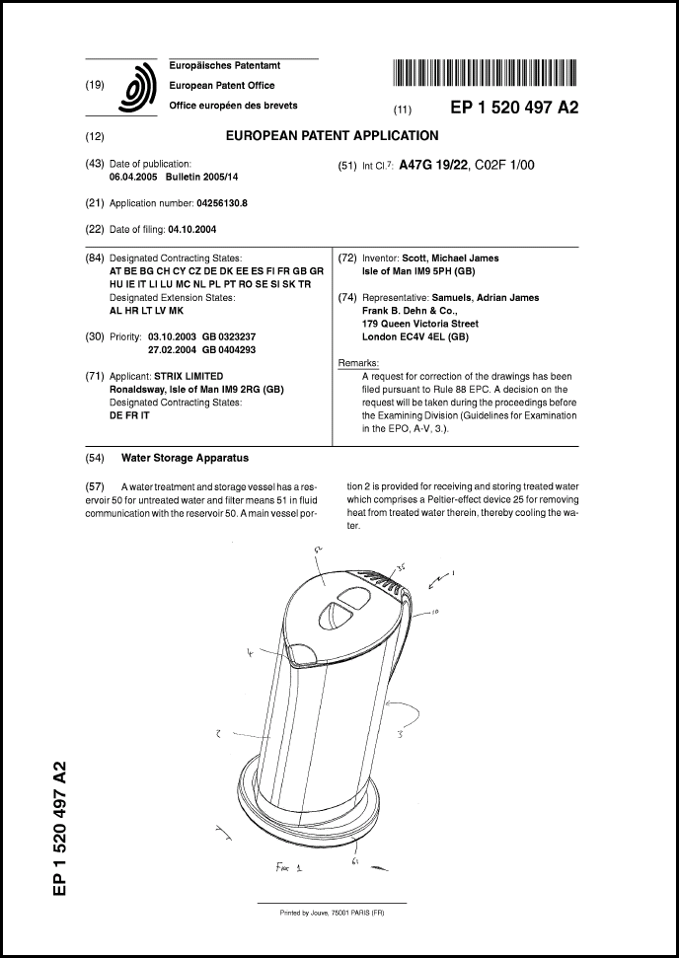


What do patent documents look like?
Application
number
Date of publication
Technical
class
Date of
filing
Inventor
Applicant
Description
Abstract
Claim(s)
Drawing(s)
EPO/OHIM Intellectual Property Teaching Kit – IP Advanced Part I Patents
9
Notes:
7
Patent applications can be filed by the inventor or the inventor's employer.
Inventions are usually the property of the company that employs the inventor. This is also the case for university researchers in many countries.
A European patent application contains a full and detailed description of the invention so that others can understand and replicate it, one or more claims which define the technical features of the invention for which protection is sought - this is called the "scope of protection“ - and optional drawings which help with understanding and interpreting the claims and description.
The cover sheet contains bibliographic information about the applicant and the inventor.
It also contains an abstract, one of the drawings, and details of the technical class.
The abstract and the technical class are useful when it comes to searching for patents.

Slide 8
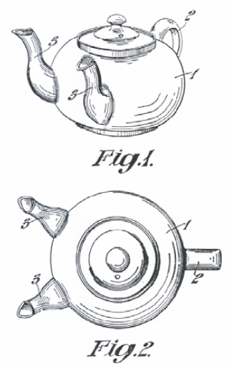
What does the description contain?
Optional
Prior art
teapot with one spout
Drawback of prior art
time-consuming
Problem to be solved
reduce filling time for multiple cups
Solution
provide a second spout
Advantage of the invention
filling time is reduced
Notes:
8
This slide shows the what a typical description contains. The description also refers to the drawings.

Slide 9
More about the claims
Two types of claim
Independent claims: the invention in its broadest scope
Dependent claims: any claim which includes all the features of any other claim
Independent claim
Claim 1 An A (product/process/apparatus/use) comprising
B
C Technical features of the claimed invention
D
Dependent claim
Claim 2 An A as claimed in claim 1, comprising
E Further particulars of claim 1
9
Notes:
As we have just seen, the claims of a patent application define the matter for which protection is sought. They express the subject-matter in a technical manner which will allow people who read the patent document to understand what is being claimed by the patentee as his invention. Claims may relate to a product, an apparatus or entity, or a process, use or activity.
Independent claims are directed to the essential features of an invention. Dependent claims relate to further details of the features of the independent claim.
In the example on the slide, “A” could, for example, be a device or apparatus for mixing concrete, or a process for stabilising an emulsion, or a method for making something.
B, C and D are the features defining what the invention claimed by the applicant actually is.
So we could have the following claim, for example: A device or apparatus for mixing concrete (A) comprising a drum (B), a handle attached to it (C) and a wheel to spin the drum (D).
A dependent claim then further defines the particulars of independent claim 1, as follows: A device (A) as claimed in claim 1, comprising a handle made of iron (E).
9

Slide 10
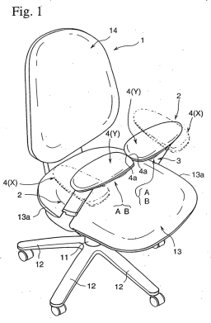





What can and can’t be patented
Patents protect technical inventions which solve technical problems:
Products, devices, systems
Chemical substances, pharmaceuticals
Processes, methods, uses
For an invention to be patentable, it must usually be
new to the world (i.e. not available to the public anywhere in the world)
inventive (i.e. not an "obvious" solution), and
susceptible of industrial application
In most countries, patents are not granted for mere business methods or rules of games, or for methods of treatment, diagnostics and surgery of the human or animal body, or for inventions that are contrary to ordre public or morality, or for plant and animal varieties.
EPO/OHIM Intellectual Property Teaching Kit – IP Advanced Part I Patents
11
Notes:
10
10
Under the European Patent Convention or EPC, "European patents shall be granted for any inventions, in all fields of technology, provided that they are new, involve an inventive step and are susceptible of industrial application."
“New” means that there should have been no previous public disclosure of the invention before the date of filing. If an invention has already been revealed to the public there is nothing to "trade" for exclusivity, and therefore no social contract.
The concept of inventive step is quite difficult to assess. The EPO must compare the invention with what would have been obvious to an imaginary skilled person at the time of filing.
The EPC does not provide a definition of what is meant by the term "invention“.
It does, however, provide a non-exhaustive list of subject-matter that are not considered inventions. The items listed at the bottom of this slide are expressly excluded from patentability.

Slide 11
Requirements for patentability
11
The invention must be
new/novel
AND
inventive
AND
industrially applicable
Notes:
In order to be patentable, an invention must be new, inventive and industrially applicable.
Industrial application is usually easy to argue. So what are the tests for novelty and inventive step?
The test for novelty is objective and we will look at it in more detail on the next slide. The test for inventive step is subjective and requires “a person skilled in the art”. The person skilled in the art is a technical expert in the field of the invention.
The European Patent Office uses the problem-solution approach to determine inventiveness. This approach comprises three main stages: determining the closest prior art; establishing the objective technical problem to be solved; and considering whether or not the claimed invention, starting from the closest prior art and the objective technical problem, would have been obvious to the skilled person.
However, there are exceptions to this rule. For example, mere discoveries or mathematical equations are not patentable in every country. In some countries, claims for methods of treatment and business methods are not allowed. In most countries software is not patentable as such.
11

Slide 12

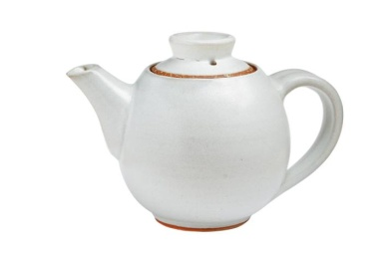
When is an invention "new"?
Keep your invention confidential until you have filed your application!
When it is not part of the state of the art
State of the art = everything made available to the public before the date of filing
Patent application
Date of filing
State of the art
Year
2008
2009
2010
2011
2012
2013
2014
EPO/OHIM Intellectual Property Teaching Kit – IP Advanced Part I Patents
12
Notes:
12
For a European patent to be granted by the EPO, the invention must be new at the date of filing of the patent application.
“New" means that the invention does not form part of the state of the art.
The state of the art comprises everything made available to the public by means of a written or oral description, by use, or in any other way, before the date of filing of the European patent application.
It is vital that you keep your invention confidential until you have filed your application.

Slide 13





Do’s and don’ts for safeguarding novelty
Don’ts
Do not publish any articles, press releases, conference presentations/ posters/ proceedings, lectures or blog posts, etc. before you file
Do not sell any products incorporating the invention before you file
Do’s
Sign a non-disclosure agreement (NDA)
Seek professional advice at an early stage
File before anyone else does!
NDA
EPO/OHIM Intellectual Property Teaching Kit – IP Advanced Part I Patents
13
Notes:
13
If you disclose your invention before the filing date you risk invalidating your patent application.
Remember the social contract? If you have already revealed your invention to the public, you will have nothing to "trade", so you won't get a patent, even if it was you who made the invention public!
Under the EPC, the first to file the patent application will be entitled to the grant of a patent on a particular invention.
If you disclose your invention before filing, it will no longer be considered "new“, regardless of the form the disclosure took, including written form (even in a publication that no-one might have read), oral disclosure (such as in a presentation or lecture), actual use or sale, and regardless of the place. In other words, all material made available to the public anywhere in the world forms part of the state of the art.
So the key message is keep it confidential! Do not disclose your invention to anyone, not even orally, until you have filed your patent application.
If you need to talk to potential customers or investors before you file, make sure you sign a non-disclosure agreement with them first.
Once you have filed your application, you are free to present, publish or sell your invention as you wish.
13

Slide 14
The test for novelty
The test for novelty is an objective test.
Are all the components of the claim of the invention known?
Are they disclosed as the state of the art in existing products or publications?
The disclosure can be anywhere in the world and in any form.
The disclosure is relevant if it was made before the filing/priority date of the patent application concerned.
All it takes to destroy novelty is for a single prior art item to disclose all the features of the claimed invention.
14
Notes:
The test for novelty is an objective test.
Are all the components of the invention known? Are they disclosed as state of the art?
The disclosure may be a similar product that already exists. It may be a write-up, scientific article or documentation of any sort. It must be before the priority date claimed by the invention. It can be anywhere in the world, in any form and in any language. It does not have to exist as a product or be in use in practice. It doesn’t matter if you are an English speaker and the invention was only ever known to a remote tribe in Indonesia whose language you don’t speak.
There is an absolute novelty requirement in Europe.
For example, let's imagine that you have an invention relating to a retractable ballpoint pen.
You file a patent application on 2 May 1988.This means that all documents prior to 2 May 1988 are relevant to the test for novelty.
If all the components of your claim are present in any one document found, your invention is not novel and is therefore not patentable.
If a claim reads as "a product A having components B, C, D and E” then the test for novelty asks "Are A, B, C, D and E present in a single document and did the publication exist prior to the date of priority claimed by the present invention?"
14

Slide 15

When is an invention "inventive"?
When it is not obvious to the person skilled in the art in view of the state of the art
The person skilled in the art
is a skilled practitioner in the relevant technical field
has access to the entire state of the art
is aware of general technical knowledge
is capable of routine work
He knows EVERYTHING, but has ZERO imagination!
EPO/OHIM Intellectual Property Teaching Kit – IP Advanced Part I Patents
14
Notes:
At the EPO, inventive step is assessed using the problem-solution approach.
This approach assesses in an objective manner whether the solution proposed to the problem presented in the patent application is obvious or not to the person skilled in the art.
The person skilled in the art is a legal fiction. He or she is considered to be a practitioner with a general technical knowledge in the relevant field, with access to the entire state of the art and capable of performing routine work and experimentation.
He does not, however, have any inventive skills.

Slide 16
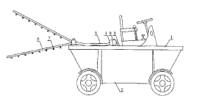
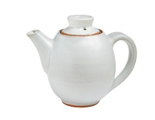
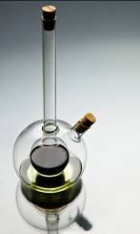

Assessing novelty
Claim: A pouring vessel comprising
(a) a compartment for liquids (1),
(b) a handle (2),
(c) a lid, and
(d) two spouts (5) extending from the compartment (1),
(e) whereby the tops of the two spouts are arranged at the same height.
Stage 1: Prior art
The prior art search revealed the following documents:
Document D1:
A teapot with one spout.
Document D2:
High efficiency distributor for fertilizer. Each rod has several nozzles for spraying liquid.
Document D3:
A filter handle with two spouts to be used with a coffee-maker.
Document D4:
An oil and vinegar bottle which reveals a second bottle inside. The two spouts are cleverly arranged to ensure the second bottle never drips while the first one is in use.
EPO/OHIM Intellectual Property Teaching Kit – IP Advanced Part I Patents
15
Notes:
16
16
The claim describes the technical features of the invention.
In order to be able to decide whether an invention is new, the patent examiner responsible for examining the application first has to define the prior art. To do this, he has to perform a search into the prior art, which will usually involve consulting databases containing patent documents and scientific journals, as well as searching the internet and other media.
In the example shown here, the search revealed four documents. The patent examiner compared the claim with each document in turn and checked whether the invention differs from it. None of the documents discloses all the features of the claim, so the invention as expressed in the claim is new.

Slide 17
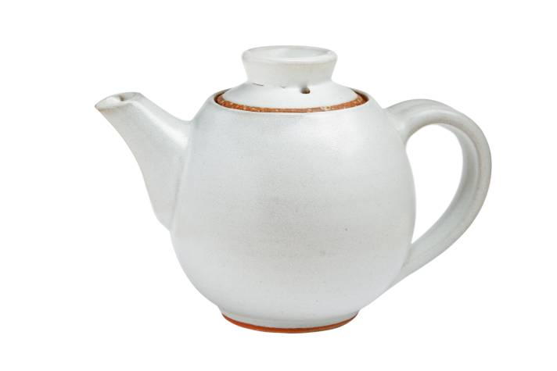

Assessing inventive step (I)
Determine the closest prior art and common features: (a) a compartment for liquids
(b) a handle
(c) a lid
(d) one spout
Differences over D1:
- two spouts instead of one - particular arrangement of the spouts
Drawback of prior art:
- time-consuming
Advantage/effect of the invention:
- the time needed to fill multiple cups is reduced
Objective problem to solve:
- how to modify the teapot of D1 to reduce the time needed to fill multiple cups
Stage 1
Stage 2: Problem
17
Notes:
17
To ensure an objective assessment of inventive step, the EPO, for example, uses a structured problem-solution approach which lessens the risk of hindsight.
The questions asked during this analysis can be grouped into three stages.
In stage 1, the examiner considers the differences between the claim and each document. He then chooses the document which comes closest to the invention. This is normally the document which has the most features in common with the invention. In our example, this is document D1 and we have identified the features that the claim has in common with it.
In stage 2, the examiner notes down differences between the claim and this document. He thinks of advantages based these differences. In this case it is the reduction in the time needed to fill several cups thanks to the second spout.
The next question is whether the skilled person would have overcome the drawback of document D1 in the same manner as the inventor did. To answer this question, the examiner formulates a so-called objective problem, which is usually how to achieve the same effect as the invention. In this case the question would be "How can we modify the teapot of D1 in order to reduce the time needed to fill multiple cups?“ We will look at the answer to this question on the next slide.

Slide 18



Assessing inventive step (II)
Stage 3: Solution
Is the claimed solution obvious in view of the prior art?
+
D2
?
D1
D4
D3
Objective problem for the skilled person: How to modify the teapot of D1 in order to reduce the time needed to fill multiple cups
EPO/OHIM Intellectual Property Teaching Kit – IP Advanced Part I Patents
18
Notes:
18
18
In stage 3, the examiner is looking for an answer to the question: How would the skilled person modify the teapot of D1 in order to reduce the filling time for multiple cups?
[Click 1]
The skilled person realistically only has access to the prior art in the technical field of the invention, which in this case is the field of kitchen utensils for food processing, in particular beverages. To come to a fair judgement, the skilled person should look at documents from this field only. The fertiliser distributor in D2 does not belong to this field, so should not be considered any further
Next, the examiner checks if the other documents - D3 and D4 - are concerned with filling several cups simultaneously and whether they offer the same advantage as the invention. D4 does not disclose the same effect, as it only uses one spout at a time, and not two together. Thus, D4 teaches away from the invention and must be discarded.
D3 discloses an espresso maker with a filter handle that allows two cups to be filled concurrently. This looks promising.
[Click 2]
The examiner then comes to the final step in his assessment, which is to make a careful judgement as to whether the invention is obvious when looking at the two documents.
[Click 3]
To do this he must ask the following hypothetical questions:
- If the skilled person looked at D1 in combination with D3, would he find a solution for the problem of reducing the filling time?
- What teaching would he take from D3?
For the sake of this example, the examiner may make the following considerations with regard to D3.
Firstly, the outlet in D3 does not reduce the time needed to fill two cups since the flow rate of the espresso maker remains the same. In fact, the opposite is true: it takes twice as long to fill two cups. Looked at another way, in the same amount of time, the two cups would only get half full.
Secondly, even if the skilled person applied the principle of the outlet with the two pipes in D3 to the known teapot in D1, he would not arrive at the claimed invention. In D3, the outlet is Y-shaped and consists of one pipe extending into two pipes, whereas the invention makes use of two separate spouts.
The examiner may therefore arrive at the conclusion that the claim is inventive, since the two documents in combination would not arrive at the claimed invention. A patent could thus be granted on the basis of this claim.

Slide 19



What is infringement?
Making use of a patented product or process without the consent of the patent owner
Making, offering, putting on the market, importing or stocking the product
Making, offering, putting on the market, importing or stocking a product directly obtained from a protected process
Using a process or offering the process for use
Infringement is determined by the national courts or by the Unified Patent Court (once it enters into force)
What constitutes infringement in one country may differ from other countries
Patent proprietors can claim damages and other remedies from alleged infringers
EPO/OHIM Intellectual Property Teaching Kit – IP Advanced Part I Patents
19
Notes:
As a general principle, any person not having the patent proprietor's consent is prohibited from certain acts, and breach of those prohibitions will constitute patent infringement.
Patent proprietors can take legal action, including filing for injunctive relief and/or claiming damages from persons considered to be infringing their patent.
Precisely what constitutes infringement of a patent may differ in each jurisdiction, and is determined by the national courts with reference to the applicable national law.
The competence for infringement and revocation actions concerning European and unitary patents will generally lie with the Unified Patent Court, once it comes into force.
The courts in European countries have adopted provisions on infringement. Typically, the acts considered to undermine the right of the patent owner to prevent third parties' direct use of the invention include
making, offering, putting on the market or using a protected product or importing or stocking the product for these purposes,
using a process or offering the protected process for use, and
offering, putting on the market, using, or importing or stocking for these purposes the product obtained directly by a protected process.

Slide 20
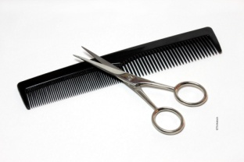

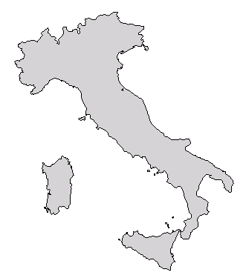
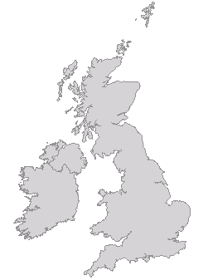
How is infringement determined? (I)
Optional
Claims
Define the features of the invention = matter for which protection is sought
Description and drawings are used to interpret the claims
Extent of protection
Everything that is literally covered by the claims
May also encompass equivalents
Infringement occurs when the infringing product possesses all the features of the claimed invention
Example:
Are PAPER-FIX infringing HAIRY-CUT's patent?
PAPER-FIX produce scissors with eye rings covered by plastic in Italy and sell them in the UK
HAIRY-CUT have a UK patent claiming cutting means with two eye rings
EPO/OHIM Intellectual Property Teaching Kit – IP Advanced Part I Patents
20
Notes:
The question of infringement is rather complex. In the European patent system, decisions on infringement are taken by the national courts. The EPC does, however, establish the principle that the scope of protection conferred by a European patent in the EPC contracting states is to be determined by the claims, with the description and drawings being used to interpret the claims.
In practice, this means that the extent of protection basically encompasses everything that is literally covered by the claims. However, it may in some cases also encompass so-called equivalents to the invention covered by the claims.
The example shown here is about two companies that are commercially active in the market for cutting tools. It illustrates both the territorial effect of patents, as well as what is meant by the "extent of protection".
PAPER-FIX is a company that produces scissors with eye rings that are covered by plastic. The plastic has good insulation properties. PAPER-FIX produce the scissors in Italy and sell them in the UK.
PAPER-FIX have been approached by a company called HAIRY-CUT, who have accused them of infringing their patent. HAIRY-CUT's patent was granted for the UK and claims “cutting means with two eye rings”.
The question is, are PAPER-FIX infringing HAIRY-CUT's patent?

Slide 21
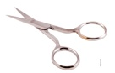
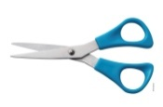
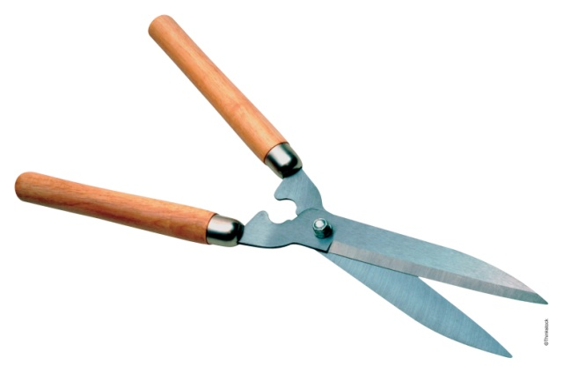
How is infringement determined? (II)
Optional
Cutting means with two eye rings
Are PAPER-FIX infringing HAIRY-CUT's patent?
HAIRY-CUT's UK patent
PAPER-FIX sell in UK
Generally speaking, production and sale are acts of infringement.
Scissors with plastic eye rings
UK: Yes. The scissors are within the extent of protection.
Italy: No. HAIRY-CUT do not have a patent in Italy. PAPER-FIX and others can freely produce insulated scissors (provided no one else has a patent there → perform patent search!)
What about the garden shears imported into the UK by SHEAR-MAN?
UK: No. The shears do not have eye rings. They are outside the extent of protection.
EPO/OHIM Intellectual Property Teaching Kit – IP Advanced Part I Patents
21
Notes:
So, are PAPER-FIX infringing HAIRY-CUT's patent? Firstly, we have to ask ourselves whether the acts done by PAPER-FIX constitute acts of infringement. PAPER-FIX produce products and sell them. Production and sale qualify as acts of infringement when done without permission.
Then we have to check in which territories HAIRY-CUT have a patent. They have a patent in the UK. So, if PAPER-FIX are infringing HAIRY-CUT's patent, then only in the UK. What about the scope of HAIRY-CUT's patent?. HAIRY-CUT have patent protection for any cutting means with two eye rings. PAPER-FIX produce special scissors where the eye rings are covered with plastic. As the graphic shows, these insulated scissors fall within the extent of protection of HAIRY-CUT's patent. Therefore, PAPER-FIX are infringing HAIRY-CUT's patent. PAPER-FIX must get a licence from HAIRY-CUT in the UK, otherwise HAIRY-CUT can stop them selling the scissors on the UK market.
What about in Italy? As HAIRY-CUT do not have patent protection for Italy, the production of insulated scissors by PAPER-FIX in Italy does not constitute infringement. Therefore, PAPER-FIX can continue producing their scissors in Italy.
By the way, PAPER-FIX should also check if anyone else has patents in the UK or Italy which cover scissors with plastic eye rings.
Continuing with our example, let’s imagine that there is a third company called SHEAR-MAN. They import garden shears into the UK. Are SHEAR-MAN infringing HAIRY CUT's patent?
Importing counts as an infringing act. Moreover, SHEAR-MAN's commercial activities are in the UK, a country for which HAIRY-CUT have patent protection.
But the garden shears they import do not have eye rings, so they do not fall within the extent of protection of HAIRY-CUT's patent. SHEAR-MAN can therefore continue to import them.
Once again, SHEAR-MAN should check if anyone else has patents in the UK that cover this kind of garden shears.

Slide 22
Advantages and disadvantages of getting a patent
Advantages
Disadvantages
Exclusivity enables investment and higher returns on investment
Strong, enforceable legal right
Makes invention tradable (licence, sale)
Reveals invention to competitors (after 18 months)
Can be expensive
Grant may take 3-5 years
Patent enforceable only after grant; proceedings can be costly
22
Notes:
The advantages of getting a patent include the fact that patent owners can exclude others from using their inventions. In other words, competitors cannot make products with the same features without obtaining a licence. This gives patent owners a competitive advantage.
European patents offer strong legal protection, as they are examined rather than simply registered. Patent rights are therefore more certain than many other forms of legal protection.
In case of infringement, patent holders can sue the infringer or order customs to intercept imports of patented products.
Last but not least, a patent makes an invention tradable. Sellers can tell prospective buyers the details of the invention without running the risk of the invention being stolen.
The disadvantages of patenting include the fact that patent applications are published after 18 months, so everybody, including competitors, can find out about the invention. The information is available free of charge from online databases such as Espacenet. However, the published application does offer some limited protection, both legal and factual. Factual means that the prospect of a patent being granted might discourage competitors from investing in the commercialisation of a potentially infringing product.
Finally, patents can be very expensive if broad international protection is sought. And because of the time lag of several years from application to grant, by the time the patent is granted, the invention may already have become obsolete. Also, enforcing patent rights may mean going to court, and this can be expensive.
22

Slide 23
Alternatives to patenting
Disclose (publish) the information
Cheap
Prevents others from patenting the same invention
Does not offer exclusivity
Reveals the invention to competitors
Keep it a secret
Cheap (but there is the cost of maintaining secrecy)
Does not reveal the invention
No protection against reverse-engineering/duplication of invention
Difficult to enforce
Secrets often leak quite fast
Do nothing
No effort required
Does not offer exclusivity
Competitors will often learn details
EPO/OHIM Intellectual Property Teaching Kit – IP Advanced Part I Patents
23
Notes:
23
What are the alternatives to patenting?
One option is to publish the invention in any newspaper, magazine, journal, book or public prior art database. Publication prevents others from applying for a patent on the same invention - although other prior patents might effectively block its use. At the same time, it discloses the invention to competitors, so improvements might be patented by a third party and this might block the further development of the initial invention.
Another option is to keep the invention secret. This is frequently used, especially for inventions that do not qualify for patent protection, and for production processes that cannot be reverse-engineered by analysing the end product. In the latter case, patent infringement would be very difficult to prove, so a patent might not be very effective. This option is inexpensive, although there is some cost involved in the signing of non-disclosure agreements with employees and/or partners. Trade secrets are, however, difficult to enforce, and proof is needed that competitors have used unlawful means to find out the secret. On average, detailed technological information will leak out within a year.
The third option is to do nothing at all.
Other options have been found to be at least as important as patent protection and other legal instruments. These include lead-time advantages, in other words being the first to introduce the product to the market, learning curve effects, which involves starting to learn about the technology earlier and thus maintaining a technical advantage, network effects - creating a user base or a technical standard first - and customer relations. All of these options are often used in conjunction with patents, rather than to replace them.
23

Slide 24
What might happen if I decide not to patent my invention?
Competitors might take advantage of it!
Somebody else might patent it!
Potential for licensing, selling or transferring the technology would be severely curtailed!
24
Notes:
24
Patenting may not always be the right solution for your business. It is therefore important to understand what might happen if you decide not to patent a patentable invention.
First of all, somebody else might patent it. The first person to apply has the right to the patent. If you do not patent your invention, somebody else might get a patent on it instead. The patent-holder would then be able to exclude you from the market and you would need a licence for the product.
Secondly, competitors may take advantage of your invention. They may well be tempted to make the same product by using your invention but without having to pay for the use. And as they would incur virtually no R&D costs, they would be able to compete at a lower market price.
And finally, the potential for licensing, selling or transferring the technology would be severely curtailed. Nobody is willing to pay for the right to use something that does not belong to anybody.

Slide 25
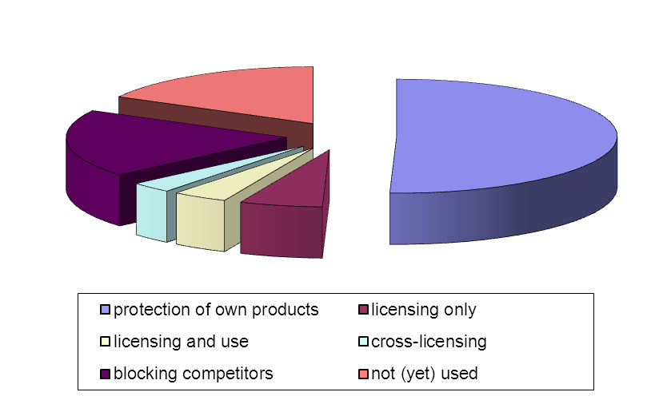
How patents are used
Protecting products and processes
increasing turnover and profits
attracting investors
Licensing
Cross-licensing
Blocking competitors
Building reputation
Not (yet) used
Survey of approx. 7 000 European patents in 2005
EPO/OHIM Intellectual Property Teaching Kit – IP Advanced Part I Patents
25
Notes:
25
A survey of more than 7 000 patents showed that 50% were used to protect companies’ own products and processes. 6% were used for licensing only, 4% for licensing and use, 3% for cross-licensing and 19% for blocking competitors and 17% had not yet been used.
It also established that there were substantial differences depending on country, industry sector and company size.
Cross-licensing is very important for certain industries. For example, ordinary mobile phones have to use technology protected by so many different patents that most mobile phone companies have made cross-licensing agreements to allow each other to use their respective patents.
25

