Slide 1

ANKARA UNIVERSITY
COMPUTER ENGINEERING
INDOOR AIR QUALITY PREDICTIONS FOR AUTOMATION
Student Number: 20290344
Student Name SURNAME: Kadir Gökdeniz
Supervisor Name SURNAME : Gazi Erkan Bostancı
Ankara 2024

Slide 2

CONTENTS
1. INTRODUCTION
1.1. Problem Definition
1.2. Aim of the Project
2. LITERATURE
3. MATERIAL and METHOD
3.1. Material
3.2. Method
4. EXPERIMENTS
5. CONCLUSION
REFERENCES

Slide 3
1. INTRODUCTION
1.1. Problem Definition
In our daily lives, we spend a significant portion indoors. The climatic conditions within these indoor spaces can profoundly impact our psychological, physical, and emotional states. Nowadays, automation systems have become capable of effortlessly regulating these indoor climatic conditions. However, sudden changes in user preferences, sensor malfunctions, and incomplete forecasts may necessitate access to future data for automation systems. The Air-Smart controller visualizes this data, enabling interaction between the user and the automation system.

Slide 4
1. INTRODUCTION
1.2. Aim of the Project
The primary goal of this project is to predict the temperature, pressure, and humidity levels of 5 different rooms in a house using deep learning models. The secondary goal is to develop a web interface called Smart-Air Controller to visualize future data. The Smart-Air Controller will also provide users with information about the future operation of the automation system. Based on this information, users will be able to create requests to suspend or modify the operation of the automation system. These data will be saved in a new file for tracking past requests and system behavior.

Slide 5
2. LITERATURE
As an early study, a research conducted in 2011 usedmultivariate analysis of variance (MANOVA) to predict the indoor air quality of a metro system [1]. In this study, the data was divided into three categories: spring and fall as the first category, summer as the second category, and winter as the third category. The variance analyses were conducted separately for these categories. This study indicates that indoor air quality varies depending on the seasons.
The study conducted by T. Akilan and K.M. Baalamurugan [2] focuses on predicting indoor weather conditions in agriculture using GRU (Gated Recurrent Unit) and LSTM(Long Short-Term Memory) to develop a warning systemthat alerts before plants encounter unfavorable conditions.This IoT (Internet of Things) based study is significant forunderstanding how GRU and LSTM models are used in time series analysis and how sensor data interacts.

Slide 6
2. LITERATURE
Another study conducted by Elnaggar and other researchers presents a risk analysis of the indoor air quality required for the preservation of artworks in a museum located in the Mediterranean region [3]. This study also provides a comprehensive examination of how risk analysis is conducted in the preparation of automation systems. By identifying the necessary indoor air quality parameters for the preservation of artworks, the study details how these parameters can be integrated into automation systems and how these systems can be managed effectively.
A. Gururaj and colleagues conducted a classification study on air quality prediction using artificial neural networks and gradient boosting models, and they developed a website to present their findings [4]. This study is an important resource for our project to compare HMI (Human-Machine Interface) design with literature studies and to learn from current applications.

Slide 7
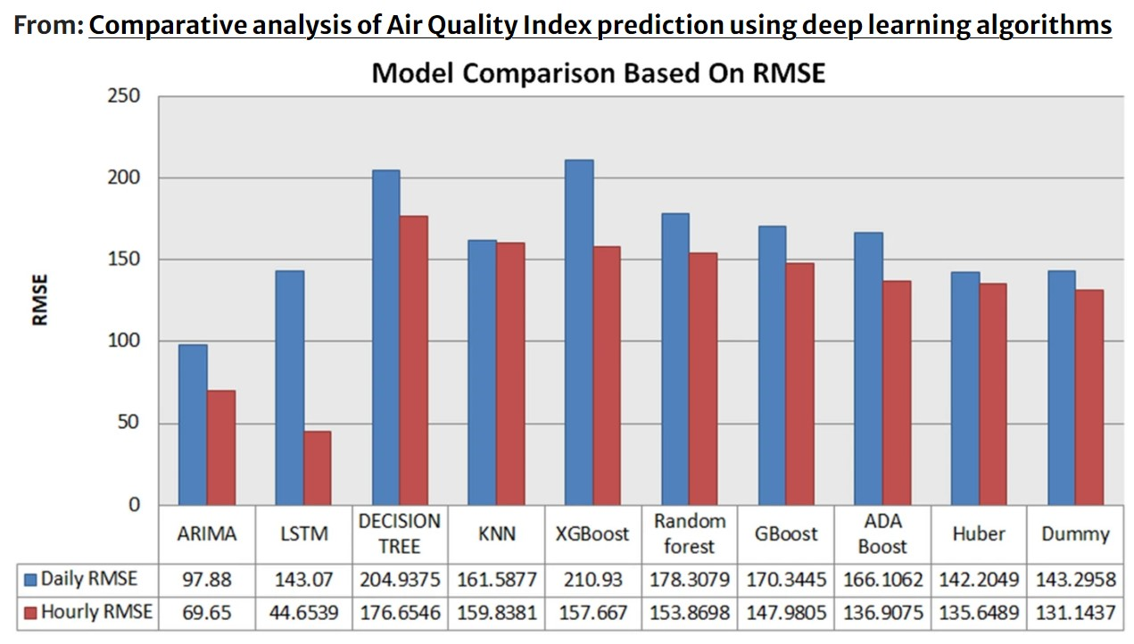
2. LITERATURE
In another study conducted by Nyoman Kusuma Wardana and other researchers, a comprehensive study was presented on the simultaneous display of predictive and real-time data in SCADA (Supervisory Control and Data Acquisition) devices [5]. This study thoroughly explores how data can be integrated and presented simultaneously in SCADA systems.
The study numbered [6] compared the performance of various machine learning methods, such as Dummy, Huber, Ada Boost, GBoost, Random Forest, XGBoost, KNN, Decision Trees, LSTM, and ARIMA models, in indoor air quality regression problems. This research has a significant impact on selecting the most appropriate model.

Slide 8
3. MATERIAL and METHOD
What is Air-Smart Controller?
SCADA and MES systems at the supervisory level in the automation pyramid enable remote management and visualization of data, crucial for controlling and analyzing industrial processes. The Air-Smart Controller integrates intelligent home automation with deep learning models by collecting real-time sensor data, storing it in a database, and using it to predict future conditions at specific intervals. This web application, utilizing a Streamlit interface, visualizes temperature, pressure, and humidity data for any room at ten-minute intervals. Users can view up to 44 days of predictions, monitor the automation system's operation mode and schedule, and make adjustments such as suspending the operation mode or setting specific operation times.

Slide 9
3. MATERIAL and METHOD
Examining datasets that encompass high-resolution, long-term, and publicly accessible electricity consumption data is crucial for smart home technologies. The dataset utilized in this project is the CN_OBEE dataset, covering data from May 31, 2021, to May 31, 2022. It includes minute-level data on occupant presence, window status (open/closed), thermal environment, and appliance usage from a single-family apartment in Beijing, China. Hourly meteorological data from the nearest weather station for the same period are also included, covering the same time intervals. The data were collected by anIoT-based data collection framework (IDCP) using sensors placed in the rooms.

Slide 10
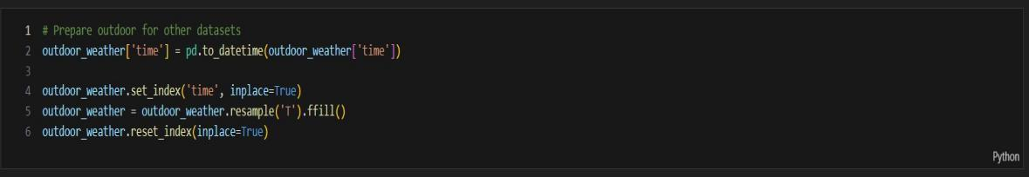
3. MATERIAL and METHOD
3.2. Methods
The electricity consumption data and the data within the rooms are divided into intervals of 10 minutes each. On the other hand, the external weather information is obtained hourly from the nearest weather station. However, there is a discrepancy because I am examining the data at 10-minute intervals in the project. To address the time misalignment issue, I assume that the external weather conditions remain constant within 10-minute intervals within each hour.

Slide 11
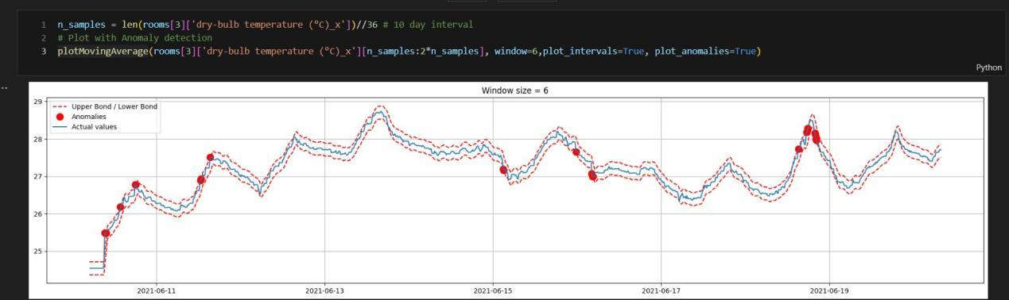
3. MATERIAL and METHOD
It is important to examine the characteristic features of the data as it is essential for understanding the data. Since we are working on a regression problem with time data, analyzing the presence of outlier behaviors and how frequently these outliers occur can facilitate this process. For this task, we have a function called 'plotMovingAverage' which utilizes the Exponential Moving Averages function to detect abnormal behavior. This function depicts the examination of temperature data in the living room over a specified time interval as shown below.

Slide 12
3. MATERIAL and METHOD
The analyses we conduct on the dataset provide us with a good resource for
training. In addition to these existing data, we can add new related data or
exclude some data. Adding new data also involves generating new data. For
example, information such as temperature, pressure, and humidity are
closely related to seasons, but the dataset may not contain season information.
In such cases, we can add season information to the data in a numerical form.
On the other hand, there may be data with similar characteristics within the
dataset. Using such data for training may increase the risk of over-fitting. We
use a correlation matrix to examine the correlational schema.

Slide 13
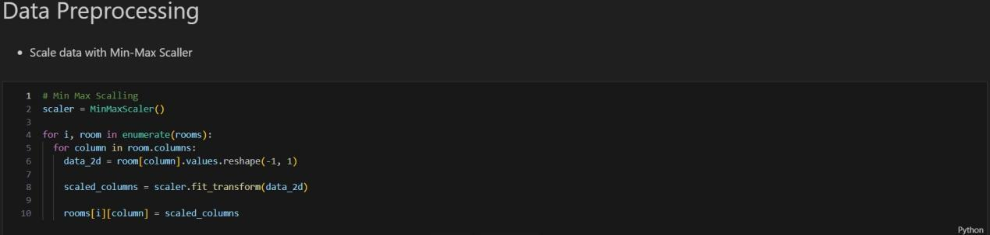
3. MATERIAL and METHOD
As frequently utilized in other deep learning methods, normalizing data
enhances prediction capability. One of the main reasons for this is its
ability to reduce the impact of outliers.

Slide 14
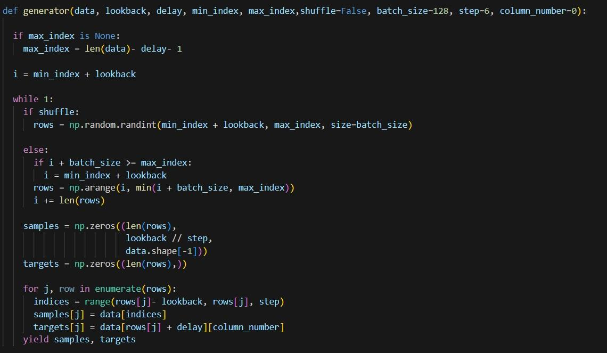
3. MATERIAL and METHOD

Slide 15
3. MATERIAL and METHOD
The function continuously produces samples in a loop. These samples are
taken from the given dataset, sliced according to the specified time intervals
and steps, and matched with the target variables.
The lookback value is set to a width of 10 days. Step indicates intervals of 30
minutes. The delay is set to a length of 1 day. The batch size is determined as
128. For training, 70% of the data is allocated, 15% for validation, and 15%
for testing.

Slide 16

3. MATERIAL and METHOD

Slide 17
3. MATERIAL and METHOD
In this project, there are three RNN models that can be used. Initially, LSTM and GRU models have been tested. Due to the more complex structure of LSTM, its performance on the model was found to be lower compared to GRU. Based on the correlation matrix obtained from the feature engineering part, some data with similar correlation values have been excluded from training. Therefore, the breadth of hypothesis sets used for temperature, pressure, and humidity predictions will vary. The artificial neural network we construct may require an alternative architecture due to this variation, as preventing over-fitting is crucial. Hence, a more complex model is initially preferred, but in case of early signs of over-fitting, an alternative simpler GRU model has been chosen. Detailed information about the model is provided in the previous page.

Slide 18
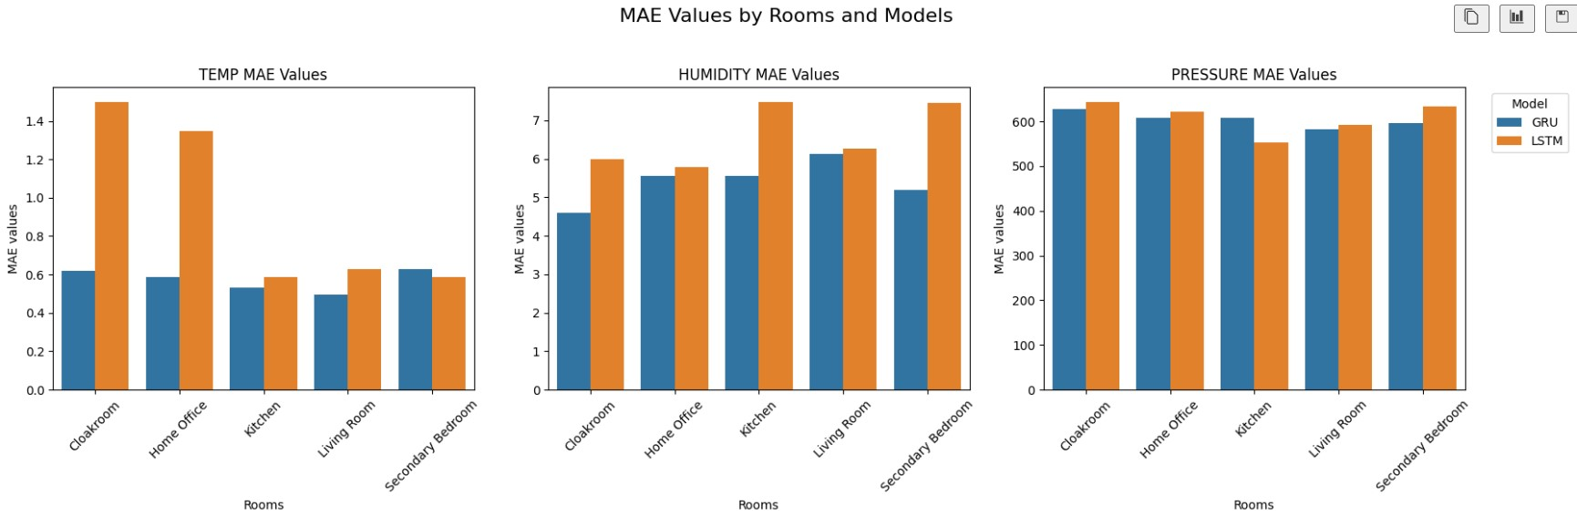
4. EXPERIMENTS
MAE metrics by rooms

Slide 19
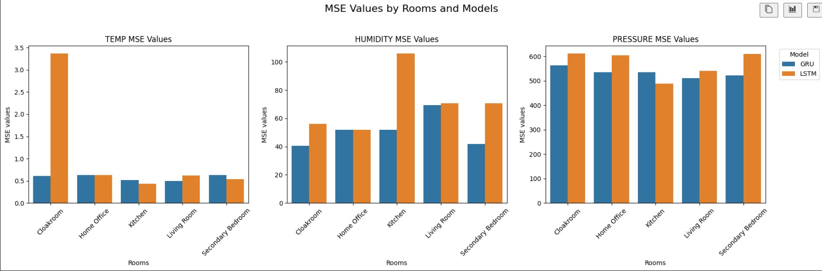
4. EXPERIMENTS
MSE metrics by rooms

Slide 20
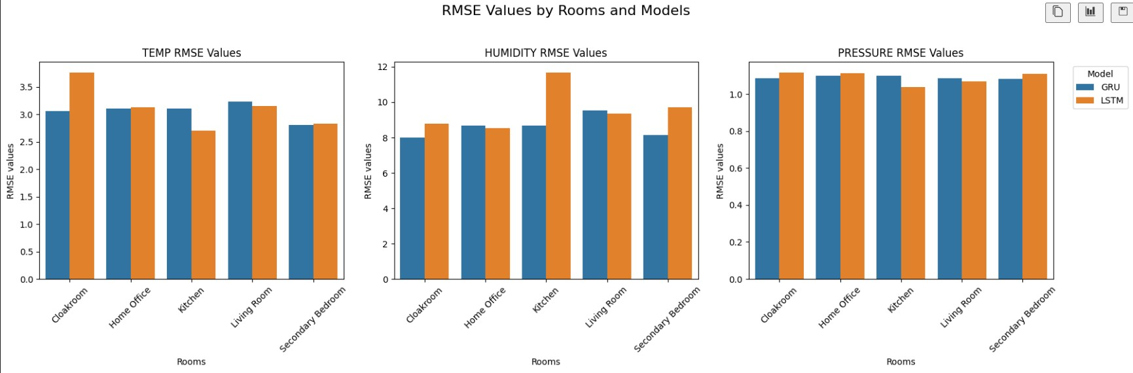
4. EXPERIMENTS
RMSE metrics by rooms

Slide 21
4. EXPERIMENTS
Overall, the data suggest that GRU models perform better than LSTM models in predicting temperature, humidity, and pressure. Generally, lower values were obtained in all three metrics (MAE, MSE, RMSE). This indicates that GRU models work better than LSTM models on this dataset. However, other factors (e.g., training time, computational cost, etc.) should also be considered when selecting a model.

Slide 22
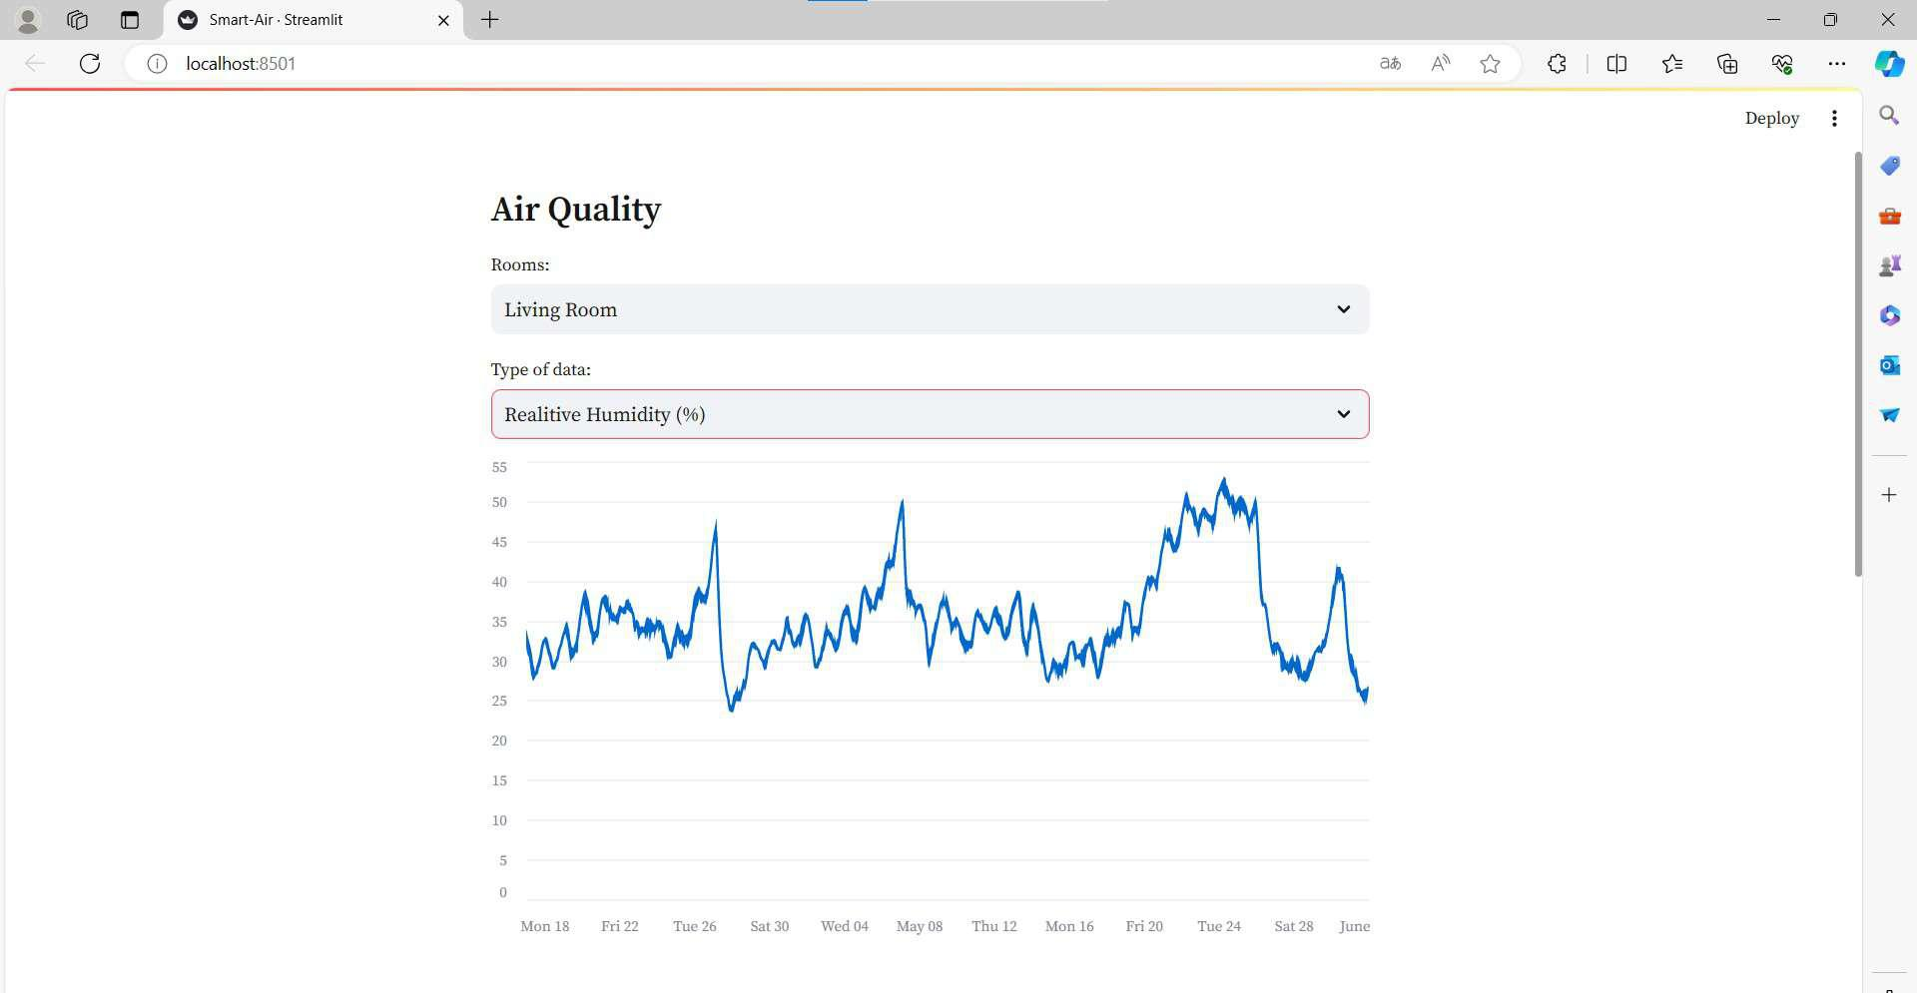
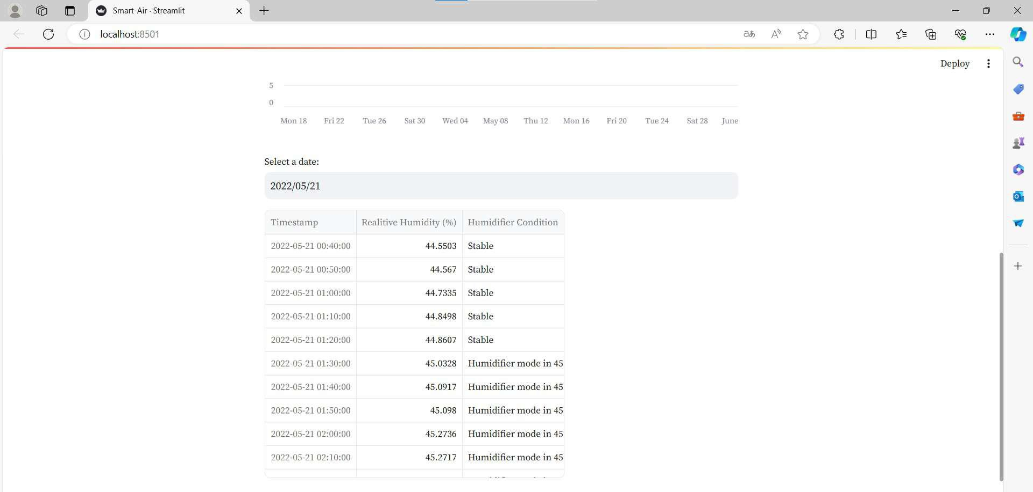
4. EXPERIMENTS

Slide 23
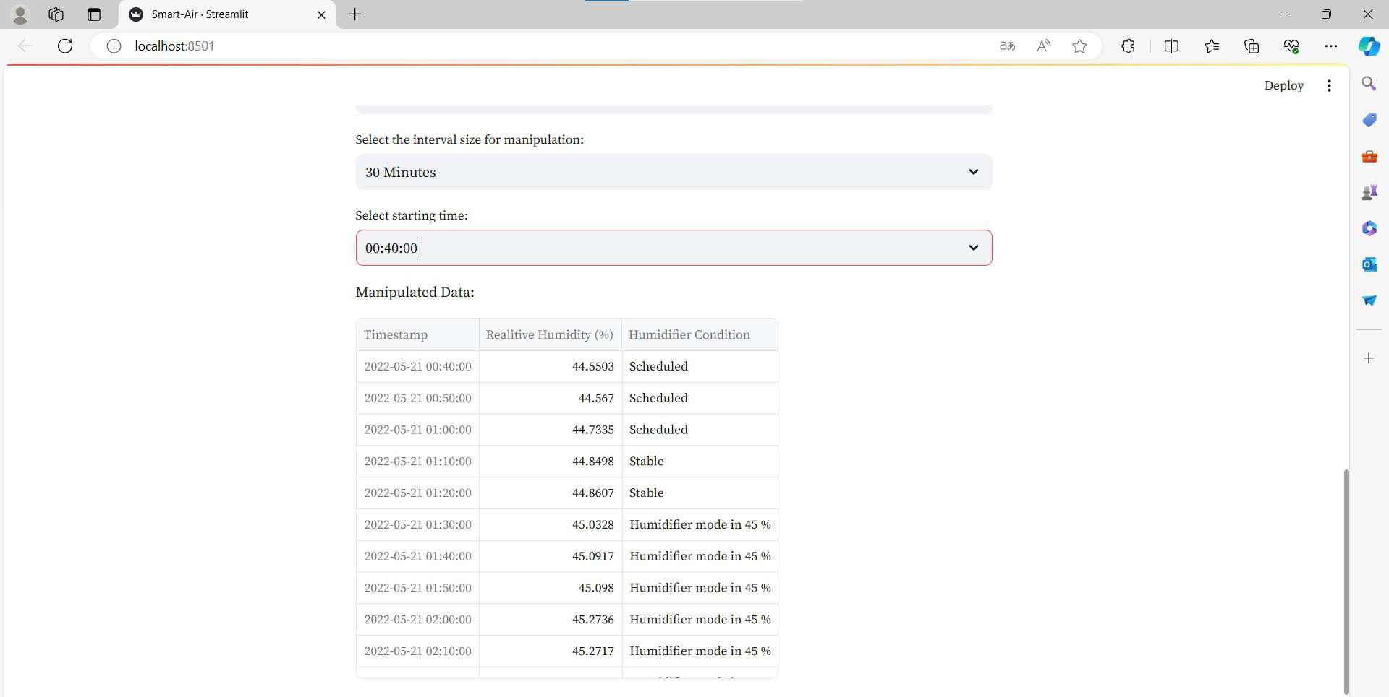
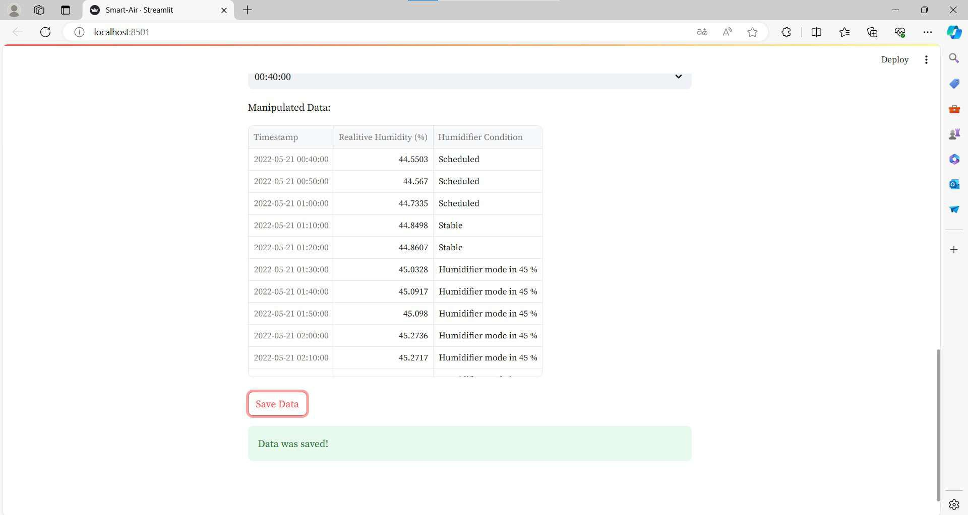
4. EXPERIMENTS

Slide 24
5. CONCLUSION
This study highlights the potential of home automation systems in predicting indoor air quality and compares the performance of different neural network architectures such as LSTM and GRU. GRU generally demonstrates better generalization performance compared to LSTM. However, when selecting a model, all scenarios should be taken into account. Additionally, an interface named Air-Smart Controller has been developed, providing users with the ability to view prediction data at ten-minute intervals and change modes of home automation systems. In conclusion, this research emphasizes the potential of home automation systems in predicting indoor air quality and could be a significant step towards their future development. Enhanced performance can be achieved with the utilization of various advanced models.

Slide 25
REFERENCES
[1] MinJeong Kim, B. SankaraRao, OnYu Kang, JeongTai Kim, ChangKyoo Yoo, “Monitoring and prediction of indoor air quality (IAQ) in subway or metro systems using season dependent models”,Energy and Buildings,Volume 46,2012,Pages 48-55, ISSN 0378-7788, doi: 10.1016/j.enbuild.2011.10.047.
[2] T. Akilan, K.M. Baalamurugan, “Automated weather forecasting andfield monitoring using GRU-CNN model along with IoT to supportprecision agriculture”, Expert Systems with Applications,Volume 249, Part A,2024,123468,ISSN 0957-4174, doi: 10.1016/j.eswa.2024.123468.
[3] Elnaggar, A., Said, M., Krasevec, I. et al. Risk analysis for preventive ˇconservation of heritage collections in Mediterranean museums: case study of the museum of fine arts in Alexandria (Egypt). Herit Sci 12,59 (2024). doi: 10.1186/s40494-024-01170-z

Slide 26
REFERENCES
[4] A. Gururaj, V. Nagaraj, R. A S, A. K N, S. M U and A. D. B, ”Air Quality Prediction and Analysis using Machine Learning,” 2024 5th International Conference on Mobile Computing and Sustainable Informatics (ICMCSI), Lalitpur, Nepal, 2024, pp. 543-550, doi: 10.1109/ICMCSI61536.2024.00086.
[5] N.Kusuma Wardana, Suhaib A. Fahmy, J. W. G,”Low-cost SCADA/HMI with Tiny Machine Learning for Monitoring Indoor CO2 Concentration”, https://warwick.ac.uk/fac/sci/eng/people/suhaibfahmy/publications/i2mtc2024 wardana.pdf
[6] Mishra, A., Gupta, Y. Comparative analysis of Air Quality Index prediction using deep learning algorithms. Spat. Inf. Res. 32, 63–72 (2024). https://doi.org/10.1007/s41324-023-00541-1

Slide 27

ANKARA UNIVERSITY
COMPUTER ENGINEERING
THANK YOU
Student Number:
Student Name SURNAME:
Supervisor Name SURNAME :

