Slide 1
MACHINE LEARNING PROJECT APPLE REVENUE WITH LOGISTIC REGRESSİON
KADİR GÖKDENİZ 20290344
MEHMET ALPAY 20290310

Slide 2

KAGGLE APPLE REVENUE DATASET
Before starting the project, Ice cream shop dataset, Netflix dataset, Starbucks dataset etc. We have dealt with many different datasets, but we did not prefer them because of the insufficient information transferred in some datasets. After training our program on some other datasets, we decided not to select these datasets as there was no binary system in the dataset we needed to test. At the end of the day, we chose to work with the Kaggle Apple Revenue dataset, as we found a large 42-year-old Apple dataset that was previously worked on.

Slide 3
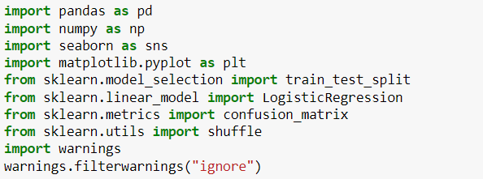
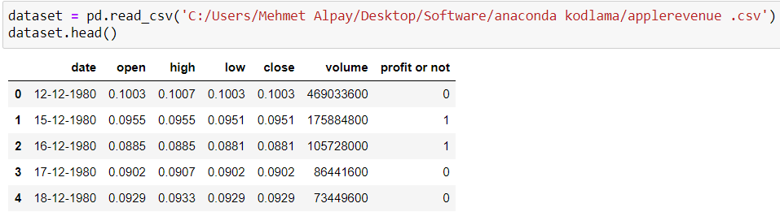
1. Before we started to write the code of our program, we first imported libraries such as numpy, pandas, seaborn, matplotlib, scikit-learn into our program. We used the pandas library to import the dataset in csv format into our program and to create the dataframe. We used the libraries called seaborn and matplotlib for graphing and confusion matrix suppression. we used the scikit-learn library for logistic regression and confusion matrix, and also to separate our data as train and test at a certain rate. 2. After importing the necessary modules, we first transferred the data set to the program with the read_csv function and printed the head part.

Slide 4
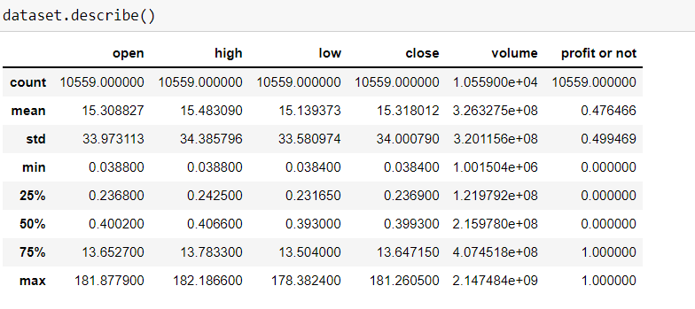
The describe function evaluates each feature of the dataset in terms of features such as count, mean, standard deviation, min, max and prints it in a table. When we apply this function to our data set, we see that the describe function works for each of the open, high, low, close, volume, profit or not parts.

Slide 5
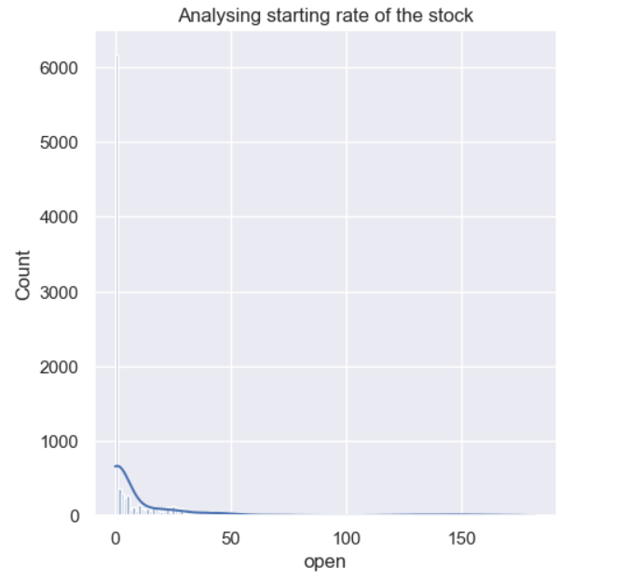
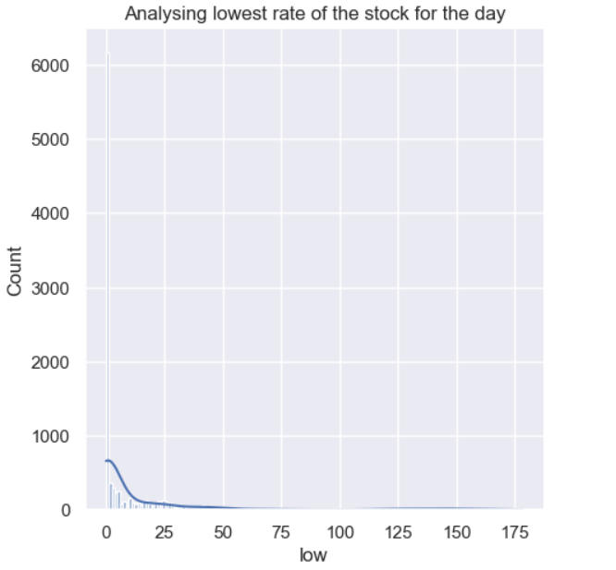
The graphs we see below are printed using the seaborn and matplotlib modules, and the open and low values are printed on the x-axis by pulling the data from the dataframe.

Slide 6
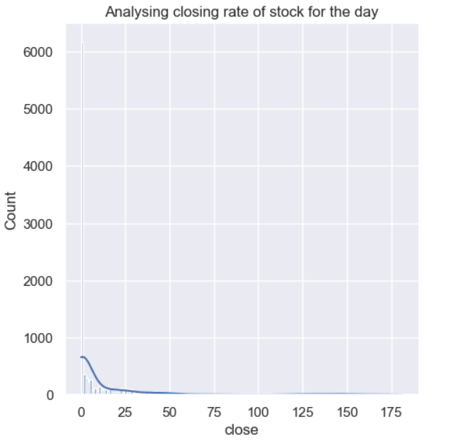
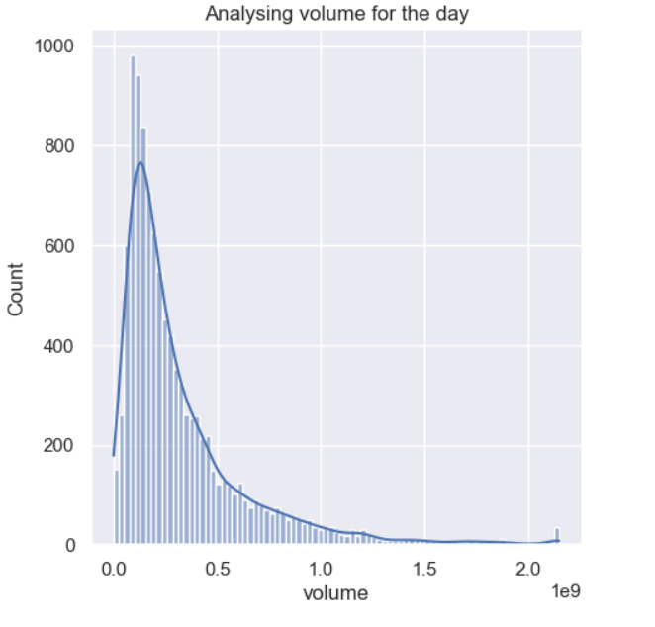
This part is processed in the same logic as the previous page. Thanks to the seaborn and matplotlib modules, the close rate and the company's daily volume values are displayed in a graphic form. This and the previous page can be evaluated in different ways, but the main purpose is to try to increase the learning rate by using visual content.

Slide 7
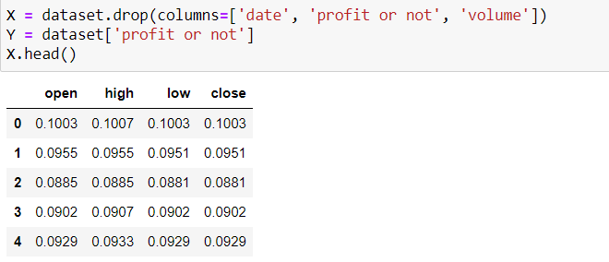
the date and volume parts do not mean anything to train the model, so we first drop them with the drop function. apart from this, we also include the profit or not part in the drop function as an extra, the reason for this is to create two different training test structures. we assign the profit or not part to the y variable and the other parts to the x variable.

Slide 8
In the train_test_split function, we divide the x and y structures that we created in the previous slide into four different structures as x_train, x_test, y_train, y_test. Giving the shuffle parameter to the train_test_split function is one of the ways to increase the accuracy rate, because it takes data randomly and breaks the sequential build logic. The test_size value is set to 0.35, which means that 35% of the dataset is reserved for testing and 65% is reserved for training. This part is completely optional, but we think this is the best ratio for this dataset. On the other hand, random_state is used to divide the data set from the same parts, and thanks to this parameter, we always get the same accuracy value. The reason the random_state parameter is 42 is because this value is thought to have a special meaning.

Slide 9
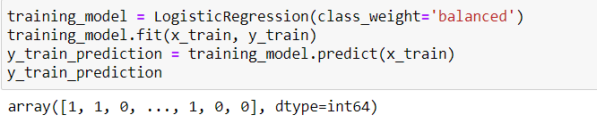
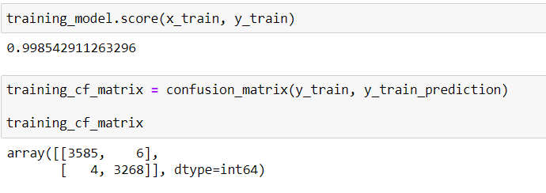
We train our data with the help of the 'logistic regression' function to train the data. The data trained with the x and y variables is assigned to a 'y_train_prediction' variable. The result is also transferred to the response matrix, and the result is as in the photo below. Also, the scikit-learn logistic regression function has the class_weight parameter. This parameter can actually be considered as a deep learning parameter. In the internet environment, one of the only ways to increase accuracy is often referred to as hyperparameter. The class_weight function can be assigned to different weight values, but since we do not have much information in this part, we made its value as 'balanced', this automatically adjusted the whole structure for us.

Slide 10
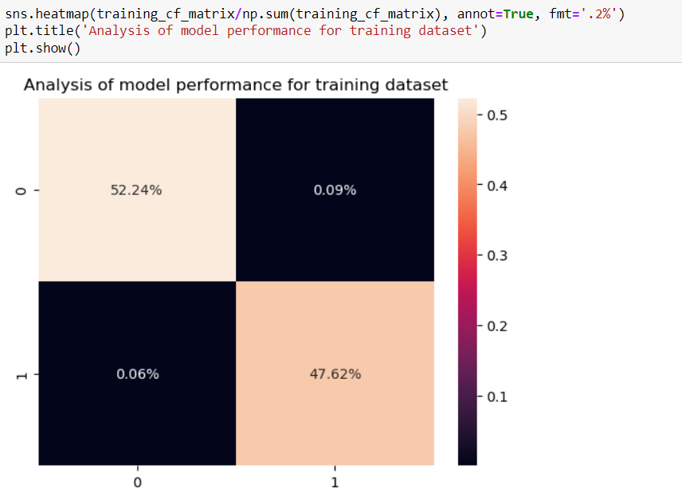
The confusion matrix to be used for the trained data is as follows.

Slide 11
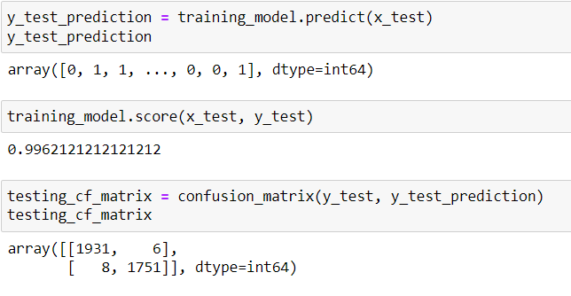
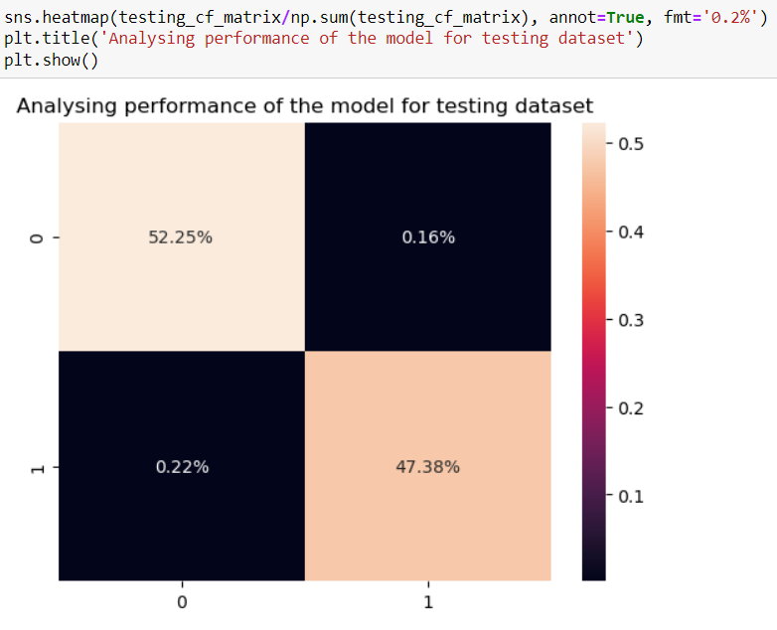
Finally, we match the data in the trained dataset we created with the test data to test it. The results are composed of zeros and ones. The test data is finally placed in the confusion matrix.The result is in the photo below.

